Slide 1
Unit- 4 Digital Forensic

Slide 2
Digital Forensic
INTRODUCTION:-
Forensic science is well established science that plays important role in criminal justice systems
Its applied to both criminal and civil action
Forensics means legal or related to courts
Digital forensics can be defined as a branch of forensic science that focuses on Identification,Preservation,Collection,Analysis, Documentation and Presentation of facts regarding digital evidences found on computer or similar digital storage media devices.
These digital evidences are often in relation with computer crime.

Slide 3
History Of Digital Forensic
Field of PC forensic began in 1980’s when personal computer become cheap to buy.
In 1984 an associate Federal Bureau of Investigation program was created, which was referred as Magnet Media Program.
It is currently called as Computer Analysis and Response Team(CART).
Michael Anderson, the Father of Computer Forensic, came into limelight during this period.
International Organization on Computer Evidence(IOCE) was formed in 1995.
In 1997, the great countries declared that law enforcement personnel should be trained and equipped to deal with sophisticated crimes.
In 1998, INTERPOL Forensic Science symposium was apprehended.
In 1999, the FBI CART case load goes beyond 2000 cases examining,
17 TB of information.
In 2000, the first FBI Regional Computer Forensic Laboratory was recognized.
In 2003, the FBI CART case load exceed 6500 cases, examining 782 TB of information.

Slide 4
Digital Forensic
Definition of Digital Forensic:-
Digital Forensics is a series of steps to uncover and analyses electronic data through scientific method.
The major goal of the process is to duplicate the original data and preserve original evidence and then performing the series of investigation by collecting, identifying and validating the digital information for purpose of restructuring past event.

Slide 5
Digital Forensic
Definition of digital forensic:-
Digital Forensics is defined as the process of Identification, Preservation, Collection , Analysis , Documentation and Presentation of computer evidence which can be used by the court of law.
Digital Forensics is a science of finding evidence from digital media like a computer, mobile phone, server, or network.
Digital evidence includes computer evidence, digital audio, digital video, cell phones, digital fax machines etc.
It provides the forensic team with the best techniques and tools to solve complicated digital-related cases.
Digital Forensics helps the forensic team to analyzes, inspect, identifies, and preserve the digital evidence residing on various types of electronic devices.

Slide 6
Rules of Digital Forensic
An examination should never be performed on original media.
A copy is made onto forensically sterile media. New media should always be used if available.
The copy of the evidence must be exact, bit-by-bit copy.
The computer and the data on it must be protected during the acquisition of the media to ensure that the data is not modified.
The examination should be conducted in such a way as to prevent any modification of the evidence.
The chain of custody of all evidence must be clearly maintained to provide an audit log of whom might have accessed the evidence and at what time.

Slide 7
Digital Forensic Investigation
It describes an investigation where digital device forms part of the incident.
The successful outcome of DFI is the presentation of digital evidence.
Digital Forensic Investigation(DFI) is a special type of investigation that is used to find digital evidences which are stored in various digital devices and that can be considered as valid evidences in the court
According to the Oxford online dictionary, the term Forensic is defined as “Relating to the investigation of crime” or “Relating to courts of law”.
From this definition it is clear that the ultimate goal of a digital forensic investigation is to present some form of digital evidences in a court of law using the correct legal procedures with scientific backing.

Slide 8
Digital Forensic Investigation
The main goal of digital forensic investigation is to examine digital evidences and to ensure that they have not been tampered in any manner.
To achieve this goal investigation must be able to handle all below obstacles:
1. Handle and locate certain amount of valid data from large amount of files stored in computer system
2. It is viable that the information has been deleted , In such situation searching inside file is worthless
3. If the files are secured by some passwords, investigators must find a way to read the protected data in an unauthorized manner
4. Data may be stored in damaged device but the investigator searches the data in working devices
5. Major obstacle is that, each and every case is different ,identifying the techniques and tools will take long time.
6. The digital data found should be protected from being modified . It is very tedious to prove that data under examination is unaltered .
7. Common procedure for investigation and standard techniques for collecting and preserving digital evidences are desired

Slide 9
Digital Forensic Investigation
The main goal of digital forensic investigation is to examine digital evidences and to ensure that they have not been tampered in any manner.
Digital evidences examined in digital forensic laboratory.
Forensic laboratory provides following services:
Data Recovery-Recover deleted data from computer, laptop, mobile phones, SD cards, CD/DVD and pen drives.
Audio Examination-Examine audio file evidence to find out any addition , alteration or deletion has been done with audio file and provide forensic report.
Video Examination-Examine video files and CCTV footage enhancement and provide forensic report. Video file evidence can provide a real time eyewitness of a crime scene.
Signature Verification-Examine the disputed signatures found on documents like rent agreement, property transfer agreement, bank cheque, etc. based on handwriting principles , handwriting characteristics , scientific tools and provide forensic report for legal purpose.
Fingerprinting Services-for police clearance certificate, visa and employment with high accuracy
Handwriting Examination-Examine the disputed handwriting found in various types of cases involving suicide note, anonymous letter , official documents , bank cheque ,etc.
and find out authorship of suspected writer and provide forensic report for legal purpose.

Slide 10
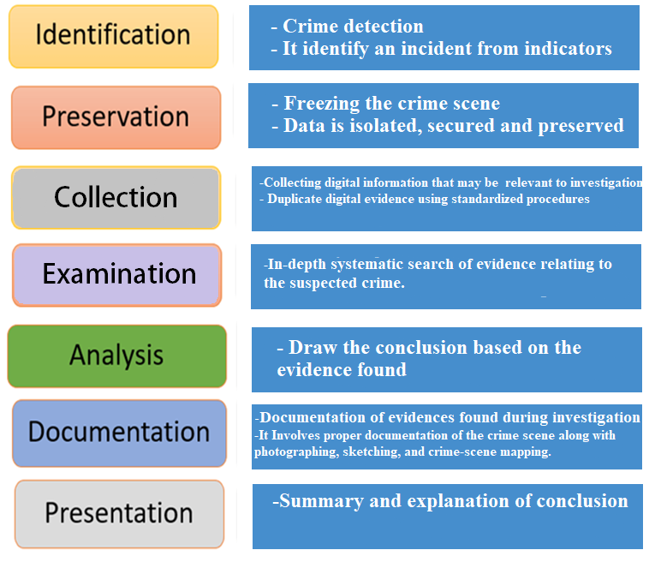
Process of Digital Forensic

Slide 11
Models of Digital forensic Investigation
Name of Author | Name of the Model
G. Palmar | Digital Forensic Research Workshop (DFRWS) Investigative Model or Road Map for Digital Forensic Research (RMDFR)
M. Reith, C. Carr and G. Gunsh | Abstract Digital Forensics Model(ADFM)
B. Carrier and E. H. Safford | Integrated Digital Investigation Process (IDIP) .
S. O. Ciardhuain | An Extended Model for Cybercrime Investigation (EMCI)

Slide 12
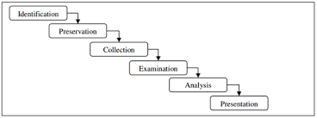
Models of Digital forensic Investigation
In 2001, the 1st Digital Forensics Research Workshop (DFRWS) proposed a general purpose digital forensics investigation process.
It is also called as Road Map for Digital Forensic Research(RMDFR)
G. Palmar designed a framework with following indexed processes as shown in fig.
Fig. Road Map for Digital Forensic Research(RMDFR)

Slide 13
Road Map for Digital Forensic Research(RMDFR)
1. Identification: It recognizes an incident from indicators and determines its type.
-Crime detection
2. Preservation: Preservation stage corresponds to freezing crime scene.
-It means preventing any activity that can damage digital information being collected.
e.g. preventing people from using the computers so that digital evidence will not be tampered.
-Isolating ,securing and preserving data
3.Collection: Collection stage consists finding and collecting digital information that may be relevant to investigation.
-collection may involve removal of personnel computers from crime scene , copying or printing contents of files, etc.
-All acquired digital evidences are duplicated and the physical scene is recorded based on standardized procedures,
4. Examination: which involves an in-depth systematic search of evidence relating to the suspected crime.
-Evidence traceability and hidden data must be discovered
5. Analysis: determine probative value of the examined evidence
-determine whether or not sufficient evidences are available to prove crime in the court
6. Presentation: It involves the summary and explanation of conclusions.
-prepare document of evidences found during investigation process and presenting evidences in the court

Slide 14
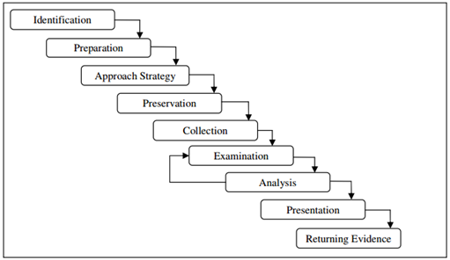
Abstract Digital Forensic Model(ADFM):-
As seen DFRWS Investigative Model was meant to be a generic “technology-independent” model, and in 2002 Mark Reith, Clint Carr, and Gregg Gunsh was inspired from DFRWS and presented the Abstract Digital Forensic Model an enhanced model consists of nine phases:
Fig.: Abstract Digital Forensic Model (ADFM)

Slide 15
Abstract Digital Forensic Model(ADFM):-
1. Identification: which recognizes an incident from indicators and determines its type.
2. Preparation: where tools, techniques, search warrants, monitoring authorization and management support are prepared,
3. Approach strategy: that develops a approaches and procedures to use in order to maximize the collection of the evidence while minimizing the impact to the victim.
4. Preservation: It involves the isolation ,securing and preserving the state of physical and digital evidences.
5. Collection: All acquired digital evidence is duplicated, and the physical scene is recorded, based on standardized procedures.
6. Examination: which involves an in-depth systematic search of evidence relating to the suspected crime.
7. Analysis: The probative value of the examined evidence is determined in Analysis phase( drawing conclusions based on evidence found)
8. Presentation: It involves summarizing the evidences found in the investigation process and present evidences in the court
9. Returning evidence: closes the investigation process by returning physical and digital evidence to the proper owner.

Slide 16
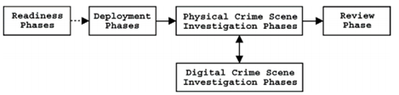
An Integrated Digital Investigation Process(IDIP)
This model was first proposed by Carrier and Safford in 2003
This model is an integration of digital investigation process to the physical investigation process.
This model is organized into 5 groups consisting of 17 phases.
- Preservation phase
- Survey phase
- Documentation phase
- Search and collection phase
- Reconstruction phase
- Presentation phase
-Operations Readiness phase
-Infrastructure Readiness phase
-Detection and Notification phase
- Confirmation and Authorization phase
- Preservation phase
- Survey phase
- Documentation phase
- Search and collection phase
- Reconstruction phase
- Presentation phase
Fig. : An Integrated Digital Investigation Process

Slide 17
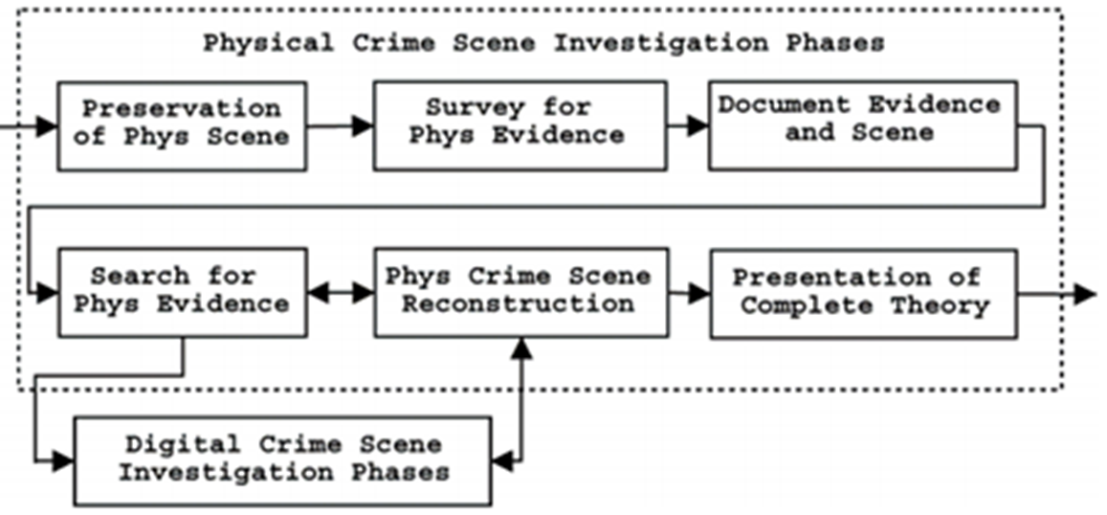
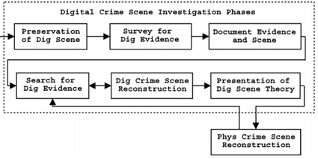
An Integrated Digital Investigation Process(IDIP)

Slide 18
An Integrated Digital Investigation Process(IDIP)
Phases of IDIP are as follows :
Readiness Phases -The goal of this phase is to ensure that the operations and infrastructure are able to fully support an investigation.
It includes two sub phases:
Operation Readiness: provide all training and equipment for investigators.
Infrastructure Readiness: provide needed infrastructure for investigators.
Deployment phases, the goal of this phase is to provide a mechanism to detect and confirm an incident.
It includes two sub phases:
Detection and notification: where incident is detected and appropriate people are notified.
Confirmation and Authorization: which confirms the incident and obtains authorization for legal approval to carry out a search warrant.

Slide 19
An Integrated Digital Investigation Process(IDIP)
Phases of IDIP are as follows :
3. Physical Crime Scene Investigation The goal of these phases is to collect and analyze the physical evidence and reconstruct the actions that took place during the incident.
This phase include six sub-phases:
Preservation: Which preserve the physical crime scène
Survey: Which involves investigator walk through physical crime scene and identify pieces of physical evidence
Documentation: Which involves taking photographs, sketches and videos of the crime scene and the physical evidence.
Search & Collection: Which involves in depth search and collection of evidence relating to the suspected crime, so that additional physical evidences are identified
Reconstruction: Which involves organizing the results from the analysis done and develop theory for incident
Presentation: that presents the physical and digital evidence to a court

Slide 20
An Integrated Digital Investigation Process(IDIP)
Phases of IDIP are as follows :
4. Digital Crime Scene Investigation Phases where investigator collect all digital evidence
This phase consists six ‘identical’ phases:
Preservation: This phase preserve the digital crime scène
Survey: This phase collects digital evidence
Documentation: It involves documenting every acquired digital evidence
Search & Collection: Which involves in depth analysis of digital evidence
- Software tools are used to recover hidden, deleted and corrupted files
Reconstruction: Which involves putting the pieces of digital puzzle together and developing investigative hypotheses
Presentation: that involves presenting the digital evidences to the physical investigation team in the case the investigation was not performed by the same team.
5. Review: In which whole investigation processes is reviewed and identifies areas of improvement

Slide 21
Extended Model of Cybercrime Investigation (EMCI)
This model was first proposed by S.O. Ciardhuain in 2004
The EMCI is more likely most comprehensive till date
The EMCI follows waterfall model as every activity occurs in sequence.
Figure : An Extended Model of Cybercrime Investigation

Slide 22
Extended Model of Cybercrime Investigation (EMCI)
Phases of EMCI:
Awareness: during which investigators are informed that crime has taken place.
This awareness is typically created externally (e.g. a crime is reported to the police) or internally (e.g. an intrusion detection system alerts crime)
Authorization: After the need for an investigation is identified, the next activity is to obtain authorization to carry out investigation and authorization is obtained internally(e.g. company management) or externally (e.g. court orders)
Planning: The planning activity is strongly affected by information from both inside and outside the investigating organization.
Notification: Notification informing the concerned parties that the investigation is taking place.
This activity may not be appropriate in some investigations, e.g. where surprise is needed to prevent destruction of evidence.
Search and Identification of Evidence This activity deals with locating and identifying the evidence
In the simplest case, this may involve finding and confirming the computer used by a suspected person.

Slide 23
Extended Model of Cybercrime Investigation (EMCI)
Phases of EMCI:
Collection : Collection is the activity in which the investigating organization takes possession(custody) of the evidence in a form which can be preserved and analyzed
e.g. copying contents of hard disks or seizure of entire computers.
Transport: After collection, evidence must be transported to a suitable location for later examination.
Storage: The collected evidence will in most cases need to be stored because examination cannot take place immediately. Storage must take into account the need to preserve the integrity of the evidence.
Examination :Examination of the evidence will involve the use of a potentially large number of techniques to find and interpret significant data. It may require repair of damaged data in ways which preserve its integrity.
Hypothesis: Based on the examination of the evidence, the investigators must construct a hypothesis(proposed explanation made on the basis of limited evidence) of what occurred.
Presentation :The hypothesis must be presented to persons other than the investigators. For a police investigation the hypothesis will be placed before a jury

Slide 24
Extended Model of Cybercrime Investigation (EMCI)
Phases of EMCI:
Proof / Defence : In general the hypothesis will be challenged;
The investigators will have to prove the validity of their hypothesis and defend it against challenge.
Successful challenges will probably result in backtracking to the earlier stages to obtain and examine more evidence, and construct a better hypothesis.
Dissemination : The final activity in the model is the dissemination of information from the investigation.
Information is often disseminated in the hope that individuals and entities in an organization will improve their knowledge base and subsequently make better judgments in future situations.

Slide 25
Ethical Issues In Digital Forensic
Ethics in digital forensic field can be defined as a set of moral principles that regulate the use of computer.
Ethical decision making in digital forensic work consist of one or more of the following:
Honesty towards the investigation
Prudence means carefully handling digital evidences.
3. Compliance with the law and professional norms.

Slide 26
Ethical Issues In Digital Forensic
General ethical norms for Digital Forensic Investigation:-
Investigator should satisfy the following points…
Should contribute to the society and human being.
Should avoid harm to others.
Should be honest and trustworthy.
Should be fair and take action not to discriminate.
Should honor property rights, including copyrights and patents.
Should give proper credit to intellectual property.
Should respect the privacy of others.
Should honor confidentially.

Slide 27
Ethical Issues In Digital Forensic
Unethical Norms for Digital Forensic Investigation:-
Investigator should not…
Uphold any relevant evidence
Declare any confidential matter or knowledge.
Express an opinion on guilt or innocence belonging to any part.
Engage or involve in any kind of unethical or illegal conduct.
Deliberately or knowingly undertake an assignment beyond him or her capability.
Distort or falsify education, training, credential.
Display bias and prejudice in finding or observation.
Exceed or outpace authorization in conducting examination.

Slide 28
Digital Evidence

Slide 29
Introduction to Digital Evidence
The investigation of computer security incident leads to legal proceeding, such as court proceeding, where the digital evidence are presented in the court
Digital devices are everywhere in today’s world, helping people communicate locally and globally with ease.
Most people immediately think of computers, cell phones and the Internet as the only sources for digital evidence, but any piece of technology that processes digital information can be considered as sources for digital evidence
For example, hand-held games can carry encoded messages between criminals and newer household appliances, such as a refrigerator with a built-in TV, could be used to store, view and share illegal images.
The important thing to know is that responders need to be able to recognize and properly seize potential digital evidence.

Slide 30
Digital Evidences(Electronic Evidences)
Evidence: Any information that can be confident or trusted, and can prove something related to a case in trial , that is, indicating that a certain substance or condition is present.
Relevant evidence: An information which has positive impact on the action occurred, such as information supporting an incident or crime.
Digital evidences are heart of digital forensic investigation process.
Digital evidence is any information or data of value to an investigation ,that is stored on, received or transmitted by an electronic device.
There are three major forensic categories of devices where evidence can be stored: Internet-based, stand-alone computers and mobile devices.
Examples of electronic devices which are potential digital Evidences are : hard disk, CD/DVD media , backup tapes, pen drive, floppy disk , digital camera , biometric scanner , smart phone, smart card , PDA,etc.

Slide 31
Digital Evidences(Electronic Evidences)
Forms of Digital evidence :Text messages, emails, pictures ,audios ,videos, office document and internet searches are some of the most common types of digital evidence.
The digital evidence are used to establish a credible link between the attacker, victim, and the crime scene.
Some of the information stored in the victim’s system can be considered as digital evidence, such as IP address, system log-in & remote log-in details, browsing history, log files, emails, images, etc.
Digital Evidences may be in the form:
Email Messages (may be deleted one also)
Office file
Deleted files of all kinds
Encrypted file
Compressed files
Temp files
Recycle Bin
Web History
Cache files
Cookies
Registry
Web/E-Mail server access Logs
Domain access Logs

Slide 32
The Best Evidence Rule
The best evidence rule is that the original or true writing or recording must be confessed in court to prove its contents without any expectations.
In the best evidence rule, an original copy of the document is considered as best evidence (superior evidence or valid proof) to prove crime in the court .
We define best evidence as the most complete copy or a copy which includes all necessary parts of evidence, which is closely related to the original evidence.
We treat forensic duplication by considering it as the best evidence. Therefore, when we say ‘best evidence’ it refers to the evidence we have in our power.

Slide 33
Original Evidence
We define Original Evidence as the truth or real(original) copy of the evidence media which is given by a client/victim.
One of the rules states that if an evidence is readable by sight such as any printout or data stored in a computer or any other output device, it is considered as ‘Original Evidence ’
There should be original evidence protector which will store either the best evidence or original evidence for every investigation in the evidence safe.

Slide 34
Rules of Digital Evidence
Rule of evidence is also called as Law of Evidence.
These rules determine what evidence must or must not be considered by a court in reaching its decision.
There are five rules of collecting digital evidence .
These relate to five properties that evidence must have to be useful.
Admissible: The evidence must be usable in the court.(evidence must be considered as valid evidence by court)
Authentic: means evidence is proven to be genuine or real (only authentic evidences are admissible in a court)
Complete: A proof that covers all the necessary parts of an incident.(its not enough to collect evidence that just covers one part of incident)
Reliable: The evidence must be reliable. (Evidence collection and analysis procedures should not be doubtful)
Believable: The evidence should be understandable and believable by court.

Slide 35
Characteristics of Digital Evidence
Locard’s Exchange Principle :
According to Edmond Locard’s principle, when two items makes contact , there will be an interchange.
When an incident takes place, a criminal will leave a hint evidence at the scene and remove a hint evidence from the scene. This alteration known as Locard’s Exchange Principle.
Many Techniques(Such as blood analysis,DNA matching,fingerprint verification) have been suggested in conventional forensic sciences to strongly prosecute criminals.
These techniques are used to certify the existence of suspected person at a physical scene.
Locard’s Exchange principle suggests that, there is a communication with computer system ,clues will be left.

Slide 36
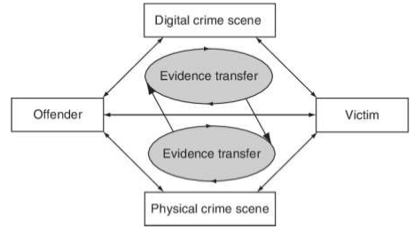
Characteristics of Digital Evidence
Locard’s Exchange Principle :
Fig. Evidence transfer in the physical and digital dimensions helps investigators establish connections between victims, offenders, and crime scenes.
For example: In a homicide case, the criminal may attempt to misdirect investigators by creating a suicide note on the victim’s computer, and in this process criminal leave his/her fingerprints on the keyboard. With one such piece of evidence, investigators can demonstrate the strong possibility that the criminal was present at the crime scene.

Slide 37
Types of Evidence
Illustrative evidence: Illustrative evidence is also called as demonstrative evidence.
It is generally a representation of an object which is a common form of proof.
For example: Photographs, videos, sound recordings, X-rays, maps, drawing, graphs, charts, simulations and models.
Electronic evidence : Electronic evidence nothing but a digital evidence.
The evidences or proof that can be obtained from an electronic source is called as Digital Evidence.
For example: Emails, hard drives, word processing documents, instant message logs, ATM transactions, cellphone logs, etc
Documented Evidence : Documented evidence is same as demonstrative evidence.
In documentary evidence, the proof is presented in writing.
For example: Contracts , wills , invoices etc.

Slide 38
Types of Evidence
Explainable Evidence : This type of evidence is typically used in criminal cases in which it supports the dependent, either partially or totally removing their guilt in the case.
It is also referred to as exculpatory evidence.
Exculpatory evidence includes any evidence that prove a defendant’s innocence.
Examples of exculpatory evidence include an alibi, such as witness testimony that a defendant was somewhere else when the crime occurred.
Exculpatory evidence might include proof that the defendant stayed in a hotel too far away from the crime scene.
substantial evidence: A proof that is introduced in the form of a physical object, whether whole or in a part, is referred to as substantial evidence.
It is also called as Physical evidence.
For example: dried blood, fingerprints, and DNA samplers, casts of footprints or tires at the crime scene .

Slide 39
Types of Evidence
Testimonial:
It is a kind of evidence spoken by a spectator(witness) under oath, or written evidence given under oath by an official declaration, that is, Affidavit.
A formal written or spoken statement, especially one given in a court of law
This is one of the common forms of evidence in the system.

Slide 40
Challenges in Evidence handling
The most difficult task for evidence handler is to authenticate the collected evidences at the judicial proceedings.
Maintaining the chain of custody is also necessary
You must have both power and skill to validate your evidences

Slide 41
Authentication of Evidence
The FRE(Federal Rules of Evidence) and the law of many state jurisdictions, define data as ‘written-works’ and ‘record-keeping”.
Before introducing them as evidence, documents and recorded material must be authenticated.
Authentic evidence means evidence is proven to be genuine or real
For e.g. persons medical records are authentic, if doctor from government hospital provides certificate in writing that copies of records are true.
The evidences that are collected by any person/investigator should be collected using authenticate methods and techniques because during court proceedings these will become major evidences to prove the crime
For an evidence to be admissible, its necessary that it should be authenticated, otherwise the evidence can not be admissible in the court.

Slide 42
Chain of Custody
What Is the Chain of Custody in Computer Forensics?
Maintaining chain of custody means that the evidences collected should not be accessed by unauthorized person and must be stored in a tamper proof manner.
The term chain of custody refers to process of maintaining and documenting the handling of evidences throughout the investigation process
Chain of custody is a document that maintains record of person who have collected , handled, transferred or analyzed evidence , the date/time it was collected or transferred and purpose of transfer.

Slide 43
Chain of Custody
Why Is It Important to Maintain the Chain of Custody?
Its important to maintain the chain of custody to preserve the integrity of evidence and prevent it from contamination, which can alter the state of the evidence.
Importance to the Court:
It is possible that evidence presented in court dismissed ,if there is a missing link in the chain of custody.
So its investigator responsibility to present proper chain of custody along with the evidence at the court.
To meet the requirements of chain of custody , evidences are stored in a secure place by investigative agencies.

Slide 44
Procedure to Establish the Chain of Custody
following procedure is followed to maintain proper chain of custody for electronic evidence:
Save the original materials
Take photos of physical evidence
Take screenshots of digital evidence content
Document date, time, and any other information of receipt
Inject a bit-for-bit clone of digital evidence content into forensic computer
Perform a hash test analysis to further authenticate the working clone

Slide 45
What Considerations Are Involved with Digital Evidence?
following considerations are involved when dealing with digital evidence
Never work with the original evidence to develop procedures
Use clean collecting media
Document any extra scope
Consider safety of personnel at the scene

Slide 46

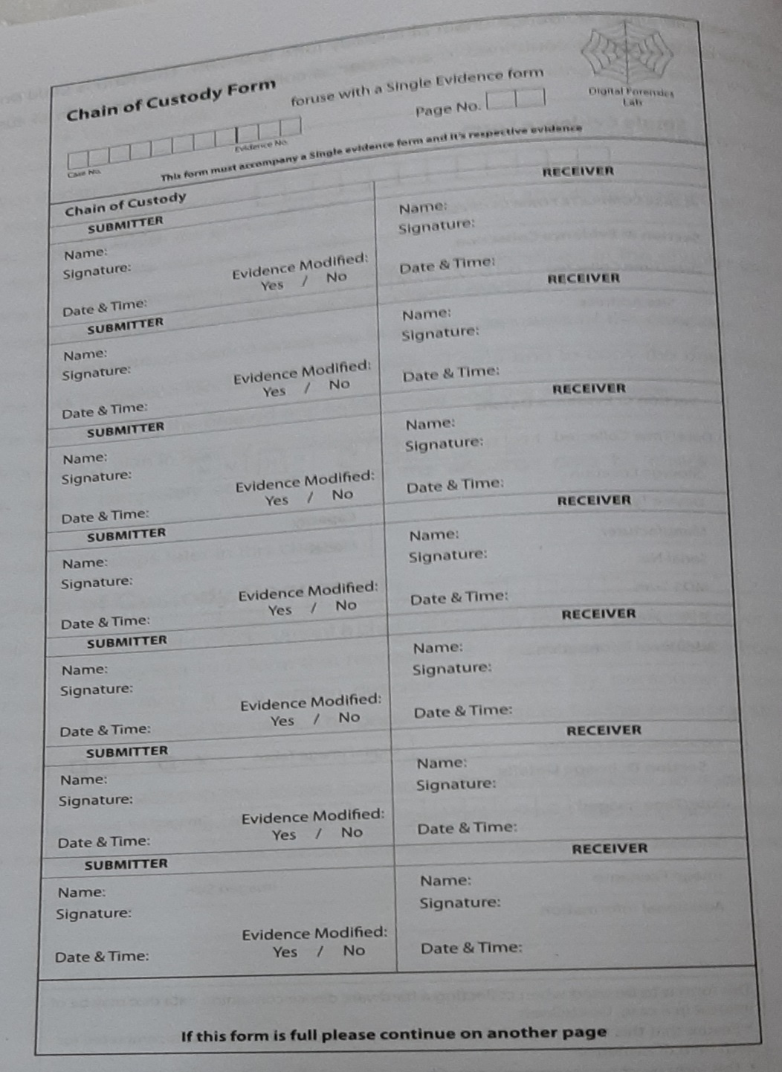

Slide 47
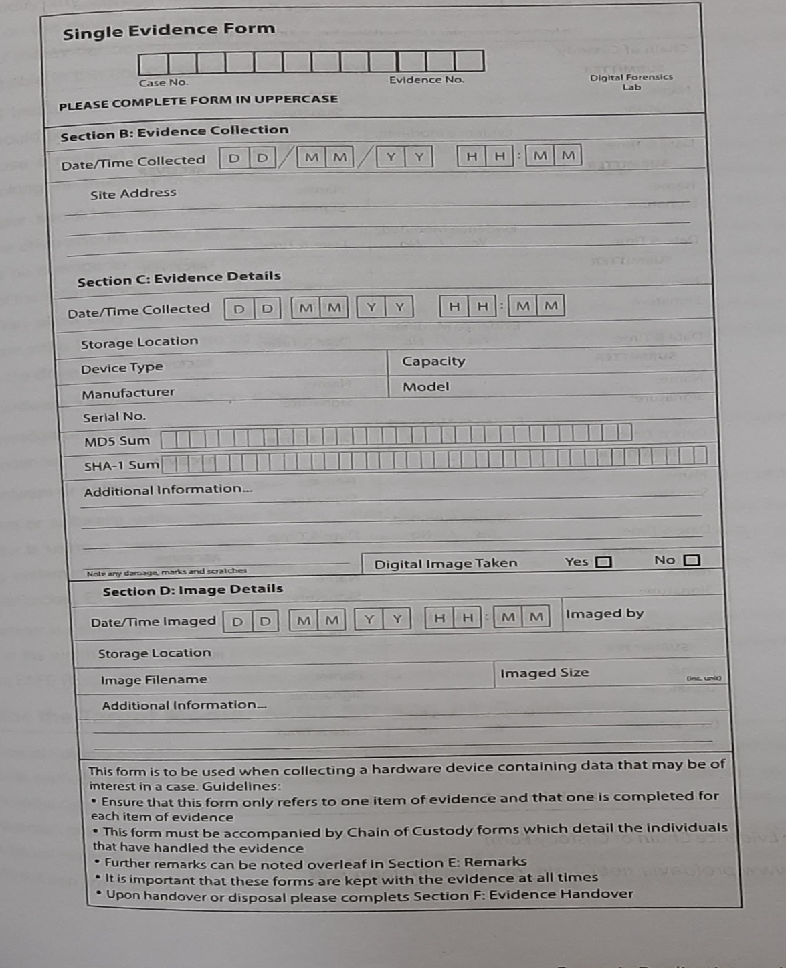

Slide 48
Evidence Validation
Evidence validation is challenging task for investigator
The Evidence validation ensure that evidence you have collected is similar to the evidence presented in the court.
Several yours pass between the collection of evidence and the production of evidence at a judiciary proceeding, which is very common.
To meet the challenge of evidence validation , its necessary to ensure that original media matches the forensic duplication by using MD5 hashes.
The evidence for every file is nothing but the MD5 hash value that are generated for every file that contributes to the case.

Slide 49
Volatile Evidence
Collecting volatile evidence is a challenging task for investigator.
Investigators need to focus on obtaining the volatile system data before shutting down the system.
At the time of collecting evidences investigator need to collect volatile data first because it can help to determine the criminal activities that can lost if system is powered off.
When collecting evidence, investigator should always try to proceed from most volatile to the least volatile.
An example of order of volatility of evidences would be:
Registers and cache
Routing tables
ARP cache
Process table
Kernel statistics and modules
Main memory
Temporary file system
Secondary memory
Router configuration
Network topology

