Slide 1
Unit-6 Types of Hacking
6.1 Network Hacking
6.2 operating system hacking
6.3 applications hacking

Slide 2
NETWORK HACKING
What is network hacking :-
In computer networking, hacking is any technical effort to manipulate the normal behavior of network connections and connected systems.
Network hacking generally refers to unauthorized intrusion into a computer network.
hackers are most commonly associated with malicious programming attacks on networks and computers over the internet.
How to avoid network hacking :-
We can eliminate many well-known network vulnerabilities by simply patching your network hosts with their latest vendor software and firmware updates.
We can eliminate many other vulnerabilities by following some security best practices on your network.
Network consist devices such as routers, firewalls, hosts that you must assess as a part of ethical hacking process.

Slide 3
NETWOK INFRASTRICTURE VULNERABILITIES
Network infrastructure vulnerabilities are the foundation for most technical security issues in your information systems.
Your focus for ethical hacking tests on your network infrastructure should be to find weaknesses that others can see in your network
Many issues are related to the security of your network infrastructure. Some issues are more technical and require you to use various tools to assess them properly.

Slide 4
NETWOK INFRASTRICTURE VULNERABILITIES
Network infrastructure security involves assessing such areas as:
Where devices such as a firewall or IDS are placed on the network and how they are configured.
What hackers see when they perform port scans and how they can exploit vulnerabilities in your network hosts
Interaction of installed security devices
Protocols in use
Commonly attacked ports that are unprotected
Network host configuration
Network monitoring and maintenance
If someone exploits any one of above vulnerability bad things can happen :-
An attacker can launch a Denial of Service (DoS) attack, which can take down your Internet connection or your entire network.
A malicious employee using a network analyzer can steal confidential information in e-mails and files sent over the network.
A hacker can set up back-door access into your network.

Slide 5
NETWOK INFRASTRICTURE VULNERABILITIES
Network Testing and port Scanning tools:
Sam Spade for tracing source of email spam.
SuperScan for ping sweeps and port scanning.
NetScanTools Pro for dozens of network security-assessment functions, including ping sweeps, port scanning, and SMTP relay testing.
Nmap for vulnerability checking ,port scanning and network mapping(study of physical connectivity of network).
Netcat the most versatile security tool for such security checks as port scanning and firewall testing.
WildPacketsEtherPeek for network analysis.

Slide 6
NETWOK INFRASTRICTURE VULNERABILITIES
Choosing Tools:
As with all security assessments, your network security tests require the right tools —you need port scanners, protocol analyzers, and vulnerability assessment tools.
Port Scanning:
Port-Identifies a specific process or a type of network service running on host.
A port scanner detects open ports, closed ports, filtered ports and running services on a target IP address or domain name.
Nmap is best tool for port scanning
As an ethical hacker, you should scan all 65,535 UDP and 65,535 TCP ports on each network host that is found by your scanner.
For speed and simplicity, you can scan commonly hacked ports.
Hackers uses port scanning tools to detects open ports, closed ports, filtered ports and running services on particular host in a network.
Protection from port scanning is often achieved through the use of a firewall

Slide 7
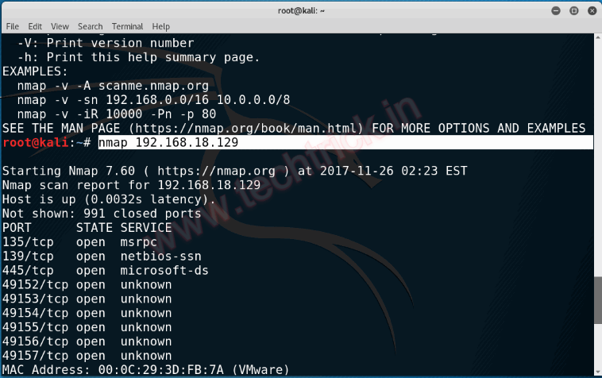
NETWOK INFRASTRICTURE VULNERABILITIES
Port Scanning: using IP address

Slide 8
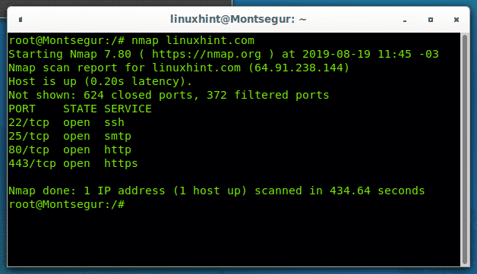
NETWOK INFRASTRICTURE VULNERABILITIES
Port Scanning: using Domain name

Slide 9
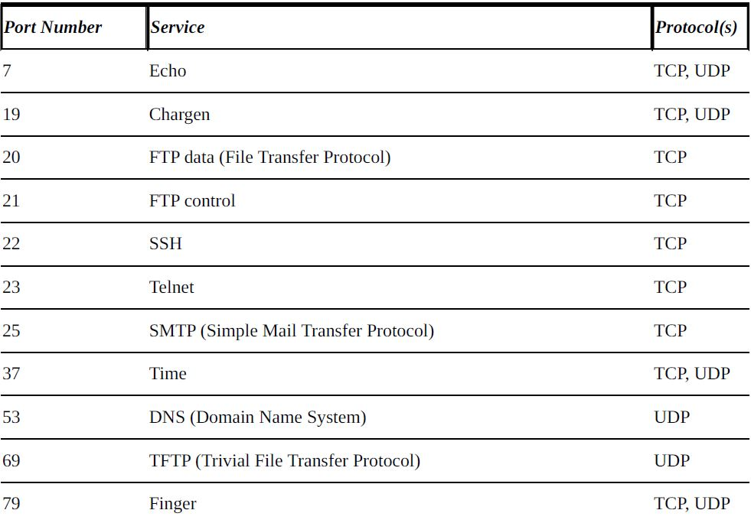
NETWOK INFRASTRICTURE VULNERABILITIES Commonly Hacked Ports:-

Slide 10
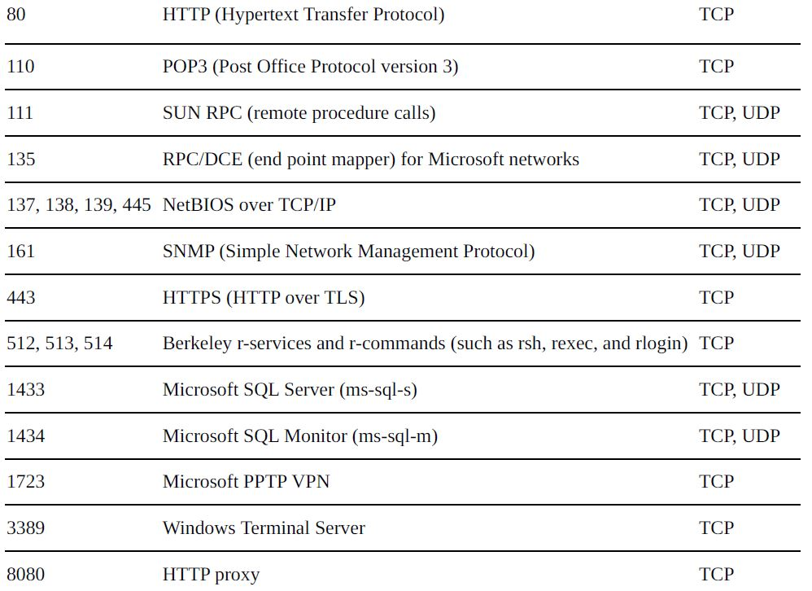

Slide 11
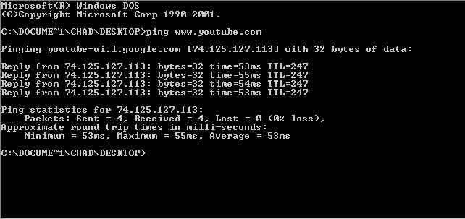
NETWOK INFRASTRICTURE VULNERABILITIES
Ping Sweeping:
Ping Sweep is a technique used to identify which hosts are alive in the networks using their IP addresses or domain name of that particular host.
If we get reply packets, it confirms that the host is alive.
we want to check the availability status of the YouTube server with IP 74.125.127.113, then
go to command prompt and type ping www.youtube.com or ping 74.125.127.113.

Slide 12
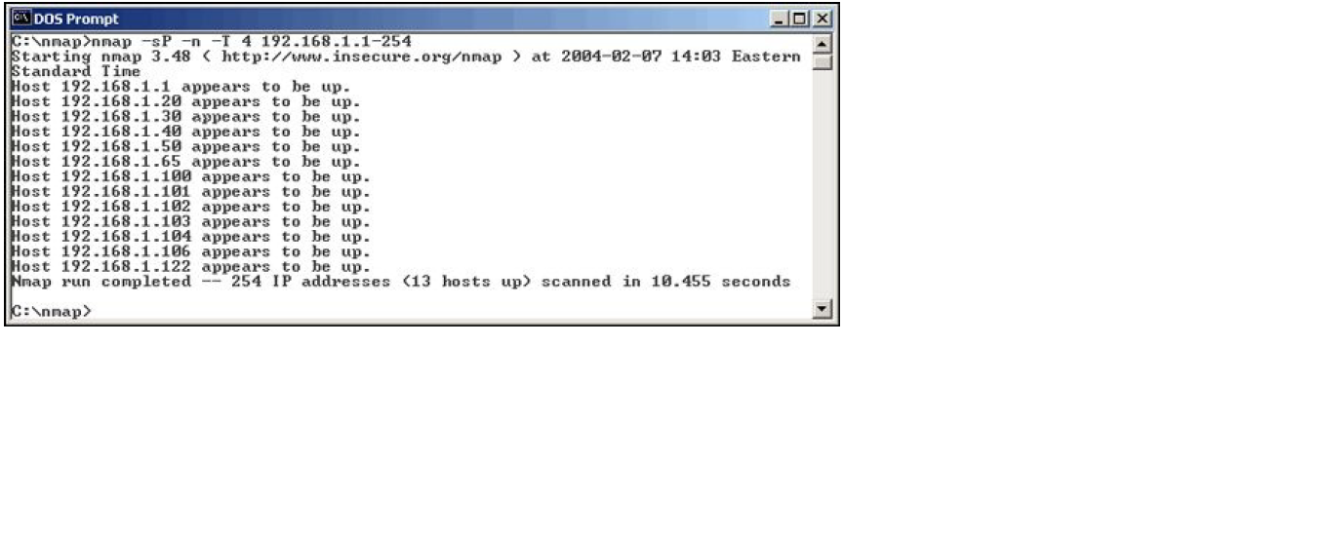
NETWOK INFRASTRICTURE VULNERABILITIES
Ping Sweeping tool:
Nmap is best tool for port scanning but it can also be used for ping sweeping.
Nmap does ping sweeping only if –sP is used.
Using Nmap we can scan the entire network or only a specific range of IP addresses
The command line options can be used for Nmap ping sweep are as follows:-
-sP tells Nmap to perform a ping scan.
-n tells Nmap not to perform name resolution.
-T 4 tells Nmap to perform an aggressive (faster) scan.
192.168.1.1-254 tells Nmap to scan the entire 192.168.1.0 subnet.

Slide 13
NETWOK INFRASTRICTURE VULNERABILITIES
Scanning SNMP:
Simple Network Management Protocol (SNMP) is an application-layer protocol used to manage and monitor network devices and their functions.
SNMP manage conventional network equipment like routers, switches and wireless access points to endpoints like printers, scanners and Internet of Things (IoT) devices.
In addition to hardware, SNMP can be used to monitor services such as Dynamic Host Configuration Protocol (DHCP).
SNMP is an application layer protocol which uses UDP port number 161/162.
Many network scanning tools use SNMP as a means to collect valuable information about the current state of devices on the immediate network.

Slide 14
NETWOK INFRASTRICTURE VULNERABILITIES
Vulnerabilities of SNMP:
The problem is the most network devices have SNMP enabled even if they don’t need it.
If SNMP is compromised, a hacker can gather network information such as ARP tables, user names and TCP connections to attack your system.
If SNMP shows up in port scans, hacker will try to compromise the system.
Here are some utilities for SNMP Scaning:
The commercial tools NetScanTools Pro and Essential NetTools
Free Windows GUI-based Getif
Free Windows text-based SNMPUTIL

Slide 15
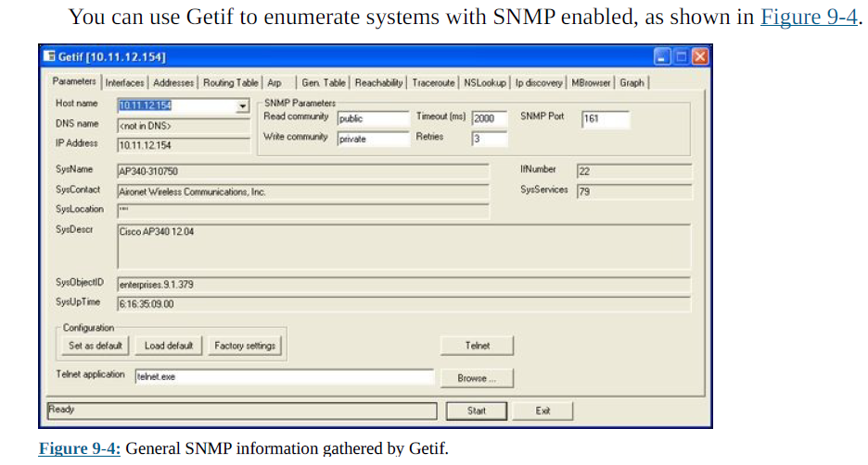
NETWOK INFRASTRICTURE VULNERABILITIES
Windows GUI-based Getif

Slide 16
NETWOK INFRASTRICTURE VULNERABILITIES
Countermeasures of SNMP
Preventing SNMP attacks can be simple as A-B-C :-
Always disable SNMP on host if you’re not using it.
Block the SNMP port (UDP port161) at the network perimeter.
Change the default SNMP community string from public to another value that’s more difficult to guess . This make SNMP hard to attack.

Slide 17
NETWOK INFRASTRICTURE VULNERABILITIES
Banner Grabbing :
Banner refers to a text message that received from the host.
Banners usually contain information about a service, such as service name and version number.
An attacker can make use of banner grabbing in order to collect information regarding any remote PC on a network and the services running on its open ports.
Banners Grabbing are often used by white hat hackers for vulnerabilities analysis and penetration testing and can be used by black hat hackers and gray hat hacker.
Tools used for banner grabbing are :-
Telnet, Nmap, Netcat, SuperScan.

Slide 18
NETWOK INFRASTRICTURE VULNERABILITIES
Banner Grabbing :
Telnet
Banners screens can be accessed through Telnet at command prompt on the target system’s IP address.
With telnet, you can query any service simply by typing : telnet IP PORT
Note that IP is the IP address, and PORT is the port where the remote service is running.
example:
[research@securitytrails ~]# telnet 192.168.0.15 22
Trying 192.168.0.15...
Connected to 192.168.0.15.
Escape character is '^]'.
SSH-2.0-OpenSSH_8.0
Connection closed by foreign host.
[research@securitytrails ~]#

Slide 19
NETWOK INFRASTRICTURE VULNERABILITIES
Banner Grabbing :
Nmap:
Nmap is another great alternative for getting software banner information
nmap -sV --script=banner IP
Example
[research@securitytrails ~]# nmap -sV --script=banner 192.168.0.15
Starting Nmap 7.70 ( https://nmap.org ) at 2019-11-11 11:14 -03
Nmap scan report for 192.168.0.15
Host is up (0.000040s latency).
Not shown: 998 closed ports
PORT STATE SERVICE VERSION
22/tcp open ssh OpenSSH 8.0 (protocol 2.0)
|_banner: SSH-2.0-OpenSSH_8.0
80/tcp open http nginx 1.16.1
|_http-server-header: nginx/1.16.1
Service detection performed. Please report any incorrect results at https://nmap.org/submit/
. Nmap done: 1 IP address (1 host up) scanned in 23.05 seconds
[research@securitytrails ~]#

Slide 20

NETWOK INFRASTRICTURE VULNERABILITIES
Banner Grabbing :
Netcat:
Type following command to grab SSH banner of remote PC.
nc -v 192.168.1.106 22

Slide 21
NETWOK INFRASTRICTURE VULNERABILITIES
MAC-daddy attack:
Attackers can use ARP running on your network to make their systems seem/appear as your system or another authorized host on your network.
ARP spoofing
An excessive number of ARP requests can be a sign of an ARP spoofing attack (also called ARP poisoning) on your network.
ARP spoofing is a type of attack in which a malicious actor sends falsified ARP messages over a local area network.
This results in the linking of an attacker’s MAC address with the IP address of a legitimate computer on the network.
Once the attacker’s MAC address is connected to an authentic IP address, the attacker will begin receiving any data that is intended for that IP address.
ARP spoofing can enable malicious parties to intercept, modify or even stop data in-transit.
ARP spoofing attacks can only occur on local area networks that utilize the Address Resolution Protocol.

Slide 22
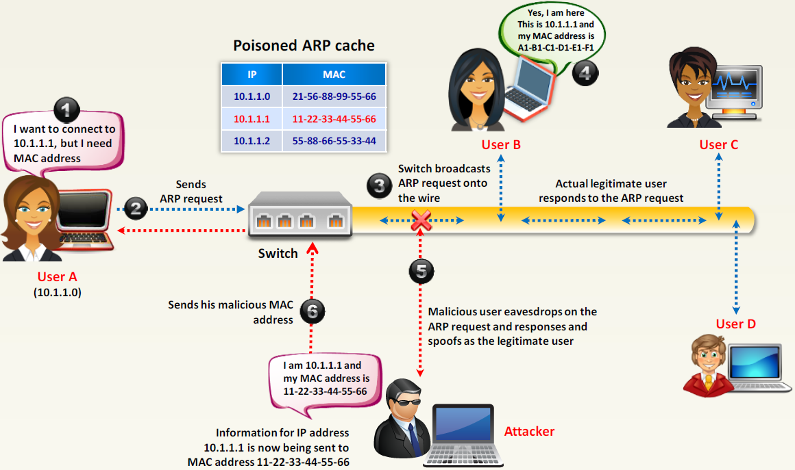
NETWOK INFRASTRICTURE VULNERABILITIES
Working of ARP spoofing
Fig. Working of ARP spoofing
This causes the victim computers to think they need to send traffic to the attacker’s computer rather than to the true destination computer when communicating on the network this is type of man-in-the-middle (MITM) attacks.
ARP spoofing is used during man-in-the-middle (MITM) attacks.

Slide 23
NETWOK INFRASTRICTURE VULNERABILITIES
MAC address spoofing :-
MAC address spoofing tricks the switch into thinking your computer is something else.
You simply change your computer’s MAC address and masquerade as another user.
You can use this trick to test access control systems, such as your IPS/firewall, and even your operating system login controls that check for specific MAC addresses.

Slide 24
NETWOK INFRASTRICTURE VULNERABILITIES
Countermeasures (MAC-daddy attack) :-
A few countermeasures on your network can minimize the effects of hacker attack against ARP and MAC addresses on your network.
If your switch can enable port security then can prevent MAC address spoofing.
No realistic countermeasures for ARP poisoning/spoofing exist.
The only way to prevent ARP poisoning/spoofing is to create and maintain static ARP entries in your switches for your host on the network.
Detection :-
ARP watch is a UNIX-based program alerts you via e-mail if it detects changes in MAC addresses associated with specific IP addresses on the network.

Slide 25
Wireless Network Vulnerabilities
WLAN is very susceptible to hacker attacks even more so than wired networks if it’s not configured or deployed properly.
Wireless networks have long standing vulnerabilities that can enable an attacker to bring your network to its knees or allow your sensitive information to be extracted right out of thin air.
If your wireless network is compromised, you can experience the following problems :-
Loss of network access, including e-mail, web, and other services that can cause business downtime.
Loss of sensitive information, including passwords, customer data, intellectual property, and more
Regulatory consequences and legal liabilities associated with unauthorized users gaining access to your business systems

Slide 26
Wireless Network Vulnerabilities
wireless vulnerabilities are in the implementation of the 802.11 standard.
The central hub like devices that allow wireless client to connect to the network.
Wireless access points (APs) and client systems have some vulnerabilities as well.
Various fixes have come along in recent years to address these vulnerabilities, yet still many of these fixes have not been properly applied or are not enabled by default.
Your employees might also install rogue wireless equipment on your network without your knowledge (This is the most serious threat to your wireless security)
“Free” Wi-Fi practically everywhere from coffee shops to hotels to conference centers, these Internet connections are one of the most serious threats to your overall information security.
Even when Wi-Fi is hardened and all the latest patches have been applied, you still might have security problems, such as denial of service (DoS), man-in-the-middle (MITM) attacks, and encryption key weaknesses

Slide 27
Wireless Network Vulnerabilities
Common Wireless Threats :-
The number of main threats that exist to wireless LANS, these includes :-
Rogue Access Points / AD-Hoc Networks
Denial of service
Configuration Problems (Mis Configurations/Incomplete Configurations)
Passive Capturing
Wireless Network Attacks :-
Wi-Fi networks can be vulnerable to a variety of different attacks.
Different kind of attacks are Encrypted traffic, Rogue Network, Physical security problems, Vulnerable wireless workstations, Default configuration settings.

Slide 28
Wireless Network Vulnerabilities
Wireless Network Attacks :-
Encrypted Traffic :-
Wireless traffic can be captured directly out of the airwaves, making this communications medium susceptible to malicious eavesdropping.
The 802.11 encryption protocols, Wired Equivalent Privacy (WEP) has it’s own weakness that allows attackers to crack the encryption keys and decrypt the captured traffic.
Rogue Network :-
Rogue access point is a wireless access point that has been installed on a secure network without explicit authorization from local network administrator.
Using NetStumbler or your client manager software, you can test for Access points that don’t belong on your network.

Slide 29
Wireless Network Vulnerabilities
Physical security problems :-
Various physical security vulnerabilities can result in physical theft, the reconfiguration of wireless devices, and the capturing of confidential information.
AP (Action Points) mounted on the outside of a building and accessible to the public.
Poorly mounted antennas or the wrong types of antennas that broadcast too strong a signal and that are accessible to the public.
You can view the signal strength in NetStumbler, or your wireless client manager.
Vulnerable wireless workstations :-
Wireless workstations have tons of security vulnerabilities from weak passwords to unpatched security holes to the storage of WEP and WPA encryption keys locally.
One serious vulnerability is for wireless clients using the Orinoco wireless card.
The Orinoco client manager software store encrypted WEP keys in the windows registry even for multiple networks.

Slide 30
Wireless Network Vulnerabilities
Default Configuration Settings :-
Similar to wireless workstations, wireless APs (Action Points) have many known vulnerabilities.
The most common ones are default SSIDs and admin passwords.
Many wireless systems still have WEP and WPA disabled by default as well.
Countermeasures against default configuration settings exploits :-
You can implement some of the simplest and most effective security countermeasures for Wi-Fi
Make sure that you change default admin passwords and SSIDs.
At a minimum, enable WPA2.
Disable SSID broadcasting if you don’t need this feature.
Apply the latest firmware patches for your APs and Wi-Fi cards.

Slide 31
Operating System Hacking
The Microsoft Windows OS is the most widely used OS in the world.
In operating system hacking most windows attacks are prevented if the patches were properly applied.
The poor security management is often the real reason for operating system hacking.
Windows Vulnerabilities :-
Today most of organizations use the Microsoft platform for much of their networking and computing needs. Many businesses especially the small-to medium-sized ones depend solely on the Windows OS for network usage.
Many large organizations run critical servers, such as web servers and database servers, on the Windows platform
If security vulnerabilities aren’t addressed and managed properly, they can bring a network or an entire organization to its knees.
When Windows and other Microsoft software are attacked especially by a widespread Internet-based worm or virus hundreds of thousands of organizations and millions of computers are affected by Many well-known attacks against Windows can lead to the following problems:
Leakage of sensitive information, including files containing healthcare information and credit card numbers.
Passwords being cracked and used to carry out other attacks.
Systems taken completely offline by denial of service (DoS) attacks.
Full remote control being obtained
Entire databases being copied or deleted

Slide 32
Operating System Hacking
Linux Vulnerabilities :-
Vulnerabilities and attacks against Linux are creating business risks in a growing number of organizations especially e-commerce companies, network and IT/security vendors, and cloud service providers that rely on Linux for many of their systems, including their own products.
When Linux systems are hacked, the victim organizations can experience the same side effects :-
Leakage of sensitive information
Cracked passwords
Corrupted or deleted databases
Systems taken completely offline DoS attacks

Slide 33
Operating System Hacking
Buffer Overflow Attack: A buffer is a temporary area for data storage.
When more data(than was originally allocated to be stored) stored by a program or system process into buffer then extra data overflows buffer.
It causes some of that data to leak out into other buffers, which can corrupt or overwrite whatever data they were stored in buffer.
In a buffer-overflow attack, the extra data sometimes holds specific instructions for actions intended by a hacker. for example, the extra data could trigger a response that damages files, changes data.
A buffer overflow attack can be:
Stack-based: attacker sends data to a program and that transmission is stored in a too-small stack buffer.
The hacker could use a "push" function to store new items on the top of the stack.
The hacker could use a "pop" function to remove the top item and replace it.
That means the hacker has officially inserted malicious code and taken control.
Heap-based: hacker corrupts data within the heap and that code change forces your system to overwrite important data.
Hackers have been leaning on buffers for years, but new opportunities for their work are appearing. For example, experts say connected devices (including Internet of Things elements like refrigerators and doorbells) could be susceptible to these attacks.

Slide 34
Application Hacking
Messaging systems are those e-mail and instant messaging applications are often hacked within a network.
Messaging System Vulnerabilities:
The following factors can create weaknesses in Messaging System : -
Security is not integrated into software development.
Many of the messaging protocols were not designed with security in mind.
Especially those developed several decades ago, when security was not an issue
Malicious attacks against messaging systems include the following:
Transmitting malware
Crashing servers
Obtaining remote control of workstations
Capturing information while it travels across the network
Perusing(Scanning) e-mails stored on servers and workstations.
Perusing instant-messaging log files on workstation hard drives
Capturing and replaying phone conversation
Gathering internal network configuration information, such as hostnames and IP addresses

Slide 35
Application Hacking
E-Mail Attacks :-
following are most common email attacks:
E-mail bombs(Letter bomb) :
E-mail bombs can crash a server and provide unauthorized administrator access.
They attack by creating DoS conditions against your e-mail software and even your network and Internet connection by taking up so much bandwidth and requiring so much storage space.
Different email bomb attacks are as attachment overloading attack, connection attack, autoresponder attack.
In Attachment-overload attack a attacker can send hundreds or thousands of e-mails with very large attachments to one or more recipients on your network.
In Connection attack a attacker can send a huge amount of e-mails simultaneously to addresses on your network.
Autoresponder attack: Auto responder is a automatic e-mail response you often get back from random users when you are subscribing to a mailing list.
Banners :
A hacker performs a basic banner grab to see what e-mail server software and its version is running on email server.

Slide 36
Application Hacking
Best practices for minimizing e-mail security risks :-
Use anti-malware software on the e-mail server.
Apply the latest operating system and e-mail server security patches consistently and after any security alerts are released.
You can use S/MIME or PGP to encrypt sensitive messages.
Put your e-mail server behind a firewall
Disable unused protocols and services on your e-mail server.
Run your e-mail server on a dedicated server
If your server doesn’t need e-mail services running (SMTP, POP3, and IMAP) disable them immediately.
Email filtering can block certain types of attachments that are known to carry malicious content.
Secure email client configurations can also reduce the risk of malicious email.

Slide 37
Application Hacking
Web Applications : Web applications like e-mail are common hacker targets.
Basic Web sites used for marketing, contact information, document downloads and so on are a common target for hackers especially the script-kiddie’s.
However, for criminal hackers, Web sites that store valuable information, like credit-card and Social Security numbers, are especially attractive.
Web applications are vulnerable because of poor software development and testing practices.
Web Vulnerabilities :-
Hacker attacks against insecure Web applications via HTTP make up the majority of all Internet-related attacks.
Most of these attacks can be carried out even if the HTTP traffic is encrypted (via HTTPS or HTTP over SSL) because the communications medium has nothing to do with these attacks.
The security vulnerabilities actually lie within either the Web applications themselves or the Web server and browser software that the applications run on and communicate with.
Some other web application security vulnerabilities are as follows :
SQL Injection - Injection is a security vulnerability that allows an attacker to alter backend SQL statements by manipulating the user supplied data.
Cross site scripting(XSS)- Attackers can use XSS to execute malicious scripts on the users browsers.
Security Misconfiguration- Security Configuration must be defined application server, web server, database server. If these are not properly configured, an attacker can have unauthorized access to sensitive data or functionality.

Slide 38
Application Hacking
Directory Traversal :-
Directory traversal or Path Traversal is an HTTP attack which allows attackers to access restricted directories and execute commands outside of the web server’s root directory.
Web servers provide two main levels of security mechanisms :
Access Control Lists (ACLs) - An Access Control List is used in the authorization process. - It is a list which the web server’s administrator uses to indicate which users or groups are able to access, modify or execute particular files on the server, as well as other access rights.
Root directory - The root directory is the top-most directory on the server file System.
- User access is confined to the root directory, meaning users are unable to access directories
or files outside of the root

Slide 39
Application Hacking
Countermeasures against Directory Traversals:-
Don’t store old,sensitive,or nonpublic files on your web server.
Configure your robots.txt file to prevent search engines, such as Google, from crawling the more sensitive areas of your site.
Ensure that your web server is properly configured to allow public access to only those directories that are needed for the site to function.

Slide 40
Application Hacking
Google Dorking(Google hacking):
Google dorking is a hacking technique that makes use of Google's advanced search services to locate valuable data or hard-to-find content.
Google dorking involves using specific modifiers to search data.
For example, instead of searching the entire Web, users can click on tags like "image" or "site" to collect images or find information about a specific site.
Google Dorking is a technique used by hackers to find the information exposed accidentally to the internet.
Google Dorks can uncover great information such as email addresses and lists, login credentials, sensitive files, website vulnerabilities, and even financial information (e.g., Payment card data).

Slide 41
Application Hacking
Google Dorking(Google hacking):
Google Dorks Operators:
intitle – This allows a hacker to search for pages with specific text in their HTML title. So intitle: “login page” will help a hacker to search the web for login pages.
allintitle – Similar to the previous operator, but only returns results for pages that meet all of the keyword criteria.
inurl – Allows a hacker to search for pages based on the text contained in the URL (i.e., “login.php”).
allinurl – Similar to the previous operator, but only returns matches for URLs that meet all the matching criteria.
filetype – Helps a hacker narrow down search results to specific files such as PHP, PDF, or TXT file types.
ext – Very similar to filetype, but this looks for files based on their file extension.
intext – This operator searches the entire content of a given page for keywords supplied by the hacker.
allintext – Similar to the previous operator but requires a page to match all of the given keywords.
site – Limits the scope of a query to a single website.

Slide 42
Application Hacking
Following are the Vulnerabilities in database management systems :
Loose access permissions
Excessive retention of sensitive data
Aggregation of personally identifiable information
Best practices for minimizing database security risks:
Keep the database server separate from the web server.
Encrypt Stored Files
Encrypt back-up files.
Use web application firewalls.
Keep Patches Current
Minimize Use of 3rd Party Apps
Don't Use a Shared Server
Enable Security Controls
Run the latest version of database server software
Use strong passwords on every database system

