Slide 1
Chapter 1:Fundamentals of Data Communication and Computer Network Marks-16

Slide 2
Process of data communication and its components:
Definition:
Data is defined as information which is stored in the digital form.
Data communications are the exchange of data between two devices via some form of transmission medium such as a wire cable or wireless transmission media such as Wi-Fi, Bluetooth.
For data communications to occur, the communicating devices must be part of a communication system made up of a combination of hardware (physical equipment) and software (programs).

Slide 3
Characteristics of data communication:
The effectiveness of a data communications system depends on four fundamental characteristics
Delivery-The system must deliver data to the correct destination. Data must be received by the intended device or user and only by that device or user.
Accuracy-The system must deliver the data accurately. Data that have been altered in transmission and left uncorrected are unusable.
Timeliness-The system must deliver data in a timely manner. Data delivered late are useless. In the case of video and audio, timely delivery means delivering data as they are produced, in the same order, and without significant delay. This kind of delivery is called real-time transmission
Jitter-Jitter refers to the variation in the packet arrival time. It is the uneven delay in the delivery of audio or video packets. For example, let us assume that video packets are sent every 30 Ms. If some of the packets arrive with 30-ms delay and others with 40-ms delay, an uneven quality in the video is the result.

Slide 4
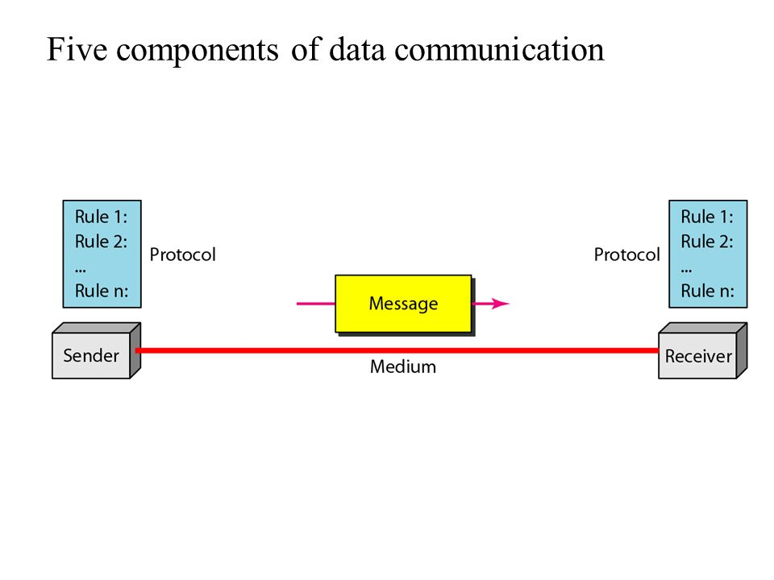
Components:
A data communications system has five component:

Slide 5
Message-The message is the information (data) to be communicated. Popular forms of information include text, numbers, pictures, audio, and video.
Sender- The sender is the device that sends the data message. It can be a computer, workstation, telephone handset, video camera, and so on
Receiver-The receiver is the device that receives the message. It can be a computer, workstation, telephone handset, television, and so on.
Transmission medium- The transmission medium is the physical path by which a message travels from sender to receiver. Some examples of transmission media cable wires or Wifi,bluetooth.
Protocol- A protocol is a set of rules that govern data communications. It represents an agreement between the communicating devices. Without a protocol, two devices may be connected but not communicating, just as a person speaking French cannot be understood by a person who speaks only Japanese.

Slide 6
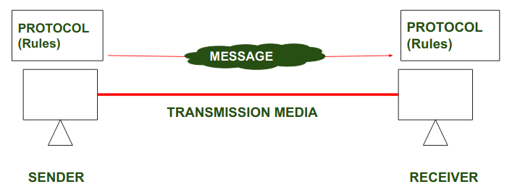
Protocols
A protocol is a set of rules that govern data communications.
It represents an agreement between the communicating devices.
To make communication successful between devices, some rules and procedures should be agreed upon at the sending and receiving ends of the system. Such rules and procedures are called Protocols.
Without a protocol, two devices may be connected but not communicating, just as a person speaking French cannot be understood by a person who speaks only Japanese.

Slide 7
Key elements of Protocol
Syntax: define structure or format of data
Semantics: Interprets meaning of the data bit
Timing: ensure that what tine data should be send and how fast data can be sent

Slide 8
Standards
Data communication standards are defined as the guidelines to product manufacturers and vendors to ensure national and international interconnectivity
Standards are the set of rules for data communication that are needed for exchange of information among devices.
Types of Standards
De Facto Standard: The meaning of the word ” De Facto ” is ” By Fact ” or “By Convention”. These are the standards that have not been approved by any Organization but have been adopted as Standards because of their widespread use. Also, sometimes these standards are often established by Manufacturers. For example : Apple and Google are two companies that established their own rules for their products which are different. Also, they use some same standard rules for manufacturing their products.
De Jure Standard: The meaning of the word “De Jure” is “By Law” or “By Regulations". Thus, these are the standards that have been approved by officially recognized bodies like ANSI, ISO, IEEE, etc. These are the standards that are important to follow if it is required or needed. For example : All the data communication standard protocols like SMTP, TCP, IP etc. are important to follow the same when we need them.

Slide 9
Standard organizations
An association of organizations, governments, manufacturers and users form the standards. organizations and are responsible for developing, coordinating and maintaining the standards .
1) International Standard Organization (ISO) – ISO is the International Organization for Standardization. It creates set of rules and standards for graphics , document exchange , data communication etc.
2) Consultative Committee for International Telephony and Telegraphy (CCITT) – CCITT is now standard organization for the United States. CCITT developer’s recommended set of rules and standards for telephone and telegraph communication.
3) American National Standard Institute (ANSI) – ANSI is primary organization for fostering the development of technology standards in the United States and providing various set of rules and standard for Data Communication.

Slide 10
4) Institute of Electrical and Electronic Engineering (IEEE) – It is US based professional organization of electronic , computer and communication engineering. It provides various set of rules and standard in communication and networking field.
5) Electronic Industries Association(EIA) – This organization establish and recommends industrial standards. EIA has developed the RS(Recommended Standards) series of Standards for data and telecommunication.

Slide 11
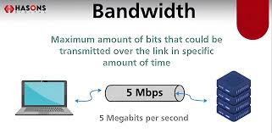
Bandwidth
Bandwidth is the maximum rate at which data transfer occurs across any particular path of the network.
Bandwidth is basically a measure of the amount of data that can be sent and received at any instance of time.
That simply means that the higher the bandwidth of a network, the larger the amount of data the network can be sending to and from across its path.
The common units of bandwidth are as follows.
bps (Bits per second)
Mbps (Megabits per second)
Gbps (Gigabits per second)
For example, if bandwidth is 100 Mbps, it means maximum
100 Mb data can be transferred per second on that channel.

Slide 12
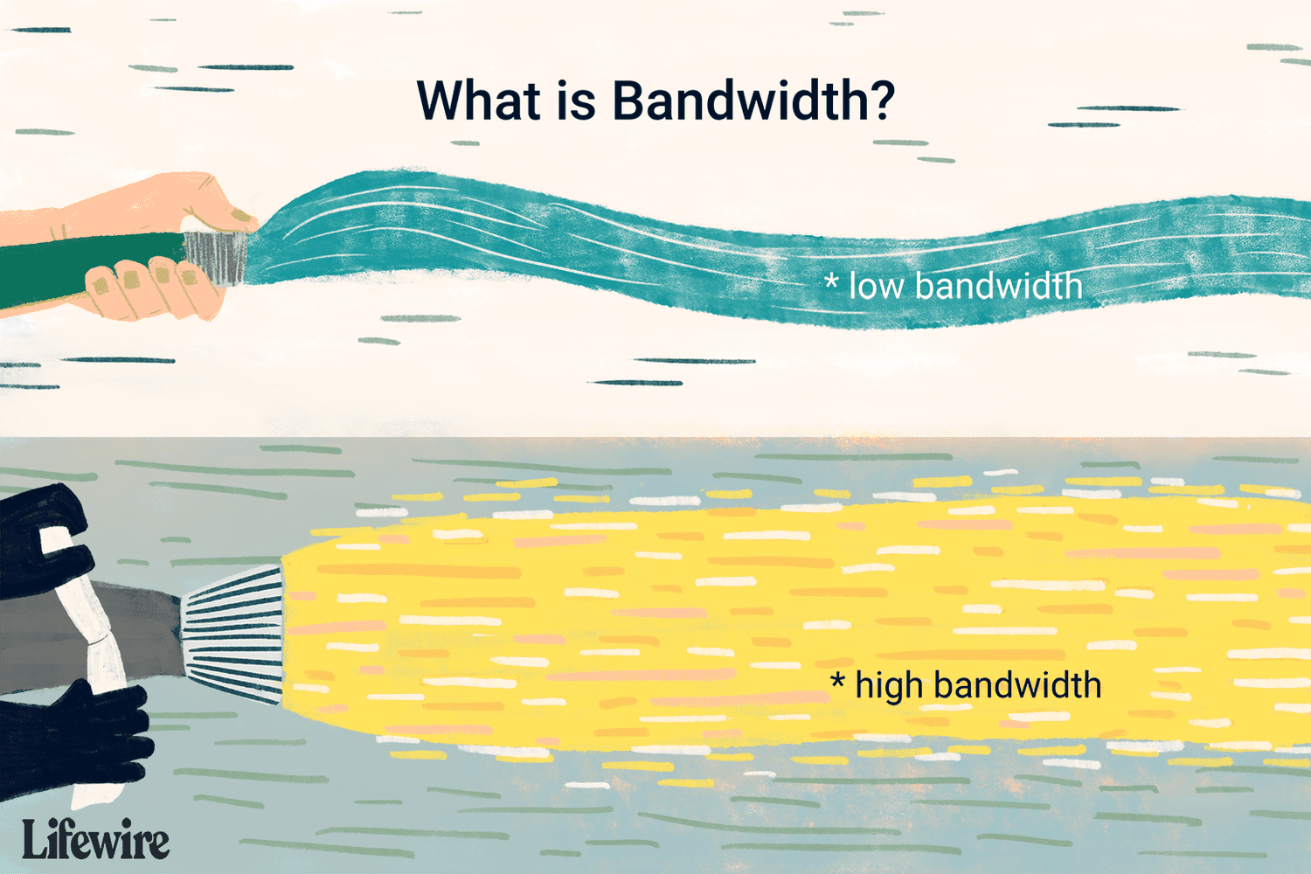
Bandwidth

Slide 13
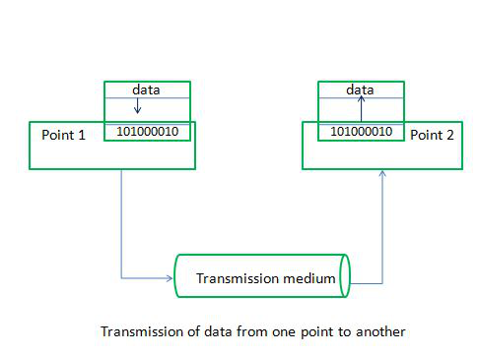
Data Transmission Rate
The data transfer rate represents the amount of data transferred per second by communications channel or a computing or storage device.
Data rate is measured in units of bits per second (bps), bytes per second (Bps), or baud.
Data transfer rate (DTR) is the speed at which data is moved from one device to another or within a network.
It's also known as transmission speed, or connection speed.

Slide 14
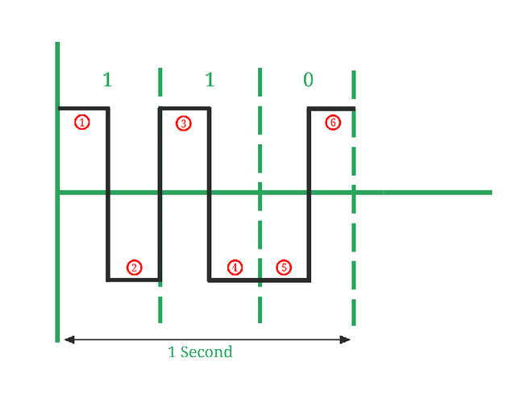
Baud Rate
Baud rate is the rate at which the number of signal elements occurs per second when it passes through a transmission medium.
The higher a baud rate is the faster the data is sent/received.
It is also called as signal rate
Baud rate = number of signal elements/total time (in seconds)
Example-Number of signal elements (marked in red color) = 6 and Baud rate = 6/1 = 6 baud per second.

Slide 15
Bits per second(bit rate)
bit rate is used to describe digital signals.
The bit rate is the number of bits sent in 1s, expressed in bits per second (bps).
Figure shows the bit rate of signals.
It is also called as data rate
Example -Number of bits transmitted (1, 1, 0) = 3. So, Here Bit rate = 3/1 = 3 bits per second.

Slide 16
1.3 Modes of Communication
Communication/Transmission mode means transferring data between two devices. It is also known as a communication mode. There are three types of transmission modes:

Slide 17
Simplex Mode:
In Simplex mode, the communication is unidirectional, as on a one-way street.
Only one of the two devices on a link can transmit, the other can only receive.
The simplex mode can use the entire capacity of the channel to send data in one direction.
Example: keyboard and traditional monitors. The keyboard can only introduce input, the monitor can only give the output.

Slide 18
Advantages of Simplex Mode:
Simplex mode is the easiest and most reliable mode of communication.
It is the most cost-effective mode, as it only requires one communication channel.
There is no need for coordination between the transmitting and receiving devices, which simplifies the communication process.
Disadvantages of Simplex Mode:
Only one-way communication is possible.
In situations where feedback or response are needed, simplex communication mode can be poor.

Slide 19
Half duplex:
In half-duplex mode, each station can both transmit and receive, but not at the same time. When one device is sending, the other can only receive, and vice versa.
The half-duplex mode is used in cases where there is no need for communication in both directions at the same time. The entire capacity of the channel can be utilized for each direction.
Example Walkie-talkies-when using a walkie-talkie, one party speaks while the other listens. After a slight pause, the other party speaks while the first party listens.

Slide 20
Advantages of Half Duplex Mode:
Half-duplex mode allows for bidirectional communication, which is useful in situations where devices need to send and receive data.
It is a more efficient mode of communication than simplex mode, as the channel can be used for both transmission and reception.
Disadvantages of Half Duplex Mode:
Half-duplex mode is less reliable than Full-Duplex mode, as both devices cannot transmit at the same time.
There is a delay between transmission and reception, which can cause problems in some applications.
There is a need for coordination between the transmitting and receiving devices, which can complicate the communication process.

Slide 21
Full Duplex:
In full-duplex mode, both stations can transmit and receive data simultaneously means at the same time.
Full-duplex mode is used when communication in both directions is required all the time.
The capacity of the channel, however, must be divided between the two directions.
Example: Telephone Network in which there is communication between two persons by a telephone line, through which both can talk and listen at the same time.

Slide 22
Advantages of Full-Duplex Mode:
Full-duplex mode allows for simultaneous bidirectional communication, which is ideal for real-time applications such as video conferencing or online gaming.
It is the most efficient mode of communication, as both devices can transmit and receive data simultaneously.
Disadvantages of Full-Duplex Mode:
Full-duplex mode is the most expensive mode, as it requires two communication channels.
It is more complex than simplex and half-duplex modes, as it requires two physically separate transmission paths or a division of channel capacity.

Slide 23
Difference Between Modes of Data Communication
Basis for Comparison | Simplex | Half Duplex | Full Duplex
Direction of Communication | Unidirectional | Two-directional, one at a time | Two-directional, simultaneously
Send / Receive | The sender can only send data | The sender can send and receive data, but one a time | The sender can send and receive data simultaneously
Performance | Worst performing mode of transmission | Better than Simplex | Best performing mode of transmission
Example | Keyboard and monitor | Walkie-talkie, Wi-Fi | Telephone

Slide 24
Analog Signal and Digital Signal
Signal:
Signal serves as carriers of information between communication devices. They can convey different types of information depending on the application required.
There are two types of signals
Analog signal
Digital signal

Slide 25
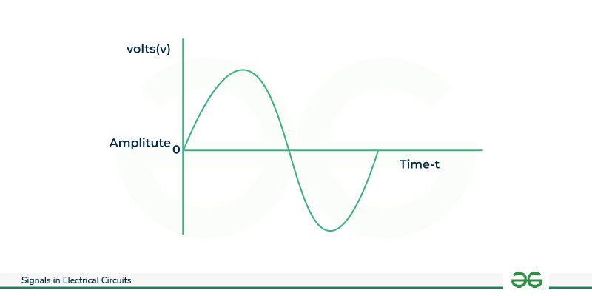
Analog Signal
The term analog refers something that is continuous in nature.
Analog data refers to information that is continuous.
Analog signals are continuing (e.g., a real variable) and infinitely varying with time parameter or can take any value within a given range().
These signals are represented by the sine wave.
Examples of analog signals are audio signals, human sound waves or television waves.
The simplest way to show signals is by plotting them on a pair of perpendicular axes. The vertical axis represents the value or strength of a signal. The horizontal axis represents time

Slide 26
Analog Signal
Analog signal described using factors like:
Amplitude is a maximum height of the signal or peak. Unit of amplitude is Volts(V)
Period is a time taken by a signal to complete 1 cycle. Unit of period is Seconds(S)
Frequency is a number of cycles or periods completed in 1second. Unit of frequency is Hertz (Hz)
Phase: Phase describes the position of the waveform relative to time 0. Unit of phase is degrees

Slide 27
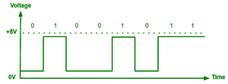
Digital Signal:
A digital signal is discrete in nature.
A digital signal is a type of signal used to represent data in binary form(0s and 1s).
Commonly used in computer systems and telecommunications.
A digital signal have discrete level, often just two namely, high and low, corresponding to binary values 1 and 0

Slide 28
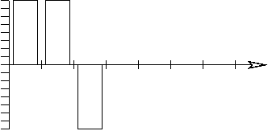
Suppose we want to transmit the number 6. In binary, that number is 110. We first decide that, say, "high" means a 1 and "low" means a 0. Thus, 6 might look like:

Slide 29
Difference Between Analog and Digital Signal
Basis for Comparison | Analog Signal | Digital Signal
Basic | An analog signal is a continuous signal that changes over a time period. | A digital signal is a non-continuous, discrete signal that carries information in binary form.
Representation | Represented by a sine wave. | Represented by square waves.
Description | Described by the amplitude, period ,frequency, and phase. | Described by bit rate and bit intervals.
Range | There is no fixed range. | Digital signal has finite range i.e. 0 and 1.
Power | Requires more power | Requires less power
Example | Human voice | Signals transmitted inside computer

Slide 30
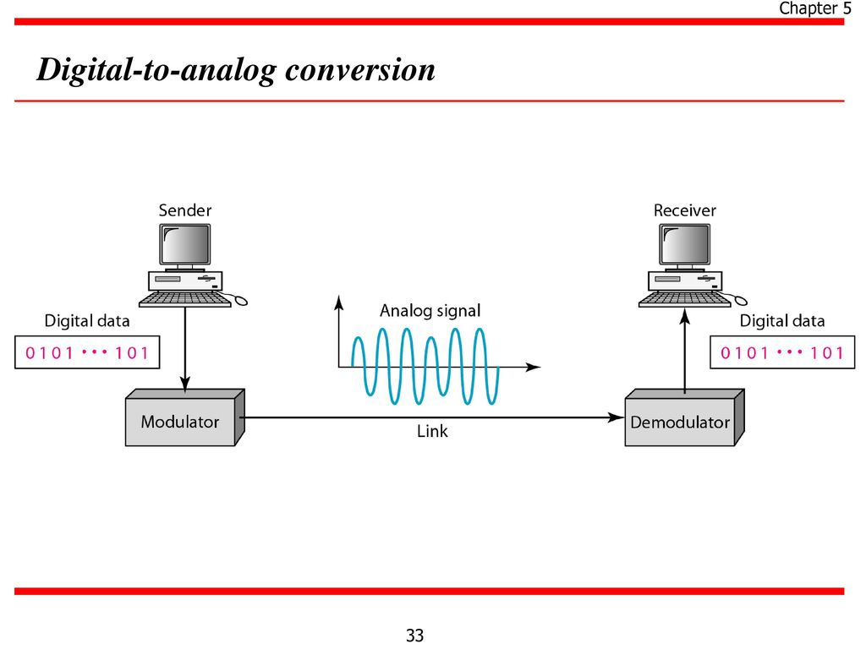
Digital To Analog Conversion
Process of changing one or more attributes of analog signal based on information in digital data is called as digital to analog conversion.
It is also called as the modulation of the digital signal. Depending on whether the amplitude, frequency or phase of the carrier signal is modified.
Modulation is the process of varying a signals characteristics (Amplitude, frequency, phase)to encode data for transmission
Modulator uses some coding scheme and
convert D into A and demodulator converts
A into D
Fig. shows D to A conversion.

Slide 31
The following techniques can be used for Digital to Analog Conversion:
Amplitude Shift Keying(ASK)
Frequency Shift Keying(FSK)
Phase Shift Keying(FSK)

Slide 32
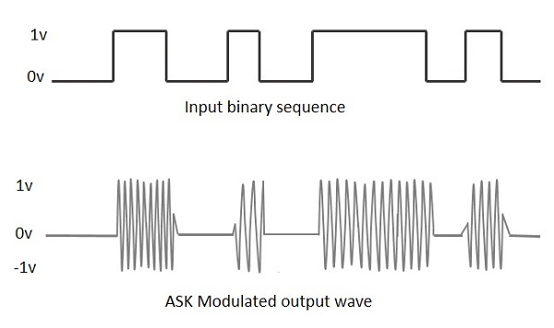
Amplitude Shift Keying(ASK)
Amplitude Shift Keying is a technique in which The amplitude of analog carrier signal is modified to reflect binary data.
When binary data represent digit 1,the amplitude is held otherwise it set to 0
The frequency and phase of the carrier signal remain constant.

Slide 33
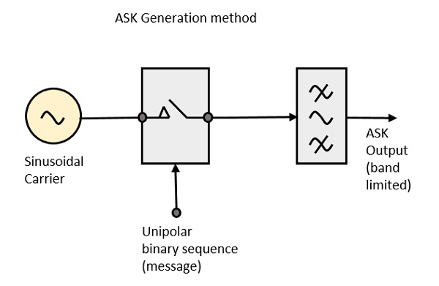
ASK Modulator

Slide 34
Advantages of Amplitude shift keying
ASK is easy to implement.
ASK is relatively low cost modulation technique.
ASK requires less bandwidth as compared to FSK and PSK
Disadvantages of Amplitude shift keying
ASK technique is not suitable for high bit rate data transmission.
ASK is vey sensitive to noise.

Slide 35
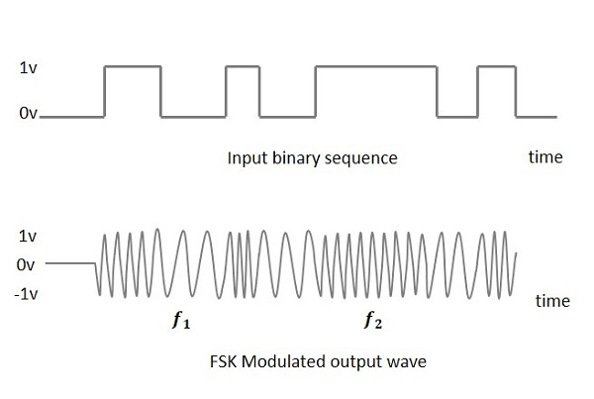
Frequency Shift Keying(FSK)
Frequency shift keying is the digital modulation technique in which the frequency of carrier signal varies according to the digital signal changes.
FSK is a scheme of frequency modulation.
The output of a FSK modulated wave is high in frequency for a binary High input and is low in frequency for a binary Low input.
The following image is the diagrammatic representation of FSK modulated waveform along with its input.

Slide 36
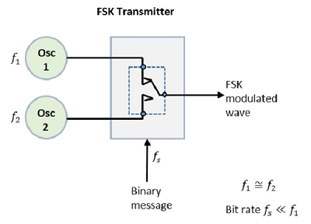
Frequency Shift Keying(FSK)
FSK Modulator
The FSK modulator block diagram comprises of two oscillators with a clock and the input binary sequence.

Slide 37
Advantages of Frequency shift keying
Simple and Easy to implement.
Easy to decode.
Used in long-distance communication
Disadvantages of Frequency shift keying
Power requirement is constant
Required high bandwidth

Slide 38
Phase Shift Keying
PSK is the digital modulation technique in which the phase of the carrier signal is changed to reflect the binary data.
When new binary symbol encountered the phase of symbol is altered.
PSK is of two types
Binary phase shift keying
Quadrature phase shift keying

Slide 39
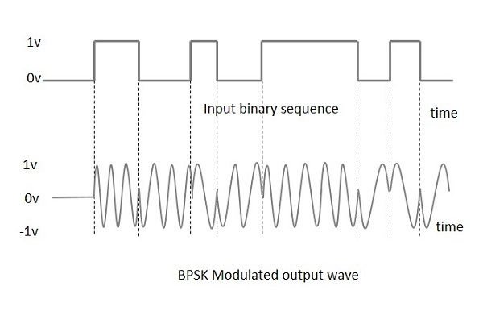
Binary phase shift keying
This is also called as 2-phase PSK .
In this technique, the sine wave carrier takes two phase reversals such as 0° and 180°.
For a zero binary input, the phase will be 0° and for a one binary input, the phase reversal is of 180°

Slide 40
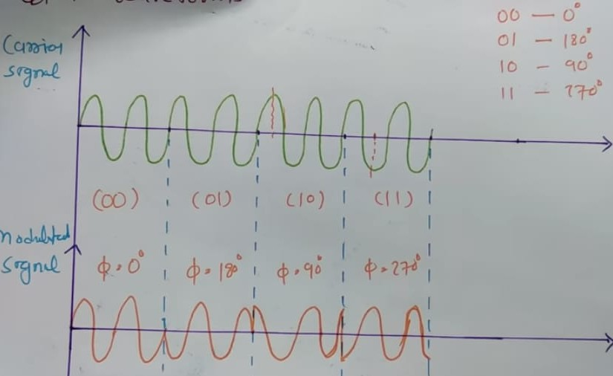
Quadrature phase shift keying:
This is the phase shift keying technique, in which the sine wave carrier takes four phase reversals such as 0°, 90°, 180°, and 270°.
In QPSK two bits are modulated at once.
QPSK used in satellite transmission.
If this kind of techniques are further extended, PSK can be done by eight or sixteen values also, depending upon the requirement.

Slide 41
Advantages of phase shift keying
High data rate of transmission can be achieved using high level of PSK modulations such as QPSK.
Efficient modulation technique as compared to ASK and FSK.
Disadvantages of Quadrature phase shift keying
The bandwidth efficiency of this PSK is less compared with ASK type of modulation
Multilevel scheme in PSK are more sensitive to phase variation.

Slide 42
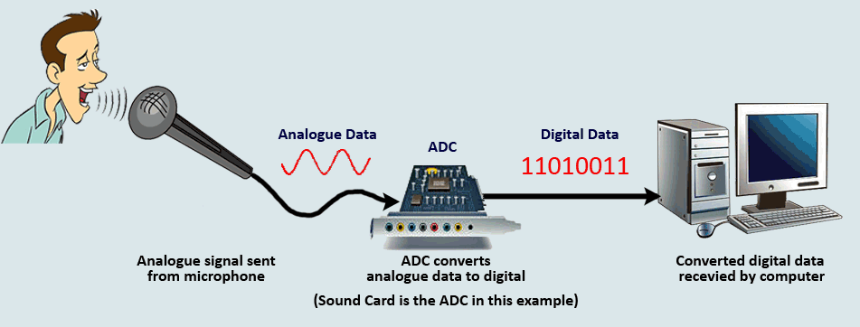
Analog To Digital:
An analog-to-digital conversion is the process of converting analog signals into digital signals
changes an analog signal that's continuous in terms of both time and amplitude to a digital signal that's discrete in terms of both time and amplitude.
Need of Analog To Digital Conversion:
Digital signals propagate more efficiently than analog signals largely because digital impulses are well defined and orderly.
Example: Computers "talk" and "think" in terms of binary digital data. While a microprocessor can analyze analog data, it must be converted into digital form for the computer to make sense of it.

Slide 43
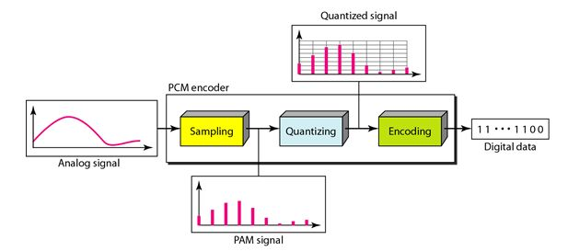
Pulse Code Modulation(PCM)
The most common technique to change an analog signal to digital data (digitization) is called pulse code modulation (PCM). A PCM encoder has three processes, as shown in Figure
1. Sampling: The analog signal is sampled.
2. Quantization: The sampled signal is quantized.
3. Encoding: The quantized values are encoded as streams of bits.

Slide 44

1.Sampling
The first step in PCM is sampling
Sampling is a process of converting the continuous signal(analog) into a discrete signal().
The analog signal is sampled every time interval.
Most important factor in sampling is the rate at which analog signal is sampled.
Sampling rate is the number of samples taken per second.
The Nyquist theorem states that to accurately capture all information in an analog signal, the sampling rate must be at least the twice the highest frequency present in the signal.

Slide 45
Advantages:
Sampling allows analog signals to be converted into digital form, which are easier to store and transmit efficiently.
Digital samples are less affected by noise than analog signals.
Disadvantages:
High sampling rates result in more data, requiring greater bandwidth for transmission

Slide 46
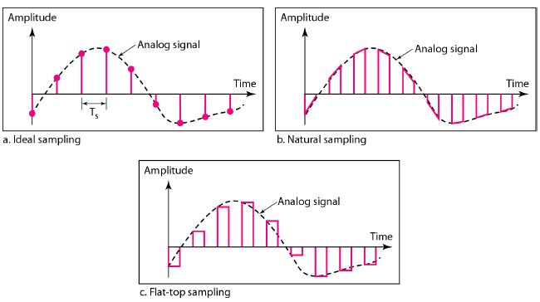
Sampling types

Slide 47
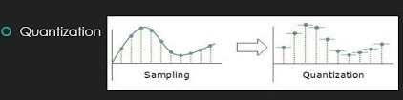
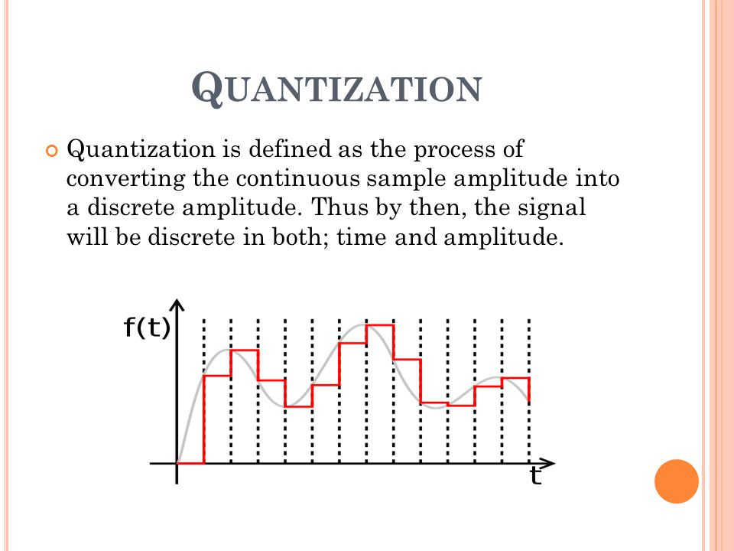
2. Quantization
Quantization is the process of mapping a continuous range of values(analog signals) into finite set of discrete levels.
Sampling yields discrete form of continuous analog signal. Every discrete pattern shows the amplitude of the analog signal at that distance.
The quantization is done between the maximum amplitude value and the minimum amplitude value. Quantization is approximation of the instantaneous analog value.

Slide 48
Advantages:
Quantization enables the digital processing and transmission of analog signals.
Increase computer efficiency.

Slide 49
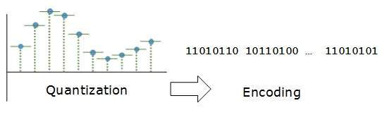
3.Encoding
The digitization of the analog signal is done by the encoder.
In encoding, each approximated value is then converted into binary format.
After each sample is quantized and the number of bits per sample is decided, each sample can be changed to an n bit code.

Slide 50
Fundamental Of Computer Network: Definition And Need Of Computer Network, Applications, Network Benefits
Computer Network:
Computer network means two or more computers connected together by cables or some other medium for purpose of sharing information and resources.
Two or more computers communicate, with each other with the help of computer network.
A computer network is a collection of two or more computer systems that are linked together. A network connection can be established using either cable or wireless media.
Need Of Computer Network
Sharing of information in the form of files, folders or drives.
Sharing of expensive software and database.
Sharing of resources such as printer, scanner etc. among all the users.
Communicating using email, video, instant messaging, etc.
Communication from one computer to the other computer.

Slide 51
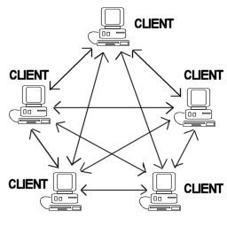
Computer Network Architecture
Peer-to-peer network:
In its simplest form, a peer-to-peer (P2P) network is created when two or more PCs are connected and share resources without going through a separate server computer.
Peer-to-peer (P2P) is defined as a decentralized network architecture in which participants, called peers, interact directly with each other without the need for a central server.
In a P2P network, each participant acts as both a client and a server, enabling them to share resources and services directly with other peers.
Peer-To-Peer network is useful for small environments, usually up to 10 computers.
usually up to 10 computers.

Slide 52
uses of P2P architecture:
● File sharing
● Instant messaging
Advantages:
Direct communication and faster content delivery
Cost savings
Resource sharing.
Disadvantages:
Lack of centralized control
Slow performance
In the case of Peer-To-Peer network, it does not contain the centralized system . Therefore, it cannot back up the data

Slide 53
2. Client-Server Network
Client-server architecture is a fundamental concept in system design where a network involves multiple clients and one server.
The central controller is known as a server while all other computers in the network are called clients.
Clients are devices or programs that request services or resources, while the server is a powerful machine providing these resources or services.
This architecture allows efficient data management and resource sharing, making it popular in web applications, databases, and other network-based systems.
Example: Bank system
Networking and Communication in Client-Server Architecture
Client-Server Model: This architecture involves two main components:
Client: Initiates requests to the server, typically in response to user actions or inputs.
Server: Responds to client requests, performing required processing and returning results.
Networking Protocols: These define rules and formats for communication between clients and servers. Examples include HTTP/HTTPS for web applications, .

Slide 54

Advantages:
All files are stored in a central location
Network peripherals are controlled centrally
Disadvantages:
The server is expensive to purchase
Specialist staff such as a network manager is needed

Slide 55
Applications:
Marketing and sales.
Printer Sharing
Application Services
E-mail Services
Remote access
Internet
Online Education
E-commerce

Slide 56
Network Benefits:
File sharing: Networking of computers helps the network users to share data files.
Hardware sharing: Users can share devices such as printers, scanners, hard drives etc. Without computer networks, device sharing is not possible.
Application sharing: Applications can be shared over the network, and this allows to implement client/server applications
Remote Access: With the help of remote access feature we can access the information which is located far away from us.
Network gaming: A lot of network games are available, which allow multi-users to play from different locations
E-Mail: Using email facility we can send the same information to the group of persons at a same time.
Backing up data: backup destination(pen drives,flopy disks, cloud storage) is the place where we store the backed-up data.
.

Slide 57
Classification Of Network: LAN, WAN,MAN
LAN:
LAN or Local Area Network connects network devices in such a way that personal computers and workstations can share data, tools, and programs.
The smallest LAN may only use two computers, while larger LANs can accommodate thousands of computers.
LAN has a range up to 1km.
a LAN can be as simple as two PCs and a printer in someone’s home office.
The data is transferred at an extremely faster rate in Local Area Network.
Local Area Network provides higher security.

Slide 58
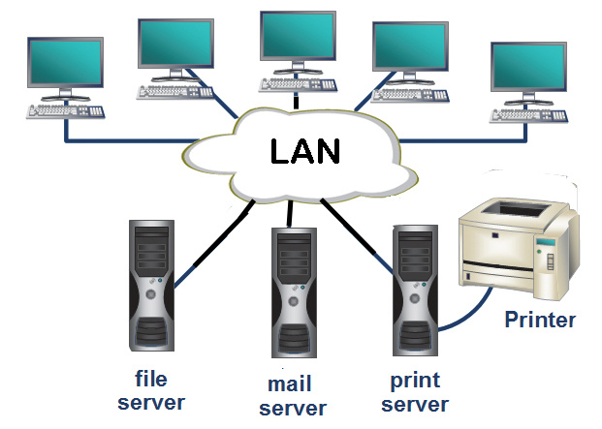
LOCAL AREA NETWORK(LAN)

Slide 59
Advantages:
Provides fast data transfer rates and high-speed communication.
Easy to set up and manage.
Can be used to share peripheral devices such as printers and scanners.
Provides increased security and fault tolerance compared to WANs.
Disadvantages:
Limited geographical coverage.
Limited scalability and may require significant infrastructure upgrades to accommodate growth.
May experience congestion and network performance issues with increased usage.

Slide 60
MAN:
MAN or Metropolitan area Network covers a larger area than that covered by a LAN and a smaller area as compared to WAN.
MAN has a range up to 80km. It connects two or more computers that are apart but reside in the same or different cities.
It covers a large geographical area .
MAN is designed for customers who need high-speed connectivity.
Speeds of MAN range in terms of Mbps.
Devices used for transmission of data through MAN are Modem and Wire/Cable.
For Example:
Suppose an company has three different offices in a city and company wants to connect computers in three offices together ,then MAN is used

Slide 61
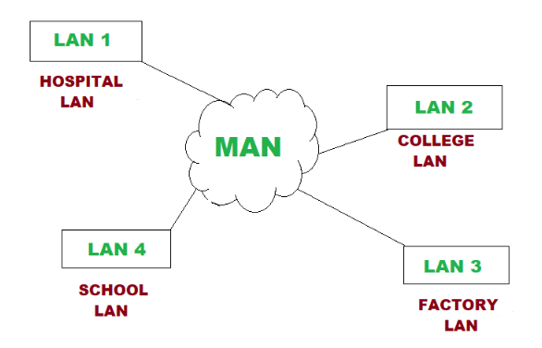
Metropolitan area Network

Slide 62
Advantages:
Provides high-speed connectivity over a larger geographical area than LAN.
large capacity for data transmission.
Offers higher data transfer rates than WAN in some cases.
Disadvantages:
Can be expensive to set up and maintain.
May experience congestion and network performance issues with increased usage.
May have limited fault tolerance and security compared to LANs.

Slide 63
WAN:
WAN or Wide Area Network is a computer network that extends over a large geographical area, like a state or a country or even entire world.
A WAN could be a connection of LAN connecting to other LANs via telephone lines and radio waves.
The speed of WAN ranges from a few kilobits per second (Kbps) to megabits per second (Mbps).
The WANs are slower than MANs and LANs because it covers very large geographic area
For Example:
A company has three offices, first in New York, second in London and third in Mumbai. each office has its own LAN. If a company connects these three LANs together using WAN technology, a WAN is created.

Slide 64
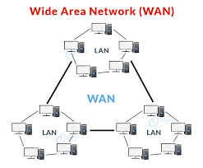

Slide 65
Advantages:
Covers large geographical areas and can connect remote locations.
Provides connectivity to the internet.
Offers remote access to resources and applications.
Can be used to support multiple users and applications simultaneously.
Disadvantages:
Can be expensive to set up and maintain.
Offers slower data transfer rates than LAN or MAN.
May experience longer propagation delays due to longer distances and multiple network hops.

Slide 66
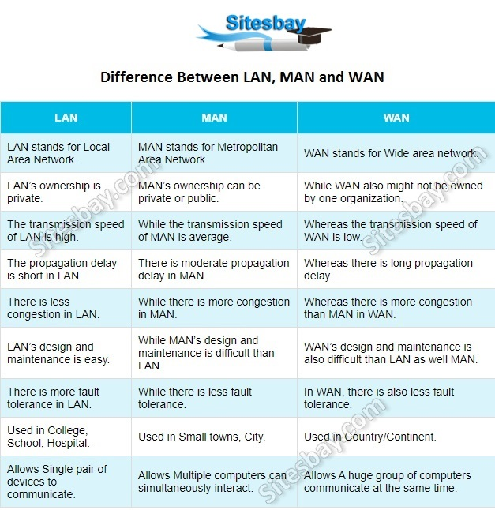

Slide 67
IMP Questions
W-19
Define bit rate and baud rate.
List different characteristics of data communication system.
Draw and explain block diagram of communication system.
Explain simplex, half duplex and full duplex modes in data communication
S-19
a)ADefine Computer Network and state it’s types. b) State various Computer Network applications
Describe the process of data communication in various modes.
Compare Analog and Digital signals.

Slide 68
S-23
Define computer Network.
Describe date communication standards.
Explain the components of Data communication.
Describe modes of communication
Differentiate any six point between LAN and WAN.
W-23
Differentiate any six point between LAN and WAN
Draw process of Data Communication
Explain modes of communication i) Simplex ii)
Explain wide Area Networks along with its advantages and disadvantages Half-Duplex iii) Full-Duplex

Slide 69
W-22
Name the components of data communication.
State any two needs of Computer Network.
Compare LAN and WAN (four points).
Describe the various modes of communication in Computer Network.
S-22
Define computer Network
Define : (i) Bit rate (ii) Baud rate
Define following terms:- (i) Protocol (ii) Bandwidth
Describe modes of communication
Describe the components of data communication with neat diagram.

