Slide 1
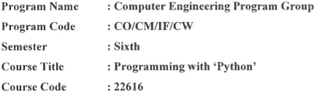

Slide 2
Chapter No 1
Introduction and syntax of Python Programming
MARKS:08

Slide 3
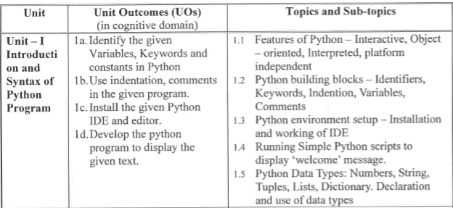

Slide 4
Course Outcome
Display message on screen using Python Script using IDE

Slide 5
What is Python?
Python is a popular programming language.
Python is widely used general purpose, high level programming language and was mainly developed for emphasis on code readability.
Python is an Open Source Language.
Pythons also supports Object Oriented Programming Features. Everything in python is primarily object

Slide 6
It was initially designed by Guido van Rossum in 1991 and developed by Python Software Foundation. The syntax of the language is clean and length of the code is relatively short.
It's fun to work in Python because it allows you to think about the problem rather than focusing on the syntax
It is used for:
web development (server-side),
software development,
mathematics,
Machine Learning
system scripting.

Slide 7
Applications of Python Programming
Google’s App Engine Web Development framework uses python as an application language.
Python Programming is used to develop an automation related applications by using an circuit ARDUINO & Raspberry-PI
YouTube video sharing services is written in Python Programming.
Google makes an extensively use of python in its Web search System.
iRobot uses Python Programming to develop commercial and Military robotics devices.
Raspberry pi single board computer promotes Python Programming as its educational language.
Maya, a powerful integrated 3D modeling & animation system provides python scripting API.

Slide 8
Facebook uses the python language in their productivity.
Instagram also uses an Python for its Front-end.
Quora is a popular social commenting websites which is also written in Python.
Nokia which is popular telecommunication company who uses python for its platform
Linux Weekly News published by using a web application written in a python programming.
NAS National security Agency uses a python Programming for cryptography and intelligence analysis.

Slide 9
Why Python is called Python?
When he began implementing Python, Guido van Rossum was also reading the published scripts from “Monty Python's Flying Circus”, a BBC comedy series from the 1970s. Van Rossum thought he needed a name that was short, unique, and slightly mysterious, so he decided to call the language Python.

Slide 10
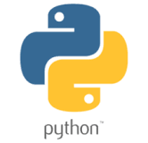
Why is Python logo a snake?
The logo is actually based on mayan representations of snakes which very often represent only the head and perhaps a short length of tail. The structure of the snake representations the natural coiling/nesting of a snake as seen side on.

Slide 11
Why Python?
Python works on different platforms (Windows, Mac, Linux, Raspberry Pi, etc).
Python has a simple syntax similar to the English language.
Python has syntax that allows developers to write programs with fewer lines than some other programming languages.
Python runs on an interpreter system, meaning that code can be executed as soon as it is written. This means that prototyping can be very quick.
Python can be treated in a procedural way, an object-orientated way or a functional way.
Python is written in C with default/”traditional” implementation as CPython.
Pyhton has very easy and readable syntax for any concept.

Slide 12
Where is Python used in real world?
The programming language is used globally to design and build 2D imaging software like Inkscape, GIMP, Paint Shop Pro, and Scribus. Also, Python is used in several 3D animation packages such as Blender, Houdini, 3ds Max, Maya, Cinema 4D, and Lightwave, to name a few.

Slide 13
Python Syntax compared to other programming languages
Python was designed for readability, and has some similarities to the English language with influence from mathematics.
Python uses new lines to complete a command, as opposed to other programming languages which often use semicolons or parentheses.
Python relies on indentation, using whitespace, to define scope; such as the scope of loops, functions and classes. Other programming languages often use curly-brackets for this purpose.

Slide 14
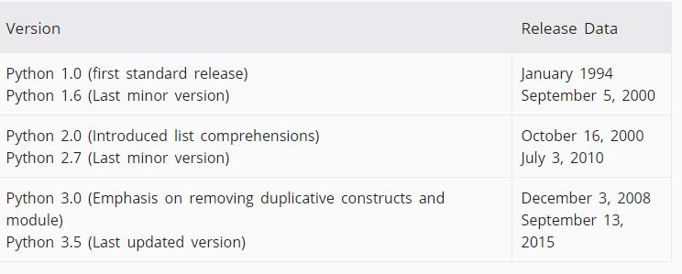
Different Version

Slide 15
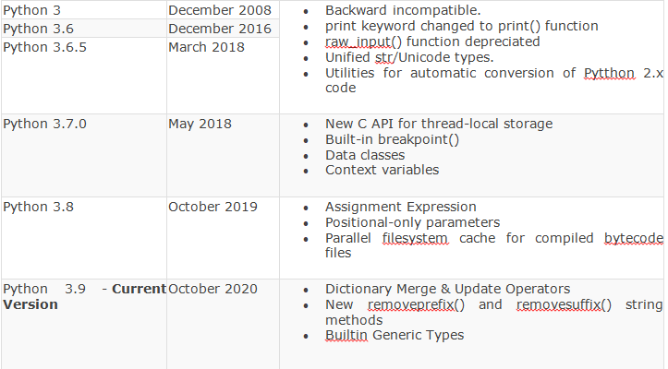

Slide 16
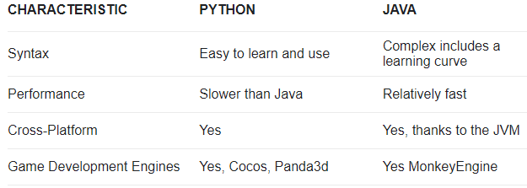
What is Python vs Java?

Slide 17
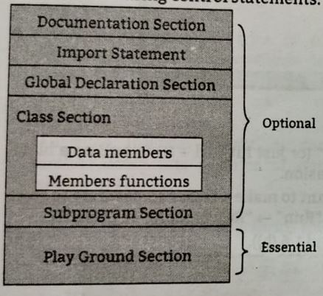
Structure of python Programming

Slide 18
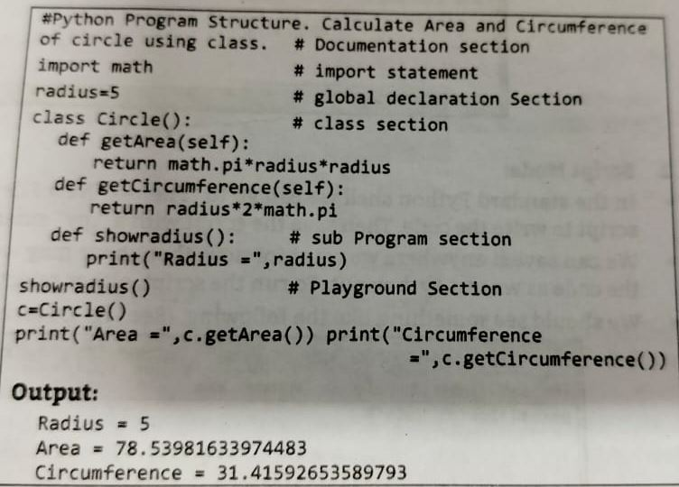

Slide 19
Features of Python Programming
Interpreted-Python is processed at runtime by the interpreter. You do not need to compile your program before executing it. This is similar to PERL and PHP.
Interactive-You can actually sit at a Python prompt and interact with the interpreter directly to write your programs.
Object-Oriented − Python supports Object-Oriented style or technique of programming that encapsulates code within objects.
Platform Independent & Portability- You can move Python programs from one platform to another, and run it without any changes. It runs seamlessly on almost all platforms including Windows, Mac OS X and Linux.

Slide 20
Large standard libraries-Python has a number of standard libraries which makes life of a programmer much easier since you don't have to write all the code yourself. Standard libraries in Python are well tested and used by hundreds of people. So you can be sure that it won't break your application.
Extensible and Embeddable-Suppose an application requires high performance. You can easily combine pieces of C/C++ or other languages with Python code.This will give your application high performance as well as scripting capabilities which other languages may not provide out of the box.
Free and open-source-You can freely use and distribute Python, even for commercial use. Not only can you use and distribute softwares written in it, you can even make changes to the Python's source code.

Slide 21
A simple language which is easier to learn-Python has a very simple and elegant syntax. It's much easier to read and write. Python makes programming fun and allows you to focus on the solution rather than syntax.
Auto destructive-It support automatic memory management.
Improved Productivity-Python is a very productive language. Due to the simplicity of Python, developers can focus on solving the problem
Dynamic Typing-In Python we do not need to declare variable type in advance as in python ,implicit memory management is there.

Slide 22
Disadvantages of Python
1. Slow Speed
As Python is an interpreted language and dynamically-typed language. The line by line execution of code often leads to slow execution.
2. Not Memory Efficient
The Python programming language uses a large amount of memory. This can be a disadvantage while building applications when we prefer memory optimization.
3. Weak in Mobile Computing
Python is generally used in server-side programming. We don’t get to see Python on the client-side or mobile applications because of the following reasons

Slide 23
4. Database Access
The Python’s database access layer is primitive and underdeveloped in comparison to the popular technologies like JDBC and ODBC.
5. Runtime Errors
As we know Python is a dynamically typed language so the data type of a variable can change anytime. A variable containing integer number may hold a string in the future, which can lead to Runtime Errors.

Slide 24
Building blocks of python
Character set
Tokens
Keyword
Identifiers
Literals
Variables
Indentation
Comments
Constant

Slide 25
1. Character set:
A character set is a set of valid characters acceptable by a programming language in scripting. The below table illustrates the Python character set along with examples
Alphabets: All capital (A-Z) and small (a-z) alphabets.
Digits: All digits 0-9.
Special Symbols: Python supports all kind of special symbols like, ” ‘ l ; : ! ~ @ # $ % ^ ` & * ( ) _ + – = { } [ ] \ .
White Spaces: White spaces like tab space, blank space, newline, and carriage return.
Other: All ASCII and UNICODE characters are supported by Python that constitutes the Python character set.

Slide 26
2. Tokens
A token is the smallest individual unit in a python program.
Python has the following tokens:
1)keywords
2)identifiers
3)literals
a)String literals
b)Numeric literals
c)Boolean Literals
d)Special literal None

Slide 27
3. Keywords or Reserved Words
Keyword are reserved words and you cannot use them as constant or variable or any other identifier names.
All the Python keywords contain lowercase letters only.
Python has 35 Keywords
The following list shows the Python keywords.

Slide 28
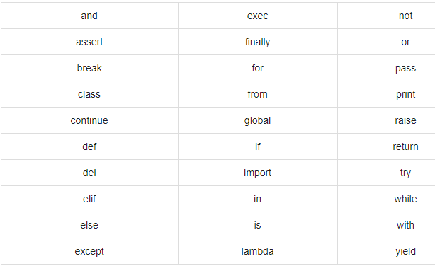

Slide 29
4. Identifiers
A Python identifier is a name used to identify a variable, function, class, module or other object.
An identifier starts with a letter A to Z or a to z or an underscore (_) followed by zero or more letters, underscores and digits (0 to 9).
Python does not allow punctuation characters such as @, $, and % within identifiers.
Python is a case sensitive programming language

Slide 30
Naming conventions for Python identifiers
Class names start with an uppercase letter. All other identifiers start with a lowercase letter.
Starting an identifier with a single leading underscore indicates that the identifier is private.
Starting an identifier with two leading underscores indicates a strongly private identifier.
If the identifier also ends with two trailing underscores, the identifier is a language-defined special name.

Slide 31
5. Literals or Values:
Literals are the fixed values or data items used in a source code. Python supports different types of literals such as:
1. String Literals: The text written in single, double, or triple quotes represents the string literals in Python.
For example: “Computer Science”, ‘sam’, etc. We can also use triple quotes to write multi-line strings.
2. Numeric Literals: These are the literals written in form of numbers. Python supports the following numerical literals:
Integer Literal: It includes both positive and negative numbers along with 0. It doesn’t include fractional parts. It can also include binary, decimal, octal, hexadecimal literal.
Float Literal: It includes both positive and negative real numbers. It also includes fractional parts.
Complex Literal: It includes a+bi numeral, here a represents the real part and b represents the complex part.
Ex.a=10,b=12.5

Slide 32
3. Boolean Literals: Boolean literals have only two values in Python. These are True and False.
4. Special Literals: Python has a special literal ‘None’. It is used to denote nothing, no values, or the absence of value.

Slide 33

6. Lines and Indentation
Python provides no braces to indicate blocks of code for class and function definitions or flow control. Blocks of code are denoted by line indentation, which is rigidly enforced.
The number of spaces in the indentation is variable, but all statements within the block must be indented the same amount.
For example

Slide 34
Indentation refers to the spaces at the beginning of a code line. Python indentation refers to adding white space before a statement to a particular block of code. In another word, all the statements with the same space to the right, belong to the same code block.

Slide 35

Multi-Line Statements
Statements in Python typically end with a new line. Python does, however, allow the use of the line continuation character (\) to denote that the line should continue. For example −

Slide 36

Statements contained within the [], {}, or () brackets do not need to use the line continuation character. For example −

Slide 37

Quotation in Python
Python accepts single ('), double (") and triple (''' or """) quotes to denote string literals, as long as the same type of quote starts and ends the string.
The triple quotes are used to span the string across multiple lines. For example, all the following are legal −

Slide 38
7. Comments in Python
Single line comment:
Single-line comments are created simply by beginning a line with the hash (#) character, and they are automatically terminated by the end of line.
Example:
# print is a statement
print(‘Hello Python’)

Slide 39
Multi line comment:
Python multi-line comment is a piece of text enclosed in a delimiter (""") Triple quotation marks.
Example: """ Multi-line comment used print("Python Comments") """ or To add a multiline comment you could insert a # for each line:
Example:
#This is a comment
#written in
#more than just one line print("Hello, World!")

Slide 40
8. Variables
A variable holds a value that may change.
Variables are nothing but reserved memory locations to store values. This means that when you create a variable you reserve some space in memory.
Based on the data type of a variable, the interpreter allocates memory and decides what can be stored in the reserved memory.
Variables do not need to be declared with any particular type and can even change type after they have been set.
A variable is created the moment you first assign a value to it.
Python variables do not need explicit declaration to reserve memory space. The declaration happens automatically when you assign a value to a variable. The equal sign (=) is used to assign values to variables.

Slide 41
Rules for Defining Variables
A variable name must start with a letter or the underscore character
A variable name cannot start with a number
A variable name can only contain alpha-numeric characters and underscores (A-z, 0-9, and _ )
Variable names are case-sensitive (age, Age and AGE are three different variables)

Slide 42
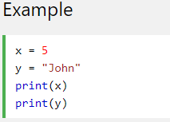
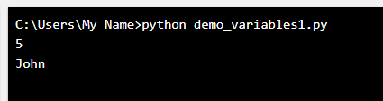

Slide 43
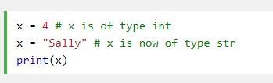


Slide 44
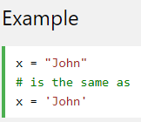
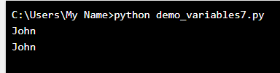
String variables can be declared either by using single or double quotes:

Slide 45
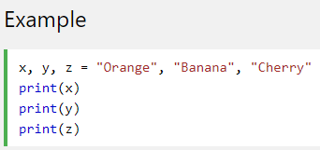
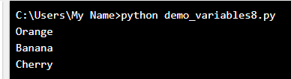
Assign Value to Multiple Variables
Python allows you to assign values to multiple variables in one line:

Slide 46
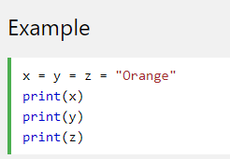
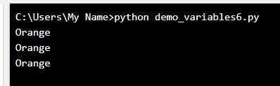
And you can assign the same value to multiple variables in one line:

Slide 47
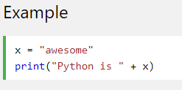

Output Variables
The python print statement is used to output variables.
To combine both text and a variable, Python uses the + Character

Slide 48
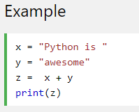

You can also use the + character to add a variable to another variable:

Slide 49
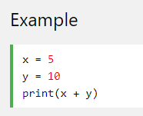

For numbers, the + character works as a mathematical operator:

Slide 50
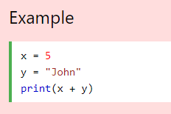

If you try to combine a string and a number, Python will give you an error:

Slide 51
Global Variables
Variables that are created outside of a function are known as global variables.
Global variables can be used by everyone, both inside of functions and outside.
To create a global variable inside a function, you can use the global keyword

Slide 52
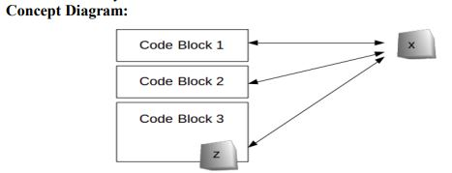
A global variable (x) can be reached and modified anywhere in the code, local variable (z) exists only in block 3.

Slide 53
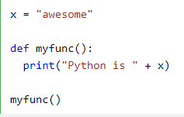
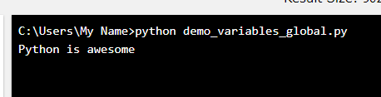
Create a variable outside of a function, and use it inside the function

Slide 54
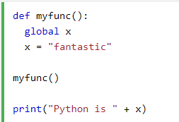
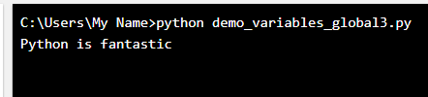

Slide 55
Local Variable
when you create a variable inside a function, that variable is local, and can only be used inside that function.

Slide 56
Example to demonstrate local and Global Variable
g=10 #global variable g
def test():
l=20
print("local variable=",l) # accessing local variable
print("Global variable=",g) # accessing global variable
test()
print("global variable=",g)
output:
local variable= 20
Global variable= 10
global variable= 10

Slide 57
9. Constants
A constant is a type of variable whose value cannot be changed.
In Python, constants are usually declared and assigned on a module. Here, the module means a new file containing variables, functions etc which is imported to main file.
Inside the module, constants are written in all capital letters and underscores separating the words.

Slide 58
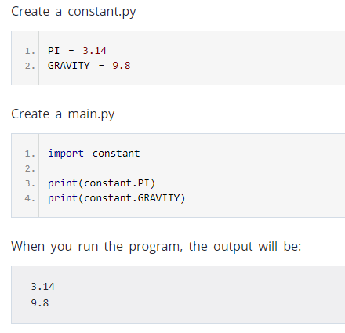
Examples

Slide 59
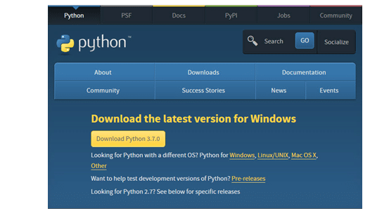
Install Python on Windows
To install Python, firstly You need to go to the Download Python page from its official site python.org/download and click on the latest version

Slide 60
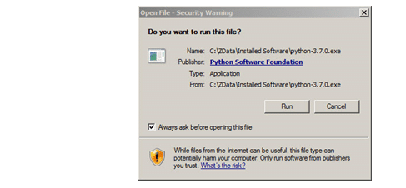
Once the Python distribution download is completed, then double-click on the executable downloaded software, and then click on Run
Now, once the installation set up starts, You need to follow the below-mentioned installation steps:

Slide 61
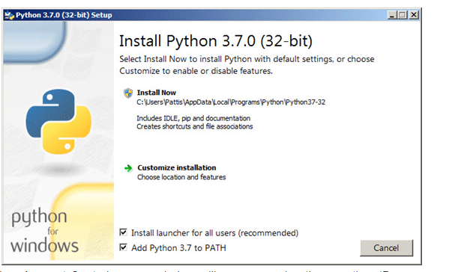
Step 1: A pop-up window, Python Version 3.7.0 (32-bit) Setup, will appear. Here, You need to ensure that You have checked the checkboxes for ‘Install launcher for all users (recommended)’ and for ‘Add Python 3.7 to PATH’ at the bottom

Slide 62
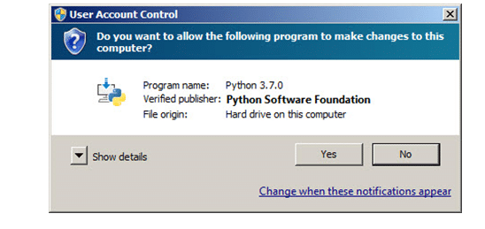
Step 2: Now, a User Account Control pop-up window will appear, posing the question, ‘Do you want to allow the following program to make changes to this computer?’ Click on Yes

Slide 63
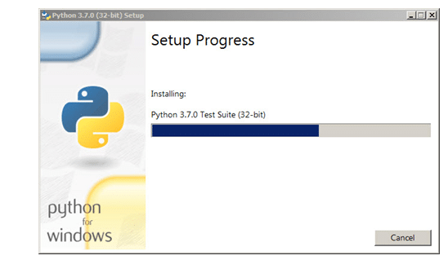
Step 3: Now, a new Python 3.7.0 (32-bit) Setup pop-up window will appear with a ‘Setup Progress’ message and a progress bar. During the installation, it will show us various components it is installing, and it will move the progress bar toward completion. Soon, a new Python 3.7.0 (32-bit) Setup pop-up window will appear with a ‘Setup was successful’ message

Slide 64
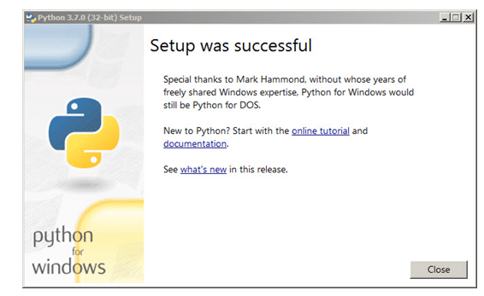
Step 4: Once the installation is done, click on the Close button. And now, Python is successfully installed

Slide 65
Step 5: Now, Python is installed in your computer directory. You need to run python by following steps.
1.Click START button
2.Go to All PROGRAMS.
3.Search for Python2.7 folder.
4.Click Python (Command Line)
This will start the Python Command Line.

Slide 66
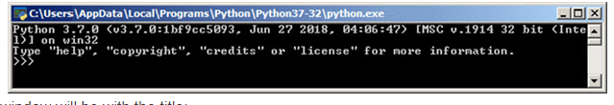

The following pop-up window will appear.

Slide 67
Once Python starts,you will see the interpreter startup message,indicating version & platform.
You will also be given the python interpreter prompt i.e. ‘>>>’ which is known as python chevron prompt.
The ‘>>>’ indicates that python interpreter is waiting for an expression or command.
This interactive Environment where we are interacting with the python interpreter is called the console or command shell

Slide 68
Setting path at Windows
To add the Python directory to the path for a particular session in Windows −
At the command prompt − type path %path%;C:\Python and press Enter.
Note − C:\Python is the path of the Python directory

Slide 69
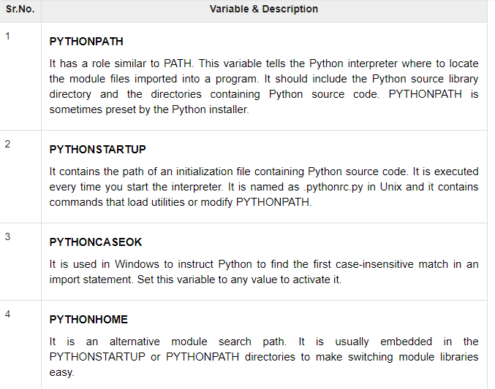
Python Environment Variables

Slide 70
Integrated Development Environment
You can run Python from a Graphical User Interface (GUI) environment as well, if you have a GUI application on your system that supports Python.
Unix − IDLE is the very first Unix IDE for Python.
Windows − PythonWin is the first Windows interface for Python and is an IDE with a GUI.
Macintosh − The Macintosh version of Python along with the IDLE IDE is available from the main website, downloadable as either MacBinary or BinHex'd files.

Slide 71
Different ways to start Python
Running a script written in python.
Using a GUI from an IDE
Employing an interactive approach.

Slide 72
Running Simple Python scripts to display ‘welcome message’ OR input() & output()
1) A Python program to display ‘welcome ‘message.
Python don’t have main() or any mandatory class definitions. we can directly starts writing python programs.
Example
#DISPLAY MSG ON SCREEN
print("WELCOME:")
print("Welcome Python Programming:")
OUTPUT:
RESTART: C:/Users/TEMP/AppData/Local/Programs/Python/Python38-32/prg/helllo.py
WELCOME:

Slide 73
2) Python program to take input from user
Input() method to read input values. The function reads any input value in form of string and returns.
Examples

Slide 74
#INPUT FROM USER
print("ENTER ROLL NO:")
roll_no=int(input())
print("Roll No=",roll_no)
print("ENTER NAME:")
name=input()
print("Name=",name)
print("ENTER percentage:")
percentage=float(input())
print("percentag=",percentage)

Slide 75
3) A python program to test prompt in input().
Examples
age=int(input("ENTER AGE:"))
print("age=",age)
Name=input(“Enter Name”)
print(“Name=",name)

Slide 76
Python Data Types
Variables can store data of different types, and different types can do different things.
Python has the following data types built-in by default,
Numeric
String
Tuple
List
Dictionary
Boolean

Slide 77
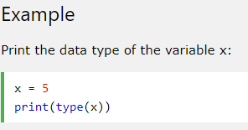
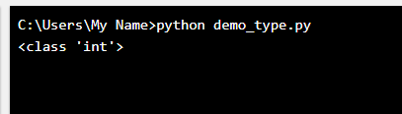
Getting the Data Type
You can get the data type of any object by using the type() function

Slide 78
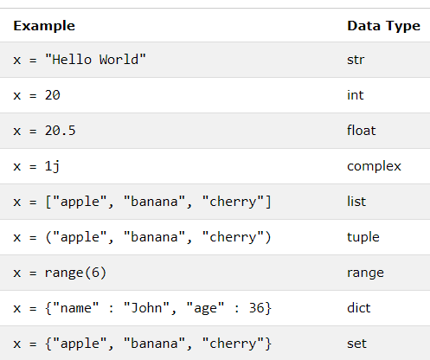
Setting the Data Type
In Python, the data type is set when you assign a value to a variable:

Slide 79
I] Number
Number data types store numeric values.
They are immutable data types, means that changing the value of a number data type results in a newly allocated object.
There are three numeric types in Python:
int
float
complex

Slide 80
int (signed integers) − They are often called just integers or ints, are positive or negative whole numbers with no decimal point.
long (long integers ) − Also called longs, they are integers of unlimited size, written like integers and followed by an uppercase or lowercase L.
float (floating point real values) − Also called floats, they represent real numbers and are written with a decimal point dividing the integer and fractional parts. Floats may also be in scientific notation, with E or e indicating the power of 10 (2.5e2 = 2.5 x 10² = 250).
complex (complex numbers) − are of the form a + bJ, where a and b are floats and J (or j) represents the square root of -1 (which is an imaginary number). The real part of the number is a, and the imaginary part is b

Slide 81
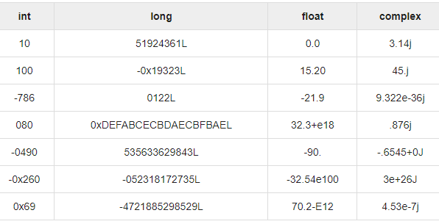
Examples

Slide 82
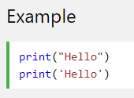
II]String
A String in python can be series or sequence of alphabets,numerals or special characters .
Similar to C ,First character is at 0 index.
String literals in python are surrounded by either single quotation marks, or double quotation marks.

Slide 83
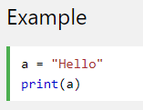
Assign String to a Variable
Assigning a string to a variable is done with the variable name followed by an equal sign and the string:

Slide 84
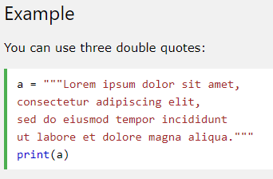
Multiline Strings
You can assign a multiline string to a variable by using three quotes:

Slide 85
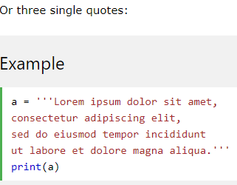

Slide 86
Updating Strings
You can "update" an existing string by (re)assigning a variable to another string.
Example
var1 = 'Hello World!'
print ("Updated String :- ", var1[:2] + 'Python')
Output
Updated String :- HePython

Slide 87
There are several operators such as slice operator ([] and [:]) ,Concatenation operator (+),repetititon operator (*),etc.
Slicing is used to take the subset of the string.
Concatenation is used to combine two or more strings.
Repetition is used to repeat the string several times.

Slide 88
Program | Output
str='welcome to python programming' print("str=",str) print("str[0]=",str[0]) print("str[3:9]=",str[3:9]) print("str[3:]=",str[3:]) print("str*3=",str*3) print("concate=",str+'java') print("last chracter=",str[-1]) | str= welcome to python programming str[0]= w str[3:9]= come t str[3:]= come to python programming str*3= welcome to python programmingwelcome to python programmingwelcome to python programming concate= welcome to python programmingjava last chracter= g

Slide 89
List
A list is a collection which is ordered and changeable.
It is an ordered and index able sequence .
All the items in a list do not need to be of the same type.
To declare list,we need to separate the items using commas and enclose them within square bracket[].
List is some what similar to array, but difference is that ,the array contain only same type of items while list contains different type of items.
Similar to string ,list also contains +,*,[:] operators.

Slide 90

Creating a list
Creating a list is as simple as putting different comma-separated values between square brackets. For example

Slide 91
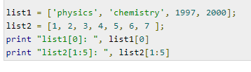

Accessing Values in Lists
To access values in lists, use the square brackets for slicing along with the index or indices to obtain value available at that index.

Slide 92
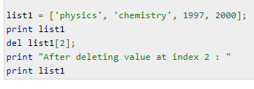

Delete List Elements
To remove a list element, you can use either the del statement if you know exactly which element(s) you are deleting or the remove() method if you do not know.

Slide 93
Program | Output
list1=[10,20,30.2,"amit",40,60] list2=[2,"amol"] print("List 1=",list1) print("list[0]=",list1[0]) print("list[2:4]=",list1[2:4]) print("list[2:]=",list1[2:]) print("list2*3=",list2*3) print("concate=",list1+list2) print("last chracter=",list1[-1]) | List 1= [10, 20, 30.2, 'amit', 40, 60] list[0]= 10 list[2:4]= [30.2, 'amit'] list[2:]= [30.2, 'amit', 40, 60] list2*3= [2, 'amol', 2, 'amol', 2, 'amol'] concate= [10, 20, 30.2, 'amit', 40, 60, 2, 'amol'] last chracter= 60

Slide 94
Tuple
A tuple is a collection which is ordered and unchangeable. In Python tuples are written with round brackets.
The differences between tuples and lists are, the tuples cannot be changed unlike lists and tuples use parentheses, whereas lists use square brackets.
Tuples are used to write-protect data and are usually faster than list as it cannot change dynamically.
Tuple is read-only Entity

Slide 95


Accessing Values in Tuples
To access values in tuple, use the square brackets for slicing along with the index or indices to obtain value available at that index.

Slide 96
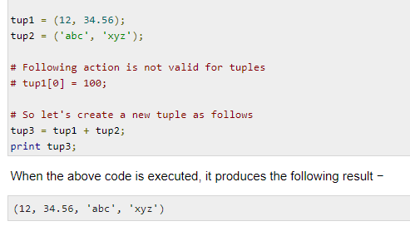
Updating Tuples
Tuples are immutable which means you cannot update or change the values of tuple elements. You are able to take portions of existing tuples to create new tuples as the following example demonstrates

Slide 97
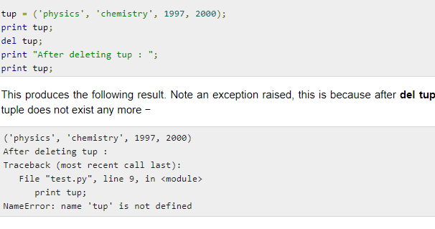
Delete Tuple Elements
Removing individual tuple elements is not possible.
To explicitly remove an entire tuple, just use the del statement.

Slide 98
Program | Output
tuple1=(10,20,30.2,"amit",40,60) tuple2=(2,"amol“) print("tuple 1=",tuple1) print("tuple1[0]=",tuple1[0]) print("tuple1[2:4]=",tuple1[2:4]) print("tuple1[2:]=",tuple1[2:]) print("tuple2*3=",tuple2*3) print("concate=",tuple1+tuple2) print("last chracter=",tuple1[-1]) | tuple 1= (10, 20, 30.2, 'amit', 40, 60) tuple1[0]= 10 tuple1[2:4]= (30.2, 'amit‘) tuple1[2:]= (30.2, 'amit', 40, 60) tuple2*3= (2, 'amol', 2, 'amol', 2, 'amol’) concate= (10, 20, 30.2, 'amit', 40, 60, 2, 'amol’) last chracter= 60

Slide 99
Dictionary
A dictionary is a collection which is unordered, changeable and indexed.
In Python dictionaries are written with curly brackets, and they have keys and values.
It is generally used when we have a huge amount of data.
Dictionaries are optimized for retrieving data. We must know the key to retrieve the value.
In Python, dictionaries are defined within braces {} with each item being a pair in the form key:value . Key and value can be of any type.

Slide 100
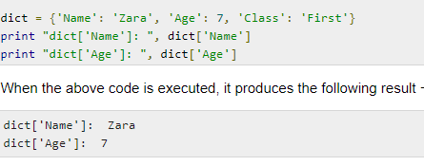
Accessing Values in Dictionary
To access dictionary elements, you can use the familiar square brackets along with the key to obtain its value.

Slide 101
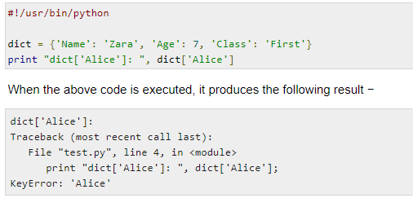
If we attempt to access a data item with a key, which is not part of the dictionary, we get an error as follows −

Slide 102

Updating Dictionary
You can update a dictionary by adding a new entry or a key-value pair, modifying an existing entry, or deleting an existing entry as shown below in the simple example −

Slide 103

Delete Dictionary Elements
You can either remove individual dictionary elements or clear the entire contents of a dictionary. You can also delete entire dictionary in a single operation.
To explicitly remove an entire dictionary, just use the del statement. Following is a simple example −

Slide 104


Boolean
Booleans represent one of two values:True or False
When you compare two values, the expression is evaluated and Python returns the Boolean answer:
Examples

Slide 105
Data Type along with size
bool: Boolean (true/false) types. Supported precisions: 8 (default) bits.
int: Signed integer types. Supported precisions: 8, 16, 32 (default) and 64 bits.
uint: Unsigned integer types. Supported precisions: 8, 16, 32 (default) and 64 bits.
float: Floating point types. Supported precisions: 16, 32, 64 (default) bits and extended precision floating point
complex: Complex number types. Supported precisions: 64 (32+32), 128 (64+64, default) bits and extended precision complex.
string: Raw string types. Supported precisions: 8-bit positive multiples.
time: Data/time types. Supported precisions: 32 and 64 (default) bits.
enum: Enumerated types. Precision depends on base type.

Slide 106
Python Modes
There are two modes for executing python program
Interactive mode
Script mode

Slide 107
Interactive mode
The code executes via the Python shell, which comes with Python installation
It is a command line shell which give the immediate feedback for each statement, while running previously statements in active memory
Invoking the interpreter without passing an script file as parameter.
When the commands or Python statements are read from a command-line shell or Python shell window, then the interpreter is said to be in an interactive mode.
The following are the advantages of running your code in interactive mode:
1. Helpful when your script is extremely short and you want immediate results.
2. Faster as you only have to type a command and then press the enter key to get the results.
3. Good for beginners who need to understand Python basics.

Slide 108
The following are the disadvantages of running your code in the interactive mode:
Editing the code in interactive mode is hard as you have to move back to the previous commands or else you have to rewrite the whole command again.
It's very tedious to run long pieces of code.

Slide 109
Script mode
Invoking the interpreter with a script parameter begins execution of the script and continues until the script is finished.when a script is finished, the interpreter is no longer active.
In script mode, You write your code in a text file then save it with a .py extension which stands for "Python"
The following are the advantages of running your code in script mode:
It is easy to run large pieces of code.
Editing your script is easier in script mode.
Good for both beginners and experts.

Slide 110
The following are the disadvantages of using the script mode:
Can be tedious when you need to run only a single or a few lines of cod.
You must create and save a file before executing your code.

Slide 111
Differences Between Interactive and Script Mode
In script mode, a file must be created and saved before executing the code to get results. In interactive mode, the result is returned immediately after pressing the enter key.
In script mode, you are provided with a direct way of editing your code. This is not possible in interactive mode.

Slide 112
Interactive mode | Script Mode
Interactive mode is used when an user wants to run one single line or one block of code | Script Mode, is used when the user is working with more than one single code or a block of code.
Editing the program in interactive mode is a difficult task | In script mode, editing Python code is quite easy.
We can not save our code in the interactive mode. So, we will not be able to use the program in the future. | In script mode, we can save our code for future use.
Interactive mode is suitable for testing and experimenting with syntax and small pieces of code because it gives immediate feedback. | Script mode is not suitable for testing and experimenting with syntax and small pieces of code because the whole program is first compiled and then executed. So, we will not get immediate feedback.

Slide 113
Interactive mode | Script Mode
You type the command in the front of python command prompt >>> | You don’t type the command in the front of python command prompt >>>
No need to use Run module to execute the commands | you need to use Run module to execute the commands
Interactive mode is where you type your code into the Python interpreter directly. | Script mode is where you write your code in a .py file and then run it with the python command.
The interactive mode is suitable for executing small programs. | Script mode is more suitable for executing large programs.

Slide 114

Internal working of Python or python interpreter or PVM

Slide 115
Step 1 : The interpreter reads a python code or instruction. Then it verifies that the instruction is well formatted, i.e. it checks the syntax of each line.If it encounters any error, it immediately halts the translation and shows an error message.
Step 2 : If there is no error, i.e. if the python instruction or code is well formatted then the interpreter translates it into its equivalent form in intermediate language called “Byte code”.Thus, after successful execution of Python script or code, it is completely translated into Byte code.
Step 3 : Byte code is sent to the Python Virtual Machine(PVM).Here again the byte code is executed on PVM.If an error occurs during this execution then the execution is halted with an error message.

Slide 116
PVM is the runtime engine of Python. It's always present as part of the python system and is the component that truly runs the script.

Slide 117
command line argument
Python Command line arguments are input parameters passed to the script when executing them.
Almost all programming language provide support for command line arguments. Then we also have command line options to set some specific options for the program.
There are many options to read python command line arguments. The three most common ones are:
Python sys.argv
Python getopt module
Python argparse module

Slide 118
Program:
import sys
x=int(sys.argv[1])
y=int(sys.argv[2])
sum=x+y
print("The addition is :",sum)
Output:
C:\Python34\python sum.py 6 4
The addition is : 10

Slide 119
Mutable and immutable data structures
The data types in Python are divided in two categories:
1. Immutable data types – Values cannot be changed.
Immutable data types in Python are
1. Numbers 2. String 3. Tuple
2. Mutable data types – Values can be changed.
Mutable data types in Python are:
1. List 2. Dictionaries 3. Sets

Slide 120
END

