Slide 1
Chapter 1
Basics of JavaScript Programming

Slide 2
Features of JavaScript
JavaScript is a object-based scripting language.
It is light weighted.
JavaScript is interpreter based scripting language.
JavaScript is case sensitive.
It is open and cross platform.
It validates form.
It supports dynamic typing.
It is used in web pages to add functionality.
Browser support.
It communicates with server.
It read write html elements.
It Handles date and time.
Every statement in JavaScript automatically terminated with semicolon .

Slide 3
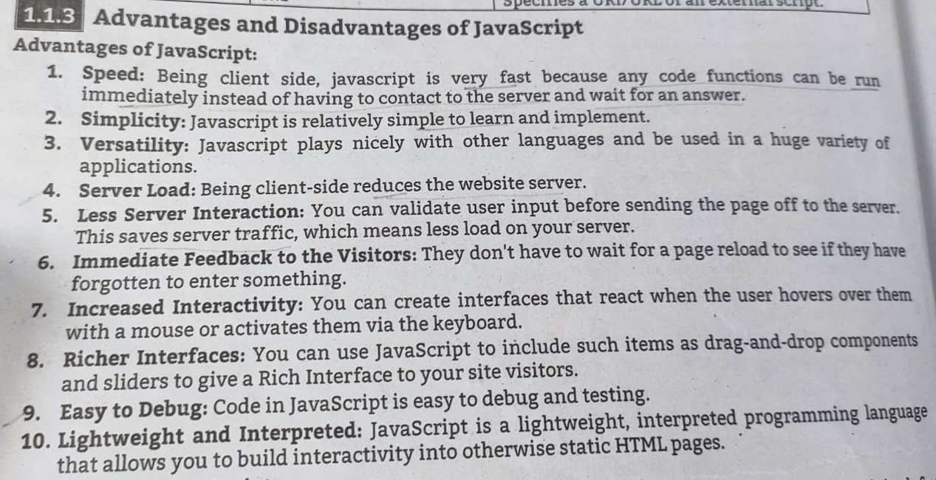
Advantages of Javascript

Slide 4
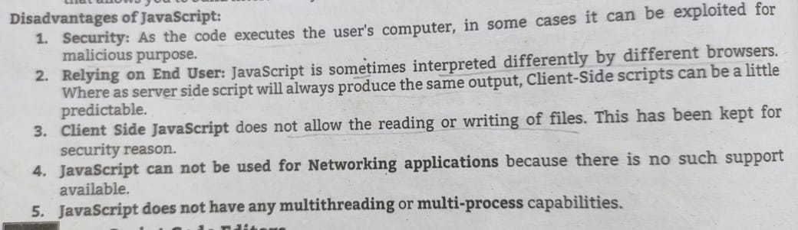

Slide 5
Basic concepts that are used in JavaScript
Object name
Property
Method
Dot syntax
Main event

Slide 6
Object Name
JavaScript is a object oriented programming language.
That means programs are written using objects.
Object is nothing but some entity.
In JavaScript document, window, forms, fields, buttons are some popularly used objects.
Each object is identified either by an ID or by a name.

Slide 7
Property
Property is actually a value associated with each object.
For example –
For the object window the height and width are the properties that are associated with it.
Each object has its own set of properties.

Slide 8
Method
Method is a function or a process associated with each object.
For example - for the document object the method is write.
To this write method we pass the string which we want to get displayed on the browser window.

Slide 9
Dot Syntax
Every object is associated with some property and method.
For accessing the properties and methods of an object, we use dot operator.
For example:
document.write("Hello“) //accessing method write of document object.

Slide 10
Main Event
Event is something that causes JavaScript to execute the code.
The change in the state of an object is known as an Event.
JavaScript reacts over the events and allows the execution.
This process of reacting over the events is called Event Handling.
In JavaScript when user submits the form, clicks some button, writes something to textbox then corresponding events get triggered

Slide 11
Methods of Math object
Math. round(value)- It returns value rounded to its nearest integer.
Math.ceil(value)- It returns value rounded up to its nearest integer.
Math.floor(value)- It returns value rounded down to its nearest
integer.
Math.trunc(Value)- It returns value as integer part of value.
Math.pow (number, power)- It returns value as power of specified
number.
Math.sqrt(value)- It returns square root of value.
Math.abs(value)- It returns absolute –positive value for given value.
Math.min ()- It returns lowest value in a list of values.
Math.max ()- It returns highest value in a list of values.

Slide 12
Date object and any two methods of Date object.
“Date” object is used when we want to perform some operation on date, it has various
method which helps you performs some task related to date.
Example:
<script>
var date = new Date();
document.write(date.getDate()); // get the current date
document.write(date.getFullYear()); // get the current Year
document.write(date.getMinutes()); // get the current minutes
</script>

Slide 13
Rules for Using Variables
Following are some conventions used in JavaScript for handling the identifiers -
Identifiers must begin with alphabet or an underscore .
It is then followed by any number of letters, underscores, dollars or digits.
3. There is no limit on the length of identifiers.
4. The letters in the identifiers are case-sensitive. That means the identifier INDEX, Index, index, inDex are considered to be distinct.

Slide 14
Declaring (Creating) JavaScript Variables
Creating a variable in JavaScript is called "declaring" a variable.
There are 3 ways:
1)You declare a JavaScript variable with the var keyword:
var carName;
Or You can also assign a value to the variable when you declare it:
var carName = "Volvo";
2) Assigning a value to the variable, use the equal sign:
carName = "Volvo";
3)You declare a JavaScript variable with the let keyword:
let carName = "Volvo";

Slide 15
One Statement, Many Variables
You can declare many variables in one statement.
Start the statement with var and separate the variables by comma.
var person = "Meenakshi Thalore", carName = "Volvo", price = 5500000;
A declaration can span multiple lines:
var person = "Meenakshi Thalore",
carName = "Volvo",
price = 5500000;

Slide 16
Javascript Data Types
JavaScript has dynamic types. This means that the same variable can be used to hold different data types:
Example
x = "Meenakshi "; // Now x is a String x = 5; // Now x is a Number var x; // Now x is undefined
JavaScript Strings
A string (or a text string) is a series of characters like "Meenakshi Thalore".
Strings are written with quotes.
You can use single or double quotes:
Example
var author1 = "Meenakshi"; // Using double quotes var author2 = 'Meenakshi'; // Using single quotes

Slide 17
JavaScript Numbers
JavaScript has only one type of number.
Numbers can be written with or without decimals.
Example
var x1 = 34.00; // Written with decimals var x2 = 34; // Written without decimals
JavaScript Booleans
Booleans can only have two values: true or false.
Example
var x = 5;
var y = 5;
var z = 6;
(x == y) // Returns true
(x == z) // Returns false
Undefined
In JavaScript, a variable without a value, has the value undefined. The type is also undefined.
Example
var car; // Value is undefined, type is undefined

Slide 18
JavaScript Arrays
JavaScript arrays are written with square brackets.
Array items are separated by commas.
The following code declares (creates) an array called cars, containing three items (car names):
Example
var cars = ["Audi", "Skoda", "BMW"];
JavaScript Objects
JavaScript objects are written with curly braces {}.
Object properties are written as name:value pairs, separated by commas.
Example
var person = {firstName:"Meenakshi", lastName:"Thalore", age:50, eyeColor:"black"};

Slide 19
JavaScript Operators
JavaScript Arithmetic Operators
Arithmetic operators are used to perform arithmetic on numbers:
Example:
var x = 5, y = 10, z = 15;
x + y; //returns 15
y - x; //returns 5
x * y; //returns 50
y / x; //returns 2
x % 2; //returns 1
x++; //returns 6
x--; //returns 4
Operator | Description
+ | Addition
- | Subtraction
* | Multiplication
** | Exponentiation
/ | Division
% | Modulus (Division Remainder)
++ | Increment
-- | Decrement

Slide 20
.
JavaScript Assignment Operators
Example:
var x = 5, y = 10, z = 15;
x = y; //x would be 10
x += 1; //x would be 6
x -= 1; //x would be 4
x *= 5; //x would be 25
x /= 5; //x would be 1
x %= 2; //x would be 1
Operator | Example | Same As
= | x = y | x = y
+= | x += y | x = x + y
-= | x -= y | x = x - y
*= | x *= y | x = x * y
/= | x /= y | x = x / y
%= | x %= y | x = x % y
**= | x **= y | x = x ** y

Slide 21
JavaScript Comparison Operators
Example:
var a = 5, b = 10, c = "5";
var x = a;
a == c; // returns true
a === c; // returns false
a == x; // returns true
a != b; // returns true
a > b; // returns false
a < b; // returns true
a >= b; // returns false
a <= b; // returns true
a >= c; // returns true
a <= c; // returns true
Operator | Description
== | equal to
=== | equal value and equal type
!= | not equal
!== | not equal value or not equal type
> | greater than
< | less than
>= | greater than or equal to
<= | less than or equal to
? | ternary operator

Slide 22
Conditional or Ternary Operator
JavaScript includes special operator called ternary operator ?: that assigns a value to a variable based on some condition. This is like short form of if-else condition.
Syntax:
<condition> ? <value1> : <value2>;
Ternary operator starts with conditional expression followed by ? operator. Second part ( after ? and before : operator) will be executed if condition turns out to be true. If condition becomes false then third part (after :) will be executed.
Example: Ternary operator
var a = 10, b = 5;
var c = a > b? a : b; // value of c would be 10
var d = a > b? b : a; // value of d would be 5

Slide 23
JavaScript Logical Operators
Example:
var a = 5, b = 10;
(a != b) && (a < b); // returns true
(a > b) || (a == b); // returns false
(a < b) || (a == b); // returns true
!(a < b); // returns false
!(a > b); // returns true
Operator | Description
&& | logical and
|| | logical or
! | logical not

Slide 24
JavaScript Bitwise Operators
Bit operators work on 32 bits numbers.
Any numeric operand in the operation is converted into a 32 bit number. The result is converted back to a JavaScript number
Operator | Description | Example | Same as | Result | Decimal
& | AND | 5 & 1 | 0101 & 0001 | 0001 | 1
| | OR | 5 | 1 | 0101 | 0001 | 0101 | 5
~ | NOT | ~ 5 | ~0101 | 1010 | 10
^ | XOR | 5 ^ 1 | 0101 ^ 0001 | 0100 | 4
<< | Zero fill left shift | 5 << 1 | 0101 << 1 | 1010 | 10
>> | Signed right shift | 5 >> 1 | 0101 >> 1 | 0010 | 2
>>> | Zero fill right shift | 5 >>> 1 | 0101 >>> 1 | 0010 | 2

Slide 25
JavaScript Comments
Single Line Comments
Single line comments start with //
Any text between // and the end of the line will be ignored by JavaScript (will not be executed).
Example
var x = 5; // Declare x, give it the value of 5
var y = x + 2; // Declare y, give it the value of x + 2

Slide 26
Multi-line Comments
Multi-line comments start with /* and end with */.
Any text between /* and */ will be ignored by JavaScript.
Example:
/*
The code below will change
the heading with id = "myH"
and the paragraph with id = "myP"
in my web page:
*/

Slide 27
Conditional Statements
Very often when you write code, you want to perform different actions for different decisions.
You can use conditional statements in your code to do this.
In JavaScript we have the following conditional statements:
Use if.. to specify a block of code to be executed, if a specified condition is true
Use if…else to specify a block of code to be executed, if the same condition is false
Use if…else if to specify a new condition to test, if the first condition is false
Use switch to specify many alternative blocks of code to be executed

Slide 28
The if Statement
Use the if statement to specify a block of JavaScript code to be executed if a condition is true.
Syntax
if (condition) {
// block of code to be executed if the condition is true
}
Example
Make a "Good day" greeting if the hour is less than 18:00:
if (hour < 18) {
greeting = "Good day";
}

Slide 29
The if..else Statement
Use the else statement to specify a block of code to be executed if the condition is false.
if (condition) {
// block of code to be executed if the condition is true
} else {
// block of code to be executed if the condition is false
}
Example
If the hour is less than 18, create a "Good day" greeting, otherwise "Good evening":
if (hour < 18) {
greeting = "Good day";
} else {
greeting = "Good evening";
}

Slide 30
The if..else if Statement
Use the else if statement to specify a new condition if the first condition is false.
Syntax
if (condition1) {
// block of code to be executed if condition1 is true
} else if (condition2) {
// block of code to be executed if the condition1 is false and condition2 is true
} else {
// block of code to be executed if the condition1 is false and condition2 is false
}
Example
If time is less than 10:00, create a "Good morning" greeting, if not, but time is less than 20:00, create a "Good day" greeting, otherwise a "Good evening":
if (time < 10) {
greeting = "Good morning";
} else if (time < 20) {
greeting = "Good day";
} else {
greeting = "Good evening";
}

Slide 31
Switch Statement
Switch case statement is basically to execute the desired choice, select one of many code blocks to be executed.
Syntax :
switch(expression) { case x: // code block break; case y: // code block break; default: // code block }

Slide 32
Switch Case Program
var grade = 'A';
switch (grade) {
case 'A': document.write(“Excellent<br />");
break;
case 'B': document.write("Pretty good<br />");
break;
case 'C': document.write(“Good<br />");
break;
case 'D': document.write("Not so good<br />");
break;
default: document.write("Unknown grade<br />")
}
Output:
Excellent

Slide 33
Looping statements
When a sequence of statements is repeated against a condition, it is said to be in a loop.
Using looping , the programmer avoid writing the same set of instructions again and again.
The looping process can be one time or multiple times until the desired output is obtained within a single program.
Looping is a process that repeats a single statement or a block of statements in a program until a specified condition become true.

Slide 34
The While Loop
The while loop loops through a block of code as long as a specified condition is true.
Syntax
while (condition) {
// code block to be executed
//stepping condition
}
Example
In the following example, the code in the loop will run, over and over again, as long as a variable (i) is less than 10:
Example
var text = “ ";
var i = 1;
while (i <= 10) {
text += "The number is " + i;
i++;
}

Slide 35
The Do/While Loop
The do/while loop is a variant of the while loop. This loop will execute the code block once, before checking if the condition is true, then it will repeat the loop as long as the condition is true.
Syntax
do {
// code block to be executed
} while (condition);
Example
The example below uses a do/while loop. The loop will always be executed at least once, even if the condition is false, because the code block is executed before the condition is tested:
i=1;
do {
text += "The number is " + i;
i++;
} while (i < =10);

Slide 36
The For Loop
The for loop has the following syntax:
for (statement 1; statement 2; statement 3) {
// code block to be executed
}
Statement 1 is executed (one time) before the execution of the code block.
Statement 2 defines the condition for executing the code block.
Statement 3 is executed (every time) after the code block has been executed.
Example
for (i = 1; i < =5; i++) {
text += "The number is " + i + "<br>";
}

Slide 37
The For/In Loop
For-in loop is used to loop through the properties of an object.
It's handy for tasks like accessing or manipulating object properties.
Syntax:
for(variable in object) {
// Code to be executed }
In syntax, variable represents the property name, and object is the object being iterated.
Example
// An object with some properties
var person = {fname:“Meenakshi", lname:“Thalore", age:25};
var x;
// Loop through all the properties in the object
for (x in person) {
document.write( x + " = " + person[x]);
}

Slide 38
Querying and setting properties
To obtain the value of a property, use the dot (.) or square bracket ([]) operators described in Property Access Expressions.
The left-hand side should be an expression whose value is an object.
If using the dot operator, the right-hand must be a simple identifier that names the property.
var author = book.author; // Get the "author" property of the book.
var name = author.surname // Get the "surname" property of the author.
If using square brackets, the value within the brackets must be an expression that evaluates to a string that contains the desired property name
var title = book["main title"] // Get the "main title" property of the book

Slide 39
To create or set a property
To create or set a property, use a dot or square brackets as you would to query the property, but put them on the left-hand side of an assignment expression:
book.edition = 6; // Create an "edition" property of book.
book["main title"] = "ECMAScript"; // Set the "main title" property.

Slide 40
Accessor Property: Getters and Setters
If the property consists of getter and setter methods then we call the property as accessor property.
Accessor property generates its value dynamically when being accessed or set.
When a program queries the value of an accessor property, JavaScript invokes getter method, the return value of this method becomes the value of the property access expression.
When a program sets the value of an accessor property, JavaScript invokes the setter method, passing the value of the right-hand side of assignment.
1. If a property has both a getter and a setter method, it is a read/write property.
2. If a property has only a getter method, it is a read-only property.
3. If a property has only a setter method, it is a write-only property.
Properties can be created at the same time when you create an object or can be added into an existing object.

Slide 41
Getter Method
Getter methods are used to access the properties of an object.
Syntax:
get propName()
{
// getter, the code executed on getting
obj.propName
}

Slide 42
Getter example
Var student={
name: “abc”,
get getName()
{
return this.name;
}
};
document.write(student.getName);
Output:
abc

Slide 43
JavaScript Getter (The get Keyword)
This example uses a lang property to get the value of the language property.
Example
// Create an object:
var person = {
firstName: “Shivaji",
lastName : “Bhosale",
language : “Marathi",
get lang() {
return this.language;
}
};
// Display data from the object using a getter:
document.getElementById("demo").innerHTML = person.lang;

Slide 44
Setter Method
Setter methods are used to change the values of an object.
Syntax:
set propName(value)
{
// setter, the code executed on setting
obj.propName=value
}

Slide 45
Setter example
var student={
name: “abc”,
get getName() //Getter
{
return this.name;
},
set changeName(newname) // Setter
{
this.name=newname;
}
};
document.write(student.getName); //abc
student. changeName=‘xyz’;
document.write(student. getName); //xyz

Slide 46
JavaScript Setter (The set Keyword)
This example uses a lang property to set the value of the language property.
Example
var person = {
firstName: " Shivaji ",
lastName : " Bhosale ",
language : "",
set lang(lang) {
this.language = lang;
}
};
// Set an object property using a setter:
person.lang = " Marathi ";
// Display data from the object:
document.getElementById("demo").innerHTML = person.language;

Slide 47
Write a program using getter and setter properties in JavaScript
<html>
<head><title>Getter and Setter Methods</title></head>
<body>
<script>
let student = {
firstName:"Ravi", // data property
get getName() // accessor property (getter)
{
return this.firstName;
},
set changeName(newName) //accessor property (setter)
{
this.firstName = newName;
}
};
document.write("Name by Data Property: " + student.firstName+"<br/>");
document.write("Name by Getter Method: " + student.getName+"<br/>");
student.changeName = 'Prashant'; // change(set) object property using a setter
document.write("New Name by Setter Method: "+student.getName);
</script>
</body>
</html>

Slide 48
Accessor Properties
<html>
<body>
<script>
var myCar = {
/* Data properties */
defColor: "blue",
defMake: "Toyota",
/* Accessor properties (getters) */
get color() {
return this.defColor;
},
get make() {
return this.defMake;
},

Slide 49
/* Accessor properties (setters) */
set color(newColor) {
this.defColor = newColor;
},
set make(newMake) {
this.defMake = newMake;
}
};
document.write("Car color:" + myCar.color + " Car Make: "+myCar.make)
/* Calling the setter accessor properties */
myCar.color = "red";
myCar.make = "Audi";
/* Checking the new values with the getter accessor properties */
document.write("<p>Car color:" + myCar.color); // red
document.write(" Car Make: "+myCar.make); //Audi
</script>
</body>
</html>

Slide 50
break statement.
It indicates the end of that particular case. It breaks the loop and continues executing the code after the loop.
<html>
<body>
<script>
var x = 1;
document.write("Entering the loop<br /> ");
while (x < 20)
{
if (x == 5)
{
break; // breaks out of loop completely
}
x = x + 1;
document.write(x + "<br />");
}
document.write("Exiting the loop!<br /> ");
</script>
</body>
</html>
Output:
Entering the loop
2
3
4
5
Exiting the loop!

Slide 51
<html>
<body>
<script>
for(i=10;i>=0;i--)
{
if (i == 5)
break;
}
document.write(“My lucky number is “+i);
</script>
</body>
</html>
Output:
My lucky number is 5

Slide 52
Continue statement
It breaks one iteration, if a specified condition occurs and continues with the next iteration in the loop
<html>
<body>
<script>
var x = 1;
document.write("Entering the loop<br /> ");
while (x < 10)
{
x = x + 1;
if (x == 5)
{
continue; // skip rest of the loop body
}
document.write(x + "<br />");
}
document.write("Exiting the loop!<br /> ");
</script>
</body>
</html>
Output:
Entering the loop
2
3
4
6
7
8
9
10
Exiting the loop!

Slide 53
<html>
<body>
<script>
for(i=10;i>=0;i--)
{
if (i == 5)
{
x=i;
continue;
}
document.write(i);
document.write(“<br/>”);
}
document.write(“The number” =x= “is missing in above list”);
</script>
</body>
</html>
Output:
10
9
8
7
6
4
3
2
1
0
The number 5 is missing in above list

Slide 54
JavaScript Functions
JavaScript functions are used to perform operations.
We can call JavaScript function many times to reuse the code.
Advantage of JavaScript function
There are mainly two advantages of JavaScript functions.
Code reusability: We can call a function several times so it save coding.
Less coding: It makes our program compact. We don’t need to write many lines of code each time to perform a common task.
JavaScript Function Syntax
function functionName([arg1, arg2, ...argN]){
//code to be executed
}

Slide 55
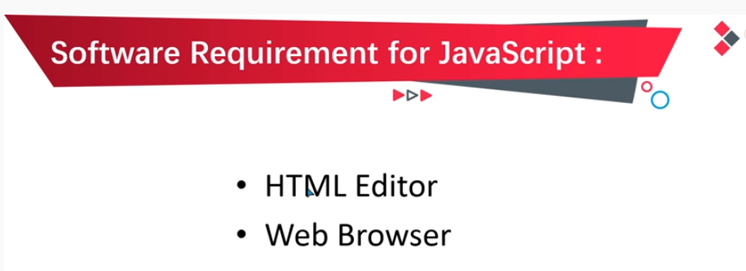

Slide 56
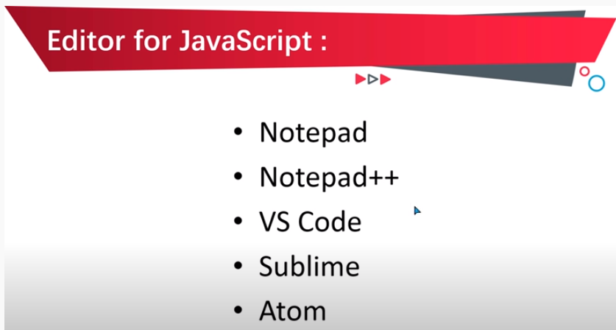

Slide 57
How to Write JavaScript Document?
Syntax
The syntax of directly embedding the JavaScript in the
HTML is
<script type="text/javascript">
</script>
There are two important attributes of script tag - type
and language.
The type attribute can be written as follows -
<script type="text/javascript">
//script here
</script>
The language attribute can be written as follows -
<script language="javascript">
//script here
</script>

Slide 58
JavaScript example
Let’s create the first JavaScript example.
<script type="text/javascript">
document.write("JavaScript is a simple language for javatpoint learners");
</script>
The script tag specifies that we are using JavaScript.
The text/javascript is the content type that provides information to the browser about the data.
The document.write() function is used to display dynamic content through JavaScript.

Slide 59
To run JavaScript with Notepad++,
Now, enclose your code with <script> and </script> tags. The above code now becomes. ...
Save the file with a . html extension.
Now, click on Run -> Launch in Chrome . ...
If you modify the code, simply save the changes ( Ctrl + s ) in Notepad++.

Slide 60
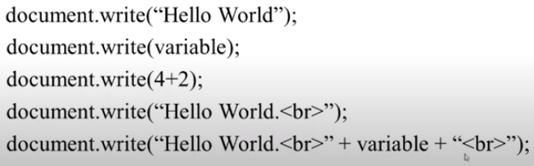
Using document.write()

Slide 61
<html>
<body>
<h2>My First Web Page</h2>
<p>My first paragraph.</p>
<p>Never call document.write after the document has finished loading.
It will overwrite the whole document.</p>
<script>
document.write(5 + 6);
</script>
</body>
</html>
My First Web Page
My first paragraph.
Never call document.write after the document has finished loading. It will overwrite the whole document.
11

Slide 62
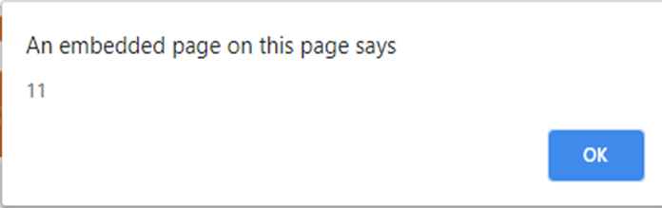
Using window.alert()
You can use an alert box to display data:
<html>
<body>
<script>
window.alert(5 + 6);
</script>
</body>
</html>

Slide 63
Using window.prompt() method
prompt() method is used to display a dialogue box to the user to prompt them to an input.
• It has two buttons “OK” and “CANCEL”, if the user click on the “OK” button then it will return the inputed value , if the user clicks on the "CANCEL” button then it will return a null value.
• Syntax: prompt(text)
Example:
<script>
var name = prompt ("Enter a name");
document.write(name);
</script>
Example:
<html>
<body>
<script>
window.prompt(5 + 6);
</script>
</body>
</html>

Slide 64
<html>
<script>
function msg(){
var v= prompt("Who are you?");
alert("I am "+v);
}
</script>
<input type="button" value="click" onclick="msg()"/>
</html>

Slide 65
confirm()
It displays the confirm dialog box. It has message with ok and cancel buttons.
Returns Boolean indicating which button was pressed
Syntax:
window.confirm("sometext");
Example :
<html>
<script>
function msg(){
var v= confirm("Are u sure?");
if(v==true){
alert("ok");
}
else{
alert("cancel");
}
}
</script>
<input type="button" value="delete record" onclick="msg()"/>
</html>

Slide 66
3 Places to put JavaScript code
Between the body tag of html
Between the head tag of html
In .js file (external javaScript)
1) JavaScript Example : code between the body tag
In the above example, we have displayed the dynamic content using JavaScript. Let’s see the simple example of JavaScript that displays alert dialog box.
<html>
<body>
<script type="text/javascript">
alert("Hello Javatpoint");
</script>
</body>
</html

Slide 67

2) JavaScript Example : code between the head tag
Let’s see the same example of displaying alert dialog box of JavaScript that is contained inside the head tag.
In this example, we are creating a function msg().
To create function in JavaScript, you need to write function with function_name as given below.
To call function, you need to work on event. Here we are using onclick event to call msg() function.
<html>
<head>
<script type="text/javascript">
function msg(){
alert("Hello Javatpoint");
}
</script>
</head>
<body>
<p>Welcome to JavaScript</p>
<form>
<input type="button" value="click" onclick="msg()"/>
</form>
</body>
</html>

Slide 68
3)External JavaScript file
We can create external JavaScript file and embed it in many html page.
It provides code reusability because single JavaScript file can be used in several html pages.
An external JavaScript file must be saved by .js extension. It is recommended to embed all JavaScript files into a single file. It increases the speed of the webpage.

Slide 69
Let's create an external JavaScript file that prints Hello in a alert dialog box. message.js function msg() { alert("Hello "); }
Let's include the JavaScript file into html page. It calls the JavaScript function on button click.
index.html
<html>
<head>
<script src="message.js"></script>
</head>
<body>
<p>Welcome to JavaScript</p>
<form>
<input type="button" value="click" onclick="msg()"/>
</form>
</body>
</html>

Slide 70
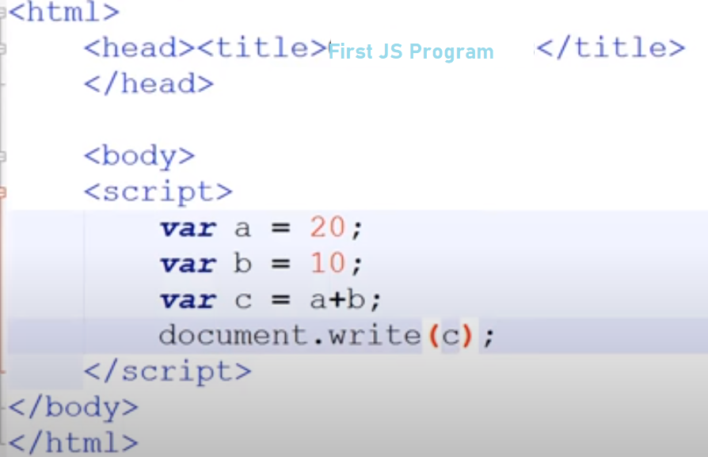
Program for Addition of 2 nos.

Slide 71
while loop
<html>
<script>
var number = 3;
while (number <= 10)
{
document.write("The number is: “ +number);
document.write("<br/>");
number++;
}
</script>
</html>
Output:
The number is: 3
The number is: 4
The number is: 5
The number is: 6
The number is: 7
The number is: 8
The number is: 9
The number is:

Slide 72
Program on while loop
<html>
<body>
<script>
var i=11;
while (i<=15)
{
document.write(i + "<br/>");
i++;
}
</script>
</body>
</html>
Output:
11 12 13 14 15

Slide 73
Program on do while loop
<html>
<body>
<script>
var i=21;
do{
document.write(i + "<br/>");
i++;
}while (i<=25);
</script>
</body>
</html>
Output:
21 22 23 24 25

Slide 74
do-while loop
<html>
<body>
<script>
var count = 0;
document.write("Starting Loop" + "<br />");
do
{
document.write("Current Count : " + count + "<br />");
count++;
}
while (count < 5);
document.write ("Loop stopped!");
</script>
</body>
</html>
Output:
Starting Loop
Current Count: 0
Current Count: 1
Current Count: 2
Current Count: 3
Current Count: 4
Loop stopped!
Set the variable to different value and then try...

Slide 75
Program on For loop
<html>
<body>
<script>
for (i=1; i<=5; i++)
{
document.write(i + "<br/>")
}
</script>
</body>
</html>
Output:
1 2 3 4 5

Slide 76
for loop
<html>
<script>
for(var x=6; x<=10; x++)
{
document.write("The number is: " +x);
document.write("<br/>");
}
</script>
</html>
Output:
The number is: 6
The number is: 7
The number is: 8
The number is: 9
The number is: 10

Slide 77
Program on For…In loop
<html >
<body>
<script>
// An array with some elements
var fruits = ["Apple", "Banana", "Mango", "Orange", "Papaya"];
// Loop through all the elements in the array
for(var i in fruits) {
document.write("<p>" + fruits[i] + "</p>");
}
</script>
</body>
</html>
Output:Apple
Banana
Mango
Orange
Papaya

Slide 78
<html>
<body>
<script>
var car = { Brand: ‘Toyota’, Model: ‘Camry’, Year: 2022};
for( key in car)
{
document.write(‘${key}: ${car[key]}’);
}
</script>
</body>
</html>

Slide 79
Write a JavaScript program to check whether a number is positive, negative or zero using switch case.
<html>
<body>
<script >
var num=prompt("Enter number");
switch (Math.sign(num))
{
case 1:
alert("The number is Positive");
break;
case -1:
alert("The number is Negative");
break;
default:
alert("The number is Zero");
}
</script>
</body>
</html>

Slide 80
Switch statement
The getDay() method returns the weekday as a number between 0 and 6 (Sunday=0, Monday=1, Tuesday=2..)
<html>
<head><title>Switch Statement Example</title> </head>
<body>
<script >
switch (new Date().getDay())
{
case 0:
day = "Sunday";
break;
case 1:
day = "Monday“;
break;
case 2:
day= "Tuesday";
break;

Slide 81
case 3:
day = "Wednesday";
break;
case 4:
day = "Thursday";
break;
case 5:
day = "Friday";
break;
case 6:
day ="Saturday";
}
document.write(day);
</script>
</body>
</html>
Output
Tuesday

Slide 82
<html>
<body>
<script>
var grade='B';
var result;
switch(grade){
case 'A':
result="A Grade";
break;
case 'B':
result="B Grade";
break;
case 'C':
result="C Grade";
break;
default:
result="No Grade";
}
document.write(result);
</script>
</body>
</html>
Program for Switch case statement
Output: B Grade

Slide 83
If statement
<html>
<head><title>If statement</title></head>
<body>
<script >
var x = 7;
var y = 7;
if(x==y)
{
document.write("Both are equal");
}
</script>
</body>
</html>
Output:
Both are equal

Slide 84
Program for If statement
<html>
<body>
<script>
var a=20;
if(a>10){
document.write("value of a is greater than 10");
}
</script>
</body>
</html>
Output:
value of a is greater than 10

Slide 85
If statement
<html>
<body>
<script >
var age=20;
if(age > 18 )
{
document.write("Qualifies for driving");
}
</script>
</body>
</html>
Output:
Qualifies for driving

Slide 86
Program for If …Else statement
<html>
<body>
<script>
var a=20;
if(a%2==0){
document.write("a is even number");
}
else{
document.write("a is odd number");
}
</script>
</body>
</html>
Output:
a is even number

Slide 87
If-else statement
<html>
<body>
<script >
var age 14;
if(age >= 18)
{
document.write("Get a drivers license.");
document.write("Drive dad’s car");
}
else
{
document.write(" ride a bicycle.");
document.write("We are only 14");
}
</script>
</body>
</html>
Output:
ride a bicycle. We are only 14

Slide 88
Program for If...else if statement
<html>
<body>
<script>
var a=20;
if(a==10){
document.write("a is equal to 10");
}
else if(a==15){
document.write("a is equal to 15");
}
else if(a==20){
document.write("a is equal to 20");
}
else{
document.write("a is not equal to 10, 15 or 20");
}
</script>
</body>
</html>
Output:
a is equal to 20

Slide 89
If-else if statement
<html>
<body>
<script >
var your_age = 14;
var friends_age = 16;
if(your_age >= 18)
{
document.write("Get a drivers license");
}
else if(friends_age >= 18)
{
document.write("Let this friend drive the car");
}
else
{
document.write("Kids, stick to bicycle");
}
</script>
</body>
</html>
Output:
Kids, stick to bicycle

Slide 90
Program on Nested if statement
<html>
<body>
<script>
var a,b,c;
a=10,b=20,c=30;
if(a>b) {
if(a>c){
document.write(“<h3>a is largest no.</h3>");
}
else{
document.write (“<h3>c is largest no.</h3>");
}
}
else{
If(b>c) {
document.write (“<h3>b is largest no.</h3>");
}
else
Document.write (“<h3>c is largest no.</h3>");
}
}
</script>
</body>
</html>
Output:
c is largest no.

Slide 91
<html>
<head>
<title> Nested If Statement </title>
</head>
<body>
<script>
var age=15;
if (age<70)
{
if (age<30)
{
document.write(" Age is less than 30");
}
else {
document.write("Age is between 30 and 70");
}
}
else
{
if (age > 85) {
document.write("Age is > 85");
}
else
{
document.write("Age is between 85 and 70");
}
}
</script>
</body>
</html>
Output:
Age is less than 30

Slide 92
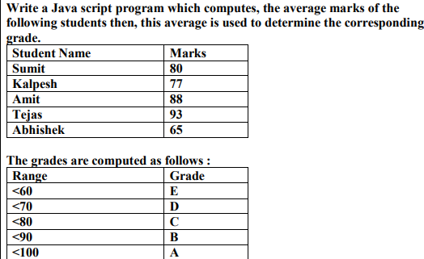
<html>
<head>
<title>Compute the average marks and grade</title>
</head>
<body>
<script>
var students = [['Summit', 80], ['Kalpesh', 77], ['Amit', 88], ['Tejas', 93], ['Abhishek', 65]];
var Avgmarks = 0;
for (var i=0; i < students.length; i++) {
Avgmarks += students[i][1];
}
var avg = (Avgmarks/students.length);
document.write("Average grade: " + (Avgmarks)/students.length);
document.write("<br>");

Slide 93
if (avg < 60){
document.write("Grade : E");
}
else if (avg < 70) {
document.write("Grade : D");
}
else if (avg < 80) {
document.write("Grade : C");
} else if (avg < 90) {
document.write("Grade : B");
} else if (avg < 100) {
document.write("Grade : A");
}
</script>
</body>
</html>

Slide 94
Operators:
<html>
<body>
<script>
var a = 33, b = 10;
var result1 = a + b;
document.write("a + b= " + result1);
document.write("<br/>");
var result2 = (a < b);
document.write("a < b= " + result2);
document.write("<br/>");
var result3 = (a && b);
document.write("a && b= " + result3);
document.write("<br/>");
var result4 = (a & b);
document.write("a & b= " + result4);
</script>
</body>
</html>
Output:
a+b= 43
a < b= false
a && b= 10
a & b= 0

Slide 95
Write a Java script to create person object with properties firstname, lastname, age, eyecolor, delete eyecolor property and display remaining properties of person object.
<html>
<body>
<script>
var person = { firstname:"John",lastname:"Doe", age:50, eyecolor:"blue“ };
delete person.eyecolor; //delete person eyecolor
document.write("After delete "+ person.firstname +" "+ person.lastname +" " +person.age +" "+ person.eyecolor);
</script>
</body>
</html>

Slide 96

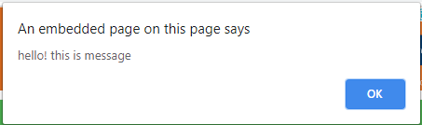
Program on function
<html>
<body>
<script>
function msg()
{
alert("hello! this is message");
}
</script>
<input type="button" onclick="msg()" value="call function"/>
</body>
</html>

Slide 97
Write an HTML script that accepts Amount, Rate of interest and Period from user. Calculate and display simple interest in a message box. (Use formula S.I. = PNR/100)
<html>
<body>
<script>
var P = parseInt(prompt(“Enter the principal amount:”));
var N = parseInt(prompt(“Enter the period:”));
var R = parseInt(prompt(“Enter the Rate of interest:”));
var SI =(P*N*R)/100;
alert(“Simple Interest is “+SI);
</script>
</body>
</html>

Slide 98
Write a script that reads an integer and displays whether it is a prime number or not
<html>
<body>
<script>
var num=prompt("Type number here.","");
var b;
var flag=1;
for(i=2;i<num;i++)
{
b=num%i;
if(b==0)
{
flag=0;
break;
}
if(flag==0)
alert(num+" is not a prime number");
else
alert(num+" is a prime number");
</script>
</body>
</html>

Slide 99
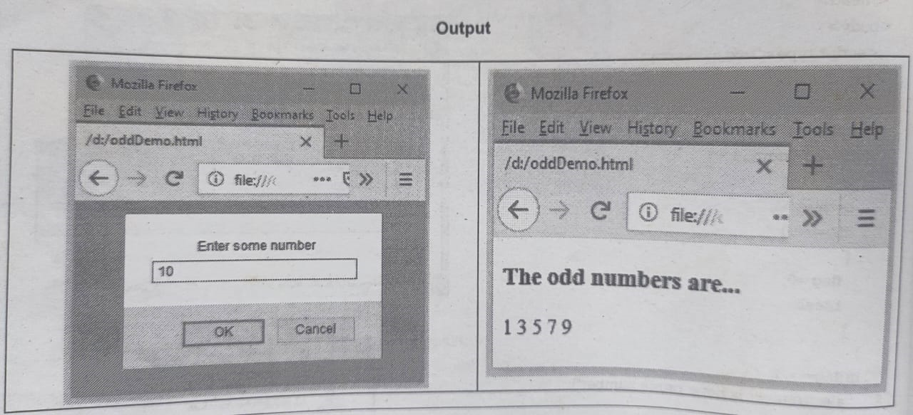
Write a JavaScript program which accepts N as input and print first N odd numbers.
<html>
<head>
<script>
function fun(str)
{
var num=Number(str);
var i,j,k,count;
document.write(" The odd numbers are...");
for(i=0;i<=num;i++)
{
if(i % 2 !=0)
document.write(" "+i);
}
}
</script></head>
<body><script>
var str1=prompt("Enter some number",");
fun(str1);
</script></body></html>

Slide 100
Using While loop
function fibonacci(num) {
if (num == 1)
return 0;
if (num == 2)
return 1;
let num1 = 0;
let num2 = 1;
let sum;
let i = 2;
while (i < num) {
sum = num1 + num2;
num1 = num2;
num2 = sum;
i += 1;
}
return num2;
}
console.log("Fibonacci(5): " + fibonacci(15));
console.log("Fibonacci(8): " + fibonacci(18));
Output:
Fibonacci(5): 3
Fibonacci(8): 13
Using For loop
<html>
<head>
<title> Fibonacci Series in JavaScript </title>
</head>
<body>
<script>
// declaration of the variables
var n1 = 0, n2 = 1, i;
var num = parseInt (prompt (" Enter the limit for Fibonacci Series "));
document.write( "Fibonacci Series: ");
for ( i = 1; i <= num; i++)
{ document.write (" <br> " + n1); // print the n1
var num 1= n1 + n2; // sum of n1 and n2 into the num1
n1 = n2; // assign the n2 value into n2
n2 = num1; // assign the num1 into n2
}
</script>
</body>
</html>

Slide 101
<html>
<body>
<h1> Factorial of a number</h1>
Enter a number: <input id = "num">
<br><br>
<button onclick = "fact()"> Factorial </button>
<p id = "res"></p>
<script>
function fact(){
var i, num, f;
f = 1;
num = document.getElementById("num").value;
for(i = 1; i <= num; i++)
{
f = f * i;
}
i = i - 1;
document.getElementById("res").innerHTML = "The factorial of the number " + i + " is: " + f ;
}
</script>
</body>
</html>

