Slide 1
Course Title: Operating System Course Code:22516
Unit 1
Overview of Operating System
Marks:08
Compiled by : Mr. Rahul Patil

Slide 2
Learning Outcomes
After watching this presentation students will be able to:
Explain the functioning of given component of os.
Explain characteristics of the given type of os.
Identify type of os suitable for given type of application.
Execute command on command line for given task.

Slide 3
1.1 What is Operating System?
A program that acts as an intermediary between a user of a computer and the computer hardware.
Operating system goals:
✦ Execute user programs and make solving user problems easier.
✦ Make the computer system convenient to use.
Use the computer hardware in an efficient manner.

Slide 4
Computer System Components
Hardware – provides basic computing resources (CPU,memory, I/O devices).
Operating system – controls and coordinates the use of the hardware among the various application programs for the various users.
Applications programs – define the ways in which the system resources are used to solve the computing problems of the users (compilers, database systems, video games, business programs).
Users (people, machines, other computers).

Slide 5
Abstract View of System Components

Slide 6
Operating System Definitions
Resource allocator – manages and allocates resources.
Control program – controls the execution of user programs and operations of I/O devices .
Kernel – the one program running at all times (all else being application programs).

Slide 7
Views of OS
User view: It depends on the system interface that is used by users.
eg. If user is using personal computer, the os is designed to make interaction easy & attention is paid to performance of system.
System view: according to computer system the os is bridge between application and hardware.
eg. Resource allocator, control program , kernel.

Slide 8
Some operations of os
Program Management.
Resource management.
Security and protection.

Slide 9
1.2 Types of Operating Systems
Batch Operating System:
The users of batch os do not interact with the computer directly.
Each user prepares his job on an off-line device like punch cards and submits it to computer operator.
Jobs with similar needs batched together and run as group.
Resident monitor
✦ initial control in monitor
✦ control transfers to job
✦ when job completes control transfers pack to monitor
Problems:
Lack of interaction between user and job.
CPU remain idle.
Difficult to provide desired priority.
Eg. Payroll systems, banking systems.

Slide 10
Multiprogrammed Operating system:
Several jobs are kept in main memory at the same time, and the CPU is multiplexed among them.

Slide 11
Multiprogrammed Operating system (Contd.)
In multiprogramming os keeps several jobs in memory at a time.
The os picks and begins to execute one of the jobs in the memory.
Os monitors state of all active programs and system resources using memory management programs to ensure that CPU is never idle.
Advantages :
High and efficient CPU utilization
User feels that many programs are allotted CPU simultaneously.
Disadvantages:
CPU scheduling is required.
To accommodate many jobs in memory, Memory management is required.

Slide 12
Time Sharing OS:
Each task is given some time to execute, so that all the tasks work smoothly.
Each user gets time of CPU as they use single system.
The time each task gets is called quantum.
After this time interval is over, os switches over to next task.
Advantages:
Each task gets equal opportunity.
CPU idle time can be reduced.
Disadvantages:
Data communication problem.
Reliability problem.
One must take care of security & integrity of user programs & data.
Eg. Unix, Multics.

Slide 13
Multiprocessor OS:
These systems have multiple processors working in parallel that share the computer clock, memory, bus, peripheral devices.
They are called tightly coupled systems.
Advantages:
Increased throughput.
Economical.
Increased reliability: Graceful degradation

Slide 14
Multiprocessor OS (Cont.)
Symmetric multiprocessing (SMP)
✦ Each processor runs and identical copy of the operating system.
✦ Many processes can run at once without performance deterioration.
✦ Most modern operating systems support SMP
Asymmetric multiprocessing
✦ Each processor is assigned a specific task; master processor schedules and allocated work to slave processors.
✦ More common in extremely large systems

Slide 15
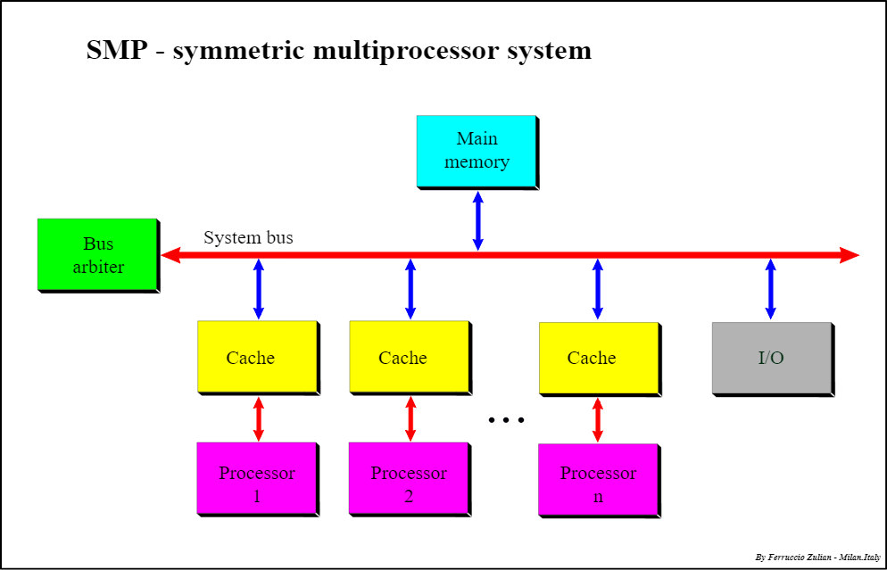
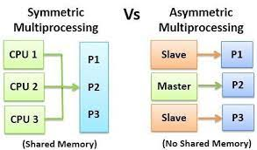

Slide 16
Distributed Systems
Distribute the computation among several physical processors.
Loosely coupled system – each processor has its own local memory; processors communicate with one another through various communications lines, such as highspeed buses or telephone lines.
Advantages of distributed systems.
✦ Resources Sharing
✦ Computation speed up – load sharing
✦ Reliability
✦ Communications

Slide 17
Distributed Systems (Contd.)
Requires networking infrastructure.
Local area networks (LAN) or Wide area networks (WAN)
May be either client-server or peer-to-peer systems.

Slide 18
Real-Time Systems
In Real time OS response should be guaranteed within a specified fixed time constraint.
For eg. Flight control systems, industrial control systems
Based on time constraint there are two types of RTOS:
Hard real time systems:
Such type of rtos never miss its deadlines. Missing the deadline may have disastrous consequences.
Secondary storage limited or absent, data stored in short term memory, or read-only memory (ROM) Eg flight control systems.
Soft real time systems:
Such type of rtos can miss its deadline occasionally with some acceptably low probability. Missing deadline have no disastrous consequences. eg. Multimedia

Slide 19
7. Mobile Operating Systems
Android
iOS
Developer Google
Open source
Customizable widgets
Chrome default browser.
Google Assistant
Available on variety of devices
Google play store
Kernel based on Linux
Developer Apple
Closed.
No, except in Notification center
Safari
Siri
On iPod, iPhone, iPad, Apple TV
App Store
Based on Darwin OS

Slide 20
1.3 Command Line based OS
DOS:
Any operating system which runs from the hard disk drive is termed as Disk Operating System ( D.O.S ).
For the very first time, It was made and introduced for IBM by Microsoft which was known as IBM PC DOS in the year 1981.
Features:
It is a 16-bit operating system
The mouse cannot be used to operate it i,e, Input in it is through basic system commands.
It is a free OS.
It uses a text-based interface and requires text and codes to operate
It does not support graphical interface
It is a single user operating system.
It is a Character Based interface system.
It is very helpful in making file management e.g., creating, editing, deleting files, etc.

Slide 21
Command Line based OS (Contd.)
2. Unix:
Unix is a family of multitasking, multiuser computer operating systems that derive from the original AT&T Unix, development starting in the 1970s at the Bell Labs research center by Ken Thompson, Dennis Ritchie, and others.
Unix Features:
Portability: support wide variety of hardware.
Multitasking
Multiuser
Hierarchical File system
Kernel and shell.

Slide 22
GUI based OS
Windows:
Microsoft Windows, commonly referred to as Windows, is a group of several proprietary graphical operating system families, all of which are developed and marketed by Microsoft.
Features of Windows 10:
Microsoft Edge
Cortana assistant
Start menu
Bundled apps like Xbox, Skype
Tablet mode

Slide 23
GUI based OS (Contd.)
2. Linux:
Linux is a family of open source Unix-like operating systems based on the Linux kernel, an operating system kernel first released on September 17, 1991, by Linus Torvalds.
Linux is typically packaged in a Linux distribution.
Popular Linux distributions include Debian, Fedora, and Ubuntu. Commercial distributions include Red Hat Enterprise Linux and SUSE Linux Enterprise Server.
Features:
Portable
Multitasking
Multiuser
Multiprocessor
Multithreading
GUI
Hierarchical FS

Slide 24
Thank You

