Slide 1
Course Title : OBJECT ORIENTED PROGRAMMING USING C++ Course Code: 313304
By: Suwarna Nimkarde

Slide 2
INDUSTRY / EMPLOYER EXPECTED OUTCOME Develop applications using concepts of OOP in C++.
COURSE LEVEL LEARNING OUTCOMES (COS)
Students will be able to achieve & demonstrate the following COs on completion of course based learning
CO1 - Write C++ programs using classes and objects.
CO2 - Develop C++ programs using constructors.
CO3 - Implement Inheritance in C++.
CO4 - Implement Polymorphism in C++.
CO5 - Develop C++ programs to perform file operations.

Slide 3
TEACHING-LEARNING & ASSESSMENT SCHEME
Course Code | Course Title | Abbr | Course Category/s | Learning Scheme |  |  |  |  | Credits | Assessment Scheme
 |  |  |  | Actual Contact Hrs./Week |  |  | SLH | NLH |  | Paper Duration | Theory |  |  |  | Based on LL & TL |  |  |  | Based on SL |  | Total Marks
 |  |  |  | CL | TL | LL |  |  |  |  |  |  |  |  | Practical
 |  |  |  |  |  |  |  |  |  |  | FA- TH | SA- TH | Total |  | FA-PR |  | SA-PR |  | SLA
 |  |  |  |  |  |  |  |  |  |  | Max | Max | Max | Min | Max | Min | Max | Min | Max | Min
313304 | OBJECT ORIENTED PROGRAMMING USING C++ | OOP | SEC | 3 | 2 | 4 | 1 | 10 | 5 | 3 | 30 | 70 | 100 | 40 | 50 | 20 | 25@ | 10 | 25 | 10 | 200

Slide 4
Total IKS Hrs for Sem. : 0 Hrs
Abbreviations: CL- Class Room Learning , TL- Tutorial Learning, LL-Laboratory Learning, SLH-Self Learning Hours, NLH-Notional Learning Hours, FA - Formative Assessment, SA -Summative assessment, IKS - Indian Knowledge System, SLA - Self Learning Assessment
Legends: @ Internal Assessment, # External Assessment, *# On Line Examination , @$ Internal Online Examination
Note :
FA-TH represents average of two c
lass tests of 30 marks each conducted during the semester.
If candidate is not securing minimum passing marks in FA-PR of any course then the candidate shall be declared as "Detained" in that semester.
If candidate is not securing minimum passing marks in SLA of any course then the candidate shall be declared as fail and will have to repeat and resubmit SLA work.
Notional Learning hours for the semester are (CL+LL+TL+SL)hrs.* 15 Weeks
1 credit is equivalent to 30 Notional hrs.
* Self learning hours shall not be reflected in the Time Table.
* Self learning includes micro project / assignment / other activities.

Slide 5
Unit - I
Principles of Object Oriented Programming
Learning Hours : 8
Total Marks: 12

Slide 6
Sr.No | Theory Learning Outcomes (TLO's)aligned to CO's. | Learning content mapped with Theory Learning Outcomes (TLO's) and CO's. | Suggested Learning Pedagogies.
1 | TLO 1.1 Compare POP vs OOP approach of programming. TLO 1.2 Describe the different features of Object Oriented Programming. TLO 1.3 Write programs to solve arithmetic expressions. TLO 1.4 Write programs to demonstrate use of special operators in C++. TLO 1.5 Develop C++ program to show the use of Classes and Objects. | Unit - I Principles of Object Oriented Programming Procedure Oriented Programming (POP) verses Object Oriented Programming (OOP) Features of Object Oriented Programming, Examples of Object Oriented languages, Applications of OOP Data types, Type compatibility, Declaration of variable, Dynamic initialization of variable, Reference variable, Type casting Special Operators in C++: Scope resolution operator, Memory management operators, Manipulators Structure of C++ program, Basic Input /Output operators and functions in C++, Simple C++ Program Class & Object: Introduction, Specifying a class, Access specifiers, Defining member functions: Inside class and Outside class, Creating objects, Memory allocations for objects | Lecture Using Chalk-Board, Demonstration, Presentations, Hands-on, Flipped Classroom.

Slide 7
TLO 1.1 Compare POP vs OOP approach of programming.
Procedure Oriented Programming (POP) verses Object Oriented Programming (OOP)
1.Procedure Oriented Programming Language(POP)
Procedure is important
Sequence of Operation to be done
Program decomposed into smaller parts
Each statement tells system to do something
When Program becomes larger, it is divided into functions having defined purpose
Example : C ,FORTRAN,Pascal

Slide 8
Characteristics of Procedure Oriented Programming(POP)
Focus on process rather than data
Problem is solved by doing sequence of operations
Data moves from series of functions
Large Program decomposed into functions having specific purpose
Functions share global data

Slide 9
Limitations of Procedure Oriented Programming
Emphasis on doing things
Priority is not given to data
Difficult to create new datatypes
Programmer may corrupt the data by writing new function
All functions need to be modified if new data added

Slide 10
Basics of Object Oriented Programming(OOP)
High Level Language Programming
Whole world is seen in the form of objects
Basics of OOP : Class, Object
Basic Concepts of OOP : Data Abstraction, Data Encapsulation, Inheritance, Polymorphism , Dynamic Binding , Message Passing

Slide 11
Basics of OOP : Class
Class has data members and member functions
It is a template used for creating Objects
e.g. Food, Animals, Fruits ,Human
class : Fruit
class : Animal

Slide 12
Basics of OOP : Object
An Instance of a class
Real world entity that has attribute and functions
Object Communicate with each other using messages
Class : Human
Objects : Boy, Girl
Class : Fruit
Objects : Apple, Grapes, Orange, Pineapple

Slide 13
Basic Concepts and Features of OOP : Data Abstraction
Hiding internal implementation, shows essential information to user. e.g. ATM
Customer is not aware about Internal Details of ATM machine

Slide 14
Basic Concepts and Features of OOP : Data Encapsulation
It is combining data and functions inside a class.
In the Class, various methods access same data.
Combining of state and behavior in a single unit is
known as encapsulation.
Protects objects from unwanted access.

Slide 15
Basic Concepts and Features of OOP : Inheritance
It is process of creating a new class from existing class.
Existing class is parent class or base class and new class
e.g. Base Class : Vehicle , sub classes : 2 wheeler,3 wheeler,4 wheeler

Slide 16
Basic Concepts and Features of OOP : Polymorphism
It is the ability to take more than one form
This property allows objects to perform different tasks
e.g. add() can be used to add integer , float , double datatype values

Slide 17
Basic Concepts and Features of OOP : Dynamic Binding
It is a process of linking a block of code executed with reference to a method call is determined at run time.
It is used when multiple class contain different implementations of the same method.
Selection of the function to be executed from various function alternatives is done at the run-time.

Slide 18
Basic Concepts and Features of OOP : Message Passing
It is sending and receiving information.
It is done by using object name along with method(function)name and parameter as information.
A message for an object is to execute a method.
It executes a method.
Object generates desired result.

Slide 19
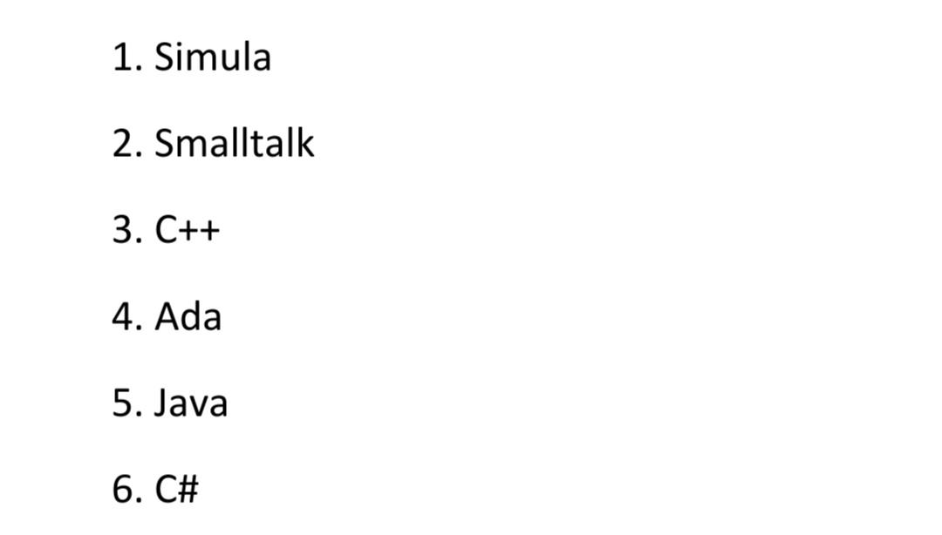
Examples of Object Oriented languages

Slide 20
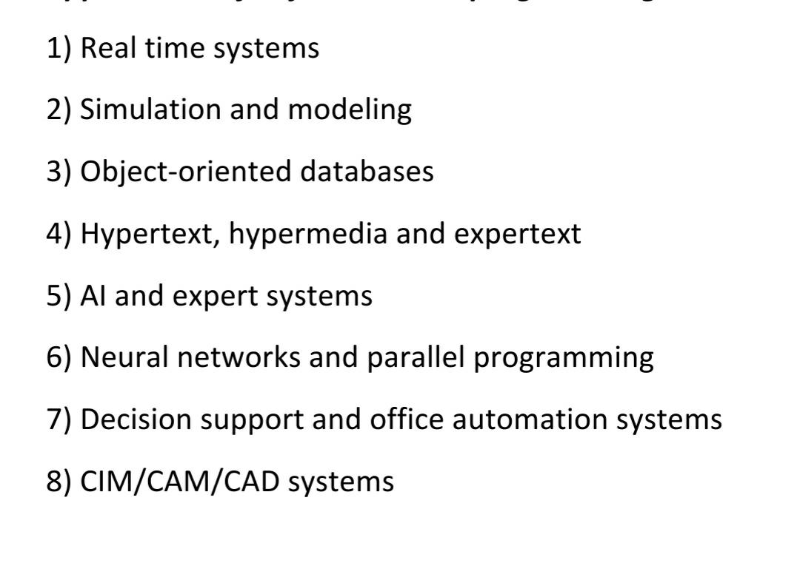
Applications of OOP

Slide 21
Memory allocations for objects
Memory space for object is allocated when they are declared and not when the class is specified.
But the member functions are created and placed in the memory space only once when they are defined as a part of the class specification.
As all objects belongs to same class, use the same member functions, no separate memory is allocated for member functions when the objects are created i.e. when the objects are created the memory space is allocated only for data members (member variables)
Space for data members is allocated separately for each object.
The memory locations are also distinct for object of same class because the data members of different object will hold different values.
Data member of the class can contain different value for the different object, memory allocation is performed separately for each data member for different object at the time of creating an object.
Member function remains common for all object. Memory allocation is done only once for member function at the time of defining it.

Slide 22
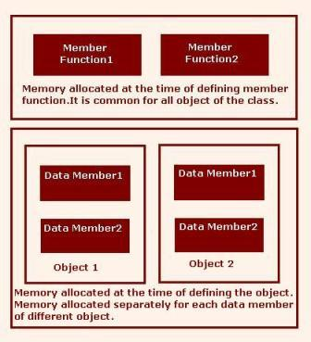

Slide 23
Example
class sample
{
int x,y;
public:
void initialize()
{
x=20;
y=30;
}
}s1,s2;
class sample
{
int x,y;
public:
void initialize()
{
x=20;
y=30;
}
}s1,s2;

Slide 24
Differentiation between C and C++
C | C++
It is Procedure Oriented Programming language. | It is Object Oriented Programming language.
It is top down programming approach. | It is bottom up programming language.
It does not have access specifiers. | It has three access specifiers : public,private,protected.
Adding new data and methods is not easy. | Adding new data and methods is easy.
For input scanf() is used, output printf() is used. | For input cin (with >>) and for output cout (with << ) is used.

Slide 25
Differentiation between C and C++
C | C++
I/O operations are supported by stdio.h header file. | I/O operations are supported by iostream.h header file.
It is not as secure as C++ as no way of hiding data. | It provides security as data hiding is possible.
Overloading is not possible. | It provides operator overloading and function overloading.
Functions can use global data that can be accessed by all other functions in the program. | Data does not move easily through functions as it can be kept public, private and protected.
Importance is given to functions and sequence of actions. | Importance is given to data rather than functions as it works on real world.

Slide 26
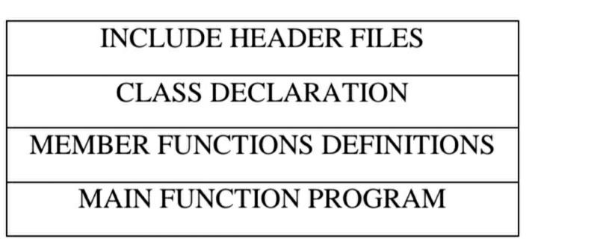
Structure of C++ Program

Slide 27
Sample program in c
//Addition of two number in c programming
#include<stdio.h>
#include<conio.h>
void main()
{
int a,b,c;
clrscr();
printf("Enter two number:");
scanf("%d %d",&a,&b);
c=a+b;
printf("c=%d",c);
getch();
}
/*output:
Enter two number:4 6
c=10 */

Slide 28
Sample program in c++
//Addition of two number in c++ programming
#include<iostream.h>
#include<conio.h>
void main()
{
int a,b,c;
clrscr();
cout<<"Enter two number:";
cin>>a>>b;
c=a+b;
cout<<"c="<<c;
getch();
}
/*output:
Enter two number:5 9
c=14 */

Slide 29
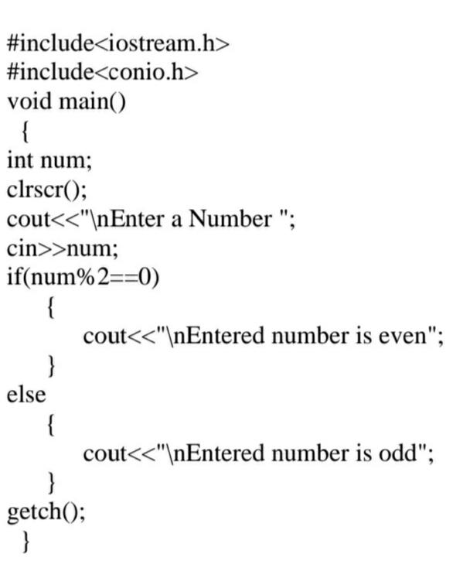
Simple C++program

Slide 30
Sample program
//Addition of two number in c programming
#include<stdio.h>
#include<conio.h>
void main()
{
int a,b,c;
clrscr();
printf("Enter two number:");
scanf("%d %d",&a,&b);
c=a+b;
printf("c=%d",c);
getch();
}
/*output:
Enter two number:4 6
c=10 */
//Addition of two number in c++ programming
#include<iostream.h>
#include<conio.h>
void main()
{
int a,b,c;
clrscr();
cout<<"Enter two number:";
cin>>a>>b;
c=a+b;
cout<<"c="<<c;
getch();
}
/*output:
Enter two number:5 9
c=14 */

Slide 31
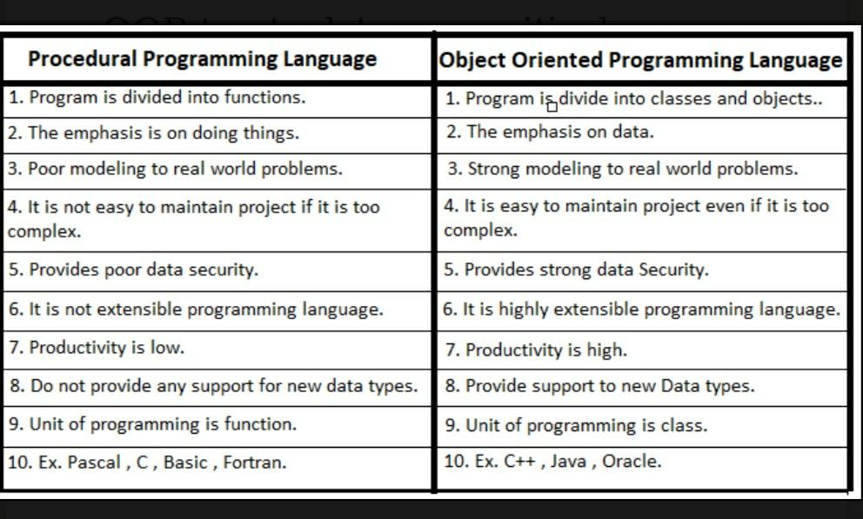
Difference between POP and OOP

Slide 32
Class & Object
Introduction
Class is an important feature of C++.
It is an extension of the idea of the structure in ‘C’.
Class is a new way of creating and implementing a user defined data type.
Class is similar to the structure data type, but structure in ‘C’ is having some limitations.
In C++ class and structure is similar in that, both can have data members as well member functions.

Slide 33
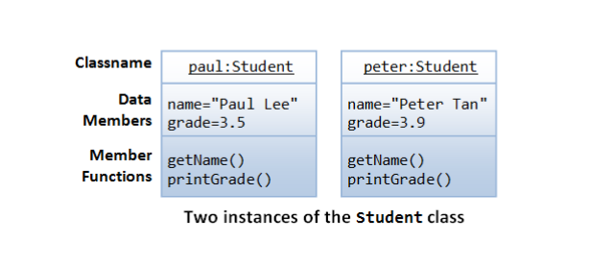

Slide 34
Specifying a class:
The class is a way of binding data and functions associated with data together.
The entire set of data and the functions can be made user defined data type with help of class. The Class is nothing but a user defined data type.
Class act as a template, which is used to create objects. The class contains data and member functions that operate on the data.
It allows the data to be hidden, if necessary from the external use.
Generally class specification has two parts
class declaration
class function definitions.

Slide 35
Syntax of class:
class class-name
{
private :
variable declarations;
function declarations;
public:
variable declarations;
function declarations;
};

Slide 36
Class Declaration:
The class declaration describes the type and scope of its members.
The class function definitions describe how the class functions are implemented.
The class body contains the declarations of variables and functions. These variables and functions are collectively called members. The variables are called data members or member variables and the functions are called member functions.
They are usually grouped under two sections, private and public.
The keyword private and public are called visibility labels.
The private members can be accessed only from within the class and the public members can be accessed from outside the class.
The use of keyword private of optional. By default all the members of class are private.
Only the member functions can access the private members of class.

Slide 37
Access specifiers:
In C++ Access specifiers are also called as visibility mode. They are as follows: Public, Private, and Protected .
Public:- When access specifier is public i.e. base class is publicly inherited by derived class all public member of base class become public members of derived class and all protected members become protected in derived class.
Private: - All public and protected members of base class become private members of derived class.
Protected: - In this all public and protected members of base class become protected of derived class

Slide 38
ACCESSING CLASS MEMBERS :
The private data of the class can be accessed only through the member functions of that class.
To call a member function use following syntax,
Syntax: Object-name. function-name ( argument-list);
E.g. If s1 is an object of student class and showdata() is a member function of the class student , then to invoke a member function we write,
s1. showdata();

Slide 39
Example:
class student
{
private :
int rollno; // data member
char name[30]; // data member
public:
void getdata (void); // member function
void showdata(void); // member function
};

Slide 40
CREATING OBJECTS OF CLASS:
After declaration of class, one can create any number of variables (objects) of that type by using class name.
Syntax: Class-name variable-name:
Example: Student s1; // memory for s1 is created.
The above statement will create a variable ‘s1’ of type student. These variables are known as objects. Here S1 is an object of class student.
One may declare more than one variable as shown.
Student s1, s2, s3;

Slide 41
A variable declared as public can be accessed directly but the private variables cannot be accessed by the object directly. Private member can be accessed using member functions.
EXAMPLE:
Class student
{
private : int rollno;
char name[30];
public: int no-of-student;
};
main()
{
student s; // create an object
s. rollno = 10 //Error , rollno is private member , cannot be accesses directly
s. no_of_student =100; // OK no_of_student is public member , can be accessed directly
return (0);
}

Slide 42
Write a C++ program to find the area of circle using class circle which have following details: a. Accept radius from the user b. Calculate the area c. Display the result
class circle { float radius, area; //data members public: circle() { cout<<"\n Enter the value of Radius : "; cin>>radius;
} void calculate()
{
area = 3.14 * radius * radius; void display()
{
cout<<"\n Area of Circle : "<<area; }
};
void main() { circle cr; //object created cr.calculate(); //calling function cr.display(); //calling function getch(); }

Slide 43
Write a program to declare a class ‘Emp’ containing data member’s emp_id and salary.
Declare accept() and showdata() function and display and accept this data for 1 object of the class.
class Emp {
private: int emp_id; float salary; public: void accept() { cout<<"\n Enter Employee id : "; cin>>emp_id; cout<<"\n Enter Salary : "; cin>>salary; }
void showdata() { cout<<"\n Employee id is “<<emp_id; cout<<"\n Employee salary is : "<<salary; }
}; void main() { Emp e; e.accept(); e.showdata();
getch();
}

Slide 44
Write a program to declare a class ‘Student’ containing data member’s name, roll_no, and percentage. Declare accept() and showdata() function and display and accept this data for 1 object of the class.
#include<iostream.h>
#include<conio.h> class Student {
private:
char name[20]; int roll_no;
float percentage; public: void getdata() { cout<<"\n Enter Student name : "; cin>>name; cout<<"\n Enter student roll number "; cin>>roll_no;
cout<<"\n Enter percentage : "; cin>>percentage;
}
void showdata() {
cout<<“ \n Student name is “<<name;’
cout<<“ \n Student roll no is “<<roll_no;’
cout<<"\n Employee salary is : "<<salary;
} }; void main() { Student s; s.getdata(); s.showdata();
getch();
}

Slide 45
Assignment:
Write a program to declare a class ‘Person’ containing data member’s name, address, and mobile_number.Declare getdata() function to accept data of one person and display with the help of showdata() function.
Write a program to declare a class ‘Person’ containing data member’s name, address, and mobile_number.Declare getdata() function to accept data of two person’s data and display with the help of showdata() function.
Write a C++ program to define a class employee having members Emp-id, Emp-name, basic salary and functions accept() and display(). Calculate DA=25% of basic salary, HRA=800, I-tax=15% of basic salary. Display the payslip using appropriate output format.
Write a program to declare a class ‘emp’ containing data member’s emp_id and salary. Accept and display this data for 1 object of the class.
Note:Run all programs on turboc++ or dev c++ complier with given syntax.

Slide 46
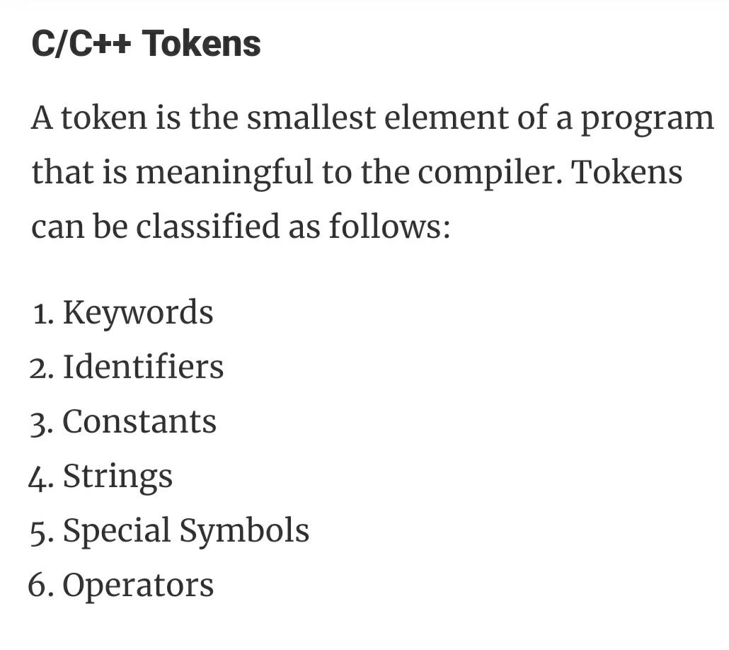
Tokens

Slide 47
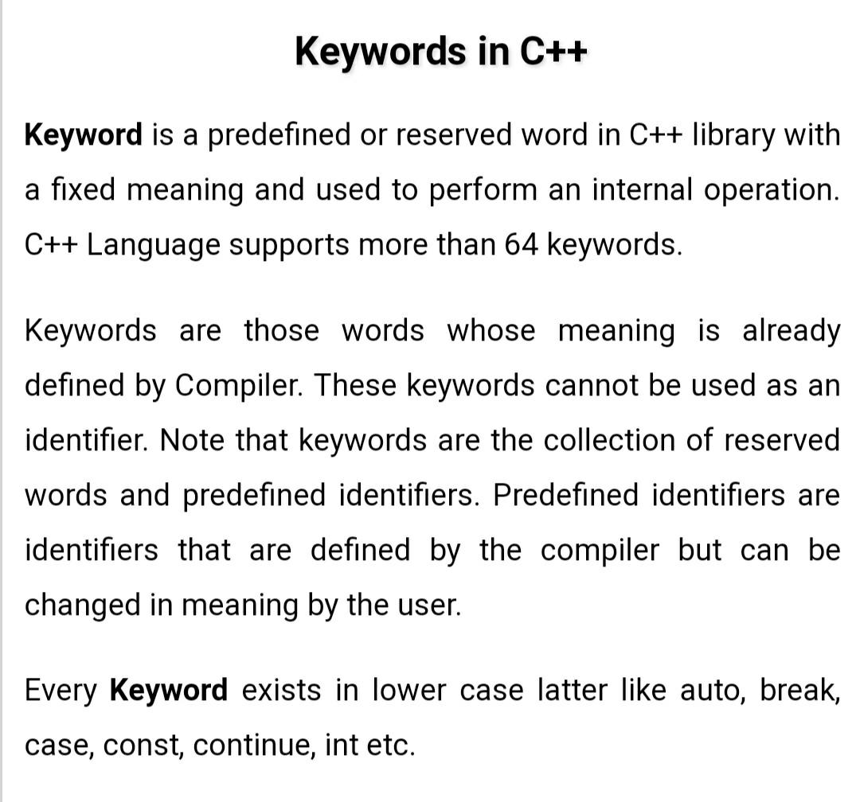
Keywords

Slide 48
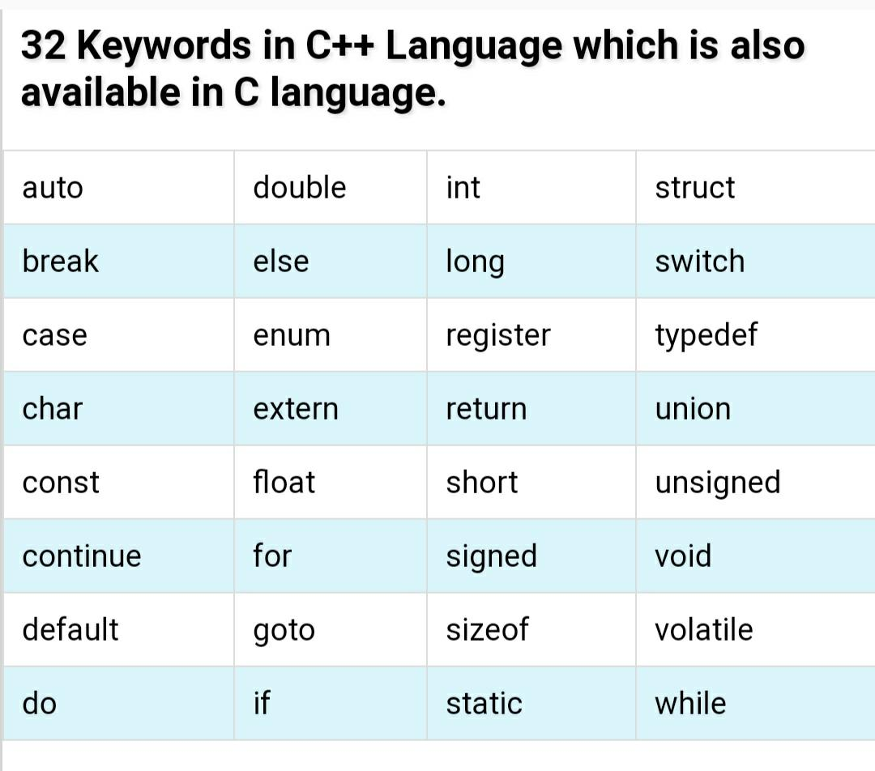
Keywords in C/C++

Slide 49
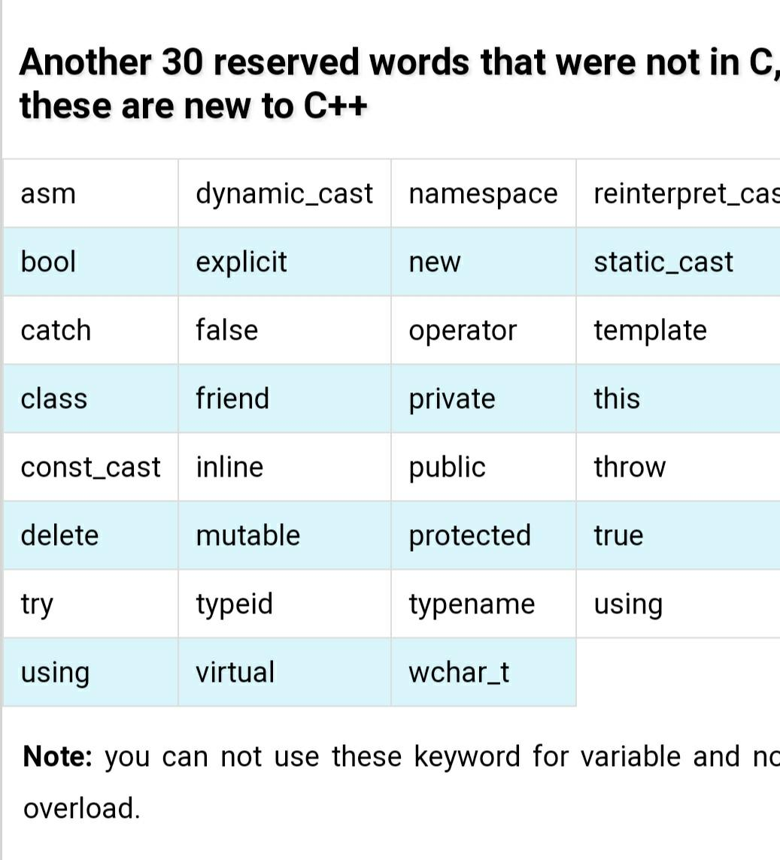
Keywords of C++

Slide 50
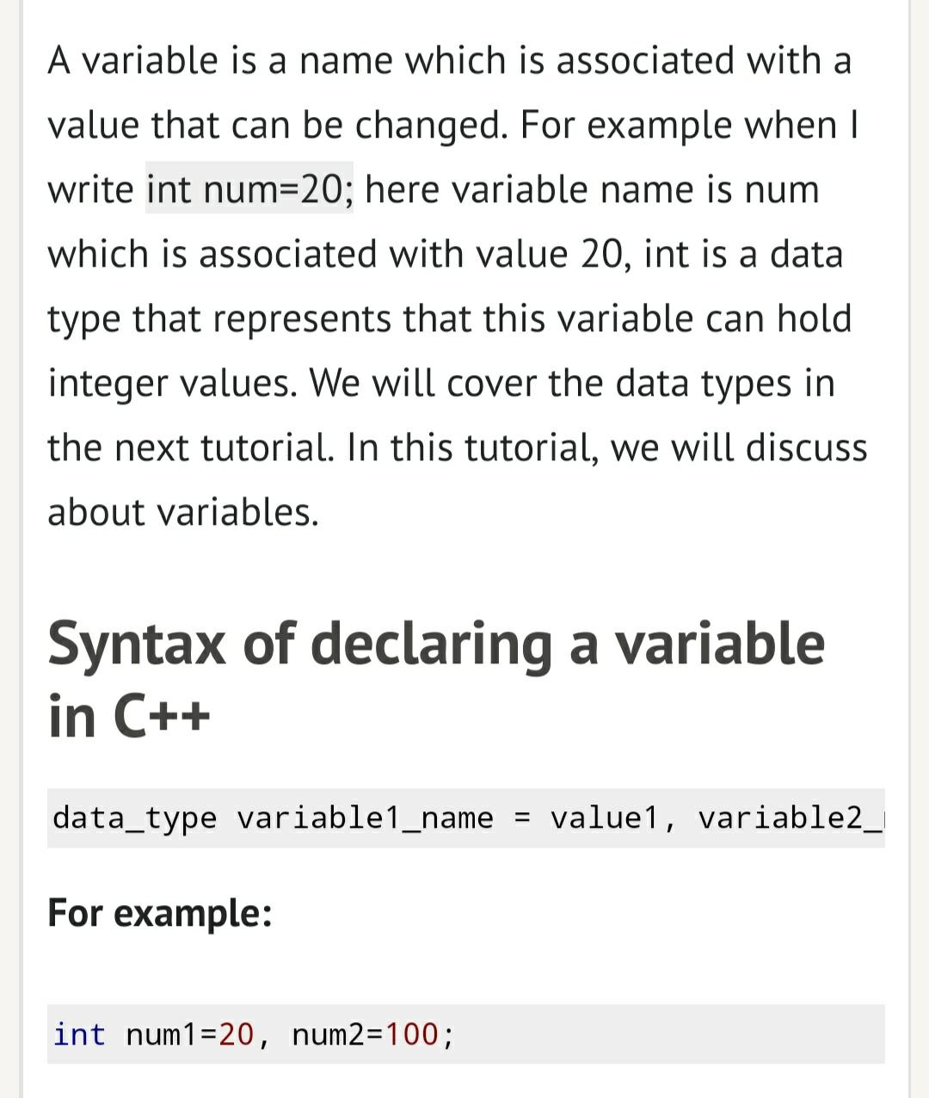
Variables

Slide 51
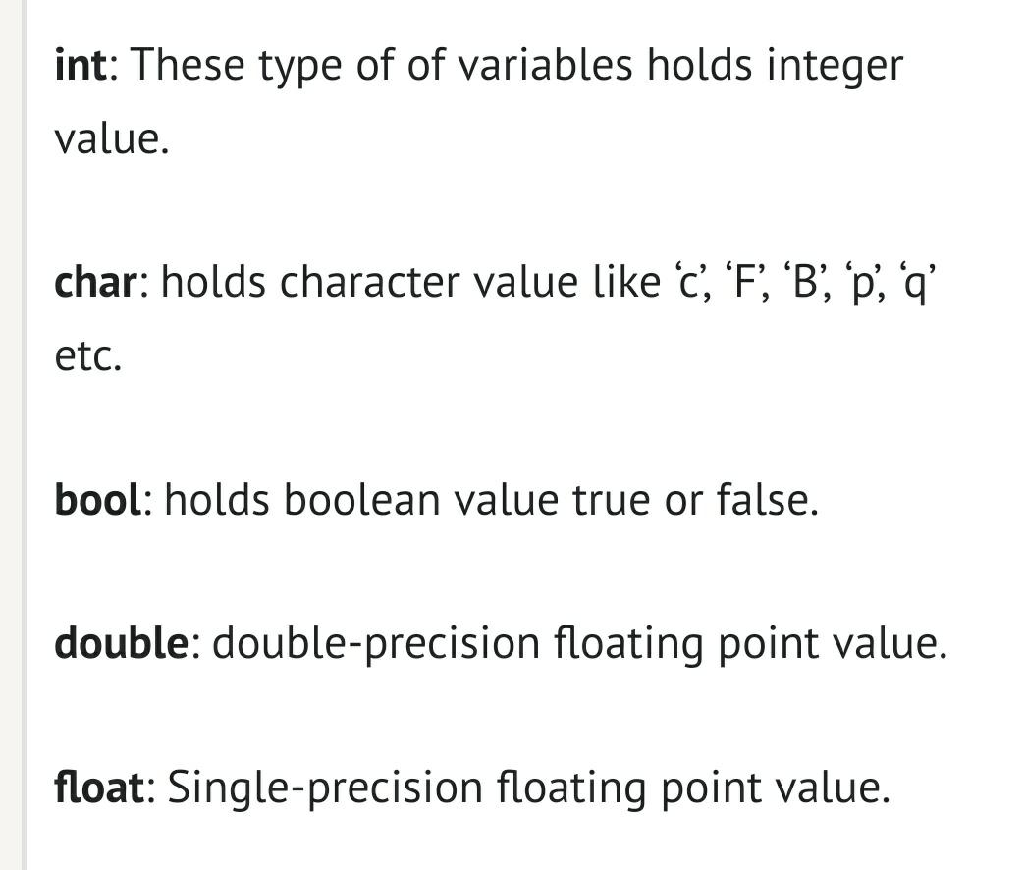
Type of variable

Slide 52
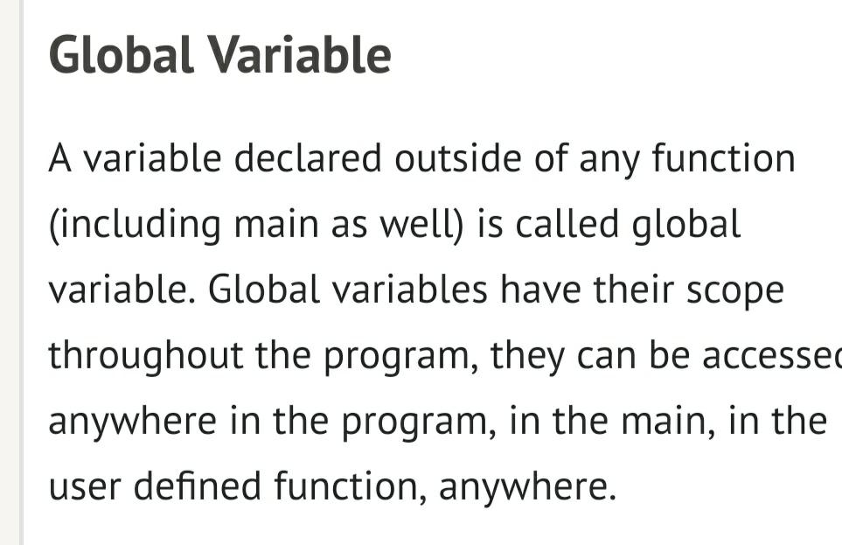
Types of variable based on their scope

Slide 53
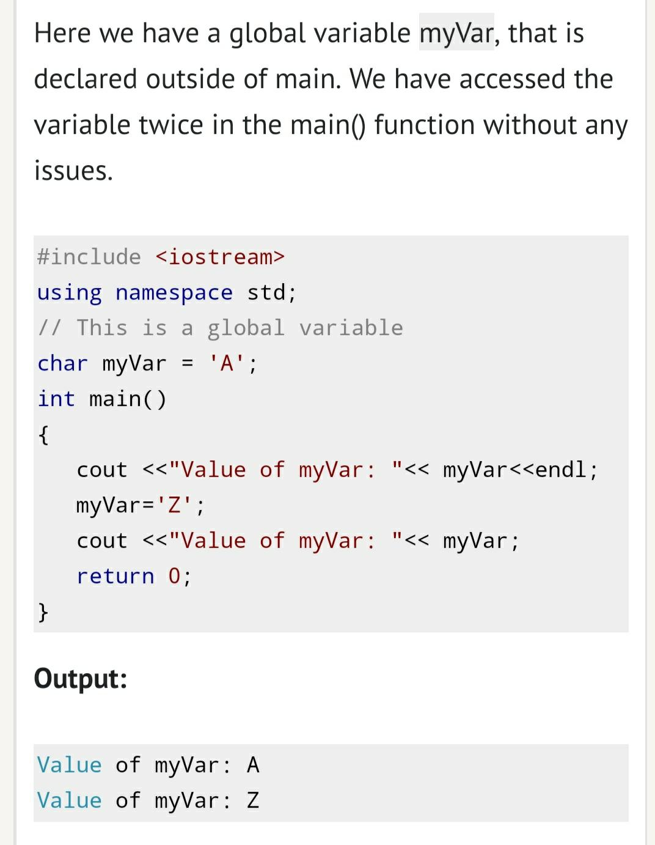
Global variable example

Slide 54
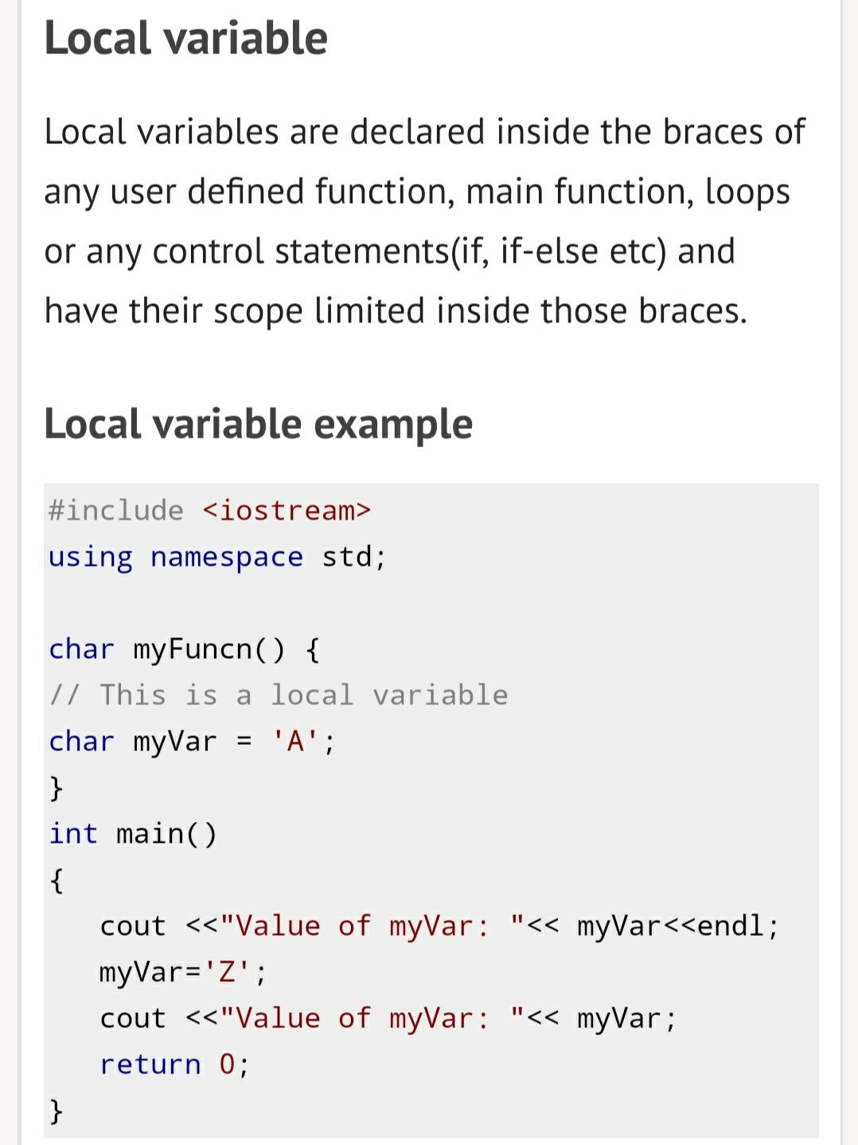
Local variable

Slide 55
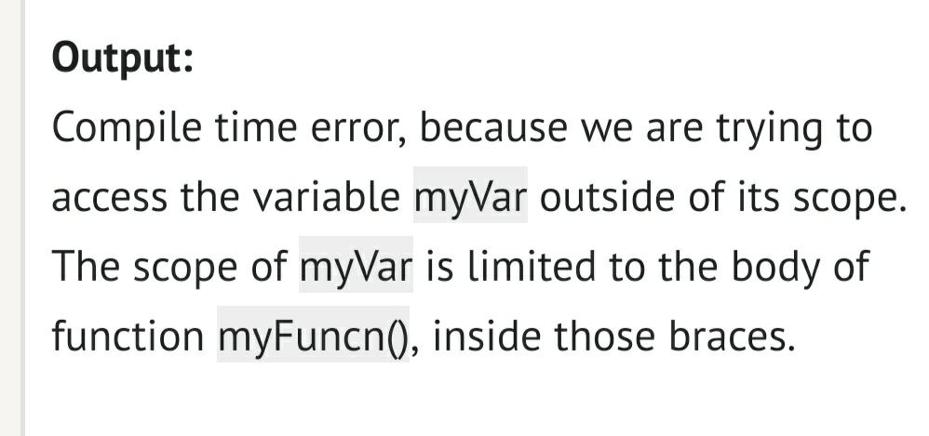

Slide 56
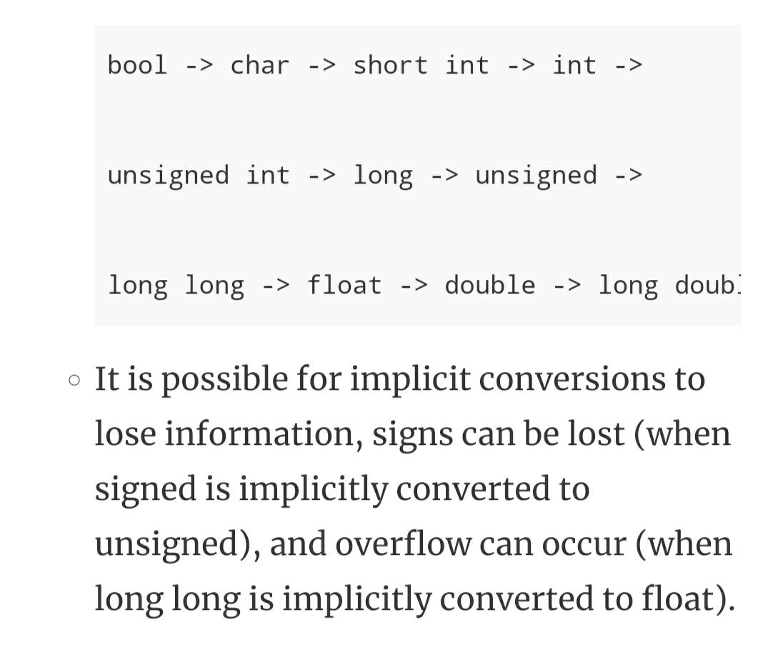
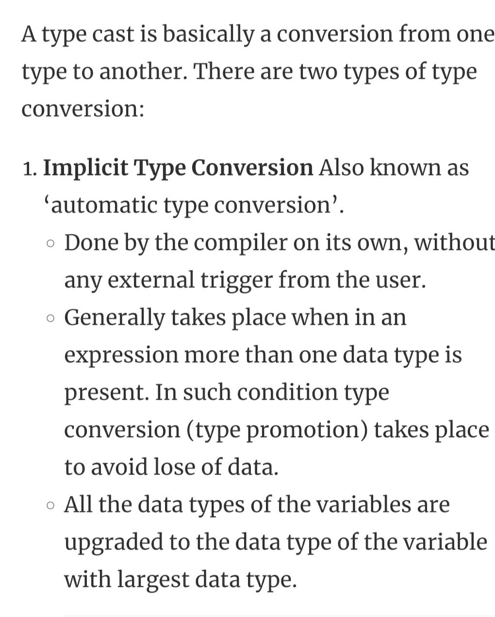
Type casting

Slide 57
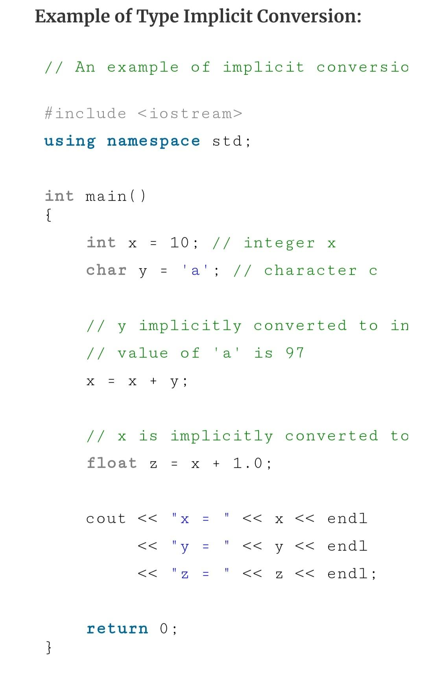
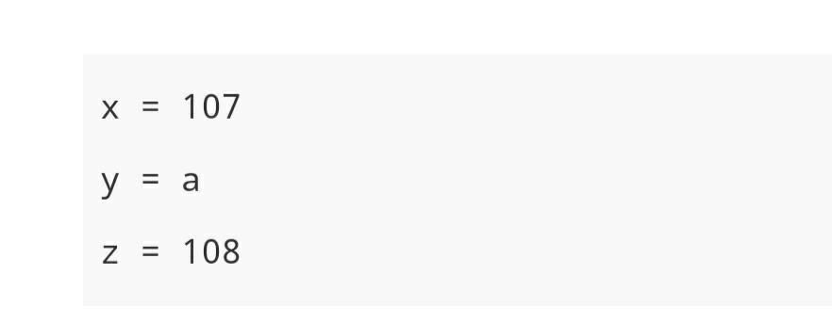

Slide 58
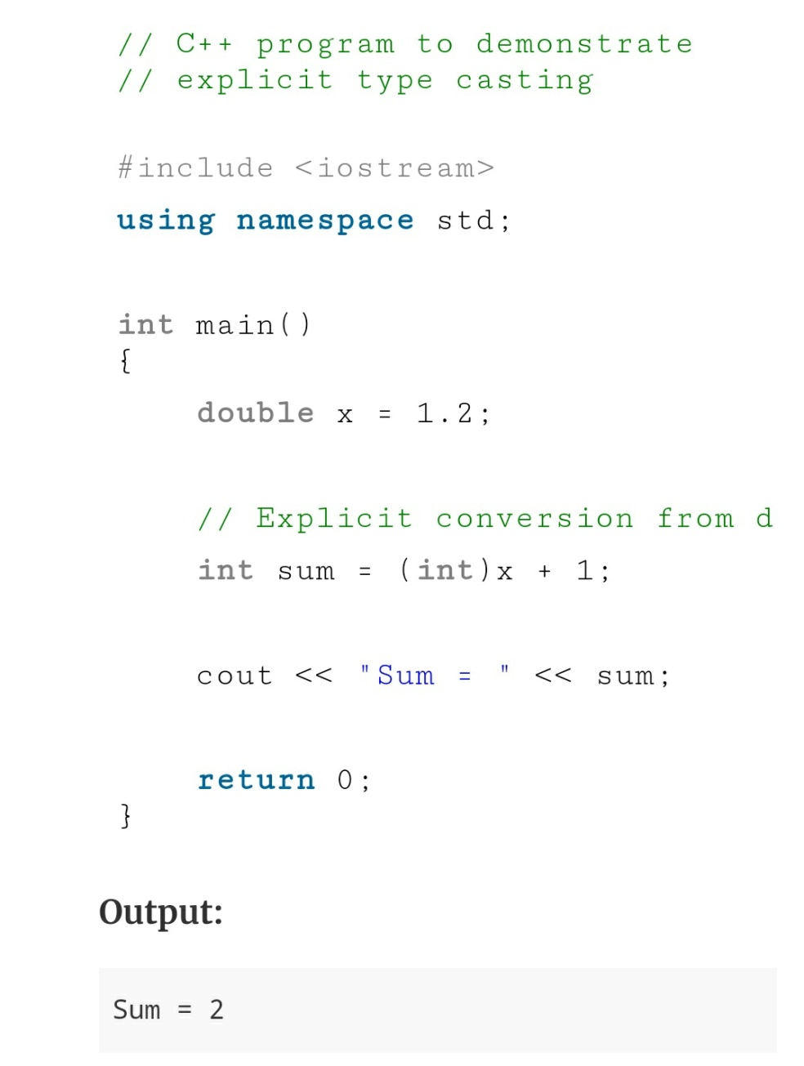
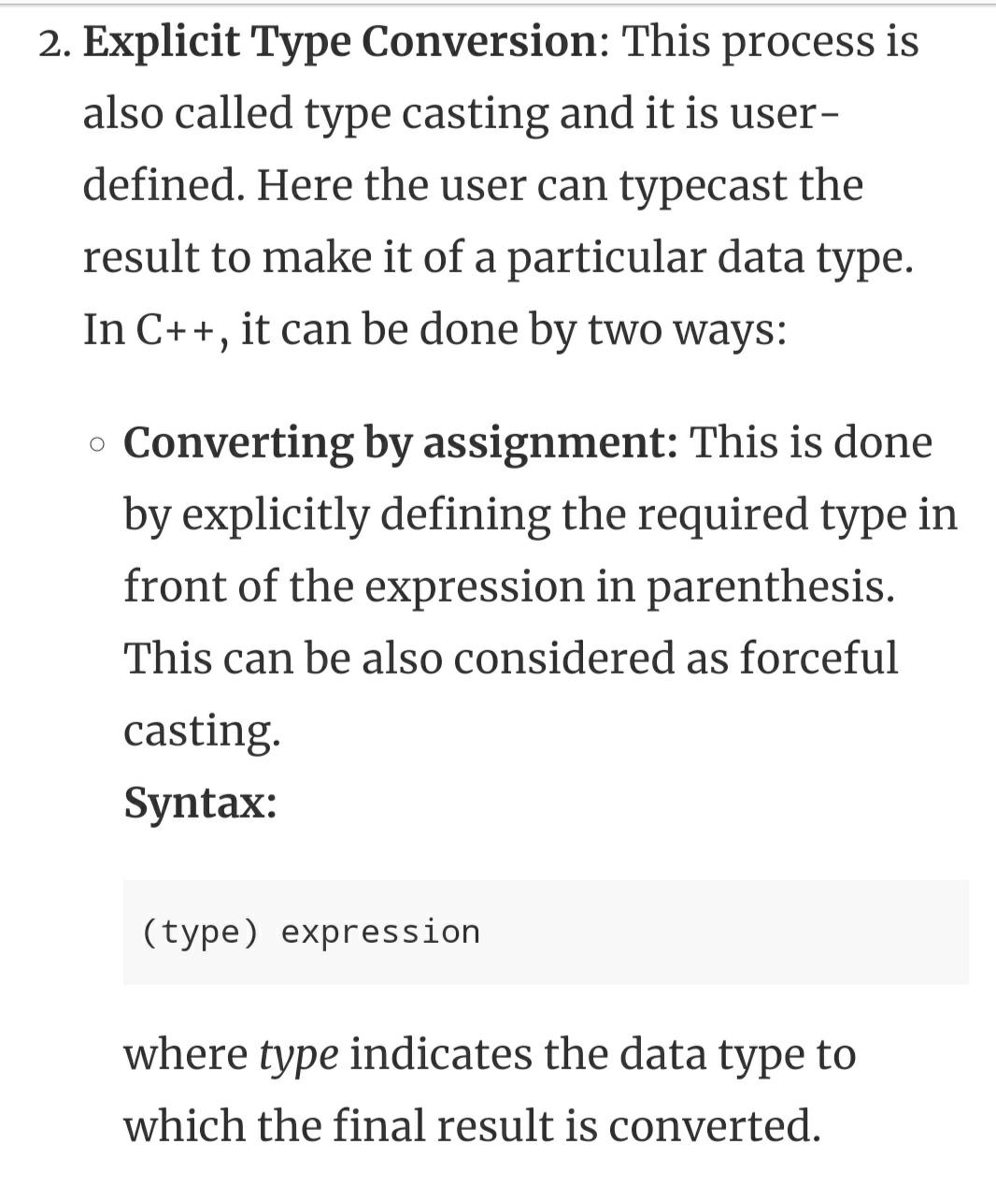
Explicit type casting

Slide 59
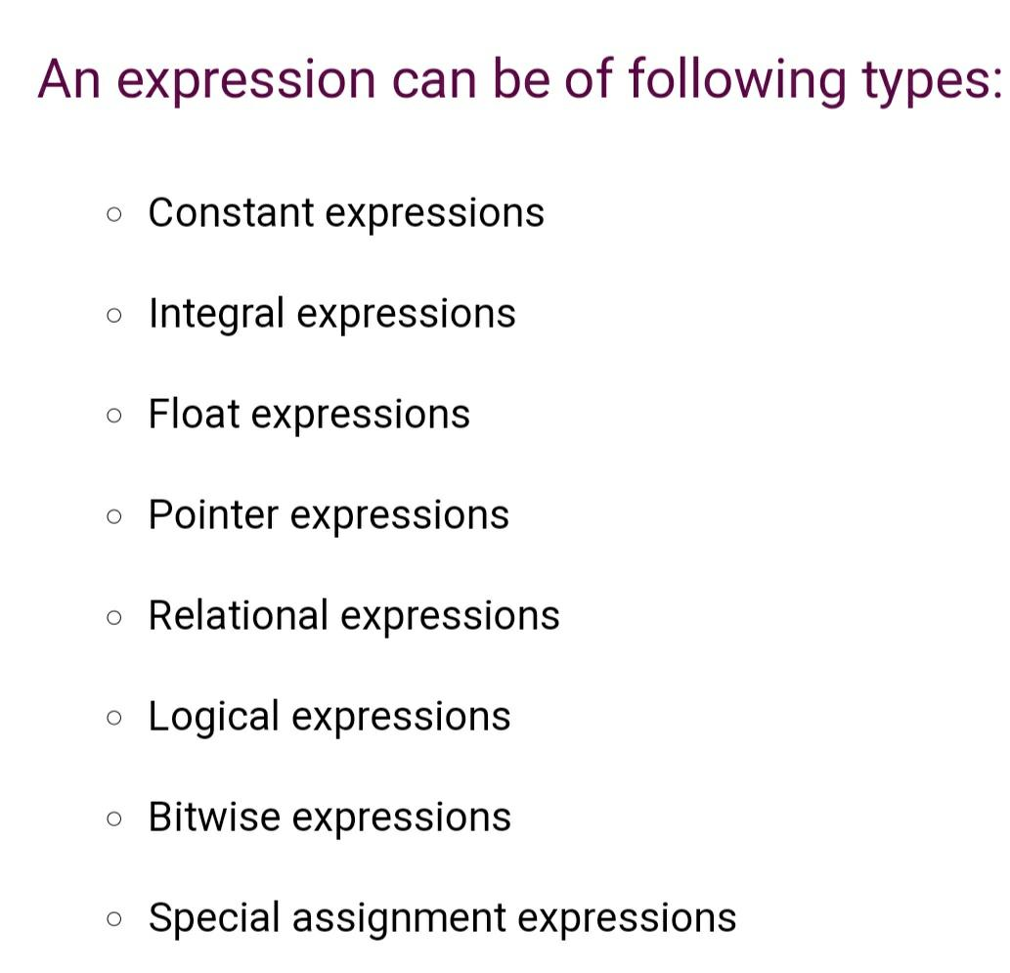
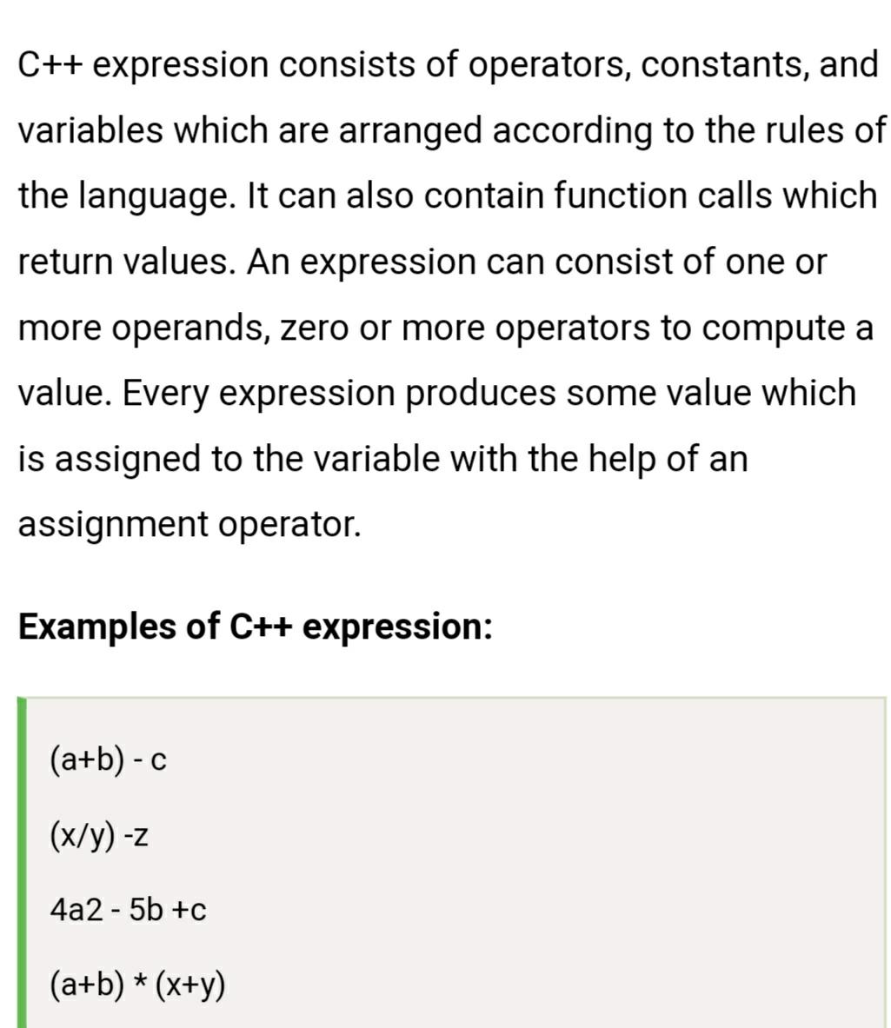
Expression in C++

Slide 60
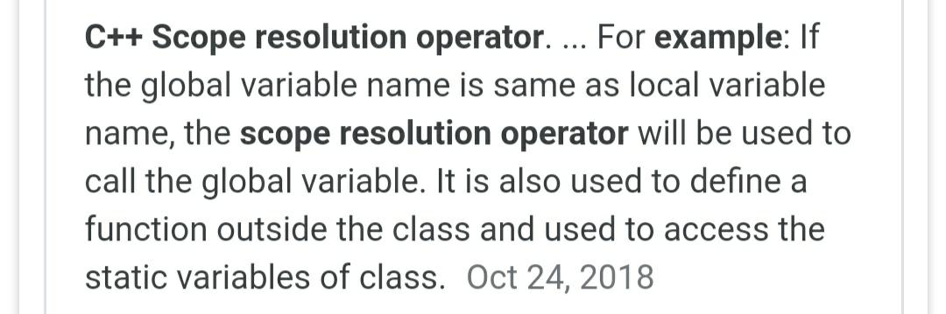
Scope resolution operator

Slide 61
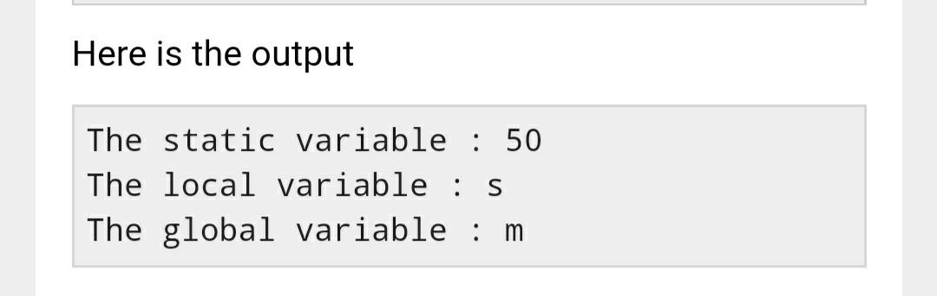
Scope resolution operator
#include <iostream.h>
char a = 'm’;
static int b = 50;
int main()
{ char a = 's’;
cout << "The static variable : "<< ::b;
cout << "\nThe local variable : " << a;
cout << "\nThe global variable : " << ::a;
return 0;
}

Slide 62
Sizeof operator in c++
C++ sizeof Operator. The sizeof is a keyword, but it is a compile-time operatorthat determines the size, in bytes, of a variable or data type. The sizeof operatorcan be used to get the size of classes, structures, unions and any other user defined data type.

Slide 63
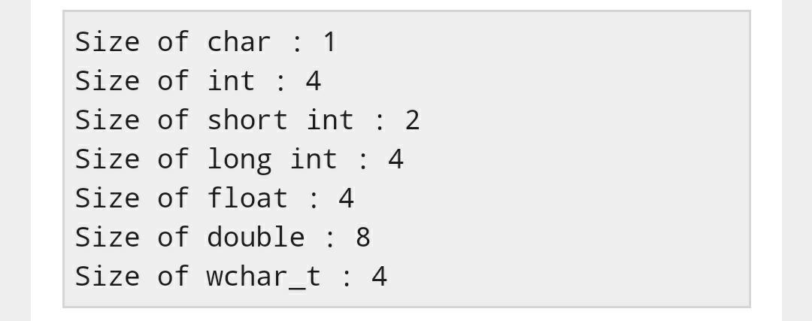
Sizeof example
Live D
#include <iostream.h>
int main()
{
cout << "Size of char : " << sizeof(char) << endl;
cout << "Size of int : " << sizeof(int) << endl;
cout << "Size of short int : " << sizeof(short int) << endl;
cout << "Size of long int : " << sizeof(long int) << endl;
cout << "Size of float : " << sizeof(float) << endl;
cout << "Size of double : " << sizeof(double) << endl;
cout << "Size of wchar_t : " << sizeof(wchar_t) << endl;
return 0; }

Slide 64
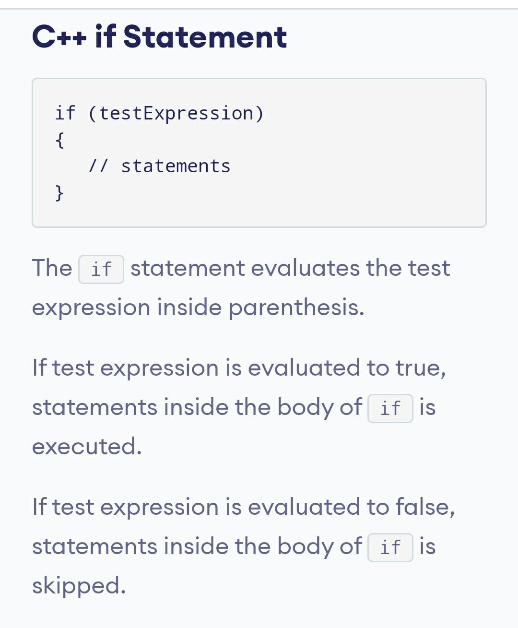
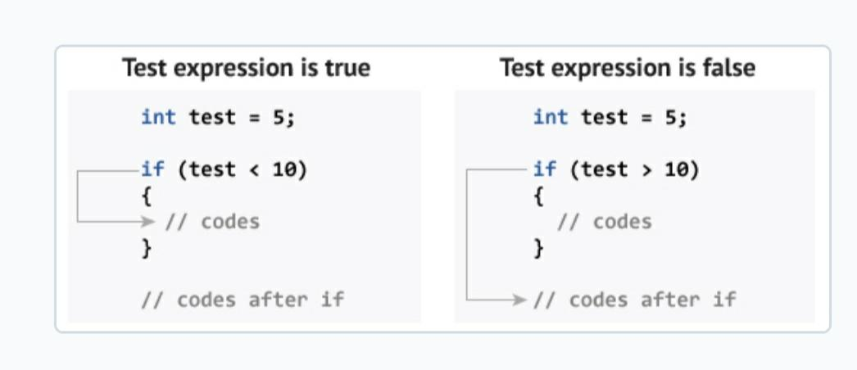

Slide 65
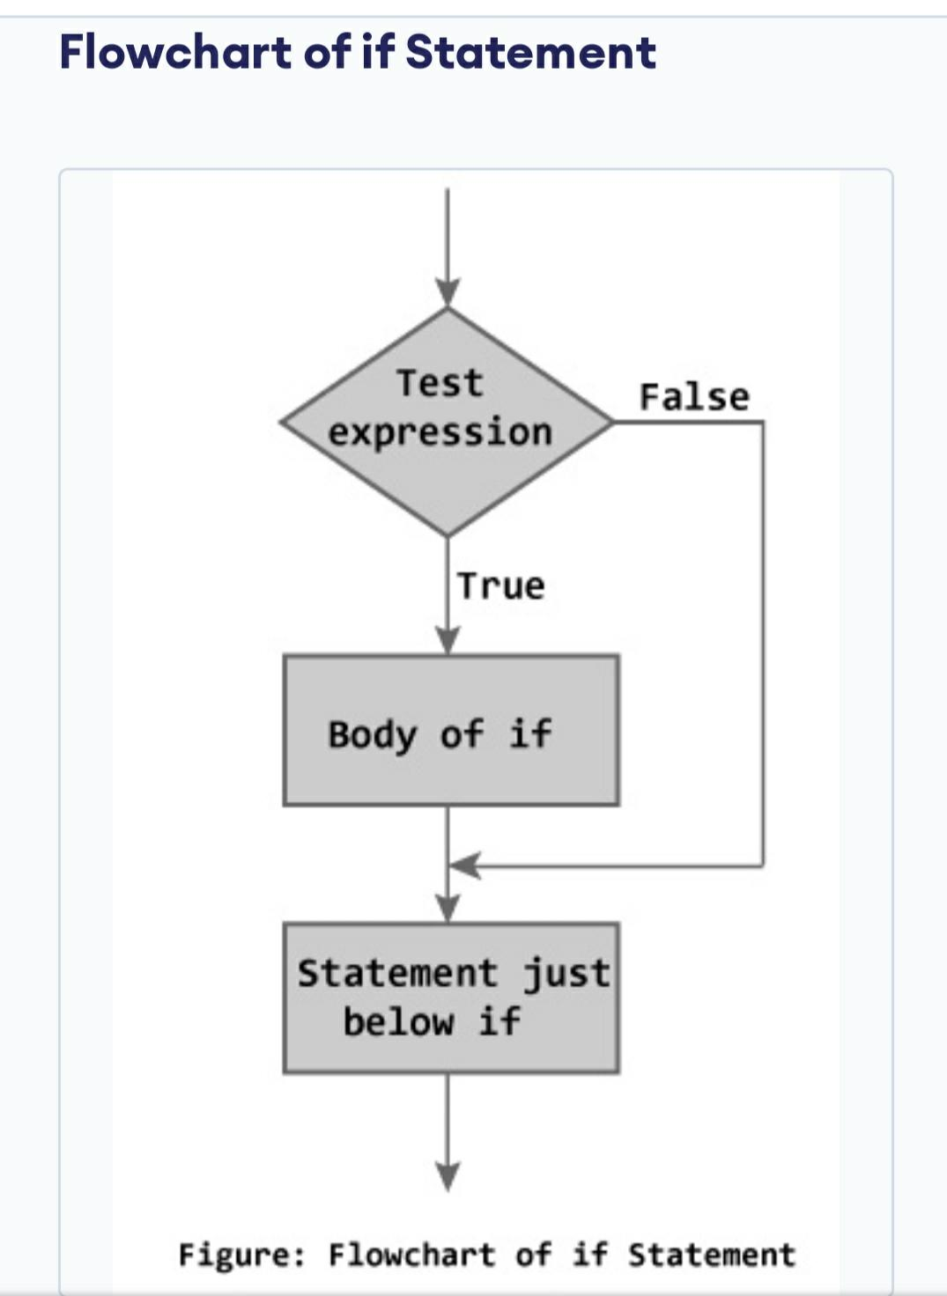

Slide 66
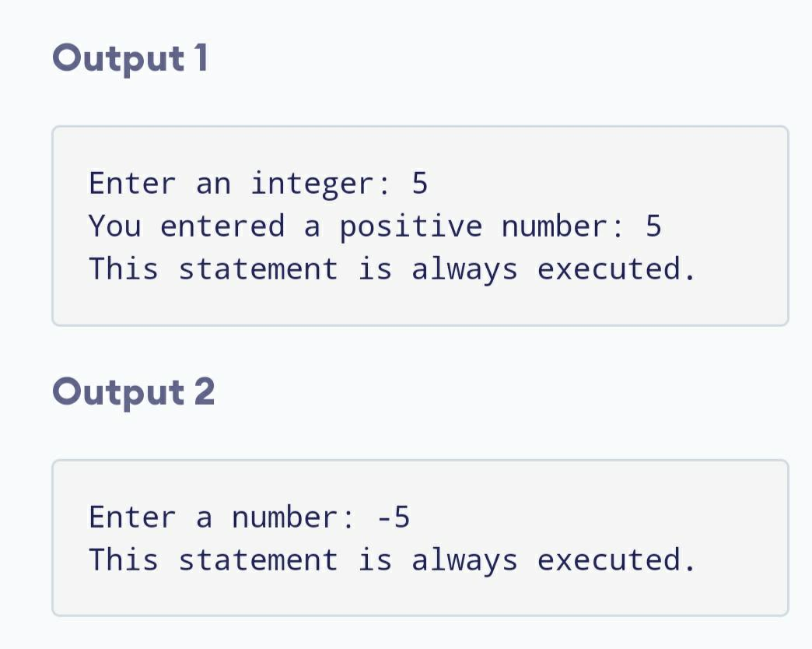
Example of if
// Program to print positive number entered by the user
// If user enters negative number, it is skipped
#include <iostream.h> int main()
{
int number;
cout << "Enter an integer: ";
cin >> number;
// checks if the number is positive
if ( number > 0)
{
cout << "You entered a positive integer: " << number << endl;
}
cout << "This statement is always executed.";
return 0;
}

Slide 67
If statement
#include<iostream.h>
#include<conio.h>
void main()
{
int x;
clrscr();
cout<<"Enter the value of x:";
cin>>x;
if(x==100)
{
cout<<"x is 100";
}
/*output:
Enter the value of x:102
x is not 100 */

Slide 68
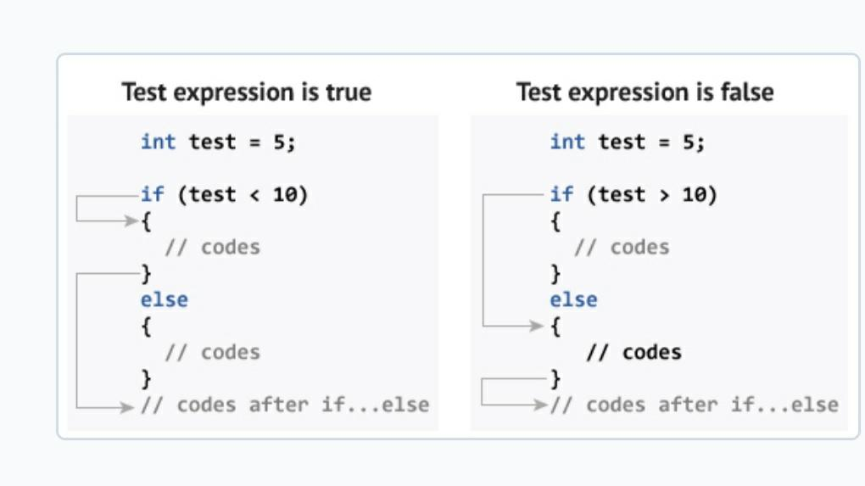
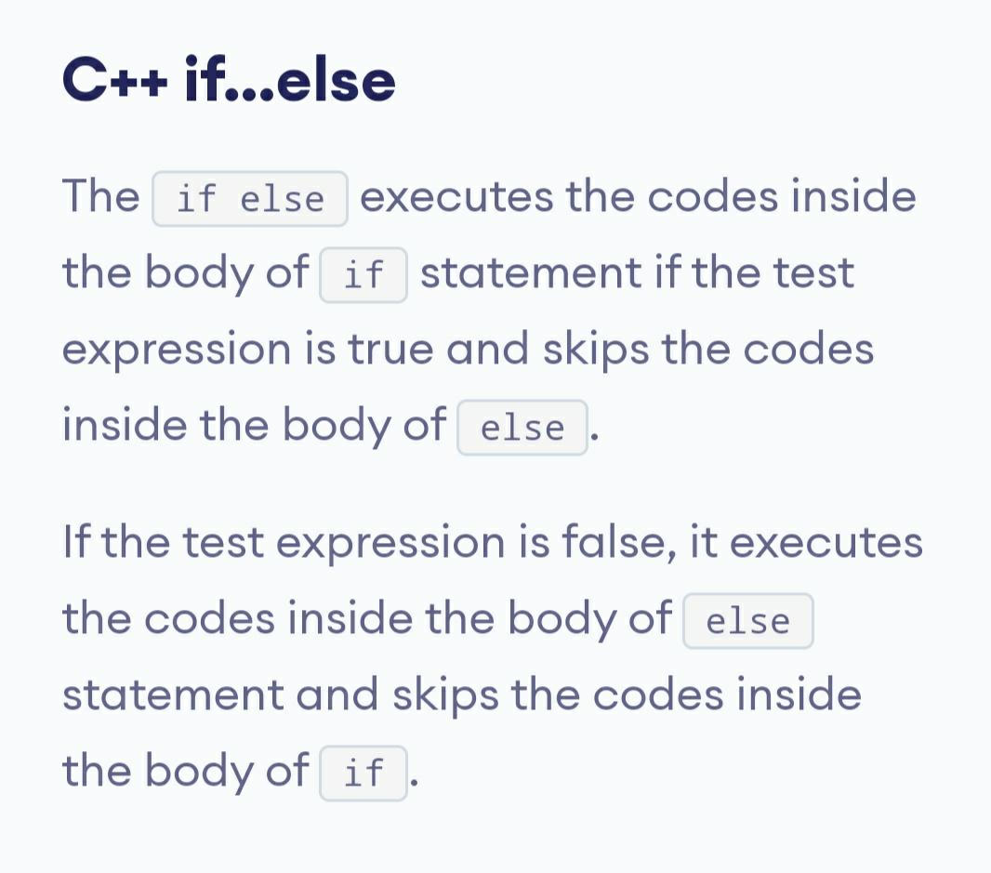

Slide 69
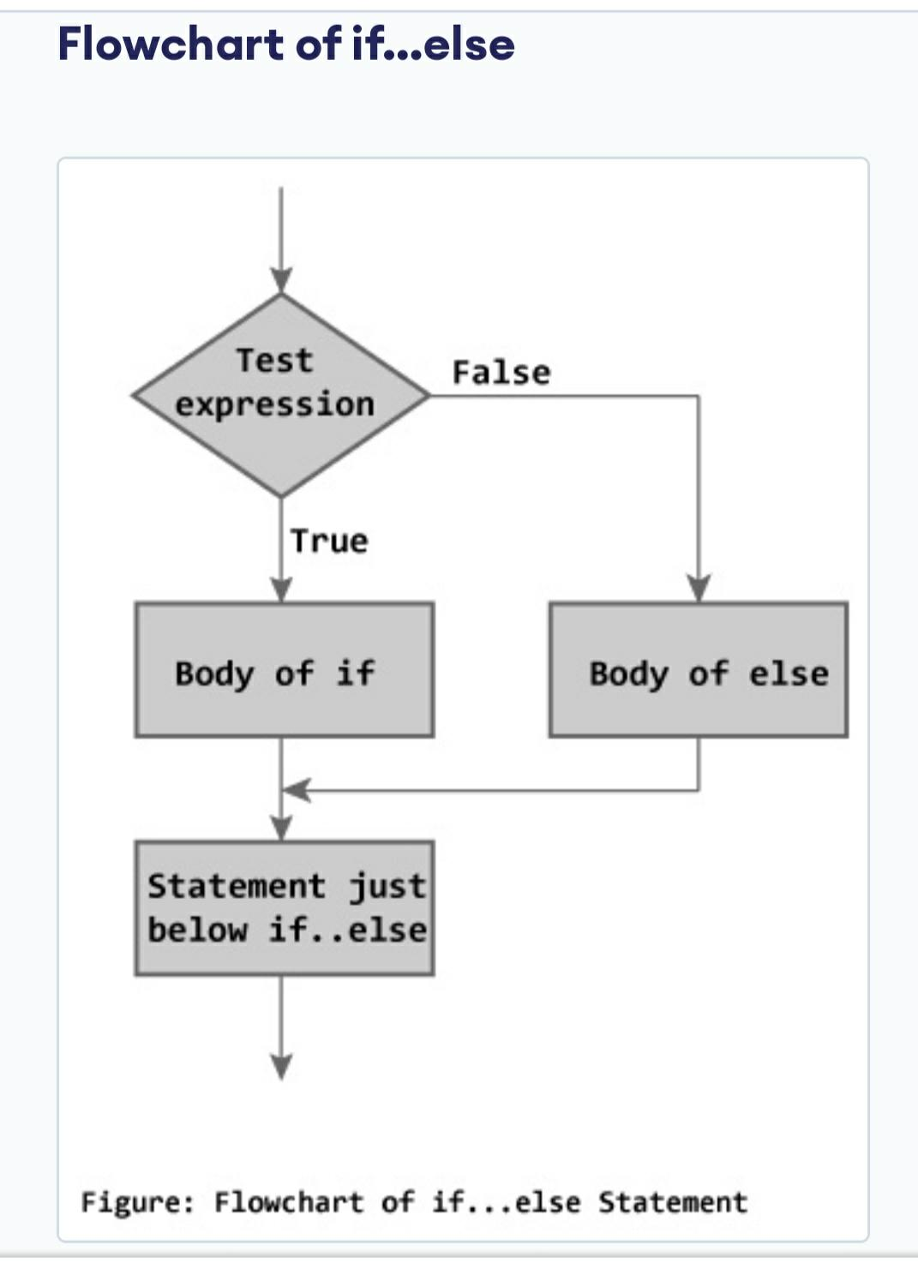
If-else

Slide 70
If-else example
#include<iostream.h>
#include<conio.h>
void main()
{
int x;
clrscr();
cout<<"Enter the value of x:";
cin>>x;
if(x==100)
{
cout<<"x is 100";
}
else
{
cout<<"x is not 100";
}
getch();
}
/*OUTPUT:
Enter the value of x:102
x is not 100 */

Slide 71
// Program to check whether an integer is positive or negative // This program considers 0 as positive numb
#include <iostream.h>
int main()
{
int number;
cout << "Enter an integer: ";
cin >> number;
if ( number >= 0)
{
cout << "You entered a positive integer: " << number << endl;
}
else
{ cout << "You entered a negative integer: " << number << endl; }
cout << "This line is always printed.";
return 0; }

Slide 72
If-else-if
#include<iostream.h>
#include<conio.h>
void main()
{
int x;
clrscr();
cout<<"Enter the value of x:";
cin>>x;
if(x>0)
cout<<"x is positive";
else if(x<0)
cout<<"x is negative";
else
cout<<"x is 0";
getch();
}
/*output:
Enter the value of x:0
x is 0 */

Slide 73
If-else-if
#include<iostream.h>
#include<conio.h>
void main()
{
int x;
clrscr();
cout<<"Enter the value of x:";
cin>>x;
if(x>0)
cout<<"x is positive";
else if(x<0)
cout<<"x is negative";
else
cout<<"x is 0";
getch();
}
/*output:
Enter the value of x:0
x is 0 */

