Slide 1
Chapter 2
Transmission Media & Switching

Slide 2
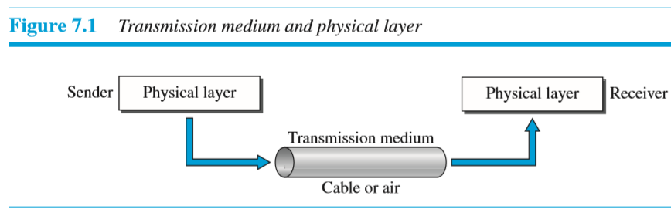
Transmission Media
2.0 Introduction:
2.1 (Communication Media):
Transmission media is a medium through which information travels from source to destination.
Examples of transmission media are:
1. Telephone wires that connects telephones
to central offices
2. Coaxial cables that connects cable television
transmission to homes.
Criteria for the selection of Transmission Media:
Type of medium (wired or wireless) required
Cost
Durability or life time
Reliability
Flexibility
Bandwidth or Data rate
Effect of external interference

Slide 3
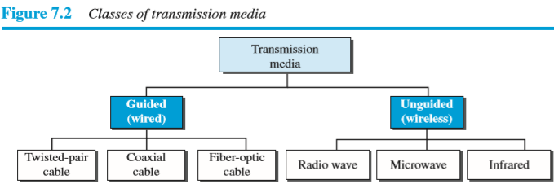
Transmission Media
2.0 Introduction:
2.1 (Communication Media):
Types of Transmission Media:

Slide 4
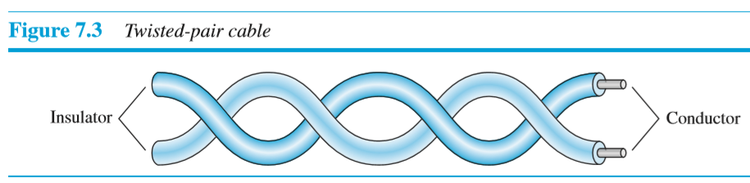
2.1.1 Guided Transmission Media
2.1.1 Guided Transmission Media (Wired Media):
In wired media signal is transmitted in the form of physical wires.
The twisted pair and coaxial cables uses copper conductor that accept and transport signals in the form of electric current.
The optical fiber that accept and transport signals in the form of light
2.1.1.1 Twisted Pair Cable:
The twisted pair cables uses copper conductors that carries signals in the form of electric current
A twisted pair consists of two copper conductors, each with its own plastic insulation twisted together as shown in fig.7.3
One of the wire is used to carry signals to the receiver and other is used only as a ground reference.
There are two types of twisted pair cable:
1. Unshielded Twisted Pair (UTP) Cable
2. Shielded Twisted Pair (STP) Cable

Slide 5
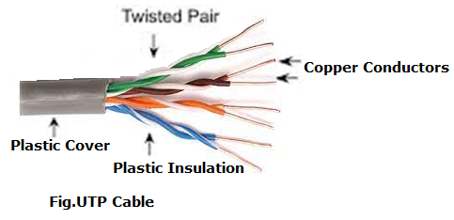
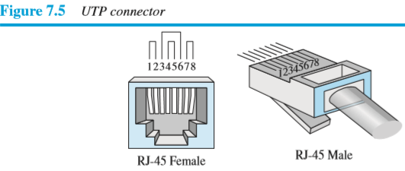
2.1.1.1 Twisted Pair Cable:
1. Unshielded Twisted Pair (UTP):
UTP cable consists of eight separate copper conductors, each conductor is insulated with its own plastic insulation.
Eight wires are arranged in four pairs and they are twisted with each other and all pairs covered with plastic cover.
Out of the four pairs of wires in a UTP cable, only two pairs are used for communication.
Twisting of wires will reduce the effect of noise(unwanted signals) or crosstalk(effect where signals from different wire pairs mix together)
UTP cable is flexible, cheap and easy to install but its data rate is less and effect of external interference is more.
To connect UTP cable to device, we use RJ45 connector(RJ stands for registered jack), as shown in Figure 7.5.

Slide 6
2.1.1.1 Twisted Pair Cable:
Characteristics of UTP:
Transmission rate of 10-100 Mbps
Most susceptible to electrical interference
Less Expensive.
Maximum cable segment is 100 meters
Advantages of UTP:
Easy installation
Capable of high speed of LAN
Low cost
Very flexible
Disadvantages of UTP:
Short distance
Limited bandwidth
Very noisy
Suffers from interference

Slide 7
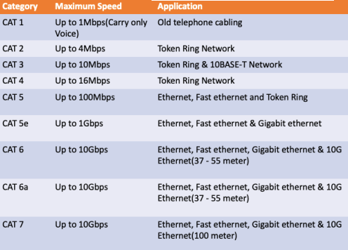
2.1.1.1 Twisted Pair Cable:
Categories of UTP Cable:

Slide 8
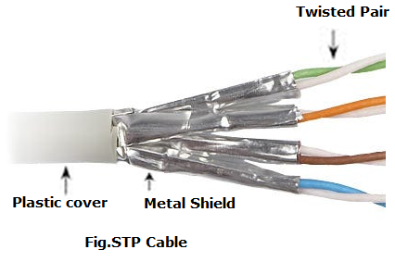
2.1.1.1 Twisted Pair Cable:
2. Shielded Twisted Pair (STP):
STP cable construction is similar with UTP except that STP twisted pairs covered with metal shield and which in turn covered with plastic cover.
The metal shield prevents effect of noise or crosstalk
STP cables are more expensive than UTP cables, and they can be more difficult to install due to the additional shielding layer.

Slide 9
2.1.1.1 Twisted Pair Cable:
2. Shielded Twisted Pair (STP):
Advantages of Shielded Twisted Pair (STP):
Reduces interference
Faster than UTP
Better performance
Disadvantages of Shielded Twisted Pair (STP):
More expensive than UTP
More difficult installation
High cost
Applications of Twisted pair cable:
Twisted-pair cables are used in telephone lines to provide voice and data channels
Twisted pair cables used to connect computers in LANs

Slide 10
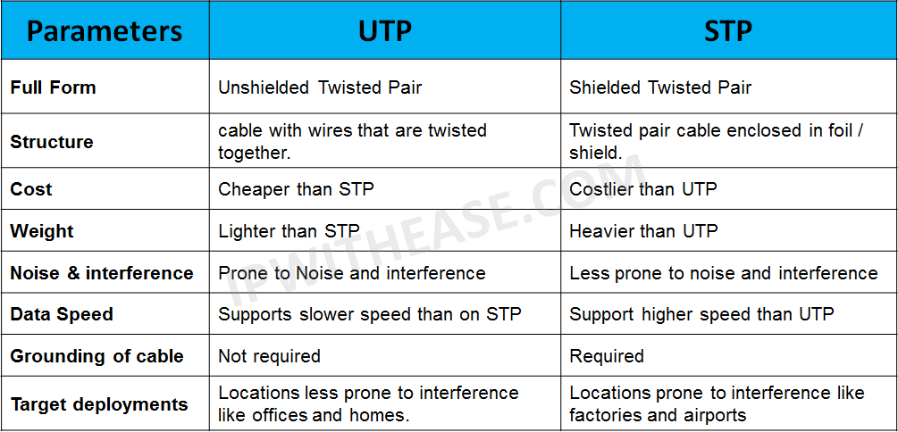
2.1.1.1 Twisted Pair Cable:
Comparison of UTP & STP

Slide 11
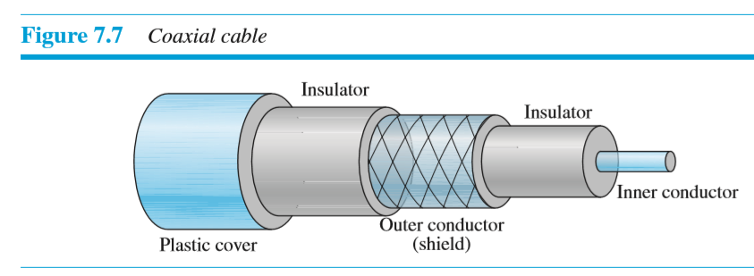
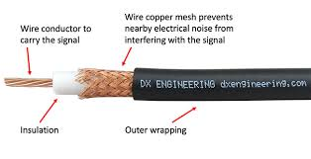
2.1.1.2 Coaxial cable:
The coaxial cables uses copper conductors that carries signals in the form of electric current.
Coaxial cable is so named because it contains two conductors, one conductor inside the other conductor. as shown in fig.7.7
At the center of cable is copper conductor, actually carries electrical signals which is surrounded by an insulating material, which in turn enclosed in outer conductor of metal foil(or copper) which acts as a shield against noise and functions as cables ground ,this outer conductor is also enclosed in an insulating sheath and the whole cable is protected by a plastic cover.

Slide 12
2.1.1.2 Coaxial cable:
Characteristics of Coaxial cable :
Used to transmit both analog & digital signals
Superior frequency as compared to twisted pair
Supports higher frequencies & data rates
Less susceptible to interference.
Advantages of Coaxial cable:
Low cost
Easy to install
Supports high bandwidth
More reliable
Disadvantages of Coaxial cable:
More expensive
Less flexible
Difficult to install
Applications of coaxial cable:
1. Coaxial cable is used in Cable TV networks
2. Coaxial cable is used in Ethernet LANs.

Slide 13
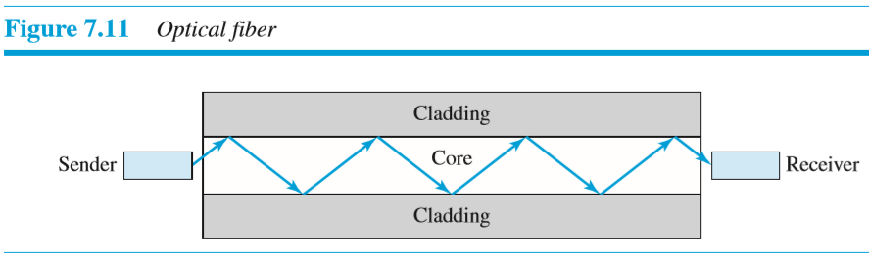
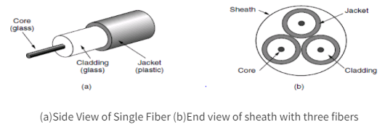
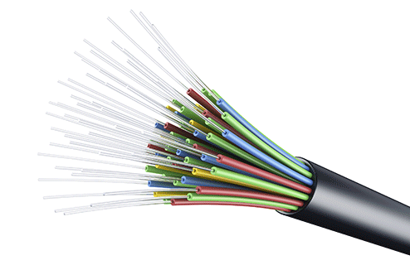
2.1.1.3 Fiber-Optic Cable
It consists of one or more optical fibers that are used to carry signals in the form of light pulse.
A fiber-optic cable is made of glass or plastic and transmits signals in the form of light.
An optical fiber cable consists of:
Core-which carries light signals
Cladding - which is a layer of glass surrounding the core
Coating- This is thin plastic layer surrounds the core
Jacket – which protect the fiber from damage
In optical fiber cable transmitter at a sender side uses LED or laser to send light pulse across the fiber and a receiver at other end makes use of photodiode to detect absence or presence of light to indicate a 0 or a 1.
Light sources for fiber optics:
There are two types of light sources for fiber optics
Light Emitting Diode(LED): It provides unfocused lights, so its useful for short distance communication
Injection Laser Diode(ILD):It provides focused lights, so its useful for long distance communication

Slide 14
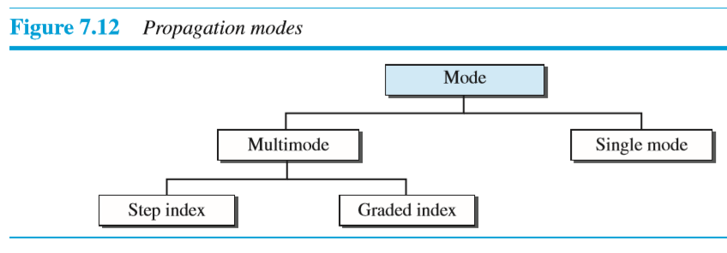
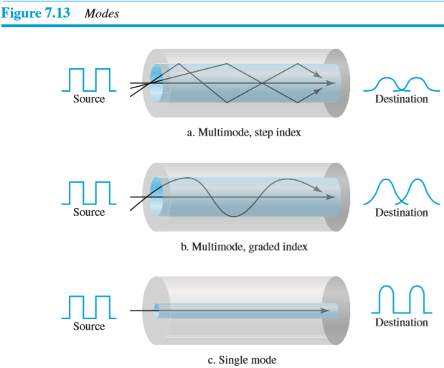
2.1.1.3 Fiber-Optic Cable
Fiber-Optic Cable:
Propagation Modes: describes the distribution of light energy across the fiber.
1. Multi mode fiber:
In multimode fiber, multiple light beams pass through the core in different paths. In this case, the LED is mostly used as a light source.
There are two types of multimode fiber:
1a. Multimode, Step Index Fiber.
In this case, core has one density and cladding has another density
The light rays move through core changes suddenly at the interface of core and cladding, therefore its called step Index.
The multiple beams takes different paths on reflection.
1b. Multimode, Graded Index Fiber.
In this case, the core has different densities. The density is highest at the core and density is gradually decreases towards the edge.
Therefore light beams move through core not changes suddenly, they change in the form of curve.
2. Single Mode Fiber.
In this case, diameter of core is smaller and density of core is lower as compared with multimedia fiber.
In single mode fiber, light follows single path through the core.

Slide 15
2.1.1.3 Fiber-Optic Cable
Advantages of optical fiber cable:
1. The light weight:
Fiber-optic cables are much lighter than copper cables
2. Higher bandwidth:
The Bandwidth of fiber optics cable is more as compared with copper cables.
The Bandwidth means how much data transmitted through a wire.
3. Higher signal carrying capacity:
The fiber optics cable can transmits signal over larger distance (50 km) without requiring regeneration of signals.
In twisted pair or coaxial cable we requires repeaters after every 5 km distance
4. Resistance to noise:
The signal transmitted in the form of light rays rather than electricity, so noise can not affect the fiber-optics cables.
5. Small size
6. Installation is easy

Slide 16
2.1.1.3 Fiber-Optic Cable
Disadvantages of optical fiber cable:
1. Cost is more:
Optical fiber is expensive than copper cable because the laser light sources are very costly as compared to electrical signal generator
2. Installation and maintenance:
Fiber optic cable is a relatively new technology.
Installation and maintenance requires expertise that is not yet available everywhere.
3. Unidirectional light propagation:
Propagation of light is unidirectional, If we need bidirectional communication, two fibers are needed.
4. Fragility:
The optical fiber is more delicate than twisted pair and coaxial cable, so the chances of its breaking are more.
Applications of optical fiber cable
It is used for high speed data transmission.
It is used in telephone systems
Its used in LAN'S
Its used in WANS
Data Storage
Medical
Defense/Government

Slide 17
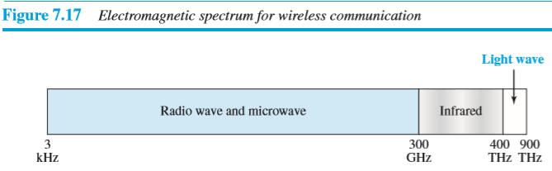
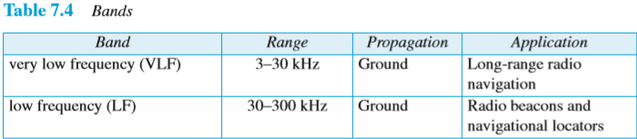
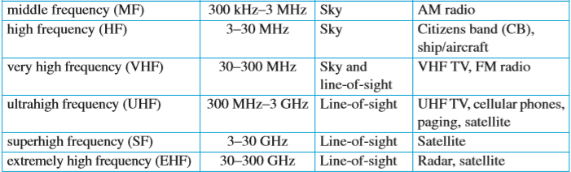
2.1.2 Unguided Media(Wireless Transmission)
In unguided media the signal is transmitted in the form of electromagnetic waves without using a physical conductor.
The signal is transmitted through air or water
Figure 7.17 shows the part of the electromagnetic spectrum, ranging from 3 kHz to 900 THz, used for wireless communication
We can divide wireless transmission into four broad groups:
Radio waves,
Microwaves
Infrared waves.
Satellite

Slide 18
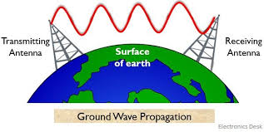
2.1.2 Unguided Media(Wireless Transmission)
Wireless signals can be sent or propagated in following 3 ways:
1.Ground-wave propagation:
In ground wave propagation , radio waves from transmitting antenna travels along the surface of earth and reach at receiving antenna.
Radio waves travel through the lowest portion of the atmosphere
These low-frequency signals travels in all directions from the
transmitting antenna
Characteristics of Ground-wave propagation:
1.Can propagate considerable distance.
2. Frequencies up to 2 MHz
Advantages of Ground-wave propagation:
1. Excellent Reliability
2. Enough Transmitting power.
Disadvantages of Ground-wave propagation:
1. Can be used for short distance
2. Gathers noise while transmitting
3. Limited no of transmitters can be used.

Slide 19
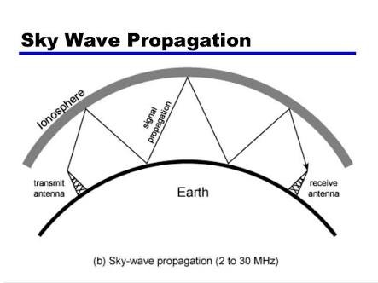
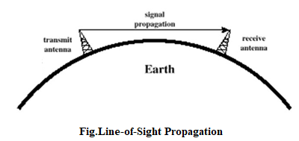
2.1.2 Unguided Media(Wireless Transmission)
2. Sky-wave propagation:
In sky propagation, higher-frequency radio waves radiate upward
into the ionosphere (the layer of atmosphere where particles exist
as ions) where they are reflected back to earth
Characteristics of Sky Wave Propagation:
1. Signal reflected from ionized layer of atmosphere back down to
earth.
2. Signal can travel a number of hops, back and forth between
ionosphere and earths surface.
3. Line-of-sight propagation:
In line-of-sight propagation, very high-frequency signals
are transmitted in straight lines directly from antenna to antenna
Example: FM Radio,Microwave

Slide 20
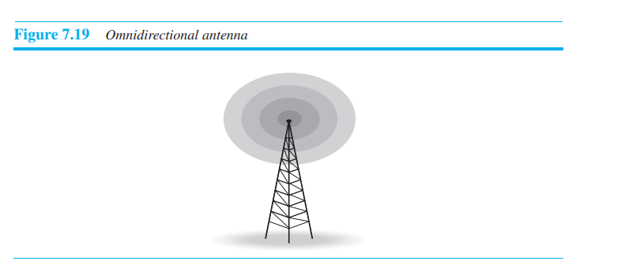
2.1.2.1 Radio Wave Transmission
Electromagnetic waves with frequencies range between 3 kHz and 1 GHz are normally called Radio Waves
Radio waves are omnidirectional-When an antenna transmits radio waves, they are propagated in all directions.
Radio waves are low and medium frequencies, can penetrate walls.
Radio waves, propagate in the sky mode, can travel long distances.
Radio waves use omnidirectional antennas that send out signals in
all directions.
Radio waves useful for multicasting, in which there is one sender
and many receivers
Applications:
AM and FM radio, Television, Mobile phone and wireless LAN
Advantages:
1.Simpler,Cheaper,High Speed
Disadvantages:
1.Limited no of Free frequency band
2.More power consumption

Slide 21
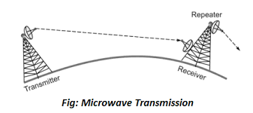
2.1.2.2. Microwave Transmission
Electromagnetic waves with frequencies range between 1 GHz and 300 GHz are called Microwaves.
Microwaves are unidirectional i.e. microwave signals travels in only one direction at a time, this means for two way communication two frequencies are need to be allocated.
Microwaves uses line of sight propagation, therefore the two antennas must be in a straight line without any obstacle in between them.
The distance travelled by wave depends on height of antennas . If the height of antenna is more, then distance travelled by wave is more . generally, antennas are positioned on mountains, tall buildings to avoid the obstacles.
Repeaters are needed for long distance communication
The data rates of microwave communication are 1 mbps to 10 Gbps
Microwave communication is relatively inexpensive than fiber optics communication.
Installation is difficult , because it require line of sight propagation.
Microwaves need unidirectional antennas that send out signals in one direction.
Microwaves communication is used for unicast communication (i.e. one to one communication between Sender and Receiver)
Applications:
Mobile phones, satellite networks, and wireless LANs.
Advantages:
Carries high quantities of information ,Low Cost , High frequency.
Disadvantages:
Attenuation by solid objects: birds , rain , snow.
Reflected from flat surface like water or metal.

Slide 22
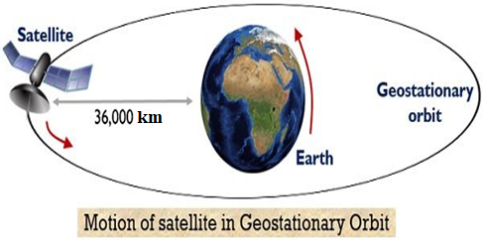
2.1.2.3 Satellite Communication
Satellites operate in three different orbits:
Low Earth orbit (LEO)-
LEO satellites are positioned at 160 km and 1,600 km above Earth
It takes 20 or more LEO satellites to cover the entire Earth
Medium Earth orbit (MEO)
MEO satellites positioned at 10,000 to 20,000 km above Earth.
It takes 10 or more MEO satellites to cover the entire Earth
Geostationary or geosynchronous orbit (GEO).
GEO satellites are positioned at 35,786 km above Earth, where they complete one orbit in 24 hours and thus remain fixed over one spot.
It only takes 3 GEO satellites to cover the entire Earth
LEO or MEO satellites are used for mobile and voice services
GEO satellites are used for broadcasting and data applications
The satellite functions of both antenna and repeaters.
The installation of satellite is difficult
The satellite communication is costly as compared with microwave communication.

Slide 23
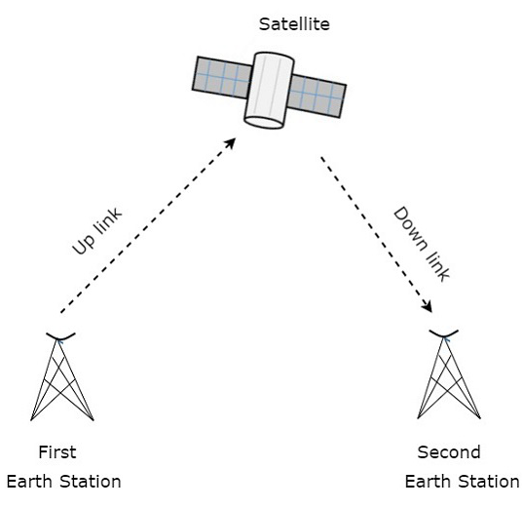
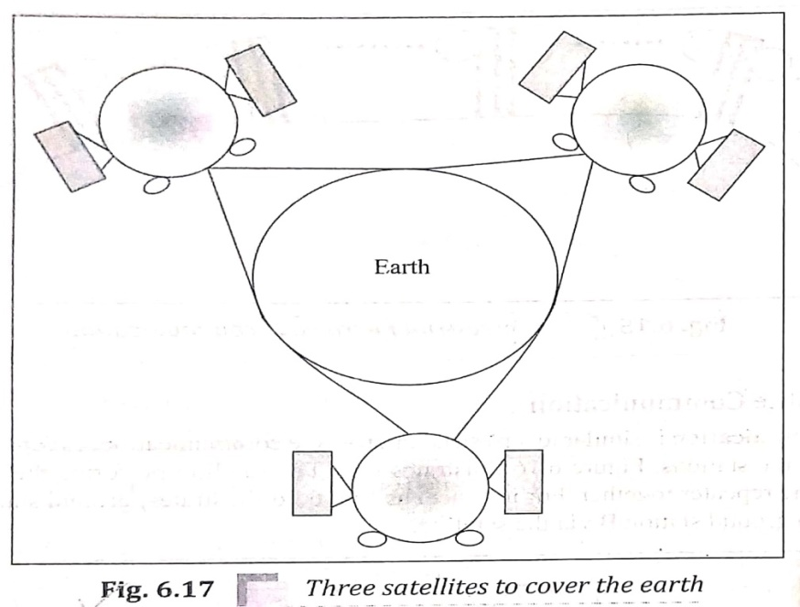
2.1.2.3 Satellite Communication
Satellite communication is transporting information from one place to another using a communication satellite in orbit around the Earth.
Normally Super High Frequency (SHF) range from 3GHz to 30GHz is used for Satellite Communication.
The satellite functions of both antenna and repeaters.
Frequency bands are used for transmitting signal from earth station to satellite called uplink frequency(6 GHz) and
Frequency bands are used for transmitting signal from satellite to earth station called downlink frequency(4 GHz)
Using satellite we can communicate from any part of world to any other part of world, but minimum three satellites are needed to cover entire earth’s surface as shown in the fig.6.17

Slide 24
2.1.2.3 Satellite Communication
Applications of Satellite Communication
Radio broadcasting and voice communications
TV broadcasting such as Direct To Home (DTH)
Internet applications such as providing Internet connection for data transfer, GPS applications, Internet surfing, etc.
Military applications and navigations
Remote sensing applications
Weather condition monitoring and Forecasting

Slide 25
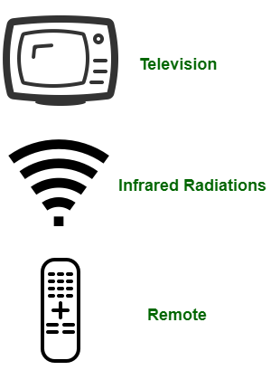
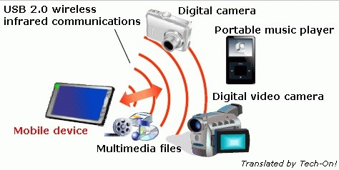
2.1.2.4 Infrared Transmission
Electromagnetic waves with frequencies from 300 GHz to 400 THz are called Infrared waves.
Infrared waves used for short-range communication.
Infrared waves uses line-of-sight propagation
Infrared waves cannot penetrate solid objects like walls.
When we use our infrared remote control, we do not interfere with the use of the remote by our neighbors.
Applications:
1.Television remote controls
2.Security control

Slide 26
Difference Between Guided and Unguided Media
Guided Media | Unguided Media
The guided media is also called wired communication or bounded transmission media. | The unguided media is also called wireless communication or unbounded transmission media.
Signals are in the form of voltage or current in the guided media. | Signals are in the form of electromagnetic waves in unguided media.
The signal propagates through wires in guided media. | The signal propagates through the air in unguided media.
Examples of guided media are twisted pair cables, coaxial cables, and optical fiber cables. | Examples of unguided media are radio wave, microwave and infrared light
It is cost is less. | It is costly.

Slide 27
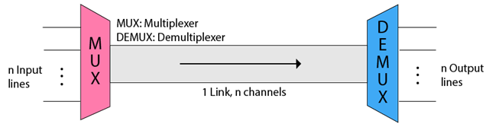
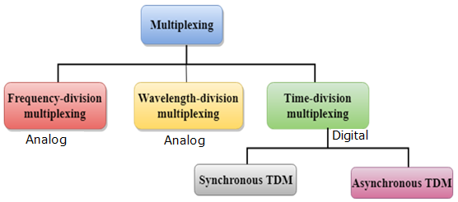
2.3 Multiplexing
Multiplexing is the set of techniques that allow the simultaneous transmission of multiple signals across a single data link.
Multiplexing is a way of transmitting multiple signals over a single media.
Concept of Multiplexing:
Multiplexing is achieved by using a device called Multiplexer (MUX) that combines multiple input lines to generate a single output line. (i.e. n inputs and one output).
Demultiplexing is achieved by using a device called Demultiplexer (DEMUX) that separates a single input line into multiple output lines (i.e one input and n outputs).
The 'n' input lines are transmitted through a multiplexer and multiplexer combines the multiple signals to form a single composite signal.
The composite signal is passed through a demultiplexer and demultiplexer separates a composite signal to its component signals and transfers them to their respective destinations.
There are three basic multiplexing techniques: frequency-division multiplexing, wavelength-division multiplexing, and time-division multiplexing. The first two are techniques designed for analog signals, the third, for digital signals.
Fig. Concept of Multiplexing
Fig. Types of Multiplexing

Slide 28
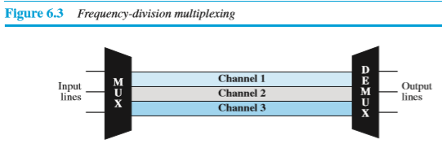
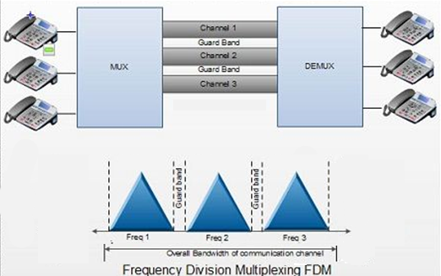
2.3.1 Multiplexing: FDM
1. Frequency-Division Multiplexing (FDM):
In FDM, multiple signals are sent simultaneously by allocating separate frequency bands or channels to each signal.
In FDM, the total available bandwidth of a communication medium is divided into a series of non-overlapping frequency bands or channels, each of which is used to carry a separate signal.
This allows a single transmission medium such as a microwave link or optical fiber to be shared by multiple independent signals.
Channels are separated by unused frequency bands called guard bands that avoids signals from overlapping with each other.
Radio and Television transmission are most common examples of FDM ,in which multiple radio signals at various frequencies travel through the air at the same time.
Cable television is another example of FDM , in which many television channels are carried simultaneously on a single cable.

Slide 29
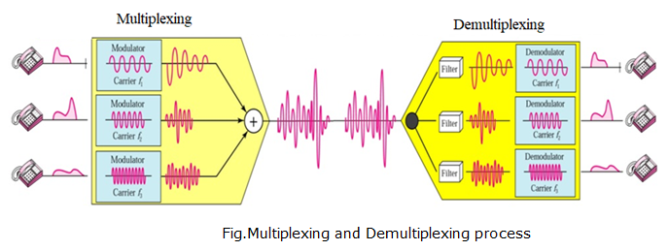
2.3.1 Multiplexing: FDM
1. Frequency-Division Multiplexing (FDM):
FDM is an analog multiplexing technique that combines analog signals.
Multiplexing Process :
Each source generates a signal of a similar frequency range. Inside the multiplexer, these similar signals modulate different carrier frequencies ( f1, f2, and f3). The resulting modulated signals are then combined into a single composite signal that is sent out over a media link that has enough bandwidth to accommodate it.
Demultiplexing Process :
The demultiplexer uses a series of filters to decompose the multiplexed signal into its constituent component signals. The individual signals are then passed to a demodulator that separates them from their carriers and passes them to the output lines.

Slide 30
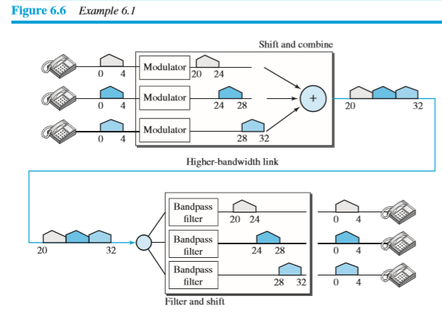
2.3.1 Multiplexing: FDM
Example 6.1 Assume that a voice channel occupies a bandwidth of 4 kHz. We need to combine three voice channels into a link with a bandwidth of 12 kHz, from 20 to 32 kHz. Show the configuration, using the frequency domain. Assume there are no guard bands.
Solution: We modulate each of the three
voice channels to a different bandwidth, as shown in Figure 6.6. We use the 20- to 24-kHz bandwidth for the first channel, the 24- to 28-kHz bandwidth for the second channel, and the 28- to 32-kHz bandwidth for the third one. Then we combine them as shown in Figure 6.6.
At the receiver, each channel receives the entire signal, using a filter to separate out its own signal. The first channel uses a filter that passes frequencies between 20 and 24 kHz and filters out (discards) any other frequencies. The second channel uses a filter that passes frequencies between 24 and 28 kHz, and the third channel uses a filter that passes frequencies between 28 and 32 kHz. Each channel then shifts the frequency to start from zero.

Slide 31
2.3.1 Multiplexing: FDM
Advantages Of FDM:
1.FDM is used for analog signals.
2.FDM process is very simple and easy modulation.
3.A Large number of signals can be sent through an FDM simultaneously.
4.It does not require any synchronization between sender and receiver.
Disadvantages Of FDM:
1.FDM technique is used only when low-speed channels are required.
2.It suffers the problem of crosstalk.
3.A Large number of modulators are required.
4.It requires a high bandwidth channel.
Applications Of FDM:
1.FDM was used in first generation mobile phones
2.FDM is used in television broadcasting
3.FDM is used in FM and AM radio broadcasting

Slide 32
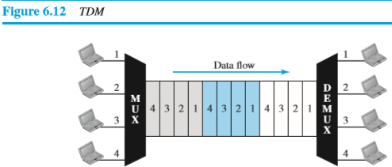
2.3.2 Multiplexing: TDM
2. Time Division Multiplexing (TDM):
In TDM, the total time available in the channel is divided into multiple time slots ,each time slot is allocated to different user and within that time slot each user transmits their data.
A user takes control of the channel for a fixed amount of time.
In TDM, data is not transmitted simultaneously rather the data is transmitted one-by-one.
Time slots are grouped into frames. A frame consists of one complete cycle of time slots, with one slot dedicated to each sending device.
If we have n devices, a frame is divided into n time slots and one slot is allocated for each device.
It can be used to multiplex both digital and analog signals but mainly used to multiplex digital signals.

Slide 33
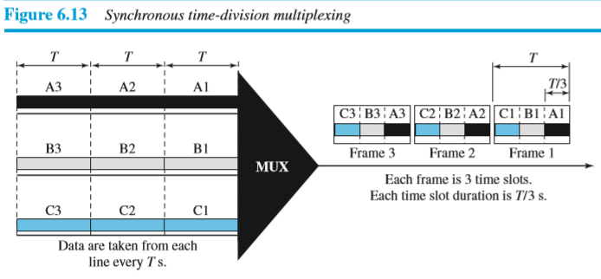
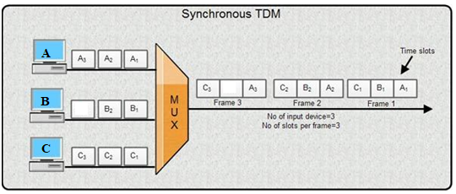
2.3.2 Multiplexing: TDM
There are two types of TDM:
1.Synchronous TDM
2. Asynchronous TDM(Statistical TDM)
1. Synchronous TDM:
In Synchronous TDM time slot is pre-assigned to every device.
Time slots are grouped into frames. A frame consists of one complete cycle of time slots, with one slot dedicated to each sending device.
If we have n devices , a frame is divided into n time slots and one slot is allocated for each device
In Synchronous TDM, each device is given fixed time slot. If the device does not have any data, then the slot will remain empty.
The most popular Synchronous TDM are T-1 multiplexing, ISDN multiplexing, and SONET multiplexing.

Slide 34
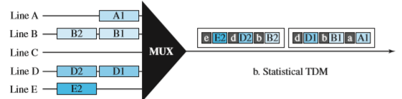
2.3.2 Multiplexing: TDM
Asynchronous TDM (Statistical TDM) :
In Asynchronous TDM ,time slots are dynamically allocated to improve bandwidth efficiency.
In Asynchronous TDM time slots are not fixed as in the case of Synchronous TDM.
Time slots are allocated to only those devices which have the data to send.

Slide 35
Difference Between FDM and TDM
FDM | TDM
FDM stands for Frequency Division Multiplexing | TDM stands for Time Division Multiplexing
FDM divides the channel into frequency bands | TDM divides the channel into time slots
FDM is used to multiplex Analog signals | TDM is used to multiplex Digital signals
In FDM Synchronization pulse is not required | In TDM Synchronization pulse is required as time slot is pre-assigned
In FDM Guard band is required | In TDM Guard band is not required
FDM is less efficient | TDM is more efficient
FDM is used in Radio and Television broadcasting, first generation mobile phones,. | TDM is used in ISDN(Integrated Services Digital Network), PSTN(Public Switched Telephone Network)

Slide 36
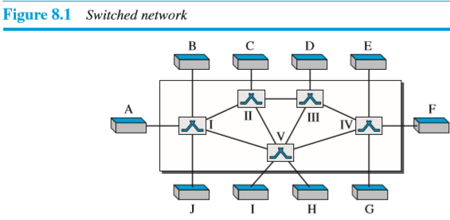
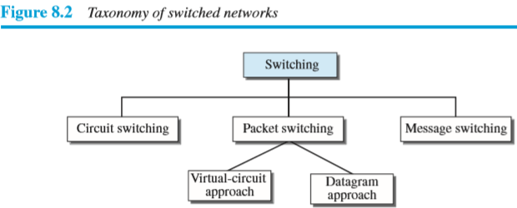
2.4 Switching
Switching is the process of transferring data packets from one device to another in a network, or from one network to another, using specific devices called switches
A switched network consists of a series of interlinked nodes, called switches.
Switches are devices capable of creating temporary connections between two or more devices linked to the switch.
In a switched network, some of these nodes are connected to the end systems (computers or telephones, for example). Others are used only for routing
Figure 8.1 shows a switched network.
The end systems (communicating devices) are labeled A, B, C, D, and so on, and the switches are labeled I, II, III, IV, and V. Each switch is connected to multiple links

Slide 37
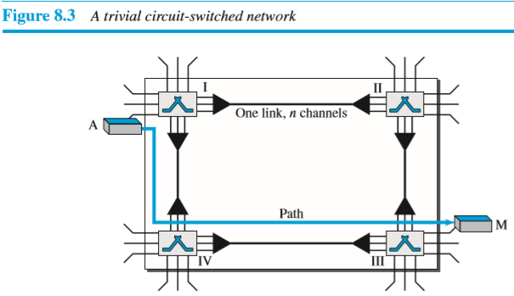
2.4.1 Circuit Switching
Circuit Switching:
A network consists of a set of switches that are connected by the physical links commonly known as Circuit-Switched Network.
In circuit-switching a dedicated circuit/path is established between the sending and receiving device before data transmission begins.
When end system A needs to communicate with end system M, system A needs to request a connection to M that must be accepted by all switches as well as by M itself. This is called the setup phase in which a circuit is reserved on each link, and the combination of circuits defines the dedicated path. After the establishment of dedicated path , the data-transfer can take place. After all data has been transferred, the circuits are tear down.
The Circuit switching takes place at the physical layer
The Circuit Switching is used in the public telephone network for voice communication as well as for data communication

Slide 38
2.4.1 Circuit Switching
Circuit Switching:
Three Phases: The communication in a circuit-switched network requires three phases:
1. Setup Phase : Before the two parties can communicate, a dedicated circuit is established between two parties with the help of intermediate switches.
2. Data Transfer Phase: After the establishment of the dedicated circuit, the two parties can transfer data.
3. Teardown Phase: When one of the parties needs to disconnect, a signal is sent to each switch to release the resources.
In circuit switching, the resources need to be reserved during the setup phase; the resources remain dedicated for the entire duration of data transfer until the teardown phase.
One of the best examples of Circuit switching is a telephone. Suppose there are two persons, Person A and Person B; they both want to communicate with each other
Person A makes a call to Person B this phase is the setup phase of circuit switching.
After the establishment of the connection and after call pick up by Person B; they both can communicate with each other. This is the data transfer phase of Circuit switching
Once the communication is complete one of them can cut the call or break the connection. This is a teardown phase.

Slide 39
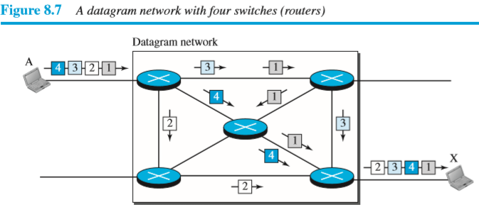
2.4.2 Packet Switching
Packet Switching:
In Packet switching, the message is divided into packets of fixed size or variable size .Each packet is then transmitted and can take different routes to reach its destination.
Each packet contains a header which includes the source address, destination address, and control information.
In a packet-switched network, there is no resource reservation; resources are allocated on demand.
Best example of packet-switching is the Internet.
There are two types of packet-switched networks:
1.Datagram networks
2.Virtual circuit networks.
1. Datagram networks(Connectionless networks):
In a datagram network, each packet is treated independently of all others
In Datagram Switching, the packet is known as a datagram.
Datagram switching is normally done at the network layer.
Figure 8.7 shows how the datagram approach is used to deliver four packets
from source A to destination X. In this example , all four packets
(or datagrams) belong to the same message, but may travel different paths
to reach their destination. This approach can cause the datagrams of a
transmission to arrive at their destination out of order with different delays
between the packets. Packets may also be lost or dropped because of a lack
of resources.

Slide 40
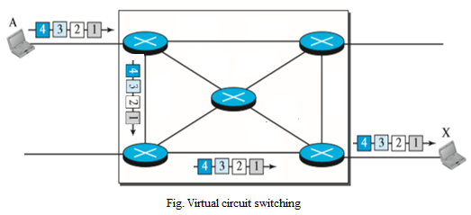
2.4.2 Packet Switching
2. Virtual Circuit network (connection-oriented network ):
A Virtual-circuit network is a combination of a circuit-switched network and a datagram network
In Virtual-circuit switching, a logical connection between the source and destination is established before transmitting any data.
These logical connections are called virtual circuits.
Each data packet follows these same logical paths and provides a reliable way of transmitting data with less chance of data loss.

Slide 41
Difference Between Circuit Switching and Packet Switching
Circuit Switching | Packet Switching
In circuit switching there is dedicated path is established between sending and receiving device. | In packet switching no dedicated path is established between sending and receiving device
All packets uses same path to reach destination | Each packet may take different path to reach destination
Circuit switching is more reliable | Packet switching is less reliable
The circuit switching network is implemented at the physical layer. | Packet switching is implemented at the data link layer and network layer
It can not support store and forward transmission | Support store and forward transmission
circuit switching designed for voice transmission | packet switching designed for data transmission

Slide 42
Thank You

