Slide 1
Chapter 2
Array ,Function and String

Slide 2
Array
JavaScript arrays are used to store multiple values in a single variable.
It is often used when we want to store list of elements and access them by a single variable.
An array in JavaScript can hold different elements
We can store Numbers, Strings and Boolean in a single array.
Example:
// Storing number, boolean, strings in an Array
var house = ["1BHK", 25000, "2BHK", 50000, "Rent", true];

Slide 3
The following example shows how to define and initialize an array using array literal syntax.
Example: Declare and Initialize JS Array
var stringArray = ["one", "two", "three"];
var numericArray = [1, 2, 3, 4];
var decimalArray = [1.1, 1.2, 1.3];
var booleanArray = [true, false, false, true];
var mixedArray = [1, "two", "three", 4];

Slide 4
There are 3 ways to declare array in JavaScript
By array literal
By creating instance of Array directly
By using an Array constructor (using new keyword)

Slide 5
1) Array literal It takes a list of values separated by a command enclosed in square brackets. The syntax of creating array using array literal is given below:
var arrayname=[value1,value2.....valueN];
Example
<script>
var emp=[“Yash","Vishal","Rahul"];
for (i=0;i<emp.length;i++){
document.write(emp[i] + "<br/>");
}
</script>
The .length property returns the length of an array.
Output :
Yash
Vishal
Rahul

Slide 6
2) Creating instance of Array directly
Syntax:
var arrayname=new Array();
Or
var arrayname=new Array(size);
Here, new keyword is used to create instance of array. We can allocate the memory dynamically for the arrays.
Example :
<script>
var i;
var emp = new Array();
emp[0] = "Aditya";
emp[1] = "Varun";
emp[2] = “Yash";
for (i=0;i<emp.length;i++){
document.write(emp[i] + "<br>");
}
</script>
Output:
Aditya
Varun
Yash

Slide 7
3) Using array constructor (new keyword)
Here, you need to create instance of array by passing arguments in constructor so that we don't have to provide value explicitly.
Syntax :
var arrayName = new Array(element1, element2, element3,... elementN);
Example:
<script>
var emp=new Array(“Tony",“Thor","Steve");
for (i=0;i<emp.length;i++){
document.write(emp[i] + "<br>");
}
</script>
Output:
Tony
Thor
Steve

Slide 8
Accessing Array Elements
An array elements (values) can be accessed using index (key). Specify an index in square bracket with array name to access the element at particular index. Please note that index of an array starts from zero in JavaScript.
Example: Access Array Elements
var stringArray = new Array("one", "two", "three", "four");
stringArray[0]; // returns "one"
stringArray[1]; // returns "two"
stringArray[2]; // returns "three"
stringArray[3]; // returns "four"
var numericArray = [1, 2, 3, 4];
numericArray[0]; // returns 1
numericArray[1]; // returns 2
numericArray[2]; // returns 3
numericArray[3]; // returns 4

Slide 9
Array program
<html>
<head>
<title>Program for array</title>
</head>
<body>
<script>
var c=[10,20,30];
for(i=0;i<=2;i++)
{
document.write(c[i]);
}
</script>
</body>
</html>
Output:
102030

Slide 10
Array program
<html>
<head>
<title>Program for array</title>
</head>
<body>
<script>
var c=[10,20,30];
for(i=0;i<=2;i++)
{
document.write(c[i]+"<br/>");
}
</script>
</body>
</html>
Output:
10
20
30

Slide 11
Write a Java script that initializes an array called flowers with the names of 3 flowers. The script then displays array elements.
<html>
<head><title>Display Array Elements</title></head>
<body>
<script>
var flowers = new Array();
flowers[0] = 'Rose ';
flowers[1] = 'Mogra';
flowers[2] = 'Hibiscus';
for (var i = 0; i < flowers.length; i++)
{
document.write(flowers[i] + '<br>');
}
</script>
</body>
</html>

Slide 12
Replace an element:
var fruits = ["Apple", "Orange", "Plum"];
Now replace plum by pear
fruits[2] = 'Pear'; // now new array is ["Apple", "Orange", "Pear"]
Add a new element to the array:
fruits[3] = ‘Mango'; // now ["Apple", "Orange", "Pear", “Mango"]
The total count of the elements in the array is its length:
let fruits = ["Apple", "Orange", "Plum"];
alert( fruits.length ); // 3
We can also use alert to show the whole array.
let fruits = ["Apple", "Orange", "Plum"];
alert( fruits ); // Apple,Orange,Plum

Slide 13
Write a Java script program which computes, the average marks of the following students then, this average is used to determine the corresponding grade.
Student Name Marks
Sumit 80
Kalpesh 77
Amit 88
Tejas 93
Abhishek 65
The grades are computed as follows :
Range Grade
<60 E
<70 D
<80 C
<90 B
<100 A

Slide 14
<html>
<head>
<title>Compute the average marks and grade</title>
</head>
<body>
<script>
var students = [['Sumit', 80], ['Kalpesh', 77], ['Amit', 88], ['Tejas', 93], ['Abhishek', 65]];
var Avgmarks = 0;
for (var i=0; i < students.length; i++) {
Avgmarks += students[i][1];
}
var avg = (Avgmarks/students.length);
document.write("Average grade: " + (Avgmarks)/students.length);
document.write("<br>");
if (avg < 60){

Slide 15
document.write("Grade : E");
}
else if (avg < 70) {
document.write("Grade : D");
}
else if (avg < 80) {
document.write("Grade : C");
} else if (avg < 90) {
document.write("Grade : B");
} else if (avg < 100) {
document.write("Grade : A");
}
</script>
</body>
</html>
Output
Average grade: 80.6
Grade : B

Slide 16
JS to find the length of array
<html>
<head>
<title>Length of Array </title>
</head>
<body>
<script>
a=new Array (10,20,30,40,50);//Creation of array
var len=a.length; //length property
document.write(“The length of an array is : “+len);
</script>
</body>
</html>
Output:
The length of an array is :5

Slide 17
Adding an array element
We can add the element in the array at the end. This increases the size of the array.
<script>
a=new Array (11,22,33,44,55,66);
document.write(“The elements in the array are: <br/>”);
for(i=0;i<a.length;i++)
{
document.write(a[i] +” ”);
}
document.write(“<br/><br/>The element is added in the array : <br/>”);
a[a.length]=77;
document.write(“<br/><br/>Now the elements in the array are: <br/>”);
for(i=0;i<a.length;i++)
{
document.write(a[i] +” ”);
}
</script>

Slide 18
Looping an array
<script>
Days=new Array ();
Days[0]=“Sunday”;
Days[1]=“Monday”;
Days[2]=“Tuesday”;
Days[3]=“Wednesday”;
Days[4]=“Thursday”;
Days[5]=“Friday”;
Days[6]=“Saturday”;
for(var i=0;i<Days.length;i++)
{
document.write(Days[i] +”<br/>”);
}
</script>
Output:
Sunday
Monday
Tuesday
Wednesday
Thursday
Friday
Saturday

Slide 19
Sorting an array element
The elements can be sorted in ascending order using the built in function sort. The sort() method calls the string casting method on every array element either it is integer,float or string.
Syntax:
arrayname.sort()
<script>
a=new Array (25,9,16,36,4,49);
document.write(“The elements in the array are: <br/>”);
for(i=0;i<a.length;i++)
{
document.write(a[i] +” ”);
}
document.write(“<br/><br/>The array is sorted…. <br/>”);
a.sort();
document.write(“<br/><br/>Now the elements in the array are: <br/>”);
for(i=0;i<a.length;i++)
{
document.write(a[i] +” ”);
}
</script>

Slide 20
Write a Java Script code to display 5 elements of array in sorted order.
<html>
<body>
<script>
var arr1 = [ “Red”, “red”, “Blue”, “Green”]
document.write(“Before sorting arr1=” + arr1);
result=arr1.sort()
document.write(“<br>After sorting arr1=” +result);
</script>
</body>
</html>
Output:
Blue, Green, Red, red

Slide 21
<html>
<body>
<script>
var array =[5,1,9,7,5];
// sorting the array
result = array.sort();
document.write(result);
</script>
</body>
</html>
Output:

Slide 22
Combining array elements into string
There are 2 functions for combining array elements into string:
1) join() 2) concat()
1) The join() method returns the array as a string.
The elements will be separated by a specified separator. The default separator is comma (,)
But you can specify a character other than a comma to separate values.
Syntax
array.join(separator)

Slide 23
<html>
<head>
<title>Array Example</title>
</head>
<body>
<script>
var arr = [1, 2, 3, 4, 5, 6 ];
document.write(arr.join('|'));
</script>
</body>
</html>
Output
1|2|3|4|5|6

Slide 24
concat() Method
The concat() method is used to join two or more arrays
Syntax
array1.concat(array2, array3, ..., arrayX)
Example:
var color = [“red", “blue"];
var color1 = [“green", “yellow", “black"];
var color2 = [“pink"];
var children = color.concat(color1,color2);
Output:
red, blue, green, yellow, black, pink

Slide 25
<html>
<head><title>Array Example</title> </head>
<body>
<script>
var arr1 = ["C", "C++", "Python"];
var arr2 = ["Java", "JavaScript", "Android"];
var result = arr1.concat(arr2);
document.write(result);
</script>
</body>
</html>
Output
C, C++, Python, Java, JavaScript, Android

Slide 26
Program
<script>
a=new Array(“red”, ”blue”, ”orange”, ”green”, ”black” );
document.write(“The join() method result <br/>”);
var str1=a.join(“ “);
document.write(str1);
document.write(“The concat() method result <br/>”);
var str2=a.concat();
document.write(str2);
</script>
Output:
The join() method result
red blue orange green black
The concat() method result
red,blue,orange,green,black

Slide 27
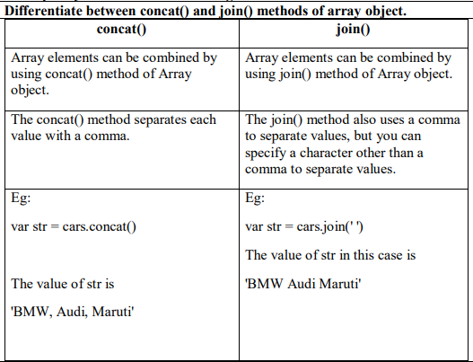

Slide 28
Changing elements of an array
There are various methods that help in changing the elements of array.
shift()Method
push() Method
pop() Method
reverse() Method
unshift() Method
slice() Method

Slide 29
shift() Method
The shift() method removes the first element of an array.
Syntax
array.shift()

Slide 30
Program for shift() method
<script>
a=new Array(10,20,30,40,50 );
document.write(“The removed element using shift() method is <br/>”);
var num=a.shift();
document.write(num);
document.write(“The elements in array are:<br/>”);
for(i=0;i<a.length;i++)
document.write(a[i]+” ”);
</script>
Output:
The removed element using shift() method is
10
The elements in array are:
20 30 40 50

Slide 31
html>
<head><title>Changing Array Demo</title></head>
<body>
<script >
a=new Array();
a[0]=10
a[1]=20
a[2]=30
a[3]=40
a[4]=50
document.write("<h4> The shift() method</h4>");
var num=a.shift();
document.write(num);
document.write("<h4>The elements in array are ...</h4>");
for(i=0;i<a.length;i++)
document.write(a[i]+" ");
</script>
</body>
</html>
Output
The shift() method
10
The elements in array are ...
20 30 40 50

Slide 32
unshift() Method
The unshift() method adds new items to the beginning of an array, and returns the new length.
Syntax
array.unshift(item1, item2, ..., item n)

Slide 33
Program
<script>
var arr=["AngularJS","Node.js"];
document.write("Length before invoking unshift(): "+arr.length+"<br>");
arr.unshift("JQuery","Bootstrap");
document.write("Length after invoking unshift(): "+arr.length+"<br>");
document.write("Updated array: "+arr);
</script>
Output:
Length before invoking unshift(): 2
Length after invoking unshift(): 4
Updated array: JQuery,Bootstrap,AngularJS,Node.js

Slide 34
<html>
<head> <title>Array Example</title> </head>
<body>
<script>
var emp = ["Ravi","Lalit","Shiva"];
emp.unshift("Prashant");
for (i=0; i<emp.length; i++)
{
document.write(emp[i] + "<br/>");
}
</script>
</body>
</html>
Output
Prashant
Ravi
Lalit
Shiva

Slide 35
push() Method
The push() method adds new items to the end of an array, and returns the new length.
Syntax
array.push(item1, item2, ..., itemX)

Slide 36
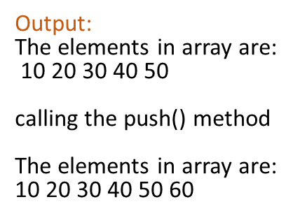
Program on push() method
<script>
a=new Array(10,20,30,40,50 );
document.write(“The elements in array are:<br/>”);
for(i=0;i<a.length;i++)
document.write(a[i]+” ”);
document.write(“calling the push() method <br/>”);
a.push(60);
document.write(“Now the elements in array are:<br/>”);
for(i=0;i<a.length;i++)
document.write(a[i]+” ”);
</script>

Slide 37
<html>
<head><title>Array Example</title> </head>
<body>
<script>
var emp = ["Ravi","Lalit","Shiva"];
emp.push("Prashant");
for (i=0; i<emp.length; i++)
{
document.write(emp[i] + "<br/>");
}
</script>
</body>
</html>
Output
Ravi
Lalit
Shiva
Prashant

Slide 38
<html>
<head><title> Array </title></head>
<body>
<script>
var items = new Array();
items[0] = "One";
items[1] = "Two";
items[2] = "Three";
items[3] = "Four";
items.push("Five");
items.push("Six", "Seven");
items.unshift("Zero");
items[items.length]="Eight";
items[items.length]="Nine";
for (i=0;i<items.length;i++)
{
document.write(items[i] + " ");
}
</script>
</body>
</html>
Output:
Zero One Two Three Four Five Six Seven Eight Nine

Slide 39
pop() Method
The pop() method removes the last element of an array, and returns that element.
Syntax
array.pop()

Slide 40
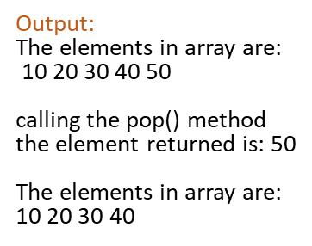
Program on pop() method
<script>
a=new Array(10,20,30,40,50 );
document.write(“The elements in array are:<br/>”);
For(i=0;i<a.length;i++)
document.write(a[i]+” ”);
document.write(“calling the pop() method <br/>”);
var b=a.pop();
document.write(“the element returned is:”+b);
document.write(“<br/>Now the elements in array are:<br/>”);
for(i=0;i<a.length;i++)
document.write(a[i]+” ”);
</script>

Slide 41
<html>
<title> Array </title></head>
<body>
<script>
var items = new Array(3);
items[0] = "One";
items[1] = "Two";
items[2] = "Three";
items.pop();
for (i=0;i<items.length;i++)
{
document.write(items[i] + " ");
}
</script>
</body>
Output:
One Two

Slide 42
reverse() Method
The reverse() method reverses the order of the elements in an array.
Syntax
array.reverse()

Slide 43
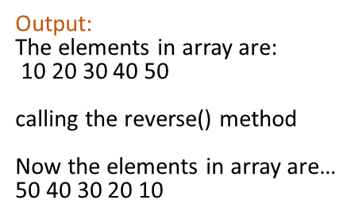
Program on reverse() method
<script>
a=new Array(10,20,30,40,50 );
document.write(“The elements in array are:<br/>”);
for(i=0;i< a.length; i++)
document.write(a[i]+” ”);
document.write(“calling the reverse() method <br/>”);
a. reverse();
document.write(“<br/>Now the elements in array are…<br/>”);
for(i=0;i< a.length; i++)
document.write(a[i]+” ”);
</script>

Slide 44
slice() Method
The slice() method returns the selected elements in an array, as a new array object, but does not include, the element indicated by end argument.
If start is negative, it is treated as length+start
If end is negative, it is treated as length+end
If end is omitted,extraction continues to the end of arrayobj
−1 indicates the last element, −2 indicates the next from the last element, and so on.
Syntax
array.slice(start, end)

Slide 45
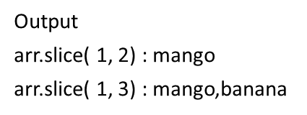
Program on slice() method
<html>
<head>
<title>JavaScript Array slice Method</title>
</head>
<body>
<script type = "text/javascript">
var arr = ["orange", "mango", "banana", “grapes", “apple"];
document.write("arr.slice( 1, 2) : " + arr.slice( 1, 2) );
document.write("<br />arr.slice( 1, 3) : " + arr.slice( 1, 3) );
document.write("<br />arr.slice( -3, -1) : " + arr.slice( -3, -1) );
document.write("<br />arr.slice( 1, -1) : " + arr.slice( 1, -1) );
</script>
</body>
</html>
arr.slice( -3, -1) : banana,grapes
arr.slice( 1, -1) : mango,banana,grapes

Slide 46
Using methods of array
<html>
<script>
var arr = new Array();
arr.push (5, 6, 7);
arr.push (8, 9);
document.write("After join method "+arr.join(","))
arr.pop();
document.write("<br>After pop method "+arr.join(","))
arr.shift();
document.write("<br>After shift method "+arr.join(","))
arr.reverse();
document.write("<br>After reverse method "+arr.join(","))
arr.unshift(1);
document.write("<br>After unshift method "+arr.join(","))
</script>
</html>
Output:
After join method 5,6,7,8,9
After pop method 5,6,7,8
After shift method 6,7,8
After reverse method 8,7,6
After unshift method 1,8,7,6

Slide 47
Objects as associative array
Associative arrays are dynamic objects that the user redefines as needed. When you assign values ​​to keys in a variable of type Array, the array is transformed into an object, and it loses the attributes and methods of Array.
Associative array is a specialized array in which the elements are stored in(Key, value) pair.

Slide 48
Associative array
var stud={rn:1,name:”abc”};
var i;
for ( i in stud)
{
document.write(“<br>”+stud[i]);
}
Output:
1
abc

Slide 49
<html>
<head><title>Associative Array Demo</title></head>
<body>
<script>
a=new Object();
a["one"]=1;
a["two"]=2;
a["three"]=3;
a["four"]=4;
a["five"]=5;
document.write("<h4>The elements in array are ...</h4>");
for(i in a)
document.write(i+"="+a[i]+"<br/>");
</script>
</body>
</html>
Output
Array elements in array are
one=1
two-2
three=3
four-4
five=5

Slide 50
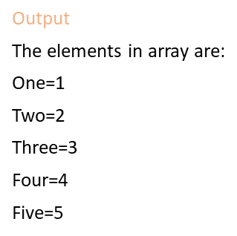
Program
<script>
A=new Object( );
A[‘one’]=1;
A[‘two’]=2;
A[‘three’]=3;
A[‘four’]=4;
A[‘five’]=5;
document.write(“The elements in array are:<br/>”);
for(i in A)
document.write(i+”=“+A[i]+”<br/> ”);
</script>

Slide 51
Using Object.keys() function: The Object.keys() is an inbuilt function in JavaScript which can be used to get all the keys of array. Syntax: Object.keys(obj)
<script>
// Associative array
var arr = {
"Newton": "Gravity",
"Albert": "Energy",
"Edison": "Bulb",
"Tesla": "AC"
};
// Get the keys
var keys = Object.keys(arr);
document.write("Keys are listed below <br>");
// Printing keys
document.write(keys);
</script>
Output:
Keys are listed below
Newton, Albert, Edison, Tesla

Slide 52
Write a JavaScript program that will remove the duplicate element from an array.
<html>
<body>
<script>
var arr = ["scale", "happy", "strength", "peace", "happy", "happy"];
function removeDuplicates(arr)
{
var unique = [];
for (i = 0; i < arr.length; i++)
{
if (unique.indexOf(arr[i]) === -1) //indexOf() returns the position of a specified value in an array
{
unique.push(arr[i]);
}
}
return unique;
}
document.write(removeDuplicates(arr));
</script>
</body>
</html>

Slide 53
Write a JavaScript function to merge two array & removes all duplicate values.
<html>
<body>
<script>
function merge_array(array1, array2)
{
var result_array = [];
var arr = array1.concat(array2);
var len = arr.length;
var assoc = {};

Slide 54
while(len--)
{
var item = arr[len];
if(!assoc[item])
{
result_array.unshift(item);
assoc[item] = true;
}
}
return result_array;
}
var array1 = [1, 2, 3,4,7,9];
var array2 = [2, 30, 1,40,9];
document.write(merge_array(array1, array2));
</script>
</body>
</html>
Output:
3,4,7,2,30,1,40,9

Slide 55
OR
<html>
<body>
<script>
function mergearr(arr1, arr2)
{
// merge two arrays
var arr = arr1.concat(arr2);
var uniqueArr = [];
// loop through array
for(var i of arr)
{
if(uniqueArr.indexOf(i) === -1)
{
uniqueArr.push(i);
}

Slide 56
}
document.write(uniqueArr);
}
var array1 = [1, 2, 3,6,8];
var array2 = [2, 3, 5,56,78,3]
mergearr(array1, array2);
</script>
</body>
</html>
Output:
1,2,3,6,8,5,56,78

Slide 57
Write a JavaScript program that will display list of student in ascending order according to the marks & calculate the average performance of the class.
<html>
<body>
<script>
var students = [["Amit", 70],["Sumit", 78],["Abhishek", 71],];
var Avgmarks = 0;
for (var i = 0; i < students.length; i++) {
Avgmarks += students[i][1];

Slide 58
for (var j = i + 1; j < students.length; j++)
{
if (students[i] > students[j])
{
a = students[i];
students[i] = students[j];
students[j] = a
}
}
}
var avg = Avgmarks / students.length;
document.write("Average grade: " + Avgmarks / students.length);
document.write("<br><br>");
for (i = 0; i < students.length; ++i){
document.write(students[i]+"<br>")
}
</script>
</body>
</html>

Slide 59
Write a JavaScript program to display the elements of array in ascending and descending order.
<script>
function func()
{
var arr = [45,12,32,78]
document.write("Original Array="+arr);
document.write("<br>Sorted Array="+arr.sort());
document.write("<br>Reverse Array="+arr.reverse());
}
func();
</script>

Slide 60
String
String is a collection of characters.
The string is written within the quotes-either single quote or double quote.
Example:
var name=“Kimaya”;
A string object is used for storing and manipulating text.
Example:
var s1=new String(); //empty string
var s1=new String (“Kimaya”);

Slide 61
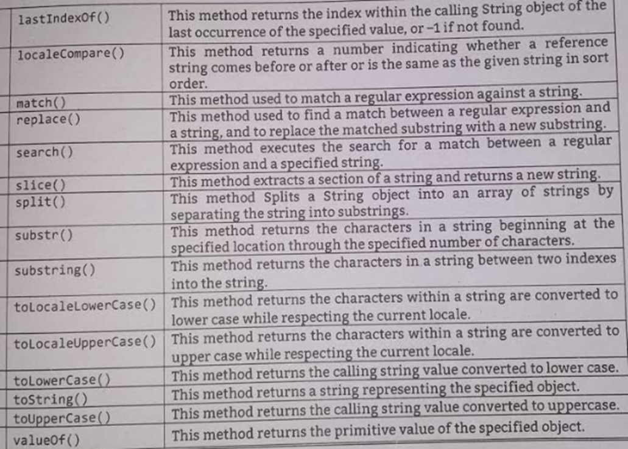
Manipulating a string
Manipulating a string means changing one string to another, joining two strings , changing the string from upper case to lower case etc.

Slide 62
Joining a string
concat() method-
It concatenates or joins two strings
Syntax:
String1.concat(String2);

Slide 63
<html>
<head><title>String Example</title> </head>
<body>
<script>
var firstName = "Ravi ";
var middleName = "Digambar ";
var lastName = "Somwanshi";
var fmName = firstName.concat(middleName);
var fullName = fmName.concat(lastName);
document.write(fullName);
</script>
</body>
</html>
Output
Ravi Digambar Somwanshi

Slide 64
We can join two strings using + operator.
<script>
var Firstname=“AAA”;
var Lastname =“BBB” ;
var name= Firstname + Lastname;
alert(name);
</script>
Output:
AAA BBB

Slide 65
Receiving a character from given position
The charAt() is a method that returns the characters from the specified index.
The index of first character is 0.
If no index is provided to charAt() method, then default is 0.
<script>
var str=“ABC”;
alert(“The character at first position of string is : “+str.charAt(0));
</script>
Output:
The character at first position of string is : A

Slide 66
<html>
<body>
<script>
var str = new String("This is string");
document.writeln("str.charAt(0) is:" + str.charAt(0));
document.writeln("<br />str.charAt(1) is:" + str.charAt(1));
document.writeln("<br />str.charAt(2) is:" + str.charAt(2));
document.writeln("<br />str.charAt(3) is:" + str.charAt(3));
document.writeln("<br />str.charAt(4) is:" + str.charAt(4));
document.writeln("<br />str.charAt(5) is:" + str.charAt(5));
</script>
</body>
</html>
Output:
str.charAt(0) is:T
str.charAt(1) is:h
str.charAt(2) is:i
str.charAt(3) is:s
str.charAt(4) is:
str.charAt(5) is:i

Slide 67
Finding a String in a String
The indexOf() method returns the index of (the position of) the first occurrence of a specified text in a string.
If the character is not in the string , this method returns -1.
This method is case sensitive.
var str = "Please locate where 'locate' occurs!";
var pos = str.indexOf("locate");
Output:
7

Slide 68
Program
<script>
var str=“I love India-my country”;
var n=str.indexOf(“India”);
alert(“The word ”India” is at index: +n);
</script>
Output:
The word ”India” is at index:7

Slide 69
<html>
<head>
<script>
function init()
{
var str "how are you?";
var n1 str.search("o");
document.write(" 'o' found at location" + n1);
var n2 str.indexOf("u");
document.write("<br>'u' found at location " + n2);
var n3 =str.search('are');
document.write("<br>'are' found at location" + n3);
var n4 =str.indexOf('you');
document.write("<br>'you' found at location + n4);
}
</script>
</head>
<body onload="init()">
</body>
</html>
Output:
'o' found at location 1
'u' found at location 10
‘are' found at location 4
'you' found at location 8

Slide 70
Dividing a text
Any text is made up of words. We can divide or split the text into a collection of these words.
split() function is used to split or divide a string into an array of substrings and puts these substrings into an array and returns the new array.
It does not change the original string.
Syntax:
stringname.split(delimiter,limit)
where delimiter specifies the point where the split should take place,
limit is a non-negative integer that specifies the no. of limits

Slide 71
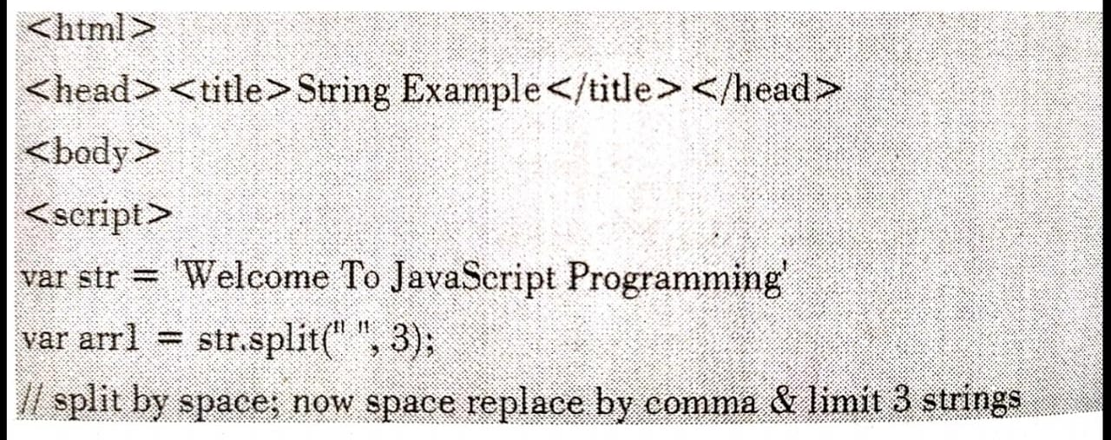
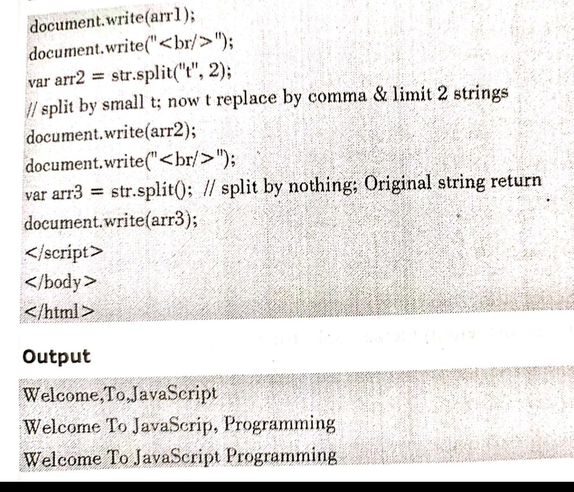

Slide 72
Program
<script>
var name=“Shivaji Shahaji Bhosale”;
var n=name.split(‘ ’);
alert(“Firstname:” +n[0]+ “Middle name:” + n[1] + “Last name:” +n[2]);
</script>
Output:
Firstname: Shivaji
Middle name: Shahaji
Last name: Bhosale

Slide 73
Write a JavaScript function that checks whether a passed string is palindrome or not.
function isPalindrome(str)
{
str = str.replace(/[^A-Za-z0-9]/g, '').toLowerCase();
return str === str.split('').reverse().join('');
}
console.log(isPalindrome("A man, a plan, a canal, Panama")); //Output: true
console.log(isPalindrome("racecar")); // Output: true
console.log(isPalindrome("hello")); // Output: false

Slide 74
Write a JavaScript that accepts a number and displays addition of digits of that number in a message box.
<html>
<body>
<script>
var num = prompt(“Enter a 2 digit number:”); //accept number from user
var digits = num.split();
var firstdigit = Integer(digits[0]);
var seconddigit = Integer(digits[1]);
var addition = firstdigit+seconddigit;
alert(“The addition is ” +addition); //display result in message box
</script>
</body>
</html>

Slide 75
Copying a substring
There are 2 methods for copying a substring- substring() and substr()
1) substring() –
This method fetch the string on the basis of provided index and returns the new sub string.
Syntax:
substring(start,end)
Where start indicates the starting index and end indicates the ending index for extracting substring.
It doesn’t accept negative index.

Slide 76
Program
<script>
var str=“TYCM Class”;
var n=str.substring(0,4)
document.write(n);
</script>
Output:
TYCM

Slide 77
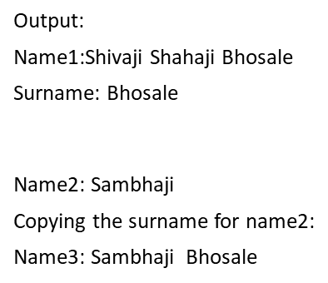
Program
<script>
var name1=“Shivaji Shahaji Bhosale”;
var name2=“Sambhaji”;
var n=name1.substring(16,23)
document.write(“Name1:” +name1);
document.write(“<br/>Surname:” +n);
document.write(“<br/>Name2:” +name2);
document.write(“<br/>Copying the surname for name2:”);
var name3=name2+“ ” +n ;
document.write(“<br/>Name3:” +name3);
</script>

Slide 78
<html>
<head>
<title>String Example</title>
</head>
<body>
<script>
var str = "HELLO WORLD!";
var res = str.substring(0,4);
document.writeln(res);
</script>
</body>
</html>
Output
HELL

Slide 79
2) substr()-
It is similar like a slice and substring methods but the difference is that the second parameter specifies the length of the extracted part of string.
Syntax:
substr (start,length)
Where start indicates the starting index and length indicates number of characters to be extracted.

Slide 80
Program
<script>
var str=“TYCM Class”;
var n=str.substr(0,6);
document.write(n);
</script>
Output:
TYCM C

Slide 81
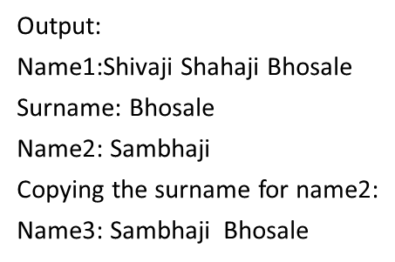
Program
<script>
var name1=“Shivaji Shahaji Bhosale”;
var name2=“Sambhaji”;
var n=name1.substr(16,7)
document.write(“<br/>Name1:” +name1);
document.write(“<br/>Surname:” +n);
document.write(“<br/>Name2:” +name2);
document.write(“<br/>Copying the surname for name2:”);
var name3=name2+” “ +n;
document.write(“<br/>Name3:” +name3);
</script>

Slide 82
<html>
<head>
<title>String Example</title>
</head>
<body>
<script>
var str = "HELLO WORLD!";
var subStr = str.substr(0, 7);
document.write(subStr);
</script>
</body>
</html>
Output
HELLO W

Slide 83
Changing case of string
toLowerCase() Method- converts a string to lowercase letters.
Syntax
string.toLowerCase()
<script>
var str = "HELLO World!";
var res = str.toLowerCase();
document.write(The ”+str+” is converted to :“+res);
</script>
Output:
The HELLO World! is converted to: hello world!

Slide 84
toUpperCase() Method
toUpperCase() Method- Convert the string to uppercase letters.
Syntax
string.toUpperCase()
<script>
var str = “hello World!";
var res = str.toUpperCase();
document.write(“The ”+ str + “ is converted to :”+res);
</script>
Output:
The hello World! is converted to: HELLO WORLD!

Slide 85
Finding Unicode of a character
Computer cannot understand characters. It understands only numbers. Hence whenever user types some letter, it gets converted automatically to a number called Unicode number. Computer can understand this Unicode number only.
Unicode is a standard that assigns a number to every character , number and symbol that can be displayed on computer screen.

Slide 86
charCodeAt() Method
charCodeAt() method-
Return the Unicode value of a character at the specific index in a string. The index starts from 0 and goes to n-1, where n is the length of the string.
Syntax
string.charCodeAt(index)
<script>
var str = "HELLO WORLD";
var n = str.charCodeAt(0);
document.write(“Unicode=“+n);
</script>
Output:
Unicode=72

Slide 87
fromCharCode()
fromCharCode()- It is used to convert the Unicode values into characters.
Syntax
string.fromCharCode(number)
<script>
var n = 97;
var ch = String.fromCharCode(n);
document.write(“<br/>The Unicode “+n+” is for letter:”+ch);
</script>
Output:
The Unicode 97 is for letter: a

Slide 88
Program
<script>
var str = String.fromCharCode(65,66,67);
document.write(str);
</script>
Output:
ABC

Slide 89
<html>
<body>
<script>
var txt= “Hello Javascript World”;
document.write(txt.charCodeAt()+”<br>”);
document.write(txt.charCodeAt(5)+”<br>”);
Var res=String.fromCharCode(77,69,69,78,65);
document.write(res);
</script>
</body>
</html>
Output:
72
32
MEENA

Slide 90
JavaScript toString( ) function
The toString() function in Javascript is used with a number and converts the number to a string. It is used to return a string representing the specified number object.
Syntax:
num.toString(base)
The toString() function is used with a number num as shown in above syntax using the ‘.’ operator. This function will convert num to a string.

Slide 91
Converting number to string using toString()
<script>
var num=100;
Var str=num.toString();
document.write(“<br/> The 100 value is converted to string:“ + str);
</script>
Output:
The 100 value is converted to string:100

Slide 92
Converting String to Number
For converting string to number we have different types of functions based on type of number.
parseInt() method-
Use to convert a string to an integer.
It returns NaN(not a number) when the string doesn’t contain number.
This function won’t accept spaces.
Syntax:
parseInt(value);

Slide 93
Program
<script>
var str=“100”;
var a=parseInt(str) ; //converting string 100 to number 100
var b=200;
result=str + b;
document.write(“<br/> Adding 200 to ‘100’=“ + result);
result=a + b;
document.write(“<br/> Adding 200 to 100=“ + result);
</script>
Output:
Adding 200 to ‘100’=100200
Adding 200 to 100=300

Slide 94
<html>
<head> <title>String Example</title> </head>
<body>
<script>
var a = "10“;
var b = parseInt(a);
document.write("value is: " + b);
var c= parseInt("423-0-567");
document.write("</br>");
document.write('value is: ' + c);
document.write("</br>");
var d = "string";
ware = parseInt(d);
document.write("value is: " + e);
document.write("</br>");
var f = parseInt("2string");
document.write("value is: " + f);
</script>
</body>
</html>
Output
value is: 10
value is: 423
value is: NaN
value is: 2

Slide 95
<html>
<head><title>String Example</title> </head>
<body>
<script>
var example = "44.09“;
var example2 = "45.00003“;
var example3 = "46“;
document.write(Number(example));
var a = Number(example2);
document.write("<br/>");
document.write(a);
document.write("<br/>");
document.write(Number(example3));
document.write("<br/>");
//check typeOf
document.write(typeof example2)
document.write("<br/>");
document.write(typeof a)
</script>
</body>
</html>
Output
44.09
45.00003
46
String
number

Slide 96
Function
Function Definition
A JavaScript function is defined with the function keyword, followed by a name, a list of parameters and a statement block surrounded by curly braces.
We can define a function anywhere in the script either in head or body section or in both. But it is a standard practice to define the function in the head and call that function from the body section.
Syntax
function functionname(parameter1, parameter2,…, parameter n)
{
statements
}

Slide 97
Calling a function without argument
A function can also be called without passing any argument. In this case , all the required variables are declared and used within that function.

Slide 98
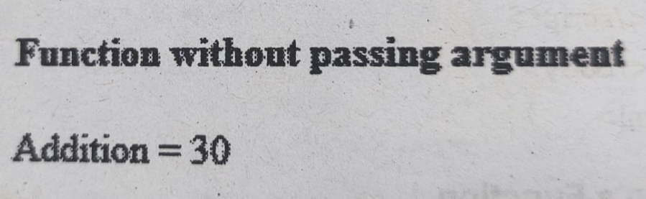
<html>
<head>
<script>
function add()
{
var a=10
var b=20
c=a+b
document.write("Addition = "+c)
}
</script>
</head>
<body>
<h4> Function without passing argument</h4>
<script>
add()
</script>
</body>
</html>

Slide 99
Calling a Function
<html>
<head>
<script>
//definition of function
function my_fun() { Output
document.write (“This statement is within the function");
} This statement is before a function call
</script> This statement is within the function
</head>
<body>
<script>
document.write (“This statement is before a function call");
document.write (“<br>");
my_fun(); //call to the function
</script>
</body>
</html>

Slide 100
Calling a function without argument
<html>
<head>
<script>
var x=10;
function show()
{
var item=“pen”;
Document.write(“The cost of “ +item +”is” +x);
}
</script>
</head>
<body>
<script>
show();
</script>
Output:
The cost of pen is 10

Slide 101

<html>
<head>
<script>
function sayHello() { Output
document.write ("Hello there!");
}
</script>
</head> Hello there!
<body>
<p>Click the following button to call the function</p>
<form>
<input type = "button" onclick = "sayHello()" value = "Say Hello">
</form>
</body>
</html>

Slide 102
Calling a function with argument
In JavaScript we can pass an argument to the function.
A function can take multiple parameters separated by comma.
Syntax:
functionname(parameter values);

Slide 103
<html>
<head>
<script>
function add (a , b)
{
c=a + b;
document.write(“Addition = “ +c);
document.write(“<br/>”);
}
</script>
</head>
<body>
<script>
var x=10;
var y=20;
add (x ,y );
add(5,6);
</script>
</body>
</html>
Output:
Addition = 30
Addition =11

Slide 104
<html>
<head>
<title>Function Example</title>
</head>
<body>
<script>
function add(a, b)
{
document.write(a + b);
}
add(5, 4); // calling functions
</script>
</body>
</html>
Output
9

Slide 105
<html>
<head>
<script>
function sayHello(name, age) {
document.write (name + " is " + age + " years old.");
} Output:
</script> Click the following button to call the function
</head>
Kimaya is 10 years old.
<body>
<p>Click the following button to call the function</p>
<form>
<input type = "button" onclick = "sayHello(‘Kimaya', 10)" value = "Say Hello">
</form>
</body>
</html>

Slide 106
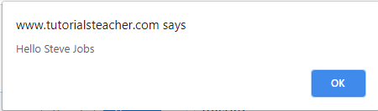
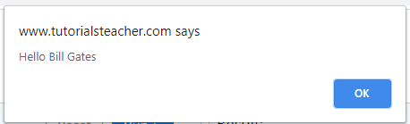
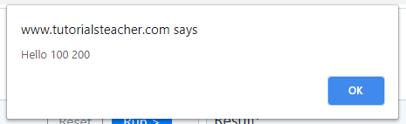
<script> Output:
function ShowMessage(firstName , lastName)
{
alert("Hello " + firstName + " " + lastName);
}
ShowMessage("Steve", "Jobs");
ShowMessage("Bill", "Gates");
ShowMessage(100, 200);
</script>

Slide 107
Calling function from HTML
A function can be called from HTML code on your web page . Now rather than explicitly calling a function, it will be called in response to an event, such as when the web page is loaded or unloaded by the browser.
For example:
We have written two different functions named as welcome() and goodbye() and you want the code of welcome function should executed when a html form body is loaded in browser and you want goodbye function should executed when a html form body is unloaded in browser.

Slide 108
Calling function from HTML
Following steps to call JavaScript function from HTML document:
Step 1: First, add <script> tag between opening <head> and closing </head> tag after the <title> tag and write the JavaScript function.
Step 2: After then, we have to call the JavaScript function in the HTML code for displaying the information or data on the web page. Therefore, we can call the function of JavaScript by its name in the input tag with onclick event. (Example: onclick="msg()")
Step 3: And, at the end, we have to save the HTML file and then run the file, which calls the JavaScript function.

Slide 109
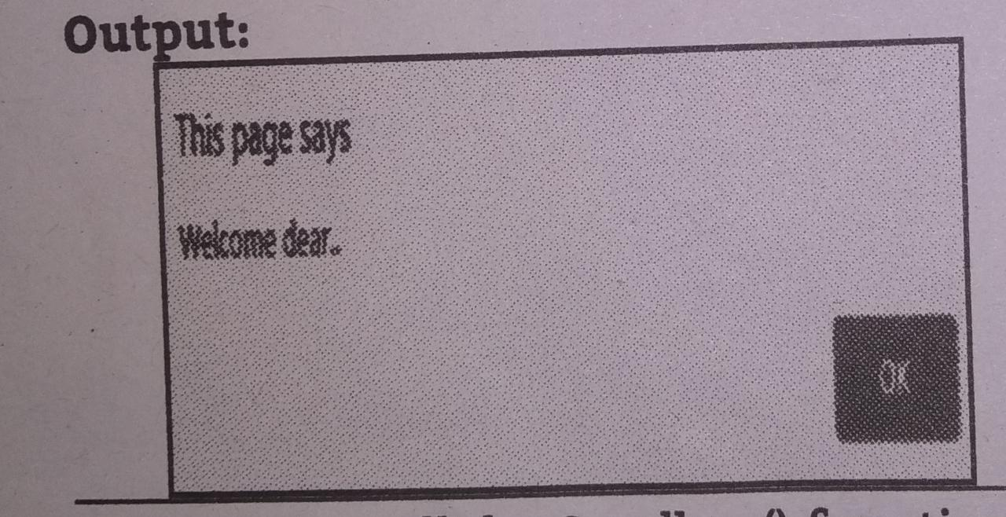
Program
<html>
<head>
<script>
function welcome()
{
alert(“welcome dear..”);
}
function goodbye()
{
alert(“bye bye….”);
}
</script>
</head>
<body onload=“ welcome() “ onunload=“goodbye()”>
</body>
</html>

Slide 110
Calling function from HTML
<html>
<head>
<script>
function A()
{
document.write(“Inside the function A”);
}
</script>
</head>
<body onload=“ A() “>
</body>
</html>

Slide 111
<html>
<head>
<script>
function msg()
{
alert(“Hello! TYCM");
}
</script>
</head>
<body>
<input type="button" onclick="msg()" value="call function"/>
</body>
</html>

Slide 112
Function calling another function
We can call one function from another function. This is called nested functions.
<html>
<head>
<script>
function A()
{
B(); //calling another function
}
function B()
{
alert(“Inside the function B() via function A()”);
}
</script>
</head>
<body onload=“ A() “>
</body>
</html>

Slide 113
Program1:
<html>
<head><title>Function calling another function</title> </head>
<body>
<script>
function sum_of_squares(x, y, z) // function 1
{
let a = square(x); // function 2 calling from function 1
let b = square(y);
let c = square(z);
return a + b + c;
}
function square(num) //function 2
{
let s = num * num;
return s;
}

Slide 114
var num1 =5;
var num2 = 6;
var num3 = 7;
var result = sum_of_squares(num1, num2, num3); // calling function 1
document.write(result);
</script>
</body>
</html>
Output
110

Slide 115
Program2:
<html>
<head>
<title> scope </title>
<script>
function Logon()
{
var userID;
var password;
var valid;
IserID = prompt('Enter ter user ID', ‘ ');
password = prompt('Enter password',‘ ');
valid = ValidateLogon(userID, password);
if ( (valid === true)
{
alert('Valid Logon');
}
else
{
alert('Invalid Logon');
}
}

Slide 116
function Validatelogon(id, pwd)
{
var ReturnValue;
if (id === '111' && pwd= 'aaa')
{
ReturnValue =true;
}
else
{
ReturnValue false;
}
return ReturnValue;
</script>
</head>
<body onload="Logon()">
</body>
</html>

Slide 117
Returning value from function
The return statement can be used to return the value to a function call.
The return statement denotes that the function has ended.
Any code after return is not executed.
This return value is either stored in variable or directly displayed on the browser window.
Syntax:
return value;

Slide 118
<html>
<body>
<script>
function add(num1, num2)
{
result = num1 + num2;
return result;
}
var x = add(5, 10); // calling functions
document.write(x);
</script>
</body>
</html>
Output
15

Slide 119
<html>
<body>
<script>
function areaRect(L,B)
{
var area L*B;
return area;
}
x=areaRect(6,8);
document.write(x);
</script>
</body>
</html>
Output:
48

Slide 120
<script>
function Sum(val1, val2) {
return val1 + val2;
};
var result = Sum(10,20); // returns 30
document.write (result );
</script>

Slide 121
The return Statement
<html>
<head>
<script >
function concatenate(first, last)
{
var full;
full = first + last;
return full; Output:
} Click the following button to call the function
function secondFunction() {
var result;
result = concatenate(‘TYCM, ‘class’); TYCMclass
document.write (result );
}
</script>
</head>
<body>
<p>Click the following button to call the function</p>
<form>
<input type = "button" onclick = "secondFunction()" value = "Call Function">
</form>
</body>
</html>

Slide 122
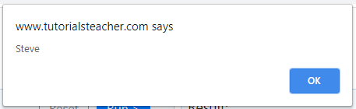
An arguments object can be iterated using for loop.
Example: Iterate all Arguments
<script>
function ShowMessage() {
for(var i = 0; i < arguments.length; i++){
alert(arguments[i]);
}
}
ShowMessage("Steve", "Jobs");
</script>

Slide 123
Scope of Variable and Argument
Scope is the block or area of program in which particular variable or argument is accessible.
The scope is defined using two types of variables –
Local Scope and Global Scope.

Slide 124
1) Local Scope
If a variable is defined inside a function then that variable is a local variable and its scope is a local scope.
local variable is accessible only within a function in which it is defined.
It is not accessible outside that function.
Local variables are created when a function starts and deleted when the function is completed.

Slide 125
<html>
<head>
<title>Function Example</title>
</head>
<body>
<script>
function myFunction(message)
{
var msg = message;
document.write(msg);
}
myFunction("My first function");
</script>
</body>
</html>

Slide 126
<html>
<head>
<script type="text/javascript">
function A() {
var a=100; //local variable
document.getElementById(“id1").innerHTML="From function A(): a = “ +a ; Output: From function A(): a=100
}
function B() {
document.getElementById(“id2").innerHTML="From function B(): a= “ +a ;
}
</script>
</head>
<body>
<p id=“id1'> </p>
<p id="id2'> </p>
<script type="text/javascript">
A()
B()
</script>
</body>
</html>

Slide 127
2) Global Variable
A variable is called global variable, if it is defined outside the function.
The variable having global scope is accessible by any function.

Slide 128
<html>
<head>
<script type="text/javascript">
var a=100 ; //Global variable
function A() {
document.getElementByld("id1").innerHTML="From function A(): a = “+a ;
}
function B() {
document.getElementById(“id2").innerHTML= “From function B(): a = “ +a ;
}
</script>
</head> Output
<body> From function A(): a = 100
<p id="id1”> </p> From function B(): a = 100
<p id="d2”> </p>
<script type="text/javascript">
A()
B()
</script>
</body>
</html>

Slide 129
getElementById() Method
The getElementById() is used to return the element that has the ID attribute with the specified value.
This is used almost every time we want to manipulate an element on our document.
This method returns null if no elements with the specified ID exists.
The ID should be unique within a page.
However, if more than one element with the specified ID exists, it returns the last element in the javascript code.

Slide 130
Example-1
In the following example, there exists a paragraph tag with the inner text "GetElementById" and with an id called "element".
Using the method "document.getElementById()" the text inside the paragraph tag is accessed and the value is displayed in the output.
Without ".innerHtml" the document.getElementById can't read the inner text part of any tag.
<html>
<body>
<p id="element"> GetElementById </p>
<script>
var s = document.getElementById("element").innerHTML;
document.write(s);
</script>
</body>
</html>
Output
GetElementById
GetElementById

Slide 131
Write a JavaScript that accents user's first name and domain name of Organization from user., The JavaScript then forms email address as
<firstname@domain> name and displays the results in the browser window.
<html>
<head>
<script>
//Email Address Function
function myemail()
{
var s1 = document.getElementById("first").value;
var s2 = document.getElementById("domain").value;
var s3=s1+"@"+s2;
document.getElementById("email").innerHTML = s3;
}
</script>
</head>
<body>
<p>First Name: <input id="first"></p>
<p>Domain Name: <input id="domain"></p>
<button onclick="myemail()">create email id</button>
<br> Email ID is
<p id="email"> </p>
</body>
</html>

