Slide 1
Chapter No 2
Python Operators and Control Flow Statements
MARKS:10

Slide 2
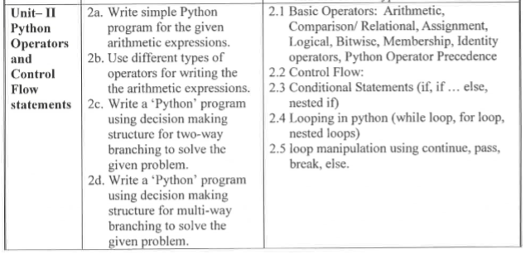

Slide 3
Course outcome
Develop a Python program to demonstrate use of Operators.

Slide 4
What are operators in python?
An Operator is a set of symbols that performs pre-defined operations on opeators.
Operators are used to perform operations on variables and values.
The value that the operator operates on is called the operand.
Consider the expression 4 + 5 = 9. Here, 4 and 5 are called operands and + is called operator.

Slide 5
Types of Operator
Python language supports the following types of operators.
Arithmetic Operators
Comparison (Relational) Operators
Assignment Operators
Logical Operators
Bitwise Operators
Membership Operators
Identity Operators

Slide 6
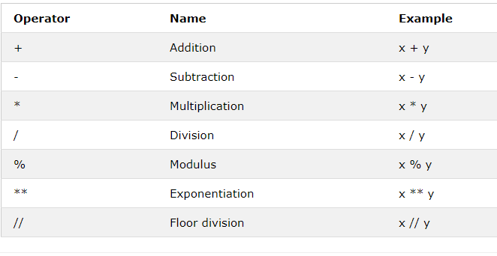
Arithmetic Operators
Arithmetic operators are used to perform mathematical operations like addition, subtraction, multiplication etc.
Arithmetic operators in Python are as follow

Slide 7
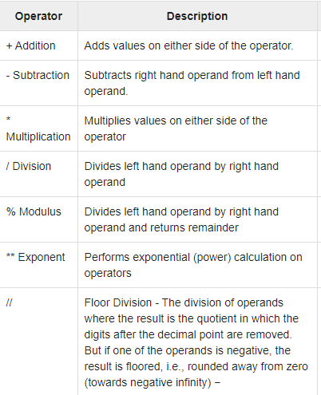
Meaning of Arithmetic Operator

Slide 8
Example
Program | Output
a,b=10,30 print("addition Operator +:",a+b) print("subtraction Operator -:",b-a) print("Multiplication Operator *=:",a*b) print("Division Operator /=:",b/a) print("Modulus Operator %=:",b%a) print("Floor Division Operator //=:",b//a) | addition Operator +: 40 subtraction Operator -: 20 Multiplication Operator *=: 300 Division Operator /=: 3.0 Modulus Operator %=: 0 Floor Division Operator //=: 3

Slide 9
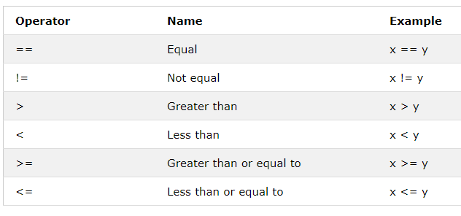
Comparison (Relational) Operators
Comparison operators are used to compare values.
It either returns True or False according to condition.
Comparison operators in Python are as Follow

Slide 10
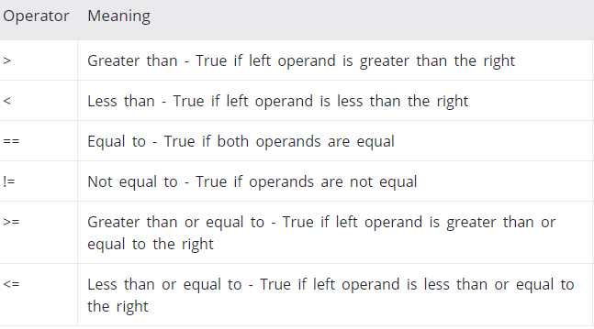
Meaning of Comparison Operator

Slide 11
Example
Program | Output
a,b=10,30 print("Greater Than Operator >:",a>b) print("Less Than Operator <:",a<b) print("Greater Than or equal to Operator >=:",a>=b) print("Less Than Operator <=:",a<=b) print("Equals To Operator ==:",a==b) print("not Equals to Operator !=:",a!=b) | Greater Than Operator >: False Less Than Operator <: True Greater Than or equal to Operator >=: False Less Than Operator <=: True Equals To Operator ==: False not Equals to Operator !=: True

Slide 12
Assignment Operators
Assignment operators are used to assign values to variables:
The Assignment Operator = is used to store right side operand in the left side operand.
There are various compound operators in Python like a+=5 hat adds to the variable and later assigns the same. It is equivalent to a=a+b

Slide 13
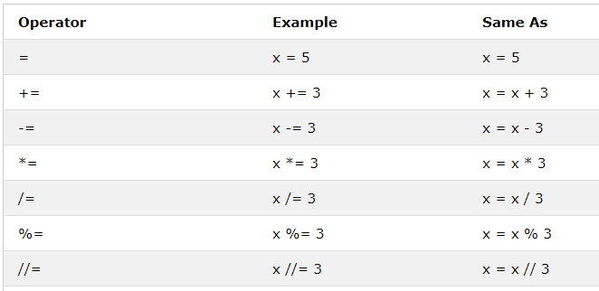
Assignment operators in Python are as Follow

Slide 14
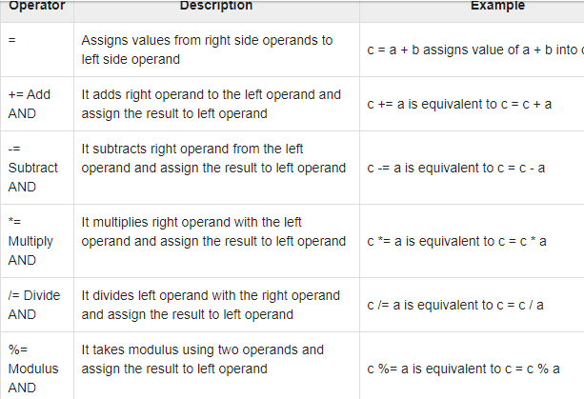
Meaning of Assignment Operator

Slide 15
Example
Program | Output
a,b=10,30 a+=b print("add AND Operator +=:",a) a-=b print("subtract AND Operator -=:",a) a*=b print("Multiply AND Operator *=:",a) a/=b print("Division AND Operator /=:",a) c=2**3 print(" Exponent AND Operator **=:",c) a//=b print("Floor Division AND Operator //=:",a) d=30%3 print(" Modulus AND Operator **=:",d) | add AND Operator +=: 40 subtract AND Operator -=: 10 Multiply AND Operator *=: 300 Division AND Operator /=: 10.0 Exponent AND Operator **=: 8 Floor Division AND Operator //=: 0.0 Modulus AND Operator **=: 0

Slide 16
Logical Operators
Logical Operator are used to check two or more conditiond.
The Resultant of this operator is always a Boolean value.
Logical operators are used to combine conditional statements

Slide 17
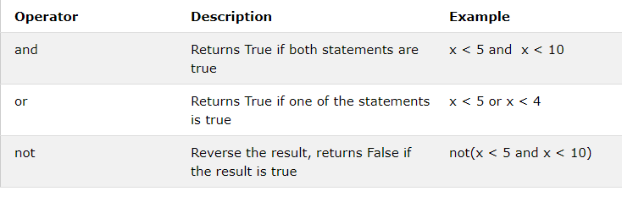
Logical operators in Python are as Follow

Slide 18
Example
Program | Output
a,b=10,30 print("Logical AND Operator and:",a>b and a<b) print("Logical OR Operator and:",a>b or a<b) print("Logical NOT Operator and:",not a>b ) | Logical AND Operator and: False Logical OR Operator and: True Logical NOT Operator and: True

Slide 19
Bitwise Operators
Bitwise operator works on bits and performs bit by bit operation
Assume if a = 60; and b = 13; Now in the binary format their values will be 0011 1100 and 0000 1101 respectively.
a = 0 0 1 1 1 1 0 0
b = 0 0 0 0 1 1 0 1
a&b = 0 0 0 0 1 1 0 0
a|b = 0 0 1 1 1 1 0 1
a^b = 0 0 1 1 0 0 0 1
~a = 1 1 0 0 0 0 1 1

Slide 20
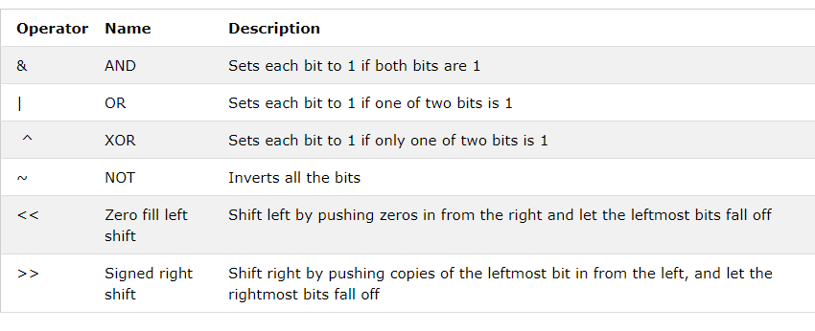
Bitwise operators in Python are as Follow

Slide 21
Example
Program | Output
a,b=4,2 print("Bitewise AND Operator a&b=",a&b) print("Bitewise OR Operator a|b=",a|b) print("Bitewise NOT Operator ~a=",~a) print("Bitewise XOR Operator a^b=",a^b) print("Bitewise LEFT SHIFT Operator a<<b=",a<<b) print("Bitewise RIGHT Operator a>>b=",a>>b) | Bitewise AND Operator a&b= 0 Bitewise OR Operator a|b= 6 Bitewise NOT Operator ~a= -5 Bitewise XOR Operator a^b= 6 Bitewise LEFT SHIFT Operator a<<b= 16 Bitewise RIGHT Operator a>>b= 1

Slide 22
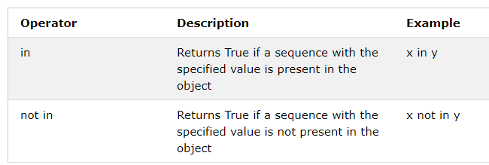
Membership Operators
It is used to check the presence of the element or object in specified Sequence(String , List, Tuple)
In a dictionary we can only test for presence of key, not the value.
Membership Operator are as Follow

Slide 23
Example
Program | Output
list=[10,20,"AMIT",30.45] print("10 is present in list in= ",10 in list) print("10 is not present in list not in= ",10 not in list) | 10 is present in list in= True 10 is not present in list not in= False

Slide 24
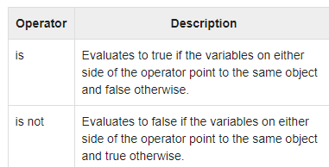
Identity Operators
Identity operators compare the memory locations of two objects.
Identity operators are used to compare the objects, not if they are equal, but if they are actually the same object, with the same memory location:
Identity Operator are as Follow

Slide 25
Example
Program | Output
a=10 b=10 c=20 print("Does a & b point to same memory location :is= ",a is b) print("Does a & c point to same memory location :is not= ",a is not c) | Does a & b point to same memory location :is= True Does a & c point to same memory location :is not= True

Slide 26
Precedence of operators
Operator precedence affects how an expression is evaluated.
When an expression has two or more operators, we need to identify the correct sequence to evaluate an expression.
To evaluate these type of expressions there is a rule of precedence in Python. It guides the order in which operation are carried out.
For example, x = 7 + 3 * 2 here, x is assigned 13, not 20 because operator * has higher precedence than +, so it first multiplies 3*2 and then adds into 7.
The following table lists all operators from highest precedence to lowest.

Slide 27
Operator Precedence
Operator | Desciption
** | Exponential Operator
*,/,%,// | Multipln,Divison,modulus,Floor Division
+,- | Addition,Sutraction
<<,>> | Bitwise left shift and Right shift
& | Bitwise AND
^,| | Bitwise XOR & OR
<=,<,>,>= | Comparison Operator
<>,==,!= | Equality Operator
=,%=,/=,//=,-=,+=,*=,**= | Assignment Operator
is ,not is | Identity Operator
in ,not in | Membership Operator
NOT,OR,AND | Logical Operator

Slide 28
Associativity
When two operators have the same precedence, associativity helps to determine which the order of operations.
Associativity is the order in which an expression is evaluated that has multiple operator of the same precedence.
Almost all the operators have left-to-right associativity.
For example, multiplication and floor division have the same precedence. Hence, if both of them are present in an expression, left one is evaluates first

Slide 29
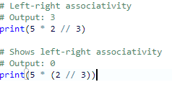
Example

Slide 30
Control Flow Statement
The control flow Statement is the order in which the program's code executes.
The control flow of a Python program is regulated by conditional statements, loops, and function calls.
The Control Flow statements are as
I].Conditional statement or Decision Making Statements.
II].Loop Control Statement or Iterative Statements.

Slide 31
I].Conditional statement or Decision Making Statements.
Conditional Statement executes the block of statements based on correctness of condition.
If the Condition is true ,then only the block of code is executed ,else it will skip.
The Conditional statement or Decision Making Statements are as Follow
if Statement
if-else statement
if- elif-else statement
nested if statement

Slide 32

if statement
An if statement consists of a boolean expression followed by one or more statements.
If Expression is True, then only block of code is executed, else it will skip the block.
Syntax

Slide 33
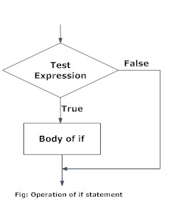
Python if Statement Flowchart

Slide 34
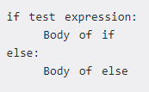
if-else statement
The if-else statement evaluates test expression and will execute body of if only when test condition is True.
If the condition is False body of else is executed. Indentation is used to separate the blocks.
Syntax of if...else

Slide 35
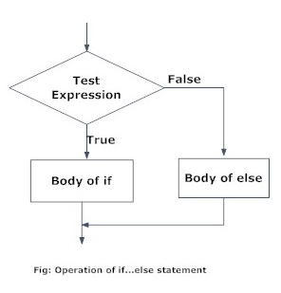
Python if...else Flowchart

Slide 36
if...elif...else Statement
The elif is short for else if. It allows us to check for multiple expressions.
If the condition for if is False, it checks the condition of the next elif block and so on.
If all the conditions are False, body of else is executed.
Only one block among the several if...elif...else blocks is executed according to the condition.
The if block can have only one else block. But it can have multiple elif blocks.

Slide 37
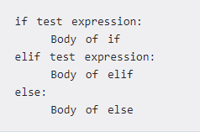
Syntax of if...elif...else

Slide 38
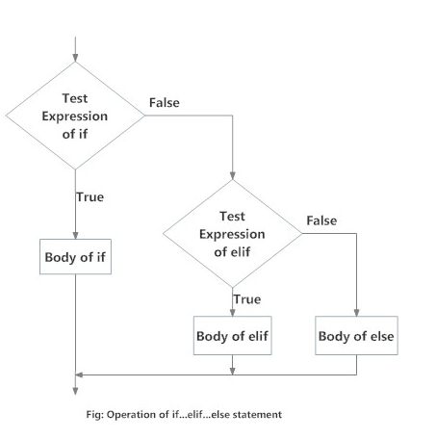
Flowchart of if...elif...else

Slide 39
Nested if statements
Nested if statements means an if statement inside another if statement.
In a nested if construct, you can have an if...elif...else construct inside another if...elif...else construct.
Any number of these statements can be nested inside one another. Indentation is the only way to figure out the level of nesting.
This can get confusing, so must be avoided if we can.

Slide 40
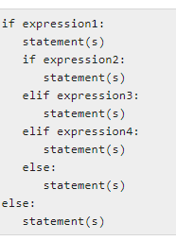
Syntax of Nested if Statement

Slide 41
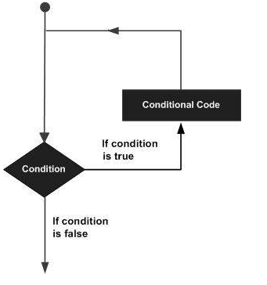
II].Loop Control Statement or Iterative Statements.
A loop statement allows us to execute a statement or group of statements multiple times.
The following diagram illustrates a loop statement −

Slide 42
Python provides the following Loop statement
while Loop
for Loop
Nested Loop

Slide 43
While loop
The while loop in Python is used to iterate over a block of code as long as the test expression (condition) is true.
In while loop, test expression is checked first. The body of the loop is entered only if the test_expression evaluates to True. After one iteration, the test expression is checked again. This process continues until the test_expression evaluates to False.
In Python, the body of the while loop is determined through indentation.

Slide 44

Syntax of While Loop

Slide 45
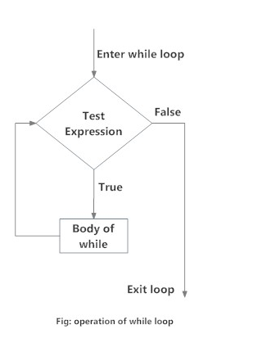
Flowchart of while Loop

Slide 46
while loop with else
Same as that of for loop, we can have an optional else block with while loop as well.
The else part is executed if the condition in the while loop evaluates to False.
The while loop can be terminated with a break statement. In such case, the else part is ignored. Hence, a while loop's else part runs if no break occurs and the condition is false.

Slide 47
Syntax of while else loop
while test expression:
block
else:
Statement

Slide 48

For Loop
The for loop in Python is used to iterate over a sequence (list, tuple, string) or other iterable objects. Iterating over a sequence is called traversal.
Syntax:
Here, val is the variable that takes the value of the item inside the sequence on each iteration.
Loop continues until we reach the last item in the sequence. The body of for loop is separated from the rest of the code using indentation.

Slide 49
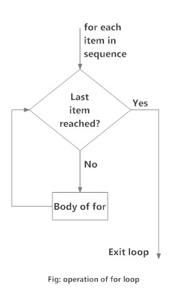
Flowchart of for Loop

Slide 50
Example
numbers = [6, 5, 3, 8, 4, 2, 5, 4, 11]
sum = 0
for val in numbers:
sum = sum+val
print("The sum is", sum)
Output:
The sum is 48

Slide 51

Nested Loop
nesting a loop means simply having a loop (let's call it outer loop) that has inside its commands another loop
Syntax nested for loop

Slide 52
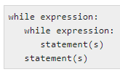
Nested While Loop

Slide 53
What is the use of break and continue in Python?
In Python, break and continue statements can alter the flow of a normal loop.
Loops iterate over a block of code until test expression is false, but sometimes we wish to terminate the current iteration or even the whole loop without checking test expression.
The break and continue statements are used in these cases.

Slide 54
Python break statement
The break statement terminates the loop containing it.
Control of the program flows to the statement immediately after the body of the loop.
If break statement is inside a nested loop (loop inside another loop), break will terminate the innermost loop.
Syntax of break
break

Slide 55
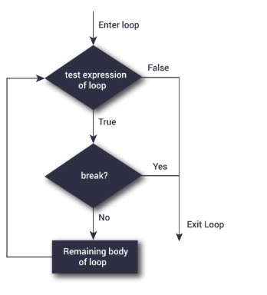
Flowchart of break

Slide 56
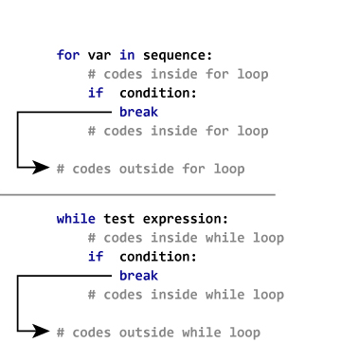
The working of break statement in for loop and while loop is shown below.

Slide 57
Example
for val in "string":
if val == "i":
break
print(val)
print("The end")
Output:
s
t
r
The end

Slide 58
Python continue statement
The continue statement is used to skip the rest of the code inside a loop for the current iteration only.
Loop does not terminate but continues on with the next iteration.
Syntax
continue

Slide 59
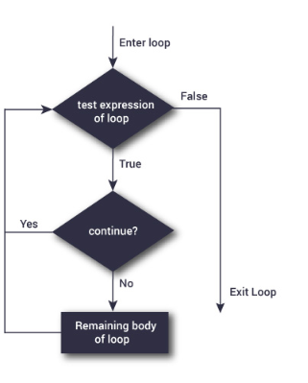
Flowchart of continue

Slide 60
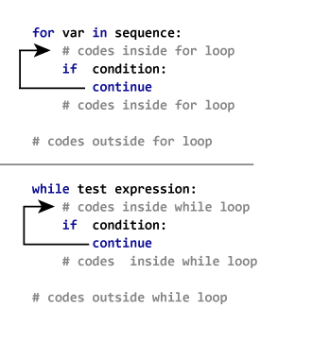
The working of continue statement in for and while loop is shown below.

Slide 61
Example
for val in "string":
if val == "i":
continue
print(val)
print("The end")
Output:
s
t
r
n
g
The end

Slide 62
pass statement
In Python programming, pass is a null statement. T
he difference between a comment and pass statement in Python is that, while the interpreter ignores a comment entirely, pass is not ignored.
However, nothing happens when pass is executed. It results into no operation (NOP).
We generally use it as a placeholder.

Slide 63
Syntax
pass
Suppose we have a loop or a function that is not implemented yet, but we want to implement it in the future. They cannot have an empty body. The interpreter would complain. So, we use the pass statement to construct a body that does nothing.

Slide 64
Example
sequence = {'p', 'a', 's', 's'}
for val in sequence:
pass
Output:
nil

Slide 65
Write a program to print following
1
1 2
1 2 3
1 2 3 4

Slide 66
for i in range(1,5):
for j in range(1,i+1):
print(j,end=' ')
print()

Slide 67
End

