Slide 1
Unit-II Services and Components of Operating System
Compiled by:Mr Rahul Patil

Slide 2
Learning Outcomes
After watching this presentation you will be able to
Start stop & restart the given service in Linux.
Explain use of the given System call of specified OS.
Explain the process the OS follows in managing the given resource.
Explain use of the given operating system tool.

Slide 3
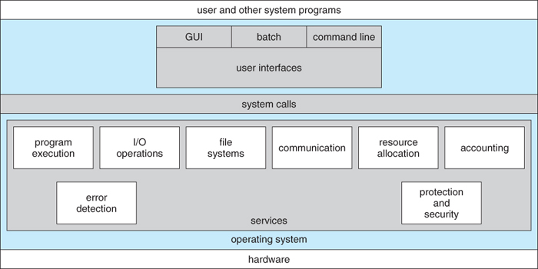
2.1 Different services of operating system

Slide 4
2.1 Different services of operating system
Program execution – system capability to load a program into memory and to run it.
I/O operations – since user programs cannot execute I/O operations directly, the operating system must provide some means to perform I/O. For example, there is difference in nature of all types of peripheral devices such as mouse or keyboard, then Operating System is responsible for handling data between them.
File-system manipulation – program capability to read, write, create, and delete files.
Communications – exchange of information between processes executing either on the same computer or on different systems tied together by a network. Implemented via shared memory or message passing.
Error detection – ensure correct computing by detecting errors in the CPU and memory hardware, in I/O devices, or in user programs.

Slide 5
Different services of operating system (Contd.)
Resource allocation – allocating resources to multiple users or multiple jobs running at the same time.
Accounting – keep track of and record which users use how much and what kinds of computer resources for account billing or for accumulating usage statistics.
Protection – ensuring that all access to system resources is controlled.

Slide 6
2.2 System Calls
System calls provide the interface between a running program and the operating system.
It is a programmatic method in which a computer program requests a service from the kernel of the OS.
✦ Generally available as assembly-language instructions.
✦ Languages defined to replace assembly language for systems programming allow system calls to be made directly (e.g., C, C++)
System calls are the only entry points for the kernel system.

Slide 7
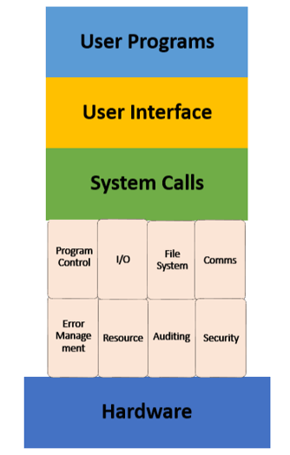
Example of system call:
For example if we need to write a program code to read data from one file, copy that data into another file. The first information that the program requires is the name of the two files, the input and output files.
In an interactive system, this type of program execution requires some system calls by OS.
First call is to write a prompting message on the screen
Second, to read from the keyboard, the characters which define the two files.

Slide 8
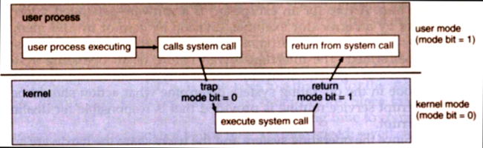
How System Call Works?
Step 1) The processes executed in the user mode till the time a system call interrupts it.
Step 2) After that, the system call is executed in the kernel-mode on a priority basis.
Step 3) Once system call execution is over, control returns to the user mode.
Step 4) The execution of user processes resumed in user mode.

Slide 9
Why do you need System Calls in OS?
Following are situations which need system calls in OS:
Reading and writing from files demand system calls.
If a file system wants to create or delete files, system calls are required.
System calls are used for the creation and management of new processes.
Network connections need system calls for sending and receiving packets.
Access to hardware devices like scanner, printer, need a system call.

Slide 10
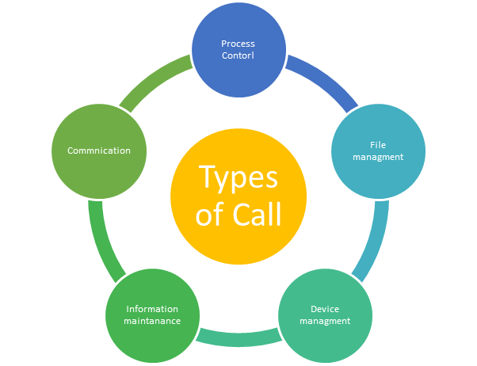
Types of System calls

Slide 11
Examples of Windows and Unix System Calls –
 | WINDOWS | UNIX
Process Control | CreateProcess() ExitProcess() WaitForSingleObject() | fork() exit() wait()
File Manipulation | CreateFile() ReadFile() WriteFile() CloseHandle() | open() read() write() close()
Device Manipulation | SetConsoleMode() ReadConsole() WriteConsole() | ioctl() read() write()
Information Maintenance | GetCurrentProcessID() SetTimer() Sleep() | getpid() alarm() sleep()
Communication | CreatePipe() CreateFileMapping() MapViewOfFile() | pipe() shmget() mmap()
Protection | SetFileSecurity() InitlializeSecurityDescriptor() SetSecurityDescriptorGroup() | chmod() umask() chown()

Slide 12
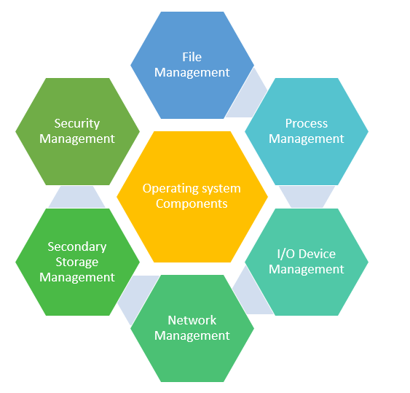
2.3 Operating System Components

Slide 13
2.3 Operating System Components
Process Management:
The operating system is responsible for the following activities in connection with process management:
Scheduling processes and threads on the CPUs
Creating and deleting both user and system processes
Suspending and resuming processes
Providing mechanisms for process synchronization
Providing mechanisms for process communication

Slide 14
Operating System Components(Contd.)
Memory Management:
The operating system is responsible for the following activities in connection with memory management:
Keeping track of which parts of memory are currently being used and who is using them
Deciding which processes (or parts of processes) and data to move into and out of memory
Allocating and deallocating memory space as needed

Slide 15
Operating System Components(Contd.)
File-System Management:
The operating system is responsible for the following activities in connection with file management:
Creating and deleting files
Creating and deleting directories to organize files
Supporting primitives for manipulating files and directories
Mapping files onto secondary storage
Backing up files on stable (nonvolatile) storage media

Slide 16
Operating System Components(Contd.)
Mass / Secondary Storage Management:
The operating system is responsible for the following activities in connection with disk management:
Free-space management
Storage allocation
Disk scheduling

Slide 17
Operating System Components(Contd.)
I/O System Management:
The operating system is responsible for the following activities in connection with I/O system management:
A memory-management component that includes buffering, caching, and spooling
A general device-driver interface
Drivers for specific hardware devices

Slide 18
Operating System Components(Contd.)
Network Management:
The operating system is responsible for the following activities in connection with network management:
Distributed systems help you to various computing resources in size and function. They may involve microprocessors, minicomputers, and many general-purpose computer systems.
A distributed system also offers the user access to the various resources the network shares.
It helps to access shared resources that help computation to speed-up or offers data availability and reliability.

Slide 19
Operating System Components(Contd.)
Protection and Security:
The operating system is responsible for the following activities in connection with protection and security:
Controlling access of process and users by imposing security policies.
Authorize user by uid and sid and gid.
For example, memory-addressing hardware ensures that a process can execute only within its own address space. The timer ensures that no process can gain control of the CPU without eventually relinquishing control. Device-control registers are not accessible to users, so the integrity of the various peripheral devices is protected.

Slide 20
2.4 Use of Operating System Tools
Monitoring the performance of operating systems and processes is essential to debug processes and systems, effectively manage system resources, making system decisions, and evaluating and examining systems

Slide 21
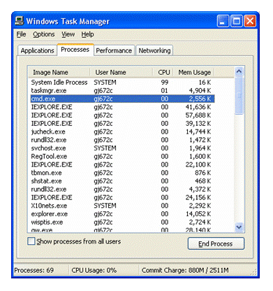
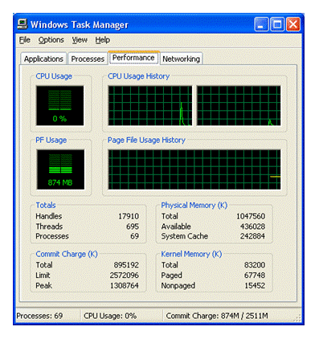
Real Time Performance Monitoring Tools Task Manager

Slide 22
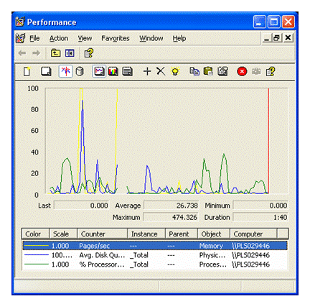
Performance Monitor

Slide 23
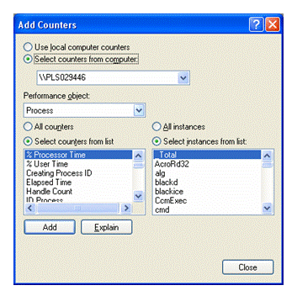
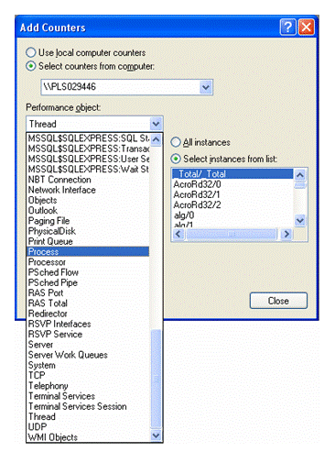

Slide 24
Log-Based Performance Monitoring Tools Event Log Service and Event Viewer
The most commonly used log-based monitoring tool in Windows is the Event Log Service.
The Event Log Service in Windows records all application, security, and system events into logs.
Event Viewer can be used to view the contents of these logs to help identify the cause of system problems or evaluate system performance to predict future problems.

Slide 25
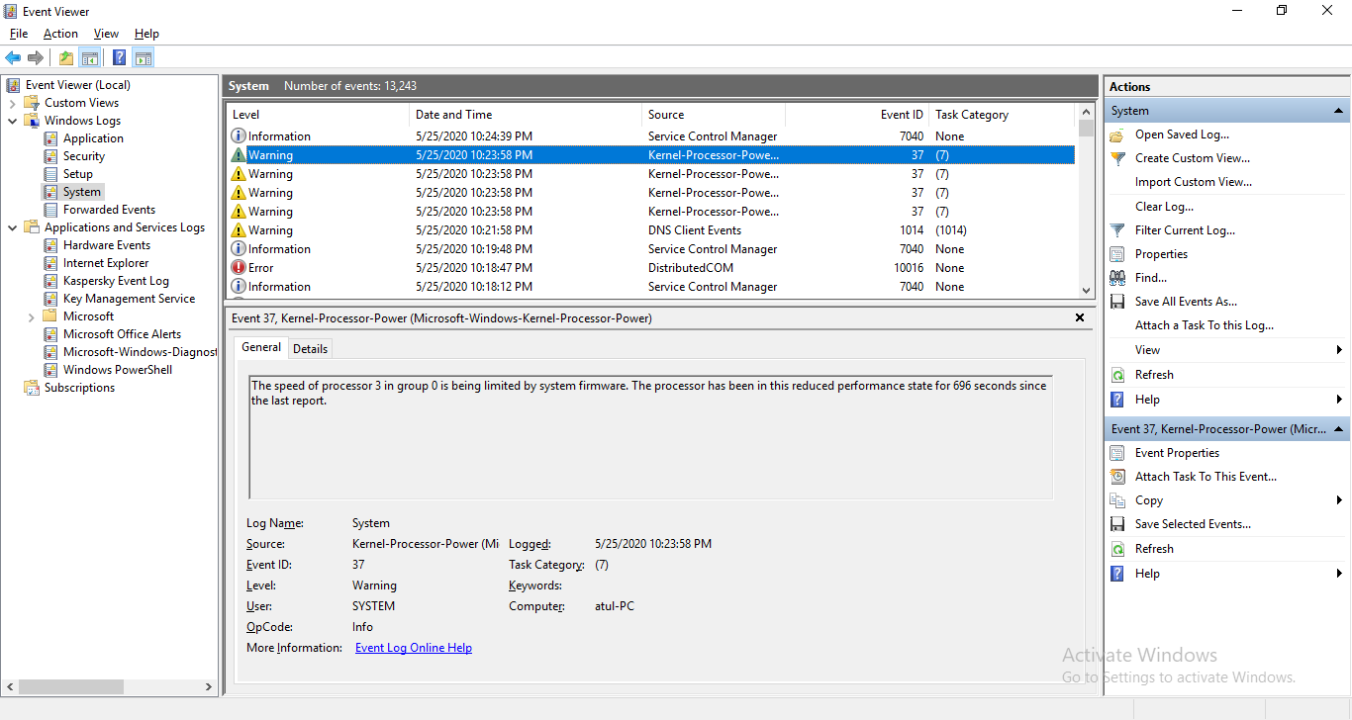
Event Viewer

Slide 26
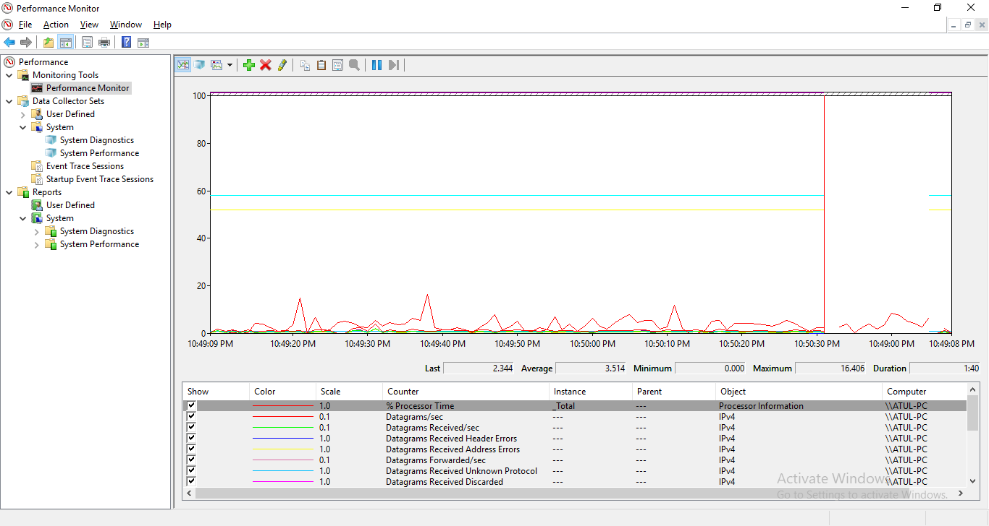
Performance Monitor

Slide 27
Computer Management Tool
Computer Management is a handy console in windows that allows you to view event logs, partition your hard drive , manage devices and services.
How to open :
Press windows logo key +R to open Run box. Type compmgmt.msc & enter.
Right click on This PC icon on your desktop, select Manage.

Slide 28
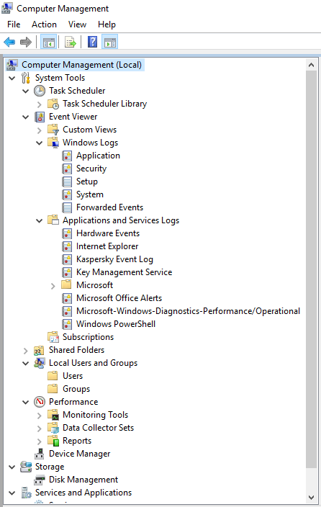
Computer Management (Contd.)

Slide 29
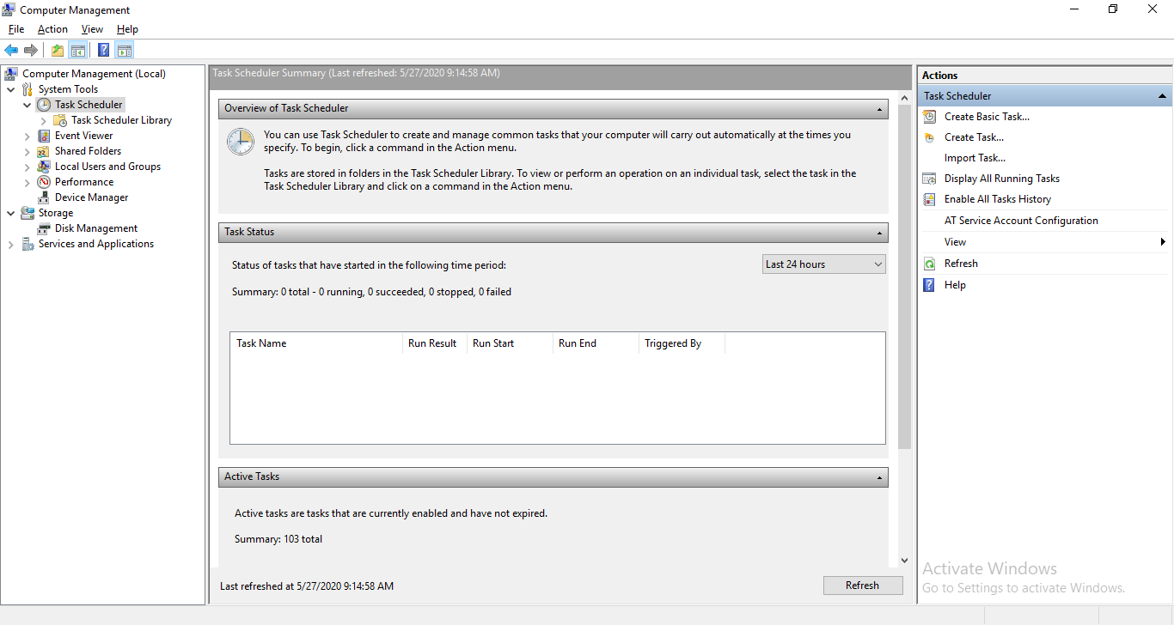
Computer Management :Task Scheduler

Slide 30
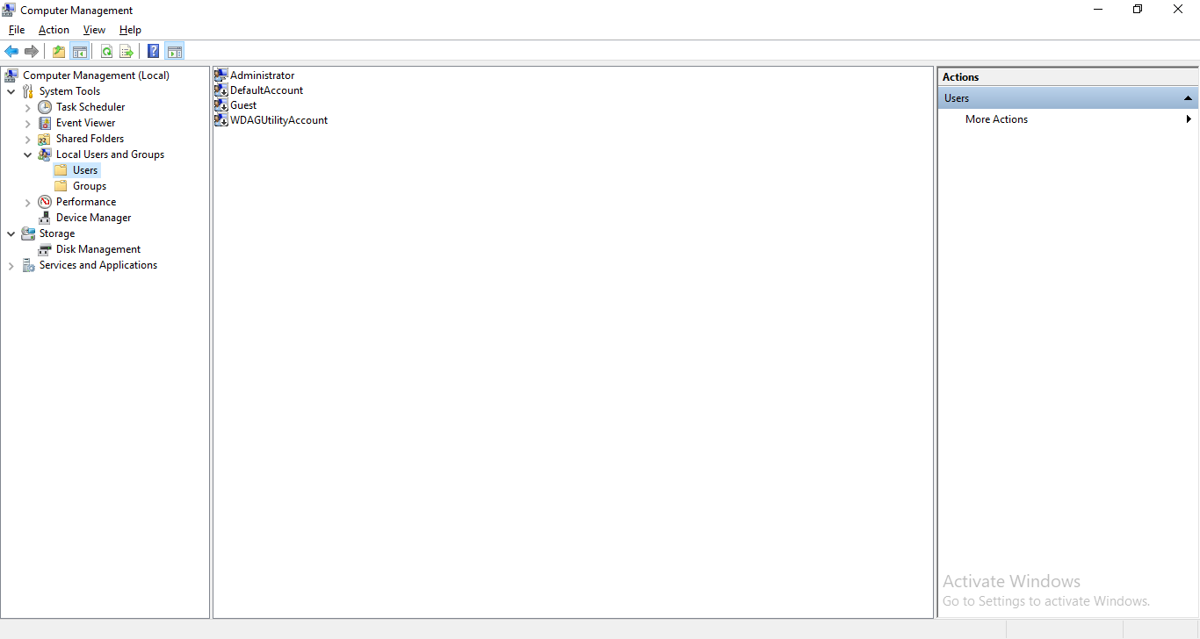
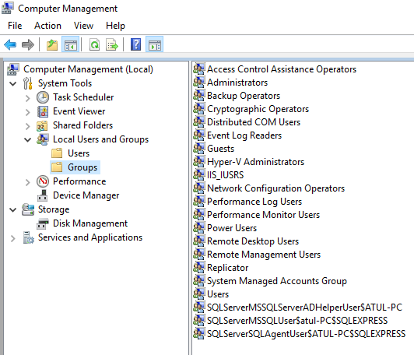
User Management :Security Policy

Slide 31
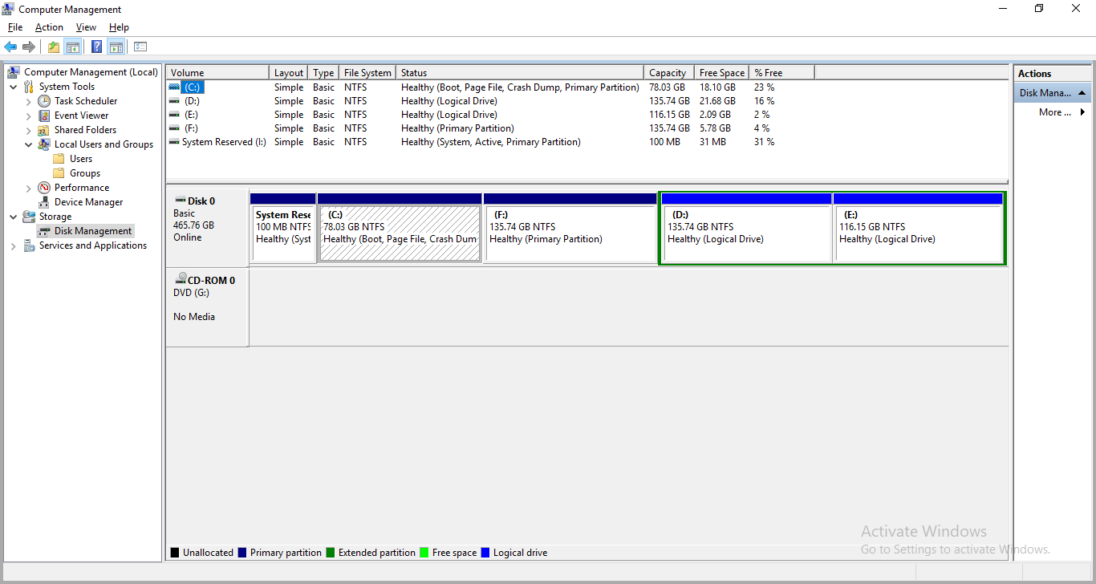
Disk Management

Slide 32
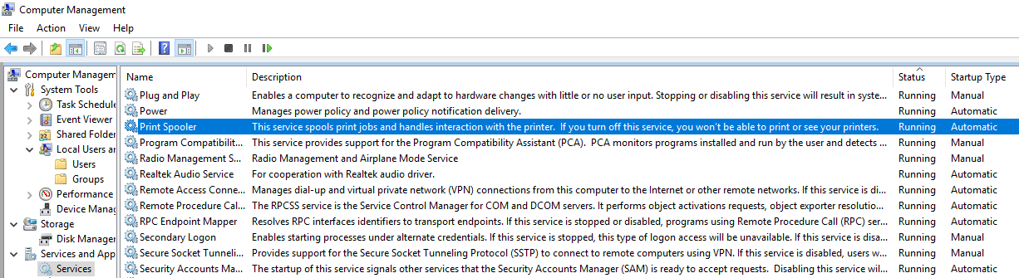
Services and Applications

Slide 33
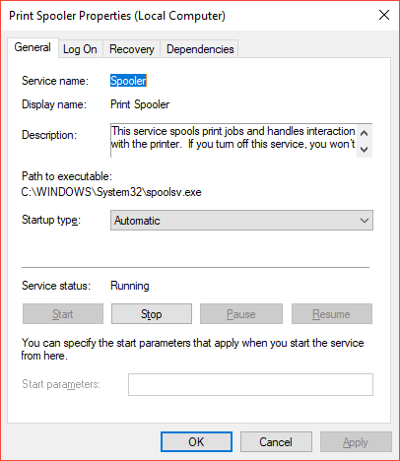
Print Spooler Service

Slide 34
Command Line Tools to Monitor Linux Performance
Top – Linux Process Monitoring:
The top command used to display all the running and active real-time processes in ordered list and updates it regularly.
It display CPU usage, Memory usage, Swap Memory, Cache Size, Buffer Size, Process PID, User, Commands and much more. It also shows high memory and cpu utilization of a running processsess.

Slide 35
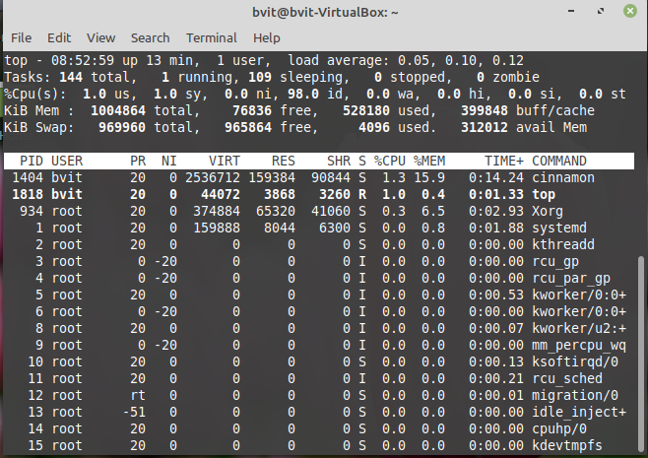

Slide 36
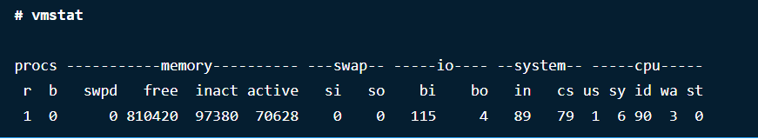
VmStat – Virtual Memory Statistics
Linux VmStat command used to display statistics of virtual memory, kernel threads, disks, system processes, I/O blocks, interrupts, CPU activity and much more.

Slide 37
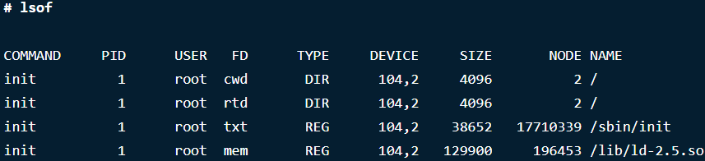
Lsof – List Open Files
Lsof command used in many Linux/Unix like system that is used to display list of all the open files and the processes. The open files included are disk files, network sockets, pipes, devices and processes.
One of the main reason for using this command is when a disk cannot be unmounted and displays the error that files are being used or opened. With this commmand you can easily identify which files are in use.

Slide 38
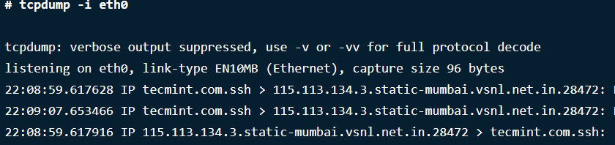
Tcpdump – Network Packet Analyzer
Tcpdump one of the most widely used command-line network packet analyzer or packets sniffer program that is used capture or filter TCP/IP packets that received or transferred on a specific interface over a network.
It also provides a option to save captured packages in a file for later analysis.

Slide 39
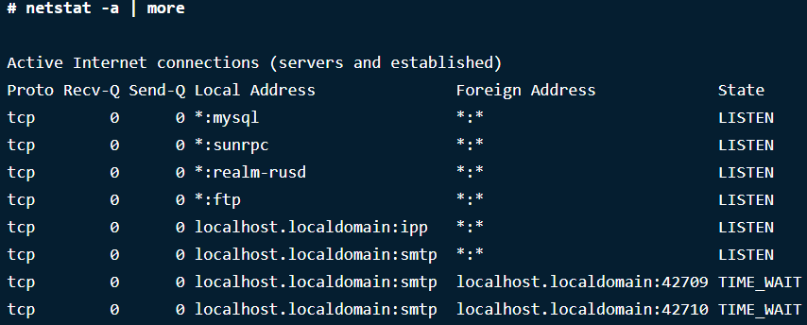
Netstat – Network Statistics
Netstat is a command line tool for monitoring incoming and outgoing network packets statistics as well as interface statistics.

