Slide 1
Unit 2 : Types and Levels of Testing
(18 Marks)
By:Vijaya Chavan

Slide 2
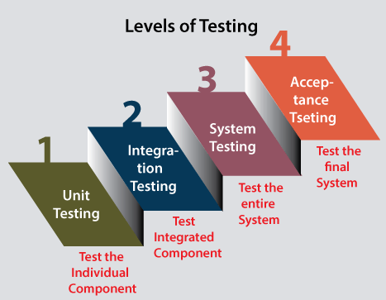

Slide 3
1.Levels of Testing:
1. Unit Testing:
This is the first level of testing done by the developers themselves before handling the software to the testing team to ensure that its individual units are working as expected.
It is done to segregate small, individual units of the software and check if they are developed as per the requirements.
Thus unit testing is done to catch bugs at the early stages of the SDLC. It identifies the regression defects as well.
The effort and cost of doing unit testing is not high, and it helps to confirm if the code developed is working properly.
2. Integration Testing:
This is the second level of testing conducted by the testers to verify if multiple unit tested modules are working together collectively without any defects at the integration or at interface of the modules.
It can be done either manually or by automation.
It helps to increase the test coverage and identifies the defects that may come up while multiple units are combined.
The defects detected at this level are easier to fix, than at later stages.

Slide 4
Levels of Testing:
3. System Testing
This is the third level of testing where the entire software comprising all the modules, and sub-modules is tested to ensure that all the requirements are fulfilled.
It covers the end to end flow of testing.
It requires a huge amount of time, effort, and resources to complete system testing.
4. Acceptance Testing
This is the fourth and final level of testing done to verify if the software has been built correctly as per the user requirements and fit to be shipped to production.
It ensures that the software is working as expected in the customer’s environment and it finds bugs or issues just before the software is released to its actual users.
In the acceptance testing, sometimes the software is also tested by the customers themselves, and thus helps in building the customer's confidence, and faith in it.
it requires a lot of planning, and resources to complete it. Any test case can be picked and chosen for acceptance testing by the customers.

Slide 5
Stubs
Definition: Stubs are placeholder implementations or simulated modules that are used in place of actual modules or components that a module being tested depends on.
Purpose: Stubs are used when a module being tested relies on the functionality of another module, which may not be available or fully implemented at the time of testing.
Functionality: Stubs provide basic functionality or predetermined responses that allow the module being tested to proceed with its execution.
Dependency: Stubs represent the dependent modules that the module being tested relies on.
Testing Focus: Stubs are primarily used in top−down testing approaches, where higher−level modules are tested before lower−level modules.
Example: In a client−server architecture, if the client module is being tested, a stub can be used to simulate the server's functionality and respond to the client's requests.

Slide 6
Drivers
Definition: Drivers are software components that enable the testing of a module in isolation by simulating the behavior and functionality of the higher−level modules that interact with it.
Purpose: Drivers are used when a module being tested requires input or interaction from other modules that are not yet developed or available.
Functionality: Drivers provide the necessary input or interaction to the module being tested to simulate the behavior of the higher−level modules.
Dependency: Drivers represent the calling modules that interact with the module being tested.
Testing Focus: Drivers are commonly used in bottom−up testing approaches, where lower−level modules are tested before higher−level modules.
Example: In a software system with a layered architecture, if the core processing module is being tested, a driver can be used to simulate the behavior of the user interface module and provide input to the core processing module.

Slide 7
Advantages of Unit Testing
Unit testing helps the developers to improve the code and make each software component work properly.
It allows testing of independent clusters of the software without depending on other clusters.
It allows early detection of defects in the initial stages of SDLC, and to fix them quickly.
It helps the developers to build confidence on the code they developed by enhancing its quality.
Unit testing helps to resolve the defects faster without requiring to wait for the development of all the modules of the software.
It assists the developers to refactor the code safely without breaking the existing functionalities.
Unit testing saves a lot of time and resources as fixing defects at the early stages of SDLC is easier and faster than at the later stages.

Slide 8
Disadvantages of Unit Testing
It requires time to develop and maintain test cases for unit testing and modify them as the requirements change.
It only identifies defects on individual units of the software and not on the integration of the units.
It cannot detect errors in the user interface of the software.
Unit testing does not include non-functional requirements of the software such as scalability, security, reliability, responsiveness, usability etc.
The quality of the unit testing depends solely on how well the unit test cases are written by the developers.
The developers face problems performing unit testing on complex applications as it is difficult to segregate their individual components and verify them.
Unit testing does not involve testing of all the execution paths within the tested module.

Slide 9
2.Integration Testing
INTEGRATION TESTING is defined as a type of testing where software modules are integrated logically and tested as a group.
A typical software project consists of multiple software modules, coded by different programmers.
The purpose of this level of testing is to expose defects in the interaction between these software modules when they are integrated
Determining the correctness of interfaces is the integration testing.

Slide 10
WHY INTEGRATION TESTING REQUIERED?
Integration Testing becomes necessary to verify the software modules work in unity.
Data may be lost during interfacing.
Global data may also cause problems.
Sub functions may not work properly when combined together.
Unit test components taken one by one and integrated incrementally.
Debugging and fault isolation become easier.

Slide 11
Types of Integration Testing
a) Top Down Integration
b) Bottom Up Integration
c) Bidirectional / Sandwich Integration

Slide 12
a) Top Down Integration
In top down integration , the top level of the application is tested first and then it goes downward till it reaches the final component of the system.
It is also referred as incremental integration testing technique.
Lower level modules are simulated by stubs which mimic functionality of lower level modules, as you add lower level code , stubs will replace with actual components.
It needs design & implementation of stubs so drivers may not be required as we go downward as earlier phase will act as driver for latter phase .

Slide 13
Top Down Integration
M1
Top Down integration can be performed in depth first or breadth first manner:
1. Breadth first :All modules directly subordinate at each level are integrated together
2. Depth first: All modules on a path are integrated first
System
M2
M8
Module1
Module2
Module3
M3
M6
M4
M7
Unit1
Unit2
Unit3
M5

Slide 14
Advantages & Disadvantages
Advantages:
Fault Localization is easier.
Possibility to obtain an early prototype.
Critical Modules are tested on priority; major design flaws could be found and fixed first.
Disadvantages:
Needs many Stubs.
Modules at a lower level are tested inadequately.

Slide 15
b) Bottom Up Approach
It is opposite of top down integration.
It focuses on testing the bottom part/individual unit first and then goes upward by integrating testing & working units for system testing & inter system testing.
In bottom up integration each sub-system is tested separately & then the full system is tested.

Slide 16
Bottom up Integration Testing
M1
Top Down integration can be performed in depth first or breadth first manner:
1. Breadth first :All modules directly subordinate at each level are integrated together
2. Depth first: All modules on a path are integrated first
M1
M2
M3
M2
M3
Driver2
a) Program Module
b) Bottom up Integration applied to a)
M4
M5
M4
M5
M6
M7
Driver1
M6
M7

Slide 17
Advantages & Disadvantages
Advantages:
Fault localization is easier.
No time is wasted waiting for all modules to be developed unlike Big-bang approach
Disadvantages:
Critical modules (at the top level of software architecture) which control the flow of application are tested last and may be prone to defects.
An early prototype is not possible

Slide 18
c) Bi-Directional/Mixed/Sandwich Integration
It combines both top down and bottom up integration.
It defines testing into two parts & follows both parts starting from both ends i.e. top down and bottom up either simultaneously or one after another
Top down testing starts only after the top level modules have been tested similarly bottom up testing can start only after bottom level modules are ready and tested.
In sandwich approach testing can start as and when modules become available.

Slide 19
Bi-Directional/Mixed/Sandwich Integration
System
Sub-System
1
Sub-System
2
Sub-System
3
Unit1
Unit2
Unit3

Slide 20
Testing on web page application
Functionality Testing: Link Testing, Web Form Testing Cookies Testing
Usability Testing: Navigation Testing, Content Testing,
Compatibility Testing: Browser Compatibility Testing, OS Compatibility Testing , Mobile Testing
Database Testing
Interface Testing
Performance Testing
Security Testing (Captcha)

Slide 21
Performance testing
Performance testing occurs throughout all steps in testing process.
Performance testing checks
Speed
Response time
Reliability
Resource usage
Scalability
Purpose : Performance Testing is not to find functional defects but to eliminate performance bottlenecks in the software or device.
It focuses on
Speed - Determines whether the application responds quickly.
Scalability - Determines maximum user load the software application can handle.
Stability - Determines if the application is stable under varying loads.

Slide 22
Factors that governs Performance testing
Throughput
Response time
Tuning
Benchmarking
Performance testing Techniques:
1.Load Testing : Checks behaviour of the system under a specific load
2.Stress Testing :Finds upper limit capacity (maximum load)of the system)
3.Soak Testing: Determines the system parameters(e.g. memory utilization) under continuous load
4.Spike Testing: Performed by increasing number of users suddenly

Slide 23
Performance testing Process:
Identify the testing environment.
Identify performance metrics.
Plan and design performance tests.
Configure the test environment.
Implement the test design.
Run the tests.
Analyze ,tune , retest
Example Performance Test Cases:
Checks response time which is not more than 4 secs when 1000 users access the website simultaneously.
Check the maximum number of users that the application can handle before it crashes.
Check database execution time when 500 records are read/written simultaneously.
Verify response time of the application under low, normal, moderate and heavy load conditions.

Slide 24
1. Load testing
Load testing determines a system's performance under a specific expected load.
Load Test is to determine how the application behaves when multiple users access it simultaneously.
Load Testing is to ensure smooth functioning of the software under real-life load conditions.
Load Testing is non functional testing type and is a subset of Performance Testing
Load testing gives confidence in the system & its reliability and performance.
Load Testing helps identify the bottlenecks in the system under heavy user stress scenarios before they happen in a production environment.

Slide 25
Examples of load testing
Downloading a series of large files from the internet
Running multiple applications on a computer or server simultaneously
Assigning many jobs to a printer in a queue
Subjecting a server to a large amount of traffic
Writing and reading data to and from a hard disk continuously

Slide 26
Advantages & Disadvantages of Load testing:
Advantages of Load testing:
Performance bottlenecks identification before production
Improves the scalability of the system
Minimize risk related to system downtime
Reduced costs of failure
Increase customer satisfaction
Disadvantages of Load testing:
Need programming knowledge to use load testing tools.
Tools can be expensive as pricing depends on the number of virtual users supported.

Slide 27
Stress testing
Stress testing is designed to determine behaviour of the software under abnormal situations
It measures the system on its robustness and error handling capabilities under extremely heavy load conditions.
Stress Testing is done to make sure that the system would not crash under crunch situations.
It even tests beyond the normal operating point and evaluates how the system works under those extreme conditions
Need for Stress Testing
To check whether the system works under abnormal conditions.
Displaying appropriate error message when the system is under stress.
System failure under extreme conditions could result in enormous revenue loss
It is better to be prepared for extreme conditions by executing Stress Testing.

Slide 28
Examples of Stress testing
E-commerce websites during mega sales
University websites publishing exam results
News or an important event that boosts traffic to news websites or blogs
Fluctuations in the stock market
Simulating a large number of visitors to an ecommerce application
Testing the number of users that can be handled by an application or website

Slide 29
Advantages of Stress testing
Identifying security problems, data issues, and bugs.
Determining how stable and strong the system is.
Evaluating system behavior after failure and ensuring quick recovery.
Preparing for extreme conditions.
Avoiding revenue and other losses due to failure.

Slide 30
Difference between Load Testing & Stress Testing
 | Load Testing | Stress Testing
 | Load Testing is a type of performance testing that determines the performance of a different application under real-life-based load conditions. | Stress Testing is performed to test the robustness of the system or software application under extreme load.
 | In load testing load limit is the threshold of a break. | In stress testing load limit is above the threshold of a break.
 | In load testing, the performance of the software is tested under multiple users. | In stress testing, the performance is tested under varying data amounts.
 | Huge number of users. | There are too many users and too much data.
 | Load testing is performed to find out the upper limit of the system or application. | Stress testing is performed to find the behavior of the system under pressure.
 | The factor tested during load testing is performance. | The factor tested during stress testing is robustness and stability.
 | Load testing determines the operating capacity of a system or application. | Stress testing ensures system security.
 | The purpose of load testing is to generate more traffic for a web application. | The goal of stress testing is to prevent server crashes under sudden, high loads for an extended period.
 | Load testing is useful in finding bugs like memory overflows, etc., finding the adequacy of current infrastructure in running the applications, determining the number of concurrent users an application can handle, checking and checking for the application’s scalability for accommodating more users, and more. | Stress testing is useful as it aids the testing unit by testing the system in failure situations, checking for data saving by the system before it crashes, seeing if any unanticipated failures potentially harm the security of the system, and more.

Slide 31
SECURITY TESTING
It is a process to determine whether system protect data and maintains functionality as intended.
It is a type of Software Testing, Non functional testing that uncovers vulnerabilities, threats , risks in a software application
It prevents malicious attacks from intruders.
Security testing is a process intended to reveal flaws in the security mechanisms of an information system that protect data and maintain functionality as it is intended.
Passwords, Encryption, Hardware permission devices ,Authorization Levels of access to information.
Basic Principles of Security Testing:
Authentication
Authorization
Confidentiality
Non-repudiation
Availability
Integrity

Slide 32
Goal of security testing
The goal of security testing is to identify the threats in the system and measure its potential vulnerabilities.
System does not stop functioning or is exploited.
It also helps in detecting all possible security risks in the system and help developers in fixing these problems through coding.
Examples of Security Testing:
Spoofing Identity
Tampering with data
Repudiation
Information Disclosure
Denial of Service (DoS)

Slide 33
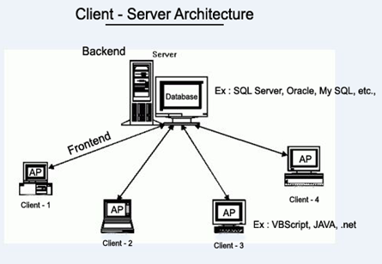
Client Server Testing
Client-server testing is a software testing methodology focused on evaluating the performance, functionality, and reliability of applications and systems built on a client-server architecture.

Slide 34
Client Server Testing approaches
Component Testing
Integration Testing
Performance Testing
Concurrency Testing
Compatibility Testing
Testing for Extended Period

Slide 35
Acceptance Testing
Acceptance Testing is an important aspect of Software Testing, which guarantees that software aligns with user needs and business requirements.
It is done by end user.
Real world environment testing.
It is verification of software requirements according to requirement specified in requirement specification document.
The major aim of this test is to evaluate the compliance of the system with the business requirements and assess whether it is acceptable for delivery or not.
Last stage of testing before delivering the software to customer.
To test flow of control from start to end.
Two or more end users will test the software product.

Slide 36
Types of Acceptance Testing:
User Acceptance Testing
Business Acceptance Testing
Alpha Testing
Beta Testing

Slide 37
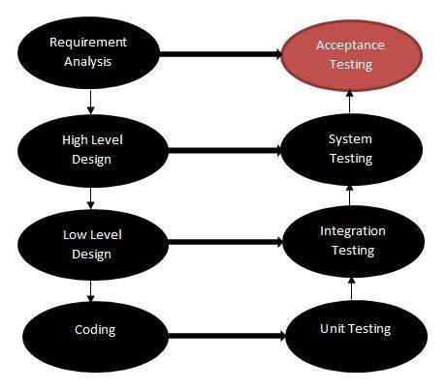
Acceptance testing in SDLC
Acceptance Criteria: Acceptance criteria may work at each stage of SDLC & testing start from proposal stage till the system is finally accepted by customer

Slide 38
Alpha Testing
Alpha testing is a software testing stage that takes place early in the development process, typically after the code has been written and before the final product is released to the public.
Alpha testing is performed by a select group of internal stakeholders, such as developers, testers, and members of the product team.
The purpose of alpha testing is to identify and resolve critical bugs and issues in the software before it is released to the public.
Alpha testing is performed in a controlled environment, such as a lab or a test network, and is used to simulate real-world use cases and identify any potential problems.
It includes two phases:
By developer.
By QA staff.

Slide 39

Alpha Testing Approach
Customer Test
Software
Developer Site

Slide 40
Beta testing
Beta testing is the process of testing a software product or service in a real-world environment before its official release.
It is an essential step in the software development lifecycle as it helps identify bugs and errors that may have been missed during the development process.
During beta testing, the software is made available to a selected group of users who are willing to test the product and provide feedback to the developers.
The beta testers typically use the software in various ways, attempting to find any issues, bugs, or usability problems.
They then provide feedback on their experience, reporting any issues or issues encountered.

Slide 41
Beta testing
It is performed at the location of customer.
In this testing intended users will test the software to determine whether the software is satisfying their needs and expectations.
Beta testing allows users to test software before it is released to public.
It minimizes the product failure risk.
It delivers quality product.

Slide 42
Beta Testing Approach
Customer Test
Software
Developer Site

Slide 43
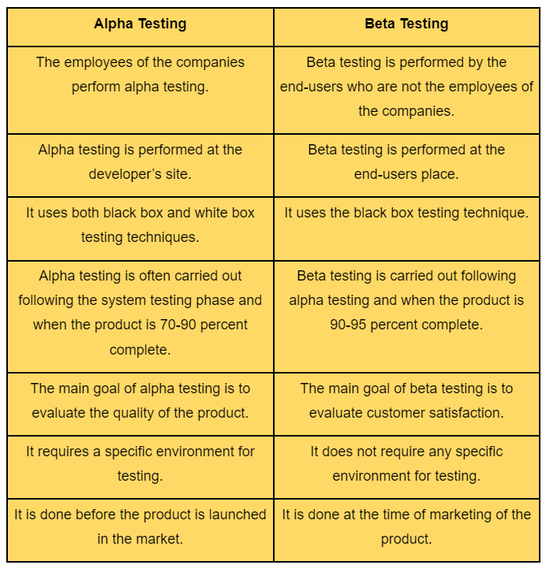
Difference between alpha and beta testing

Slide 44
Special Tests: 1.Regression Testing
Software testing which confirms that change in existing code has not adversely affected in current features.
It is process of testing modifications to system to ensure that system is still functioning well with the new changes.
Regression testing is performed when code is changed or
new features are added to satisfy business needs when defects are fixed or performance issues are fixed.
To maintain quality of software with modification.

Slide 45
1.Regression testing
Regression testing is applied under these circumstances:
A new requirement is added to an existing feature.
A new feature or functionality is added.
The codebase is fixed to solve defects.
The source code is optimized to improve performance.
Changes in configuration.

Slide 46
2. GUI Testing
Any application is good if it is user friendly and look and feel is good.
It is not only limited for desktop but also smartphones and tablets.
GUI testing is used for images and text buttons to validate their functions.
In this testing graphical icons are tested like:
Radio Button
Check Box
Text Box
List Box
Menu
Dialog Box
Bars.

Slide 47
3. Smoke testing
Smoke testing involves testing basic functionality of software application to ensure that application is living and one can work on it.
It is performed without any user input.
Smoke testing term came from hardware testing.
Smoke testing, also known as “Build Verification Testing” or “Build Acceptance Testing,” that is typically performed at the beginning of the development process to ensure that the most critical functions of a software application are working correctly.
It is used to quickly identify and fix any major issues with the software before more detailed testing is performed.

Slide 48
4. Sanity testing
Sanity testing is performed to test the major functionality or behavior of the system
Sanity testing aims to quickly evaluate whether the basic functionality of a new software build is working correctly or not.
It is usually performed on builds that are in the initial stages of development before the full regression testing is performed. Sanity testing is limited in scope and typically focuses on critical functionality and does not aim to uncover every possible error or bug in the system.
It is a quick and lightweight way to ensure that the software is functioning as expected before further testing is conducted.

Slide 49
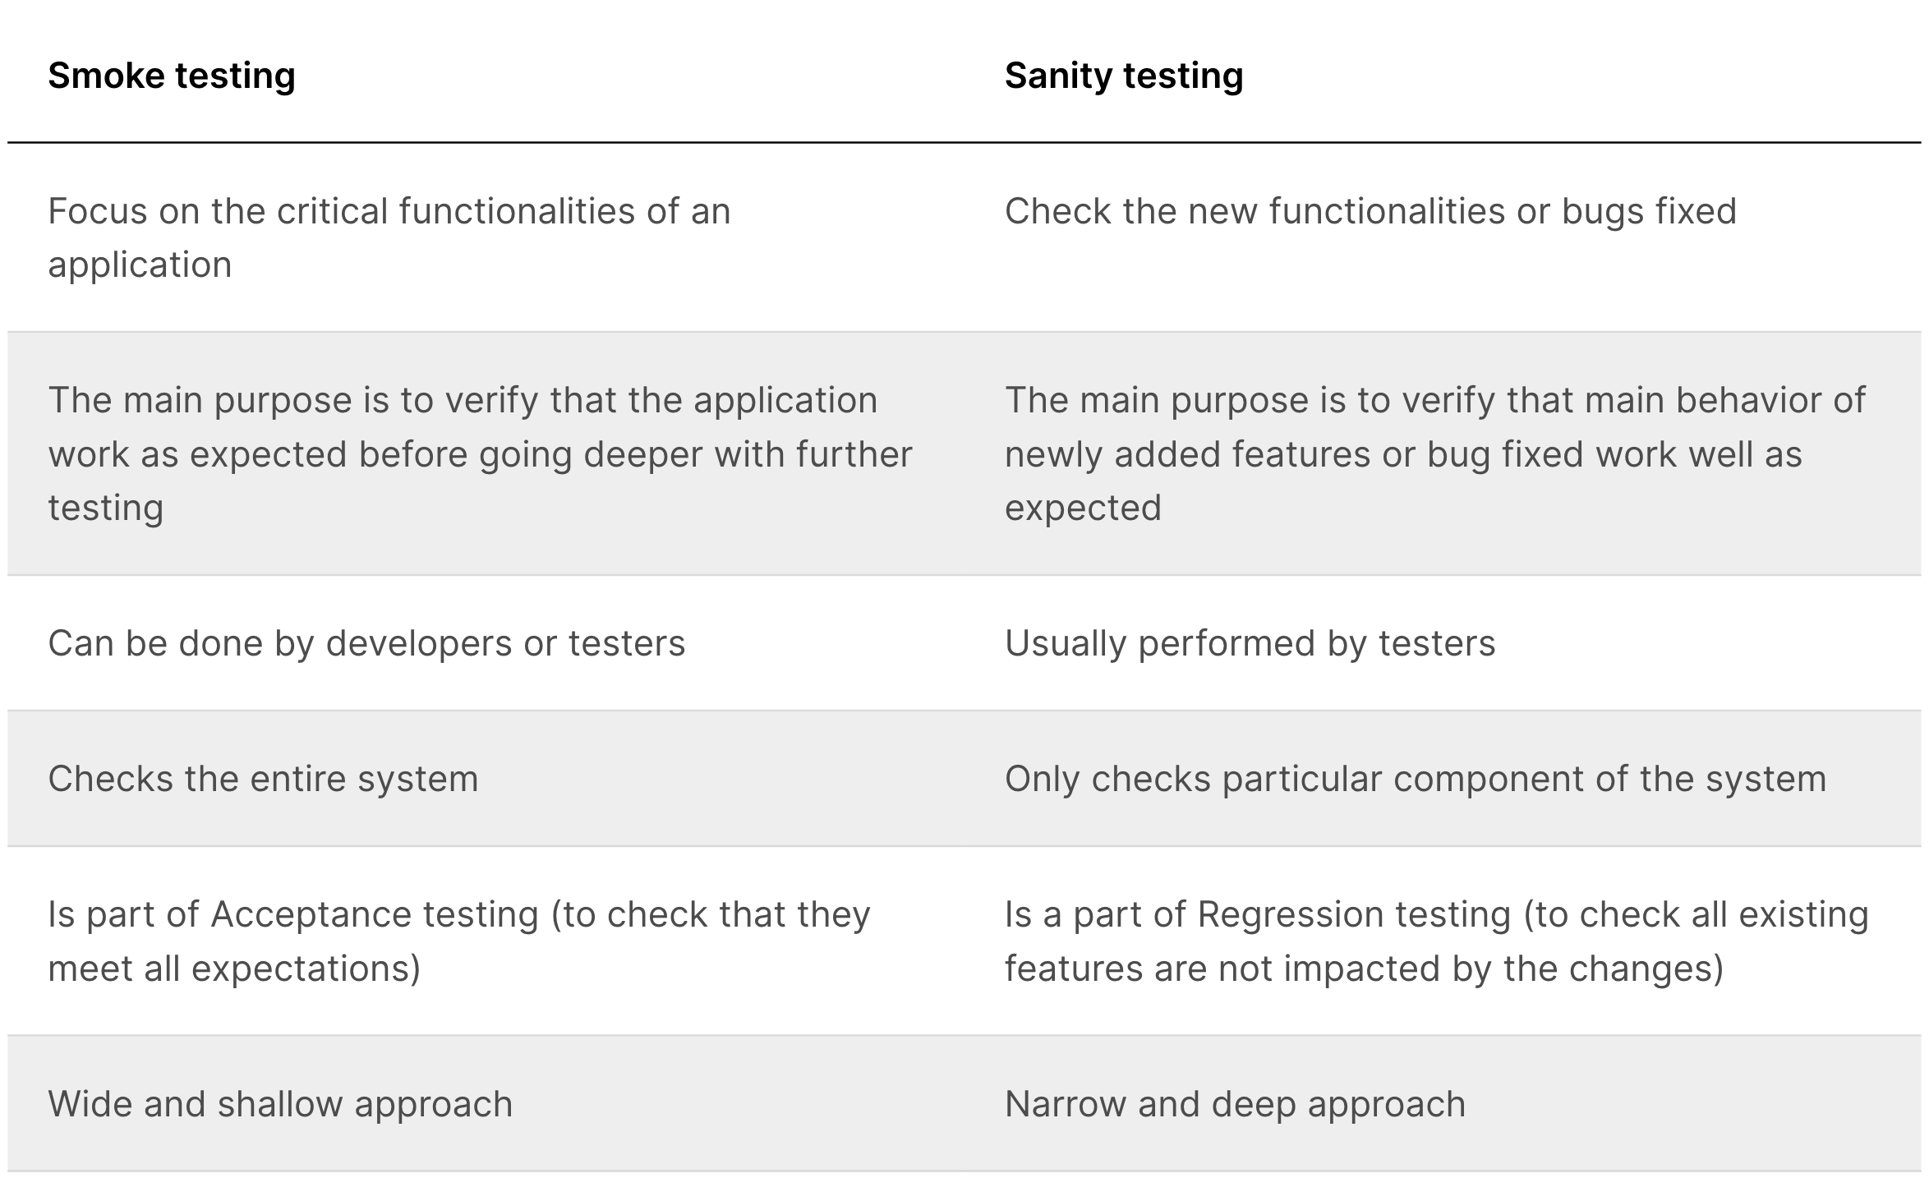
sanity testing vs smoke testing

Slide 50
Thank You

