Slide 1
Unit-III Error Detection and Correction

Slide 2
What is a error
Error is a condition when the receiver’s information does not match the sender’s. Digital signals suffer from noise during transmission that can introduce errors in the binary bits traveling from sender to receiver. That means a 0 bit may change to 1 or a 1 bit may change to 0.
There are 2 types of error
Single-Bit Error
Burst Error

Slide 3
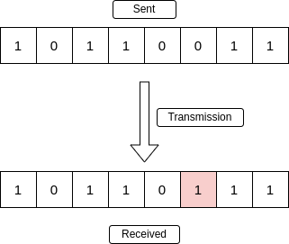
Types of Errors
Single-Bit Error:
Term single bit error means that only 1 bit of given data is changed from 1 to 0 or from 0 to 1.
A single-bit error refers to a type of data transmission error that occurs when one bit (i.e., a single binary digit) of a transmitted data unit is altered during transmission, resulting in an incorrect or corrupted data unit.

Slide 4
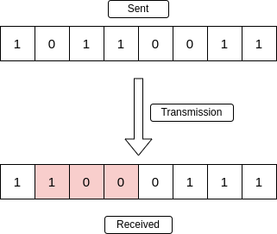
3. Burst Error:
The term burst error means that two or more bits in data have changed from 0 to 1 or from 1 to 0
When several consecutive bits are flipped mistakenly in digital transmission, it creates a burst error.

Slide 5
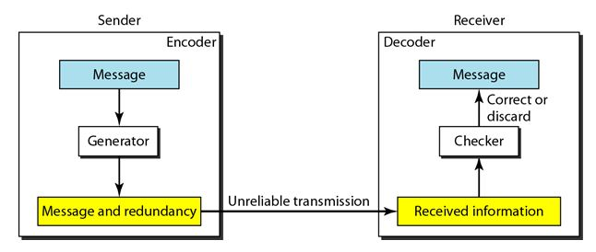
Forward Error Correction Versus Retransmission
Forward error correction FEC: it is the process in which the receiver tries to guess the message by using redundant bits(Redundant bits are extra binary digits that are added to data to detect or correct errors during transmission).
Forward error correction is a redundant data that is added to the message on the sender side.
Retransmission :it is a technique in which the receiver detects the occurrence of an error and asks the sender to resend the message.
In this fig. the sender add redundant bits through a process that creates a relationship between the redundant bits and the actual data bits.
The receiver checks relationships between two sets to detect or correct the errors.

Slide 6
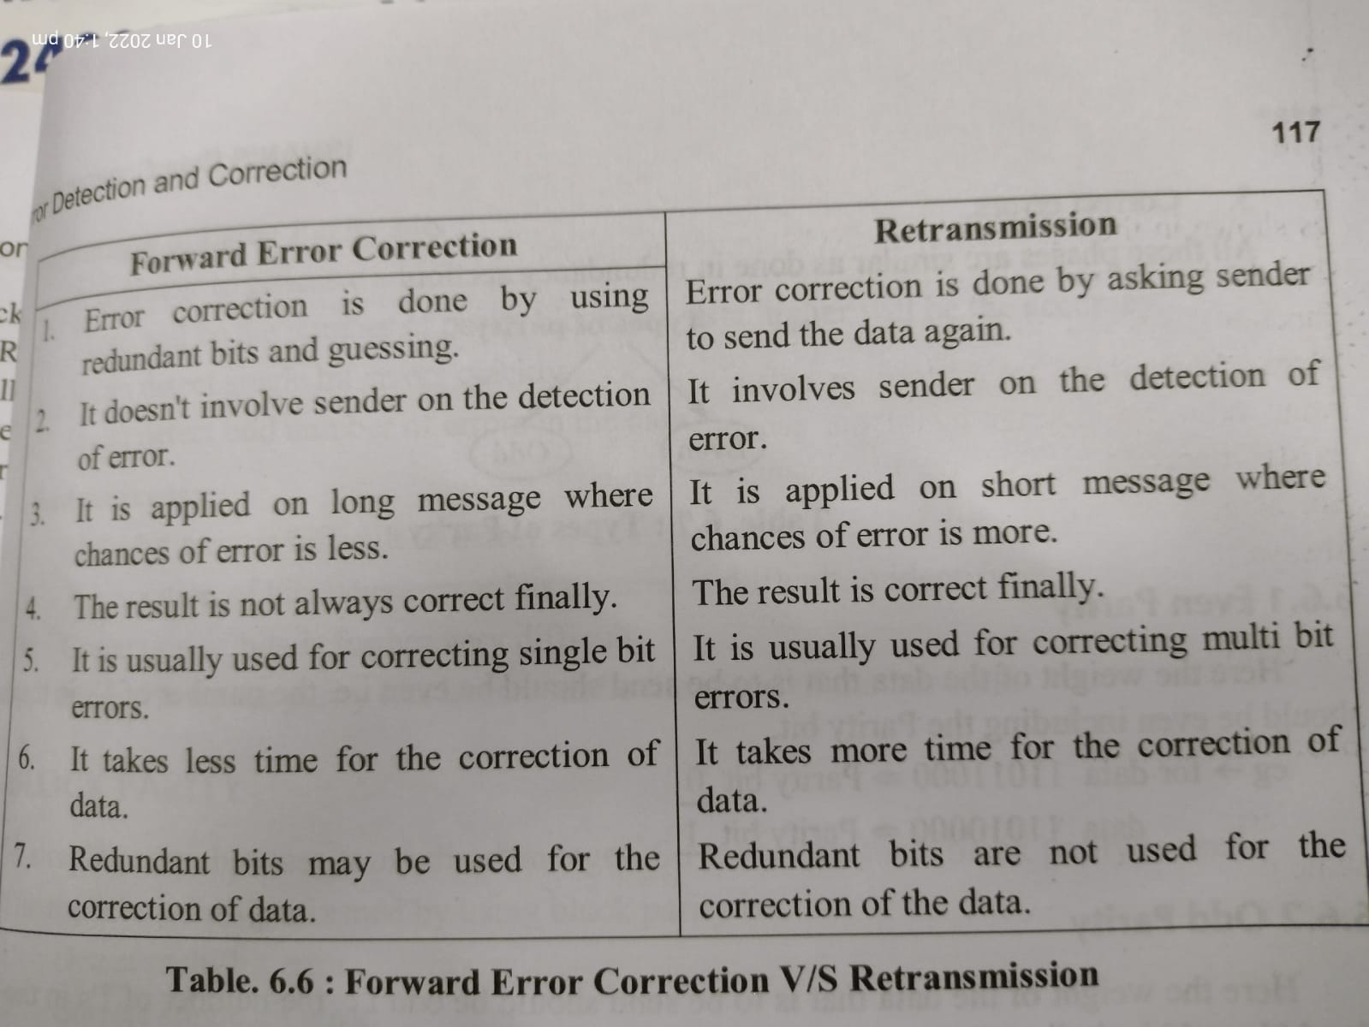

Slide 7
Error Detection:
error detection refers to the methods and techniques used to identify errors that may occur during the transmission or storage of data.
Types of error detection:
Parity bits(Vertical Redundancy Check)
CRC
Checksum
Repetition codes

Slide 8
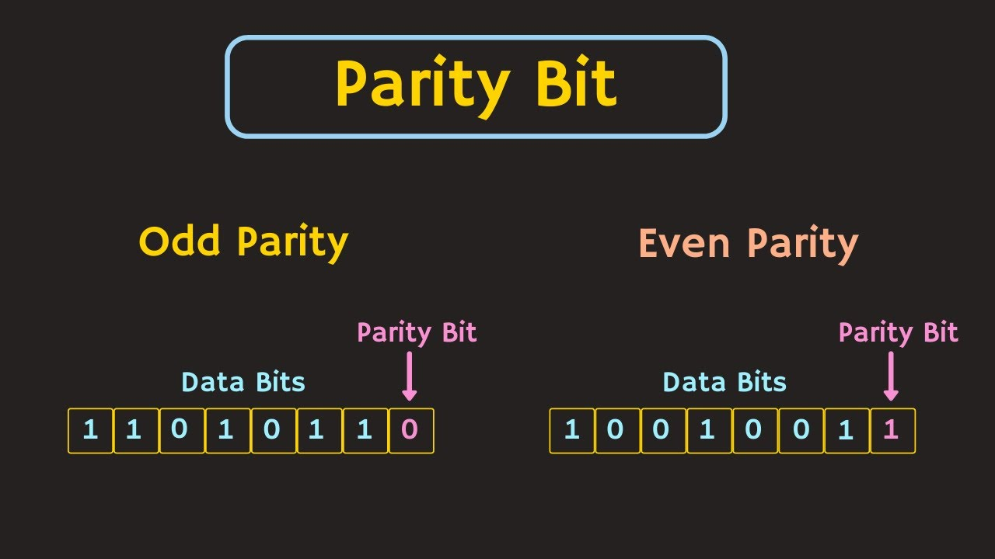
Parity bits(Vertical Redundancy Check):
The parity check is done by adding an extra bit(parity) to the data to make number of 1s either even or odd depending upon the type of parity.
At sender side:
While creating a frame, the sender counts the number of 1s in it and adds the parity bit in following way:
In case of odd parity: if the number of 1s is odd then parity bit value is 0.if number of 1s is even then parity bit value is 1
In case of even parity: if the number of 1s is even then parity bit value is 0.if number of 1s is odd then parity bit value is 1

Slide 9
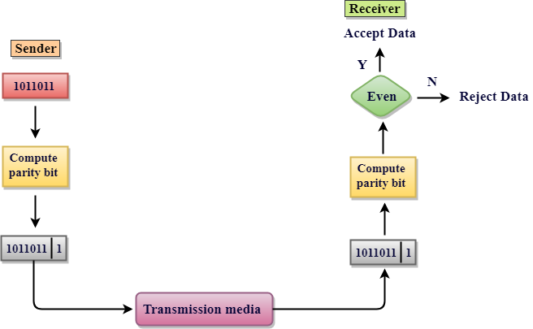
At receiver side:
On receiving a frame, the receiver counts the number of 1s in it.
In case of even parity: if the count of 1s is even, the frame is accepted, otherwise it is rejected.
In case of odd parity: if the count of 1s is odd, the frame is accepted, otherwise it is rejected.
The basic idea of VRC or parity bit check is shown in fig.
In data communication, parity checking refers to the use of
parity bits to check that data has been transmitted accurately.
The parity bit is added to every data unit that are transmitted.
Advantage of parity bit is to detect all single bit errors.

Slide 10
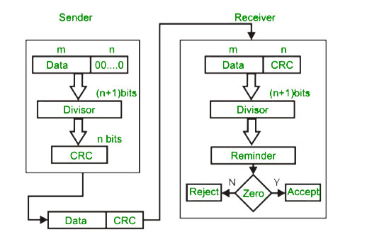
CYCLIC REDUNDENCY CODE
CRC is a technique involves binary division of data bits being sent.
The deviser is generated using the polynomials.
The sender perform a division operation on the bits being sent and calculates the reminder.
Before sending the actual bits, the sender adds the reminder at the end of the calculated bits.
Actual data plus reminder is called as codeword.
The sender transmit data bits as codewords.
The receiver perform division operation on codewords using
the same CRC deviser.
if the reminder contains all zeroes the data bits are accepted,
otherwise it is considered as there some data corrupted
and is therefore rejected
Fig shows CRC generator and checker.

Slide 11
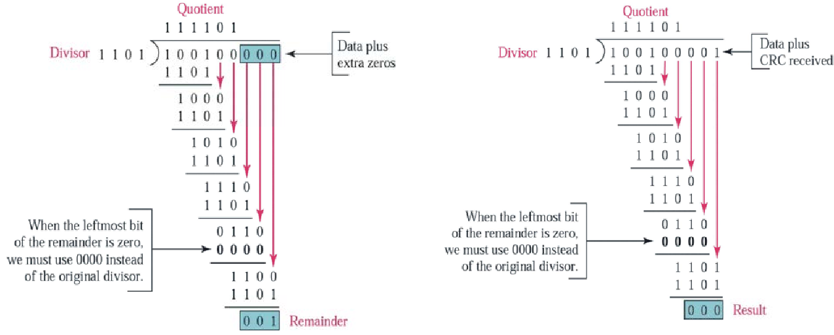
Advantages of CRC:
CRC detect larger proportion of the possible errors.
CRC can be efficiently applied larger blocks of data
Example of CRC:

Slide 12
Difference Between VRC and CRC
VRC | CRC
VRC stands for Vertical redundancy Check | CRC stands for cyclic redundancy check
VRC used to check single bit error. | CRC is used to check multi-bit error.
The parity bits(even or odd) becomes the VRC value. | The remainder of this division operation becomes the CRC value.
VRC is very easy to implement | CRC is very complex to implement.

Slide 13
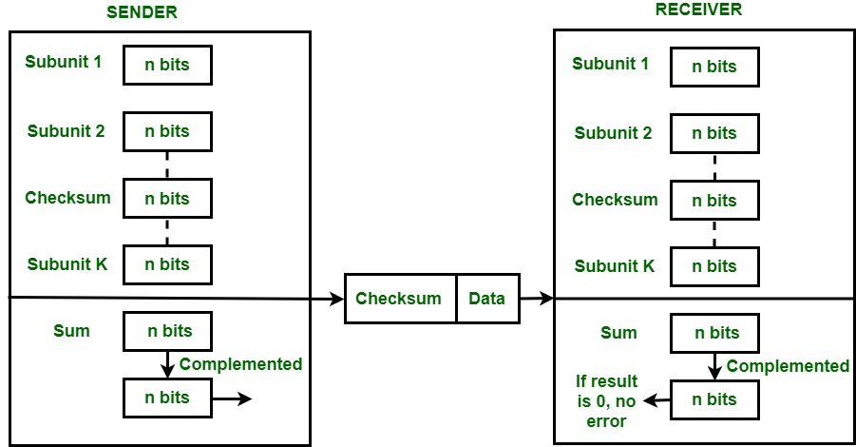
Checksum
Checksum is an error detection technique in which a message is a modular arithmetic sum of message code words of fixed word length.
Procedure:
Sender side:
The unit is divided into k sections, each of n bits.
All sections are added together to get the sum.
The sum is complemented and becomes the checksum.
The checksum is sent with the data to the receiver.
Receiver side:
The unit is divided into k sections, each of n bits.
All sections are added together with the checksum
which is received by the sender to get the sum.
The sum is complemented.
If the result is zero, the data are accepted; otherwise
rejected.

Slide 14
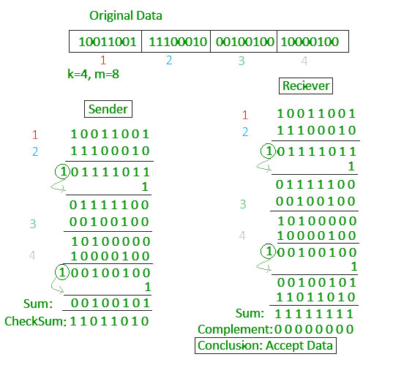
Advantages:
Error Detection: It helps detect data corruption during transmission or storage.
Simple and Fast: Easy to implement with quick calculations.
Example:

Slide 15
Repetition codes
The repetition code is one of the most basic error-correcting codes.
In order to transmit a message over a noisy channel that may corrupt the transmission in few places, the idea of the repetition code is to just repeat the message several times.
A repetition code is a coding scheme that repeats the bits across a channel to achieve error free communication.
Given stream of data to be transmitted, the data are divided into blocks of bits. Each block is transmitted some predetermined number of times.
For example:
Data bit 1011 is send across a channel then these 4 bits data can be repeated 3 times thus producing 1011 1011 1011.
If this 12 bit pattern was received as 1010 1011 1011 ,where the first block is unlike the other two then it can be determined that an error has occurred.
Advantages:
They are extremely simple, and used in applications of both error detection and correction.

Slide 16
Error Correction
Error correction is the detection of errors and reconstruction of the original, error free data.
Error correction refers to techniques used to detect and correct errors in transmitted data, ensuring that the received information matches what was sent.
Error correction done in two ways:
Backward error detection
Forward error detection
There are two types of error correction
Hamming code
Automatic Repeat Request(ARQ)

Slide 17
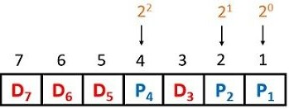
Hamming code:
The Hamming Code method is one of the most effective ways to detect single-data bit errors in the original data at the receiver end.
It is not only used for error detection but is also for correcting errors in the data bit.
Hamming code is an error-correcting code used to ensure data accuracy during transmission or storage.
It adds extra bits to the original data, allowing the system to detect and correct single-bit errors
To solve the data bit issue with the hamming code method, some steps need to be followed:
Calculate The position of the data bits and the number of redundant bits in the original data. The number of redundant bits is calculated from the expression [2^r >= m+r+1].
Fill in the data bits and redundant bit, and find the parity bit value using the expression [2^p, where, p - {0,1,2, …… n}].
Fill the parity bit obtained in the original data and transmit the data to the receiver side.
Check the received data using the parity bit and detect any error in the data, and in case damage is present, use the parity bit value to correct the error.

Slide 18
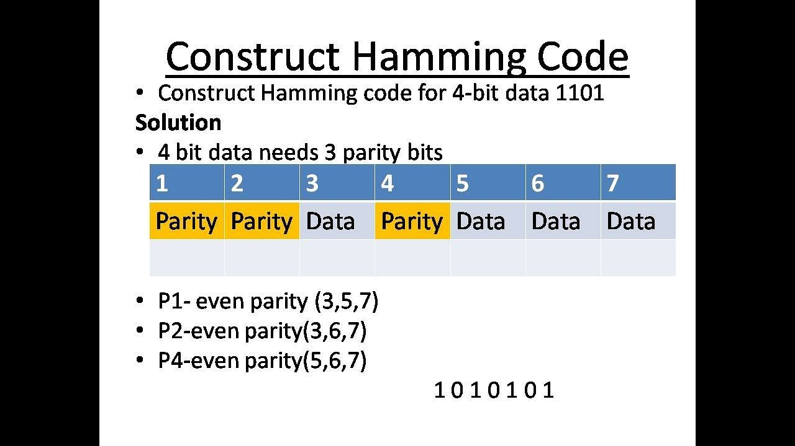
Advantages:
Hamming code uses simple parity check, making it easy to implement.
Hamming code include redundant bits for error correction, so retransmission is not needed.
Example:

Slide 19
2. Automatic Repeat Request(ARQ)
Automatic Repeat Request (ARQ) is an error-control mechanism for data transmission which uses acknowledgements (or negative acknowledgements) and timeouts to achieve reliable data transmission
In an ARQ scheme, the receiver uses an error detection code, typically (CRC), to detect whether the received packet is in error. If no error is detected in the received data, the transmitter is notified by sending a positive acknowledgement. If an error is detected, the receiver discards the packet and sends a negative acknowledgement to the transmitter, and requests a re-transmission.
An Acknowledgement (ACK) or Negative Acknowledgement (NACK) is a short message sent by the receiver to the transmitter to indicate whether it has correctly or incorrectly received a data packet, respectively.
Timeout is a predetermined time interval after the sender sends the packet; if the sender does not receive an acknowledgement before the timeout, it usually re-transmits the packet until it receives an acknowledgement or exceeds a predefined number of re-transmissions.

Slide 20
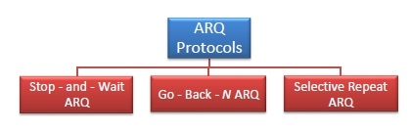
Types of ARQ :

Slide 21
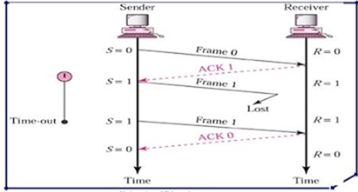
Types of Automatic Repeat Request(ARQ):
Stop – and – Wait ARQ :
In this ARQ the sending end transmit one block of data at a time and then waits for acknowledgments from the receiver.
The sender keeps a copy of the sent frame. It then waits for a finite time to receive a positive acknowledgement from receiver. If a positive acknowledgement is received then the next frame is sent.
If the acknowledgement does not arrive after a certain period of time, the sender times out and retransmits the original frame.

Slide 22
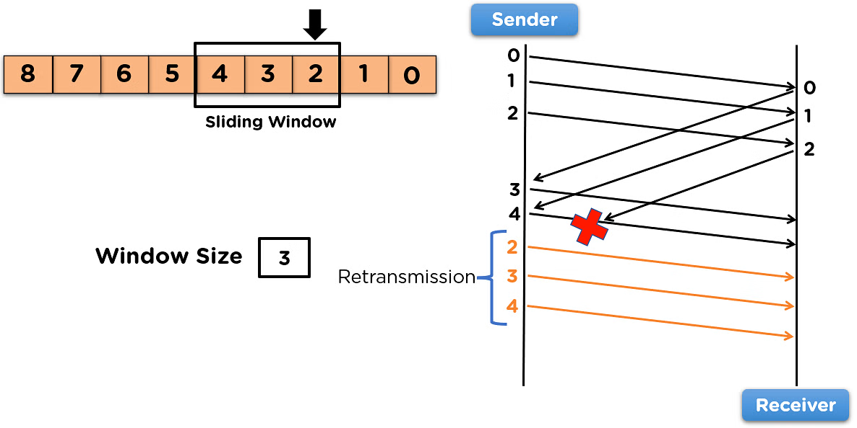
2. Go-Back-N ARQ:
Go – Back – N ARQ provides for sending multiple frames before receiving the acknowledgement for the first frame. It uses the concept of sliding window.
The frames are sequentially numbered and a finite number of frames are sent.
If the acknowledgement of a frame is not received within the time period, all frames starting from that frame are retransmitted

Slide 23
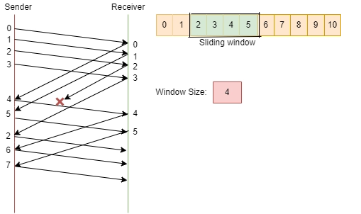
3. Selective Repeat ARQ:
Selective Repeat ARQ also provides for sending multiple frames before receiving the acknowledgement for the first frame.
It also uses sliding window approach.
However, here only the erroneous or lost frames are retransmitted, while the good frames are received and buffered.

Slide 24
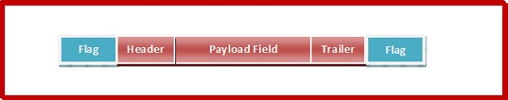
Framing:
Framing in a data communication uses frames to send & receive data.
It works by breaking data into smaller ,manageable units called frames.
A frame has the following parts −
Frame Header − It contains the source and the destination addresses of the frame.
Payload field − It contains the message to be delivered.
Trailer − It contains the error detection and error correction bits.
Flag − It marks the beginning and end of the frame.
Fig. shows structure of the frame.

Slide 25
Types Framing
Fixed-size Framing:
The frame is of fixed size and there is no need to provide boundaries to the frame, the length of the frame itself acts as a delimiter.
In fixed size framing sender and receiver knows the size of frame.
Advantage: Fixed size framing is simple and efficient as all frames are of the same size.
Disadvantage: It suffers from wastage of frame memory if the data size is less than the frame size

Slide 26
2. variable size framing:
In variable size framing the dividing data size into frames where each Frame can have a different in size.
Variable size framing involves dividing the data into frames of varying sizes.
In variable size framing, we need a way to define the end of one frame and the beginning of the next,
The two approaches were used for this framing purpose
Character Oriented /Byte Oriented Framing
Bit Oriented Framing

Slide 27
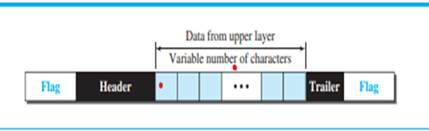
Character Oriented /Byte Oriented Framing:
In this type of framing, data to be carried are 8-bit characters from a coding system such as ASCII.
The header, which normally carries the source and destination addresses and other control information, and the trailer, which carries error detection redundant hits. are also multiples of 8 bits.
To separate one frame in this framing from the next, an 8-bit (1-byte) flag is added at the beginning and the end of a frame.
The flag, composed of protocol-dependent special characters, signals the start or end of a frame.
Fig. shows the format of a frame in a character-oriented protocol.

Slide 28
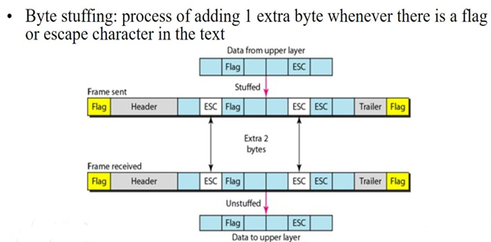
byte stuffing:
Need: Now, however, we send other types of information like graphic, audio and video; any character used for the flag could also be part of the information. If this happens, the receiver, when it encounters this pattern in the middle of the data, thinks it has reached the end of the frame. To fix this problem, a byte-stuffing strategy was added to byte-oriented framing.
In byte stuffing or character stuffing, a special byte is added to the data section of the frame when there is a character with the same pattern as the flag. The data section is stuffed with an extra byte.

Slide 29
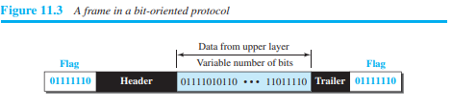
2. Bit Oriented Framing:
In this type of framing, the data section of a frame is a sequence of bits to be interpreted by the upper layer as text, graphic, audio, video, and so on. However, in addition to headers (and possible trailers), we still need a delimiter to separate one frame from the other.
Most protocols use a special 8-bit pattern flag, 01111110, as the delimiter to define the beginning and the end of the frame, as shown in fig

Slide 30
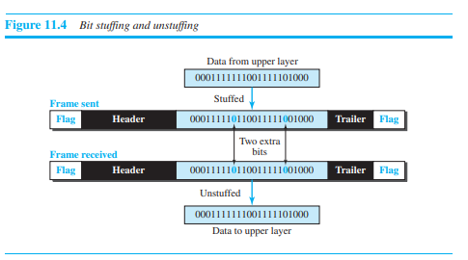
Bit stuffing:
This flag creates as in same type of problem the byte oriented .To fix this problem, a bit-stuffing strategy was added to bit-oriented framing.
We do this by stuffing 1 single bit (instead of 1 byte) to prevent the pattern from looking like a flag. The strategy is called bit stuffing.
Additional bits are added at the transmitting end and removed at the receiving end of the channel as the data is processed.
In a bit stuffing, if a 0 and five consecutive 1 bits are encountered ,an extra 0 is added. This extra 0 stuffed but it removed from the data at the end by the receiver as shown in fig.

Slide 31
Advantage of Variable Size Framing:
Variable size framing provides more flexibility than fixed-size framing and also increase efficiency.
Disadvantage of Variable Size Framing:
Variable size framing is more complex to implement, as each frame must contain a header specifying the length of the payload.

Slide 32
Wireless LAN
A wireless Local Area Network(WLAN) is a group of computers or other devices that form a network based on radio transmissions.
WLAN are wireless computer networks that uses high frequency radio waves instead of cables for connecting the devices within a limited area.
In the year 1990, IEEE 802.11 Committee formed a new working group, the IEEE 802.11 standard which defines protocols for Wireless Local Area Networks (WLANs).
Most WLANs are based upon the IEEE 802.11 Standard or WIFI(Wireless Fidelity)
Example: home, school, office LAN.

Slide 33
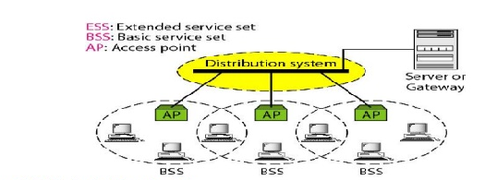
IEEE 802.11 Architecture
In the year 1990, IEEE 802.11 Committee formed a new working group, the IEEE 802.11 standard which defines protocols for Wireless Local Area Networks (WLANs).
Most WLANs are based upon the IEEE 802.11 Standard or WIFI(Wireless Fidelity)
Fig. shows Architecture of 802.11 WLAN

Slide 34
The Components of IEEE 802.11 Architecture
Stations (STA):
Stations refer to all the devices connected to a wireless LAN, including computers, laptops, smartphones, printers, and more. Each station has a wireless network interface controller that enables communication with other devices in the network.
Access Point (AP):
Access Points (WAPs) serve as base stations or access points for the wireless LAN. They are typically wireless routers that connect the devices within the network to other networks or the internet.
Basic Service Set (BSS):
A Basic Service Set (BSS) is a group of stations that communicate at the physical layer level. There are two types of BSS: Infrastructure BSS and Independent BSS:
Extended Service Set (ESS)
An Extended Service Set (ESS) is a set of interconnected Basic Service Sets (BSS) within a wireless LAN. It allows devices connected to different BSSs to communicate with each other.
Distribution System (DS)
The Distribution System (DS) connects multiple access points within an Extended Service Set (ESS). It enables seamless roaming and communication between devices connected to different access points.

Slide 35
Advantages of 802.11 WLAN:
1.High Scalability
2.Easy Installation
3.Mobility
4.Flexibility
Dis-Advantages of 802.11 WLAN:
1.Less Secure
2.Limited Bandwidth
3.WLAN can be affected by network congestion

Slide 36
Features of IEEE 802.11 Versions
1. IEEE 802.11 standard:
It was the original version released in 1997.
It provided 1 Mbps or 2 Mbps data rate in the 2.4 GHz band and used either frequency-hopping spread spectrum (FHSS) or direct-sequence spread spectrum (DSSS). IEEE 802.11a
2. 802.11a standard :
It was published in 1999 as a modification to 802.11, with orthogonal frequency division multiplexing (OFDM) .
It provides a maximum data rate of 54 Mbps operating in the 5 GHz band.
Further amendments to 802.11a are 802.11ac, 802.11ad, 802.11af, 802.11ah, 802.11ai, 802.11aj etc.
3. IEEE 802.11b standard:
802.11b is a direct extension of the original 802.11 standard that appeared in early 2000.
It uses the same modulation technique as 802.11, i.e. DSSS and operates in the 2.4 GHz band.
It has a higher data rate of 11 Mbps as compared to 2 Mbps of 802.11, due to which it was rapidly adopted in wireless LANs.

Slide 37
Features of IEEE 802.11 Versions
4. IEEE 802.11g standard:
802.11g was indorsed in 2003.
It operates in the 2.4 GHz band (as in 802.11b) and provides a average throughput of 22 Mbps.
It uses OFDM technique (as in 802.11a).
5. IEEE 802.11n standard:
802.11n was approved and published in 2009
It operates on both the 2.4 GHz and the 5 GHz bands.
It has variable data rate ranging from 54 Mbps to 600 Mbps.
6. IEEE 802.11p standard:
They include network communications between vehicles moving at high speed and the environment.
They have a data rate of 27 Mbps and operate in 5.9 GHz band.

Slide 38
Bluetooth Architecture:
What is Bluetooth?
Bluetooth is a wireless LAN technology used to connect different devices such as mobile phones, laptops, notebooks, computers, cameras, printers and so on.
It is used for exchanging data over smaller distances.
It operates in the unlicensed, industrial, scientific and medical (ISM) band at 2.4 GHz to 2.485 GHz.
Its ranges up to 10 to 200 meters.
It provides data rates up to 1 to 2 Mbps depending upon the version

Slide 39
Architecture of Bluetooth
Bluetooth defines two types of networks:
Piconet: A Bluetooth network is called a piconet
Scatternet: a collection of interconnected piconets is called as scatternet.

Slide 40
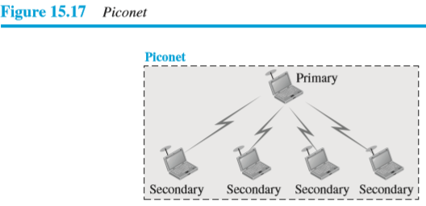
Bluetooth Architecture Piconet:
Piconet: A Bluetooth network is called a piconet
Master is the device that initiate the connection and
control communication within the piconet.
Slave are the devices that respond to the masters.
A piconet can have up to 8 active nodes ,1 node is a
Primary(Master) node and remaining 7 nodes are
Secondary(Slave) nodes .
All the secondary nodes synchronize their clocks and
hopping sequence with the primary nodes.
The communication between the primary and secondary
nodes can be one-to-one or one-to-many.
piconet is suitable for small device networks such as
mobile to headphones.
Figure shows a piconet.

Slide 41
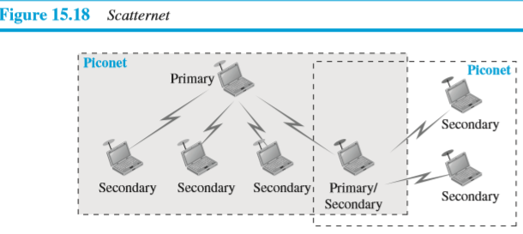
Bluetooth Architecture Scatternet:
Scatternet: A collection of interconnected piconets is called as scatternet.
A secondary node in one piconet can acts as a primary node in another piconet. This node can receive messages from the primary node in the first piconet and deliver them to secondary nodes in a second piconet.
A node can be a member of two piconets.
Scatternet are suitable for larger interconnected
network such as industrial setup, smart buildings
Figure 15.18 shows a scatternet.

Slide 42
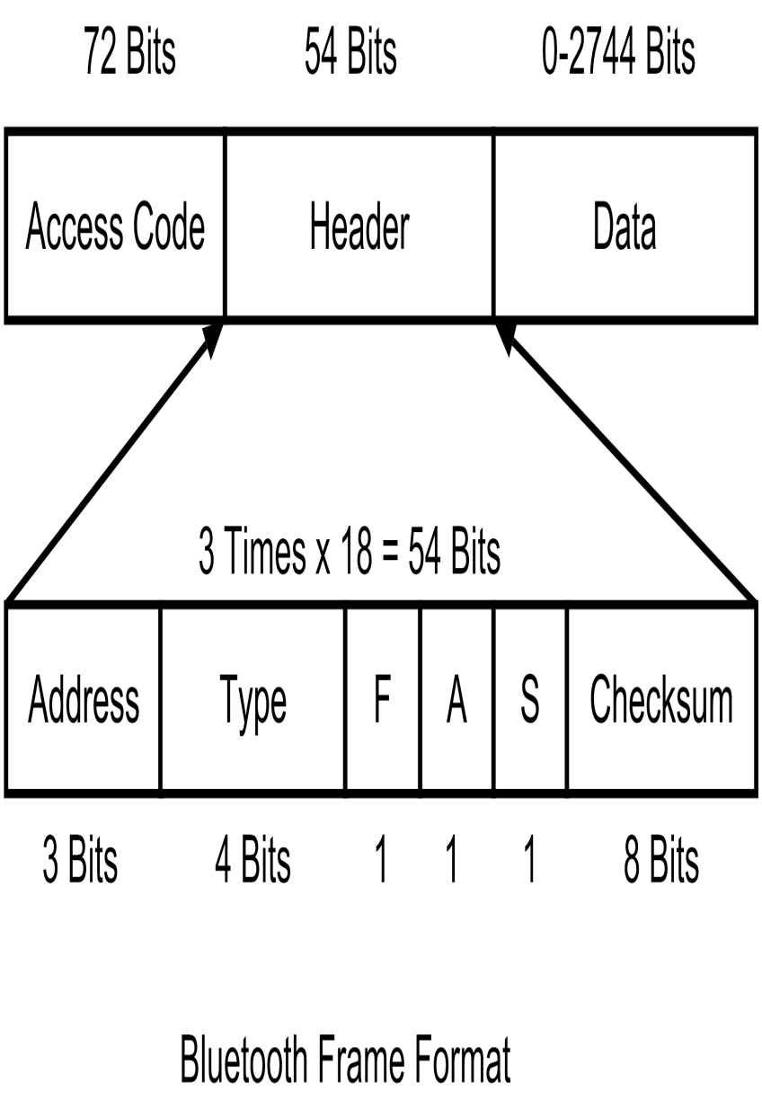
Frame Format of Bluetooth
Access Code− A 72-bit field containing synchronization bits to identify the master.
Header− A 54-bit field containing 18-bit patterns repeated thrice, having the following subfields−
Address− A 3 bit-field that can identify a maximum of seven slaves numbered 1 to 7. An address 0 depicts broadcast.
Type− A 4-bit field that identifies the type of data from upper layers. It identifies whether the frame is ACL, SCO, poll or null.
F− A bit for flow control. When the device cannot receive more frames, F is set to 1.
A− A bit for acknowledgement, for piggybacking an ACK to the end of the frame.
S− A bit denoting sequence number of the frame for detect retransmission. Only a single bit suffices since stop and wait protocol is used.
Checksum− An 8-bit field containing checksum for error detection.
Data− A variable length field ranging from 0 to 2744 bits that contains data or control information from upper layers.

Slide 43
Advantages of Bluetooth
Bluetooth is a wireless technology that is not dependent on wires, cables, and codes. This is considered a key advantage of Bluetooth.
It consumes low power and energy.
They can transfer audio, text, videos, picture and all media using Bluetooth.
They are very compatible with other devices..
Disadvantages of Bluetooth
They are slower compared to other wireless technology like WI-FI and LAN with optic fibre.
They have a small data range of up to 50 meters.
They have lower bandwidth.
Limited devices can be connected to Bluetooth.
Applications of Bluetooth
They can be used in LAN {Local Area Networks}.
They are used in cars, music systems, headphones, mobile phones, laptops and desktops.
They are used in automation devices.
They are used in medical and healthcare devices.

Slide 44
Mobile Generations (3G to 5G)
The Mobile Generation (G) generally refers to a change in the nature of the system, speed, technology, frequency, data capacity, latency etc.
Each generation have some standards, different capacities, new techniques and new features which differentiate it from the previous one.
The Third Generation (3G) provides higher data rate, increased capacity and provide multimedia support.
The Fourth Generation (4G) it’s an extension of 3G and provides high speed internet access
The Fifth Generation(5G) is going to be a new revolution in mobile market which has changed the means to use cell phones within very high bandwidth.

Slide 45
3G – Third generation communication system
3G introduced in the early 2000s.
3G offers data transfer rate of up to 2 mbps and it support video calling for the first time on mobile devices.
After the introduction of 3G mobile communication system, smart phones became popular across the global.
Specific applications were developed for smartphones which handles multimedia chat, email, video calling, games, social media and healthcare.
Disadvantages of 3G system
Expensive spectrum licenses
Costly infrastructure, equipment and implementation
Higher bandwidth requirements to support higher data rate
Costly mobile devices
Key features of 3G system
Higher data rate
Video calling
Enhanced security, more number of
users and coverage
Multimedia message support
Location tracking and maps
Better web browsing
TV streaming
High quality 3D games

Slide 46
4G – forth generation communication system
4G systems are enhanced version of 3G which is introduced in 2010.
offers higher data rate and capable to handle more advanced multimedia services.
It provides an all IP packet switched network for transmission of voice, data and multimedia.
4G comes in two main categories :
Long Term Evolution (LTE):It is a standard for high-speed mobile communication, based upon GSM and UMTS technologies.
LTE Advanced offering higher speed
Key features of 4G system
it offer High data speed 100 mbps to 1 Gbps.
4G support interactive multimedia such as voice and video
4G is more secure than 3G
4G offers global mobile networks.
Disadvantages of 4G system
Expensive hardware and infrastructure
Costly spectrum in most countries, frequency bands are too expensive

Slide 47
5G – Fifth generation communication system
3G introduced in the early 2020s.
5G network is using advanced technologies to deliver ultra-fast internet and multimedia experience for customers.
The main focus of 5G will be on Wireless World Wide Web (WWWW).
Its a complete wireless communication with no limitations.
Key features of 5G system
5G offers high speed upto 10 Gbps.
5G Offers low latency.
5G is 10 time faster than 4G.
Higher security and reliable network.
Disadvantages of 5G system
The possibility of hacking is one of 5G's drawbacks.
Upload rate is shorter as compare to 4G
Higher bandwidth requirement

