Slide 1
Ch no 3 DATA STRUCTURE IN PYTHON MARKS:14

Slide 2
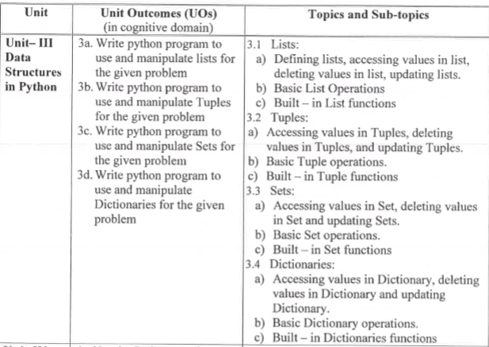

Slide 3
Course outcome
Perform operation on Data Structure in Python

Slide 4
List

Slide 5
List
A list is a collection which is ordered and changeable. In Python lists are written with square brackets.
The list is a most versatile datatype available in Python which can be written as a list of comma-separated values (items) between square brackets.
Important thing about a list is that items in a list need not be of the same type.

Slide 6

Creating a list
Creating a list is as simple as putting different comma-separated values between square brackets. For example −
Similar to string indices, list indices start at 0, and lists can be sliced, concatenated and so on.

Slide 7
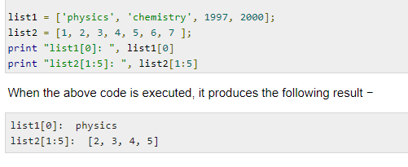
Accessing Values in Lists
To access values in lists, use the square brackets for slicing along with the index or indices to obtain value available at that index.
For example −

Slide 8
Copying the List
We can make a duplicate or copy of an existing list.
For Example.
List1=[10,20,30,40]
List2=List1
In the first statement List1 is pointing to the List[10,20,30,40]
In The second statement we are not copying List but we are making another variable List2 and attach it to the list pointed by List1.
Both Variable are pointing to the same list.
Due to this if we modify the List1 ,then the modification will also take place and vice versa. in List2

Slide 9
example
List1=[10,20,30,40]
List2=List1
print(List2)
List1.append(50)
print(List1)
print(List2)
Output:
[10, 20, 30, 40]
[10, 20, 30, 40, 50]
[10, 20, 30, 40, 50]

Slide 10
There are two ways to make a copy of a List
1.Using [:] operator
For Example:
List1=[10,20,30,40]
List2=List1[:]
print(List1)
print(List2)
Output
[10, 20, 30, 40]
[10, 20, 30, 40]

Slide 11
2.using Built in copy Function
It use copy function to make copy of an existing list.
In order to use copy function,first we have to import
For example
from copy import copy
List1=[10,20,30,40]
List2=copy(List1)
print(List1)
print(List2)
Output
[10, 20, 30, 40]
[10, 20, 30, 40]

Slide 12
Traversing a List
Accessing all elements of the List.
It can be done by any conditional statement of python,but it is preferable to use for loop.
Example1
List1=[10,20,30,40]
for x in List1:
print(x)
Output:
10
20
30
40

Slide 13
Example2
List1=[10,20,30,40]
for i in range (len(List1)):
List1[i]=List1[i]+4
print(List1)
Output
[14, 24, 34, 44]

Slide 14
List are mutable
The value of any element inside the List can be changed at any point of time.
The Elements of the List are accessible with their index value.The index always start with 0 and ends with n-1,if the list contains n elements.
Example
List1=[10,20,30,40]
List1[2]=50
print(List1)
Output
[10, 20, 50, 40]

Slide 15
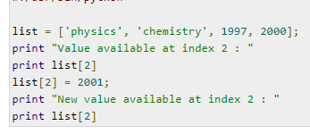

Updating Lists
You can update single or multiple elements of lists by giving the slice on the left-hand side of the assignment operator, and you can add to elements in a list with the append() method.
For example −
output

Slide 16
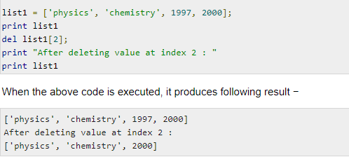
Delete List Elements
del operator or del statement-
To remove a list element, you can use either the del statement if you know exactly which element(s) you are deleting For example −

Slide 17
2. pop operator or pop statement-
If we know the index of the element that we want to delete ,then we can use pop statement.
For Example
list=[10,20,30,40]
list.pop(3)
print(list)
output
[10, 20, 30]

Slide 18
3.remove operator or remove statement:-
If we know the item that we want to remove or delete from the list(but not index),then we can use remove statement
For Example
list=[10,20,30,40]
list.remove(30)
print(list)
output:
[10, 20, 40]

Slide 19
Basic List Operations
How to change or add elements to a list?
append(),extend(),insert()
How to slice lists in Python?
We can access a range of items in a list by using the slicing operator (colon).
Negative indexing
Python allows negative indexing for its sequences. The index of -1 refers to the last item, -2 to the second last item and so on.

Slide 20
How to change or add elements to a list?
List are mutable, meaning, their elements can be changed unlike string or tuple.
We can use assignment operator (=) to change an item or a range of items.

Slide 21
For Example
odd = [2, 4, 6, 8]
# change the 1st item
odd[0] = 1
# Output: [1, 4, 6, 8]
print(odd)
# change 2nd to 4th items
odd[1:4] = [3, 5, 7]
# Output: [1, 3, 5, 7]
print(odd)

Slide 22
append()
We can add one item to a list using append() method.
Syntax
list1.append(element)
We can also use + operator to combine two lists.
Example
odd = [1, 3, 5]
odd.append(7)
print(odd)
# Output: [1, 3, 5, 7]

Slide 23
We can also use + operator to combine two lists. This is also called concatenation.
The * operator repeats a list for the given number of times.
For Example
odd = [1, 3, 5]
# Output: [1, 3, 5, 9, 7, 5]
print(odd + [9, 7, 5])
#Output: ["re", "re", "re"]
print(["re"] * 3)

Slide 24
extend()
We can several items to a list using extend().
Syntax
list1.extend(list2)
Example
odd = [1, 3, 5]
odd.append(7)
# Output: [1, 3, 5, 7]
print(odd)
odd.extend([9, 11, 13])
# Output: [1, 3, 5, 7, 9, 11, 13]
print(odd)

Slide 25
insert()
we can insert one item at a desired location by using the method insert() or insert multiple items by squeezing it into an empty slice of a list.
Syntax
list1.insert(index,element)
Example
odd = [1, 9]
odd.insert(1,3)
# Output: [1, 3, 9]
print(odd)
odd[2:2] = [5, 7]
# Output: [1, 3, 5, 7, 9]
print(odd)

Slide 26
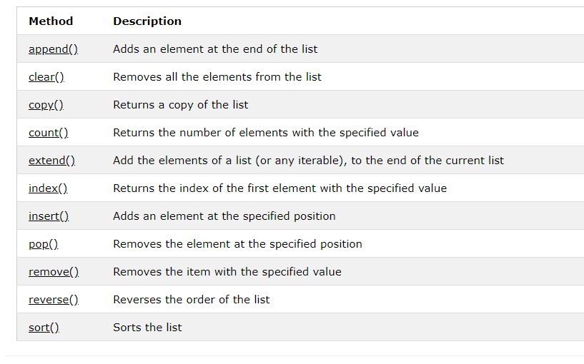
Built in functions

Slide 27
1.append() Method
The append() method appends an element to the end of the list.
Syntax
List.append(Element)
Example
List1=[10,20,30,40]
List1.append(50)
print(List1)
Output
[10, 20, 30, 40, 50]

Slide 28
2.clear() Method
The clear() method removes all the elements from a list.
Syntax
List.clear()
Example
List1=[10,20,30,40]
List1.clear()
print(List1)
Output
[ ]

Slide 29
3.copy() Method
The copy() method returns a copy of the specified list.
Syntax
List.copy()
Example
List1=[10,20,30,40]
List2=List1.copy()
print(List2)
Output
[10, 20, 30, 40]

Slide 30
4.count() Method
The count() method returns the number of elements with the specified value.
Syntax
list.count(value)
Example
List1=[10,20,30,40,20,30,20]
x=List1.count(20)
print(x)
Output
3

Slide 31
5.extend() Method
The extend() method adds the specified list elements (or any iterable) to the end of the current list.
Syntax
List.extend(Sequence)
Sequence can be List,Tuple,Set etc
Example
List1=[10,20,30,40]
List2=[50,60]
List1.extend(List2)
print(List1)
Output
[10, 20, 30, 40, 50, 60]

Slide 32
6.index() Method
The index() method returns the position at the first occurrence of the specified value.
Syntax List.index(Element)
Example
List1=[10,20,30,40]
x=List1.index(30)
print(x)
Ouptut
2

Slide 33
7. insert() Method
The insert() method inserts the specified value at the specified position.
Syntax
List.insert(position,element)
Example
List1=[10,20,30,40]
List1.insert(2,50)
print(List1)
Output
[10, 20, 50, 30, 40]

Slide 34
8.pop() Method
The pop() method removes the element at the specified position.
Syntax
List.pop(position)
Example
List1=[10,20,30,40]
List1.pop(2)
print(List1)
Output
[10, 20, 40]

Slide 35
9.remove() Method
The remove() method removes the first occurrence of the element with the specified value
Syntax
List.remove(Element)
Example
List1=[10,20,30,40]
List1.remove(20)
print(List1)
Output
[10, 30, 40]

Slide 36
10.reverse() Method
The reverse() method reverses the sorting order of the elements.
Syntax
List.reverse()
Example
List1=[10,20,30,40]
List1.reverse()
print(List1)
Output
[40, 30, 20, 10]

Slide 37
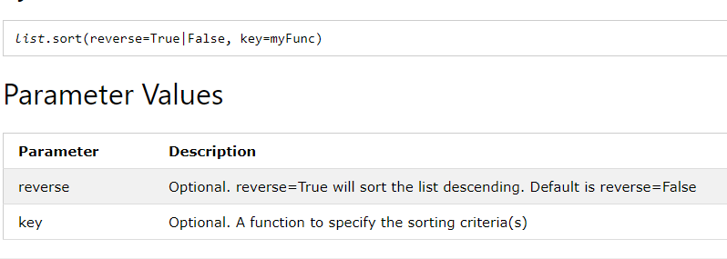
11.sort() Method
The sort() method sorts the list ascending by default.
You can also make a function to decide the sorting criteria(s).
Syntax

Slide 38
Example
List1=[10,20,30,40]
List1.sort(reverse=True)
print(List1)
output
[40, 30, 20, 10]

Slide 39
12.Len() method
It returns the number of elements in the list.
Syntax
len(List)
Example
List1=[10,20,30,40]
x=len(List1)
print(x)
Output
4

Slide 40
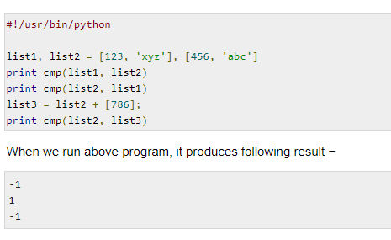
13.Cmp() method
It compares Elements of both the lists
Syntax
cmp(List1,List2)

Slide 41
1.Write the output of the following
>>> a=[2,5,1,3,6,9,7]
>>> a[2:6]=[2,4,9,0]
>>> print(a)
2.
>>> b=[“Hello”,”Good”]
>>> b.append(“python”)
>>>print(b)
3.
>>>t1=[3,5,6,7]
>>>print(t1[2])
>>>print(t1[-1])
>>>print(t1[2:])
>>>print(t1[:])

Slide 42
output
Output:
[2, 5, 2, 4, 9, 0, 7]
['Hello', 'Good', 'python']
>>>6
>>>7
>>>[6, 7]
>>>[3, 5, 6, 7]

Slide 43
Write Python code for finding greatest among four numbers
list1 = [ ]
num = int(input("Enter number of elements in list: "))
for i in range(1, num + 1):
element = int(input("Enter elements: "))
list1.append(element)
print("Largest element is:", max(list1))

Slide 44
Explain indexing and slicing in list with example Indexing:
1. Indexing: An individual item in the list can be referenced by
using an index, which is an integer number that indicates the
relative position of the item in the list.
There are various ways in which we can access the elements
of a list some as them are given below:
a). List Index: We can use the index operator [] to access an
item in a list. Index starts from 0. So, a list having 5 elements
will have index from 0 to 4.
Example: For list index in list.
>>> list1=[10,20,30,40,50]
>>> list1[0]
10
>>> list1[1:3] # list[m:n] will return elements indexed from m to n-1.
[20, 30]

Slide 45
b). Negative Indexing: Python allows negative indexing for its sequences. The index of −1 refers to the last item, −2 to the second last item and so on.
Example: For negative indexing in list.
>>> list2=['p','y','t','h','o','n']
>>> list2[-1]
'n'
>>> list2[-6]
'p

Slide 46
2. List Slicing:
Slicing is an operation that allows us to extract elements from units. The slicing feature used by Python to obtain a specific subset or element of the data structure using the colon (:) operator.
The slicing operator returns a subset of a list called slice by specifying two indices, i.e. start and end.
Syntax: list_variable[start_index:end_index]
This will return the subset of the list starting from start_index
to one index less than that of the endind
Example: For slicing list.
>>> l1=([10,20,30,40,50])
>>> l1[1:4]
[20, 30, 40

Slide 47
Write basis operations of list
1)Accessing values in list:
To access values in lists, use the square brackets for slicing along with the index or
indices to obtain value available at that index.
Example: accessing list values.
>>> list1 = ["one","two",3,10,"six",20]
>>> list1[0]
'one'

Slide 48
2) Deleting Values in List
The pop() method in Python is used to remove a particular item/element from the given
index in the list. The pop() method removes and returns the last item if index is not
Provided
>>> list[10, 20, 40]
>>> list.pop()
40

Slide 49
We can delete one or more items from a list using the keyword del. It can even delete
the list entirely. But it does not store the value for further use
>>> list= [10, 20, 30, 40]
>>> list
[10, 20, 30, 40]
>>> del (list[1]) # del() with index
>>> list
[10, 30, 40]

Slide 50
The remove() method in Python issued to remove a particular element from the list. We
use the remove() method if we know the item that we want to remove or delete from the
list (but not the index).
>>> list=[10,"one",20,"two"]
>>> list.remove(20)
>>> list
[10, 'one', 'two']

Slide 51
3. Updating Lists: • List are mutable, meaning their elements can be changed or updated unlike string or tuple.
We can update items of the list by simply assigning the value at the particular index
position. We
can also remove the items from the list using remove() or pop() or del statement.
>>> list1= [10, 20, 30, 40, 50]
>>> list1
[10, 20, 30, 40, 50]
>>> list1[0]=0 # change 0th index element
>>> list1
[0, 20, 30, 40, 50]

Slide 52
4 Indexing
There are various ways in which we can access the elements of a list.
List Index: We can use the index operator [] to access an item in a list. Index starts
from 0. So, a list having 5 elements will have index from 0 to 4.
Example:
>>> list1=[10,20,30,40,50]
>>> list1[0]
10

Slide 53
5. List Slicing
The slicing operator returns a subset of a list called slice by specifying two indices, i.e.
start and end.
Syntax:
List_variable[start_index:end_index]
Example:
>>> l1=([10,20,30,40,50])
>>> l1[1:4]
[20, 30, 40]

Slide 54
Tuples

Slide 55
Tuples
A tuple is a collection which is ordered and unchangeable.
The difference between the two is that we cannot change the elements of a tuple once it is assigned whereas, in a list, elements can be changed.
In Python tuples are written with round brackets whereas List are written in Square brackets.

Slide 56
Creating a Tuple
A tuple is created by placing all the items (elements) inside parentheses (), separated by commas.
A tuple can also be created without using parentheses. This is known as tuple packing.
A tuple can have any number of items and they may be of different types (integer, float, list, string, etc.).
The empty tuple is written as two parentheses containing nothing
Tuple1=()
To write a tuple containing a single value you have to include a comma, even though there is only one value Tuple1=(10,)

Slide 57
Example
tuple1=(10,20,30,40)
tuple2=50,60,70
tuple3=()
tuple4=(80,)
print(tuple1)
print(tuple2)
print(tuple3)
print(tuple4)
Output:
(10, 20, 30, 40)
(50, 60, 70)
()
(80,)

Slide 58
Accessing Values in Tuples
To access values in tuple, use the square brackets for slicing along with the index or indices to obtain value available at that index.
There are various ways in which we can access the elements of a tuple.
Indexing
2. Negative Indexing
3.. Slicing

Slide 59
Indexing
We can use the index operator [] to access an item in a tuple where the index starts from 0.
So, a tuple having 6 elements will have indices from 0 to 5. Trying to access an element outside of tuple (for example, 6, 7,...) will raise an IndexError.
The index must be an integer; so we cannot use float or other types. This will result in TypeError.
nested tuples are accessed using nested indexing

Slide 60
Example
tuple1 = ('p','e','r','m','i','t')
print(tuple1[0])
print(tuple1[5])
tuple2 = ("mouse", [8, 4, 6], (1, 2, 3))
print(tuple2[0][3])
print(tuple2[1][1]
Output:
p
t
s
4
)

Slide 61
Negative Indexing
Python allows negative indexing for its sequences.
The index of -1 refers to the last item, -2 to the second last item and so on.
tuple1 = ('p','e','r','m','i','t')
print(tuple1[-1])
print(tuple1[-5])
Output:
t
e

Slide 62
Slicing
We can access a range of items in a tuple by using the slicing operator - colon ":“
Example
my_tuple = ('p','r','o','g','r','a','m','i','z')
print(my_tuple[1:4])
print(my_tuple[:-7])
print(my_tuple[7:])
print(my_tuple[:])
Output
('r', 'o', 'g')
('p', 'r')
('i', 'z')
('p', 'r', 'o', 'g', 'r', 'a', 'm', 'i', 'z')

Slide 63
Updating Tuples
Tuples are immutable which means you cannot update or change the values of tuple elements.
You are able to take portions of existing tuples to create new tuples as the following example demonstrates
tup1 = (12, 34.56);
tup2 = ('abc', 'xyz');
# Following action is not valid for tuples
# tup1[0] = 100;
# So let's create a new tuple as follows
tup3 = tup1 + tup2;
print tup3;
Output
(12, 34.56, 'abc', 'xyz')

Slide 64
Delete Tuple Elements
we cannot change the elements in a tuple. That also means we cannot delete or remove items from a tuple.
But deleting a tuple entirely is possible using the keyword del
Example

Slide 65
my_tuple = ('p','r','o','g','r','a','m','i','z')
# TypeError: 'tuple' object doesn't support item deletion
# del my_tuple[3]
# Can delete an entire tuple
del my_tuple
# NameError: name 'my_tuple' is not defined
print(my_tuple)

Slide 66
Basic tuple operation
Tuples respond to the + and * operators much like strings; they mean concatenation and repetition here too, except that the result is a new tuple, not a string.
In fact, tuples respond to all of the general sequence operations we used on strings in the prior

Slide 67
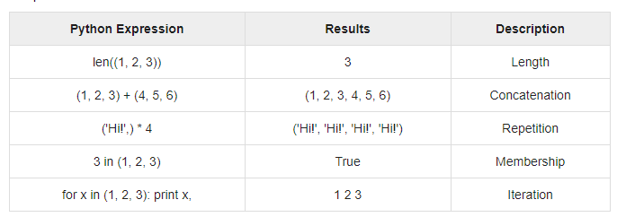
Example

Slide 68
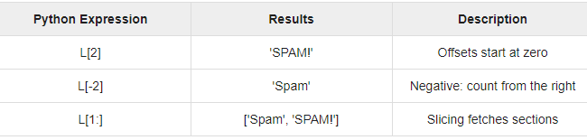
Indexing, Slicing, and Matrixes
Because tuples are sequences, indexing and slicing work the same way for tuples as they do for strings. Assuming following input −
L=(‘spam’,’Spam’,’SPAM!’)

Slide 69
Built-in Tuple Functions
Function | Description
cmp(tuple1,tupl2) | Compares elements of both tuples.
len(tuple1) | Returns the length of a tuple
max(tuple1) | Returns item from the tuple with max value.
min(Tuple) | Returns item from the tuple with min value.
tuple(sequence) | Converts a list into tuple.
Zip(tuple1,tupl2) | Zip elements from two tuples into a list of tu[les
count() | Returns the number of occurrences of a given element in the tuple.
index(x) | Returns the index of the first item that is equal to x

Slide 70
cmp()
Python tuple method cmp() compares elements of two tuples.
Syntax
cmp(tuple1, tuple2)
Example
tuple1, tuple2 = (123, 'xyz'), (456, 'abc')
print cmp(tuple1, tuple2)
Output
-1

Slide 71
len()
Python tuple method len() returns the number of elements in the tuple.
Syntax
len(tuple)
Example
tuple1=(10,20,30,"amit",50)
print("Length=",len(tuple1))
Output
Length= 5

Slide 72
max()
Python tuple method max() returns the elements from the tuple with maximum value.
Syntax
max(tuple)
Example
tuple1=(10,20,30,80,50)
tuple2=("Tiger","Lion","Dog","Zebra","Cat")
print("Max value in Tuple=",max(tuple1))
print("Max value in Tuple=",max(tuple2))
Output
Max value in Tuple= 80
Max value in Tuple= Zebra

Slide 73
min()
Python tuple method min() returns the elements from the tuple with minimum value.
Syntax
min(tuple)
Example
tuple1=(10,20,30,80,50)
tuple2=("Tiger","Lion","Dog","Zebra","Cat")
print("Min value in Tuple=",min(tuple1))
print("Min value in Tuple=",min(tuple2))
Output
Min value in Tuple= 10
Min value in Tuple= Cat

Slide 74
tuple()
Python tuple method tuple() converts a list of items into tuples
Syntax
tuple( seq )
Example
List1=[10,20,30,80,50]
print("Tuple=",tuple(List1))
Output
Tuple= (10, 20, 30, 80, 50)

Slide 75
count()
count() method searches the given element in a tuple and returns how many times the element has occurred in it.
Syntax
tuple.count(element)
Example
tuple1=(10,20,30,80,50,20,40,20,30,20)
print("count of 20 in tuple=",tuple1.count(20))
Output
count of 20 in tuple= 4

Slide 76
index()
The index() method searches an element in a tuple and returns its index.
Syntax
tuple.index(element)
Example
tuple1=(10,20,30,80,50,20)
print("index of 20 in tuple=",tuple1.index(20))
Output
index of 20 in tuple= 1

Slide 77
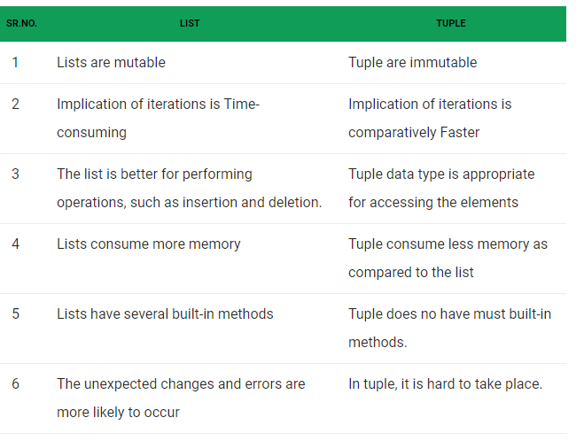
Difference Between List and Tuple in Python:

Slide 78
List | Tuple
Lists can be used to store homogeneous and heterogeneous elements | Tuples are used to store only heterogeneous elements.
The List has the variable length | The List has the variable length
List iteration is slower and is time consuming. | List iteration is slower and is time consuming.
List operations are more error prone. | List operations are more error prone.

Slide 79
Advantages of Tuple over List
We generally use tuple for heterogeneous (different) datatypes and list for homogeneous (similar) datatypes.
Since tuples are immutable, iterating through tuple is faster than with list. So there is a slight performance boost.
Tuples that contain immutable elements can be used as a key for a dictionary. With lists, this is not possible.
If you have data that doesn't change, implementing it as tuple will guarantee that it remains write-protected.

Slide 80
SET

Slide 81
SET
A set is a collection which is unordered and un indexed.
Every element is unique (no duplicates) .
In Python sets are written with curly brackets.
Sets can be used to perform mathematical set operations like union, intersection, symmetric difference etc.

Slide 82
CREATING A SET
A set is created by placing all the items (elements) inside curly braces {}, separated by comma by using the built-in function set().
It can have any number of items and they may be of different types (integer, float, tuple, string etc.).
But a set cannot have a mutable element, like list, set or dictionary, as its element.

Slide 83
set1={10,20,30,40,20}
set2={50,60,"hello",(10,20,30)}
set3={}
set4=set(set1)
print(set1)
print(set2)
print(set3)
print(set4)
Output:
{40, 10, 20, 30}
{'hello', 50, (10, 20, 30), 60}
{}
set()

Slide 84
Accessing values in set
You cannot access items in a set by referring to an index, since sets are unordered the items has no index.
But you can loop through the set items using a for loop, or ask if a specified value is present in a set, by using the in keyword.

Slide 85
Example
set1={10,20,30,40}
for x in set1:
print(x)
print("wheather 20 is present or not",20 in set1)
Output:
40
10
20
30
wheather 20 is present or not True

Slide 86
How to change a set in Python or update a set ?
Sets are mutable. But since they are unordered, indexing have no meaning.
We cannot access or change an element of set using indexing or slicing. Set does not support it.
We can add single element using the add() method and multiple elements using the update() method. The update() method can take tuples, lists, strings or other sets as its argument. In all cases, duplicates are avoided.

Slide 87
set1={10,20,30,40}
set1.add(50)
print(set1)
set1.update([40,70,80],{90,60,20})
print(set1)
Output
{40, 10, 50, 20, 30}
{70, 40, 10, 80, 50, 20, 90, 60, 30}

Slide 88
How to remove elements from a set?
A particular item can be removed from set using methods, discard() and remove().
The only difference between the two is that, while using discard() if the item does not exist in the set, it remains unchanged. But remove() will raise an error in such condition.
Similarly, we can remove and return an item using the pop() method-Set being unordered, there is no way of determining which item will be popped. It is completely arbitrary.
We can also remove all items from a set using clear().

Slide 89
Example
set1={10,20,30,40,80}
set1.discard(30)
print(set1) {40, 10, 80, 20}
set1.remove(40)
print(set1) {10, 80, 20}
set1.pop()
print(set1) {80, 20}
set1.clear()
print(set1) set()

Slide 90
BASIC SET OPERATION
Sets can be used to carry out mathematical set operations like union, intersection, difference and symmetric difference
Set operations are as Follow
Set Union
Set Intersection
Set Difference
Set Symmetric Differnce

Slide 91
Set Union
Union of A and B is a set of all elements from both sets.
Union is performed using | operator.
Syntax
Set1|Set2
The union() method returns a new set containing all items from both sets.
Syntax
set1.union(set2)

Slide 92
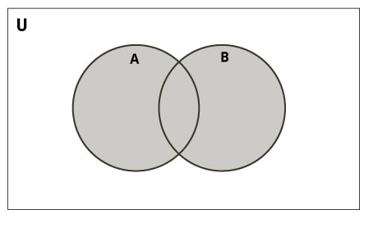

Slide 93
Let us consider the following two sets for the following operations.
A = {1, 2, 3, 4, 5}
B = {4, 5, 6, 7, 8}
union of Set A and Set B is
A|B={1, 2, 3, 4, 5, 6, 7, 8}

Slide 94
EXAMPLE
A = {1, 2, 3, 4, 5}
B = {4, 5, 6, 7, 8}
C= {9,11,10,3}
print(A | B)
print(C.union(A))
output:
{1, 2, 3, 4, 5, 6, 7, 8}
{1, 2, 3, 4, 5, 9, 10, 11}

Slide 95
Set Intersection
Intersection of A and B is a set of elements that are common in both sets.
Intersection is performed using & operator.
Syntax
Set A & Set B
The intersection() method returns a set that contains the similarity between two or more sets
Syntax
set.intersection(set1, set2 ... etc)

Slide 96
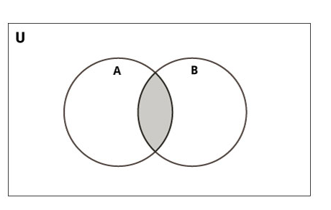

Slide 97
Let us consider the following two sets for the following operations.
A = {1, 2, 3, 4, 5}
B = {4, 5, 6, 7, 8}
Intersection of of Set A and Set B is
A & B={4, 5}

Slide 98
A = {1, 2, 3, 4, 5}
B = {4, 5, 6, 7, 8}
C= {3,5,8,9}
print(A & B)
print(C.intersection(A))
Output
{4, 5}
{3, 5}

Slide 99
Set Difference
Difference of A and B (A - B) is a set of elements that are only in A but not in B. Similarly, B - A is a set of element in B but not in A.
Difference is performed using - operator.
Syntax
Set A - Set B or Set B-Set A
The difference() method returns a set that contains the difference between two sets.
set.difference(set)

Slide 100
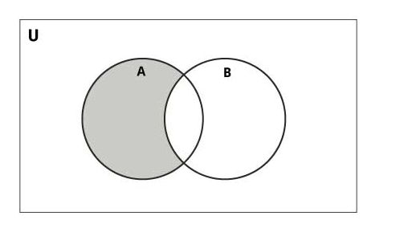

Slide 101
Let us consider the following two sets for the following operations.
A = {1, 2, 3, 4, 5}
B = {4, 5, 6, 7, 8}
Difference of Set A and Set B is
A - B={1,2,3}
B – A={6,7,8}

Slide 102
EXAMPLE
A = {1, 2, 3, 4, 5}
B = {4, 5, 6, 7, 8}
C= {3,5,8,9}
print(A - B)
print(B - A)
print(C.difference(A))
OUTPUT:
{1, 2, 3}
{8, 6, 7}
{8, 9}

Slide 103
Set Symmetric Difference
Symmetric Difference of A and B is a set of elements in both A and B except those that are common in both.
Symmetric difference is performed using ^ operator.
Syntax
Set A ^ Set B
Same can be accomplished using the method symmetric_difference().
Syntax
set.symmetric_difference(set)

Slide 104
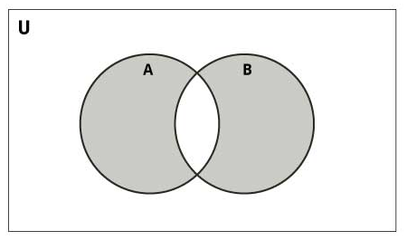

Slide 105
Let us consider the following two sets for the following operations.
A = {1, 2, 3, 4, 5}
B = {4, 5, 6, 7, 8}
Symmetric Difference of of Set A and Set B is
A ^ B={1,2,3,6,7,8}

Slide 106
A = {1, 2, 3, 4, 5}
B = {4, 5, 6, 7, 8}
C= {3,5,8,9}
print(A ^ B)
print(C.symmetric_difference(A))
Output:
{1, 2, 3, 6, 7, 8}
{1, 2, 4, 8, 9}

Slide 107
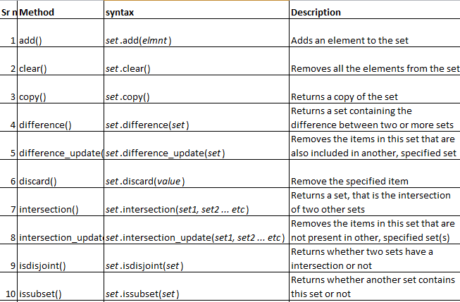
BUITL IN SET FUNCTION

Slide 108
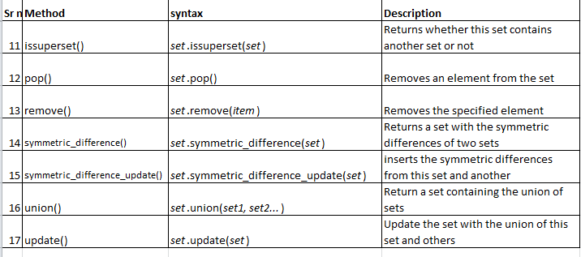

Slide 109
add() method
The add() method adds an element to the set.
If the element already exists, the add() method does not add the element.
Syntax
set.add(elmnt)

Slide 110
A = {1, 2, 3, 4, 5}
B = {4, 5, 6, 7, 8}
A.add(6)
print(A)
B.add(6)
print(B)
Output
{1, 2, 3, 4, 5, 6}
{4, 5, 6, 7, 8}

Slide 111
clear()
The clear() method removes all elements in a set.
Syntax
set.clear()
Example
A = {1, 2, 3, 4, 5}
A.clear()
print(A)
output
Set()

Slide 112
copy()
The copy() method copies the set.
Syntax
set.copy()
Example
A = {1, 2, 3, 4, 5}
B=A.copy()
print(B)
Output
{1, 2, 3, 4, 5}

Slide 113
difference_update()
The difference_update() method removes the items that exist in both sets.
The difference_update() method is different from the difference() method, because the difference() method returns a new set, without the unwanted items, and the difference_update() method removes the unwanted items from the original set.
Syntax
set.difference_update(set)

Slide 114
A = {1, 2, 3, 4, 5}
B = {4, 5, 6, 7, 8}
A.difference_update(B)
print(A)
OUTPUT
{1, 2, 3}

Slide 115
intersection_update()
The intersection_update() method removes the items that is not present in both sets (or in all sets if the comparison is done between more than two sets).
The intersection_update() method is different from the intersection() method, because the intersection() method returns a new set, without the unwanted items, and the intersection_update() method removes the unwanted items from the original set.
Syntax
set.intersection_update(set1, set2 ... etc)

Slide 116
A = {1, 2, 3, 4, 5}
B = {4, 5, 6, 7, 8}
A.intersection_update(B)
print(A)
OUTPUT
{4, 5}

Slide 117
isdisjoint()
The isdisjoint() method returns True if none of the items are present in both sets, otherwise it returns False.
Syntax
set.isdisjoint(set)
Example
A = {1, 2, 3, 4, 5}
B = {4, 5, 6, 7, 8}
C=A.isdisjoint(B)
print(C)
Output
False

Slide 118
issubset()
The issubset() method returns True if all items in the set exists in the specified set, otherwise it retuns False.
Syntax
set.issubset(set)
Example
A = {4, 5}
B = {4, 5,6,7,8}
C=A.issubset(B)
print(C)
Output
True

Slide 119
issuperset()
The issuperset() method returns True if all items in the specified set exists in the original set, otherwise it retuns False.
Syntax
set.issuperset(set)
Example
A = {4, 5,3}
B = {4, 5,6,7,8}
C=A.issuperset(B)
print(C)
Output
False

Slide 120
symmetric_difference_update()
The symmetric_difference_update() method updates the original set by removing items that are present in both sets, and inserting the other items.
Syntax
set.symmetric_difference_update(set)
Example
A = {3,4, 5}
B = {4, 5,6,7,8}
A.symmetric_difference_update(B)
print(A)
Output
{3, 6, 7, 8}

Slide 121
Write python program to perform following operations on Set (Instead of
Tuple)-06Marks
i) Create set
ii) Access set Element
iii) Update set
iv) Delete set

Slide 122
# To Create set
S={10,20,30,40,50}
# To Access Elements from set
print (S)
#To add element into set using add method
S.add(60)
print(S)
#To update set using update method
S.update(['A','B'])
print(S)

Slide 123
#To Delete element from Set using discard() method
S.discard(30)
print(S)
#To delete element from set using remove() method
S.remove('A')
print(S)
#To delete element from set using pop() method
S.pop()
print(S)

Slide 124
output:
{50, 20, 40, 10, 30}
{50, 20, 40, 10, 60, 30}
{'B', 50, 20, 'A', 40, 10, 60, 30}
{'B', 50, 20, 'A', 40, 10, 60}
{'B', 50, 20, 40, 10, 60}
{50, 20, 40, 10, 60}

Slide 125
Using Tuples
#To create tuple
tuple1=(10,20,30,40,50)
print (tuple1)
#Access tuple values
print (tuple1[1])
print (tuple1[0:3])
# deleting tuple
del tuple1
print (tuple1)

Slide 126
output:
(10, 20, 30, 40, 50)
20
(10, 20, 30)
Traceback (most recent call last):
File "C:\Users\Vijay Patil\AppData\Local\Programs\Python\Python310\temp.py", line
9, in <module>
print (tuple1)
NameError: name 'tuple1' is not defined. Did you mean: 'tuple'?

Slide 127
Dictionary

Slide 128
Dictionary
Python dictionary is an unordered collection of items. While other compound data types have only value as an element, a dictionary has a key: value pair.
A dictionary is a collection which is unordered, changeable and indexed.
In Python dictionaries are written with curly brackets, and they have keys and values.

Slide 129
How to create a dictionary?
Creating a dictionary is as simple as placing items inside curly braces {} separated by comma.
An item has a key and the corresponding value expressed as a pair, key: value.
While values can be of any data type and can repeat, keys must be of immutable type (string, number or tuple with immutable elements) and must be unique.
Each key is separated from its value by a colon (:), the items are separated by commas, and the whole thing is enclosed in curly braces.
An empty dictionary without any items is written with just two curly braces, like this: {}.
we can also create a dictionary using the built-in function dict()

Slide 130
Example
# empty dictionary
my_dict = { }
# dictionary with integer keys
my_dict = {1: 'apple', 2: 'ball'}
# dictionary with mixed keys
my_dict = {'name': 'John', 1: [2, 4, 3]}
# using dict()
my_dict = dict({1:'apple', 2:'ball'})
# sequence having each item as a pair
my_dict = dict([(1,'apple'), (2,'ball')])

Slide 131
Accessing Values in Dictionary
To access dictionary elements, you can use the square brackets along with the key to obtain its value.
While indexing is used with other container types to access values, dictionary uses keys. Key can be used either inside square brackets or with the get() method.
The difference while using get() is that it returns None instead of KeyError, if the key is not found.

Slide 132
Dict1={1:20,2:'Amit',3:20.54}
print(Dict1[2])
print(Dict1.get(3))
print(Dict1[4])
Ouptut
Amit
20.54
Traceback (most recent call last):
File "E:/prg/Dict.py", line 4, in <module>
print(Dict1[4])
KeyError: 4

Slide 133
Updating Dictionary
You can update a dictionary by adding a new entry or a key-value pair, modifying an existing entry, or deleting an existing entry

Slide 134
How to change or add elements in a dictionary?
Dictionary are mutable. We can add new items or change the value of existing items using assignment operator.
If the key is already present, value gets updated, else a new key: value pair is added to the dictionary.
Example

Slide 135
Dict1={1:20,2:'Amit',3:20.54}
Dict1[2]='Rohan'
print(Dict1)
Dict1[4]='Amol'
print(Dict1)
Output
{1: 20, 2: 'Rohan', 3: 20.54}
{1: 20, 2: 'Rohan', 3: 20.54, 4: 'Amol'}

Slide 136
How to delete or remove elements from a dictionary?
We can remove a particular item in a dictionary by using the method pop(). This method removes as item with the provided key and returns the value.
The method, popitem() can be used to remove and return an arbitrary item (key, value) form the dictionary. All the items can be removed at once using the clear() method.
We can also use the del keyword to remove individual items or the entire dictionary itself.

Slide 137
Example
Dict1={1:20,2:'Amit',3:20.54,4:'Amol',5:60}
Dict1.pop(3)
print(Dict1)
Dict1.popitem()
print(Dict1)
del Dict1[1]
print(Dict1)
Dict1.clear()
print(Dict1)
Output
{1: 20, 2: 'Amit', 4: 'Amol', 5: 60}
{1: 20, 2: 'Amit', 4: 'Amol'}
{2: 'Amit', 4: 'Amol'}
{}

Slide 138
Properties of Dictionary Keys
Dictionary values have no restrictions. They can be any arbitrary Python object, either standard objects or user-defined objects
There are two important points to remember about dictionary keys −
(a) More than one entry per key not allowed. Which means no duplicate key is allowed. When duplicate keys encountered during assignment, the last assignment wins.
Dict1={1:20,2:'Amit',3:20.54,4:'Amol',1:60}
print(Dict1[1])
Output
60

Slide 139
(b) Keys must be immutable. Which means you can use strings, numbers or tuples as dictionary keys but something like ['key'] is not allowed.
Example
Dict1={1:20,[2]:'Amit',3:20.54,4:'Amol',1:60}
print(Dict1)
Output
Traceback (most recent call last):
File "E:/prg/Dict.py", line 1, in <module>
Dict1={1:20,[2]:'Amit',3:20.54,4:'Amol',1:60}
TypeError: unhashable type: 'list'
>>>

Slide 140
BASIC Dictionary Operations
1.Traversing OR Iterating Through a Dictionary
2. Dictionary Membership Test

Slide 141
1.Traversing OR Iterating Through a Dictionary
Using a for loop we can iterate though each key in a dictionary.
Example
Dict1={1:20,2:'Amit',3:20.54,4:'Amol'}
for i in Dict1:
print(Dict1[i])
Output
20
Amit
20.54
Amol

Slide 142
2. Dictionary Membership Test
We can test if a key is in a dictionary or not using the keyword in. Notice that membership test is for keys only, not for values.
Example
Dict1={1:20,2:'Amit',3:20.54,4:'Amol'}
print(2 in Dict1)
print(6 in Dict1)
Output
True
False

Slide 143
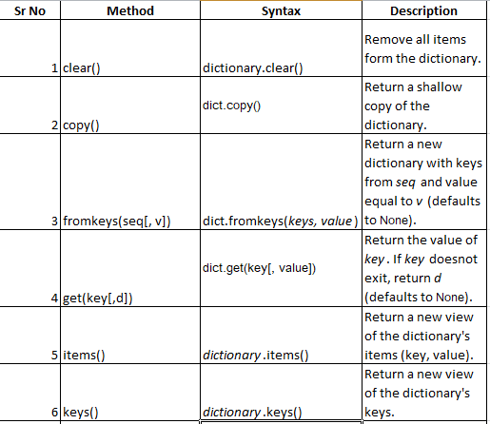
Built in Dictionary FUNCTION

Slide 144
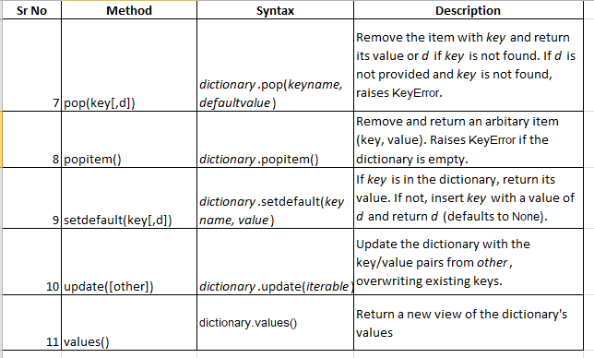

Slide 145
clear()
The clear() method removes all the elements from a dictionary.
Syntax
dictionary.clear()
Example
Dict1={1:20,2:'Amit',3:20.54,4:'Amol'}
Dict1.clear()
print(Dict1)
Output
{ }

Slide 146
copy()
The copy() method returns a copy of the specified dictionary.
Syntax
dictionary.copy()
Example
Dict1={1:20,2:'Amit',3:20.54,4:'Amol'}
Dict2=Dict1.copy()
print(Dict2)
Output
{1: 20, 2: 'Amit', 3: 20.54, 4: 'Amol'}

Slide 147
fromkeys()
The fromkeys() method returns a dictionary with the specified keys and values.
Syntax
dict.fromkeys(keys, value)
Example
key =(1,2,3,4)
value=20
Dict2=dict.fromkeys(key,value)
print(Dict2)
Output
{1: 20, 2: 20, 3: 20, 4: 20}

Slide 148
get()
The get() method returns the value of the item with the specified key.
Syntax
dict.get(key[, value])
The get() method takes maximum of two parameters:
key - key to be searched in the dictionary
value (optional) - Value to be returned if the key is not found. The default value is None.

Slide 149
example
Dict1={1:20,'Name':'Amit',3:20.54,4:'Amol'}
print(Dict1.get('Name'))
print(Dict1.get(5))
print(Dict1.get(5,40))
Output
Amit
None
40

Slide 150
items()
The items() method returns a view object. The view object contains the key-value pairs of the dictionary, as tuples in a list.
The view object will reflect any changes done to the dictionary,
Syntax
dictionary.items()

Slide 151
Example
Dict1={1:20,2:'Amit',3:20.54,4:'Amol'}
print(Dict1.items())
Dict1[2]='Amar'
print(Dict1.items())
Output
dict_items([(1, 20), (2, 'Amit'), (3, 20.54), (4, 'Amol')])
dict_items([(1, 20), (2, 'Amar'), (3, 20.54), (4, 'Amol')])

Slide 152
keys()
The keys() method returns a view object. The view object contains the keys of the dictionary, as a list.
The view object will reflect any changes done to the dictionary,
Syntax
dictionary.keys()

Slide 153
Dict1={1:20,2:'Amit',3:20.54,4:'Amol'}
print(Dict1.keys())
Dict1[5]='Amar'
print(Dict1.keys())
Output
dict_keys([1, 2, 3, 4])
dict_keys([1, 2, 3, 4, 5])

Slide 154
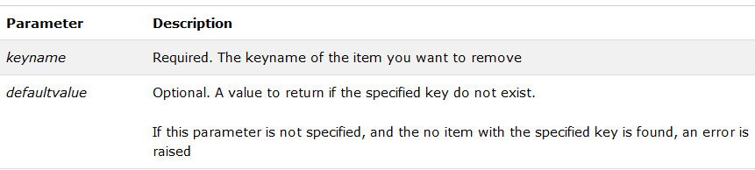
pop()
The pop() method removes the specified item from the dictionary.
The value of the removed item is the return value of the pop() method,
Syntax
dictionary.pop(keyname, defaultvalue)

Slide 155
Dict1={1:20,2:'Amit',3:20.54,4:'Amol'}
Dict1.pop(2)
print(Dict1)
element=Dict1.pop(5,'Amar')
print(element)
Dict1.pop(6)
print(Dict1)
Output
{1: 20, 3: 20.54, 4: 'Amol'}
Amar
Traceback (most recent call last):
File "E:\prg\Dict.py", line 6, in <module>
Dict1.pop(6)
KeyError: 6

Slide 156
popitem()
The popitem() method removes the item that was last inserted into the dictionary. In versions before 3.7, the popitem() method removes a random item.
The removed item is the return value of the popitem() method, as a tuple
Syntax
dictionary.popitem()
Example
Dict1={1:20,2:'Amit',3:20.54,4:'Amol'}
element=Dict1.popitem()
print(element)
Output
(4, 'Amol')

Slide 157
setdefault()
The setdefault() method returns the value of a key (if the key is in dictionary). If not, it inserts key with a value to the dictionary.
Syntax
dictionary.setdefault(keyname, default_value)
The setdefault() takes maximum of two parameters:
key - key to be searched in the dictionary
default_value (optional) - key with a value default_value is inserted to the dictionary if key is not in the dictionary. If not provided, the default_value will be None.

Slide 158
Dict1={1:20,2:'Amit',3:20.54,4:'Amol'}
print(Dict1.setdefault(2))
element=Dict1.setdefault(5,'Amar')
print(element)
print(Dict1)
Output
Amit
Amar
{1: 20, 2: 'Amit', 3: 20.54, 4: 'Amol', 5: 'Amar'}

Slide 159
update()
The update() method adds element(s) to the dictionary if the key is not in the dictionary. If the key is in the dictionary, it updates the key with the new value.
Syntax
dictionary.update(iterable)

Slide 160
Dict1={1:20,2:'Amit',3:20.54,4:'Amol'}
Dict2={2:50}
Dict1.update(Dict2)
print(Dict1)
Dict3={5:90}
Dict1.update(Dict3)
print(Dict1)
Output
{1: 20, 2: 50, 3: 20.54, 4: 'Amol'}
{1: 20, 2: 50, 3: 20.54, 4: 'Amol', 5: 90}

Slide 161
values()
The values() method returns a view object. The view object contains the values of the dictionary, as a list.
The view object will reflect any changes done to the dictionary
Syntax
dictionary.values()
Example
Dict1={1:20,2:'Amit',3:20.54,4:'Amol'}
print(Dict1.values())
Output
dict_values([20, 'Amit', 20.54, 'Amol'])

Slide 162
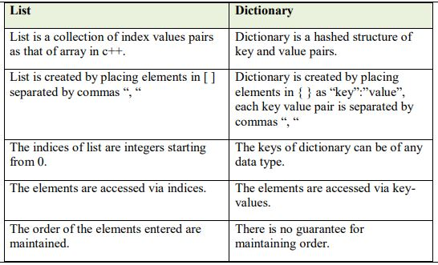
Compare list and dictionary

Slide 163
Write a program to create dictionary of student the includes their ROLL NO and NAME
i) Add three students in above dictionary
ii) Update name=’Shreyas’ of ROLL NO=2
iii) Delete information of ROLL NO=1

Slide 164
1)
>>> dict1={1:"Vijay",2:"Santosh",3:"Yogita"}
>>>print(dict1)
{1: 'Vijay', 2: 'Santosh', 3: 'Yogita'}
ii)
>>>dict1[2]="Shreyas"
>>>print(dict1)
{1: 'Vijay', 2: 'Shreyas', 3: 'Yogita'}
iii)
>>>dict1.pop(1)
‘Vijay'
>>>print(dict1)
{2: 'Shreyas', 3: 'Yogita'}

Slide 165
End

