Slide 1

Unit-III Process Management Marks:14
Compiled by: Mr Rahul Patil
Department of Computer Technology
BVIT Kharghar.

Slide 2
Learning Outcomes
After watching this presentation you will be able to
Explain functions carried out in the given process state.
Describe the function of given component of process stack in PCB
Explain characteristics of given multithreading model.
Describe method of executing the given process command with example.

Slide 3
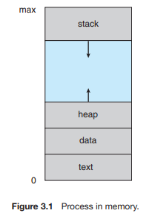
3.1 Process
A process is a program in execution.

Slide 4
Process contd.
A process is more than the program code, which is sometimes known as the text section.
It also includes the current activity, as represented by the value of the program counter and the contents of the processor’s registers.
A process generally also includes the process stack, which contains temporary data (such as function parameters, return addresses, and local variables).
A data section contains global variables.
A process may also include a heap, which is memory that is dynamically allocated during process run time.

Slide 5
Difference between process and program
process
program
When a program is executed, it is known as process.
Active
Lifespan is Limited
Process holds resources such as CPU, memory address, disk, I/O etc.
Program is a set of instruction stored on disk.
Passive
Lifespan is Longer
Program is stored on disk in some file and does not require any other resources.

Slide 6
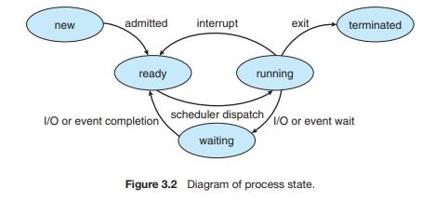
Process State

Slide 7
Process State contd.
As a process executes, it changes state.
The state of a process is defined in part by the current activity of that process.
A process may be in one of the following states:
New: The process is being created.
Ready: The process is waiting to be assigned to a processor.
Running: Instructions are being executed.
Waiting: The process is waiting for some event to occur (such as an I/O completion or reception of a signal).
Terminated: The process has finished execution.

Slide 8
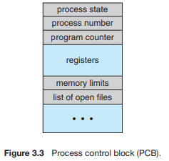
Process Control Block (PCB)
Each process is represented in the operating system by a process control block (PCB)—also called a task control block.
It contains many pieces of information associated with a specific process.

Slide 9
PCB fields
Process state: The state may be new, ready, running, waiting, halted, and so on.
Program counter: The counter indicates the address of the next instruction to be executed for this process.
CPU registers: They include accumulators, index registers,stack pointers, and general-purpose registers, plus any condition-code information. Along with the program counter.
CPU-scheduling information: This information includes a process priority, pointers to scheduling queues, and any other scheduling parameters.
Memory-management information: This information may include such items as the value of the base and limit registers and the page tables, or the segment tables, depending on the memory system used by the operating system.

Slide 10
PCB fields contd.
Accounting information: This information includes the amount of CPU and real time used, time limits, account numbers, job or process numbers, and so on.
I/O status information: This information includes the list of I/O devices allocated to the process, a list of open files, and so on.

Slide 11
3.2 Process scheduling
The objective of multiprogramming is to have some process running at all times, to maximize CPU utilization.
The objective of time sharing is to switch the CPU among processes so frequently that users can interact with each program while it is running.
To meet these objectives, the process scheduler selects an available process (possibly from a set of several available processes) for program execution on the CPU.
For a single-processor system, there will never be more than one running process.
If there are more processes, the rest will have to wait until the CPU is free and can be rescheduled.

Slide 12
Process Scheduling Queues
Job queue – set of all processes in the system.
Ready queue – set of all processes residing in main memory, ready and waiting to execute.
Device queues – set of processes waiting for an I/O device.
Process migration between the various queues.

Slide 13
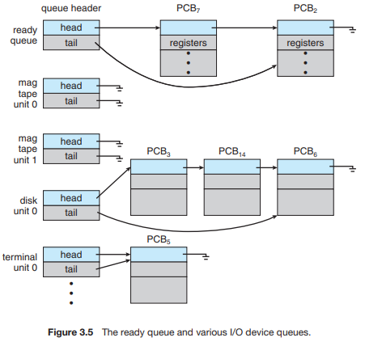
Ready Queue And Various I/O Device Queues

Slide 14
Scheduling Queues contd.
As processes enter the system, they are put into a job queue, which consists of all processes in the system.
The processes that are residing in main memory and are ready and waiting to execute are kept on a list called the ready queue.
This queue is generally stored as a linked list.
A ready-queue header contains pointers to the first and final PCBs in the list.
Each PCB includes a pointer field that points to the next PCB in the ready queue.
The list of processes waiting for a particular I/O device is called a device queue.

Slide 15
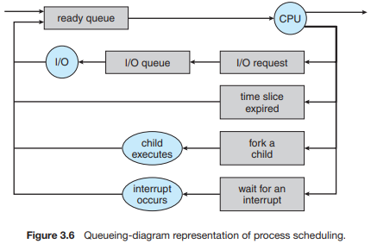
Representation of Process Scheduling

Slide 16
Process Scheduling contd.
rectangle represents a queue. Two types of queues are present: the ready queue and a set of device queues.
circles represent the resources that serve the queues, and the arrows indicate the flow of processes in the system.
A new process is initially put in the ready queue. It waits there until it is selected for execution, or dispatched.
Once the process is allocated the CPU and is executing, one of several events could occur:
The process could issue an I/O request and then be placed in an I/O queue.
The process could create a new child process and wait for the child’s termination.
The process could be removed forcibly from the CPU, as a result of an interrupt, and be put back in the ready queue.
In the first two cases, the process eventually switches from the waiting state to the ready state and is then put back in the ready queue.
A process continues this cycle until it terminates, at which time it is removed from all queues and has its PCB and resources deallocated.

Slide 17
Schedulers:
Schedulers are special system software which handle process scheduling in various ways.
Their main task is to select the jobs to be submitted into the system and to decide which process to run.
Schedulers are of three types −
Long-Term Scheduler
Short-Term Scheduler
Medium-Term Scheduler

Slide 18
Long Term Scheduler/ job scheduler
A long-term scheduler determines which programs are admitted to the system for processing. It selects processes from the queue and loads them into memory for execution.
The primary objective of the job scheduler is to provide a balanced mix of jobs, such as I/O bound and processor bound.
It also controls the degree of multiprogramming. If the degree of multiprogramming is stable, then the average rate of process creation must be equal to the average departure rate of processes leaving the system.
On some systems, the long-term scheduler may not be available or minimal. Time-sharing operating systems have no long term scheduler.
When a process changes the state from new to ready, then there is use of long-term scheduler.

Slide 19
Short Term Scheduler
It is also called as CPU scheduler.
Its main objective is to increase system performance in accordance with the chosen set of criteria.
CPU scheduler selects a process among the processes that are ready to execute and allocates CPU to one of them.
Short-term schedulers make the decision of which process to execute next.
Short-term schedulers are faster than long-term schedulers.

Slide 20
Medium Term Scheduler
Medium-term scheduling is a part of swapping. It removes the processes from the memory.
It reduces the degree of multiprogramming. The medium-term scheduler is in-charge of handling the swapped out-processes.
A running process may become suspended if it makes an I/O request. A suspended processes cannot make any progress towards completion.
In this condition, to remove the process from memory and make space for other processes, the suspended process is moved to the secondary storage.
This process is called swapping, and the process is said to be swapped out or rolled out. Swapping may be necessary to improve the process mix.

Slide 21
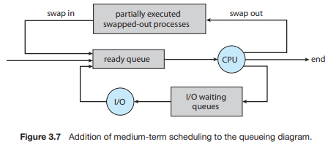
Medium Term Scheduler contd.

Slide 22
Comparison among Scheduler
S.N. | Long-Term Scheduler | Short-Term Scheduler | Medium-Term Scheduler
1 | It is a job scheduler | It is a CPU scheduler | It is a process swapping scheduler.
2 | Speed is lesser than short term scheduler | Speed is fastest among other two | Speed is in between both short and long term scheduler.
3 | It controls the degree of multiprogramming | It provides lesser control over degree of multiprogramming | It reduces the degree of multiprogramming.
4 | It is almost absent or minimal in time sharing system | It is also minimal in time sharing system | It is a part of Time sharing systems.
5 | It selects processes from pool and loads them into memory for execution | It selects those processes which are ready to execute | It can re-introduce the process into memory and execution can be continued.

Slide 23
Context Switch
A context switch is the mechanism to store and restore the state or context of a CPU in Process Control block so that a process execution can be resumed from the same point at a later time.
Using this technique, a context switcher enables multiple processes to share a single CPU.
Context switching is an essential part of a multitasking operating system features.
When the scheduler switches the CPU from executing one process to execute another, the state from the current running process is stored into the process control block.
After this, the state for the process to run next is loaded from its own PCB and used to set the PC, registers, etc. At that point, the second process can start executing.

Slide 24
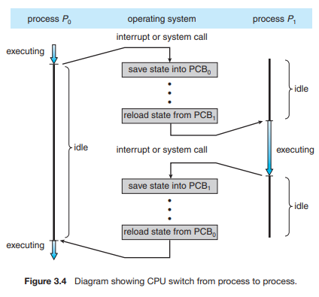
Context Switch contd.

Slide 25
Context Switch contd.
Context switches are computationally intensive since register and memory state must be saved and restored.
To avoid the amount of context switching time, some hardware systems employ two or more sets of processor registers. When the process is switched, the following information is stored for later use.
Program Counter
Scheduling information
Base and limit register value
Currently used register
Changed State
I/O State information
Accounting information

Slide 26
3.3 Interprocess communication (IPC)
Processes executing concurrently may be either independent processes or cooperating processes.
A process is independent if it cannot affect or be affected by the other processes executing in the system.
Any process that does not share data with any other process is independent.
A process is cooperating if it can affect or be affected by the other processes executing in the system.

Slide 27
Reasons for process cooperation/IPC:
Information sharing: eg a shared file to allow concurrent access to multiple users
Computation speedup: If we want a particular task to run faster, we must break it into subtasks, each of which will be executing in parallel with the others.
Modularity: dividing the system functions into separate processes or threads.
Convenience: Even an individual user may work on many tasks at the same time. For instance, a user may be editing, listening to music, and compiling in parallel.

Slide 28
IPC contd.
Interprocess communication (IPC) is a mechanism that allow processes to exchange data and information.
There are two fundamental models of interprocess communication: 1. shared memory
2. message passing

Slide 29
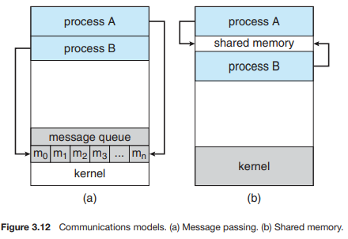
IPC models:

Slide 30
shared-memory model:
In the shared-memory model, a region of memory that is shared by cooperating processes is established.
Processes can then exchange information by reading and writing data to the shared region.
Shared memory can be faster than message passing, In shared-memory systems, system calls are required only to establish shared-memory regions.
Once shared memory is established, all accesses are treated as routine memory accesses, and no assistance from the kernel is required.

Slide 31
Message passing model:
In the message-passing model, communication takes place by means of messages exchanged between the cooperating processes.
Message-passing systems are typically implemented using system calls and thus require the more time-consuming task of kernel intervention.
Message passing is useful for exchanging smaller amounts of data, because no conflicts need be avoided.
Message passing is also easier to implement in a distributed system than shared memory.

Slide 32
Shared-memory
Message passing
The shared memory region is used for communication.
It is used for communication between processes on a single processor or multiprocessor systems.
It is useful for sharing large amounts of data.
No kernel intervention.
Example-
Data from a client process may need to be transferred to a server process for modification before being returned to the client.
A message passing facility is used for communication.
It is typically used in a distributed environment in network.
It is useful for sharing small amounts of data.
It involves kernel intervention.
Example- Web servers, web browsers.

Slide 33
3.4 Threads:
A thread is a basic unit of CPU utilization; it comprises a thread ID, a program counter, a register set, and a stack.
A thread is a path of execution within a process.
A process can contain multiple threads.
It shares with other threads belonging to the same process its code section, data section, and other operating-system resources, such as open files and signals.
A thread is also known as lightweight process.
For example, in a browser, multiple tabs can be different threads.
MS Word uses multiple threads: one thread to format the text, another thread to process inputs, etc.

Slide 34
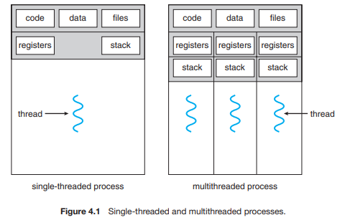
Single-threaded and multithreaded processes:

Slide 35
Thread benefits:
Responsiveness: Multithreading an interactive application may allow a program to continue running even if part of it is blocked or is performing a lengthy operation, thereby increasing responsiveness to the user.
Resource sharing: threads share the memory and the resources of the process to which they belong by default. it allows an application to have several different threads of activity within the same address space.
Economy: Allocating memory and resources for process creation is costly. Because threads share the resources of the process to which they belong, it is more economical to create and context-switch threads.
Scalability: The benefits of multithreading can be even greater in a multiprocessor architecture, where threads may be running in parallel on different processing cores.

Slide 36
Process vs thread
S.N. | Process | Thread
1 | Process is heavy weight or resource intensive. | Thread is light weight, taking lesser resources than a process.
2 | Process switching needs interaction with operating system. | Thread switching does not need to interact with operating system.
3 | In multiple processing environments, each process executes the same code but has its own memory and file resources. | All threads can share same set of open files, child processes.
4 | If one process is blocked, then no other process can execute until the first process is unblocked. | While one thread is blocked and waiting, a second thread in the same task can run.
5 | Multiple processes without using threads use more resources. | Multiple threaded processes use fewer resources.
6 | In multiple processes each process operates independently of the others. | One thread can read, write or change another thread's data.

Slide 37
Types of threads:
Threads are implemented in following two ways −
User Level Threads − User managed threads.
Kernel Level Threads − Operating System managed threads acting on kernel, an operating system core.

Slide 38
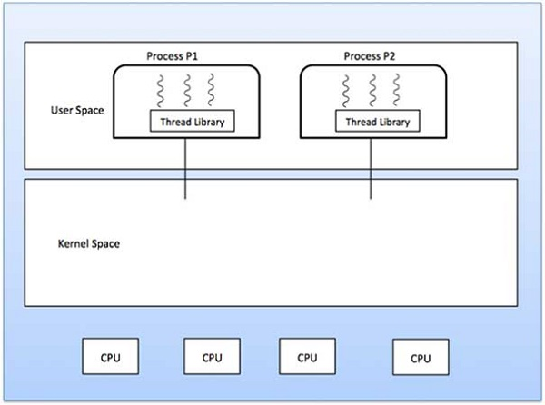
User Level Threads

Slide 39
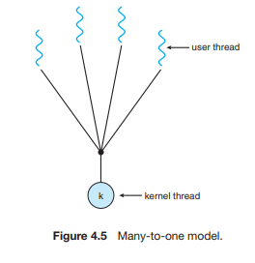
Multithreading Models
Many-to-one model maps many user level threads to one Kernel-level thread.
Thread management is done in user space by the thread library.
When thread makes a blocking system call, the entire process will be blocked.
Only one thread can access the Kernel at a time, so multiple threads are unable to run in parallel on multiprocessors.
Eg green threads in solaris
Many-to-One Model:

Slide 40
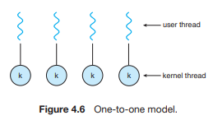
One-to-One Model
The one-to-one model maps each user thread to a kernel thread.
It provides more concurrency than the many-to-one model by allowing another thread to run when a thread makes a blocking system call.
It also allows multiple threads to run in parallel on multiprocessors.
The only drawback to this model is that creating a user thread requires creating the corresponding kernel thread.

Slide 41
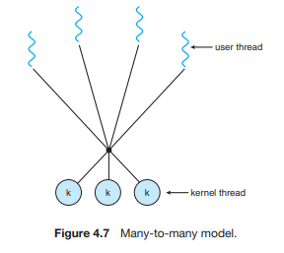
Many-to-Many Model
The many-to-many model multiplexes any number of user threads onto an equal or smaller number of kernel threads.
The diagram shows the many-to-many threading model where 4 user level threads are multiplexing with 3 kernel level threads.
In this model, developers can create as many user threads as necessary and the corresponding Kernel threads can run in parallel on a multiprocessor machine.
This model provides the best accuracy on concurrency and when a thread performs a blocking system call, the kernel can schedule another thread for execution.

Slide 42
Thank you

