Slide 1
Chapter 3
Test Management

Slide 2
Testing Activities
Test policy
Test Strategy
Test Planning
Test Scenario Definition
Test Cases Definition
Test Data Definition

Slide 3
Steps in Test Plan
Test plan is a strategic document which describes how to perform a task in an effective and optimized way
Steps in Test Plan
Set objectives of test plan
Develop a test matrix
Develop test administrative component
Write the test plan

Slide 4
Test Planning Activities
Determine scope and risks
Documenting Test Strategy.
Making sure about test activities have been included
Deciding entry and exit criteria
Evaluate Test estimation
The test artefacts delivered as part of execution
Defining management information
Make sure that test documentation involves repeatable tests

Slide 5
Test Planning:
Test Plan
Preparing a Test plan
Scope management
Deciding Test Approch /Strategy
Setting up criteria for testing
Identifying responsibility
Staffing and Training Needs
Resource Requirements
Identifying Test Deliverables
Testing Tasks(Size & Effort Estimation)
Schedule

Slide 6
1.Test Plan
A test plan is a document describing software Testing scope , approch , schedule, resource and activities.
It is the basis for formally testing any software in the project.
A document describing the scope, approach, and schedule of intended test activities.
In this documentation of features to be tested, testing task, test design techniques, entry and exit criteria.
It is a record of planning process.

Slide 7
1.Test Plan
There are two types of plans
Master test plan
A plan that typically consists addresses different test levels.
Phase test plan
A plan that typically consist one test phase.

Slide 8
1.1 Structure of a Test Plan
Testing Process
Requirement Traceability
Tested Items
Testing Schedule
Test Recording Procedures
H/W and S/W Requirements
Constraints
System Tests

Slide 9
1.2 Test plan Format/Template(IEEE)
1. Test plan identifier: unique number to identify test plan.
e.g. project_name001
2. References: supportive documents for test plan.
e.g SRS
Use case documents, test strategy, test plan.
3. Introduction : Purpose and scope of the project.
To test functionality of the project name.
4. Test items: A list of test items which will be tested.

Slide 10
1.2 Test plan Format/Template(IEEE)
5. Features to be tested: login functionality, dashboard, reports.
6. Features not to be tested:
7. Test approach: Test types, test techniques.
8. Setting up criteria for pass/fail
9. Suspension criteria: login functionalities or major functionalities not performed.
10. Test deliverables :bug report.
11. Testing task : test environment, test execution, test summary report.

Slide 11
1.2 Test plan Format/Template(IEEE)
12. Resource requirement.
13. Identifying responsibilities.
14. Staffing and training needs.
15. Schedule
16. Risk
17. Approval
18.Glossary: (Summary)

Slide 12
2.Preparing a Test plan
Test Plan is deals with objectives of a software.
The test plan acts as an anchor for execution of entire software
Following points are followed while preparing a Test Plan:
1.What is to be tested?
2.How testing will be performed?
3.Which resources are needed?
4.When each test will occurs?
5.Which will be deadline for testing?
6.Risks that may be faced through out testing.

Slide 13
3.Scope Management
The Scope describes the activities included and excluded from quality assurance/quality control activities.
Scope of the test includes what items, features , procedures , functions ,objects , will be tested
Test Scope includes:
1.Functional/Structural Requirements
2.Infrastucture Components
3.Application Components
4.System Interface

Slide 14
3.Scope Management
Feature to be considered in scope management:
1.Features that is new and critical for release
2.Features whose failures can be disastrous
3.Features that are expected to be complex to test
4.Features which are extensions of earlier features

Slide 15
4.Deciding Test Approach/Strategy
Test Approach/Strategy should result in identifying the right type of test for each of the features.
This includes identifying:
Which tools to be used?
Will that tool require special training?
Which metrics to be collected and at what level?
How many configurations will be tested?
H/W and S/W

Slide 16
5.Setting up criteria for testing
Test strategies decide how to test these features and combinations would be tested.
To avoid last minute pressure of executing tests after development.
The Entry criteria for a test specify threshold criteria for each phase.
Exit criteria decide when a cycle can be completed.

Slide 17
5.Setting up criteria for testing
Number of times it is suspended because it is not proceed further.
When situation comes under control it will be resumed.
Some of the typical suspension criteria include:
1.Encountering more than a certain number of defects
2.Hitting show stoppers that make difficult further progress of testing.
3.Developers releasing new version should be used

Slide 18
6.Identifying Responsibility
Fix responsibilities to different individuals .(Project Manager,Leader,Programmer,Tester)
Some Responsibility task are given below:
1.Identify the group responsible for designing , executing , checking , managing.
2.Identify the group responsible for providing test items.
3.Identify the group responsible for providing environmental needs

Slide 19
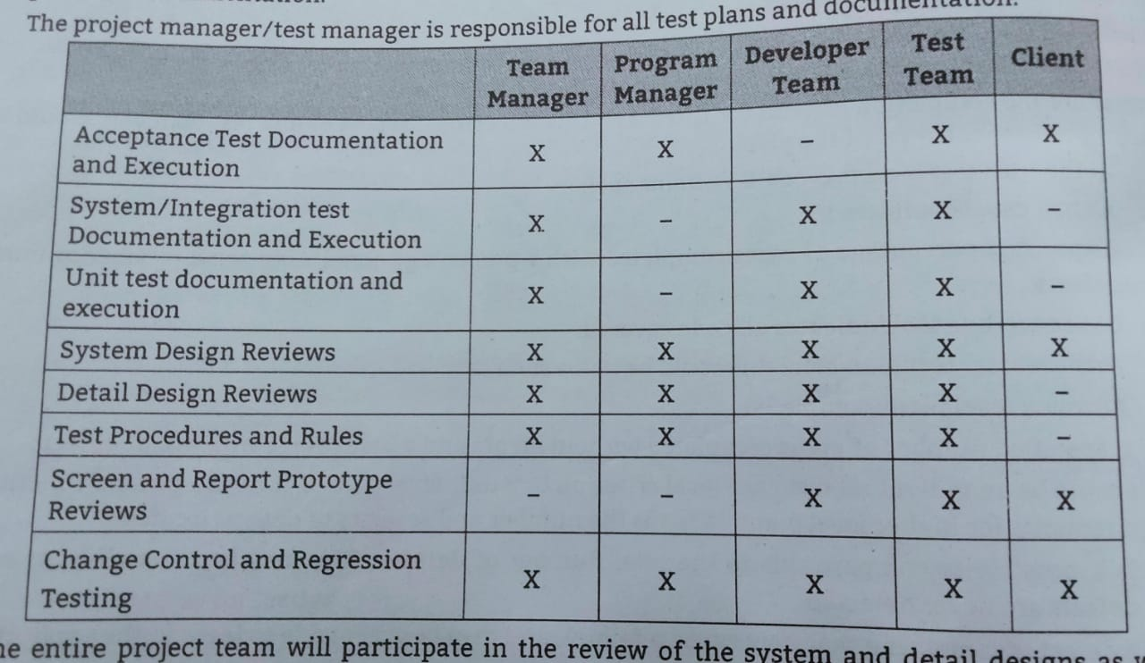
6.Identifying Responsibility

Slide 20
7. Staffing and Training Needs
There are different roles in testing strategy:
Test Engineers
Test Leaders
Test Managers
8.Resource Requirements:
Machine configuration like RAM, Processor disk.
Automation tool.
Supporting tools like test data generators, configuration management tools.
Load tests and performance tests.
Appropriate number of licenses of all the software

Slide 21
9.Identifying Test Deliverables
Test deliverables is the product being delivered and is normally the software under test.
Deliverables include following:
Test plan document
Test cases
Test design specifications
Tools and their Outputs
Simulators
Static and Dynamic generators
Error logs and execution logs
Problem reports and corrective actions
Test summary reports.

Slide 22
3.1.10.Testing tasks (Size & Effort Estimation)
Estimation in three phases
Size Estimation
Effort Estimation
Schedule Estimation

Slide 23
Number of factors contribute Size Estimate of a testing project:
1. Size of the product under test
2. Extent of Automation required
3. No. of platforms & Inter-operability environments to be tested
4. Productivity Data
5. Reuse Opportunities
6. Robustness of Processes

Slide 24
Number of factors contribute Size Estimate of a testing project:
1. Size of the product under test
a) Lines of code:
b) Function point:
c) Simpler representation of application size (i.e. Simple, Medium, Complex)
a) Lines of code:
It depends on:
language used for coding,
respective style of programming,
compactness of programming,
only considered for coding phase.
not for requirement and design.

Slide 25
Number of factors contribute Size Estimate of a testing project
b) Function point:
A function point can be widely used to measure the size of software.
To measure functionality.
To measure complexity of software.
Parameters for function point
External input
External output
Logical internal files
External interface files
External inquiry

Slide 26
3.1.11. Schedule
1.Date
2.Time

Slide 27
3.2 Test Management
It is a method of organizing test assets such as test requirements, test cases, test results.
It refers to the activity of the managing software testing process.
Test management allows different teams to plan, develop, execute and access all testing activities.

Slide 28
3.2.1 Choice of standard
Standards means it gives uniformity in understanding the subject for which they written or developed.
Two Types:
1. External Standards:
a) Customer Standards
b) National Standards
c) International Standards
2. Internal Standards :
a) Naming & Storage Conventions foe test Artifacts
b) Documentation Standards
c) Test Coding Standards
d) Test Reporting Standards

Slide 29
3.2.2 Test Infrastructure Management
Testing requires robust Infrastructure.
Stronger infrastructure provides stability, continuity, reliability.
Testing infrastructure made up of 3 essential elements:
1. A Test Code DataBase(TCDB)
2. A Defect Repository
3. A Configuration Management Repository & Tool

Slide 30
3.2.2 Test Infrastructure Management
1. A Test Code DataBase(TCDB):
TCDB captures all relevant information about the test cases.
2. A Defect Repository:
It captures all relevant details of defects reported for a product.
3. A Configuration Management Repository & Tool
It is a collection of software elements that concerned with labelling,tracking,comtrolling changes in the software.

Slide 31
3.2.3 Test people management
A test team: A test team comprise of individuals having varying
skill levels.
experience levels.
expertise levels.
different attitudes.
different expectations/interest levels.

Slide 32
3.2.4 Integrating with people Release
Success of product depend on Integrating with people of the development.
Following points to be decided:
Sync Points
Service Level Agreements
Consistancy
Communication

Slide 33
3.3 Test Process
Testing is not a single activity.
It is a set of number of processes.
Test Process Activities:
Base lining a test plan.
Test case specification.
Update of traceability Matrix

Slide 34
3.3 Test Process
3.3.1. Base lining a test plan:
A Test Plan combines all the points in a single document that acts as an anchor point for entire project
Each testing project puts together a test plan based on a template
The baselined test plan becomes basis for successfully running project.
If any change in a testing project be reflected in a test plan.

Slide 35
3.3 Test Process
3.3.2. Test case specification
Test case specification describes what scenarios will be tested , how they will be tested how often they will be tested. It has to be done separately for each unit.
It involves:
a) Purpose of a test plan
b) Items being tested
c) Environment that needs to be set up for running test case
d) Input data used to test case
e) Steps to be followed to execute the test
f) The expected result
g) a step to compare the actual results produced with expected result
h) Relationship between this test & another Test

Slide 36
3.3 Test Process
3.3.3.Update of Traceability Matrix
It is a document which contains a table of linking information used for tracking back for reference in any kind of confusion or questionable situation

Slide 37
3.4 Test Reporting
A Test report is any description explanation or justification of the status of a test project.
Two types of report:
1. Test Incident Report
2. Test Cycle Report
3 .Test Summary Report:
a) Phase-wise Test Summary report
b) Final Test Summary report
A summary report includes:
i) Summary of activities
ii) Variance of activities
iii)Summary of results
iv) Comprehensive Assesment & Recommendation

Slide 38
3.4 Test Reporting
3.4.1 Recommending Product Release:
Based on summary report an organization takes a decision whether to release product or not.
Recommending Product Release Criteria:
Checks fitness of product
Which is defect
Severity of defect
Risk of releasing product

Slide 39
3.4 Test Reporting
3.4.2 Executing Test Cases
Execute test cases at the appropriate times during a project.
Defect repository updated with defects with previous test cycles and updated with defects from previous test cycles which are fixed in current build.
Defect repository is communication among with test team and development team.
Defect repository defects which are uncovered during testing.

Slide 40
3.4 Test Reporting
3.4.2 Executing Test Cases
Defect repository is reported to stakeholders for current status.
Communicated with the help of mails, conference calls.
Test may be suspended at the mid of execution due to
show stopper defects.
Suspended criteria wait still resumption criteria.
Traceability matrix is used while execution of test cases.

Slide 41
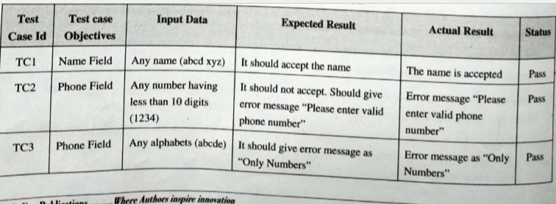
Executing Test Cases

Slide 42
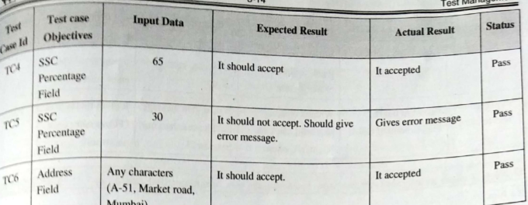
Executing Test Cases

Slide 43
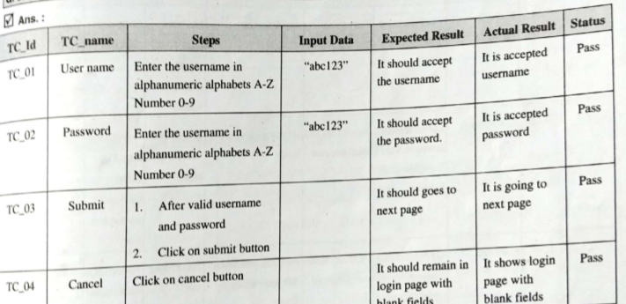
Executing Test Cases

Slide 44
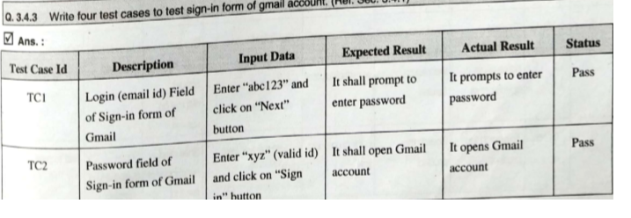
Executing Test Cases

Slide 45
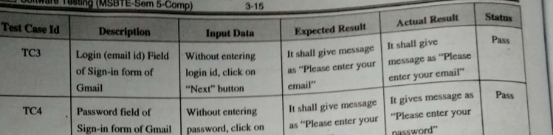
Executing Test Cases

Slide 46
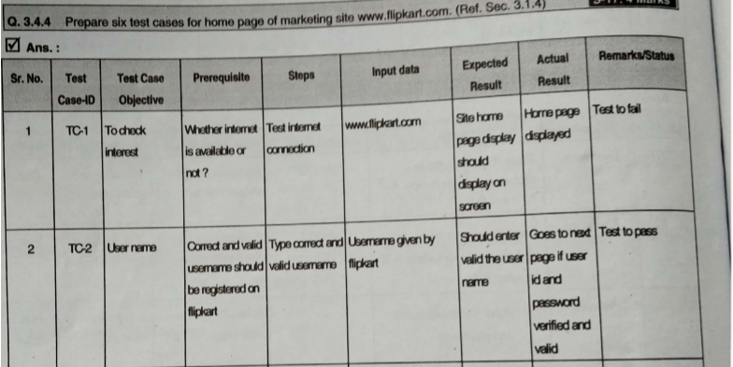
Executing Test Cases

Slide 47
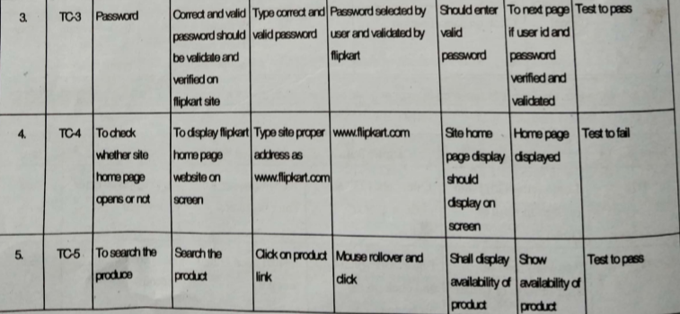
Executing Test Cases

Slide 48
3.4.4 Preparing Test Summary
Testing needs communication between test team and other team.
There are two types of communication report:
Test incident report
Test summary report.
Test incident report communication which occurs through testing cycle whenever defects are encountered.
A test incident report is an entry which has been made in the corresponding defect repository.

Slide 49
Format of summary report
Test Summary Report Identifier : Company generated unique number that is allocated to this report.
Summary :After assigning unique id summarize test report.
Test items: Test items should match test items provided in the definition of test plan.
Test Environment: It should be according to the test plan and
and validate correct set up used by team.

Slide 50
Format of summary report
References: Includes any document or evidence that can support to the report.
Variances : The team documents any deviation or changes from those areas and plans which were agreed by everyone from the document.
These includes references supporting the documentation like change requests, enhancement request , incident report ,test plan and specifications among other references.

Slide 51
Format of summary report
Comprehensiveness assessment : This involves evaluation of testing and testing process for determining quality and effectiveness of testing activities.
To find out weakness and any challenge while executing it.
Summary of results: It includes impact of testing.
Resolved incidents and defects.
Division of these defects as per severity and priority.

Slide 52
Format of summary report
Some of other information included in this document are:
Nature and cause of problems.
Cost , impact and positive trends.
Severity and priority of impact and defects.
Defect pattern.
Pass and failure of incident.

Slide 53
Format of summary report
Evaluation :On the basis of evaluation the team offers information about the testing process, its information, drawbacks, failure, high and medium risk areas ,good quality areas and features.
Summary of activities: It defines testing activities, the time and efforts invested in it.
The main focus is on the process , techniques, used to achieve set goals and requirements, changes in the plan.

Slide 54
Format of summary report
Approval : Approval in the form of signature and documentation are included by the team provided by testers These should match the approval provided in the test plan to verify the result of testing.

Slide 55
Thank You

