Slide 1

Unit IV CPU Scheduling and Algorithms Marks:14
Compiled by: Mr Rahul Patil
Department of Computer Technology
BVIT Kharghar.

Slide 2
Learning Outcomes
After watching this presentation you will be able to:
Justify the need and objective of given job scheduling criteria with relevant example.
Explain with example the procedure of allocating CPU to the given process using the specified os.
Calculate turnaround time and average waiting time of given scheduling algorithm.
Explain functioning of the given necessary condition leading to deadlock.

Slide 3
4.1 Scheduling Types
Scheduling :
CPU scheduling is a process which allows one process to use the CPU while the execution of another process is on hold(in waiting state) due to unavailability of any resource like I/O etc, thereby making full use of CPU.
Objectives:
Maximize throughput
Be fair
Prevent indefinite postponement
Complete process by given deadline
Maximize processor utilization
Balance resource use
Enforce Priorities

Slide 4
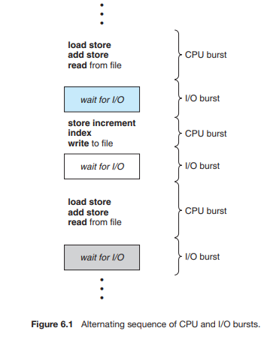
CPU and I/O burst cycles:
process execution consists of a cycle of CPU execution and I/O wait.
Processes alternate between these two states.
Process execution begins with a CPU burst. That is followed by an I/O burst, which is followed by another CPU burst, then another I/O burst, and so on.
The final CPU burst ends with a system request to terminate execution .

Slide 5
Preemptive scheduling
The scheduling in which a running process can be interrupted if a high priority process enters the queue and is allocated to the CPU is called preemptive scheduling.
In this case, the current process switches from the running queue to ready queue, and the high priority process utilizes the CPU cycle.
Algorithms that are backed by preemptive Scheduling are round-robin (RR), priority, SRTF (shortest remaining time first).
Windows 95 introduced preemptive scheduling, and all subsequent versions of Windows operating systems have used preemptive scheduling.
The Mac OS X operating system for the Macintosh also uses preemptive scheduling.

Slide 6
Non-Preemptive scheduling
The scheduling in which a running process cannot be interrupted by any other process is called non-preemptive scheduling.
Any other process which enters the queue has to wait until the current process finishes its CPU cycle.
Algorithms that are based on non-preemptive Scheduling are non-preemptive priority, and shortest Job first.
This scheduling method was used by Microsoft Windows 3.x.

Slide 7
Preemptive Vs Non-Preemptive Scheduling
Preemptive Scheduling | Non-Preemptive Scheduling
1.Resources are allocated according to the cycles for a limited time. | 1.Resources are used and then held by the process until it gets terminated.
2.The process can be interrupted, even before the completion. | 2.The process is not interrupted until its life cycle is complete.
3.Starvation may be caused, due to the insertion of priority process in the queue. | 3.Starvation can occur when a process with large burst time occupies the system.
4.Maintaining queue and remaining time needs storage overhead. | 4.No such overheads are required.

Slide 8
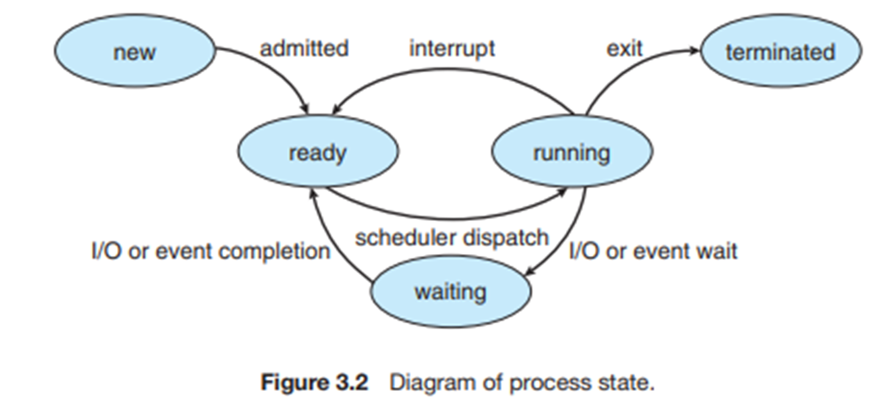
Preemptive Vs Non-Preemptive Scheduling
CPU-scheduling decisions may take place under the following four circumstances:
1. When a process switches from the running state to the waiting state (for example, as the result of an I/O request or an invocation of wait() for the termination of a child process)
2. When a process switches from the running state to the ready state (for example, when an interrupt occurs)
3. When a process switches from the waiting state to the ready state (for example, at completion of I/O)
4. When a process terminates

Slide 9
Preemptive Vs Non-Preemptive Scheduling contd.
For situations 1 and 4, there is no choice in terms of scheduling. A new process (if one exists in the ready queue) must be selected for execution.
There is a choice, however, for situations 2 and 3.
When scheduling takes place only under circumstances 1 and 4, we say that the scheduling scheme is nonpreemptive or cooperative.
Otherwise , it is preemptive.
Under nonpreemptive scheduling, once the CPU has been allocated to a process, the process keeps the CPU until it releases the CPU either by terminating or by switching to the waiting state.
This scheduling method was used by Microsoft Windows 3.x

Slide 10
Scheduling Criteria
CPU utilization. We want to keep the CPU as busy as possible. Conceptually, CPU utilization can range from 0 to 100 percent. In a real system, it should range from 40 percent (for a lightly loaded system) to 90 percent (for a heavily loaded system).
Throughput. The number of processes that are completed per time unit, called throughput. For long processes, this rate may be one process per hour; for short transactions, it may be ten processes per second.
Turnaround time. The interval from the time of submission of a process to the time of completion is the turnaround time. Turnaround time is the sum of the periods spent waiting to get into memory, waiting in the ready queue, executing on the CPU, and doing I/O.
Waiting time. Waiting time is the sum of the periods spent waiting in the ready queue.
Response time. It is the time from the submission of a request until the first response is produced. This measure, called response time, is the time it takes to start responding, not the time it takes to output the response.

Slide 11
4.2 Types of scheduling algorithms
First-Come, First-Served (FCFS) Scheduling
Shortest-Job-First (SJF) Scheduling
Shortest Remaining Time First Scheduling
Round Robin(RR) Scheduling
Priority Scheduling
Multiple-Level Queues Scheduling

Slide 12
First-Come, First-Served (FCFS) Scheduling
The simplest CPU-scheduling algorithm is (FCFS) scheduling algorithm.
The process that requests the CPU first is allocated the CPU first.
Its implementation is based on FIFO queue.
Easy to understand and implement.
Poor in performance as average wait time is high.
FCFS scheduling algorithm is nonpreemptive

Slide 13



FCFS example
Consider following set of processes arrive at time 0, with length of CPU burst given in milliseconds:
If the processes arrive in the order P1, P2, P3, and are served in FCFS order, we get the result shown in the following Gantt chart
The waiting time is 0 milliseconds for process P1, 24 milliseconds for process P2, and 27 milliseconds for process P3. Thus, the average waiting time is (0 + 24 + 27)/3 = 17 milliseconds
If the processes arrive in the order P2, P3, P1, however, the results will be as shown in the following Gantt chart:
The average waiting time is now (6 + 0 + 3)/3 = 3 milliseconds.

Slide 14
FCFS contd…
Advantages –
It is simple and easy to understand.
Disadvantages –
The process with less execution time suffer i.e. waiting time is often quite long.
Favors CPU Bound process then I/O bound process.
Here, first process will get the CPU first, other processes can get CPU only after the current process has finished it’s execution. Now, suppose the first process has large burst time, and other processes have less burst time, then the processes will have to wait more unnecessarily, this will result in more average waiting time, i.e., Convey effect.
This effect results in lower CPU and device utilization.
FCFS algorithm is particularly troublesome for time-sharing systems, where it is important that each user get a share of the CPU at regular intervals.

Slide 15
Shortest Job First(SJF):
This algorithm associates with each process the length of the process's next CPU burst.
When the CPU is available, it is assigned to the process that has the smallest next CPU burst.
If the next CPU bursts of two processes are the same, FCFS scheduling is used to break the tie.

Slide 16
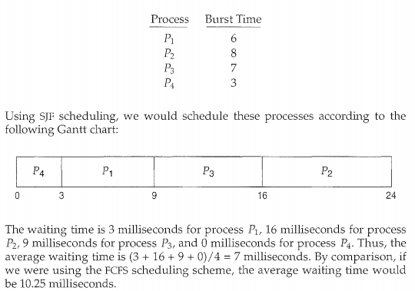
Non preemptive SJF contd…

Slide 17
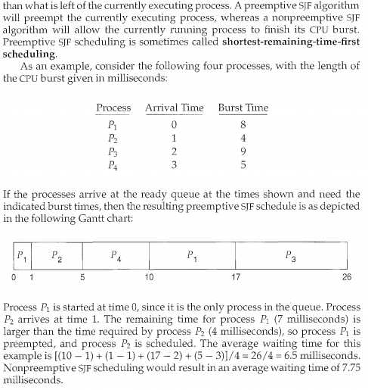
preemptive SJF contd…

Slide 18
SJF contd….
Advantages –
Shortest jobs are favored.
It is optimal, in that it gives the minimum average waiting time for a given set of processes.
Disadvantages –
SJF may cause starvation, if shorter processes keep coming. This problem is solved by aging.
Job completion time must be known earlier, but it is hard to predict.

Slide 19
Priority Scheduling
A priority is associated with each process, and the CPU is allocated to the process with the highest priority.
Equal-priority processes are scheduled in FCFS order.
An SJF algorithm is simply a priority algorithm where the priority (p) is the inverse of the (predicted) next CPU burst.
The larger the CPU burst, the lower the priority, and vice versa.

Slide 20
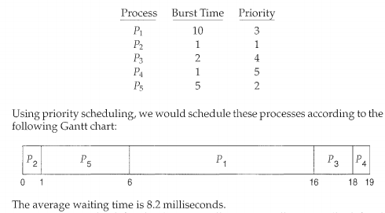
Priority Scheduling example

Slide 21
Priority Scheduling contd..
Advantages –
This provides a good mechanism where the relative importance of each process maybe precisely defined.
Disadvantages –
If high priority processes use up a lot of CPU time, lower priority processes may starve and be postponed indefinitely.The situation where a process never gets scheduled to run is called starvation.
Another problem is deciding which process gets which priority level assigned to it.

Slide 22
Round-Robin Scheduling
The round-robin (RR) scheduling algorithm is designed especially for timesharing systems.
It is similar to FCFS scheduling, but preemption is added to enable the system to switch between processes.
A small unit of time, called a time quantum or time slice, is defined.
A time quantum is generally from 10 to 100 milliseconds in length.

Slide 23
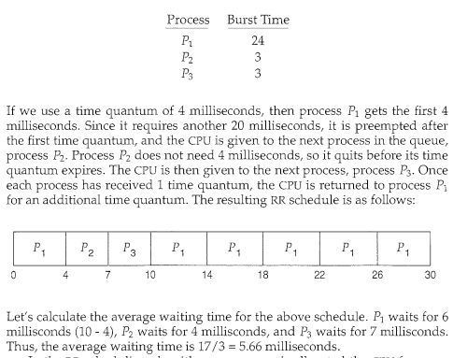
Round-Robin Scheduling example

Slide 24
Round-Robin Scheduling contd…
Advantages –
Every process gets an equal share of the CPU.
RR is cyclic in nature, so there is no starvation.
Disadvantages –
Setting the quantum too short, increases the overhead and lowers the CPU efficiency, but setting it too long may cause poor response to short processes.
Average waiting time under the RR policy is often long.

Slide 25
Multilevel Queue Scheduling
processes are classified into different groups.
For example, a common division is made between foreground (interactive) processes and background (batch) processes.
These two types of processes have different response-time requirements and so may have different scheduling needs.
In addition, foreground processes may have priority (externally defined) over background processes.

Slide 26
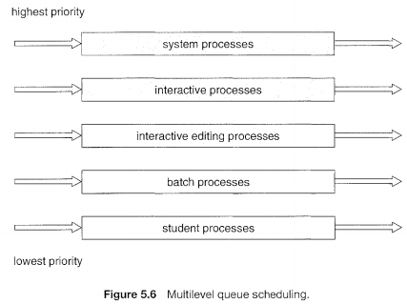
Multilevel Queue Scheduling contd…
A multilevel queue scheduling algorithm partitions the ready queue into several separate queues.

Slide 27
Multilevel Queue Scheduling contd…
Advantages –
Application of separate scheduling for various kind of processes is possible.
System Process – FCFS
Interactive Process – SJF
Batch Process – RR
Student Process – PB
Disadvantages –
The lowest level process faces starvation problem.

Slide 28
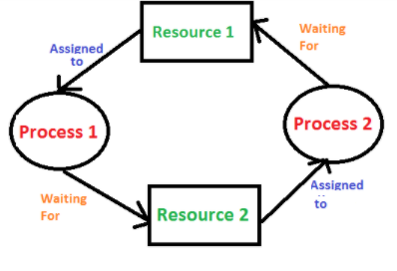
Deadlock:
In a multiprogramming environment, several processes may compete for a finite number of resources.
A process requests resources; if the resources are not available at that time, the process enters a waiting state.
Sometimes, a waiting process is never again able to change state, because the resources it has requested are held by other waiting processes.
This situation is called a deadlock

Slide 29
System model:
A system consists of a finite number of resources of several types, each consisting of some number of identical instances.
Memory space,CPU cycles, files, and I/0 devices (such as printers and DVD drives) are examples of resource types.
If a system has two CPUs, then the resource type CPU has two instances.
Similarly, the resource type printer may have five instances.

Slide 30
System model contd…
Under the normal mode of operation, a process may utilize a resource in only the following sequence:
Request. The process requests the resource. If the request cannot be granted immediately (for example, if the resource is being used by another process), then the requesting process must wait until it can acquire the resource.
Use. The process can operate on the resource (for example, if the resource is a printer, the process can print on the printer).
Release. The process releases the resource.

Slide 31
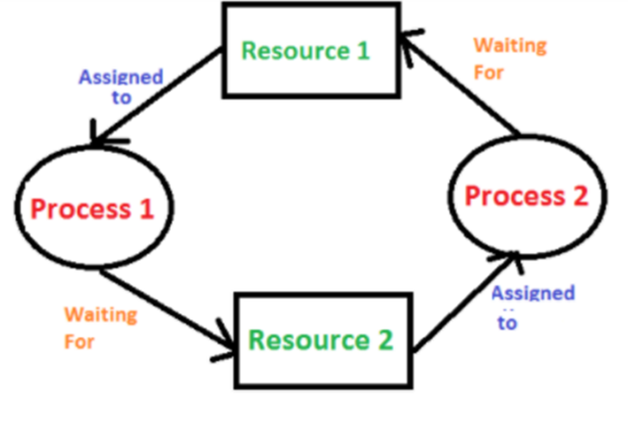
Necessary Conditions for deadlock
Mutual exclusion. At least one resource must be held in a nonsharable mode; that is, only one process at a time can use the resource.
Hold and wait. A process must be holding at least one resource and waiting to acquire additional resources that are currently being held by other processes.
No preemption. Resources cannot be preempted; that is, a resource can be released only voluntarily by the process holding it, after that process has completed its task.
Circular wait. A set { P0 , P1, ... , P11 } of waiting processes must exist such that Po is waiting for a resource held by P1, P1 is waiting for a resource held by P2, ... , Pn-1 is waiting for a resource held by Pn and Pn is waiting for a resource held by Po.

Slide 32
Methods for handling deadlock
There are three ways to handle deadlock
1) Deadlock prevention or avoidance: The idea is to not let the system into a deadlock state.
Prevention is done by negating one of above mentioned necessary conditions for deadlock.
Avoidance is kind of futuristic in nature. By using strategy of “Avoidance”, we have to make an assumption. We need to ensure that all information about resources which process will need are known to us prior to execution of the process. We use Banker’s algorithm in order to avoid deadlock.
2) Deadlock detection and recovery: Let deadlock occur, then do preemption to handle it once occurred.
3) Ignore the problem altogether: If deadlock is very rare, then let it happen and reboot the system. This is the approach that both Windows and UNIX take.

