Slide 1
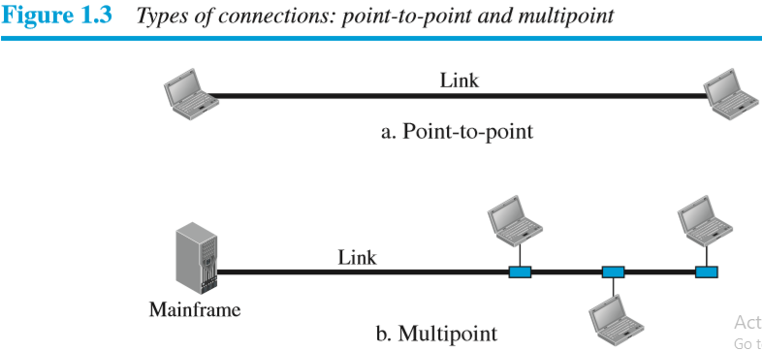
Network Topologies
Type of Connection: In a network two or more devices connected through links
In Point-to-Point connection there is dedicated link between two devices.
In Multipoint connection more than two devices share a single link

Slide 2
Network Topologies
What is Topology?
The network topology means way in which computers connected in a network.
The network topology is a physical layout of the network.
The network topology describes which type of cable and which network connectivity device used to connect computers in a network.
Types of Topology:
Bus Topology
Star Topology
Ring Topology
Mesh Topology
Tree Topology
Hybrid Topology

Slide 3
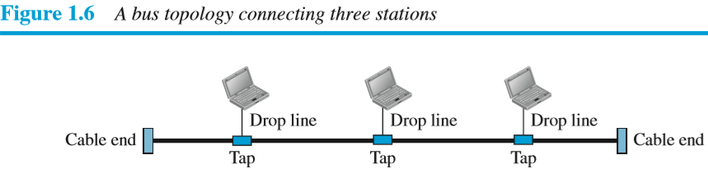
Bus Topology
In Bus topology all computers are connected to a single cable called a Bus
The computers are connected to main cable with the help of drop lines and taps.
A drop line is a cable between computer and main cable.
A tap is a connector which connects drop line with main cable
In bus topology multipoint connection is used.
The bus topology requires a terminator at both ends of the cable.
The bus topology is a passive topology, because bus topology will not use any active device to amplify the signals or to connect computers in a network.
When a one computer want to send data to another computer in a network, then it will send data to main cable and main cable sends data to all other computers in a network. The computer that requires data, takes the data and all other computer discards the data.

Slide 4
Bus Topology
Advantages of Bus Topology
Bus topology is easy to install.
Bus topology uses less cables than star, ring and mesh topologies. (i.e. Bus topology has cost is low)
Disadvantages of Bus Topology
The main disadvantage of bus topology is that single faulty connector, faulty terminator or break in the cable affects the functionality of entire network.
It's difficult to add new node (computer) to bus because addition of node changes the number of taps and average distance between them.
Fault identification and fault isolation is difficult.
Bus topology is not useful to connect large number of computers in a network.

Slide 5
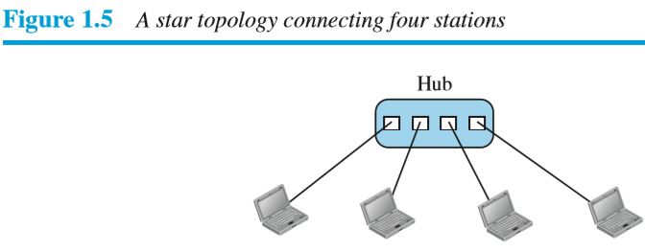
Star Topology
In star topology, each computer is connected to hub or switch using separate cable.
When a one computer want to send data to another computer , then it will send central hub and then hub sends data to specific computers in a network.
The star topology is active topology because, it will uses active device to amplify the signals or to connect computers in a network.
Advantages of Star Topology
Star topology is easy to install.
Fault identification and fault isolation is easy.
Star topology is robust i.e. If one link fails, then only that link is affected, it will not affect on entire network.
Star topology is less expensive than mesh topology because it requires less cables than mesh topology.
Its easy to modify or add new computers in star network.
Disadvantages of Star Topology
If central hub or switch fails, then entire network goes down
It requires additional hardware such as hub or switch to connect computers in the network.

Slide 6
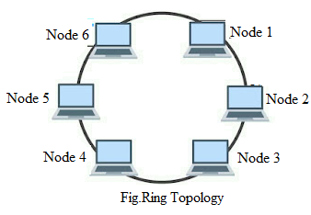
Ring Topology
In ring topology,еach node is connected with its neighbouring nodes using dedicated point to point connection.
In a ring topology ,data travels in a unidirеctional manner.
When one node want to send data to another node in a ring, then the data is transmitted through many intermediate nodes until it reaches its destination node.
Each intermediate node acts as a repeater which regenerates and retransmits the signal to the next node in a ring topology.
Advantages of Ring Topology
Ring Topology is easy to install and reconfigure.
Each node is linked to only its immediate neighbors. To add or delete a node requires changing only two connections.
Fault identification and fault isolation is easy.
Disadvantage of Ring Topology
Unidirectional traffic can be a disadvantage of ring topology
If one link fails, then it will affects on entire network
Ring topology is not useful to connect large number of nodes in a network

Slide 7
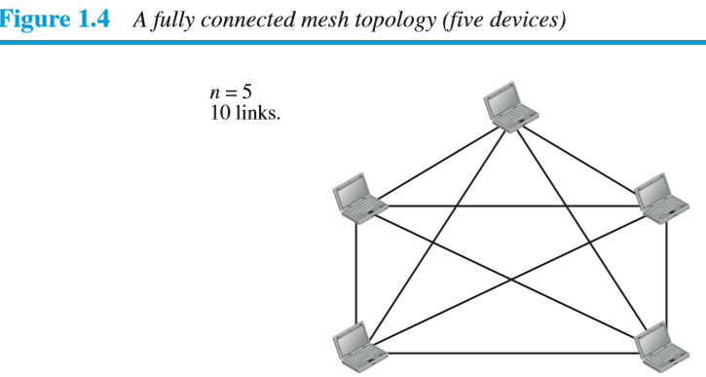
Mesh Topology
The mesh topology is also called as complete topology
In mesh topology ,each computer is connected to every other computer with separate cable(dedicated link )
The term dedicated link means the link that carries traffic between the two computers.
The mesh topology is a passive topology, because mesh topology will not use any active device to amplify the signals or to connect computers in a network.
To connect n computers with mesh topology, it requires n(n-1)/2 links or cables.
For example : To connect 5 computers with mash topology, it requires = 5 (5-1)/2 = 10 links or cables.
To connect n computers with mesh topology , each computer requires (n-1) network interface cards
For example : to connect 5 computers with mesh topology, each computer requires (5 - 1) = 4 network interface cards
One practical example of a mesh topology is the connection of telephone regional offices, in which each regional office needs to be connected to every other regional office

Slide 8
Mesh Topology
Advantages of Mesh Topology
The mesh topology is robust i.e. If one link fails, then only that link is affected, it will not affect on entire network.
Fault isolation and fault identification is easy.
Use of mesh topology eliminates traffic problems i.e. use of dedicated link guarantees that each connection can carry its own load.
The mesh topology provides privacy or security i.e. every message travels along a dedicated line, only the intended recipient sees it.
Disadvantages of Mesh Topology
Mesh topology is difficult to install and reconfigure.
Mesh topology requires large amount of cables and network interface cards.
Mesh topology is not useful to connect large numbers of computers in a network.

Slide 9
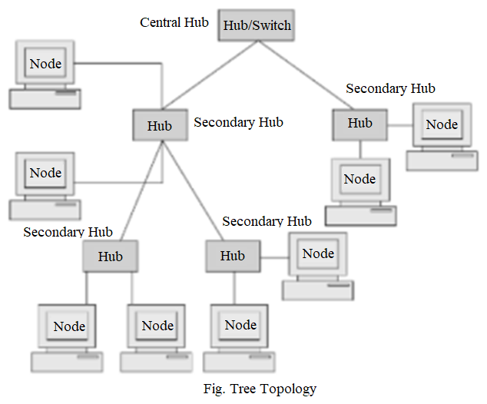
Tree Topology
The Tree Topology is derived from star topology.
The Tree Topology is a combination of two or more star topologies.
In tree topology more than one hub is used to connect nodes in a network.
In tree topology every node connected to a some secondary hub, which in turn is connected to the central hub, few nodes are directly connected to central hub.
The central hub is active hub, which performs regeneration of signals, so signals can easily traverse over longer distance.
The secondary hub may be passive or active
the passive hub just connect multiple nodes but it will not perform regeneration of signals.
Nowdays, central hub is replaced with a switch or a router
The tree topology is a most widely used topology for connecting multiple nodes in a network

Slide 10
Tree Topology
Advantages of tree topology
The main advantage of tree topology is to connect large number of computers in a network.
Failure of single node don't affect entire network.
Fault identification and fault isolation is easy.
Its easy to modify or add new nodes in tree topology.
Disadvantages of Tree topology
If central hub or switch fails, then entire network goes down
Another disadvantages of tree topology, is that it requires additional hardware's such as hub or switch to connect nodes in a network.

Slide 11
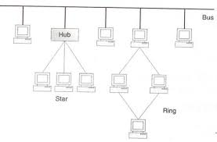
Hybrid Topology
The Hybrid Topology is a combination of two or more topologies such as Star, Bus, Ring and Mesh topologies
For example:
In a college we have three departments, let us consider Computer department uses Star topology, Mechanical department uses Ring topology and Civil department uses Bus topology, connecting these three topologies which results in Hybrid Topology.
The Hybrid Topology is active topology because it uses active device to amplify the signal or to connect nodes in a network.
Advantages of hybrid topology
Its easy to modify or add new computers in hybrid network.
The hybrid topology is useful to connect large number of nodes in a network.
Disadvantages of hybrid Topology
Designing is difficult or complex.
The hybrid topology is costly.
Fig. Hybrid Topology

Slide 12
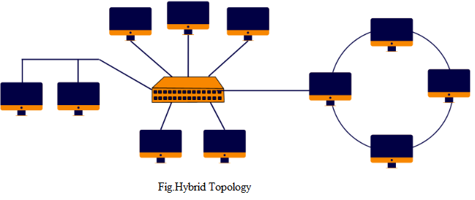
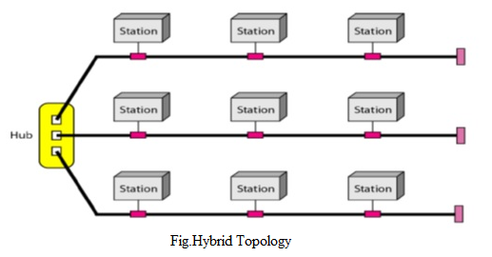
Hybrid Topology
The following are some of the most common hybrid topologies.
Star-ring Hybrid Topology
Star-bus-ring Hybrid topology
Star-bus Hybrid Topology

Slide 13
Selection Criteria for Selecting a Topology
Each network topology has its own advantages and disadvantages.
Hence the selection of a topology depends on the needs of the particular application.
Following are some of the selection criteria for selecting a topology for an application :
1. Size of the network and number of devices (nodes) being connected.
2. Ease of configuration and installing.
3. The ease of adding a new device in an existing network.
4. The ease of fault indication and rectification.
5. Number of physical links required to be used for connecting the devices.
6. Whether connecting devices such as switches, hubs etc are required or not.
7. Costs involved.
8. Need of data security.
9. Need of network administration.

Slide 14
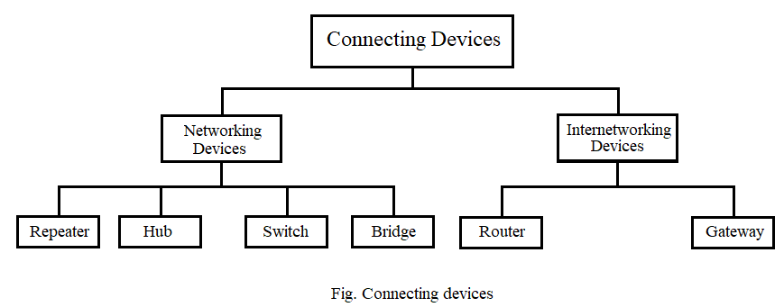
Network Connecting Devices
Connecting devices are used to connect multiple computers in a network or to connect multiple networks together to make an internet.

Slide 15
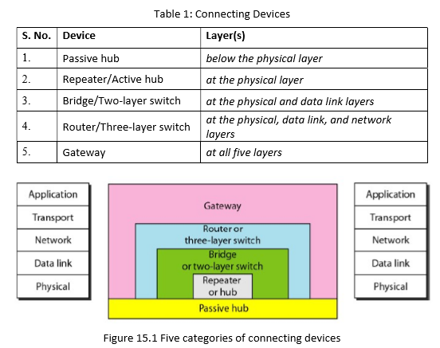
Network Connecting Devices
Fig 15.1 shows different connecting devices and the layer at which it operates in a Internet model

Slide 16
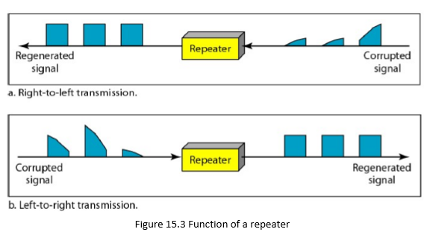
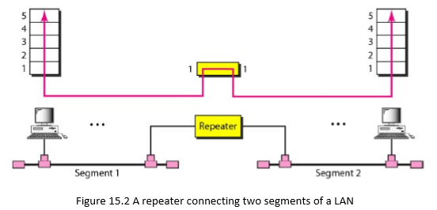
Network Connecting Devices
Repeater:
A repeater is a device that operates at the physical layer of the Internet model.
A repeater receives an incoming signal and before it becomes too weak, repeater regenerates the original bit pattern and then sends the refreshed signal.
A repeater does not actually connect two LANs but it connects two segments of the same LAN.
The repeater acts as a two-port device, it receives a signals from one of the port, regenerates it and forwards it to the other port.
A repeater has no filtering capability. it does not have the intelligence to find from which port the frame should be sent out

Slide 17
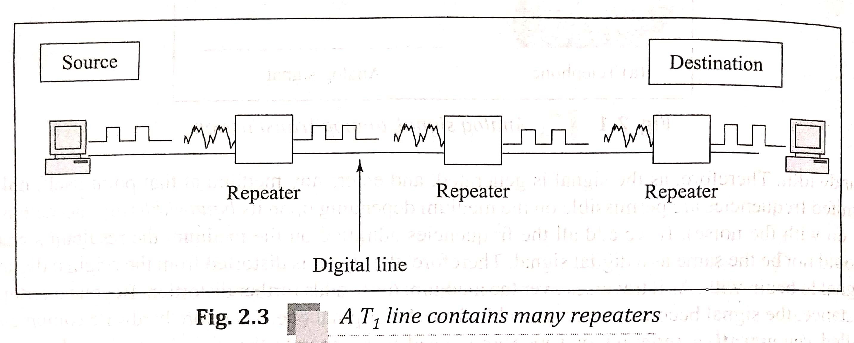
Network Connecting Devices
Repeater:

Slide 18
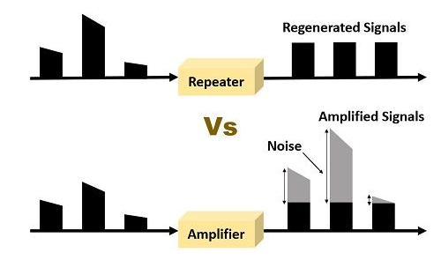
Network Connecting Devices
Repeater:
If cable length is more than 500 m ,then we divide the cable into two segments and install repeaters between these segments. Note that the whole network is still considered one LAN, but the portions of the network separated by repeaters are called segments.
Difference between repeater and amplifier
Repeater and Amplifier both are electronic devices used for enhancing the power of the transmitted signal. The difference between them is that repeater is used as a regenerator of the signal which also eliminates the noise from the signal. On the other hand, amplifier just increases the amplitude of the signal and does not care about the noise that is being amplified along with the signal.
Thus A repeater is a regenerator, not an amplifier.
Summary
A repeater is a connecting device that operates at the physical layer of the Internet model.
A repeater regenerates a signal, connects segments of a LAN, and has no filtering capability.

Slide 19
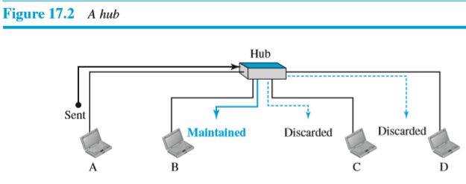
Network Connecting Devices
Hub:
The hub is a central connecting device used to connect multiple computers in a LAN network.
A hub is a device that operates at the physical layer of the Internet model.
Hub receives the signals from one port and transmit it to all other ports.
Hub is commonly used in small networks or home networks, where there is a need to connect multiple devices, such as computers, laptops, printers, and other network devices.
The hubs are available with 4,8,12,24 ports
Hub can operates in half duplex mode-it can send and receive data on the wire but not at a same time.
The hub has two types of ports: uplink ports and downlink ports
Figure 17.2 shows a node A wants to send a packet to node B ,first node A forwards packet to hub ,then hub forwards the packet to all outgoing ports except the one from which the packet was received. In other words, hub broadcasts the packet to all other nodes in a network. All nodes in the network receive the packet, but only node B keeps it. The rest of the nodes discard it.
.

Slide 20
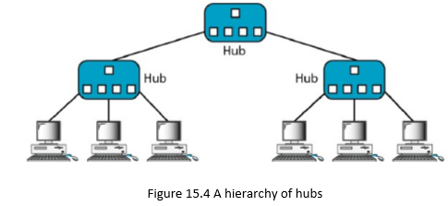
Network Connecting Devices
Types of Hub:
Passive Hubs :
A passive hub is just a connector.
Its used to connect computers in star topology.
It receives the signals from one port and transmit it to all other ports.
It will not perform any regeneration of signals
It operates below the physical layer of the Internet model.
It does not require any external power supply and operates using the power provided by the devices that are connected to it
Active Hubs:
A active hub is hub is actually a multipart repeater.
Its used to connect computers in star topology . However, active hubs can also be used to create multiple levels of hierarchy, as shown in Figure 15.4.
It receives the signals from one port, regenerates it and transmit it to specific port.
It operates at the physical layer of the Internet model.
It require external power supply
Active hub is expensive than passive hub
Intelligent Hub:
Intelligent hubs are similar to active hubs, but with additional features such as network management capabilities, error detection and troubleshooting tools, etc.
This type of hub is also known as a managed hub.
A switch is an example of an intelligent hub

Slide 21
Network Connecting Devices
Switch:
A switch is a connecting device used to connect multiple computers in a LAN network
A link-layer switch (or switch) operates at the physical and the data-link layers of the Internet model.
As a physical-layer device, it regenerates the signal it receives.
As a data link-layer device, it has filtering capability , means when switch receives frame from one port , then switch check the destination MAC address in the frame and decide from which outgoing port the frame should be send. A link-layer switch has a switching table used to take filtering decisions.
The switch are available with 4,8,12,24,48 ports
Switch can operates in full duplex mode-it can send and receive data on the wire at a same time
Hub just performs work of data forwarding but switch performs work of data filtering and forwarding
.

Slide 22
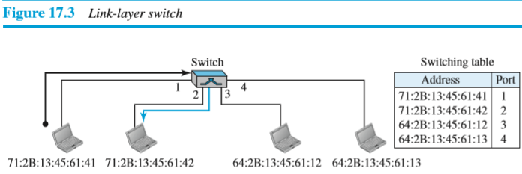
Network Connecting Devices
Link-Layer Switch:
For example:
In Figure 17.3, we have a LAN with four nodes that are connected to a switch. If a frame for destination 71:2B:13:45:61:42 arrives at port 1, the switch consults its switching table to find the outgoing port. According to its switching table, frames for destination 71:2B:13:45:61:42 should be sent out only through port 2; therefore, there is no need for forwarding the frame through other ports.

Slide 23
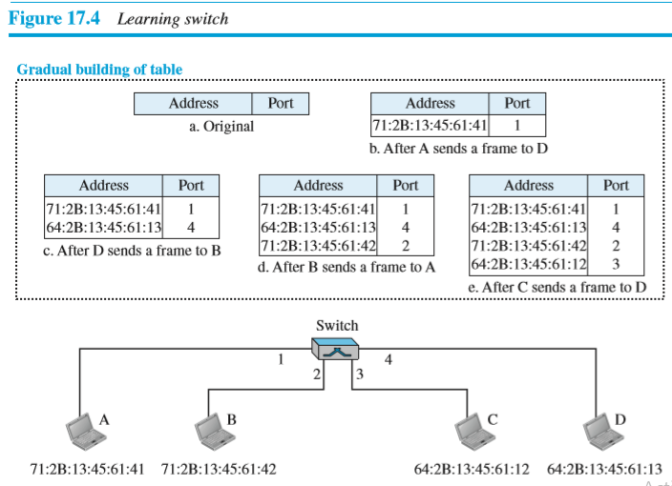
Network Connecting Devices
Transparent switch:
A transparent switch can forward and filter frames and automatically build its forwarding table

Slide 24
Network Connecting Devices
Transparent switch:
Forwarding: A transparent switch must correctly forward the frames, as discussed in the previous section.
Learning The earliest switches had static switching tables . The system administrator would manually enter each table entry during switch setup. Although the process was simple, it was not practical. If a station was added or deleted, the table had to be modified manually.
A better solution to the static table is a dynamic table that maps addresses to ports automatically.
To make a table dynamic, we need a switch that gradually learns from the frames movements. To do this, the switch checks both the destination and the source addresses in each frame that passes through the switch.
The destination address is used for the forwarding decision ; the source address is used for adding entries to the table and for updating purposes. Let us elaborate on this process using Figure 17.4.
When station A sends a frame to station D, the switch does not have an entry for either D or A. The frame goes out from all three ports; the frame floods the network. However, by looking at the source address, the switch learns that station A must be connected to port 1. This means that frames destined for A, in the future, must be sent out through port 1. The switch adds this entry to its table. The table has its first entry now.
When station D sends a frame to station B, the switch has no entry for B, so it floods the network again. However, it adds one more entry to the table related to station D.
The learning process continues until the table has information about every port. However, note that the learning process may take a long time. For example, if a station does not send out a frame (a rare situation), the station will never have an entry in the table.

Slide 25
Network Connecting Devices
Switch:
Switches support following three methods of switching
Store-and-Forward Switching:
In this method, the switching device waits to receive the entire frame and then stores the frame in the buffer memory. Then the frame is checked for errors by using CRC, if the error is found then the frame is discarded else it is forwarded to the next device.
Cut-Through Switching
In this method , the switching device forwards the frames as soon as the destination address is available without waiting for the rest of the frame to arrive.
It does not perform any error checking. The frame with or without errors will be forwarded.
Fragment-Free switching
This is hybrid version of store-and-forward and cut-through switching
Switches operating in this mode must receive and examine the first 64 bytes of the frame for error and then make a forwarding decision.
If the first 64 bytes of the frame are valid then switch forwards frame to the destination otherwise switch discards the frame.

Slide 26
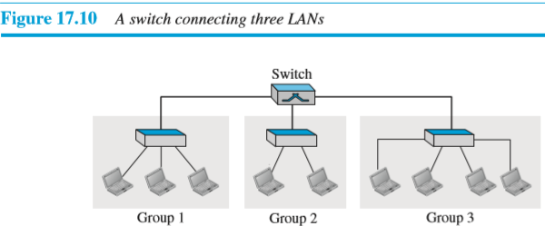
Network Connecting Devices
Switch:
Figure 17.10 shows a switched LAN in an engineering firm in which nine nodes are grouped into three LANs that are connected by a switch.
The first three engineers work together as the first group, the next two engineers work together as the second group, and the last four engineers work together as the third group
Summary
A link-layer switch is a connecting device that operates at the physical and data-link layers of the Internet model.
A link-layer switch has filtering capability and it has static switching tables .
A transparent switch can forward and filter frames and automatically build its switching tables

Slide 27
Difference between Hub and Switch
Hub | Switch
Hub is used to connect computers in a star topology | switch is used to connect computers in a star topology or in a tree topology
hub operates at the physical layer of the Internet model. | switch operates at the physical and the data-link layers of the Internet model.
Hub can operates in half duplex mode | switch can operates in full duplex mode
hub has no filtering capability | switch has filtering capability
hub is less expensive than switch | switch is more expensive than hub
hub is not an intelligent device (i.e hub forwards every incoming packet to all its ports) | switch is an intelligent device (i.e switch forwards every incoming packet to specific port)

Slide 28
Network Connecting Devices
Bridge:
The bridge is a connecting device used to connect two or more LANs.
Bridge can divide a large network into smaller segments
A bridge operates at the physical and the data link layer of Internet model.
As a physical layer device, it regenerates the signal it receives.
As a data link-layer device, it has filtering capability. , means when bridge receives frame, then bridge check the destination MAC address in the frame and decide if the frame should be forwarded or dropped. If the frame is to be forwarded, then bridge decides to which port to forward the frame.
A bridge has a bridge table used to take filtering decisions

Slide 29
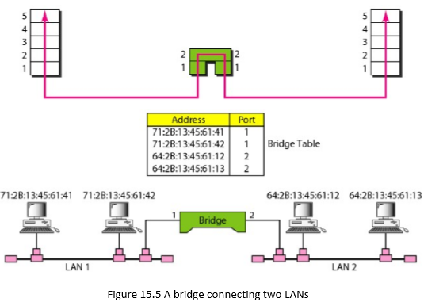
Network Connecting Devices
Bridge:
For Example. In Figure 15.5, two LANs are connected by a bridge.
If a frame for destination 71:2B:13:45:61:42 arrives at port 1, the bridge consults its table and decides there is no need forward the frame because destination is on same port, so bridge drops the frame(means bridge minimize the network traffic)
If a frame for destination 71:2B:13:45:61:41 arrives at port 2, the bridge consults its table and decides to forward frame to port 1, because destination is on port 1.
In our example, we show a two-port bridge; in reality a bridge usually has more ports.

Slide 30
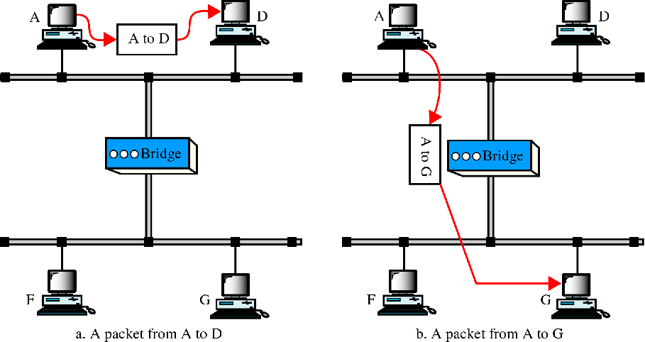
Network Connecting Devices
Basic Functions of a Bridge:
Bridge can divide a large network into smaller segments
Bridge can reduce the network traffic on segments
Bridge can connects network segments with different media types such as UTP with Optical Fiber cable
Bridge can connects network segments with different network architectures such as Ethernet and Token Ring

Slide 31
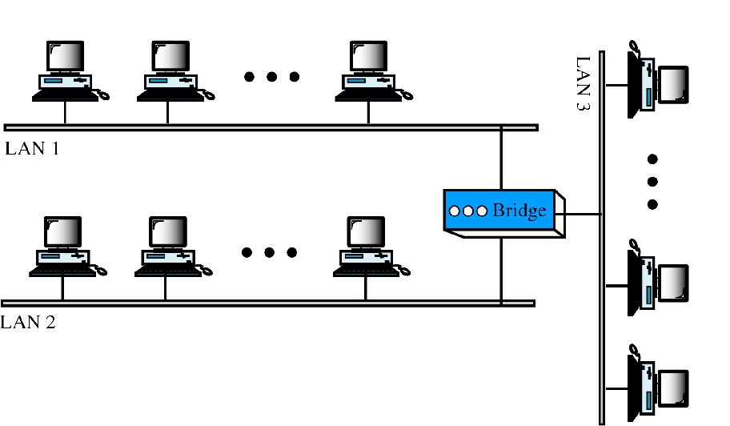
Network Connecting Devices
Multiport bridge:

Slide 32
Network Connecting Devices
Types of Bridge:
Local bridge:
Local bridge is used to connect network segments of the same type and the same location.
It simply performs packet filtering
Translational Bridge
Translational bridge is used to connect network segments using different network media(cable types) or different network architectures such as Ethernet and Token Ring
Remote Bridge:
Remote bridge is used to connects network segments at different locations using a WAN link such modem or leased lines
Multiport bridge:
Multiport bridge is used to connect more than two LANS.
.

Slide 33
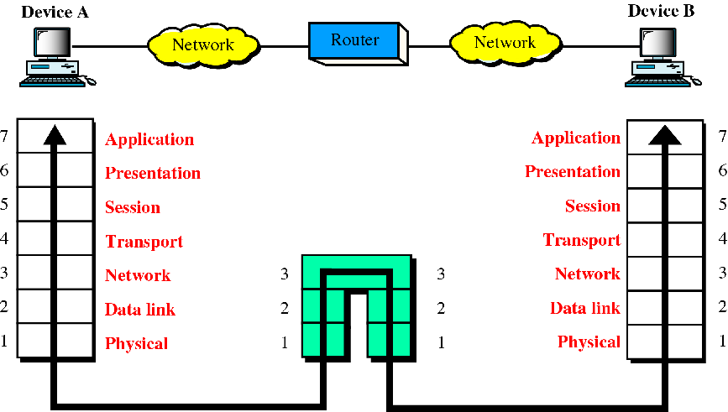
Network Connecting Devices
Router:
A router is an internetworking device; it connects independent networks to form an internetwork
A router is a connecting device used to interconnect two or more networks that uses different network media(cable types) or different network architectures such as Ethernet and Token Ring
A router operates at the physical ,data-link and network Layers of the Internet model.
A routers are more powerful and more expensive than hubs, switches, bridges.
Fig. A Router interconnects two different networks

Slide 34
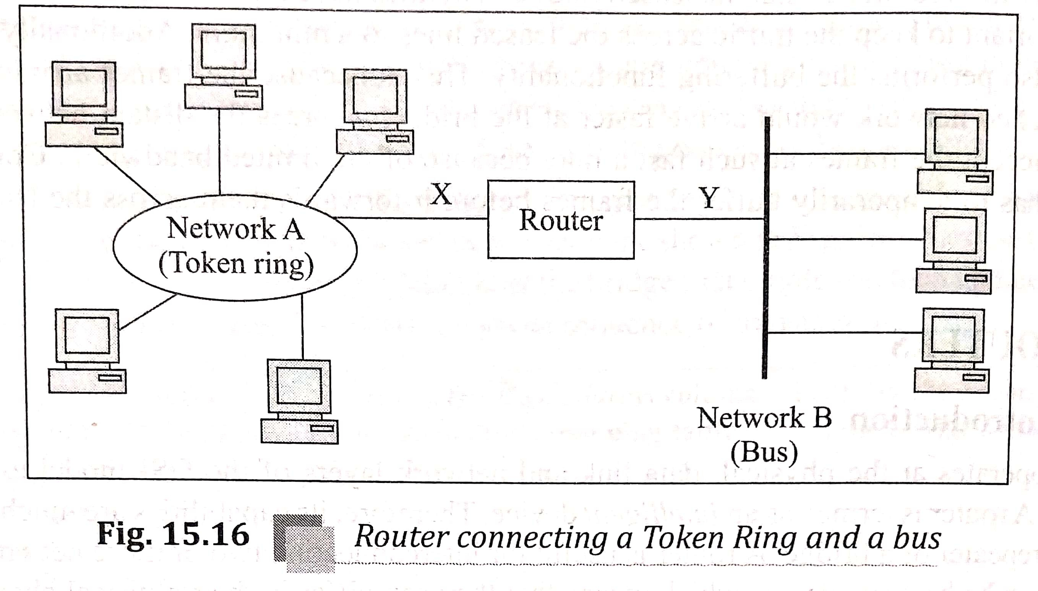
Network Connecting Devices
Router:
In fig 15.16 two different networks, network A is token ring network and network B is bus network are connected together with router

Slide 35
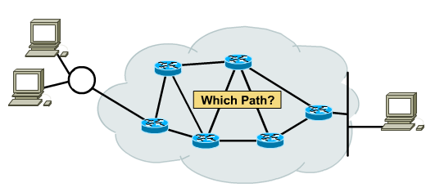
Network Connecting Devices
Function of Router:
A routers is responsible for receiving, analysing, and forwarding data packets between computers in a networks.
When a router receives packet, then router checks the destination IP address in packet header and it consults with its routing tables to decide the optimal route to reach a destination and then it transfers the packet along this route.
The main function of router is to select best possible path(route) for transmitting packet from source to destination.
Fig. Function of Router

Slide 36
Network Connecting Devices
Types of Routers:
There are two types of routers:
1. Static Router-
In static router, routing tables are configured manually by network administrator.
A static routing tables are updated manually by network administrator ,when there is change in route.
A static routing table can be used in a small network.
2.Dynamic Router-
In dynamic router ,routing tables are configured automatically by using one of dynamic routing protocols such as RIP, OSPF, or BGP.
A dynamic routing tables are updated automatically when there is a change somewhere in the internet.
A dynamic routing table can be used in large network.
Today, an internet needs dynamic routing tables.

Slide 37
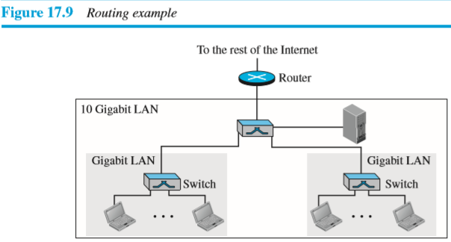
Network Connecting Devices
Router
Let us give an example. In Figure 17.9, assume an organization has two separate buildings with a Gigabit Ethernet LAN installed in each building. The organization uses switches in each LAN. The two LANs can be connected to form a larger LAN using 10 Gigabit Ethernet technology that speeds up the connection to the Ethernet and the connection to the organization server. A router then can connect the whole system to the Internet.

Slide 38
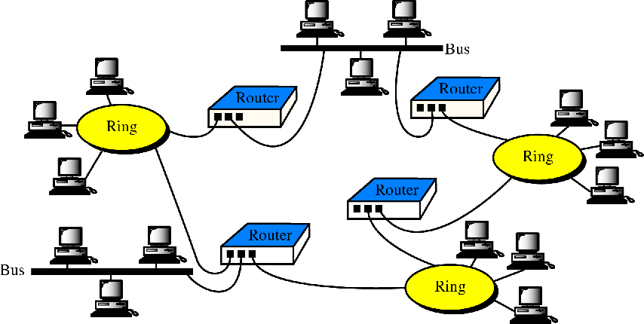
Network Connecting Devices
Routers in an internet:

Slide 39
Network Connecting Devices
Gateways (protocol converter)

Slide 40
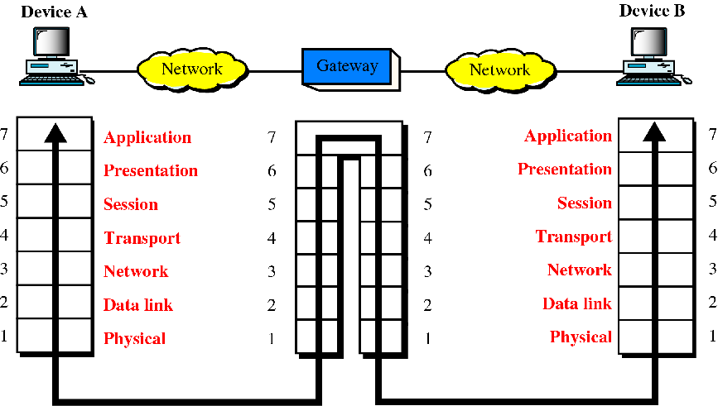
Network Connecting Devices
Gateways (protocol converter)

Slide 41
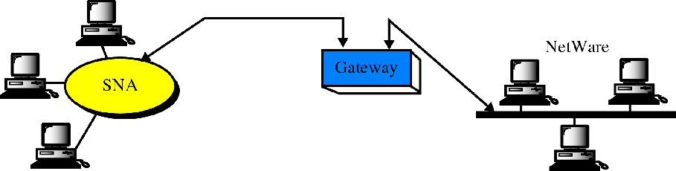
Network Connecting Devices
Gateway:
SNA network (IBM)
Netware network (Novell)

Slide 44
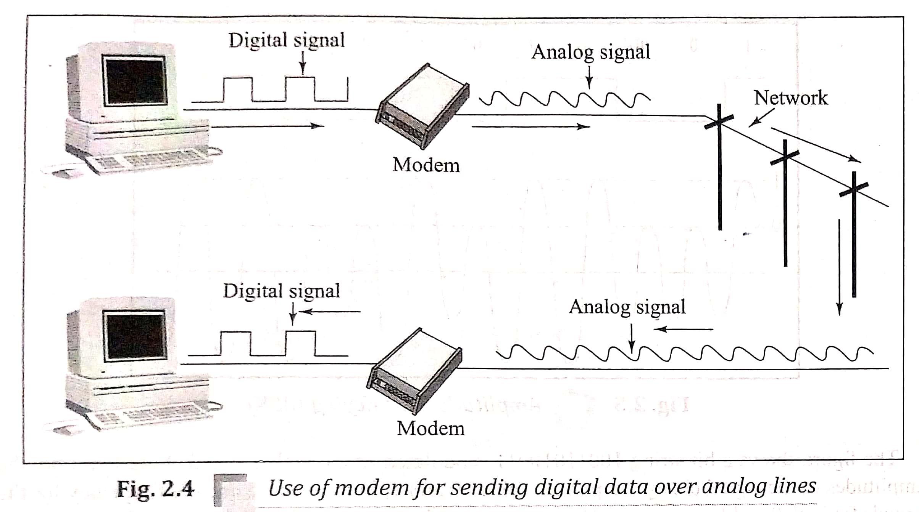
Network Connecting Devices
Modem:
The modem is used to connect computer to telephone line
The term MODEM is derived from two components:a Modulator and a Demodulator
The Modulator converts a digital signal into an analog signal
The Demodulator converts a analog signal back into digitak signal
The fig.2.4 shows use of modem,the digital signal originating from computer go through the modem where they are converted into analog signals and can be transmitted over telephone line.
At the other end,this analog signal is given to another modem where they are converted back into original digital signal,which can be understood by destination computer.

