Slide 1
Chapter 4
Defect Management
12 Marks

Slide 2
4.0 Introduction
Quality:
It is defines as meeting the requirements as specified by customer
Defect:
Does not meets customer requirements
Does not worked as planning
Root Causes of Defect:
Requirements are not clearly defined by customer
Designs are wrong
People are not trained
Processes used for development are not capable

Slide 3
4.1 Basics for Defect Management
4.1.1 What is Defect?
It is an error/bug
It is an undesirable state
It is cause of Customer dissatisfaction
It is variation in actual & expected result
It is an inconsistency in the behavior of s/w.
It is an error in coding or logic that causes program to malfunction

Slide 4
4.1 Basics for Defect Management
4.1.2 What is Defect Management?
It is the process of recognizing, investigating, taking action& removing of defect.
Need of Defect Management:
Defect analysis at early stage of software development reduces time,cost,resources.
Early defect detection prevents migration from one phase to another phase of SDLC.
It enhances reliablity,efficiency,portability,maintenability.

Slide 5
4.1 Basics for Defect Management
4.1.3 Defect classification: Defect may be seen as the deviation in the actual working of a product against what was specified and expected by it.
A “defect” in a software product reflects its inability or inefficiency to meet the specified requirements and criteria to the subsequently prevent the software application to perform its desired and expected working.

Slide 6
4.1 Basics for Defect Management
4.1.3 Defect classification:
Defect Classification
Requirement Defect
Design
Defect
Coding
Defect
Testing
Defect
Functional Defects
System Interface Defects
Variable Declaration/ Initialization Defects
Test Environment Defects
User Interface Defects
Interface Defects
Database Related Defects
Test Tool
Defects
Module Defects
Commenting
Defects
Test Design Defects
Algorithmic Defects

Slide 7
4.1 Basics for Defect Management
4.1.4 Defect Management Process/ Approach
It focuses on preventing defects,
catching defects as early in the process
Minimizing impact of defect
Defect Management Process is defined by organizations QA function.

Slide 8
4.1 Basics for Defect Management
4.1.4 Defect Management Process/ Approach
4.1.4.1 Principles of Defect Management Process
Primary goal is to prevent defect
DMP should be risk driven
Defect measurement should be integrated into the s/w development process
Capturing & analysis of the information should be automated
Defect information should be used to improve process.
Defects are caused by imperfect or faulty process

Slide 9
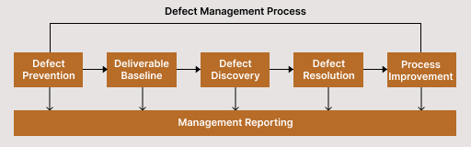
4.1 Basics for Defect Management
4.1.4 Defect Management Process/ Approach
4.1.4.2 Steps in Defect Management Process

Slide 10
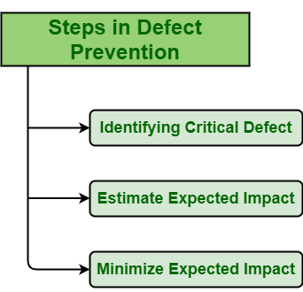
4.1 Basics for Defect Management
4.1.4 Defect Management Process/ Approach
4.1.4.3 Defect Prevention Process/ Defect Fixing

Slide 11
4.1 Basics for Defect Management
4.1.4 Defect Management Process/ Approach
4.1.4.3 Defect Prevention Process/ Defect Fixing
a) Identifying Critical Risk:
i) Missing a key requirement
ii) Critical application software that does not function properly
iii)Vendor supplied s/w does not function properly
iv) Performance is unacceptably poor
v)H/W malfunctioning
vi)Hardaware & software does not integrate properly
vii)Users unable/unwilling to hold new system

Slide 12
4.1 Basics for Defect Management
4.1.4 Defect Management Process/ Approach
4.1.4.3 Defect Prevention Process/ Defect Fixing
b) Estimate Expected Impact:
When critical risks are identified then financial impact of each risk must be calculated.
E=P*I
E-Expectd Impact
P-Probability of Risk becoming a problem
I-Impact in dollars if the risk becomes a problem

Slide 13
4.1 Basics for Defect Management
4.1.4 Defect Management Process/ Approach
4.1.4.3 Defect Prevention Process/ Defect Fixing
b) Minimize Expected Impact
Expected Impact may be strongly affected not only by
Whether Risk becoming a problem or not but also by how long it takes for a problem to become recognized and fixed. It involves following three strategies:
i)Eliminate the risk
ii) Reduce Probability of Risk becoming a problem
iii)Reduce Impact if there is a problem

Slide 14
4.1 Basics for Defect Management
4.1.4 Defect Management Process/ Approach
4.1.4.4 Deliverable Baseline:
A deliverable i.e. Work product is baselined when it reaches a predefined milestone.
It involves following activities:
a) Identify Key deliverable
b) Define standards for each deliverable.

Slide 15
4.1 Basics for Defect Management
4.1.4 Defect Management Process/ Approach
4.1.4.5 Defect Discovery:
If technology cannot guarantee that defect will not be created then defects should be found quickly before the cost to fix becomes expensive.
The steps involved in defect discovery are:
Find defects:
Use standard testing methods to find defects as early as possible
Report defects:
Inform the development team of the defects using an automated bug reporting tool.
Acknowledge defects:
Get confirmation from the development team that the defect is valid and needs to be addressed

Slide 16
4.1 Basics for Defect Management
4.1.4 Defect Management Process/ Approach
4.1.4.6 Defect Resolution Process:
Once the developer acknowledged valid defect the resolution process starts.
In Prioritization of risk involves three levels:
Critical, Major, Minor
Defect Resolution Process :
Prioritize Risk
Schedule Fix
Fix Defect
Report Resolution

Slide 17
4.1 Basics for Defect Management
4.1.4 Defect Management Process/ Approach
4.1.4.7 Process Improvement:
Process improvement is the stage of the defect management process, where the focus is on identifying and fixing areas of improvement to prevent future defects.
4.1.4.8 Management Reporting:
It consist of following tasks:
Tracking defects: Defect reports can help track the status of individual defects.
Providing metrics: Defect reports can provide metrics to help project management and senior management make decisions.
Communicating: Defect reports can help ensure transparent communication between teams.
Getting feedback: Defect reports can help management teams review issues and provide feedback.

Slide 18
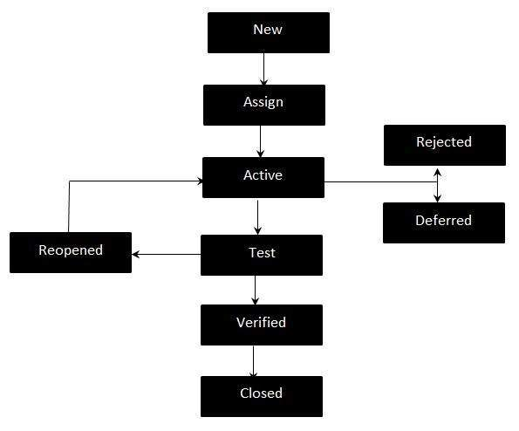
4.2 Defect Life Cycle & Defect Template
4.2.1 Defect / Bug Life cycle

Slide 19
4.2 Defect Life Cycle & Defect Template
4.2.1 Defect / Bug Life cycle
New - Potential defect that is raised and yet to be validated.
Assigned - Assigned against a development team to address it but not yet resolved.
Active - The Defect is being addressed by the developer and investigation is under progress. At this stage there are two possible outcomes; viz - Deferred or Rejected.
Test - The Defect is fixed and ready for testing.
Verified - The Defect that is retested and the test has been verified by QA.
Closed - The final state of the defect that can be closed after the QA retesting or can be closed if the defect is duplicate or considered as NOT a defect.
Reopened - When the defect is NOT fixed, QA reopens/reactivates the defect.
Deferred - When a defect cannot be addressed in that particular cycle it is deferred to future release.
Rejected - A defect can be rejected for any of the 3 reasons; viz - duplicate defect, NOT a Defect, Non Reproducible.

Slide 20
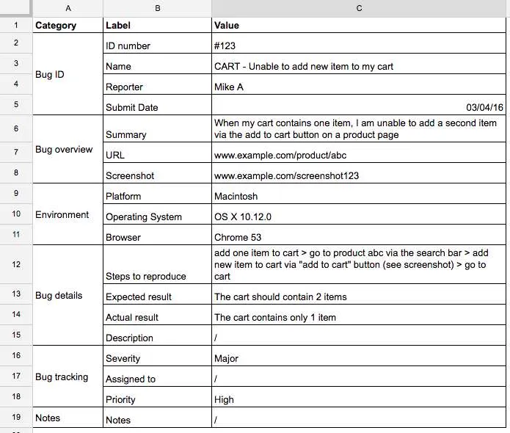
4.2 Defect Life Cycle & Defect Template
4.2.2 Defect Template

Slide 21
4.2 Defect Life Cycle & Defect Template
4.2.2 Defect Template:
Attributes of Defect:
Defect ID
Defect Name
Project Name
Module/Sub-Module Name
Phase
Defect Type
Severity: Critical,Mjor,Minor,Trivial
Priority: High,Medium,Low
Summary
Description
Status of Defect
Reported By,Reported on

Slide 22
4.3 Estimate Expected Impact of a Defect
Actual impact of a defect can be measured when the risk realises or becomes a problem but,people close to risk able to estimate the impact with some level of certainty.
Risk impact may be high,medium or low
It can be calculated on the basis of money loss value.
Ways to handle the risk:
Accept the risk as it is: Natural Disaster,
Bypassing the risk. By avoiding particular approach.
Minimize Risk Impact / Probability
Minimization of a problem due to risk happens in following manner:
Eliminate Risk
Mitigation of Risk
Detection Ability Improvement
Contingency Planning

Slide 23
4.4 Techniques for finding defects
Techniques to find defects can be divided into three categories:
Static techniques: Testing that is done without physically executing a program or system. A code review is an example of a static testing technique.
Dynamic techniques: Testing in which system components are physically executed to identify defects. Execution of test cases is an example of a dynamic testing technique.
Operational techniques: An operational system produces a deliverable containing a defect found by users, customers, or control personnel.i.e., the defect is found as a result of a failure.

Slide 24
4.5 Reporting a defect
A defect report provides information about the defects that are related to test plan,status of defect,
A defect report describes software and documentation
A defect report is having a priority rating, that indicates the impact of a problem on customer.
Software engineers prepare a defect report which provides the detailed information of the defects and errors found during SDLC.
Defect report prepared by tester and inform to developers and stakeholders for clear communication and transparency.
When initially discovered one can confused with undocumented changes a user error or misunderstanding.
Defect is quickly identified and noticed to developer.
Tester generate formal defect report.
Due to this developer can easily reflect and fix it.

Slide 25
4.5 Reporting a defect
Important points to be noted in defect report:
Complete record of Discrepancies
Defect report forms the base for Quality measurement.
Stages in a Defect Management:
Correct the defect
Report status of system
Gather statistics to predict failure
Process Improvements
A good report should :
Give Sufficient & high quality information to fix the defect.
Be well written and simple to understand
Enable stakeholders to make wise decisions about which defect to fix

Slide 26
Thank You

