Slide 1
Chapter no 4 python functions,modules and packages marks 14

Slide 2
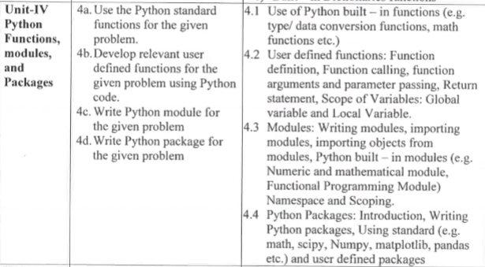

Slide 3
Course outcome
Develop Functions for given problems

Slide 4
Type conversion
The process of converting the value of one data type (integer, string, float, etc.) to another data type is called type conversion. Python has two types of type conversion.
Implicit Type Conversion
Explicit Type Conversion

Slide 5
Implicit Type Conversion:
In Implicit type conversion, Python automatically converts one data type to another data type. This process doesn't need any user involvement.
Implicit conversion is when data type conversion take place either during compilation or during run time and is handled by python.
Implicit Type Conversion is automatically performed by the Python interpreter.
Python avoids the loss of data in Implicit Type Conversion.
It is also known as Type coercion

Slide 6
a=12
b=12.34
c=a+b
print(c)
Output:
24.34
In above Ex, an int value ‘a’ is added to float value ‘b’, and result is automatically converted to a float value ‘c’ without having to tell the compiler.
In this lowest priority data type always get converted to highest priority data type.

Slide 7
Explicit Type Conversion:
In Explicit Type Conversion, users convert the data type of an object to required data type. We use the predefined functions like int(), float(), str(), etc to perform explicit type conversion.
This type conversion is also called typecasting because the user casts (change) the data type of the objects.
Explicit Type Conversion is also called Type Casting, the data types of object are converted using predefined function by user.
In Type Casting loss of data may occur as we enforce the object to specific data type.
Syntax :
(required_datatype)(expression)

Slide 8
a=12
b="20"
print("Data type of b before Type Casting:",type(b))
b=int(b)
print("Data type of b after Type Casting:",type(b))
Output
Data type of b before Type Casting: <class 'str'>
Data type of b after Type Casting: <class 'int'>

Slide 9
List of data type conversion functions
1.int(a,base) : This function converts any data type to integer. ‘Base’ specifies the base in which string is if data type is string.
2. float() : This function is used to convert any data type to a floating point number
3. ord() : This function is used to convert a character to integer.
4. hex() : This function is to convert integer to hexadecimal string.
5. oct() : This function is to convert integer to octal string.

Slide 10
6. tuple() : This function is used to convert to a tuple.
7. set() : This function returns the type after converting to set.
8. list() : This function is used to convert any data type to a list type.
9. dict() : This function is used to convert a tuple of order (key,value) into a dictionary.
10. str() : Used to convert integer into a string.
11. complex(real,imag) : : This function converts real numbers to complex(real,imag) number.

Slide 11
12.eval(str)-Evaluate an string and return an objects
13.chr(x)-converts an integer to a character

Slide 12
a=24
print("str(a)=",str(a))
b=int('1100',base=2)
print("b=",b)
c=float('12.34')
print("c=",c)
list1=list('12345')
print(list1)
tuple1=tuple('12345')
print(tuple1)
set1=set('python')
print(set1)
d=hex(12)
print("d=",d)
e=oct(8)
print("e=",e)
f=ord('a')
print("F=",f)
g=chr(65)
print("g=",g)

Slide 13
output
str(a)= 24
b= 12
c= 12.34
['1', '2', '3', '4', '5']
('1', '2', '3', '4', '5')
{'y', 'o', 't', 'p', 'n', 'h'}
d= 0xc
e= 0o10
F= 97
g= A

Slide 14
Formatting Number and string
format() formats a specified value into a specified format.
Syntax
format(value,format)

Slide 15
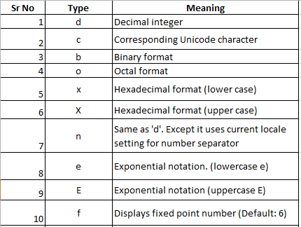
Numbers formatting with format()

Slide 16
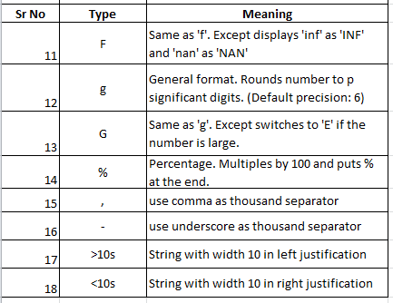

Slide 17
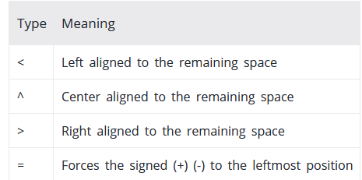
Number formatting with alignment

Slide 18
PROGRAM | OUTPUT
a=24 x=10.23456 y=-12 z=1000000 str="hello" print("a=",format(a,"d")) print("a=",format(a,"c")) print("a=",format(a,"b")) print("a=",format(a,"e")) print("a=",format(a,"E")) print("a=",format(a,"f")) print("a=",format(a,"g")) print("a=",format(a,"o")) | a= 24 a= a= 11000 a= 2.400000e+01 a= 2.400000E+01 a= 24.000000 a= 24 a= 30

Slide 19
PROGRAM | OUTPUT
print("a=",format(a,"x")) print("a=",format(a,"X")) print("a=",format(a,"%")) print("x=",format(x,"<10.2f")) print("x=",format(x,">10.2f")) print("x=",format(x,"^10.2f")) print("x=",format(x,"+")) print("y=",format(y,"-")) print("z=",format(z,",")) print("z=",format(z,"_")) print("str=",format(str,">10s")) print("str=",format(str,"<10s")) | a= 18 a= 18 a= 2400.000000% x= 10.23 x= 10.23 x= 10.23 x= +10.23456 y= -12 z= 1,000,000 z= 1_000_000 str= hello str= hello

Slide 20
Built in MATHEMATICAL FUNCTION
The math module is a standard module in Python and is always available.
It is module that contains some predefined python codes.
To use mathematical functions under this module, you have to import the module using import math.

Slide 21
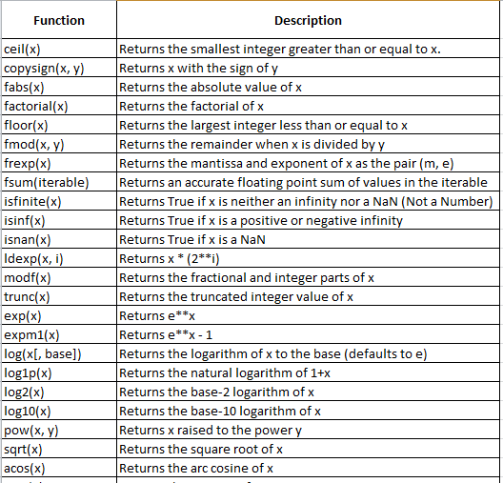
List of Functions in Python Math Module

Slide 22
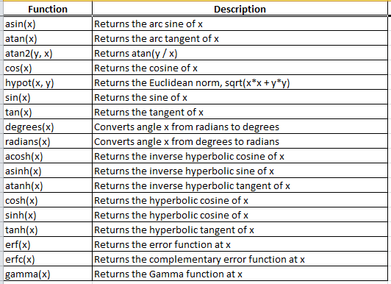

Slide 23
Example
Program | output
#log and Exp function import math print("sqrt=",math.sqrt(4)) print("log (2,3)=",math.log(2,3)) print("exp(4)=",math.exp(4)) print("log2(16)",math.log2(16)) print("log10(10000)",math.log10(10000)) print("power=",math.pow(3,2)) | sqrt= 2.0 log (2,3)= 0.6309297535714574 exp(4)= 54.598150033144236 log2(16) 4.0 log10(10000) 4.0 power= 9.0

Slide 24
Program | output
#numerical Maths function import math a = 2.6 b=5 print ("Ceil=",math.ceil(a)) print ("Floor=",math.floor(a)) print ("abs=",math.fabs(a)) print ("fact=",math.factorial(b)) print ("copysign=",math.copysign(5.5, -10)) print ("gcd=",math.gcd(5,15)) | Ceil= 3 Floor= 2 abs= 2.6 fact= 120 copysign= -5.5 gcd= 5

Slide 25
Program | output
#Trignometric Function import math a = math.pi/6 print ("sin(a)=",math.sin(a)) print ("cos(a)",math.cos(a)) print ("tan(a)=",math.tan(a)) print ("degree=",math.degrees(a)) print ("radians=",math.radians(30)) | sin(a)= 0.49999999999999994 cos(a) 0.8660254037844387 tan(a)= 0.5773502691896257 degree= 29.999999999999996 radians= 0.5235987755982988

Slide 26
Write use of lambda function in python[2M]
The lambda function, which is also called anonymous function. A lambda function can
take any number of arguments, but can only have one expression.
Syntax: lambda arguments : expression
Example: x= lambda a,b : a*b
Print(x(10,5)
Output: 50

Slide 27
String built in function
In Python, string is a sequence of Unicode character.
Strings can be created by enclosing characters inside a single quote or double quotes. Even triple quotes can be used in Python but generally used to represent multiline strings and docstrings.
We can access individual characters using indexing and a range of characters using slicing. Index starts from 0. Trying to access a character out of index range will raise an IndexError. The index must be an integer. We can't use float or other types, this will result into TypeError

Slide 28
Python allows negative indexing for its sequences.
The index of -1 refers to the last item, -2 to the second last item and so on. We can access a range of items in a string by using the slicing operator (colon).
Strings are immutable. This means that elements of a string cannot be changed once it has been assigned. We can simply reassign different strings to the same name.
We cannot delete or remove characters from a string. But deleting the string entirely is possible using the keyword del.

Slide 29
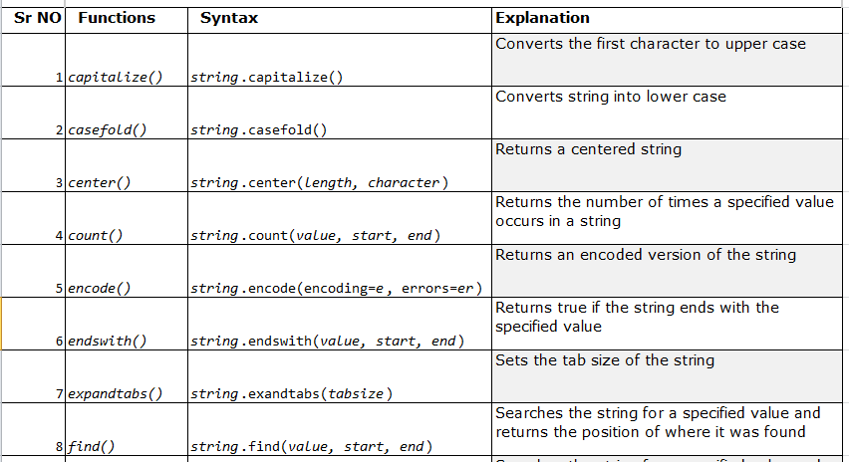
Built in string function

Slide 30
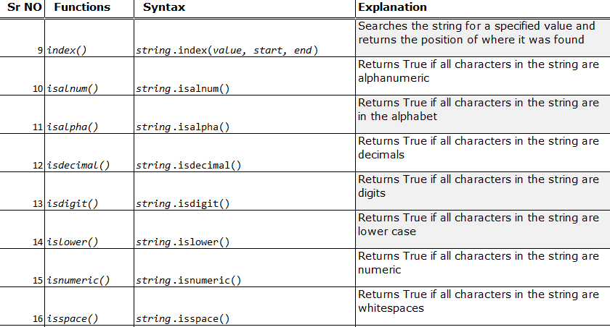

Slide 31
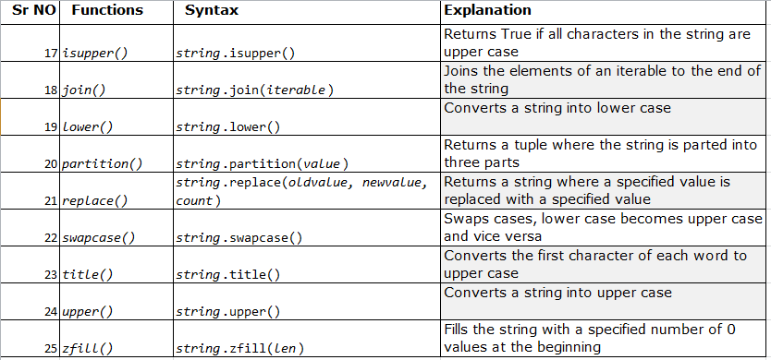

Slide 32
txt = "hello, and welcome to my world."
x = txt.capitalize()
print (x)
x = txt.casefold()
print(x)
txt = "banana"
x = txt.center(20)
print(x)
txt = "I love apples, apple are my favorite fruit"
x = txt.count("apple")
print(x)

Slide 33
output
Hello, and welcome to my world.
hello, and welcome to my world.
banana
2

Slide 34
txt = "My name is Ståle"
x = txt.encode()
print(x)
txt = "Hello, welcome to my world."
x = txt.endswith(".")
print(x)
txt = "H\te\tl\tl\to"
x = txt.expandtabs(2)
print(x)
txt = "Hello, welcome to my world."
x = txt.find("welcome")
print(x)

Slide 35
output
b'My name is St\xc3\xa5le'
True
H e l l o
7

Slide 36
txt = "Hello, welcome to my world."
x = txt.index("welcome")
print(x)
txt = "Company12"
x = txt.isalnum()
print(x)
txt = "\u0033" #unicode for 3
x = txt.isdecimal()
print(x)
txt = "50800"
x = txt.isdigit()
print(x)

Slide 37
7
True
True
True

Slide 38
txt = "hello world!"
x = txt.islower()
print(x)
txt = " "
x = txt.isspace()
print(x)
txt = "50"
x = txt.zfill(10)
print(x)
txt = "hello, and welcome to my world."
x = txt.title()
print (x)

Slide 39
True
True
0000000050
Hello, And Welcome To My World.

Slide 40
output
Hello, and welcome to my world.
hello, and welcome to my world.
banana
2
b'My name is St\xc3\xa5le'
True
H e l l o
7
7
True
True
True
True
True
0000000050

Slide 41
USER DEFINED FUNCTION

Slide 42
What is a function in Python?
In Python, function is a group of related statements that perform a specific task.
Functions help break our program into smaller and modular chunks. As our program grows larger and larger, functions make it more organized and manageable.
Furthermore, it avoids repetition and makes code reusable.
A function is a block of code which only runs when it is called.
You can pass data, known as parameters, into a function.
A function can return data as a result.

Slide 43
Types of Functions
Basically, we can divide functions into the following two types:
Built-in functions- Functions that are built into Python.
User-defined functions - Functions defined by the users themselves.

Slide 44
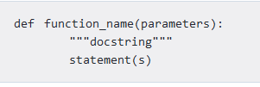
Creating a Function
In Python a function is defined using the def keyword:
Syntax
Above shown is a function definition which consists of following components.
Keyword def marks the start of function header.

Slide 45
A function name to uniquely identify it. Function naming follows the same
Parameters (arguments) through which we pass values to a function. They are optional.
A colon (:) to mark the end of function header.
Optional documentation string (docstring) to describe what the function does.
One or more valid python statements that make up the function body. Statements must have same indentation level (usually 4 spaces).
An optional return statement to return a value from the function.

Slide 46

How to call a function in python?
Once we have defined a function, we can call it from another function, program or even the Python prompt.
To call a function, use the function name followed by parenthesis:
Example-Function without Parameters

Slide 47

Example - calling function through python prompt

Slide 48
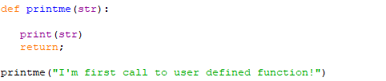
Example-Function with Parameters

Slide 49
Pass by reference vs value
All parameters (arguments) in the Python language are passed by reference.
It means if you change what a parameter refers to within a function, the change also reflects back in the calling function.

Slide 50
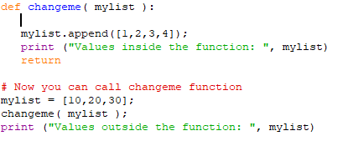

Example

Slide 51
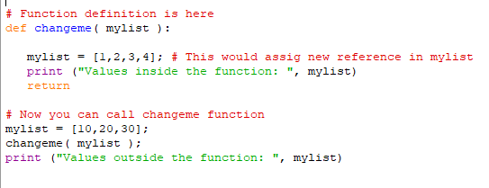
There is one more example where argument is being passed by reference and the reference is being overwritten inside the called function.
Example

Slide 52

Output

Slide 53
Function Arguments
You can call a function by using the following types of formal arguments −
Required arguments
Keyword arguments
Default arguments
Variable-length arguments

Slide 54
Required arguments
Required arguments are the arguments passed to a function in correct positional order. Here, the number of arguments in the function call should match exactly with the function definition.
To call the function printme(), you definitely need to pass one argument, otherwise it gives a syntax error as follows −

Slide 55
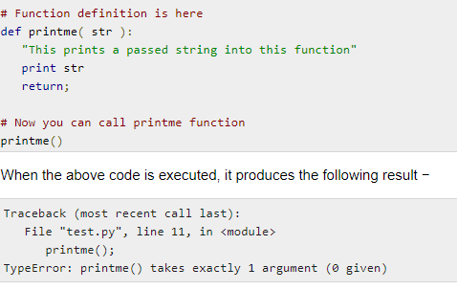

Slide 56
Keyword arguments
Keyword arguments are related to the function calls. When you use keyword arguments in a function call, the caller identifies the arguments by the parameter name.
This allows you to skip arguments or place them out of order because the Python interpreter is able to use the keywords provided to match the values with parameters.
We can also make keyword calls to the printme() function in the following ways −

Slide 57
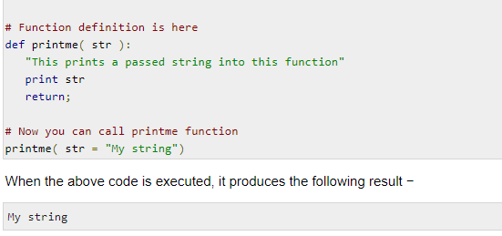

Slide 58
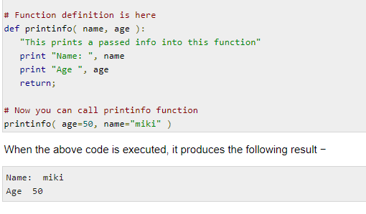
Example shows that order of parameters does not matter.

Slide 59
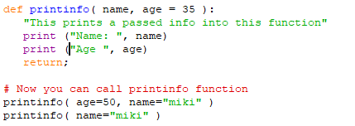
Default arguments
A default argument is an argument that assumes a default value if a value is not provided in the function call for that argument.
Example

Slide 60
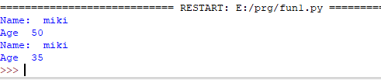
Output

Slide 61

Variable-length arguments
The process of defining a function for more arguments than you specified function. These arguments are called variable-length arguments and are not named in the function definition, unlike required and default arguments.
Syntax

Slide 62
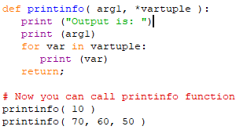
An asterisk (*) is placed before the variable name that holds the values of all nonkeyword variable arguments.
Example

Slide 63
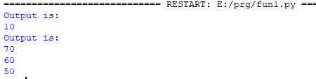
Output

Slide 64
The return Statement
The return statement is used to exit a function and go back to the place from where it was called.
Syntax of return
return [expression_list]
This statement can contain expression which gets evaluated and the value is returned. If there is no expression in the statement or the return statement itself is not present inside a function, then the function will return the None object.

Slide 65
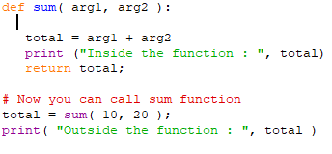

example

Slide 66
Scope of Variables
All variables in a program may not be accessible at all locations in that program. This depends on where you have declared a variable.
The scope of a variable determines the portion of the program where you can access a particular identifier. There are two basic scopes of variables in Python −
Global variables
Local variables

Slide 67
Global vs. Local variables
Variables that are defined inside a function body have a local scope, and those defined outside have a global scope.
This means that local variables can be accessed only inside the function in which they are declared, whereas global variables can be accessed throughout the program body by all functions. When you call a function, the variables declared inside it are brought into scope

Slide 68
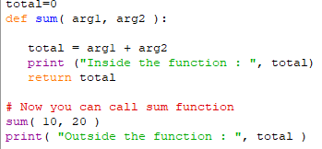

EXAMPLE

Slide 69
MODULES

Slide 70
What are modules in Python?
Modules refer to a file containing Python statements and definitions.
A file containing Python code, for e.g.: example.py, is called a module and its module name would be example.
We use modules to break down large programs into small manageable and organized files.
Modules provide reusability of code.
We can define our most used functions in a module and import it, instead of copying their definitions into different programs.

Slide 71

Create or writing a Module
To create a module just save the code you want in a file with the file extension .py:
Example
Save this code in a file named mymodule.py

Slide 72
How to import modules in Python?
We can import the definitions inside a module to another module or the interactive interpreter in Python.
We use the import keyword to do this. To import our previously defined module mymodule ,we type the following in the Python prompt.

Slide 73
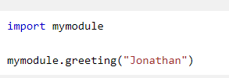

Import the module named mymodule, and call the greeting function:
Output

Slide 74
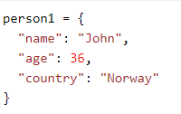
Variables in Module
The module can contain functions, as already described, but also variables of all types (arrays, dictionaries, objects etc):
Example
Save this code in the file mymodule.py

Slide 75
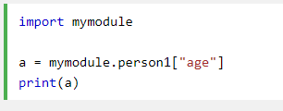
Import the module named mymodule, and access the person1 dictionary:

Slide 76


Import with renaming
We can import a module by renaming it as follows.
Example
Output

Slide 77

Python from...import statement
We can import specific names from a module without importing the module as a whole. Here is an example.
Output

Slide 78
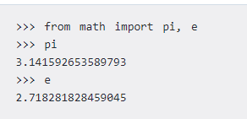
We imported only the attribute pi from the module.
In such case we don't use the dot operator. We could have imported multiple attributes as follows.

Slide 79

Import all names
We can import all names(definitions) from a module using the following construct.
Example

Slide 80
Python built in module
1]Numeric and Mathematical Module
2]Functional Programming Module

Slide 81
1]Numeric and Mathematical Module
To provide numeric and mathematical operations , python provides the following built in modules.
1) fractions(Rational Numbers)
2)math(Mathematical functions)
3)random(Generate Pseudo-random numbers)
4)statistics(Mathematical static function)
5)decimal(Decimal fixed point & floating point arithmetic)

Slide 82
Fractions
The Fraction Module is used to return the instance with the value=numerator/Denomenator.
The fractions module provides support for rational number arithmetic.
A Fraction is a number which represent a whole number being divided into multiple parts.
Python Fractions module allows us to manage fractions in our python programs.
For Example
from fractions import Fraction
print(Fraction(21,49))
Output
3/7

Slide 83
import fractions
for deci in [‘0.6’,’2.5’,’2.3’]:
f=fractions.Fraction(deci)
print(f)
Output:
3/5
5/2
23/10

Slide 84
Math & cmath modules
Python provides two mathematical modules such as math & cmath
math Module
The math Module is used for various mathematical operations such as finding log , computing sine , calculate square root etc of real numbers .
The math module gives us access to hyperbolic, trignometric,&logarithmic functions for real numbers
The math Module provide functions such as
sqrt(x)
factorial(x)
sin(x)
cos(x)
pow(x,y)
exp(x)
ceil(x)

Slide 85
Example for math module
>>> import math
>>> math.ceil(1.001)
2
>>>import math
>>>math.floor(1.001)
1
>>>form math import *
>>>sqrt(144)
12

Slide 86
Cmath module
Cmath module allows us to work with mathematical functions for complex numbers

Slide 87
Example for cmath module
>>> from cmath import *
>>> c=2+2j
>>>exp(c )
-3.0749323206
>>>log(c,2)
1.500000000000001+1.1330

Slide 88
Random module
Sometimes we want the computer to pick a random number in a given range , pick a random number from a list etc.So for this we use random modules.
This module implements pseudo-random number generators for various distributions.
Example
import random
list=[5,2,15,25,70,30]
r1=random.randint(10,20)
print(r1)
r2=random.choice(list)
print(r2)
r3=random.random()
print(r3)
Output
16
70
0.30539906405659734

Slide 89
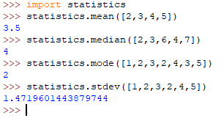
Statistics module
It provides access to different statistics functions.
Example includes mean,median,mode,standard deviation.

Slide 90

Decimal module
Decimal numbers are just the floating-point numbers with fixed decimal points
We can create decimals from integers,string,float or tuples.

Slide 91
2]Functional Programming Module
This modules provide functions and classes that support a functional programming style and general operations on callables.
It inlcudes
itertools Module
functools Module
Operator Module

Slide 92
Itertools module
For creating iteration or repetition ,itertools are used.
It provides us various ways to manipulate the sequence while we are traversing it.
It includes chain() and cycle()
Itertools chain() functions accepts multiple iterable and return a single sequence as if all items belongs to that sequence

Slide 93
Example
>>>from itertools import *
>>>for value in chain([1.3,2.51,3.3],[‘c++’,’python’,’java’])
Output
1.3
2.51
3.3
C++
Python
java

Slide 94
Python itertools cycle() function iterate through a sequence upto infinite.
This works just like a circular Linked List
Example
>>>from itertools import *
>>>for value in cycle([c++’,’python’,’java’])
i=i+1
if i==10:
break
print(value)
Output
C++
Python
Java
C++
Python
java
C++
Python
java

Slide 95
Functools Module
It provides us various tools which allows and encourage us to write reusable code
It includes partial() function which are used to replicate existing function with some arguments already passed in it.

Slide 96
Example
from functools import partial
def multiplier(x,y):
return x*y
double=partial(multiplier,y=2)
triple=partial(multiplier,y=3)
print(‘Double of 5 is {}’.format(double(5)))
print(‘Triple of 5 is {}’. format(triple(5)))
Output
Double of 5 is 10
Triple of 5 is 15

Slide 97
map
The map() applies the values to every member of the list and returns the result.
Syntax
result-=map(function,sequence)
Example
name=['sandip','amit']
length=list(map(len,name))
print(length)
Output
6,4

Slide 98
Operator module
This module provides functions to replace and shorten built in operations for arithmetic and comparison as well as sequence and dictionary related.
The operator module supplies function that are equivalent to python operators
The Python operator module is one of the inbuilt modules in Python, and it provides us with a lot of functions such as add(x, y), floordiv(x, y) etc., which we can use to perform various mathematical, relational, logical and bitwise operations on two input numbers

Slide 99
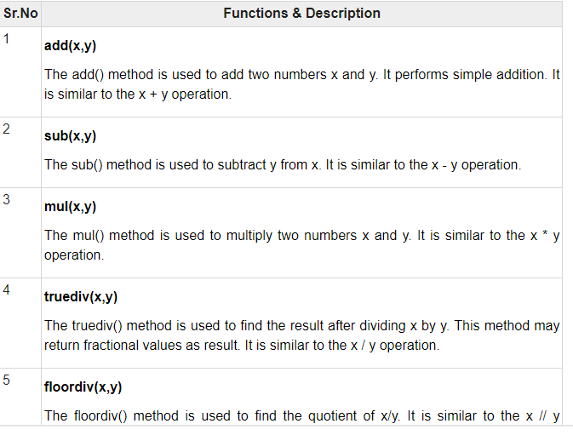
It includes Arithmetic and relational operators
The Arithmetic Operator are as

Slide 100
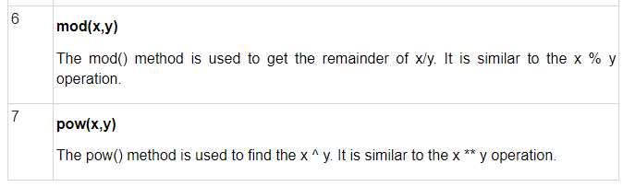

Slide 101
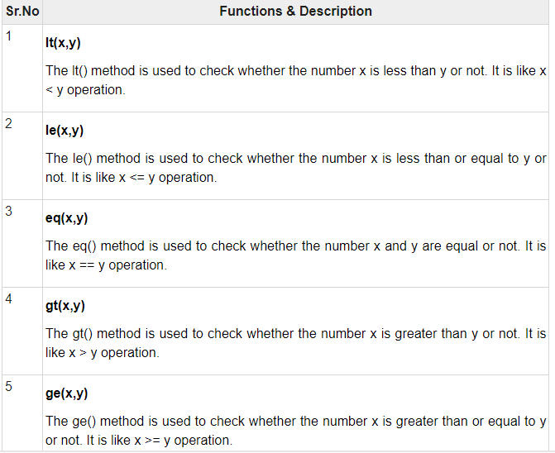
TheRelational Operations functions are

Slide 102
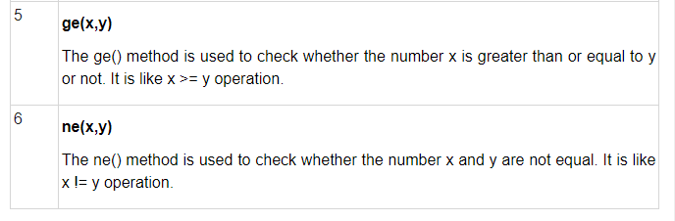

Slide 103
Example
import operator
print("addition =",operator.add(10,20))
print("substraction =",operator.sub(10,20))
print("mul =",operator.mul(10,20))
print("greater then =",operator.gt(10,20))
print("less then =",operator.lt(10,20))

Slide 104
Namespaces and Scoping
A namespace is a collection of names.
A namespace allows us to have unique names for each object.
Variables are names (identifiers) that map to objects. A namespace is a dictionary of variable names (keys) and their corresponding objects (values).
A Python statement can access variables in a local namespace and in the global namespace. If a local and a global variable have the same name, the local variable shadows the global variable.
Each function has its own local namespace. Class methods follow the same scoping rule as ordinary functions.

Slide 105
Python makes educated guesses on whether variables are local or global. It assumes that any variable assigned a value in a function is local.
Therefore, in order to assign a value to a global variable within a function, you must first use the global statement.
The statement global VarName tells Python that VarName is a global variable. Python stops searching the local namespace for the variable.

Slide 106
For example, we define a variable Money in the global namespace. Within the function Money, we assign Money a value, therefore Python assumes Money as a local variable. However, we accessed the value of the local variable Money before setting it, so an UnboundLocalError is the result. Uncommenting the global statement fixes the problem.

Slide 107
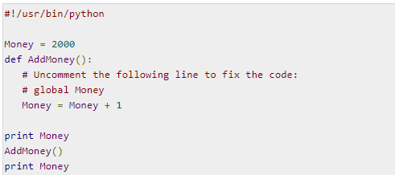

Slide 108
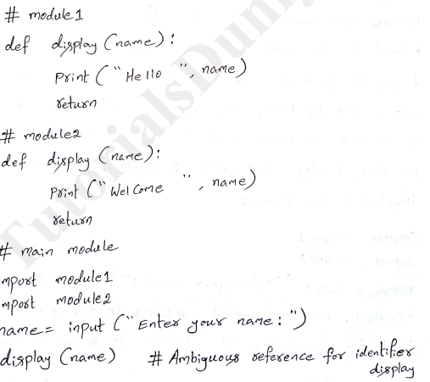

Slide 109
In above Example Each module has display() and name which provide clashes.So Namespace provide means for resolving such problem
In python ,each module has its ownspace.This namespace includes the names of all items(function & variable)defined in the module.Therefore two instance of display(),each defined in their own module, are distinguished by being fully qualified with the name of module
i.e module1.display() & module2.display()

Slide 110
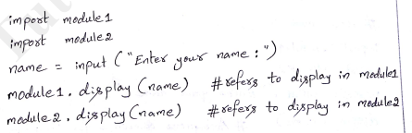

Slide 111
There are three namespace
Local Namespace:The local names inside the function comes under a local namespace. This namespace is created when the function is called and the scope ends when the value is returned.
Global Namespace:This namespace includes names from the modules that are imported in the project. It is created when we include the module and it lasts until the script ends.

Slide 112
Built-in Namespace:This namespace includes functions and exception names that are built-in in the Python.

Slide 113
Write a program for importing module for addition and subtraction of two numbers[4M]

Slide 114
calculation.py:
def add(x,y):
return (x+y)
def sub(x,y):
return (x-y)
operation.py:
import calculation
print(calculation.add(1,2))
print(calculation.sub(4,2))

Slide 115
Packages

Slide 116
Introduction to packages
Packages are namespaces which contain multiple packages and modules themselves. They are simply directories
Each package in Python is a directory which MUST contain a special file called __init__.py. This file can be empty, and it indicates that the directory it contains is a Python package, so it can be imported the same way a module can be imported.

Slide 117
As our application program grows larger in size with a lot of modules, we place similar modules in one package and different modules in different packages. This makes a project (program) easy to manage and conceptually clear.
Similar, as a directory can contain sub-directories and files, a Python package can have sub-packages and modules.
Here is an example. Suppose we are developing a game, one possible organization of packages and modules could be as shown in the figure below.

Slide 118
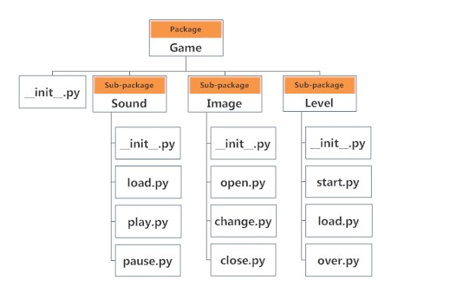

Slide 119
Importing module from a package
We can import modules from packages using the dot (.) operator.
For example, if want to import the start module in the above example, it is done as follows.
import Game.Level.start
Now if this module contains a function named select_difficulty(), we must use the full name to reference it.
Game.Level.start.select_difficulty(2)
If this construct seems lengthy, we can import the module without the package prefix as follows.
from Game.Level import start

Slide 120
We can now call the function simply as follows.
start.select_difficulty(2)
Another way of importing just the required function (or class or variable) form a module within a package would be as follows.
from Game.Level.start import select_difficulty
Now we can directly call this function.
select_difficulty(2)

Slide 121
WRITING PYTHON PACKAGE
Let's create a package named mypackage, using the following steps:
1.Create a new folder named D:\MyApp.
2. Inside MyApp, create a subfolder with the name 'mypackage'.
3. Create an empty __init__.py file in the mypackage folder.
4. Using a Python-aware editor like IDLE, create modules greet.py and functions.py with following code:

Slide 122
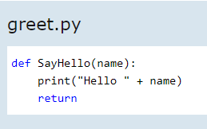
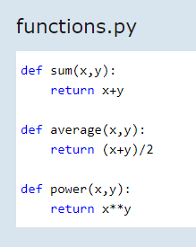

Slide 123
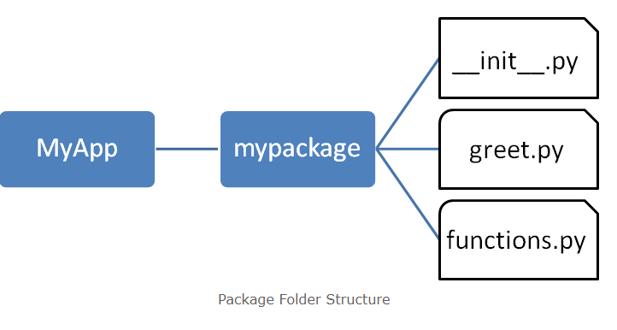
The following is a folder structure:

Slide 124

5. Importing a Module from a Package
Now, to test our package, invoke the Python prompt and write the command

Slide 125

Import the greet module from the mypackage package and call its SayHello() function

Slide 126
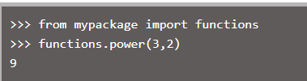
Import the functions module from the mypackage package and call its power() function

Slide 127
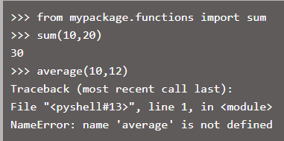
Import specific functions from a module in the package

Slide 128
Python Standard Library
The Python Standard Library is a collection of exact syntax, token, and semantics of Python.
It comes bundled with core Python distribution.
It includes :-math
numpy
scipy
pandas
matplotlib

Slide 129
1. Math
This is the most basic math module that is available in Python.
It covers basic mathematical operations like sum, exponential, modulus, etc.
This library is not useful when dealing with complex mathematical operations like multiplication of matrices.
The calculations performed with the functions of the python math library are also much slower.
However, this library is adequate when you have to carry out basic mathematical operations.

Slide 130

Example

Slide 131
2. Numpy
NumPy is the fundamental package for scientific
computing with Python. NumPy stands for
"Numerical Python". It provides a high-performance
multidimensional array object, and tools for working
with these arrays.
An array is a table of elements (usually numbers), all
of the same type, indexed by a tuple of positive
integers and represented by a single variable.
NumPy's array class is called ndarray. It is also known
by the alias array.
In NumPy arrays, the individual data items are called
elements. All elements of an array should be of the
same type. Arrays can be made up of any number of
dimensions.

Slide 132
In NumPy, dimensions are called axes. Each
dimension of an array has a length which is the total
number of elements in that direction.
The size of an array is the total number of elements
contained in an array in all the dimension. The size of
NumPy arrays are fixed; once created it cannot be
changed again.
Numpy arrays are great alternatives to Python Lists.
Some of the key advantages of Numpy arrays are that
they are fast, easy to work with, and give users the
opportunity to perform calculations across entire
arrays.

Slide 133
A one dimensional array has one axis indicated by Axis-0. That axis has five elements in it, so we say it has length of five.
A two dimensional array is made up of rows and
columns. All rows are indicated by Axis-0 and all
columns are indicated by Axis-1. If Axis-0 in two
dimensional array has three elements, so its length it three and Axis-1 has six elements, so its length is six
Advantage of numpy is
Array oriented computing
Efficient implemented multi dimensional arrays
Designed for scientific computation.

Slide 134
Using NumPy, a developer can perform the following operations:
1. Mathematical and logical operations on arrays.
2. Fourier transforms and routines for shape manipulation.
3. Operations related to linear algebra.
4. NumPy has in-built functions for linear algebra and random number generation

Slide 135
Installation of numpy
Step1:open command prompt and type comand
C:\>python -m pip install numpy
Step2:The Package will be installed on your PC.

Slide 136
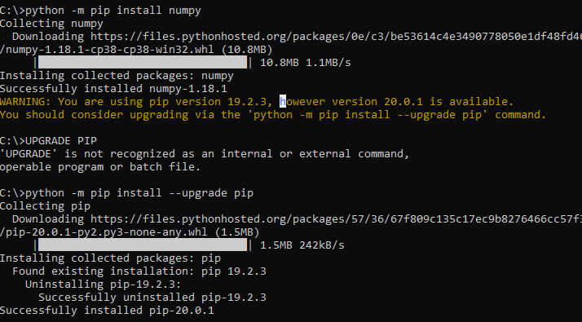

Slide 137
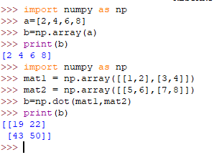

Slide 138
3. SciPy
This python math library provides all the scientific tools for Python.
It contains various models for mathematical optimization, linear algebra, Fourier Transforms, etc
Scipy is pronounced as “sign pi”
It is an open source python based library,which is used in mathematics, scientific computing , engineering and technical computing.
Most new Data Science features are available in scipy

Slide 139
Installation of Scipy
Step1:open command prompt and type comand
C:\>python -m pip install scipy
Step2:The Package will be installed on your PC.

Slide 140
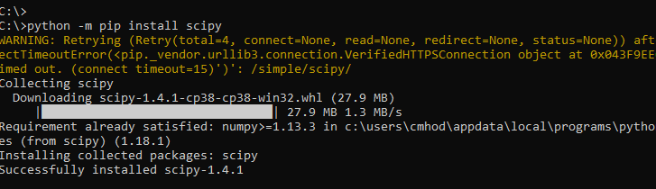

Slide 141
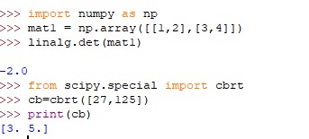
example

Slide 142
4.pandas
It is a python package providing fast , flexible and expressive data structure designed to make working with data structure (tabular,multidimensional) and time series data both easy and intuitive.
Pandas is well suited for many different kinds of data such as Tabular data ,Ordered & Un-Ordered Time series data , Arbitary matrix data
Data structure used in pandas are
Series:-It is one Dimensional Homogeneous Array.The Size of this array is immutable.

Slide 143
DataFrame:-It is Two Dimensional Array.The Size Mutable.
Panel:-It is Three Dimensional labelled Array.The Size is mutable

Slide 144
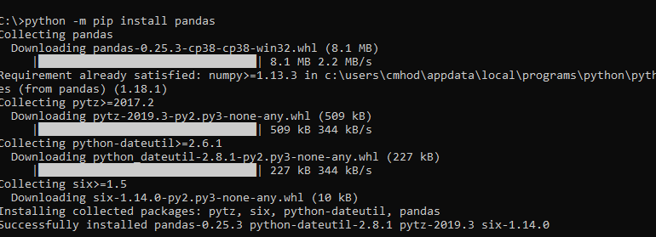
Installation of pandas
Step1:open command prompt and type comand
C:\>python -m pip install pandas
Step2:The Package will be installed on your PC.
import pandas as pd

Slide 145
program
import pandas as pd
import numpy as np
a=[[10,20],[30,40]]
d=pd.DataFrame(a)
print(d)
import pandas as pd
import numpy as np
a=np.array([1,2,3,4,5])
s=pd.Series(a)
print(s)

Slide 146
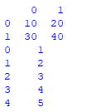
output

Slide 147
5.matplotlib
It is plotting Library for Python Programming language and its numerical mathematics extension numpy.
It consists of several plots like line ,bar ,scatter , histogram etc.
We have to import pylab module of matplotlib
import matplotlib.pylab as plt
plot() is used to draw the line with the help of data points provided through array
show() is used to display the plotted line on the window

Slide 148
Installation of matplotlib
Step1:open command prompt and type comand
C:\>python -m pip install matplotlib
Step2:The Package will be installed on your PC.

Slide 149
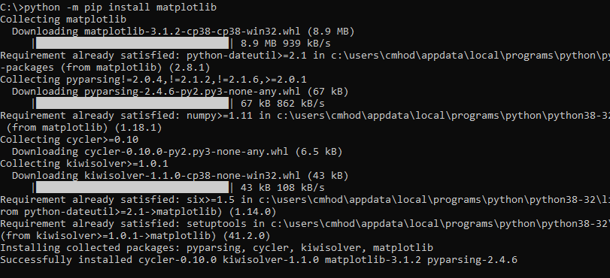

Slide 150
import matplotlib.pylab as plt
import numpy as np
a=[5,10,15,20,30]
b=np.array(a)
plt.plot(b)
plt.show()

Slide 151
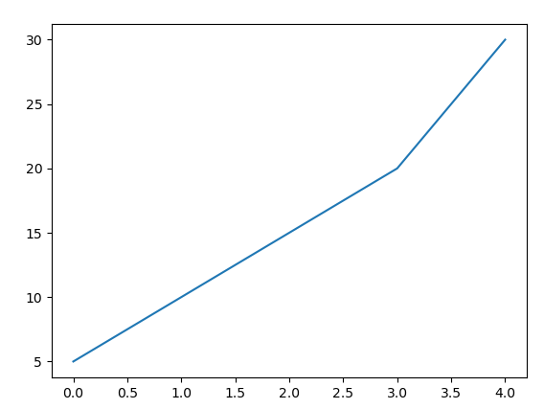
output

Slide 152
import matplotlib.pylab as plt
import numpy as np
x=[2,4,6]
y=[5,10,15]
plt.bar(x,y)
plt.show()

Slide 153
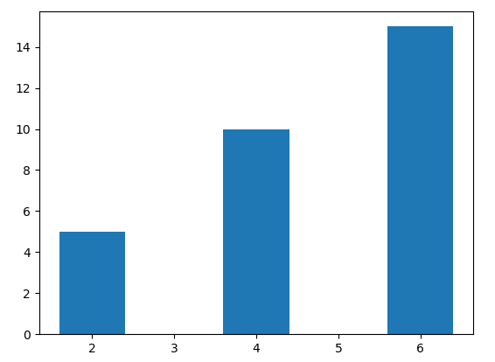

Slide 154
MSBTE QUESTIONS
Write use of lambda function in python(2M)]
Example module. How to define module. (4M)
Explain how to use user defined function in python with example (4M)
Write a program for importing module for addition and subtraction of two numbers (4M)
Explain use of format() method with example (4M)
Write a program illustrating use of user defined package in python (4M)
Explain package Numpy with example (6M)

Slide 155
End

