Slide 1
Course Title : OBJECT ORIENTED PROGRAMMING USING C++ Course Code: 313304

Slide 2
Unit - V
File Operations CO5 - Develop C++ programs to perform file operations.
Learning Hours : 6
Total Marks: 10

Slide 3
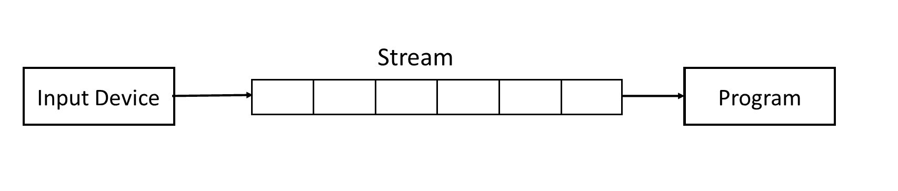
C++ Streams:
A stream is a sequence of bytes. It acts as a source from which the input data can be obtained or as a destination to which the input data can be sent.

Slide 4
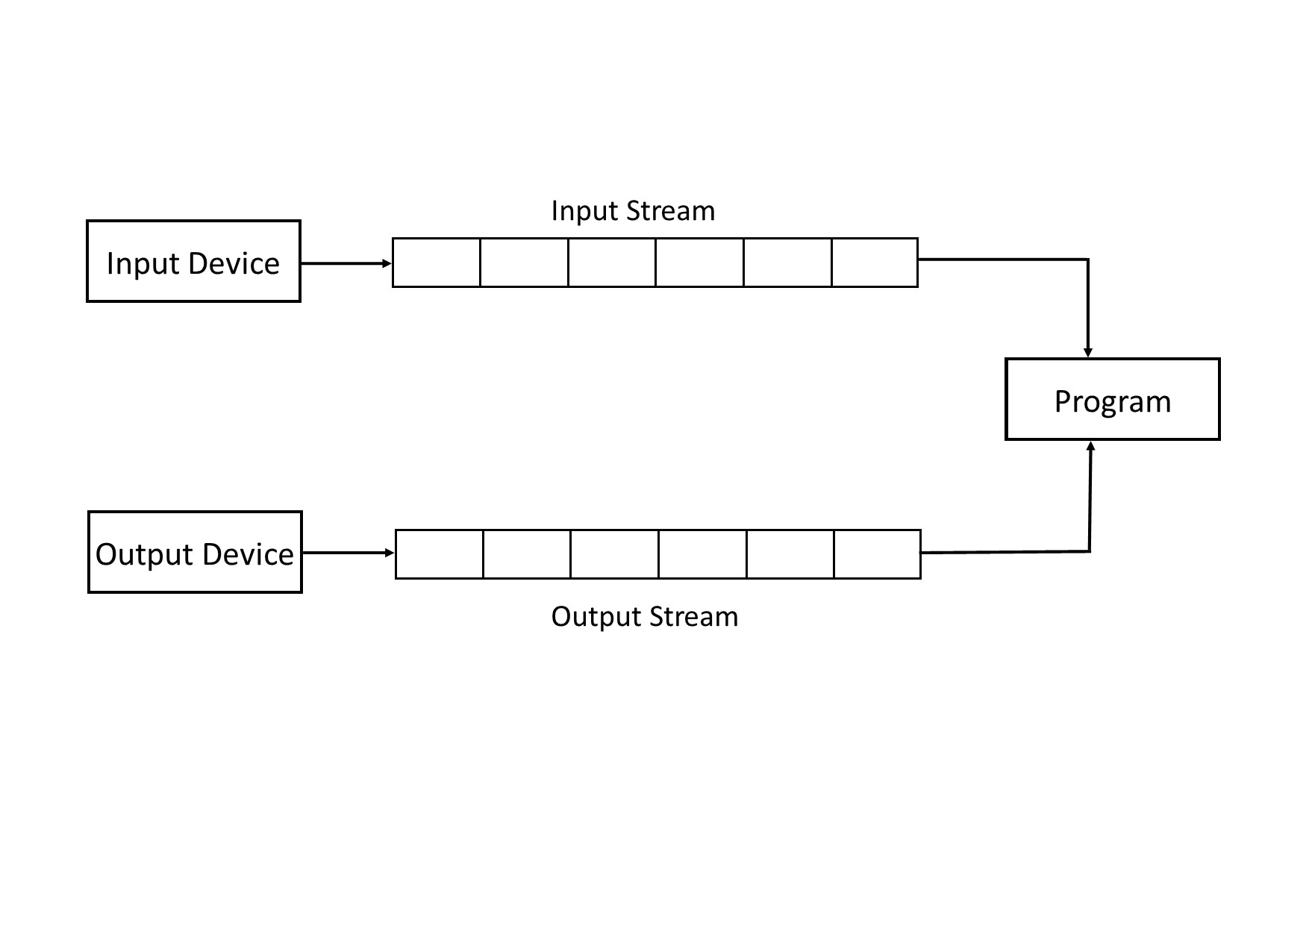
Input Stream & Output Stream
Input Stream
The source stream that provides data to the program is called input stream.
Output Stream
The destination stream that receives output from the program is called output stream.

Slide 5
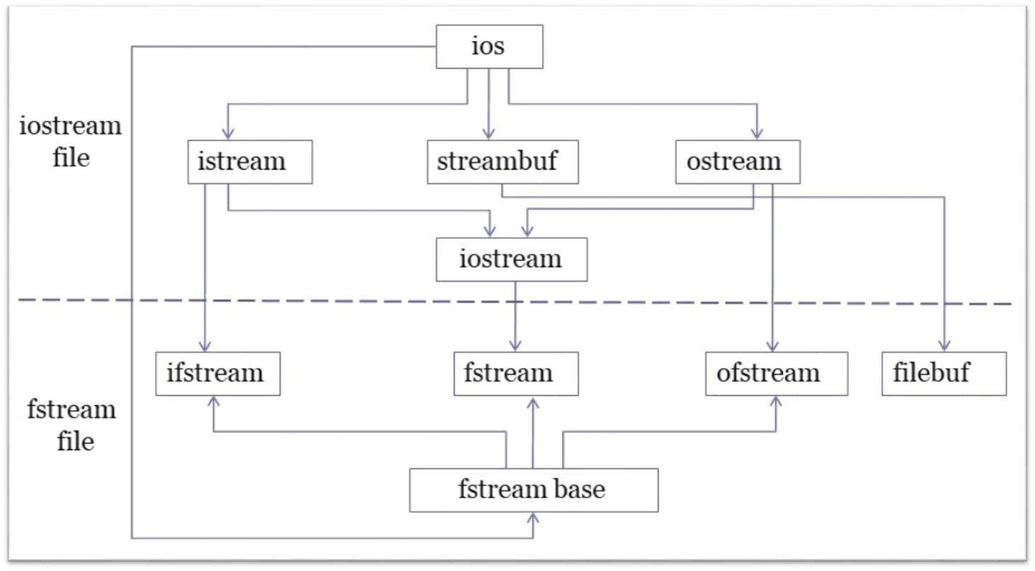
Classes for File Stream Operations

Slide 6
ios
Contains basic facilities that are used by all other input and output classes.
Also contains a pointer to a buffer object.
Declares constants and functions that are necessary for handling formatted input and output functions.
istream
Inherits the properties of ios.
Contains overloaded extraction operator >>
ostream
Inherits the properties of ios.
Contains overloaded insertion operator <<

Slide 7
iostream
Inherits the properties of ios, istream and ostream through multiple inheritance and
Thus contains all the input and output functions.
It provides input operations for file.
streambuf
Provides an interface to physical devices through buffers.
Acts as a base for filebuf class used ios files.

Slide 8
Classes for file stream operations
filebuf
It sets the file buffers to read and write.
fstreambase
This is the base class for fstream, ifstream and
ofstream classes.
ifstream
It provides input operations for file.
ofstream
It provides output operations for file.
fstream
It is an input-output stream class

Slide 9
Unformatted I/O Operations:
get():
The class istream defines a member function get() which is used to handle single character Input operations at a time.
There are two types of get() functions:

Slide 10
Eg.
Syntax:
1)get(char)
cin.get(char);
2)get(void)
char=cin.get();

Slide 11
#include<iostream.h>
#include<conio.h>
#include<fstream.h>
void main()
{
char c;
clrscr();
cout<<"Enter Char:";
cin.get(c);
cout<<c;
getch();
}
/*output
Enter Char:suwarna
s
*/

Slide 12
#include<iostream.h>
#include<conio.h>
void main()
{
char c;
clrscr();
cout<<"Enter Char:";
c=cin.get();
cout<<c;
getch();
}
/*output
Enter Char:suwarna
s
*/

Slide 13
put()
The e class ostream defines the member function put() which is used to output a line of text on a screen character by character.
The function put(),outputs one character at a time.
Syntax:
cout.put(char);
Eg.
cout.put(‘s’);

Slide 14
cout.put(ch);
cout.put(65);

Slide 15
Program:
#include<iostream.h>
#include<conio.h>
#include<fstream.h>
void main()
{
clrscr();
char c;
cout.put(65)<<endl;
cout.put('s')<<endl;
cout<<"\nEnter Char:";
cin.get(c);
cout.put(c);
getch();
}
/*output
A
s
Enter Char:h
h
*/

Slide 16
getline()
The getline() function reads a whole line of text ending with a newline character. This function reads the newline character but it does not save it.
Syntax:
Cin.getline(line,size);

Slide 17
#include<iostream.h>
#include<conio.h>
#include<fstream.h>
void main()
{
int n=20;
char c[20];
clrscr();
cout<<"Enter Line:";
cin.getline(c,n);
cout<<c;
getch();
}
/*output
Enter Line:object oriented programming is fun
object oriented pro
*/

Slide 18
write()
The write() is a member function of ostream class it is used to display entire line on the screen.
Syntax:
cout.write(line,size);

Slide 19
#include<iostream.h>
#include<conio.h>
void main()
{
clrscr();
int n=20;
char c[20];
cout<<"Enter the Line:";
cin.getline(c,n);
cout.write(c,16);
getch();
}
/*output
Enter the Line:object oriented programming is fun
object oriented
*/

Slide 20
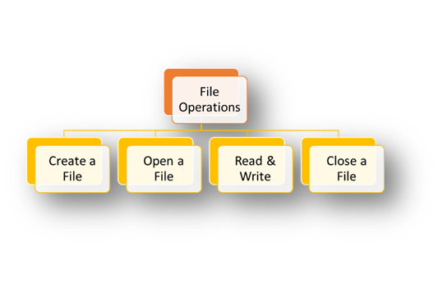
Concept Map

Slide 21
File opening modes
In C++, for every file operation, exists a specific file mode.
These file modes allow us to create, read, write, append or modify a file.
The file modes are defined in the class ios.
A File stream act as an interface between the program and the files.
Parameter | Meaning
ios :: app | Append to end-of-file
ios :: ate | Go to end-of-file on opening
ios :: binary | Binary file
ios :: in | Open file for read only
ios :: nocreate | Open fails if file does not exist
ios :: noreplace | Open fails if file does already exist
ios :: out | Open file for writing only
ios :: trunc | Delete the contents of the file if it exists

Slide 22
Default opening modes of a file
For ifstream ----- ios::in
For ofstream ------ ios::out
For fstream --------- ios::in | ios::out

Slide 23
Opening a File
A file must be opened before reading from it or writing into it.
Either ofstream or fstream object may be used to open a file for writing.
And ifstream object is used to open a file for reading purpose only.
Syntax to open a file:
1. file_stream_object.open(“filename”,mode);
2. file_stream_class file_stream_object(“filename”,mode);
23222
where,
file_stream-object: is the an object of a file stream class used to perform a specific file operation.
file_stream-class: is ofstream is used to create o/p stream and ifstream is used to create i/p stream.
filename: is the name of a file on which we are going to perform file operations.
mode: is single or multiple file modes in which we are going to open a file.

Slide 24
Closing a File
When a C++ program terminates it automatically flushes all the streams, release all the allocated memory and close all the opened files.
But it is always a good practice that a programmer should close all the opened files before program termination.
Syntax to close a file:
file_stream_object.close();
where,
file_stream-object: is the an object of a file stream class used to perform a specific file operation.

Slide 25
/*WAP to opening a file and closing a file */
#include<iostream.h>
#include<conio.h>
#include<fstream.h>
void main()
{
clrscr();
fstream f;
f.open("shakir.cpp",ios::in);
cout<<"File opened"<<endl;
f.close();
cout<<"File closed";
getch();
}

Slide 26
/*WAP to opening a file and reading the data from that file and closing a file */
#include<iostream.h>
#include<conio.h>
#include<fstream.h>
void main()
{
clrscr();
fstream f;
char line[100];
f.open("shakir.cpp",ios::in);
cout<<"File opened"<<endl;
while(f)
{
f.getline(line,100);
cout<<line<<endl;
}
f.close();
cout<<"File closed";
getch();
}
/*Output:
File opened
Opening a file
File closed
*/

Slide 27
Writing into a File
While programming in C++, the information to be written into a file uses the stream insertion operator (<<) operator to output information to the screen.
The only difference is that you use an ofstream or fstream object instead of the cout object.

Slide 28
Writing data into file using open function
#include<iostream.h>
#include<conio.h>
#include<fstream.h>
void main()
{
clrscr();
ofstream outfile;
outfile.open("w1.cpp",ios::out);
cout<<"Writting into the File"<<endl;
outfile<<"suwarna nimkarde";
outfile.close();
getch();
}
/* Output:
Writting into the File
*/

Slide 29
Writing data into file using constructor
#include<iostream.h>
#include<conio.h>
#include<fstream.h>
void main()
{
clrscr();
ofstream outfile("w1.cpp",ios::out);
cout<<"Writting into the File"<<endl;
outfile<<"suwarna nimkarde BVIT";
outfile.close();
getch();
}
/* Output:
Writting into the File
*/

Slide 30
#include<iostream.h>
#include<conio.h>
#include<fstream.h>
void main()
{
clrscr();
fstream f;
f.open("Harshal.cpp",ios::out);
cout<<"Writting into the File"<<endl;
f<<"suwarna";
f.close();
getch();
}
/* Output:
Writting into the File
*/

Slide 31
#include <iostream.h>
#include <fstream.h>
void main()
{
ofstream fout;
fout.open("marks.cpp", ios::out);
char ans = 'y';
int rollno;
float marks;
while (ans == 'y' || ans == 'Y')
{
cout << "Enter the roll number: ";
cin >> rollno;
cout << "Enter the mark: ";
cin >> marks;
fout << rollno << '\n' << marks << '\n';
cout << "\nWant to enter more? (y/n): ";
cin >> ans;
cout << endl;
}
fout.close();
getch();
}

Slide 32

/*Output
Enter the roll number: 2101
Enter the mark: 98
Want to enter more? (y/n): n
*/

Slide 33
Reading from a File
The information can be read from a file into another program using the stream extraction operator (>>)
The only difference is that you use an ifstream or fstream object instead of the cin object.

Slide 34
#include<iostream.h>
#include<conio.h>
#include<fstream.h>
void main()
{
clrscr();
fstream f;
char line[100];
f.open("fun.cpp",ios::in);
cout<<"Content of files are:"<<endl;
while(f)
{
f.getline(line,100);
cout<<line<<endl;
}
f.close();
getch();
}

Slide 35
Reading from file using constructor
#include<iostream.h>
#include<conio.h>
#include<fstream.h>
void main()
{
clrscr();
char line[100];
ifstream infile("w1.cpp",ios::in);
cout<<"Reading fron File"<<endl;
while(infile)
{
infile.getline(line,100);
cout<<line;
}
infile.close();
getch();
}

Slide 36
#include<iostream.h>
#include<conio.h>
#include<fstream.h>
void main()
{
clrscr();
ofstream outfile("w1.cpp",ios::out);
cout<<"Writting into the File"<<endl;
cout<<"Enter data:";
char name[100];
cin>>name;
outfile<<name<<endl;
outfile.close();
ifstream infile("w1.cpp",ios::in);
infile>>name;
cout<<endl;
cout<<"name:"<<name;
infile.close();
getch();
}
/* Output:
Writting into the File
Enter data:OOP
name:OOP
*/

Slide 37
Detecting End of File
Method 1:
Detection of the end-of-file condition is necessary for preventing any further attempt to read data from the file.
while(fin)
An ifstream object returns a value zero if any error occurs in the file operation including the end-of-file condition.

Slide 38
Detecting End of File
Method 2:
if(fin1.eof() != 0 )
{
exit(1);
}
The eof() of ios class returns a non zero value if the end-of-file condition is encountered and zero otherwise.

Slide 39
Concept Map
File manipulations
Copy content from one file to another
Count no of lines
Count no of specific character
Count no of spaces

Slide 40
WAP to copy content of one file into another using open function
#include<iostream.h>
#include<conio.h>
#include<fstream.h>
void main()
{
clrscr();
ifstream infile;
ofstream outfile;
char ch;
infile.open("harshal.cpp",ios::in);
outfile.open("gauri.cpp",ios::out);
cout<<"copied content"<<endl;
while(infile)
{
infile.get(ch);
cout<<ch;
outfile.put(ch);
}
infile.close();
outfile.close();
getch();
}

Slide 41
WAP to copy content of one file into another using constructor
#include<iostream.h>
#include<conio.h>
#include<fstream.h>
void main()
{
clrscr();
char ch;
ifstream infile("harshal.cpp");
ofstream outfile("gauri.cpp");
cout<<"copied content"<<endl;
while(infile)
{
infile.get(ch);
cout<<ch;
outfile.put(ch);
}
infile.close();
outfile.close();
getch();
}

Slide 42
#include<iostream.h>
#include<conio.h>
#include<fstream.h>
void main()
{
int nob=0,not=0,nol=0,cnt=0;
clrscr();
char c;
ifstream infile;
infile.open("virtual.cpp");
while(!infile.eof())
{
infile.get(c);
cnt++;
if(c==' ')
nob++;
else if(c=='\t')
not++;
else if(c=='\n')
nol++;
}
cout<<"No. of Lines:"<<nol<<endl;
cout<<"No. of Blank:"<<nob<<endl;
cout<<"No. of Tab"<<not<<endl;
getch();
}
/* Output:
No. of Lines:28
No. of Blank:11
No. of Tab0
*/

Slide 43
#include<iostream.h>
#include<conio.h>
#include<fstream.h>
void main()
{
int cnt=0;
clrscr();
char c,choice;
cout<<"Enter character tobe counted:"<<endl;
cin>>choice;
ifstream infile;
infile.open("virtual.cpp");
while(!infile.eof())
{
infile.get(c);
if(c==choice)
cnt++;
}
cout<<"No. of characters:"<<cnt<<endl;
getch();
}
/* Output:
Enter character tobe counted:
s
No. of characters:18
*/

Slide 44
outfile.open("item3.cpp");
outfile<<"External"<<endl;
outfile<<"Internal"<<endl;
outfile.close();
const int n=40;
char line[n];
ifstream infile;
infile.open("item2.cpp");
cout<<endl;
while(infile)
{
infile.getline(line,n);
cout<<line<<endl;
}
#include<iostream.h>
#include<fstream.h>
#include<conio.h>
void main()
{
clrscr();
ofstream outfile;
outfile.open("item2.cpp");
outfile<<"OOP"<<endl;
outfile<<"RDBMS"<<endl;
outfile.close();

Slide 45
infile.close();
infile.open("item3.cpp");
cout<<endl;
while(infile)
{
infile.getline(line,n);
cout<<line<<endl;
}
infile.close();
getch();
}
/* Output:
OOP
RDBMS
External
Internal
*/

Slide 46
#include<iostream.h>
#include<conio.h>
#include<fstream.h>
void main()
{
char s[20],d[20],data;
clrscr();
cout<<"Enter Source File name:";
cin>>s;
cout<<"Enter Destination File Name:";
cin>>d;
ifstream inf;
inf.open(s);
ofstream outf;
outf.open(d);
while(inf)
{
inf.get(data);
cout<<data;
outf.put(data);
}
inf.close();
outf.close();
getch();
}
/* Output:
Enter Source File name:w1.cpp
Enter Destination File Name:w2.cpp
OOP
*/

