Slide 1
CH NO 5 OBJECT ORIENTED PROGRAMMING IN PYTHON MARKS 12

Slide 2
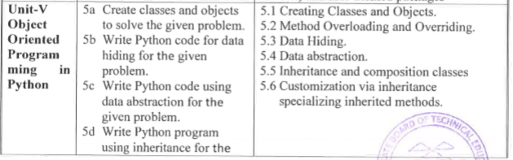

Slide 3
COURSE OUTCOME
Design a classes for given Problem

Slide 4
Python is object oriented programming language.
It helps the programmer to reduce the complexity of programs by reusing existing modules or functions.
The OOP approach mainly focuses on the objects and classes.

Slide 5
Overview of OOP Terminology
Class
A class is a user-defined blueprint or prototype from which objects are created.
Classes provide a means of bundling data and functionality together
It consist of data members and methods that are used by the instance of the class.
Methods
Methods are the functions defined in the definition of class and are used by various instances of the class.
Instance
An object is an instance of the class

Slide 6
Instance Variable:
A variable that is defined in a method ,its scope is only within the object that defines it.
Class Variable:
A variable that is defined in the class and can be used by all instances of that class.
Instantiation
The process of creation of an object of a class

Slide 7
Function Overloading
A function defined more than one time with different behaviors is known as Function Overloading. The operation performed by these functions are different
Inheritance
The transfer of the characteristics of a class to other classes that are derived from it.
Object
An object is an instance of a class that has some attributes and behavior. Objects can be used to access the attributes of the class.

Slide 8
Creating class and object
To create a class, use the keyword class:
Syntax
class ClassName:
'Optional class documentation string‘
class_suite
The class has a documentation string, which can be accessed via ClassName.__doc__.
The class_suite consists of all the component statements defining class members, data attributes and functions.

Slide 9
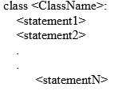
Syntax to define class

Slide 10
Creating Instance Objects
To create instances of a class, you call the class using class name and pass in whatever arguments its __init__ method accepts.
Syntax
object_name=classname()

Slide 11
Accessing attribute of a class
The syntax to access the attribute of a class are:
object_name.attribute

Slide 12
ASSIGNING VALUE TO AN ATTRIBUTE
The syntax to access a value to an attribute of an object is:
object_name.attribute=value

Slide 13
Example
class Rectangle:
length=10
breadth=20
r1=Rectangle()
print(“Length=",r1.length)
print("Breadth=",r1.breadth)
OUTPUT:
Length= 10
Breadth= 20

Slide 14
class Rectangle():
length=10
breadth=20
def area(self):
return(self.length*self.breadth)
r1=Rectangle()
print("Length=",r1.length)
print("breadth=",r1.breadth)
print(r1.area())

Slide 15
The __init__() Function
All classes have a function called __init__(), which is always executed when the class is being initiated.
Use the __init__() function to assign values to object properties, or other operations that are necessary to do when the object is being created:

Slide 16
The self Parameter
The self parameter is a reference to the current instance of the class, and is used to access variables that belongs to the class.
It does not have to be named self , you can call it whatever you like, but it has to be the first parameter of any function in the class:

Slide 17
class Person: def __init__(self, name, age): self.name = name self.age = age def myfunc(abc): print("Hello my name is " + abc.name) p1 = Person("John", 36) p1.myfunc()

Slide 18
class Rectangle:
def __init__(self, length, breadth):
self.length = length
self.breadth = breadth
def area(self):
return self.length * self.breadth
a = int(input("Enter length of rectangle: "))
b = int(input("Enter breadth of rectangle: "))
obj = Rectangle(a, b)
print("Area of rectangle:", obj.area())

Slide 19
Modify Object Properties
You can modify properties on objects like this:
r1.length=20
class Rectangle():
length=10
breadth=20
def area(self):
return(self.length*self.breadth)
r1=Rectangle()
r1.length=20
print("Length=",r1.length)
print("breadth=",r1.breadth)
print(r1.area())

Slide 20
Delete Object Properties
You can delete objects by using the del keyword:
class Person:
def __init__(self, name, age):
self.name = name
self.age = age
def myfunc(self):
print("Hello my name is " + self.name)
p1 = Person("John", 36)
del p1.age
print(p1.age)

Slide 21
Delete Objects
You can delete objects by using the del keyword:
class Person:
def __init__(self, name, age):
self.name = name
self.age = age
def myfunc(self):
print("Hello my name is " + self.name)
p1 = Person("John", 36)
del p1
print(p1)

Slide 22
Write a program to create class EMPLOYEE with ID and NAME and display its contents.[6M]

Slide 23
class employee :
id=0
name=""
def getdata(self,id,name):
self.id=id
self.name=name
def showdata(self):
print("ID :", self.id)
print("Name :", self.name)
e = employee()
e.getdata(11,"Vijay")
e.showdata()
Output:
ID : 11
Name : Vijay

Slide 24
Design a class student with data members; Name, roll number address. Design a class student with data members; Name, roll number address. [6M]

Slide 25
class Student:
def getStudentDetails(self):
self.rollno=input("Enter Roll Number : ")
self.name = input("Enter Name : ")
self.address =input("Enter Address : ")
def printStudentDetails(self):
print(self.rollno,self.name, self.address)
S1=Student()
S1.getStudentDetails()
print("Student Details ")
S1.printStudentDetails ()

Slide 26
Output:
Enter Roll Number : 001
Enter Name : ABC
Enter Address : New York
Student Details :
001 ABC New York

Slide 27
Constructor & Destructor

Slide 28
Constructor and destructor
In python ,we defined constructor as _ _init_ _() function.
The _ _init_ _() method is known as initialiser.
It is special method that is used to initialized the instance variable.
This method run as soon as an object of a class is instantiate.
Syntax
class A:
def _ _init_ _(self):
pass

Slide 29
The init() method needs to be preceded and followed by two underscores.
init() method must have self as first argument.
The self parameter with in the _ _init_ _() automatically sets the reference for the object just created.

Slide 30
destructor
The method _ _del_ _() denotes destructor in python
Python invokes the destructor method when an instance is about to be destroyed.
It is invoked one per instance
The self refers to the instance on which _ _del __() method is invoked
Python manages garbage collection of objects by reference counting.
This function is executed only if all the references to an instance object have been removed

Slide 31
Synatx
def _ _del_ _():
block
The destructor _ _del_ _() is not invoked unless all the aliases are deleted
All the aliases are removed by del statement
Destructor is called exactly once

Slide 32
class A:
def __init__(self):
print("constructor is invoked")
def __del__(self):
print("Destructor is invoked")
obj=A()
print("Id of Obj=",id(obj))
del obj
Output
constructor is invoked
Id of Obj= 50228672
Destructor is invoked

Slide 33
Constructor and destructor in inheritance
As per other object oriented languages, when an object of derived class is declared, first of all it executes constructor of base class then the constructor of derived class executes. But this is not in python.
Same when an scope of objects of derived class ends, first it executes destructor of derived class then the destructor of base class executes. But this is not in python.
In python as we defined constructor and destructor in the derived class. Python Interpreter will treats as method overridding

Slide 34
class A:
def __init__(self):
print("super class constructor is invoked")
def __del__(self):
print("super class Destructor is invoked")
class B(A):
def __init__(self):
print("sub class constructor is invoked")
def __del__(self):
print("sub class Destructor is invoked")
print("program start")
obj=B()
print("program ends")
del obj

Slide 35
Output
program start
sub class constructor is invoked
program ends
sub class Destructor is invoked
In this above program No constructor and destructor of base class is executed.
We can call them from function of derived class by using
base_classname._ _init_ _(self)
base_classname._ _del_ _(self)

Slide 36
class A:
def __init__(self):
print("super class constructor is invoked")
def __del__(self):
print("super class Destructor is invoked")
class B(A):
def __init__(self):
A.__init__(self)
print("sub class constructor is invoked")
def __del__(self):
A.__del__(self)
print("sub class Destructor is invoked")
print("program start")
obj=B()
print("program ends")
del obj

Slide 37
Output
program start
super class constructor is invoked
sub class constructor is invoked
program ends
super class Destructor is invoked
sub class Destructor is invoked

Slide 38
Parameterized constructor in base class and derived class
class A:
def __init__(self,roll,name):
self.roll=roll
self.name=name
class B(A):
def __init__(self,roll,name,per):
A.__init__(self,roll,name)
self.per=per
def display(self):
print("a=" ,self.roll)
print("b=" ,self.name)
print("c=" ,self.per)
obj=B(10,'amit',30)
obj.display()

Slide 39
Constructor with default arguments
As python does not allow constructor overloading and function overloading.
But by assigning default values to constructor’s parameters ,we can achieve benefits as we can do by overloading

Slide 40
class student:
def __init__(self,roll=12,name='amit',per=23.4):
self.roll=roll
self.name=name
self.per=per
def dis(self):
print("roll=",self.roll)
print("name=",self.name)
print("per=",self.per)
s1=student()
s1.dis()
s2=student(13,'amar',88.8)
s2.dis()

Slide 41
Output
roll= 12
name= amit
per= 23.4
roll= 13
name= amar
per= 88.8

Slide 42
Constructor overloading
Python don’t allow the constructor overloading

Slide 43
class A:
def __init__():
self.roll=1
self.name="amit"
def __init__(self,roll,name):
self.roll=roll
self.name=name
def display(self):
print("a=" ,self.roll)
print("b=" ,self.name)
obj=A()
obj.display()
obj1=A(10,'amit')
obj1.display()

Slide 44
Output
Traceback (most recent call last):
File "E:/prg/meth.py", line 15, in <module>
obj=A()
TypeError: __init__() missing 2 required positional arguments: 'roll' and ‘name’

Slide 45
Inheritance

Slide 46
What is Inheritance?
Inheritance allows us to define a class that inherits all the methods and properties from another class.
Parent class is the class being inherited from, also called base class.
Child class is the class that inherits from another class, also called derived class.

Slide 47
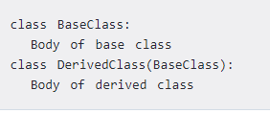
Python Inheritance Syntax

Slide 48
Types of inheritance
Single Inheritance
Multiple inheritance
Multilevel Inheritance
Hierarchical Inheritance
Hybrid Inheritance

Slide 49
Singel inheritance
There is only one base class and one derived class
Syntax

Slide 50
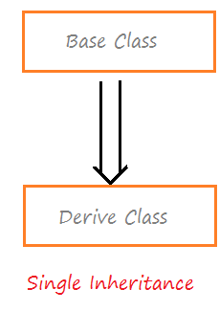

Slide 51
Example
class A:
def dis(self):
print("class A")
class B(A):
def show(self):
print("class B")
obj=B()
obj.dis()
obj.show()

Slide 52
Multilevel inheritance
In this type of inheritance, a class can inherit from a child class/derived class.
The procedure of deriving a class from a derived class is called as Multi level Inheritance
In multilevel inheritance, features of the base class and the derived class is inherited into the new derived class.

Slide 53
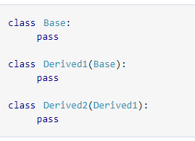

Slide 54
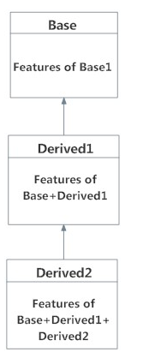

Slide 55
class A:
def dis(self):
print("class A")
class B(A):
def show(self):
print("class B")
class C(B):
def der(self):
print("class C")
obj=C()
obj.dis()
obj.show()
obj.der()

Slide 56
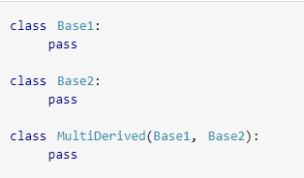
MULTIPLE INHERITANCE
When two or more base classes are used for derivation of a new class
Syntax

Slide 57
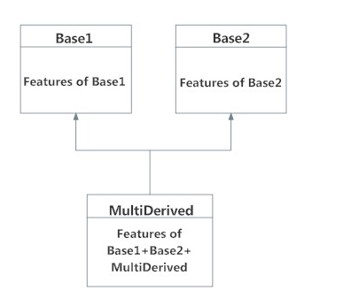

Slide 58
class A:
def dis(self):
print("class A")
class B:
def show(self):
print("class B")
class C(A,B):
def der(self):
print("class C")
obj=C()
obj.dis()
obj.show()
obj.der()

Slide 59
Hierarchical Inheritance
When more than one class inherits from a class, it is hierarchical Python inheritance.
SYNTAX
class A:
body
class B(A):
body class C(A):
body

Slide 60
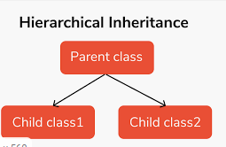

Slide 61
SUPER()
Any sub class can call the constructer i.e. _int_() defined by its super class by making use of super.
The syntax to call the constructor of a super class is in python 3.X
super()._init_(parameters of super class constructor)
The syntax to call the constructor of a super class is in python 2.X
super(Dervied_classname,self)._init_(parameters of super class constructor)

Slide 62
In Python, super() has two major use cases:
Allows us to avoid using the base class name explicitly
Working with Multiple Inheritance

Slide 63
class Parent:
def __init__(self, txt):
self.message = txt
def printmessage(self):
print(self.message)
class Child(Parent):
def __init__(self, txt):
super().__init__(txt)
x = Child("Hello, and welcome!")
x.printmessage()

Slide 64
Create a parent class named Animals and a child class Herbivorous which will extend the class Animal. In the child class Herbivorous over side the method feed ( ). Create a object[6M]

Slide 65
# parent class
class Animal:
# properties
multicellular = True
# Eukaryotic means Cells with Nucleus
eukaryotic = True
# function breath
def breathe(self):
print("I breathe oxygen.")
# function feed
def feed(self):
print("I eat food.")

Slide 66
# child class
class Herbivorous(Animal):
# function feed
def feed(self):
print("I eat only plants. I am vegetarian.")
herbi = Herbivorous()
herbi.feed()
# calling some other function
herbi.breathe()
Output:
I eat only plants. I am vegetarian.
I breathe oxygen.

Slide 67
Method overloading and Method Overriding

Slide 68
Method overloading
It is an ability of a function to behave in different ways based on the number of parameters passed to it.
In Method Overloading ,the same function name is used for different behavior
It simply refers to having multiple methods with the same name which accepts different sets of arguments

Slide 69
class test:
def add(self,a,b):
return(a+b)
def add(self,x,y,z):
return(x+y+z)
obj=test()
print("add=",obj.add(2,3))
print("add=",obj.add(2,3,4))
Output
Error Msg
print("add=",obj.add(2,3))
TypeError: add() missing 1 required positional argument: 'z'

Slide 70
This is because python understands the last definition of the method add(self,x,y,z) which takes only three arguments apart from self.
Therefore while calling the add() method ,it is forced to pass three arguments.
In other words ,it forget the previous definition of method add()

Slide 71
class test:
def add(self,a,b):
return(a+b)
def add(self,x=0,y=0,z=0):
return(x+y+z)
obj=test()
print("add=",obj.add(2,3))
print("add=",obj.add(2,3,4))
Output
add= 5
add= 9

Slide 72
METHOD OVERRIDDING
In a class Hierarchy ,when a method in a sub class has the same name and same header as that of a super class then the method in the sub class is said to override the method in the super class.
When an overridden method is called,it always invoke the method defined by its sub class.The same method defined by the super class is hidden.

Slide 73
class A:
def display(self):
print("I am in super class")
class B(A):
def display(self):
print("I am in sub class")
obj=B()
obj.display()
Output
I am in sub class

Slide 74
In above program, when display() method is invoked on an instance of class B,the method display() defined within B is invoked.Therefore ,the method display() overrides the method display() defined in the base class A.
We can access the overridden method that is defined in super class by using super()
super().methodname

Slide 75
class A:
def display(self):
print("I am in super class")
class B(A):
def display(self):
print("I am in sub class")
super().display()
obj=B()
obj.display()
Output
I am in sub class
I am in super class

Slide 76
Difference between method overloading and metho
Method Overloading | Method Overridding
In case of method overloading, parameter must be different. | In case of method overriding, parameter must be same.
Method overloading is performed within class. | Method overriding occurs in two classes that have IS-A (inheritance) relationship.
Method overloading is the example of compile time polymorphism. | Method overriding is the example of run time polymorphism.
The overloaded function can have different return types | In this,all the methods will have same return types
Method overloading is used to increase the readability of the program. | Method overriding is used to provide the specific implementation of the method that is already provided by its super class.

Slide 77
Data Hiding

Slide 78
Data hiding
Data hiding is one of the important features of Object Oriented Programming which allows preventing the functions of a program to access directly the internal representation of a class type.
By default all members of a class can be accessed outside of class.
You can prevent this by making class members private or protected.
In Python, we use double underscore (__) before the attributes name to make those attributes private.
We can use single underscore (_) before the attributes name to make those attributes protected.

Slide 79
class Data:
__a=0
def sum(self,incr):
self.__a+=incr
print(self.__a)
obj=Data()
obj.sum(3)
print(obj.__a)
Output
3
Traceback (most recent call last):
File "E:/prg/meth.py", line 29, in <module>
print(obj.__a)
AttributeError: 'Data' object has no attribute '__a'

Slide 80
In the above program, we tried to access hidden variable outside the class using object and it threw an exception.
We can access the value of hidden attribute by using a special syntax as follows:
objectname._className__attrName

Slide 81
class Data:
__a=0
def sum(self,incr):
self.__a+=incr
print(self.__a)
obj=Data()
obj.sum(3)
print(obj._Data__a)
Output
3
3

Slide 82
Data Abstraction

Slide 83
Data abstraction
It is a mechanism in which the abstract class is created.
The abstract class is a class in which abstract method is defined.
An abstract method is a method which does not have any implementation or defination.
The abstract method is defined in the child class.
Like other programming language,pyhton does not have keyword “abstract” to define abstract function of class.

Slide 84
So python use module which provide the base for defining Abstract Base Classes(ABC) and that module name is ABC.
ABC works by marking methods of the base class as abstract and then registring concrete classes as implementations of the abstract base.
A method becomes abstract by tinted with a keyword @absractmethod.

Slide 85
from abc import ABC,abstractmethod
class A:
@abstractmethod
def function1(self):
pass
def function2(self):
pass

Slide 86
In this function1 is tinted with abstractmethod but function2 is not.
Hence function1 becomes abstract function.
But if we want to make all functions of a class as abstract functions, then simply inherit class ABC of module in your user defined class.
from abc import ABC,abstractmethod
class A(ABC):
def function1(self):
pass
def function2(self):
pass

Slide 87
from abc import ABC,abstractmethod
class Color(ABC):
#@abstractmethod
def show(self):
pass
class Red(Color):
def show(self):
print("red color")
class Blue(Color):
def show(self):
print("blue color")
r=Red()
r.show()
b=Blue()
b.show()

Slide 88
Composition

Slide 89
composition
It is a relationship in which one object is defined as a part of another object.
Composition is a way of aggregating objects together by making some objects attributes of other objects.
In composition, we do not inherit from the base class but establish relationships between classes through the use of instance variables that are references to other objects.

Slide 90
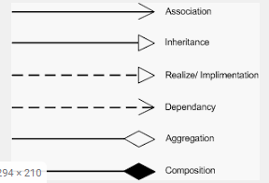
To show a composition relationship in a UML diagram, use a directional line connecting the two classes, with a filled diamond shape adjacent to the container class and the directional arrow to the contained class

Slide 91
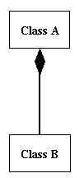

Slide 92
class marks:
def __init__(self,m1,m2):
self.m1=m1
self.m2=m2
def calculate(self):
return(self.m1+self.m2)
class student:
def __init__(self,roll,name,m1,m2):
self.roll=roll
self.name=name
self.m1=m1
self.m2=m2
self.obj_marks=marks(self.m1,self.m2)#composition
def total(self):
return self.obj_marks.calculate()
s=student(1,'amit',60,70)
print("roll no=",s.roll)
print("name=" ,s.name)
print("total=",s.total())

Slide 93
OUTPUT
roll no= 1
name= amit
total= 130

Slide 94
CUSTOMIZATION VIA INHERITANCE speacializing inherited methods
Two python function that will be helpful in customization of an objects response
_ _str_ _()
_ _repr_ _()

Slide 95
__str__()
This methods return the string representation of the object.
This method is called when an object is printed or manually __str__() function is called for an object.
This function will return the string.

Slide 96
class A:
pass
class B:
def __str__(self):
return "class B"
obj1=A()
obj2=B()
print("when obj1 is printed",obj1)
print("when obj2 is printed",obj2)
Output
when obj1 is printed <__main__.A object at 0x02FC6DC0>
when obj2 is printed class B

Slide 97
__repr__()
This function is used as a fallback/backup that executes for an object on the same moments
Difference is that __str__() function must return string only whereas the __repr__() function can return any informatics object such as Tuple,List etc

Slide 98
class A:
pass
class B:
def __repr__(self):
return (1,2,3,4,5)
obj1=A()
obj2=B()
print("when obj1 is printed",obj1)
print("when obj2 is printed",obj2.__repr__())
Output
when obj1 is printed <__main__.A object at 0x033C6DC0>
when obj2 is printed (1, 2, 3, 4, 5)

Slide 99
MSBTE QUESTION
Define class and object in python (2M)
Write a program to create class EMPLOYEE with ID and NAME and display its contents(4M)
Explain method overloading in python with example [6M]
Write a program to implement the concept of inheritance in python [6M]
Write syntax of defining class in Python. [2M]
Illustrate with example method over loading[4M]
Design a class student with data members; Name, roll number addressCreate suitable method for reading and printing students details. [6M]

Slide 100
Create a parent class named Animals and a child class Herbivorous which will extend the class Animal. In the child class Herbivorous over side the method feed ( ). Create a object [6M]

Slide 101
END

