Slide 1
Chapter 5
Testing Tools & Measurements
14 Marks

Slide 2
5.0 Introduction
Testing tools are software or hardware that evaluate the performance, functionality, and security of software applications or systems.
Two Type of Tools:
1. Static Tool: Based on execution of test cases
2. Dynamic Tool: Based on dynamic testing activities
Testing can be done:
1. Manual
2. Automation

Slide 3
5.1 Manual testing & Automation Testing
5.1.1 Manual Testing
Manual testing is the process of manually reviewing and testing a software application to find bugs, errors, and other issues.
It involves simulating the behavior of a real user without the use of automated tools.
Manual Testing is performed by human sitting in front of the computer & going through application screens, trying various input combinations, comparing results with expected results, recording their observations
Different stages of manual testing : Unit Testing, Integration Testing, System Testing, User Acceptance Testing

Slide 4
5.1 Manual testing & Automation Testing
5.1.1 Manual Testing
Process of Manual Testing
Understanding the Requirements
Test Plan Creation
Write Test Cases
Conduct The Tests
Defect Logging
Defect Fix & Re-Verification
1. Explore
2. Create
3. Recommend
4. Implement

Slide 5
5.1 Manual testing & Automation Testing
5.1.1 Manual Testing
Advantages Manual Testing
Human judgment
Flexibility
Cost-effectiveness
Early defect detection
User insight
No automation overhead
Detects errors outside of the code

Slide 6
5.1 Manual testing & Automation Testing
5.1.1 Manual Testing
Limitations of Manual Testing:
It is slow & costly
Manual tests do not scale well
Manual Testing is not consistent or repeatable
Lack of training
Testing is difficult to manage

Slide 7
5.1 Manual testing & Automation Testing
5.1.2 Automation Testing
Developing a software to test the software is called automation.
Test automation is the process of using automation tools to maintain test data, execute tests, and analyze test results to improve software quality.
Test Script
Test Automation
Test Execution

Slide 8
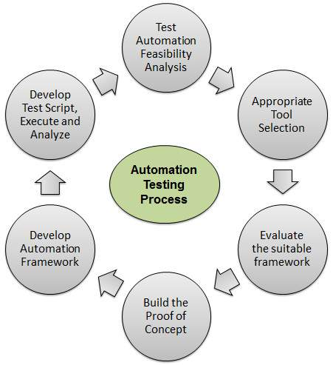
5.1 Manual testing & Automation Testing
5.1.2 Process of Automation Testing

Slide 9
5.1 Manual testing & Automation Testing
5.1.2 Process of Automation Testing
What to Automate?:
Backups, Customer, service, Social media content, Repetitive tasks, Time-sensitive tasks, Cost reduction, Test automation
When to Automate?:
Large & Critical Projects, Repeatative areas,Requirements not changing frequntly,Stable s/w.
Software Testing tools:
Selenium,Test Complete,SilkTest,Win Runner,Load Runner

Slide 10
5.1 Manual Testing & Automation Testing
5.1.2 Process of Automation Testing
Advantages of Automation Testing:
Reliable
Repeatable
Programmable
Comprehensive
Reusable
Better Quality S/w
Fast
Cost Reduction

Slide 11
5.1 Manual Testing & Automation Testing
5.1.2 Process of Automation Testing
Disadvantages of Automation Testing:
Proficiency is required to write the automation test script
Debugging the test script is major issue.
Test Maintenance is costly

Slide 12
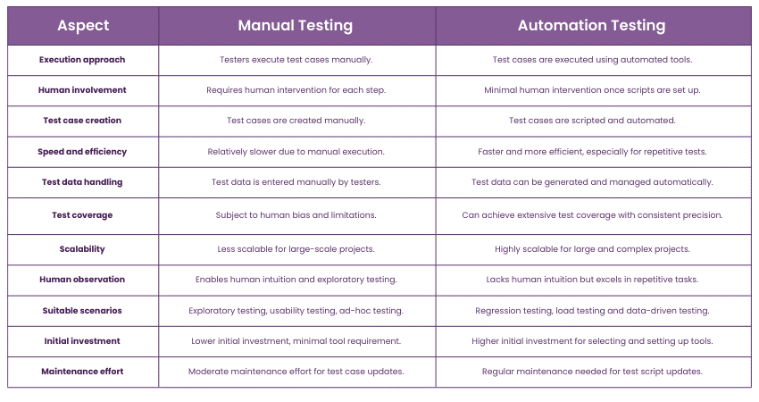
5.1 Manual Testing & Automation Testing
5.1.2 Comparison between Manual Testing & Automation Testing

Slide 13
5.1 Manual Testing & Automation Testing
5.1.3 Need of Automated Testing Tools:
Quality Assurance
Error or Bug-free Software
Automation testing is more efficient for detecting bugs in comparison to manual testing.
No Human Intervention
Some manual tests are impossible or difficult to run manually, while skipping them will result in skewered results of testing or an incomplete testing project.
The test suite contains many repetitive tests, such as regression testing, which not only take too much time, but also lower the job satisfaction of manual QAs who are stuck doing monotonous tasks.

Slide 14
5.1 Manual Testing & Automation Testing
5.1.3 Need of Automated Testing Tools:
Principal Attributes of tools & Automation:
Speed
Efficiency
Accuracy
Resource Reduction
Simulation & Emulation
Relentlessness

Slide 15
5.2 Advantages & Disadvantages of using Tools
Advantages of using Tools:
Fast
Repeatable
Reusable
Reliable
Comprehensive
Programmable
Consistent

Slide 16
5.2 Advantages & Disadvantages of using Tools
Disadvantages of using Tools:
Unrealistic expectations from tool.
People often make mistakes by underestimating the time, cost & effort for the initial introduction of a tool.
People frequently miscalculate the time & effort needed to achieve significant & continuing benefits from the tool
Mostly people underestimate the effort required to maintain the test assets generated by the tool
People depend on the tool a lot

Slide 17
5.3 Selecting a Tool
Reasons for selecting a Tool:
Free tools are not well supported
Developing in-house tool takes a time
Test tools sold by vendors are expensive
Test tools require strong training
Test tools generally do not meet all the requirements for automation
Not all test tools run on all platforms
We have to select the tool which is appropriate, affordable

Slide 18
5.3 Selecting a Test Tool
Criteria for selecting a Test Tool:
Meeting Requirement
Technology Expectations
Training or Skills
Management Aspects
5.4 When to use Automated Test Tool:
Complexity of test cases
Test case Dependency
Number of iterations of Testing

Slide 19
5.5 Testing using Automated Tools
Testing is important to determine quality.
Aim of testing is verification, error detection, validation
Test tools uses test cases to create manage and execute tests for particular environment
3 Important Aspects of Testing:
Partial Automation
Framework Approach in Automation
Synchronization

Slide 20
5.5 Testing using Automated Tools
3 Important Aspects of Testing:
Partial Automation:
Automating parts of testing but not all of the software
In Software Testing many processes do not need complete automation, in that case partial testing is used without involvement of too much cost & time
PA is used in cases where full automation test is difficult to apply

Slide 21
5.5 Testing using Automated Tools
3 Important Aspects of Testing:
2. Framework Approach in Automation
A Test Automation framework is an integrated system that sets the rules of automation of specific product.
This system integrates the function libraries, test data sources, object details, reusable modules etc.
If there is any change in test case then only test case file needs to be updated ,driver script & start up script remain same.

Slide 22
5.5 Testing using Automated Tools
3 Important Aspects of Testing:
2. Framework Approach in Automation
Various Types of frameworks:
Data Driven Testing
Modularity Driven Testing
Keyword Driven Testing
Model Based Testing
Hybrid Testing

Slide 23
5.5 Testing using Automated Tools
3 Important Aspects of Testing:
3. Synchronization
Synchronization ensures that all the tests happen on all of the system in correct order
Synchronization of test cases either done automatically ,at system determined points or user can determine the points
Synchronization is cooperative. E.g. If system 1 expects to synchronize with system 2 then system 2 must also synchronize with system 1
Various Types of Synchronization:
Automatic Synchronization
User defined Synchronization

Slide 24
5.5 Testing using Automated Tools
3 Important Aspects of Testing:
3. Synchronization
Various Types of Synchronization:
1. Automatic Synchronization:
In Automatic Synchronization, at run time, system will determine when it shall take place as per defined criteria.
This will be at points in test process like:
When a group of tests starts
When a single test starts
At the end of each test
At the end of each group test
2. User defined Synchronization:
If the user choose to define Synchronization themselves they must define the individual sync events during execution

Slide 25
5.6 Metrics & Measurement
What is Metric?
It is “standards of measurement”.
It is defined by Paul Goodman
A software metric is a measure of some property of a piece of software or its specification.
It is used to evaluate an attribute,progress,quality,health of s/w testing a
It is used to evaluate past performance,current status,future trends.

Slide 26
5.6 Metrics & Measurement
Test Metric Process:
Measurement Based Techniques
Applied to
To Supply
Engineering Management Information
Process, Product, Services
To Improve

Slide 27
5.6 Metrics & Measurement
Test Metric Example:
1.How many defects are existed within the module?
2.How many test cases are executed per person?
3.What is the test coverage%?
Need of software Measurement:
Software Metrics
Understanding
Software Engineering Processes
Control
Improvement

Slide 28
5.6 Metrics & Measurement
Steps involved in Collecting & analyzing Test Metric:
Identify what to measure
Transform measurements to metrics
Refine measurements & Metrics
Decide operational requirements
Take actions & follow up
Perform metrics analysis

Slide 29
5.6 Metrics & Measurement
5.6.1 Metrics in Testing?
It is used to measure:
Progress of testing
Product Quality
Tracking test progress
Checks how much testing completed
Calculate days needed for testing
Calculate no. of test cases executed per person
Predicts no. of defects found
Estimates no. of days needed to fix defects

Slide 30
5.6 Metrics & Measurement
5.6.2 Types of Metrics in Testing
Metrics can be classified based on:
1.What they measure?
2.Which area they focus on?
Types of Metrics
Product Metrics
Process Metrics
Project Metrics
Progress Metrics
Productivity Metrics

Slide 31
5.6 Metrics & Measurement
5.6.2 Types of Metrics in Testing
1. Product Metrics: Those metrics which has more meaning in the perspective of the software product being developed.
e.g. Quality of s/w.
Types of Product Metrics:
Project Metric :Related to project planning & execution
Progress Metrics : Tracks how the different activities of the project are processing.
Productivity Metrics : Related to various productivity numbers that can be used for planning & tracking testing activities

Slide 32
5.6 Metrics & Measurement
5.6.2 Types of Metrics in Testing
5.6.2.1 Project Metric :
Mainly Related to individual project/product.
Used to measure ,monitor & control project.
It minimizes development time
Asses product quality
It is used in estimation technique.
Project scope translated to size,size gets translated to effort estimate using data & productivity available,this initial effort is called Base Lined Effort.
If the scope of project changes then effort estimates are re-evaluated then that effort is called Revised Effort

Slide 33
5.6 Metrics & Measurement
5.6.2 Types of Metrics in Testing
5.6.2.1 Project Metric :
If Planned effort & actual effort are same but if schedule is not met then project can not be considered as successful.
The basic measurements for project metric are:
The different activities , initial base lined effort & schedule: This is i/p at the beginning of a project
The actual effort & time taken for each activity.
The revised estimate of effort & Schedule

Slide 34
5.6 Metrics & Measurement
5.6.2 Types of Metrics in Testing
5.6.2.1 Project Metrics can be categorized as :
1. Effort Variance(Planned vs Actual)
EV=[(Actual Person Hours-Estimated Person Hours )/ Estimated Person Hours ]x 100.
2. Schedule Variance(Planned vs Actual)
SV=[(Actual Number of Days –Planned Number of Days )/ Planned Number of Days]x 100.
3.Effort Distribution Across Phases:

Slide 35
5.6 Metrics & Measurement
5.6.2 Types of Metrics in Testing
5.6.2.1 Project Metrics can be categorized as :
3.Effort Distribution Across Phases:
Variance calculation helps in finding whether commitments are met or not
Spending very little effort on requirements may lead to frequent changes
Spending less effort on testing may lead to defects

Slide 36
5.6 Metrics & Measurement
5.6.2 Types of Metrics in Testing
5.6.2.1 Project Metrics can be categorized as :
3.Effort Distribution Across Phases:

Slide 37
5.6 Metrics & Measurement
5.6.2 Types of Metrics in Testing
5.6.2.1 Project Metrics can be categorized as :
3.Effort Distribution Across Phases:
Cost Variance:(Actual Cost vs Estimated Cost)
CV=[(Actual Cost-Estimated Cost )/ Estimated Cost]x 100.
Size Variance:(Actual size vs Estimated size)
SV=[(Actual Size-Estimated Size )/ Estimated Size]x 100.

Slide 38
5.6 Metrics & Measurement
5.6.2 Types of Metrics in Testing
5.6.2.2 Progress Metrics
Automation progress is no. of tests cases that are automated as a percentage of all test cases
How many defects already found & how many defects may get discovered are two factors used to determine quality & its assessment.
Project is tracked by two ways:
1. How project is doing with respect to efforts & schedule.
2. How project is meeting quality requirements.

Slide 39
5.6 Metrics & Measurement
5.6.2 Types of Metrics in Testing
5.6.2.2 Progress Metrics
Progress Metrics
Test Defect Metrics
Development Defect Metrics
1.Defect find Rate
2.Defect Fix Rate
3.Outstanding Defect Rate
4.Priority Outstanding Rate
5.Defect Trend
6.Defect Classification Trend
7.Weighted defects Trend
8.Defect cause Distribution
1.Component wise Defect Distribution
2.Defect Density & Defect Removal Rate
3.Age Analysis of Outstanding Defects
4.Introduced & Reopened defect Trend

Slide 40
5.6 Metrics & Measurement
5.6.2 Types of Metrics in Testing
5.6.2.2 Progress Metrics:
1.Test Defect Metric:
This helps us to understand how defects are found & how it is used to increase product quality.
Organizations classify defects by assigning defect priority & severity.
Priority can be changed ,
severity is absolute &
does not change

Slide 41
5.6 Metrics & Measurement
5.6.2 Types of Metrics in Testing
5.6.2.3 Productivity Metrics:
Productivity Metrics combine several measurements & parameters with efforts spent on the product.
They help in :
finding capability of team.
Estimating for new release
Estimating no. of defects
Estimating release date & quality
Estimating cost involved in release

Slide 42
5.6 Metrics & Measurement
5.6.2 Types of Metrics in Testing
5.6.2.3 Productivity Metrics:
They help in finding:
1. Defects per 100 hours of Testing:
Defects per 100 hours of Testing=(Total defects found in the product for a period/Total hours spent to get those defects)*100
2. Test cases executed per 100 hours of Testing:
Test cases executed per 100 hours of Testing=(Total Test cases executed for a period/Total hours spent in test case execution)*100

Slide 43
5.6 Metrics & Measurement
5.6.2 Types of Metrics in Testing
5.6.2.3 Productivity Metrics:
They help in finding:
3. Test cases developed per 100 hours of Testing:
Test cases developed per 100 hours of Testing=(Total Test cases developed for a period/Total hours spent in test case development)*100
4. Defects per 100 Test cases:
Defects per 100 Test Cases=(Total defects found for a period/Total Test cases executed for the same period)*100

Slide 44
5.6 Metrics & Measurement
5.6.2 Types of Metrics in Testing
5.6.2.3 Productivity Metrics:
They help in finding:
5. Defects per 100 failed Test cases:
Defects per 100 Failed Test Cases=(Total defects found for a period/Total Test cases Failed due to those defects)*100
6. Test Phase Effectiveness: A testing performed by various teams with the objective of finding defects in early at various phase
7.Closed Defect Distribution:
Ensure that most of the defects are fixed

Slide 45
5.6 Metrics & Measurement
5.6.2 Types of Metrics in Testing
5.6.2.4 Process Metrics:
Used in the process of test preparation & test execution phase.
The following are generated during test preparation :
1.Test Case Preparation Productivity:
Test Case Preparation Productivity=
No of test cases/Efforts spent for test case Preparation.
2.Test Design Coverage:
Test Design Coverage =
(Total No of requirements mapped to test cases/ Total No of requirements )*100

Slide 46
5.6 Metrics & Measurement
5.6.2 Types of Metrics in Testing
5.6.2.4 Process Metrics:
3.Test Execution Productivity:
Test Execution Productivity=
No of test cases executed/Efforts spent for test case execution.
4.Test Execution Coverage:
Test Execution Coverage =
(Total No of test cases executed/ Total No of test cases planned to execute)*100

Slide 47
5.6 Metrics & Measurement
5.6.2 Types of Metrics in Testing
5.6.2.4 Process Metrics:
5.Test cases passed:
Test cases passed=
(Total No of test cases passed/ Total No of test cases executed)*100
6.Test cases Failed:
Test cases Failed=
(Total No of test cases Failed/ Total No of test cases executed)*100
7.Test cases Blocked:
Test cases Blocked=
(Total No of test cases Blocked / Total No of test cases executed)*100

Slide 48
5.6 Metrics & Measurement
5.6.2 Types of Metrics in Testing
5.6.2.5 object Oriented Metrics in Testing:
It is used to measure the design structure ,data structure,combination of function and data as an integrated object.
1. Methods
Cyclomatic Complexity
Size
2. Class
3. Inheritance
4.Tree Structure

Slide 49
Thank You

