Slide 1
Unit VI: File-System Management
File Concept
Access Methods
File allocation methods
Disk and Directory Structure
Disk Organization

Slide 2
File Concept
Contiguous logical address space
Types:
Data
numeric
character
binary
Program
Contents defined by file’s creator
Many types
Consider text file, source file, executable file

Slide 3
File Attributes
Name – only information kept in human-readable form
Identifier – unique tag (number) identifies file within file system
Type – needed for systems that support different types
Location – pointer to file location on device
Size – current file size
Protection – controls who can do reading, writing, executing
Time, date, and user identification – data for protection, security, and usage monitoring
Information about files are kept in the directory structure, which is maintained on the disk
Information kept in the directory structure

Slide 4
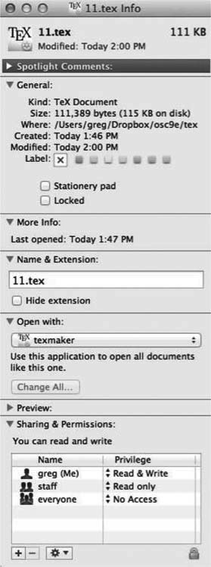
File info Window on Mac OS X

Slide 5
File Operations
File is an abstract data type
Create
Write – at write pointer location
Read – at read pointer location
Reposition within file - seek
Delete
Truncate
Open(F_{i}) – search the directory structure on disk for entry F_{i}, and move the content of entry to memory
Close (F_{i}) – move the content of entry F_{i} in memory to directory structure on disk

Slide 6
Open Files
Several pieces of data are needed to manage open files:
Open-file table: tracks open files
File pointer: pointer to last read/write location, per process that has the file open
File-open count: counter of number of times a file is open – to allow removal of data from open-file table when last processes closes it
Disk location of the file: cache of data access information
Access rights: per-process access mode information

Slide 7
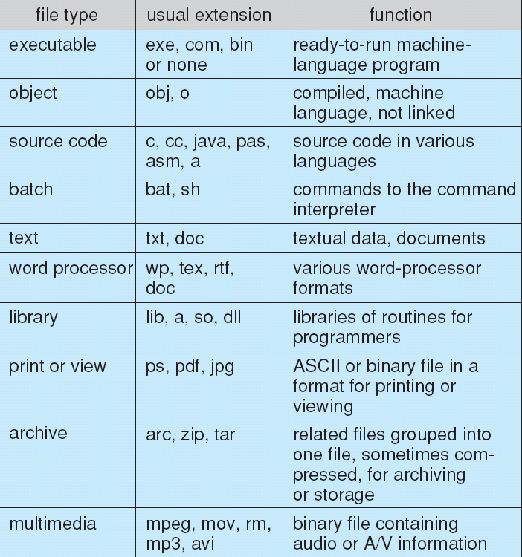
File Types – Name, Extension

Slide 8
File Structure
File - sequence of words, bytes
Simple record structure
Lines
Fixed length
Variable length
Complex Structures
Formatted document
Relocatable load file

Slide 9
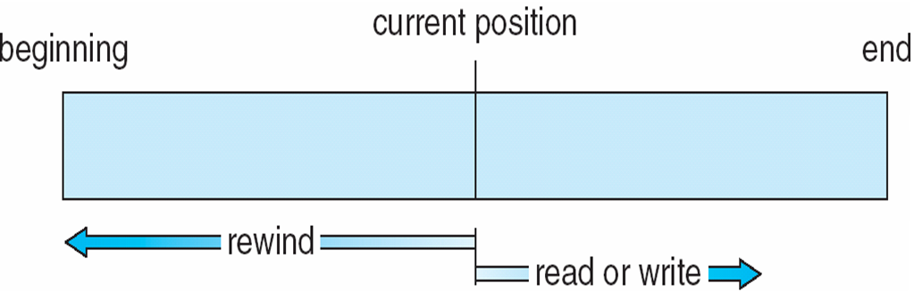
Access Methods Sequential-access File

Slide 10
Access Methods
Sequential Access
read next
write next
reset
Direct Access – file is fixed length logical records
read n
write n
position to n
read next
write next
rewrite n
n = relative block number

Slide 11
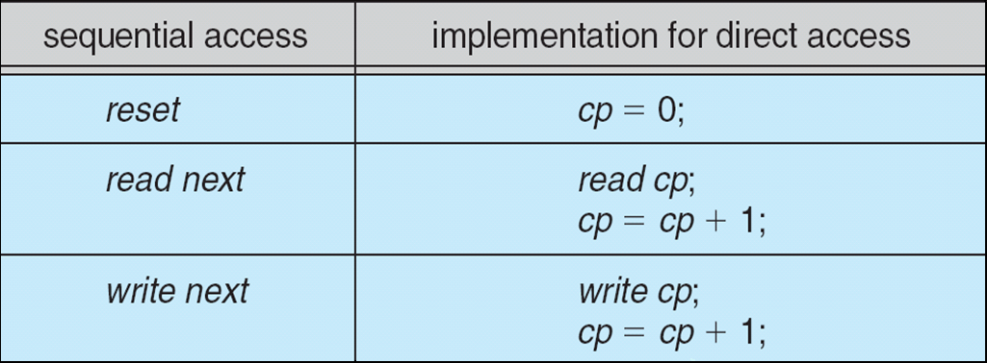
Simulation of Sequential Access on Direct-access File

Slide 12
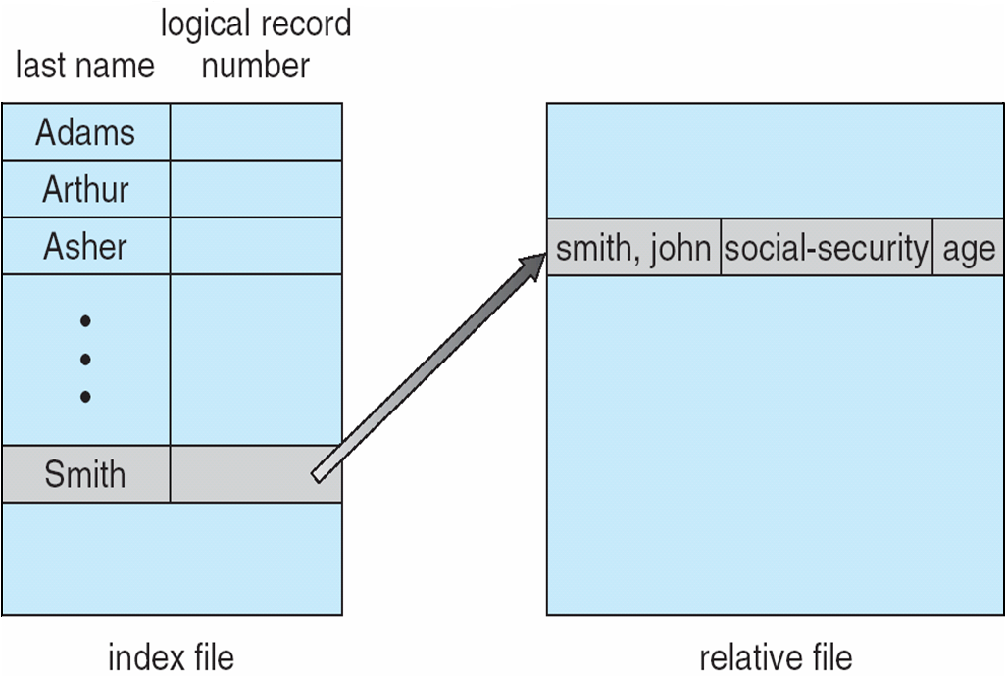
Example of Index and Relative Files Access

Slide 13
Directory Structure
A collection of nodes containing information about all files
Directory
Files
F 1
F 2
F 3
F 4
F n
Both the directory structure and the files reside on disk

Slide 14
Directory Organization
The directory is organized logically to obtain
Efficiency – locating a file quickly
Naming – convenient to users
Two users can have same name for different files
The same file can have several different names
Grouping – logical grouping of files by properties, (e.g., all Java programs, all games, …)

Slide 15
Operations Performed on Directory
Search for a file
Create a file
Delete a file
List a directory
Rename a file
Traverse the file system

Slide 16
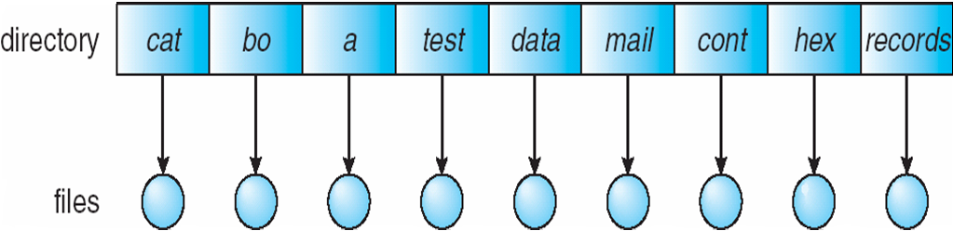
Single-Level Directory
A single directory for all users
Naming problem
Grouping problem

Slide 17
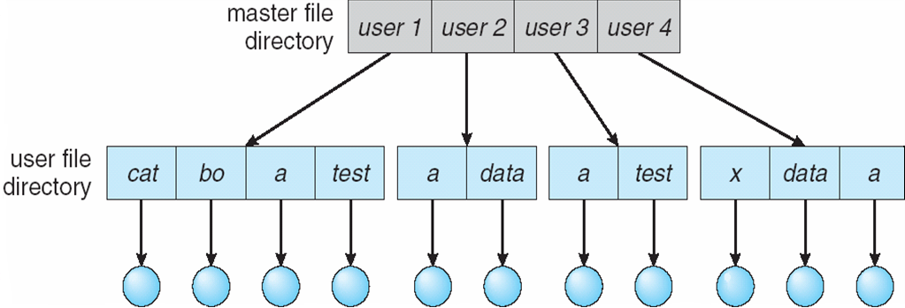
Two-Level Directory
Separate directory for each user
Path name
Can have the same file name for different user
Efficient searching
No grouping capability

Slide 18
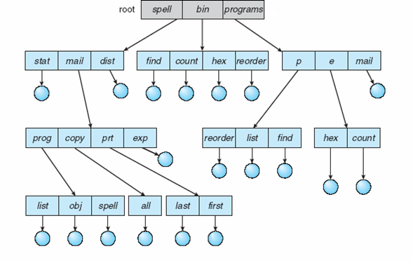
Tree-Structured Directories

Slide 19
Tree-Structured Directories (Cont.)
Efficient searching
Grouping Capability
Current directory (working directory)
cd /spell/mail/prog

Slide 20
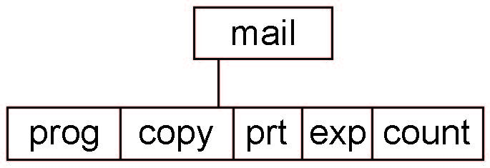
Tree-Structured Directories (Cont)
Absolute or relative path name
Creating a new file is done in current directory
Delete a file
rm <file-name>
Creating a new subdirectory is done in current directory
mkdir <dir-name>
Example: if in current directory /mail
mkdir count
Deleting “mail” ⇒ deleting the entire subtree rooted by “mail”

Slide 21
File Allocation Methods - Contiguous
An allocation method refers to how disk blocks are allocated for files:
Contiguous allocation – each file occupies set of contiguous blocks
Best performance in most cases
Simple – only starting location (block #) and length (number of blocks) are required
Problems include finding space for file, knowing file size, external fragmentation, need for compaction off-line (downtime) or on-line

Slide 22
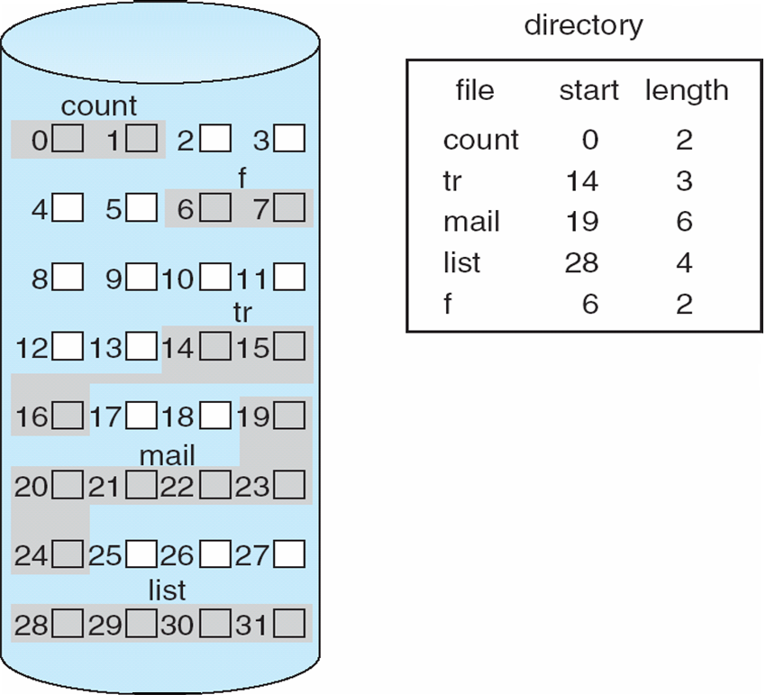
Contiguous Allocation

Slide 23
Allocation Methods - Linked
Linked allocation – each file a linked list of blocks
File ends at nil pointer
No external fragmentation
Each block contains pointer to next block
No compaction, external fragmentation
Free space management system called when new block needed
Improve efficiency by clustering blocks into groups but increases internal fragmentation
Reliability can be a problem
Locating a block can take many I/Os and disk seeks

Slide 24
Allocation Methods – Linked (Cont.)
FAT (File Allocation Table) variation
Beginning of volume has table, indexed by block number
Much like a linked list, but faster on disk and cacheable
New block allocation simple

Slide 25
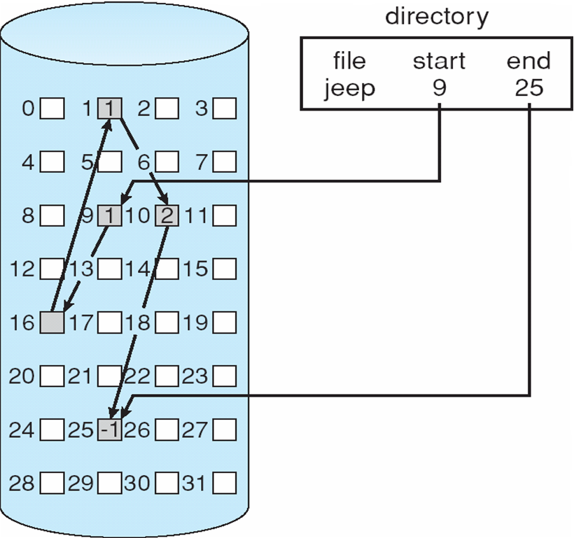
Linked Allocation

Slide 26
Allocation Methods - Indexed
Indexed allocation
Each file has its own index block(s) of pointers to its data blocks
Logical view

Slide 27
Indexed Allocation (Cont.)
Need index table
Random access
Dynamic access without external fragmentation, but have overhead of index block

Slide 28
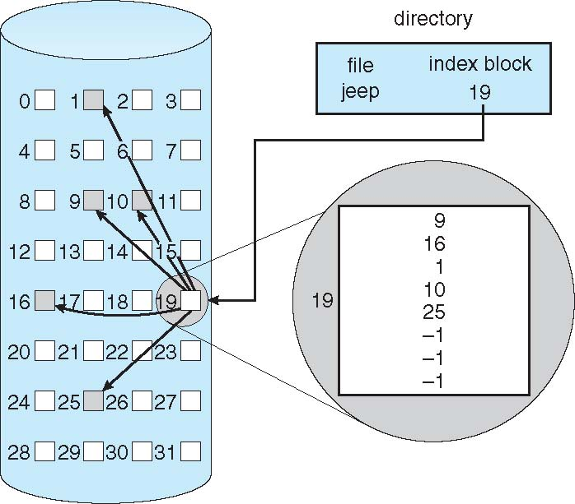
Example of Indexed Allocation

Slide 29
Disk Structure
Disk can be subdivided into partitions
Disks or partitions can be RAID protected against failure
Disk or partition can be used raw – without a file system, or formatted with a file system
Entity containing file system known as a volume
Each volume containing file system also tracks that file system’s info in device directory or volume table of contents
As well as general-purpose file systems there are many special-purpose file systems, frequently all within the same operating system or computer

Slide 30
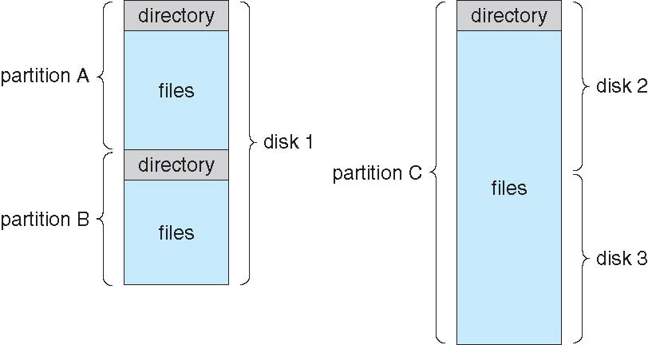
A Typical File-system Organization

Slide 31
Partitions and Mounting
Partition can be a volume containing a file system or raw – just a sequence of blocks with no file system
Boot block can point to boot volume or boot loader set of blocks that contain enough code to know how to load the kernel from the file system.
Or a boot management program for multi-os booting
Root partition contains the OS, other partitions can hold other Oses, other file systems, or be raw
Mounted at boot time
Other partitions can mount automatically or manually
At mount time, file system consistency checked
Is all metadata correct?
If not, fix it, try again
If yes, add to mount table, allow access

Slide 32
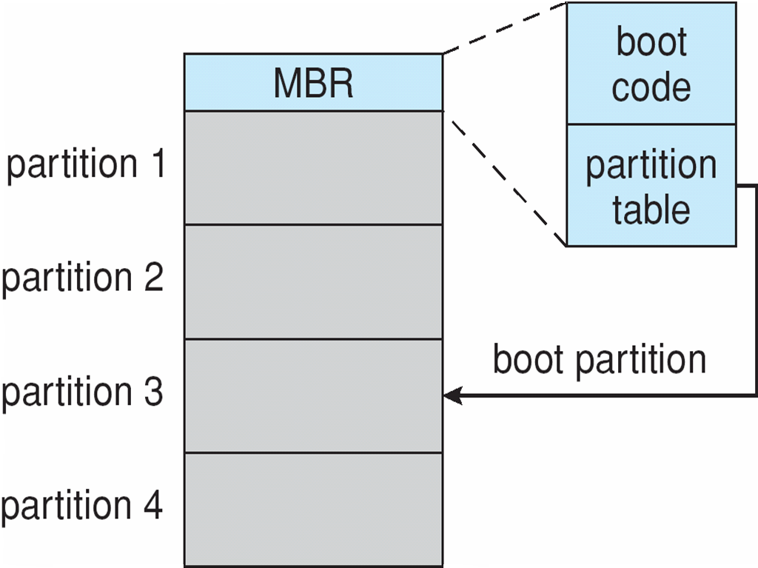
Booting from a Disk in Windows

Slide 33
RAID Structure
RAID – redundant array of inexpensive/independent disks
multiple disk drives provides reliability via redundancy
It’s a technology that enables greater levels of performance, reliability and/or large volumes when dealing with data.
How?? By concurrent use of two or more ‘hard disk drives’.
How Exactly?? Mirroring, Stripping (of data) and Error correction techniques combined with multiple disk arrays give you the reliability and performance.

Slide 34
RAID (Cont.)
Disk striping uses a group of disks as one storage unit
RAID is arranged into six different levels
RAID schemes improve performance and improve the reliability of the storage system by storing redundant data
Mirroring or shadowing (RAID 1) keeps duplicate of each disk
Striped mirrors (RAID 1+0) or mirrored stripes (RAID 0+1) provides high performance and high reliability
Block interleaved parity (RAID 4, 5, 6) uses much less redundancy
RAID within a storage array can still fail if the array fails, so automatic replication of the data between arrays is common
Frequently, a small number of hot-spare disks are left unallocated, automatically replacing a failed disk and having data rebuilt onto them

Slide 35
RAID Levels

Slide 36
RAID (0 + 1) and (1 + 0)

Slide 37
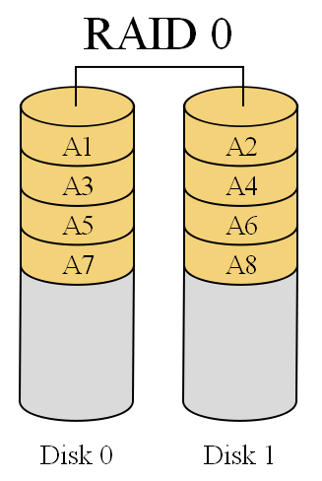
RAID 0- striping
It splits data among two or more disks.
Provides good performance.
Lack of data redundancy means there is no fail over support with this configuration.
In the diagram to the right, the odd blocks are written to disk 0 and the even blocks to disk 1 such that A1, A2, A3, A4, … would be the order of blocks read if read sequentially from the beginning.
Used in read only NFS systems and gaming systems.

Slide 38
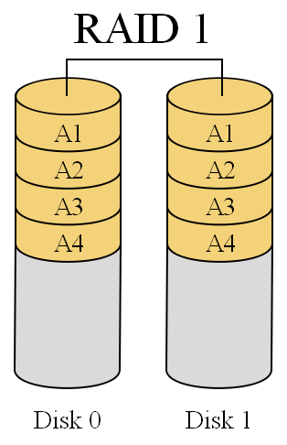
RAID 1- mirroring
RAID1 is ‘data mirroring’.
Two copies of the data are held on two physical disks, and the data is always identical.
Twice as many disks are required to store the same data when compared to RAID 0.
Array continues to operate so long as at least one drive is functioning.

Slide 39
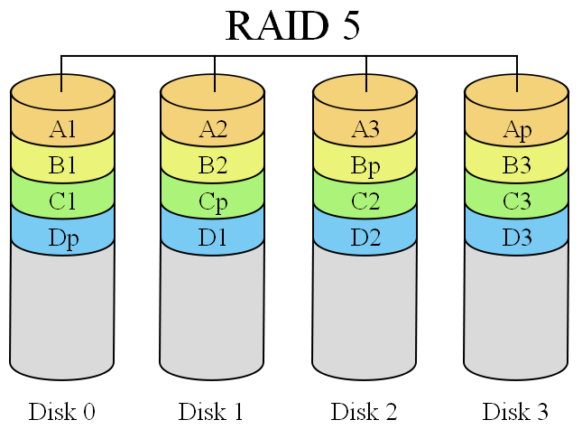
RAID 5- striping with parity
RAID 5 is an ideal combination of good performance, good fault tolerance and high capacity and storage efficiency.
An arrangement of parity and CRC to help rebuilding drive data in case of disk failures.
“Distributed Parity” is the key word here.

Slide 40
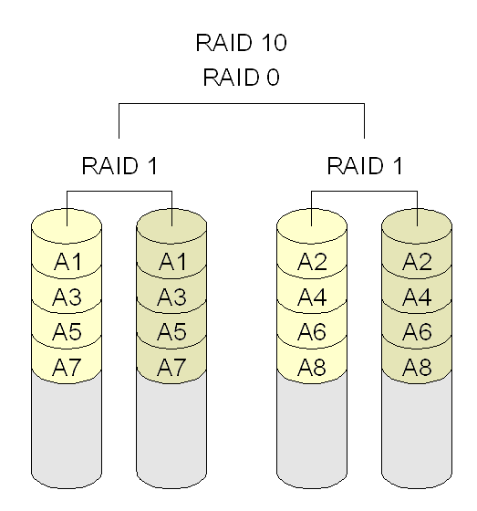
RAID 10- combining mirroring & striping
Combines RAID 1 and RAID 0.
Which means having the pleasure of both - good performance and good failover handling.
Also called ‘Nested RAID’.

Slide 41
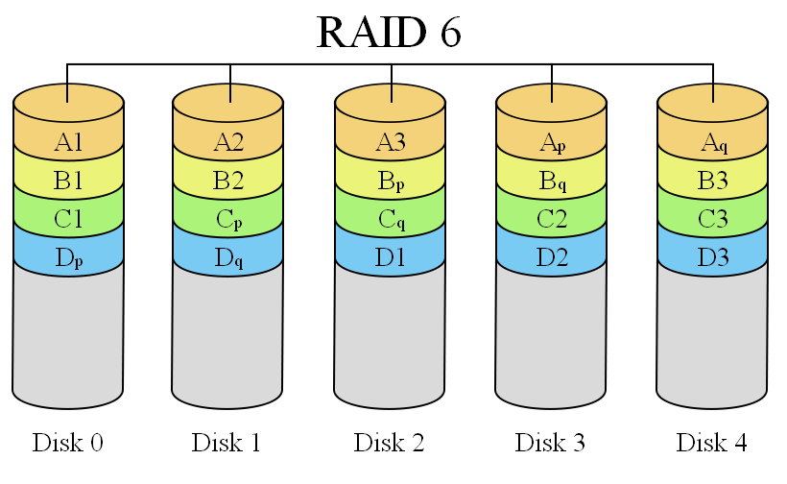
RAID 6- striping with double parity
It is seen as the best way to guarantee data integrity as it uses double parity.
Lesser MTBF compared to RAID5.
It has a drawback though of longer write time.

