Slide 1
Ch no 6 file i/o handling and exceptional handling
Marks-12

Slide 2
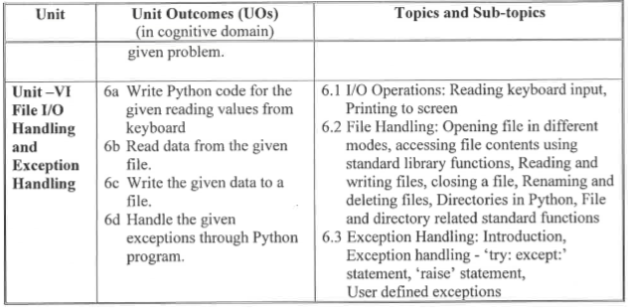

Slide 3
Course outcome
Handle Exception

Slide 4
What is a file?
File is a named location on disk to store related information. It is used to permanently store data in a non-volatile memory (e.g. hard disk).
Since, random access memory (RAM) is volatile which loses its data when computer is turned off, we use files for future use of the data.
When we want to read from or write to a file we need to open it first. When we are done, it needs to be closed, so that resources that are tied with the file are freed.

Slide 5
Hence, in Python, a file operation takes place in the following order.
Open a file
Read or write (perform operation)
Close the file

Slide 6
List file operations in Python. [2m]
Opening file (using open() function)
Reading file (using read() function)
Writing file (using write() function)
Copy files
Delete files (using remove() function)
Closing file (Using close() function)

Slide 7
Reading Keyboard Input
Python provides two built-in functions to read a line of text from standard input, which by default comes from the keyboard. These functions are −
raw_input
input

Slide 8
The raw_input Function
The raw_input([prompt]) function reads one line from standard input and returns it as a string (removing the trailing newline).
This raw_input() syntax was used in Python v2.x:
Example
str = raw_input("Enter your input: ")
print ("Received input is : ", str)
This prompts you to enter any string and it would display same string on the screen. When I typed "Hello Python!", its output is like this −
Enter your input: Hello Python
Received input is : Hello Python

Slide 9
The input Function
Input() is used to read input values.
This input() reads any input value in the form of string and returns
Example
print("enter name")
name=input()
To read any data types values except string,int() function is used along with input() function.That will convert the string type value into integer .
print("enter age")
age=int(input())

Slide 10
Input() function also allow to write a prompt.This prompt message will be displayed for taking input.
Example
name=input("enter name")

Slide 11
example
print("enter name")
name=input()
print ("Received input is : ", name)
print("enter age")
age=int(input())
print ("Received input is : ", age)
per=float(input("enter percentage"))
print ("Received input is : ", per)

Slide 12
Printing to screen
Using print function we can print the information to the screen.
Syntax
print( )
Exaple
print("welcome")
print(10)
print(10,20,30)
print(10,20,30,sep="/")
print("Hello",end="###")
Output
welcome
10
10 20 30
10/20/30
Hello###

Slide 13
Opening file in a different modes
Python has a built-in function open() to open a file.
This function returns a file object, also called a handle, as it is used to read or modify the file accordingly.
This function requires one mandatory argument ,which is file name and another argument is file mode which is optional because it has default value “r” to read.
Syntax
file_object=open(“file name”,”file mode”)

Slide 14
Example
f=open("E:/b.txt","w")
The default is reading in text mode. In this mode, we get strings when reading from the file.
On the other hand, binary mode returns bytes and this is the mode to be used when dealing with non-text files like image or exe files.

Slide 15
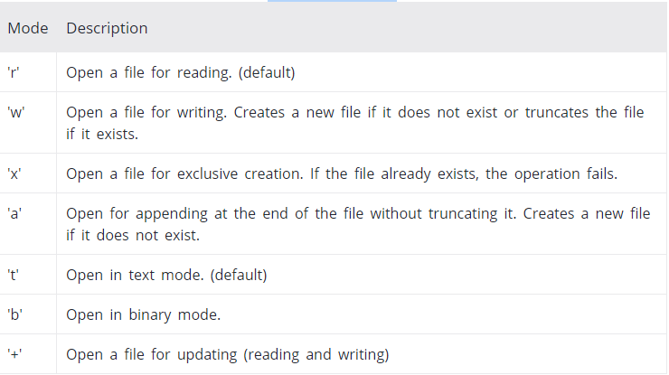
Python File Modes

Slide 16
List different modes of opening file in Python [2m]
r: open an existing file for a read operation.
• w: open an existing file for a write operation. If the file already contains some data then it will be overridden.
• a: open an existing file for append operation. It won’t override existing data.
• r+: To read and write data into the file. The previous data in the file will be overridden.
• w+: To write and read data. It will override existing data.
• a+: To append and read data from the file. It won’t override existing data.

Slide 17
Accessing file contents using standard library function
List of Standard Library Function are as follow
1)read() :-To read and return complete content of file
2)mode :-Return the mode of the file which is opened
3)name :-Contain the name of the file
4)isatty() :-used to check wheather the specified file descriptor is open and connected to a teletype or not
5)closed :-contains wheather file closed or not
6)close():-closes file and release the file pointer from it

Slide 18
7)readline():-Read a single line from a file.
8)readlines():-Read all the lines from a file.

Slide 19
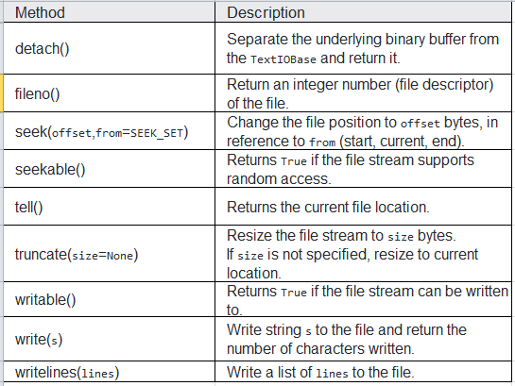

Slide 20
f=open("E:/b.txt","r")
print("file is open successfully")
#print("content of file is",f.read())
print("content of file is",f.readlines())
print("mode of file =",f.mode)
print("Name of file is=",f.name)
print("is file is connected",f.isatty())
print("file is closed=",f.closed)
f.close()
print("file is closed=",f.closed)

Slide 21
How to Create a New File in python
To create a new file in Python, use the open() method, with one of the following parameters:
"x" - Create - will create a file, returns an error if the file exist
"a" - Append - will create a file if the specified file does not exist
"w" - Write - will create a file if the specified file does not exist

Slide 22
f=open("E:/MyFile1.txt","x")

Slide 23
How to close a file Using Python?
When we are done with operations to the file, we need to properly close the file.
Closing a file will free up the resources that were tied with the file and is done using Python close() method.
Python has a garbage collector to clean up unreferenced objects but, we must not rely on it to close the file.
f = open("test.txt",encoding = 'utf-8')
# perform file operations
f.close()

Slide 24
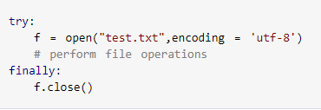
This method is not entirely safe. If an exception occurs when we are performing some operation with the file, the code exits without closing the file.
A safer way is to use a try...finally block.

Slide 25

Even if an exception is raised, causing program flow to stop.
The best way to do this is using the with statement. This ensures that the file is closed when the block inside with is exited.
We don't need to explicitly call the close() method. It is done internally.

Slide 26
How to write to File Using Python?
In order to write into a file in Python, we need to open it in write 'w', append 'a' or exclusive creation 'x' mode.
We need to be careful with the 'w' mode as it will overwrite into the file if it already exists. All previous data are erased.
Writing a string or sequence of bytes (for binary files) is done using write() method. This method returns the number of characters written to the file.

Slide 27
Write()
write() writes a string str to the file.
The write() method writes a specified text to the file.
There is no return value. Due to buffering, the string may not actually show up in the file until the flush() or close() method is called.
Syntax
fileObject.write( str )
Where the specified text will be inserted depends on the file mode and stream position.
"a": The text will be inserted at the current file stream position, default at the end of the file.
"w": The file will be emptied before the text will be inserted at the current file stream position, default 0.

Slide 28
f = open("E:\myfile.txt","a")
f.write("my first file and second file\n")
f.close()
with open("E:\myfile.txt",'w') as f:
f.write("my first program file\n")
f.write("This file\n\n")
f.write("contains three lines\n")
f.close()

Slide 29
writelines()
writelines() writes a sequence of strings to the file. The sequence can be any iterable object producing strings, typically a list of strings. There is no return value.
Syntax
fileObject.writelines( sequence )
Where the texts will be inserted depends on the file mode and stream position.
"a": The texts will be inserted at the current file stream position, default at the end of the file.
"w": The file will be emptied before the texts will be inserted at the current file stream position, default 0.

Slide 30
lines=["Hello world.\n", "Welcome to TutorialsTeacher.\n"]
f=open(“E:\myfile.txt","w")
f.writelines(lines)
f.close()

Slide 31
How to read files in Python?
To read a file in Python, we must open the file in reading mode.
There are various methods available for this purpose. We can use the read(size) method to read in size number of data. If size parameter is not specified, it reads and returns up to the end of the file.
We can change our current file cursor (position) using the seek() method. Similarly, the tell() method returns our current position (in number of bytes).
Syntax of seek()
file.seek(offset)
where offset is Required. A number representing the position to set the current file stream position.
Syntax of tell()
fileObject.tell()

Slide 32
readline()
The readline() method is used to read individual lines of a file.
The readline() function by default reads only one line , in which currently file is pointing
Syntax
fileobject.readline()

Slide 33
readlines()
The readlines() method returns a list of remaining lines of the entire file.
The readlines() function reads all the lines and returns a list in which its each line is as list string elements.
Syntax
fileobject.readlines()

Slide 34
read()
The read() method returns the whole text, but you can also specify how many characters you want to return:
Syntax
Fileobject.read(size)

Slide 35
f = open("E:\myfile.txt",'r')
print(f.read(4))
print("cursor is =",f.tell())
print(f.read())
print("cursor is =",f.seek(8))
print(f.readlines())

Slide 36
We can read a file line-by-line using a for loop. This is both efficient and fast.
Example
f = open("E:\myfile.txt",'r')
for line in f:
print(line)

Slide 37
Renaming and Deleting Files
Python os module provides methods that help you perform file-processing operations, such as renaming and deleting files.
To use this module you need to import it first and then you can call any related functions.

Slide 38
The rename() Method
The rename() method takes two arguments, the current filename and the new filename.
Syntax
os.rename(current_file_name, new_file_name)
Example
import os
os.rename( "E:\myfile.txt", "E:\myfile2.txt" )
print("File is renamed")

Slide 39
Delete a File
To delete a file, you must import the OS module, and run its os.remove() function:
Syntax
os.remove(file_name)
Example
import os
os.remove( "E:\MyFile1.txt" )
print("File is removed")

Slide 40
Check if File exist:
To avoid getting an error, you might want to check if the file exists before you try to delete it:
Example
import os
if os.path.exists("E:\demofile.txt"):
os.remove( "E:\demofile.txt" )
else:
print("File not exists")

Slide 41
Write python program to read contents of abc.txt and write same content to pqr.txt.[4M]

Slide 42
with open('abs.txt','r') as firstfile, open('prq.txt','w') as secondfile:
# read content from first file
for line in firstfile:
# write content to second file
secondfile.write(line)

Slide 43
Write python code to count frequency of each characters in a given file[4M]

Slide 44
import collections
import pprint
file_input = input('File Name: ')
with open(file_input, 'r') as info:
count = collections.Counter(info.read().upper())
value = pprint.pformat(count)
print(value)

Slide 45
Write a program to open a file in write mode and append some content at the end of file[6M]

Slide 46
file1 = open("myfile.txt", "w")
L = ["This is Delhi \n", "This is Paris \n", "This is London"]
file1.writelines(L)
file1.close()
# Append-adds at last
# append mode
file1 = open("myfile.txt", "a")
# writing newline character
file1.write("\n")
file1.write("Today")
# without newline character
file1.write("Tomorrow")

Slide 47
file1 = open("myfile.txt", "r")
print("Output of Readlines after appending")
print(file1.read())
print()
file1.close()
Output:
Output of Readlines after appending
This is Delhi
This is Paris
This is London
TodayTomorrow

Slide 48
Directories in Python

Slide 49
Directories in Python
If there are a large number of files to handle in your Python program, you can arrange your code within different directories to make things more manageable.
A directory or folder is a collection of files and sub directories.
Python has the os module, which provides us with many useful methods to work with directories (and files as well).

Slide 50
Get Current Directory
We can get the present working directory using the getcwd() method.
This method returns the current working directory in the form of a string. We can also use the getcwdb() method to get it as bytes object.
Synatx
os.getcwd()
Example
import os
print(os.getcwd())
print(os.getcwdb())
Output
E:\prg
b'E:\\prg'

Slide 51
Changing Directory
We can change the current working directory using the chdir() method.
The new path that we want to change to must be supplied as a string to this method. We can use both forward slash (/) or the backward slash (\) to separate path elements.
It is safer to use escape sequence when using the backward slash.
Synatx
os.chdir("newdir")
Example
import os
os.chdir('E:\\prg')
print(os.getcwd())

Slide 52
List Directories and Files
All files and sub directories inside a directory can be known using the listdir() method.
This method takes in a path and returns a list of sub directories and files in that path. If no path is specified, it returns from the current working directory.
Synatx
os.listdir(dir name)
Example
import os
print(os.listdir('E:\\'))

Slide 53
Making a New Directory
We can make a new directory using the mkdir() method.
This method takes in the path of the new directory. If the full path is not specified, the new directory is created in the current working directory.
Synatx
os.mkdir("newdir")
Example
import os
os.mkdir('E:\\test6')
print("New Directory created")

Slide 54
Renaming a Directory or a File
The rename() method can rename a directory or a file.
The first argument is the old name and the new name must be supplies as the second argument.
Example’
import os
os.rename('E:\\test6','E:\\new_one')
print("Directory renamed")

Slide 55
Removing Directory or File
The rmdir() method deletes the directory, which is passed as an argument in the method.
Before removing a directory, all the contents in it should be removed.
Synatx
os.rmdir('dirname')

Slide 56
Exception Handling

Slide 57
What is Exception?
An exception is an event, which occurs during the execution of a program that disrupts the normal flow of the program's instructions.
In general, when a Python script encounters a situation that it cannot cope with, it raises an exception.
An exception is a Python object that represents an error.
When a Python script raises an exception, it must either handle the exception immediately otherwise it terminates and quits.

Slide 58
Handling an exception
When an error occurs, or exception as we call it, Python will normally stop and generate an error message.
These exceptions can be handled using :
The try :except Clause
The try with multiple except Clause
The try:except:else Clause
The except Clause with No Exceptions
The except Clause with Multiple Exceptions The try-finally Clause

Slide 59
The try :except Clause
If you have some suspicious code that may raise an exception, you can defend your program by placing the suspicious code in a try: block. After the try: block, include an except: statement, followed by a block of code which handles the problem
Syntax
try:
You do your operations here;
......................
except Exception:
If there is Exception, then execute this block.

Slide 60
Example
try:
print(x)
except:
print("An exception occurred")
Output
An exception occurred

Slide 61
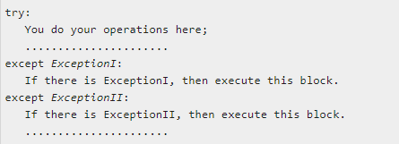
The try with multiple except Clause
A single try statement can have multiple except statements. This is useful when the try block contains statements that may throw different types of exceptions.
Syntax

Slide 62
example
try:
print(x)
except NameError:
print("Variable x is not defined")
except:
print("Something else went wrong")
Output
Variable x is not defined

Slide 63
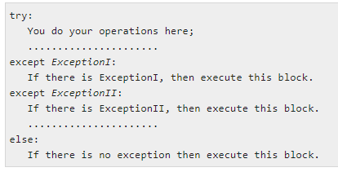
The try:except:else Clause
After the except clause(s), you can include an else-clause. The code in the else-block executes if the code in the try: block does not raise an exception.
The else-block is a good place for code that does not need the try: block's protection.
Syntax

Slide 64
example
try:
print("Hello")
except:
print("Something went wrong")
else:
print("Nothing went wrong")
Output
Hello
Nothing went wrong

Slide 65
The except Clause with No Exceptions
You can also use the except statement with no exceptions defined as follows
This kind of a try-except statement catches all the exceptions that occur. Using this kind of try-except statement is not considered a good programming practice though, because it catches all exceptions but does not make the programmer identify the root cause of the problem that may occur.

Slide 66
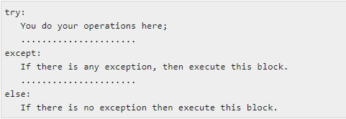
Syntax

Slide 67
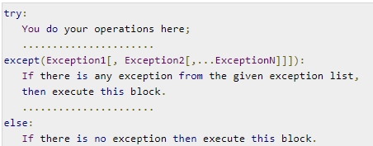
The except Clause with Multiple Exceptions
You can also use the same except statement to handle multiple exceptions as follows
Syntax

Slide 68
try:
a=15/0
print("Division="+a)
print("Value b="+b)
except(ZeroDivisionError,NameError):
print("Exception handled")
Output
Exception handled

Slide 69
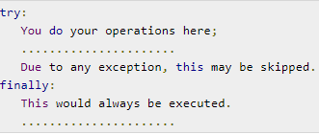
The try-finally Clause
You can use a finally: block along with a try: block. The finally block is a place to put any code that must execute, whether the try-block raised an exception or not.The syntax of the try-finally statement is this

Slide 70
try:
print(x)
except:
print("Something went wrong")
finally:
print("The 'try except' is finished")
Output
Something went wrong
The 'try except' is finished

Slide 71
Raising an Exceptions or Raise Statement
As a Python developer you can choose to throw an exception if a condition occurs.
To throw (or raise) an exception, use the raise keyword.
Syntax
raise [Exception [, args [, traceback]]]
Here, Exception is the type of exception (for example, NameError) and argument is a value for the exception argument. The argument is optional; if not supplied, the exception argument is None.
The final argument, traceback, is also optional (and rarely used in practice), and if present, is the traceback object used for the exception.

Slide 72
Example
x = -1
if x < 0:
raise Exception("Sorry, no numbers below zero")
Output
Sorry, no numbers below zero

Slide 73
User-Defined Exceptions
Python has many built in exceptions which forces our program to raise an error when something goes wrong.
However ,sometimes we may need to create custom exceptions that serve for our purpose.
In python we can define such exceptions by creating a new user defined class that has to be directly or indirectly be derived from class exception.
Syntax
Class MyError(Exception):
pass

Slide 74
Custom exception that throws an exception if length is less 6 characters
class CustExp(Exception):
pass
try:
i=input("enter a text")
if len(i) <6:
raise CustExp()
except CustExp:
print("CustomException: Expected length is 6")

Slide 75
Program to raise an exception if length is less than 6
class custExp(Exception):
pass
try:
i=input("enter the text")
if len(i)<6:
raise custExp()
except custExp as ce:
print("CustomException:Execpt len atleast 6")
Output
enter the textmit
CustomException:Execpt length atleast 6

Slide 76
List file operations in Python. [2m]
List different modes of opening file in Python [2m]
Write a program to open a file in write mode and append some content at the end of file [6m]
Explain Try-except block used in exception handling in python with example [6m]
Explain how try-catch block is used for exception handling in python. [4m]
Write python code to count frequency of each characters in a given file[4m]
Write python program to read contents of abc.txt and write same content to pqr.txt. [4m]

