Slide 1
Unit-II Derived Syntactical Constructs in Java
CO1: Develop Programs Using Object Oriented Methodology in Java Marks: 18

Slide 2
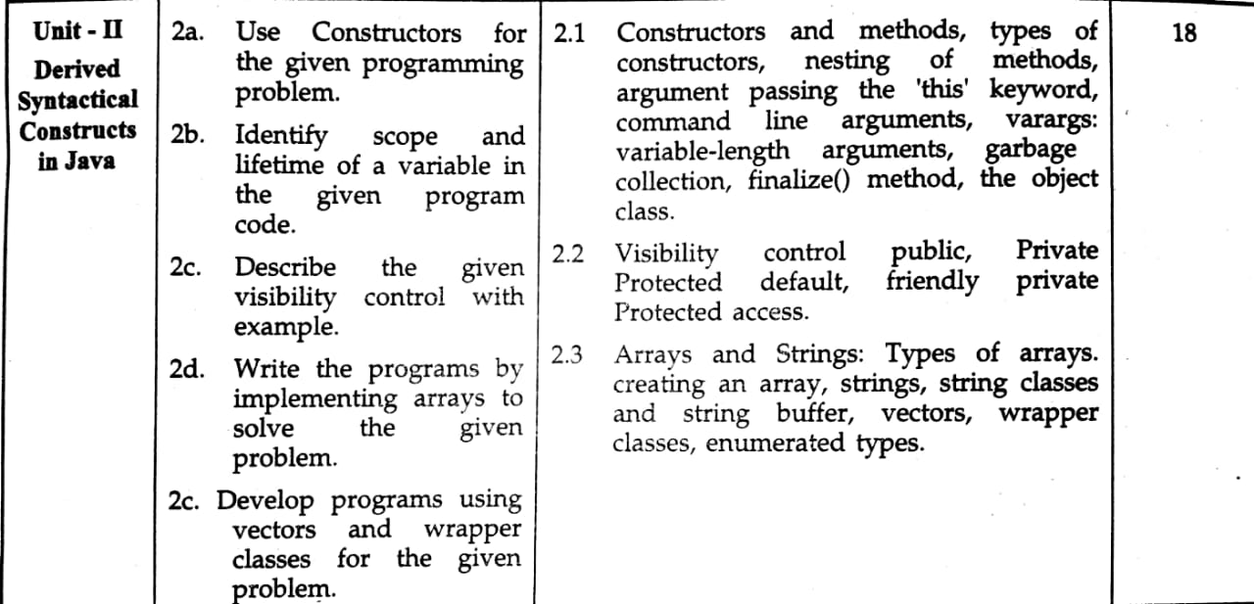

Slide 3
Constructor
A constructor is a special method which initializes an object immediately upon creation.
It has the same name as class name in which it resides and it is syntactically similar to any method.
When a constructor is not defined, java executes a default constructor which initializes all numeric members to zero and other types to null or spaces.

Slide 4
Once defined, constructor is automatically called immediately after the object is created before new operator completes.
Constructors do not have return value, but they don‟t require „void‟ as implicit data type as data type of class constructor is the class type itself.

Slide 5
Types of Constructor
1)Default Constructor.
When constructor doesn't take any argument ,then it is called Default Constructor.
It is also known as No-Arg Constructor.
If program dose not have default constructor, then when object is created ,java creates a default constructor.
Default constructor automatically initialize all the class variable to zero.

Slide 6
Syntax
1) To define a constructor
class-name()
{
//Body
}
2)Invoking constructor
Class-name obj-name=new Class-name();

Slide 7
class condef
{
condef()
{
System.out.println("This is default constructor");
}
public static void main(String args[])
{
condef c=new condef();
}
}

Slide 8


Slide 9
class condef1
{
int length,breadth;
condef1()
{
length=4;
breadth=5;
}
public static void main(String args[])
{
condef1 c=new condef1();
System.out.println("Area:"+(c.length * c.breadth));
}
}

Slide 10


Slide 11
class condef2
{
int length,breadth,a;
condef2()
{
length=4;
breadth=5;
}
int area()
{
return length*breadth;
}
public static void main(String args[])
{
condef2 c=new condef2();
//a=c.area();
//a=c1.area();
System.out.println("Area:"+(c.area()));
}
}

Slide 12


Slide 13
class condef3
{
int length,breadth,a;
condef3()
{
length=4;
breadth=5;
}
void area()
{
a=length*breadth;
System.out.println("Area:"+a);
}
public static void main(String args[])
{
condef3 c=new condef3();
c.area();
}
}

Slide 14


Slide 15
2)Parameterized Constructor
When a constructor takes parameters, then it is called parameterized constructor.
Syntax
1) To define a constructor
class-name(Data type arg1,Data type ar2,……)
{
//Body
}
2)Invoking constructor
Class-name obj-name=new Class-name(arg1,arg2,….);

Slide 16
class conpara
{
int id;
String city;
conpara(int i,String c)
{
id=i;
city=c;
}
void display()
{
System.out.println("Id:"+id);
System.out.println("city:"+city);
}
public static void main(String args[])
{
conpara p1=new conpara(10,"Mumbai");
conpara p2=new conpara(20,"Pune");
p1.display();
p2.display();
}
}

Slide 17
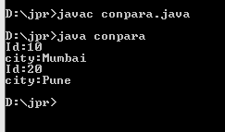

Slide 18
class conpara1
{
int length,breadth;
conpara1(int l,int b)
{
length=l;
breadth=b;
}
public static void main(String args[])
{
conpara1 c=new conpara1(4,5);
conpara1 c1=new conpara1(6,7);
System.out.println("Area:"+(c.length * c.breadth));
System.out.println("Area:"+(c1.length * c1.breadth));
}
}

Slide 19
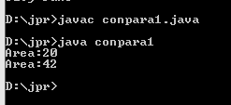

Slide 20
class conpara2
{
int length,breadth,a;
conpara2(int l,int b)
{
length=l;
breadth=b;
}
int area()
{
return length*breadth;
}
public static void main(String args[])
{
conpara2 c=new conpara2(4,5);
conpara2 c1=new conpara2(6,7);
System.out.println("Area:"+(c.area()));
System.out.println("Area:"+(c1.area()));
}
}

Slide 21
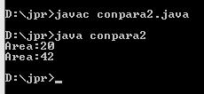

Slide 22
class conparaAdd
{
int Add,a,b;
conparaAdd(int c,int d)
{
a=c;
b=d;
}
void display()
{
Add=a+b;
System.out.println("Add:"+Add);
}
public static void main(String args[])
{
conparaAdd p1=new conparaAdd(10,16);
conparaAdd p2=new conparaAdd(20,14);
p1.display();
p2.display();
}
}

Slide 23
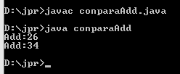

Slide 24
class conparaAdd1
{
int Add,a,b;
conparaAdd1()
{
a=0;
b=0;
}
conparaAdd1(int c,int d)
{
a=c;
b=d;
}
void display()
{
Add=a+b;
System.out.println("Add:"+Add);
}
public static void main(String args[])
{
conparaAdd p1=new conparaAdd(10,16);
conparaAdd p2=new conparaAdd(20,14);
p1.display();
p2.display();
}
}

Slide 25


Slide 26
Program
Define a class Fraction having data members Numerator & Denomenator.Initialize 3 objects using 3 different constructor & Display its fractional values.
Define class Cube having data members length, breadth & height.Initilaize 3 object using different constructor and display its volume.

Slide 27
Nesting of method
class nesting1
{
void first()
{
System.out.println("first method");
}
void second()
{
first();
System.out.println("Now in second method");
}
}
class nesting2
{
public static void main(String args[])
{
nesting1 e=new nesting1();
e.second();
}
}

Slide 28
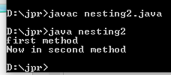

Slide 29
Argument Passing
Argument or parameter can be passed to the function by two ways:
Call by value
Call by reference
2. In the call by value method the value of the actual argument is assigned to the formal parameter.If any change is made in the formal parameter in the subroutine definition then the change does not reflect the actual parameter.

Slide 30
public class ParameterByValue
{
void Fun(int a,int b)
{
a=a+5;
b=b+5;
}
public static void main(String args[])
{
ParameterByValue ob1=new ParameterByValue();
int a,b;
a=10;b=20;
System.out.println("The value of a and b before function call");
System.out.println("a="+a);
System.out.println("b="+b);
ob1.Fun(a,b);
System.out.println("The value of a and b after function call");
System.out.println("a="+a);
System.out.println("b="+b);
}
}

Slide 31
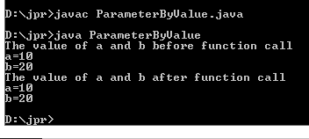

Slide 32
Instance Variable Hiding
It is illegal in java to declare two local variable with same name inside the same scope.
But when local variable has same name as that of the instance variable then the local variables hides instance variable.
So to overcome this problem, we use this keyword.

Slide 33
this keyword
This keyword can be used inside any method to reference current object, it always referring to an object which method was invoked.
We can use “this” keyword anywhere in the program reference to a current class.
To overcome the problem of variable hiding “this” keyword is used.
It can be resolve any name collisions that can occur between instance variable and local variable.
It can also use this with a constructor to call another constructor.

Slide 34
class Exthis
{
int a,b;
void sum(int a,int b)
{
this.a=a;
this.b=b;
}
void display()
{
int c=a+b;
System.out.println("a="+a);
System.out.println("b="+b);
System.out.println("sum="+c);
System.out.println();
}
public static void main(String args[])
{
Exthis e=new Exthis();
Exthis e1=new Exthis();
e.sum(10,20);
e1.sum(30,40);
e.display();
e1.display();
}
}

Slide 35
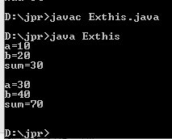

Slide 36
//this with constructor
class Exthis1
{
int len,breadth,height;
int volume()
{
return len*breadth*height;
}
Exthis1()
{
this(10,10);
System.out.println("Default constructor");
}
Exthis1(int l,int b)
{
this(l,b,10);
System.out.println("Two arg constructor");
}
Exthis1(int l,int b,int h)
{
len=l;
breadth=b;
height=h;
System.out.println("Three arg constructor");
}
public static void main(String args[])
{
Exthis1 e=new Exthis1();
Exthis1 e1=new Exthis1(10,30);
Exthis1 e2=new Exthis1(10,20,30);
System.out.println("volume="+e.volume());
System.out.println("volume="+e1.volume());
System.out.println("volume="+e2.volume());
}
}

Slide 37
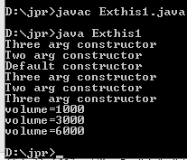

Slide 38
Command Line Arguments
In Java the command line argument is the argument which is passed at the time of running the java program.
The argument is passed to the main() method as parameter.

Slide 39
class Command
{
public static void main(String args[])
{
for(int i=0;i<args.length;i++)
System.out.println(args[i]);
}
}

Slide 40


Slide 41
class argArray
{
public static void main(String args[])
{
int add=0;
for(int i=0;i<args.length;i++)
{
add=add+Integer.parseInt(args[i]);
System.out.println(args[i]);
}
System.out.println("Addition:"+add);
}
}

Slide 42
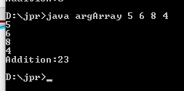

Slide 43
class argArray1
{
public static void main(String args[])
{
System.out.println("Arguments are:");
for(int i=0;i<args.length;i++)
{
System.out.print("A["+i+"]=");
System.out.println(args[i]);
}
}
}

Slide 44
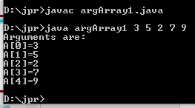

Slide 45
class addi
{
public static void main(String args[])
{
int a=Integer.parseInt(args[0]);
int b=Integer.parseInt(args[1]);
int c=a+b;
System.out.println("Addition:"+c);
}
}

Slide 46
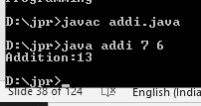

Slide 47
Varargs:Variable Length Arguments
If we want to pass variable length arguments to the method then varargs is used.
Syntax:
access-specifier static void method-name(object arg)
{
//Method body
}
3. The ellipse is used while representing the varargs.
4. Thus with the help of three dots one can specify variable length arguments for a particular method.

Slide 48
public class vararg
{
public static void main(String args[])
{
avg(15,100);
avg(15,100,150);
avg(15,100,105,210);
}
static void avg(int...num)
{
double sum=0,a;
for(int i=0;i<num.length;i++)
{
sum=sum+num[i];
}
a=sum/num.length;
System.out.println("average="+a);
}
}

Slide 49
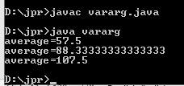

Slide 50
class vararg1
{
public static void main(String args[])
{
test("Java","Dcc");
test("Mic","Gad","Sen");
}
public static void test(String...Student)
{
for(String name:Student)
System.out.println("Welcome "+name);
}
}

Slide 51
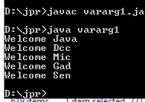

Slide 52
Garbage Collector
As in java objects are dynamically allocated using new operator.
While in some language like C++,the dynamically allocated object must be manually released by using delete operator.
But in java destruction of objects take place automatically by using technique called as Garbage Collector.

Slide 53
Whenever there is no reference to an object exist then object is assume to be no longer needed, the memory occupied by the object can be released.
The garbage collectors run whenever the system is idle or there is no enough memory.

Slide 54
class garbage
{
int a;
garbage()
{
a=0;
}
protected void finalize()
{
System.out.println("Destroy object.");
}
public static void main(String args[])
{
garbage g=new garbage();
garbage g1=new garbage();
g=g1;
}
}

Slide 55
Finalize() Method
Sometimes an object will need to perform some action when it is .
For Ex if an object is printing something i.e object holding printer.So before the object is destroyed, we must see that the object must released the printer it is holding.So java provides an mechanism called as Finalization.
To add a finalizer to a class, you simply define the finalize( ) method

Slide 56
The finalize( ) method has this general form:
protected void finalize( )
{
// finalization code here
}

Slide 57
Visibility Control
Java has three commonly used access specifier-public,private and protected.Java also defines default access level.
The protected acess specifier is used only during inheritance.
Public allows classes,methods and data fields accessible from any class.
Private allows classes,methods and data fields accessible only from within own class.
If private or public access is not mentioned then that member uses default access which is just similar to public.

Slide 58
Visibility Control
class visibility
{
int a;
public int b;
private int c;
void fun(int val)
{
c=val;
}
void display()
{
System.out.println("C="+c);
}
}
class test
{
public static void main(String args[])
{
visibility v=new visibility();
v.a=100;
v.b=200;
v.c=300; //Error c has private access.
v.fun(200);
v.display();
}
}

Slide 59


Slide 60
Array

Slide 61
Array
One - Dimensional array
1)Declaration of array
type arrayname[];
type [] arrayname;
Ex.
int a[];
float[] a;
2)Creation of array
arrayname=new type[size];
Ex
a=new int[3];

Slide 62
3)combine both steps
type arrayname[]=new type[size];
Ex.
int a[]=new int[5];
4) Initialization of an array
type arrayname[subscript no]=value;
Ex.
int a[0]=12;

Slide 63
5)Declaration and initialization of an array
type arrayname[]={List of values};
Ex.
int a[]={1,2,3,4,5};
6)Array Length
type variable=arrayname.length;
Ex.
int size=a.length;

Slide 64
2 D-Array
1)Declaration of 2-D array
type arrayname[][];
type [][] arrayname;
Ex.
int a[][];
float[] []a;
2)Creation of array
arrayname=new type[size][size];
Ex
a=new int[3][4];

Slide 65
3)combine both steps
type arrayname[][]=new type[size][size];
Ex.
int a[][]=new int[2][3];
int a[][]=new int[2][];
4) Initialization of an 2-D array
type arrayname[size][size]={List of values};
Ex.
int a[2][3]={ 1,2,3,4,5,6};
int a[][]={ {1,2,3},{4,5,6}};

Slide 66
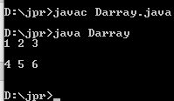
Array
class Darray
{
public static void main(String args[])
{
int a[][]={{1,2,3},{4,5,6}};
for(int i=0;i<2;i++)
{
for(int j=0;j<3;j++)
{
System.out.print(a[i][j]+" ");
}
System.out.println("\n");
}
}
}

Slide 67
class TDarray
{
public static void main(String args[])
{
int a[][]=new int[3][3];
int k=0;
for(int i=0;i<3;i++)
{
for(int j=0;j<3;j++)
{
a[i][j]=k+10;
k=k+10;
}
}
for(int i=0;i<3;i++)
{
for(int j=0;j<3;j++)
{
System.out.print(" "+a[i][j]);
}
System.out.println();
}
}
}

Slide 68
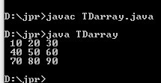

Slide 69
class array
{
public static void main(String args[])
{
int a[]=new int[10];
System.out.println("Array Element:");
a[0]=1;
a[1]=2;
a[2]=3;
a[3]=4;
a[4]=5;
a[5]=6;
a[6]=7;
a[7]=8;
a[8]=9;
a[9]=10;
System.out.println("Array Element at a[5]:"+a[5]);
}
}

Slide 70
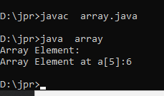

Slide 71
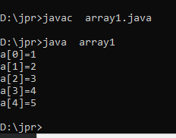
class array1
{
public static void main(String args[])
{
int a[]={1,2,3,4,5};
for(int i=0;i<a.length;i++)
{
System.out.println("a["+i+"]="+a[i]);
}
}
}

Slide 72
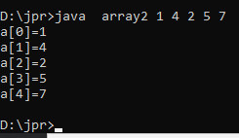
class array2
{
public static void main(String args[])
{
int a[]=new int[5];
for(int i=0;i<a.length;i++)
{
a[i]=Integer.parseInt(args[i]);
}
for(int i=0;i<a.length;i++)
{
System.out.println("a["+i+"]="+a[i]);
}
}
}

Slide 73
String class and methods

Slide 74
STRING CLASSES
Syntax -Implicitly
String str;
str="welcome";
Syntax -Explicitly
String str=new String("welcome");
1 String class

Slide 75
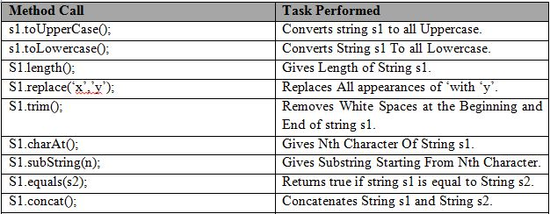

Slide 76
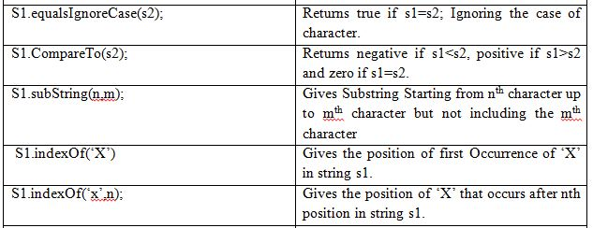

Slide 77
class case1
{
public static void main(String args[])
{
String s1="JAVA";
String s2="java";
System.out.println("upper:"+s2.toUpperCase());
System.out.println("lower:"+s1.toLowerCase());
System.out.println("replace:"+s2.replace('j','J'));
System.out.println("indexof:"+s2.indexOf('v'));
System.out.println("indexof:"+s2.indexOf('v',2));
}
}

Slide 78
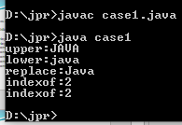

Slide 79
class lenst
{
public static void main(String args[])
{
String s=new String("How are you?");
System.out.println(s);
System.out.println(s.length());
}
}

Slide 80
class compareto
{
public static void main(String args[])
{
String s1="JAVA";
String s2="JAVA";
String s3="Java";
String s4="programming";
System.out.println(s1.compareTo(s2));
System.out.println(s1.compareTo(s3));
System.out.println(s1.compareTo(s4));
System.out.println(s4.compareTo(s3));
}
}

Slide 81
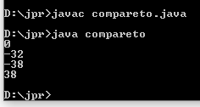

Slide 82
class concat
{
public static void main(String args[])
{
String s1="JAVA ";
String s2="programming";
s1=s1.concat(s2);
System.out.println(s1);
}
}

Slide 83


Slide 84
class charatst
{
public static void main(String args[])
{
String s=new String("How are you?");
System.out.println(s);
char ch;
ch=s.charAt(2);
System.out.println(ch);
}
}

Slide 85


Slide 86
class equal
{
public static void main(String args[])
{
String s1=new String("JAVA");
String s2=new String("java");
//String s3=new String("programming");
if(s1.equals(s2)==true)
System.out.println("Two strings are equals");
else
System.out.println("Two are not strings are equals");
}
}

Slide 87


Slide 88
class equalsignore
{
public static void main(String args[])
{
String s1="JAVA";
String s2="java";
String s3="programming";
System.out.println(s1.equalsIgnoreCase(s2));
System.out.println(s2.equalsIgnoreCase(s3));
}
}

Slide 89


Slide 90
class substring
{
public static void main(String args[])
{
String s1=new String("java programming is fun");
System.out.println("substring:"+s1.substring(2,6));
}
}

Slide 91


Slide 92
class extest
{
public static void main(String args[])
{
String str="Kunal";
String str1="Phoenix InfoTech";
System.out.println(str);
System.out.println(str1);
System.out.println(str.charAt(2));
System.out.println(str.length());
System.out.println(str.substring(1));
System.out.println(str.substring(1,3));

Slide 93
System.out.println(str.startsWith("Ku"));
System.out.println(str.endsWith("abc"));
System.out.println(str.equals("KUNAL"));
System.out.println(str.equalsIgnoreCase("KUNAL"));
System.out.println(str1.indexOf('e'));
System.out.println(str1.lastIndexOf('e'));
System.out.println("Hello".concat(str));
System.out.println(str.compareTo(str1));
System.out.println(str.toLowerCase());
System.out.println(str.toUpperCase());
System.out.println(str.replace('l','m'));

Slide 94
System.out.println(str1.contains("Info"));
System.out.println("Hello".trim());
}
}

Slide 95
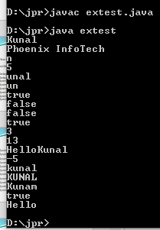

Slide 96
2) StringBuffer class
Syntax-
StringBuffer str=new StringBuffer("welcome");

Slide 97
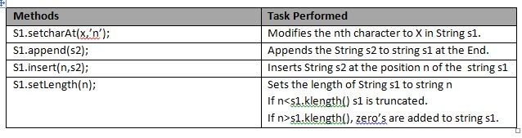
StringBuffer class Methods

Slide 98
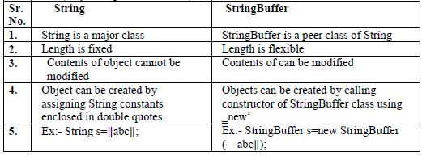
Difference between String class and StringBuffer class

Slide 99
String Array
Syntax
String arr[]=new String[3];

Slide 100
Vector

Slide 101
Vector
Vectors are used to create dynamic array that can hold object of any type and any number.
The vector class is an Example of container class i.e. they automatically resize themselves so they can put in any no of objects.
The vector class is contained in the java.util package.
Syntax for creation of vector with default size:-
Vector v=new Vector();

Slide 102
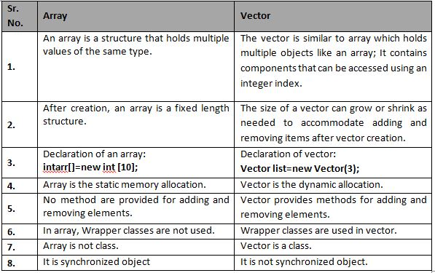
Difference between Vector and Array

Slide 103
Vector:
Vector(): Creates a default vector of initial capacity is 10.
Vector(int size): Creates a vector whose initial capacity is specified by size.
Vector(int size, int incr): Creates a vector whose initial capacity is specified by size and increment is specified by incr. It specifies the number of elements to allocate each time that a vector is resized upward.

Slide 104
Advantages & Disadvantages of Vectors
Advantages of vector
It is convenient to use vector to store object
It is used to store list of objects that may vary in size
we can add or delete object from list when required
Disadvantage of vector
we cannot store simple data type in a vector, we can only store objects. Therefore we need to convert simple data type to object us

Slide 105
Methods OF Vectors
v.addElement(item)
v.elementAt(n)
v.size()
v.removeElement(item)
v.removeElementAt(n)
v.removeAllElements()
v.copyInto(v1)
v.insertElementAt(item,n)

Slide 106
Others Methods of vectors
v.add(o)
v.add(i,o)
v.clear()
v.contains(o)
v.get(i)
v.firstElement(i)
v.lastElement(i)
v.set(i,o)
v.remove(i)

Slide 107
import java.io.*;
import java.util.*;
class v1
{
public static void main(String args[])throws IOException
{
Vector v=new Vector();
v.addElement(new Integer(10));
v.addElement(new Integer(20));
v.addElement(new Integer(30));
v.addElement(new Integer(40));
v.addElement(new Integer(50));
System.out.println("Elements are:"+v);

Slide 108
System.out.println("Removing Elements 2 and 3:");
v.remove(2);
System.out.println("Elements are:"+v);
v.remove(3);
System.out.println("Elements are:"+v);
System.out.println("Elements at 3 rd:");
v.insertElementAt(100,2);
System.out.println("After insertion Elements are:"+v);
}
}

Slide 109
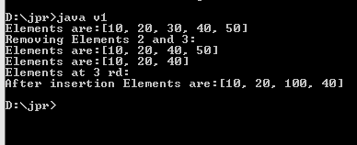

Slide 110
import java.io.*;
import java.util.Vector;
class v2
{
public static void main(String args[])
{
Vector v=new Vector();
v.add(new Double(10.896));
v.add(new Integer("20"));
v.add(new Float("30.56"));
v.add(new Character('a'));
v.add(new String("Suwarna"));
v.insertElementAt("java",2);
System.out.println("Elements are:"+v);
}
}

Slide 111
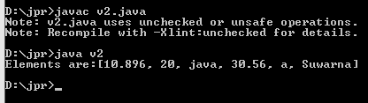

Slide 112
import java.io.*;
import java.util.*;
class v3
{
public static void main(String args[])throws IOException
{
Vector v=new Vector();
v.add(10);
v.add(20);
v.add(30);
v.add(40);
v.add(50);
System.out.println("Elements are:"+v);

Slide 113
System.out.println("Removing Elements 3 and 4:");
v.remove(2);
System.out.println("Elements are:"+v);
v.remove(3);
System.out.println("Elements are:"+v);
System.out.println("Elements at 3 rd:");
v.insertElementAt(100,2);
System.out.println("After insertion Elements are:"+v);
}
}

Slide 114
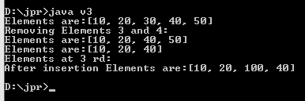

Slide 115
import java.io.*;
import java.util.Vector;
class v4
{
public static void main(String args[])
{
Vector v=new Vector();
v.add(10.896);
v.add(20);
v.add(30.56);
v.add('a');
v.add("Suwarna");
System.out.println("Elements are:"+v);
}
}

Slide 116
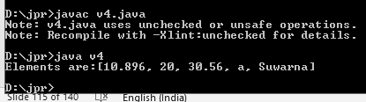

Slide 117
//Add no and find maximum using vector.
import java.io.*;
import java.util.Vector;
import java.util.Collections;
class v5
{
public static void main(String args[])
{
Vector v=new Vector();
v.add("10.896");
v.add("20");
v.add("30.56");
System.out.println("Elements are:"+v);
Object ob=Collections.max(v);
System.out.println("Elements are:"+ob);
}
}

Slide 118
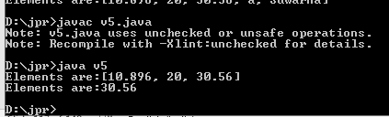

Slide 119
//Program to demostrate the use of vector method
import java.io.*;
import java.util.Vector;
class v6
{
public static void main(String args[])throws IOException
{
Vector v=new Vector(3,2);
System.out.println("Initial size:"+v.size());
System.out.println("Initial capacity:"+v.capacity());

Slide 120
v.addElement(new Integer(23));
v.addElement(new Float(9.6f));
v.addElement(new String("Hello"));
v.addElement(new Integer(42));
System.out.println("capacity after 4 additions:"+v.capacity());
v.addElement(new Double(63.2));
System.out.println("Current capacity:"+v.capacity());
System.out.println("Current size:"+v.size());
v.addElement(new Double(19.44));

Slide 121
v.addElement(new Integer(7));
System.out.println("First element:"+v.firstElement());
System.out.println("Last element:"+v.lastElement());
if(v.contains(new Integer(42)))
System.out.println("Vector contains 3");
System.out.println("vector: "+v.toString());
v.setSize(8);
System.out.println("vector: "+v.toString());
Object o=new Object();
o=v.clone();

Slide 122
System.out.println(" New vector:"+o);
v.removeElement(1);
v.removeElement("Hello");
v.removeAllElements();
if(v.isEmpty())
System.out.println("vector is empty");
System.out.println("Elements are:"+v);
}
}

Slide 123
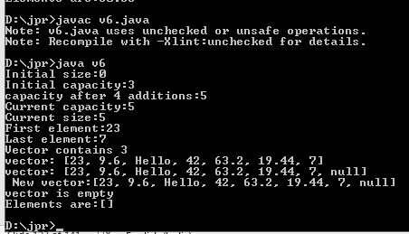

Slide 124
Wrapper Class

Slide 125
Need of Wrapper class
Java uses simple data types such as int, float ,char for storing the values.
These data types are not part of Object hierarchy.
They are passed by the values to the methods & cannot directly passed as a reference.
The vectors cannot handle the primitive data types.
For this purpose primitive data types are converted into object type to store & manipulated in vectors.
These conversions done by wrapper class methods, which contained in java.lang Package.

Slide 126
Wrapper Class
As they wrap primitive data type into an object of that class.so they are known as wrapper class.
E.g int x=25;
Integer y=new Integer(22);

Slide 127
Table showing simple data type & its corresponding wrapper classes
Primitive Data Type | Wrapper Class
int | Integer
byte | Byte
long | Long
short | Short
float | Float
double | Double
char | Character
boolean | Boolean

Slide 128
Wrapper class Methods
The Wrapper class methods for converting primitive data type to object by using constructor.
1)Integer obj=new Integer(i);
2)Float obj=new Float(f);
3)Long obj=new Long(l);
4)Double obj=new Double(d);

Slide 129
//primitive to object
class wrapper
{
public static void main(String args[])
{
Integer ob1=new Integer(10);
Integer ob2=new Integer("10");
System.out.println("ob1="+ob1);
System.out.println("ob2="+ob2);
}
}

Slide 130


Slide 131
The Wrapper class methods to convert object to primitive data type by using typeValue()
1)int i=obj.intValue();
2)float f=obj.floatValue();
3)long l=obj.longValue();
4)double d=obj.doubleValue();

Slide 132
//object to primitive
class wrapper1
{
public static void main(String args[])
{
Float ob1=new Float(10.78);
float f=ob1.floatValue();
int i=ob1.intValue();
System.out.println("f="+f);
System.out.println("i="+i);
}
}

Slide 133
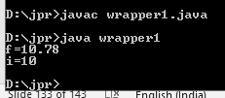

Slide 134
The Wrapper class methods to convert primitive data type to String by using toString().
1)String str=Integer.toString(i);
2)String str=Float.toString(i);
3)String str=Long.toString(i);
4)String str=Double.toString(i);

Slide 135
//primitive to string
class wrapper2
{
public static void main(String args[])
{
int i=32;
String str1=Integer.toString(i);
String str2=Integer.toHexString(i);
String str3=Integer.toOctalString(i);
String str4=Integer.toBinaryString(i);
System.out.println("str1="+str1);
System.out.println("str2="+str2);
System.out.println("str3="+str3);
System.out.println("str4="+str4);
}
}

Slide 136
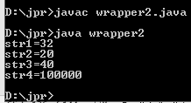

Slide 137
The Wrapper class methods to convert String object to numeric object by using valueOf()
1)Integer i=Integer.valueOf(str);
2)Float f=Float.valueOf(str);
3)Long l=Long.valueOf(str);
4)Double d=Double.valueOf(str);

Slide 138
The Wrapper class methods to convert String object to numeric object by using valueOf()
1)Integer i=Integer.valueOf(str);
2)Float f=Float.valueOf(str);
3)Long l=Long.valueOf(str);
4)Double d=Double.valueOf(str);

Slide 139
//string object to numeric object using valueOf
class wrapper3
{
public static void main(String args[])
{
String str1="32";
Float f=Float.valueOf(str1);
Integer i=Integer.valueOf(str1);
System.out.println(f);
System.out.println(i);
}
}

Slide 140


Slide 141
The Wrapper class methods to convert String to primitive data type by using parsing method.
1)int i=Integer.parseInt(str);
2)float f=Float.parseFloat(str);
3)long l=Long.parseLong(str);
4)double d=Double.parseDouble(str);

Slide 142
//string to primitive nos using parsing method
class wrapper4
{
public static void main(String args[])
{
String str1="32";
Float f=Float.parseFloat(str1);
Integer i=Integer.parseInt(str1);
System.out.println(f);
System.out.println(i);
}
}

Slide 143
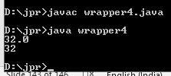

Slide 144
Enumerated Types
The enumerated data type can be denoted by the keyword enum.
The enum helps to define the user defined data type.
The value can be assigned to the elements in the enum data type.

Slide 145
Enumerated Types
class Enum
{
public enum students{JAVA,SEN,MIC}
public static void main(String args[])
{
for(students s:students.values())
System.out.println(s);
}
}

Slide 146
End

