Slide 1
UNIT No 4. Exception Handling & Multithreading(12 marks)
CO4- Implement Exception Handling

Slide 2
UNIT-IV Exception Handling And Multithreading.
Exception Handling

Slide 3
What IS AN exception?
An exception is a condition that is caused by a run-time error in the program.
Exception Handling Mechanism performs
Find the problem (Hit the exception).
Inform that an error has occurred (Throw the exception)
Receive the error information (Catch the exception)
Take corrective actions (Handle the exception)

Slide 4
WHAT IS AN ERROR
Errors are the mistakes that can makes program to go wrong.
Error may produce an incorrect output or may terminate the execution of the program or even may cause the system to crash.
So it is important to detect & manage all error condition in the program. So that programs will not terminate or crash during execution.

Slide 5
TYPES OF ERROR
Error are classified in two types as follows :
Compile Time Error
Run Time Error

Slide 6
Compile Time Error:-
All the syntax errors will be detected & displayed by the java compiler are known as Compile Time Errors.
Whenever compiler displays this syntax errors, it will not crate .class file.
The most common compile Time Errors are missing semicolon, missing brackets in class & methods definition, misspelling of variables & keywords, use of undeclared variables.

Slide 7
types of errors
Examples of Compile Time Error:-
Missing semicolons
Missing (or mismatch of) brackets in classes and methods
Misspelling of identifiers and keywords
Missing double quotes in strings
Use of undeclared variables
Incompatible types in assignments / initialization
Bad references to objects

Slide 8
Run Time Error:-
Sometimes, a program may compile successfully, creating .class file , but may not run properly such programs may terminate due to errors such as file not found or memory problem.
The error which are generated while program is running are known as Run Time Errors.
The most common Run Time Errors are dividing an integer by zero, accessing an array that is out of the bound of an array, trying to store data at negative value, opening file which does not exist.

Slide 9
Examples of Run Time Error:-
Dividing an integer by zero
Accessing an element that is out of the bounds of an array
Trying to store a value into an array of an incompatible class or type
Trying to cast an instance of a class to one of its subclasses
Passing a parameter that is not in a valid range or value for a method
Attempting to use a negative size for an array

Slide 10
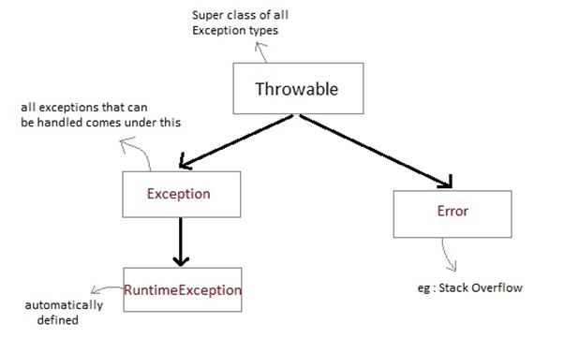
Types of exceptions
IOException

Slide 11
Exception are categorized into 3 category.
Checked Exception
The exception that can be predicted by the programmer at the compile time. Example : File that need to be opened is not found. These type of exceptions must be checked at compile time.
Unchecked Exception
Unchecked exceptions are the class that extends RuntimeException. Unchecked exception are ignored at compile time. Example : ArithmeticException, NullPointerException, Array Index out of Bound exception. Unchecked exceptions are checked at runtime.
Error
Errors are typically ignored in code because you can rarely do anything about an error. Example :if stack overflow occurs, an error will arise. This type of error cannot be handled in the code.

Slide 12
Example of Exceptions
ArithmeticException-Arithmetic error, such as divide-by-zero.
ArrayIndexoutOfBoundException-Array index is out-of-bounds.
ArrayStoreException-Assignment to an array element of an incompatible type.
IllegalAccessException -Access to a class is denied.
NegativeArraySizeException-Array created with a negative size.
NulPointerException-valid use of a null reference.

Slide 13
Exception Handling clause
In java, exception handling is done using five keywords,
try
catch
throw
throws
finally

Slide 14
I] try-catch Exception:-
A block of a code that is likely causes an error condition & throw an exception should be enclosed in a try block. An exception thrown by the try block should be caught & this statement enclosed under the catch box.
The try block contains one or more statement, which generates an exception. If the one statement generates an exception then the remaining statements are skipped & execution jumps to the catch block.

Slide 15
Every try block must be followed by at least one catch statement, otherwise compilation error occurs.
The catch statement is passed a single parameter which is reference to the exception object thrown by the try block.
If the catch parameter matches with the type of exception object, then the exception is caught and the statements in the catch block will be executed, otherwise it terminates the execution of the program.

Slide 16
Syntax:-
try
{
//Block of code to monitor for error
}
catch(Exception e)
{
//Exception handling for exception
}

Slide 17
Example of try-catch

Slide 18
Nested try
class Trynested
{
public static void main(String args[])
{
try
{
int a=Integer.parseInt(args[0]);
int b=Integer.parseInt(args[1]);
int ans=0;
try
{
ans=a/b;
System.out.println("ans="+ans);
}
catch(ArithmeticException e)
{
System.out.println("\nDivide by zero");
}
}
catch(NumberFormatException e)
{
System.out.println("Incorrect data");
}
}
}

Slide 19
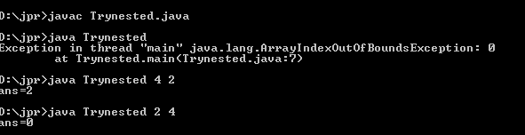

Slide 20
II] throw clause:-
All the system defined exception is thrown automatically, but the user defined exception must be thrown explicitly using throw clause.
throw clause is used to explicitly throw a user defined exception.
When throw statement is executed, the flow of execution stops immediately after the throw statement & any subsequent statements are not executed.
Syntax to create an object of throw an object of throwable or subclass of throwable class:
throw new throwable_subclass;
throw throbj;

Slide 21
Example of throw clause
Exception caught".

Slide 22
class ThrowEx
{
static void fun()
{
int a,b,c;
a=10;
b=0;
if(b==0)
throw new ArithmeticException("Divide by zero");
else
c=a/b;
}
public static void main(String args[])
{
fun();
}
}

Slide 23


Slide 24
User defined exception:-
It is an exception which created by defining a subclass by inheriting the built in exception class and then by throwing an object of user defined exception class from try-catch block.
Syntax for defining user define exception:-
class classname extends Exception
{
//body;
}

Slide 25
/*WAP to input age of person and throw an user define exception if entered age is negative*/
import java.lang.Exception;
import java.util.Scanner;
class throwown1 extends Exception
{
throwown1(String msg)
{
super(msg);
}
}
class throwAge
{
public static void main(String args[])
{
System.out.println("Enter your age:");
Scanner in=new Scanner(System.in);
int age=in.nextInt();
try
{
if(age<0)
throw new throwown1("Your age Negative");
else
System.out.println("Correct age");
}
catch(throwown1 e)
{
System.out.println("This is my Exception block");
System.out.println(e.getMessage());
}
}
}

Slide 26
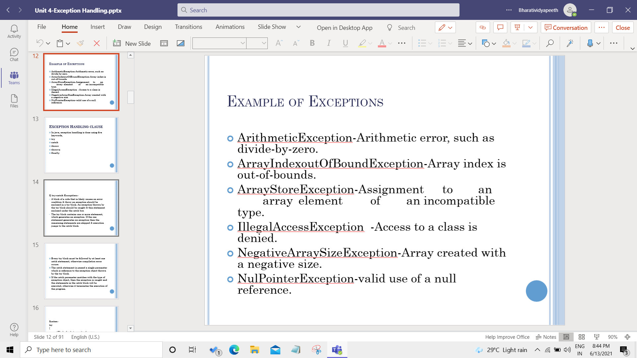

Slide 27


Slide 28
EXAMPLES
Write a Program to accept a password from user & throw “Authentication Failure” Exception if the password is incorrect.
WAP to accept a number from user & throw an Exception if the Number is not even number.
WAP to accept a number from user & throw an Exception if the Number is not positive number

Slide 29
/*WAP to accept password from user and throw "Authentication Failure" exception if the password is correct*/
import java.lang.Exception;
import java.util.Scanner;
class throwown2 extends Exception
{
throwown2(String msg)
{
super(msg);
}
}

Slide 30
class throwPass
{
public static void main(String args[])
{
System.out.print("Enter your password:");
Scanner in=new Scanner(System.in);
String password=in.next();
try
{
if(!password.equals("ABC123"))
throw new throwown2("Authentication Failure");
else
System.out.println("Welcome User");
}
catch(throwown2 e)
{
System.out.println(e.getMessage());
}
}
}

Slide 31
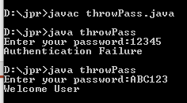

Slide 32
III] throws Clause
If the method is capable of causing an exception that does not handled, it must be specify this behavior to the callers of the method so that they can guard themselves against that exception.
This can be done by including throws clause in the method declaration.
throws clause can throw a number of exceptions.
General form of the method declaration that includes throws clause:
data_type method_name(parameters) throws Exceptionlist
{
//body;
}

Slide 33
Example of throws clause

Slide 34

class throws1
{
static void fun() throws ArithmeticException
{
int a,b,c;
a=10;
b=0;
try
{
c=a/b;
}
catch(ArithmeticException e)
{
System.out.println("\nCaught Exception:"+e);
}
}
public static void main(String args[])
{
fun();
}
}

Slide 35
Difference between throw and throws

Slide 36
IV] finally Clause:-
It is used to handle an exception i.e. not caught by any previous catch statement.
Finally creates a block of code that will be executed after try-catch block has completed.
Finally block will execute whether or not an exception is thrown. If an exception is thrown, this finally block is executed even if no catch statements matches the exception.
If exception is generated, control will go to catch where it will handle it. After handling an exception, it will go to the finally block, then the finally block gets executed.

Slide 37
But the program does not generate an exception, the catch block will skip & control will go to finally block where it will be executed.
If finally block is associated with the try, finally block will executed upon the conclusion of the try block. If try with the catch block it will be executed after the catch. In short, finally always main here with the try-catch or try.
Finally clause is used when you want to perform certain operations like - closing the files-releasing system resource

Slide 38
Syntax:-
a)
try
{
//body;
}
catch(Exception e)
{
//body;
}
finally
{
//body;
}

Slide 39
2)syntax
try
{
//body;
}
finally
{
//body;
}

Slide 40
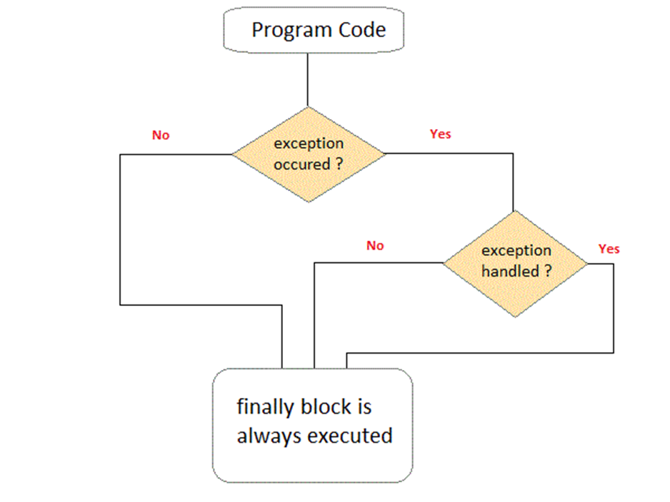
Flowchart

Slide 41
Example of finally block

Slide 42
public class finally2
{
public static void main(String args[])
{
try
{
int a[]=new int[5];
System.out.println(a[10]);
}
catch(ArithmeticException e)
{
System.out.println("Arithmetic exception occurs");
}
catch(ArrayIndexOutOfBoundsException e)
{
System.out.println("ArrayIndexOutOfBoundsException occurs");
}
finally
{
System.out.println("program end");
}
}
}

Slide 43


Slide 44
import java.lang.Exception;
class throwown extends Exception
{
throwown(String msg)
{
super(msg);
}
}
class throwown1
{
public static void main(String args[])
{
int age=15;
try
{
if(age<21)
throw new throwown("Your age is very less than the condition");
}
catch(throwown e)
{
System.out.println("This is my Exception block");
System.out.println(e.getMessage());
}
finally
{
System.out.println("finally block");
}
}
}

Slide 45


Slide 46
V] Multiple catch statement.
In Some cases, more than one exception could be generated by single try block ,to handle this situation ,we can specify two or more catch block.
When an exception in try block is generated, java treat multiple catch statements like switch statement, which executes the statement whose parameters matches with exception objects & remaining statement will skipped.

Slide 47
Syntax
try
{
//code
}
catch (ExceptionType name)
{
//code
}
catch (ExceptionType name)
{
//code
}
catch (ExceptionType name)
{
//code

Slide 48
Example of Multiple catch statment

Slide 49
Multithreading

Slide 50
What is Thread ?
Thread is similar to a program that has a single flow of control.
It has beginning, a body & an end and executes command sequentially.
Java enables us to use multiple flows of control in developing programs, where each flow of control is a separate tiny program known as thread that runs in parallel to other.
Since threads in java are subprograms of main application program & share the same memory space. So they are known as lightweight threads or process.

Slide 51
As that the threads running in parallel does not really mean that they actually run at the same time. Since all the threads are running on a single processor, flow of execution is shared between the threads. So java handles the switching of control between the threads in such a way that they are running concurrently.

Slide 52
What is different between multiprocessing & multithreading?
Sr. No. | Multithreading | Multiprocessing
1. | Multithreading is a programming concept in which a program or a process is divided into two or more subprograms or threads that are executed at the same time in parallel. | Multiprocessing is an operating system concept in which multiple processes are performed simultaneously.
2. | It supports execution of multiple parts of a single program simultaneously. | It supports execution of multiple programs simultaneously.
3. | It is highly efficient. | It is less efficient
4. | A thread is the smallest unit in multithreading. | A program or process is the smallest unit in multiprocessing.
5. | It helps in developing efficient programs. | It helps in developing efficient operating system.
6. | It is a light weight process and can run in the same address space so context switch or intercommunication between processes is less expensive. | It is a heavyweight process and can run in the same address space so context switch or intercommunication between processes is much expensive.
7. | Multithreading requires less overhead than multitasking. | Multitasking requires more overhead.

Slide 53
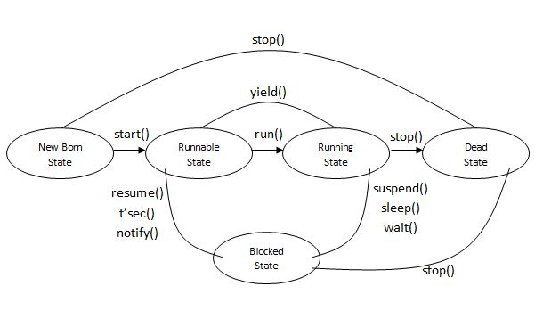
life cycle of thread

Slide 54
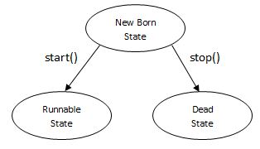
I] Newborn State:-
When we create a thread object, our thread is born & is said to the newborn state.
Syntax:-
Thread t = new Thread();
In newborn state, thread is not yet scheduled; once it is scheduled it can move into the runnable state.

Slide 55
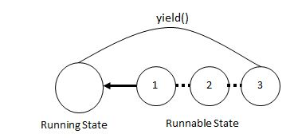
II] Runnable State(Ready to run):-
Runnable state means that thread is ready for execution & is waiting for availability of the process.
Syntax:-
t.start();
yield() :-
If we want thread to give up the control to another thread of equal priority before its turns come, we can do so by using yield method.

Slide 56
III] Running State :-
It means that the processor has given it time to the thread for its execution.
Syntax:-
t.run();
Thread run until it gives up controls on its own or it is preempted by higher priority thread.
Running thread may give up its control in one of the following situation:-

Slide 57
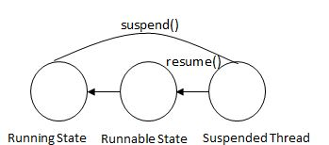
suspend():-
It is use to suspend a thread for some time due to certain reason but do not want to kill it. A suspended thread can be revived by using resume().

Slide 58
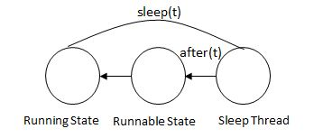
sleep():-
It is use to make the thread to sleep for specific time period (time in milliseconds). This means that thread is out of queue during this time period. The thread reenters into runnable state as soon as time period is elapsed.

Slide 59
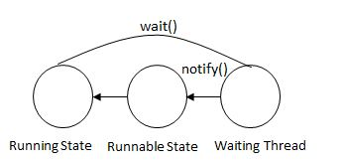
wait():-
It is use to tell the thread to wait until some event occurs. The thread can be scheduled to run again using notify() method.

Slide 60
IV] Blocked State:-
A thread is said to be a block when it is prevented from entering into runnable & running.
Thread can enter in a blocked state because of waiting for the resources that are hold by another thread.
To come out of the block state
In case of suspend() method it use resume() method.
In case of sleep() method it use t’sec() method.
In case of wait() method it use notify() method.

Slide 61
V] Dead State:-
Every thread has life cycle. Running thread ends its life when it has completed executing its run method.
Syntax:-
t.stop();

Slide 62
Creation of Thread
By Extending Thread Class
1)Declare class as extending Thread class
Syntax
Class class-name extends Thread
{
//body
}
2)Implement run() method that thread will be execute
Syntax
public void run()
{
//body
}

Slide 63
3)Create thread object in main program
Syntax
Class-name Threadobj=new class-name();
4) Call start() method
Syntax
Threadobj.start();
5)Both steps 3 & 4 are combined into
new class-name().start();

Slide 64
WAP to create two threads such that one will print odd Number and other thread will print even Number between 21 to 20 Nos.
WAP to create two threads, one thread prints Nos from 1 to 10 and other thread will print Nos from 10 to 1.First thread should transfer control to second thread often printing second No.

Slide 65
/*WAP to create two thread one to print odd number only and other to print even no.*/
class A extends Thread
{
public void run()
{
System.out.println("Even no Thread:");
try
{
for(int i=1;i<=20;i++)
{
if(i%2==0)
System.out.println(i);
Thread.sleep(500);
}
}catch(InterruptedException e){}
}
}
class B extends Thread
{
public void run()
{
System.out.println("Odd no Thread:");
try
{
for(int i=1;i<=20;i++)
{
if(i%2!=0)
System.out.println(i);
Thread.sleep(500);
}
}catch(InterruptedException e){}
}
}

Slide 66
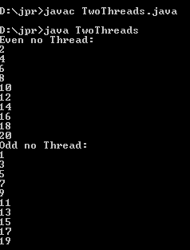
class TwoThreads
{
public static void main(String args[])
{
A t1=new A();
t1.start();
try
{
t1.join();
}catch(InterruptedException e){}
B t2=new B();
t2.start();
}
}

Slide 67
/*WAP to create two thread one to print 1-10 number only and other to print 10-1 no. First transfer control to second thread after delay of 500 ms.*/
class A1 extends Thread
{
public void run()
{
System.out.println("1 to 10 Thread:");
try
{
for(int i=1;i<=10;i++)
{
System.out.println(" "+i);
Thread.sleep(500);
}
}catch(InterruptedException e){}
}
}
class B1 extends Thread
{
public void run()
{
System.out.print("10 to 1 Thread:");
try
{
for(int i=10;i>=1;i--)
{
System.out.print(" "+i);
Thread.sleep(500);
}
}catch(InterruptedException e){}
}
}

Slide 68
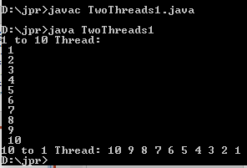
class TwoThreads1
{
public static void main(String args[])
{
A1 t1=new A1();
t1.start();
try
{
t1.join();
}catch(InterruptedException e){}
B1 t2=new B1();
t2.start();
}
}

Slide 69
Implementing Runnable Interface.
Steps
1)Declare the class as implementing Runnable interface
Syntax
Class class-name implements Runnable
{
}
2)Implement run() method
Syntax
Public void run()
{
}

Slide 70
3)Create a thread object
Syntax
Class-name obj=new class-name();
4)Instantenous from runnable interface
Syntax
Thread threadobj=new Thread(obj);
5)Call start() method
threadobj.start();

Slide 71

class MyThread extends Thread
{
public void run()
{
System.out.println("Thread is created");
}
}
class ThreadProg
{
public static void main(String args[])
{
MyThread t=new MyThread();
t.start();
}
}

Slide 72

class MyThread implements Runnable
{
public void run()
{
System.out.println("Thread is created");
}
}
class ThreadProgRunn
{
public static void main(String args[])
{
MyThread obj=new MyThread();
Thread t=new Thread(obj);
t.start();
}
}

Slide 73
What is Thread Priority? Write default priority values and methods to change them.
Every thread in java has equal priority i.e. default=5. So they share processor on basis of FCFS.
Priority determines that how thread should be treated with respect to other.
Priority is considered by thread scheduler who decides which ready thread should execute
Java permits us to set priority of a thread using setPriority() method.
Syntax:-
Threadname.setPriority(int no.);
Where int no. is an integer value to which thread priority is to be set.

Slide 74
Thread class defines several priority constants
MIN_PRIORITY = 1
NORM_PRORITY = 5
MAX _PRIORITY =10
The getPriority() method returns the priority of the thread.

Slide 75
/*WAP to create two thread one to print 1-10 number only and other to print 10-1 no. Using thread priority.*/
class A1 extends Thread
{
public void run()
{
System.out.println(" Thread 1 started:");
for(int i=1;i<=5;i++)
{
System.out.println("A1:"+i);
}
System.out.println("End of thread 1");
}
}
class B1 extends Thread
{
public void run()
{
System.out.println("Thread 2 started:");
for(int k=5;k>=1;k--)
{
System.out.println("B1:"+k);
}
System.out.println("End of thread 2");
}
}

Slide 76
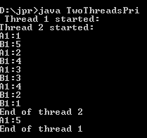
class TwoThreadsPri
{
public static void main(String args[])
{
A1 t1=new A1();
B1 t2=new B1();
t1.setPriority(1);
t2.setPriority(10);
t1.start();
t2.start();
}
}

Slide 77
/*WAP to create two thread one to print 1-10 number only and other to print 10-1 no. Using thread priority.*/
class A1 extends Thread
{
public void run()
{
System.out.println(" Thread 1 started:");
for(int i=1;i<=5;i++)
{
System.out.println("A1:"+i);
}
System.out.println("End of thread 1");
}
}
class B1 extends Thread
{
public void run()
{
System.out.println("Thread 2 started:");
for(int k=5;k>=1;k--)
{
System.out.println("B1:"+k);
}
System.out.println("End of thread 2");
}
}

Slide 78
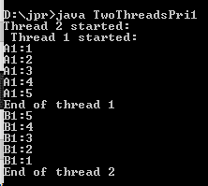
class TwoThreadsPri1
{
public static void main(String args[])
{
A1 t1=new A1();
B1 t2=new B1();
t1.setPriority(Thread.MAX_PRIORITY);
t2.setPriority(Thread.MIN_PRIORITY);
t1.start();
t2.start();
}
}

Slide 79
class A1 extends Thread
{
public void run()
{
System.out.println(" Thread 1 started:");
System.out.println("End of thread 1");
}
}
class B1 extends Thread
{
public void run()
{
System.out.println("Thread 2 started:");
System.out.println("End of thread 2");
}
}
class C1 extends Thread
{
public void run()
{
System.out.println("Thread 3 started:");
System.out.println("End of thread 3");
}
}

Slide 80
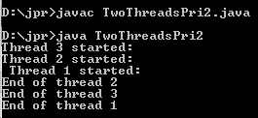
class TwoThreadsPri2
{
public static void main(String args[])
{
A1 t1=new A1();
B1 t2=new B1();
C1 t3=new C1();
t1.setPriority(Thread.MAX_PRIORITY);//10
t2.setPriority(Thread.MIN_PRIORITY);//1
t3.setPriority(Thread.NORM_PRIORITY);//5
t1.start();
t2.start();
t3.start();
}
}

Slide 82
What is synchronization? How do we achieve it
When two or more threads need to access to a shared resource i.e. either of method or an object then they need some way to ensure that the shared resource will be used by only one thread at a time. The process by which it is achieved is known as Synchronization.
When method is mark as synchronized java creates some monitor object for the class. i.e. monitor is used as mutually exclusive lock called as “mutex”.
When the first time thread calls the synchronized method, java gives the monitor object to that thread. As long as the thread holds the monitor object, no other thread can enter in the synchronized session of the code.
When thread completes its work of using synchronized() method, It will hand over the monitor to the next thread to use the same resource

Slide 83
Syntax for Synchronized() method & Synchronized object.
synchronized return_type method_name(Parameter List)
{
//Body
}
Synchronized(object)
{
//Body
}

Slide 84
/*WAP for Synchronization.*/
class Test
{
synchronized void display(int num)
{
System.out.println("Table:"+num);
for(int i=1;i<=5;i++)
{
System.out.println(" "+num*i);
}
System.out.println("End of Table");
try
{
Thread.sleep(1000);
}catch(Exception e){}
}
}
class A extends Thread
{
Test th1;
A(Test t)
{
th1=t;
}
public void run()
{
th1.display(2);
}
}

Slide 85
class B extends Thread
{
Test th2;
B(Test t)
{
th2=t;
}
public void run()
{
th2.display(4);
}
}
class synchro
{
public static void main(String args[])
{
Test obj=new Test();
A t1=new A(obj);
B t2=new B(obj);
t1.start();
t2.start();
}
}

Slide 86
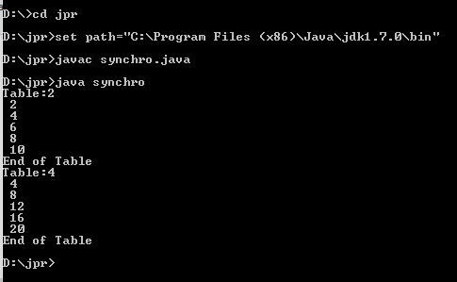

Slide 87
/*WAP for Synchronized Block.*/
class Test
{
void display(int num)
{
synchronized(this)
{
System.out.println("Table:"+num);
for(int i=1;i<=10;i++)
{
System.out.println(" "+num*i);
}
System.out.println("End of Table");
try
{
Thread.sleep(1000);
}catch(Exception e){}
}
}
}
class A extends Thread
{
Test th1;
A(Test t)
{
th1=t;
}
public void run()
{
th1.display(2);
}
}

Slide 88
class B extends Thread
{
Test th2;
B(Test t)
{
th2=t;
}
public void run()
{
th2.display(4);
}
}
class synchroBlock
{
public static void main(String args[])
{
Test obj=new Test();
A t1=new A(obj);
B t2=new B(obj);
t1.start();
t2.start();
}
}

Slide 89
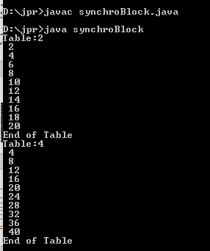

Slide 91
How can two threads be made to communicate with each other or Interthread communication
By using the keyword synchronized, we invoke the monitor on shared resource by an object, but by doing this we block other threads from asynchronous access to certain other methods in the same class or object.
This problems of invariably blocking all others threads against one thread which is in synchronized method, we use Interthread Communication.
In this Interprocess communication, multiple threads in a program are capable of interacting with each other & sharing certain information, such as their state & locking status.
For e.g., A thread in the waiting state continuously checks whether an object lock for a synchronization is available or not, which cause unnecessary wastage of time & resource. After current thread release the shared resource, it can notify the waiting threads about status of lock.

Slide 92
Hence java includes a interthread communication mechanism using wait(),notify(),notifyAll() methods.
These methods are final methods. All the three methods can be called from within synchronized method.
wait() :- This method tells the calling thread to give up the monitor & go to sleep until some other threads enters the same monitor & calls notify.
notify() :- Wake up the first thread that called wait() on the same object.
notifyAll() :- Wake up all the thread that called wait() on the same object. The highest priority thread will run fast

