Slide 1
INTERNSHIP PROJECT · PERSEVEX · DATA SCIENCE · 2026
Resume Parsing and Candidate Ranking for Recruiters
82
fit score
HireSight — layout-aware parsing, explainable ranking, blind screening
Omkar Vijay Ghate
Bajaj Degree College
Notes:
Introduce the project: a system that reads resumes and ranks candidates for a job, with a reason for every rank.

Slide 2



Keyword-matching ATS tools lose good candidates
The two-column problem
60%
of a recruiter's day can go into manual screening, pipeline admin and keyword searches
Naive extraction reads straight across the page and mixes the skills sidebar into the work history.
Keyword games
Stuffed resumes win; an honest "GCP" loses to a search for "Google Cloud".
No explanation
Recruiters must defend a shortlist to the hiring manager. A bare number doesn't help.
Notes:
These three issues come straight from the project brief.

Slide 3



HireSight covers the four objectives in the brief
Layout-aware parsing
Granular extraction
Semantic ranking
Explainable UI
PDF + DOCX, column gutter detection, hidden-text filter
Jobs, durations, internships at half weight, metrics
Ontology-normalised TF-IDF, rerank, 50/30/20 fit score
3-point reason per candidate, blind mode, feedback loop
Runs fully in the browser · same engine exposed as a REST API on Vercel

Slide 4
From a folder of resumes to a ranked shortlist
1
2
3
4
5
Extract
Structure
Normalise
Blind
Rank
pdf.js text + x/y positions; DOCX unzipped
Sections, jobs, dates, degrees, metrics → JSON
72-node skill ontology, implied skills, tenure
PII, ages, identity groups redacted
Retrieval → rerank → fit score + reasons
Shared ES modules: the browser app and the /api functions run the exact same code

Slide 5
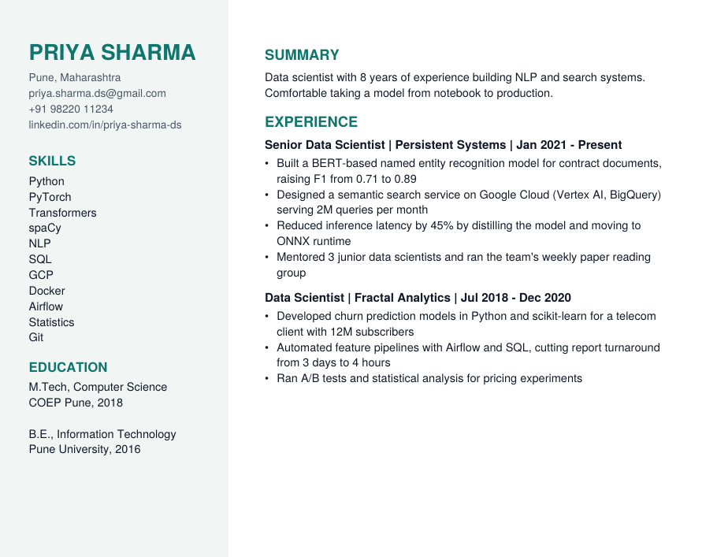

Two-column resumes are read column by column
Find the gutter
Try vertical lines at 25–75% of the width; keep the one almost no text crosses
Read in order
Name banner first, then left column, then right
Drop hidden text
Runs under 3.5 pt are removed — the 1 pt white "AWS Kubernetes…" line here is gone
Rebuild entities
Wrapped bullets re-joined; jobs, months, internships, metrics extracted

Slide 6
A skill ontology turns words into meaning
Normalise
Infer
Adjacent credit
K8s · EKS · helm
PyTorch
AWS ← Azure
→ Kubernetes
→ Python, Deep Learning
→ 0.70
GCP · BigQuery
Deep Learning
Vue.js ← React
→ Google Cloud
→ Machine Learning
→ 0.70
sklearn
BERT · LLM
TensorFlow ← PyTorch
→ scikit-learn
→ NLP, Transformers
→ 0.75
72 canonical skills · ambiguous tokens like "Go", "R", "Excel" only count when written as a skill

Slide 7
Fit score = 50% semantic + 30% experience + 20% skills
50%
30%
20%
Semantic
Experience
Skills
TF-IDF cosine with canonical skill tokens, blended with per-job passage similarity (recent roles weigh more)
Full credit at the requirement; below it e^(−2·shortfall/required). 1 yr short of 5 → 67%
Used = 1.0 · inferred 0.85 · listed-only 0.75 · adjacent 0.25–0.75. Must-haves count double
Weights are sliders in the app — recruiters can re-rank live. Plain Jaccard was dropped: it punishes candidates for knowing more.

Slide 8
Relevant seniors rise, keyword stuffing doesn't
Top 4 = the four real ML/NLP profiles
with 6+ years
Keyword-stuffed fresher: 5th of 8
22 skills listed, 19 never used, flag raised
GCP / Azure ≠ zero for AWS
70% adjacency credit with a clear note
200 resumes in ~305 ms
18 / 18 automated tests passing

Slide 9
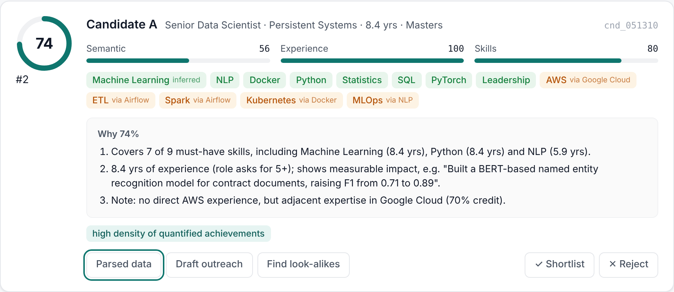

Every score explained, every resume blinded
Blind mode redacts
Names, contacts, address, profile links
Graduation years (age)
DOB, gender, religion, marital status lines
Identity-linked groups → "University Association"
Gendered pronouns
Why 74%: covers 7 of 9 must-haves · 8.4 yrs, F1 0.71 → 0.89 · no AWS but Google Cloud (70% credit)

Slide 10
What's next
Sentence embeddings + vector DB for stage 1, cross-encoder for stage 2
Fine-tuned NER (BIO tagging) for entities rules miss
OCR for scanned resumes
Learn the 50/30/20 weights from recruiter decisions
Flight-risk and salary-band prediction
Thank you
Omkar Vijay Ghate
Bajaj Degree College · Persevex 2026
linkedin.com/in/-omkar-ghate-profile
Live demo: open /app on the project site

