Slide 1

ZERO HUNGER
No one should sleep Hungry.

Slide 2

In this world many people are sleeping hungry.
Our motto is to reduce
the Hunger problem in
this world.

Slide 3

So we came up with an idea.
To donate the excess food and food grains.

Slide 4
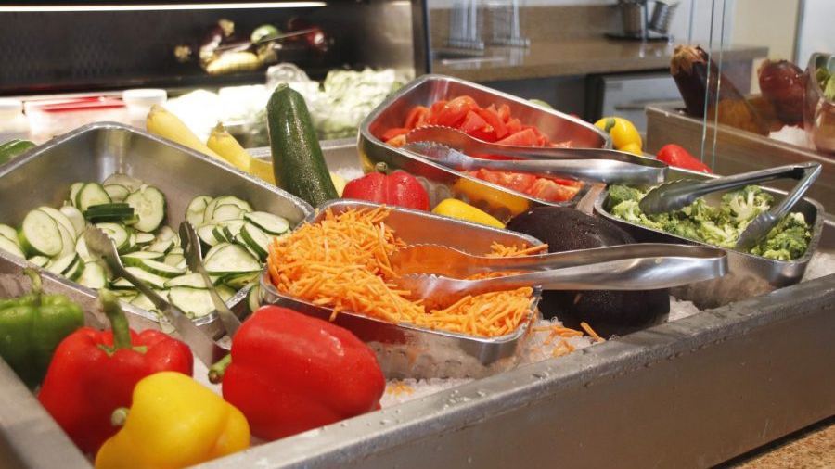
We make collaboration with restaurants on daily basis
1.The 19's Restaurant
2.Hotel Rau
3.The Food Court

Slide 5
RESULT
Collaborations with government and non-government organizations in promoting Food Donations.
With the help of website we collect funds to solve food crisis.
More people came forward for volunteering.

Slide 6
CONCLUSION
The main reason of food crisis is wastage of food. So we can solve it with our website.

Slide 7
REFERANCE
https://www.wix.com/mysite

