Slide 1
IBM UNIVERSITY ENGAGEMENT — PROJECT SUBMISSION
SafeSurge AI
Agentic Coastal Disaster Intelligence & Response Platform
Gujarat Hackathon 2026 · Challenge 6 — AI-Driven Cyclone & Coastal Disaster Early Warning System
Built with IBM watsonx.ai · IBM Granite (granite-4-h-small) · IBM Bob
Omkar Shyam Gunde

Slide 2

Project Title – SafeSurge AI — Agentic Coastal Disaster Intelligence & Response Platform
Domain of Project - Disaster Management
Student Name | Recent Passport Photo | Email ID | Mobile number [WhatsApp]
Omkar Shyam Gunde |  | 2403051247006@paruluniversity.ac.in gundeomkar2004@gmail.com | 8104945507
Team members: 1. Omkar Shyam Gunde 2. Ridam Saxena
3. Prem Arvind Patil

Slide 3
PROJECT INFORMATION
Domain & Project Title
Domain of Project
Project Title
Disaster Management
(closest official category if a fixed dropdown is required: Environment / Agriculture — confirm exact wording with your program coordinator)
SafeSurge AI — Agentic Coastal Disaster Intelligence & Response Platform
Built for Gujarat Hackathon 2026, Challenge 6
One-line Summary
A multi-agent AI system that fuses live INCOIS ocean forecasts and real historical cyclone data (Cyclone Biparjoy, 2023) with IBM Granite reasoning to deliver hyperlocal fishermen safety alerts, evacuation prioritization, and relief coordination for Gujarat's coastal districts — with every data point transparently labeled as live, historical, or demonstration.
02

Slide 4
PROBLEM STATEMENT
Challenge 6: Cyclone & Coastal Disaster Early Warning
The Challenge
Gujarat's 1,600+ km coastline is highly vulnerable to cyclones (e.g., Tauktae, Biparjoy).
Coastal communities and fishermen often receive delayed or generalized warnings, leading to preventable loss of life, boats, and property.
The Objective
Build Agentic AI solutions that provide hyperlocal cyclone tracking, fishermen safety alerts, and coordinated evacuation and relief planning for coastal districts.
Cyclone Track & Intensity Interpretation — contextualize authoritative forecast data (never self-generate a meteorological prediction)
Fishermen Safety Alerts — localized, multilingual (English / Hindi / Gujarati)
Evacuation Route & Priority Planning — population, exposure, and shelter-aware
Relief Resource Coordination — shortage detection and prioritization
Post-Disaster Damage Assessment — structured, AI-scored intake
03

Slide 5
PROPOSED SOLUTION
SafeSurge AI — System Overview
SafeSurge AI is a six-agent, IBM Granite-powered decision-support platform built on a React + Node.js/Express stack. Its central design principle is data honesty: every value shown in the UI is tagged 🟢 LIVE, 🔵 HISTORICAL, or 🟡 DEMONSTRATION, so operators and judges always know exactly what they're looking at. Live ocean conditions are fetched from INCOIS's Ocean State Forecast service; when unavailable, the system falls back transparently to a real historical replay of Cyclone Biparjoy (June 2023, NOAA IBTrACS data) rather than fabricating live-looking numbers.
Cyclone Interpretation Agent
Fishermen + Evacuation Agents
Relief + Orchestrator
Ingests live/historical ocean data
Classifies operational risk level
Never claims to forecast independently
Run in parallel (independent inputs)
Trilingual safety alerts (EN/HI/GU)
Population & shelter-aware prioritization
Relief waits on Evacuation's output
Orchestrator assembles Command Summary
Damage Assessment runs independently
04

Slide 6
TECHNOLOGY STACK
Technology Used
IBM watsonx.ai
IBM Granite (granite-4-h-small)
Model hosting, deployment, and inference for all agent reasoning calls
Chat-completions model powering risk interpretation, alerts, planning, and summarization — selected via runtime model discovery, not hardcoded
IBM Bob
React + Vite
Autonomous agentic build tool used to implement the full-stack application end-to-end from a single detailed specification
Frontend command-center dashboard
Node.js + Express
SQLite (sql.js — WebAssembly)
Backend API, agent orchestration, and data fusion layer
Zero native compilation required on Windows; in-memory DB persisted to disk every 10s
Leaflet + OpenStreetMap
INCOIS Ocean State Forecast
Gujarat coastline map, no paid API key required
Live wind, wave, and sea-surface data via WMS GetFeatureInfo
NOAA IBTrACS
Real historical Cyclone Biparjoy (2023) track data for guaranteed offline replay
05

Slide 7
SYSTEM COMPONENTS
Core Application Components
Backend Components
Frontend Components
graniteClient.js — single centralized watsonx.ai client; runtime model discovery, IAM token caching, sanitized logging, malformed-JSON retry with deterministic fallback
dataFusionEngine.js — live INCOIS attempt → historical Biparjoy fallback, honest provenance tagging on every field
incoisAdapter.js — real WMS GetFeatureInfo calls to INCOIS's Ocean State Forecast service
commandOrchestrator.js — sequences the 5-agent operational chain with correct data dependencies
5 individual agent modules — Cyclone Interpretation, Fishermen Alert, Evacuation, Relief Coordination, Damage Assessment
Command Center Dashboard — live risk status, provenance-tagged conditions
GujaratMap.jsx — Leaflet map with settlement markers, priority coloring
BiparjoyReplay.jsx — historical timeline scrubber + Simulate Intensification sliders with click-triggered “Run AI Response”
AgentChainPanel.jsx — live visual chain of agent execution
FishermenAlertCard.jsx — trilingual (EN/HI/GU) alert display
EvacuationList.jsx, ReliefPanel.jsx, DamageAssessment.jsx, Badges.jsx (provenance badges)
06

Slide 8
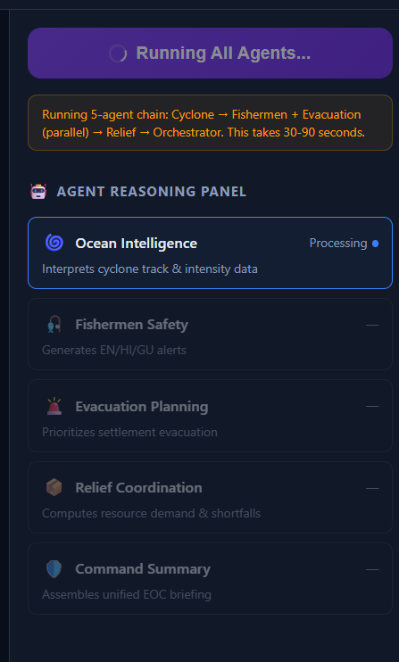
SYSTEM IN ACTION
Agent Execution Workflow
07

Slide 9
ARCHITECTURE
Architecture Blueprint
IBM Granite
(watsonx.ai)
INCOIS OSF
live ocean data
DataFusionEngine
Cyclone Interpretation
NOAA IBTrACS
provenance tagging
Agent 1
Biparjoy historical
Fishermen Alert
Evacuation Plan
Agent 2 (parallel)
Agent 3 (parallel)
Relief Coordination
Agent 4 (waits on Evac.)
Command Orchestrator
Agent 6 — summary
Damage Assessment
React Command Center
Agent 5 — independent
map · alerts · evac · relief
08

Slide 10
AGENTIC AI
Role of Agentic AI in the Solution
SafeSurge AI is not a single chatbot wrapped around one prompt — it is a coordinated system of six independently-invokable agents, each with a defined responsibility, input/output JSON schema, and explicit constraints. IBM Granite, accessed through IBM watsonx.ai, powers the reasoning inside each agent, while deterministic application logic (thresholds, numeric calculations) handles what doesn't need an LLM.
Coordinated, Not Isolated
Context-Aware & Constrained
Efficient by Design
Agents pass structured JSON between each other
Relief explicitly waits for Evacuation's output before running
Orchestrator synthesizes all outputs into one Command Summary
Cyclone agent is explicitly forbidden from claiming to generate its own forecast
Every agent's disclaimer states its output is AI-support, not an official order
Damage Assessment honestly declares no vision capability rather than pretending
Independent agents (Fishermen, Evacuation) run in parallel
IAM token cached; responses validated with one retry before deterministic fallback
Sanitized execution log surfaced directly in the UI's Agent Reasoning Panel
09

Slide 11
DIFFERENTIATION
Novelty and Uniqueness
Data Provenance as a First-Class Design Principle
Guaranteed-Reliable Demo Path
Every value in the UI is explicitly tagged LIVE / HISTORICAL / DEMONSTRATION — not a common feature in hackathon prototypes, and directly addresses the credibility gap most AI disaster-tech demos face.
Historical replay of a real, Gujarat-relevant cyclone (Biparjoy 2023) is the primary demo path, not an emergency fallback — the system works fully offline with real data, not fabricated placeholders.
Genuine Live Data Integration
Correctly Modeled Agent Dependencies
Real WMS calls to INCOIS's Ocean State Forecast service, verified working in runtime, not a simulated API response.
Relief Coordination explicitly waits on Evacuation Planning's actual output — not run in naive parallel — reflecting real operational logic.
Trilingual, Human-Centered Alerts
Honest AI Capability Claims
Fishermen safety alerts generated natively in English, Hindi, and authentic Gujarati Unicode script in a single structured call.
The system explicitly states what it cannot do (e.g., no image-analysis capability) rather than presenting a misleading feature.
11

Slide 12
REPOSITORY
GitHub Link
Submission Checklist
Public GitHub repository created, README enabled
app.json / project configuration file uploaded
Problem statement PDF (Challenge 6) uploaded
This project presentation (.pptx) uploaded
Link - https://github.com/OmkarGunde/SafeSurge-AI
12

Slide 13
WHAT'S NEXT
Future Scope
Near-Term Enhancements
Longer-Term Vision
IMD API integration once registration reopens, for authoritative cyclone track/intensity warnings alongside INCOIS ocean data
SMS/IVR delivery of fishermen alerts for offline-first reach in low-connectivity coastal areas
Real-time shelter capacity feeds from district disaster management authorities, replacing demonstration data with live government data
Vision-capable Granite model integration for genuine post-disaster image damage assessment
Expansion beyond Gujarat to other Indian coastal states with state-specific settlement and shelter datasets
Integration with NDRF/Coast Guard operational systems for direct relief-resource dispatch coordination
Wearable/IoT integration for real-time fisherman location and distress signaling
13

Slide 14
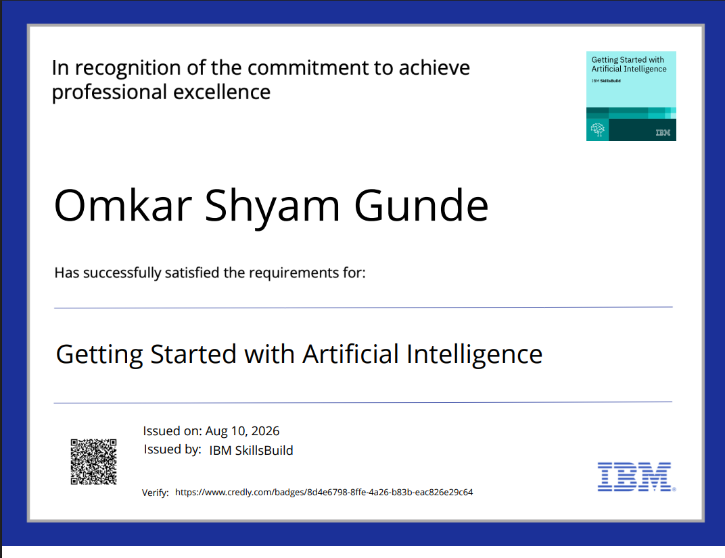
CERTIFICATION
Certificates Earned — Credly
14

Slide 15
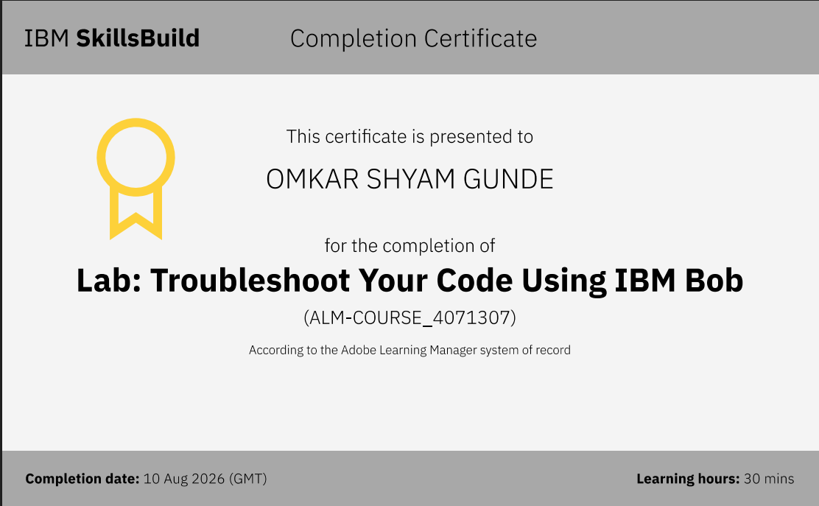
CERTIFICATION
Certificates Earned — IBM Bob
15

Slide 16
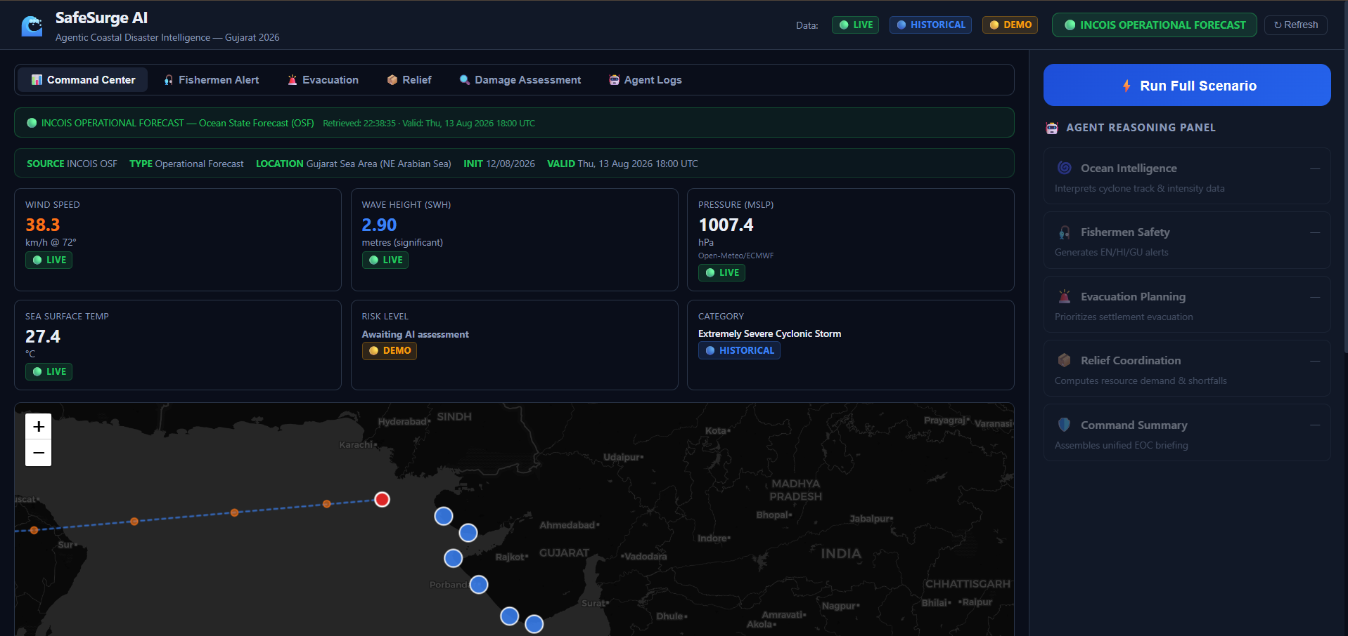
APPLICATION WALKTHROUGH
Command Center Dashboard
16

Slide 17
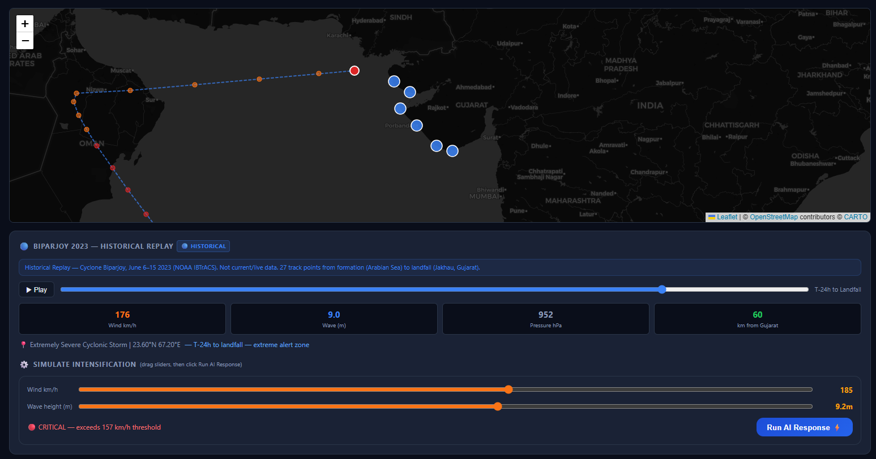
APPLICATION WALKTHROUGH
Biparjoy Historical Replay + Simulate Intensification
17

Slide 18
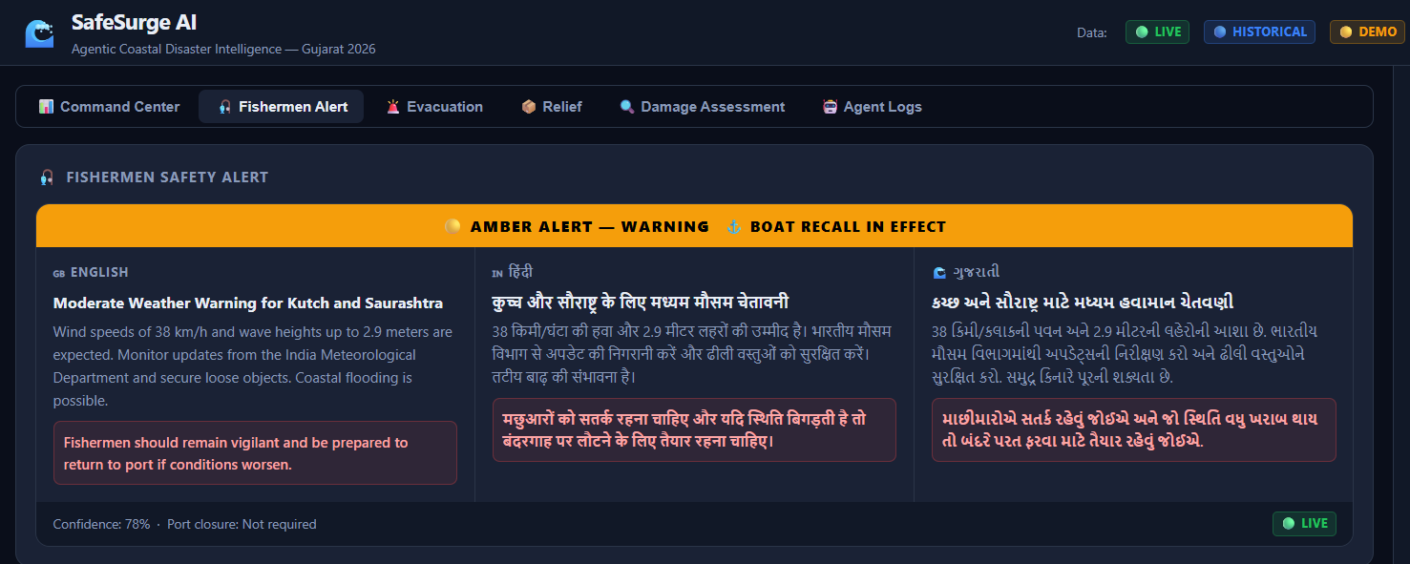
APPLICATION WALKTHROUGH
Fishermen Safety Alert Card
18

Slide 19
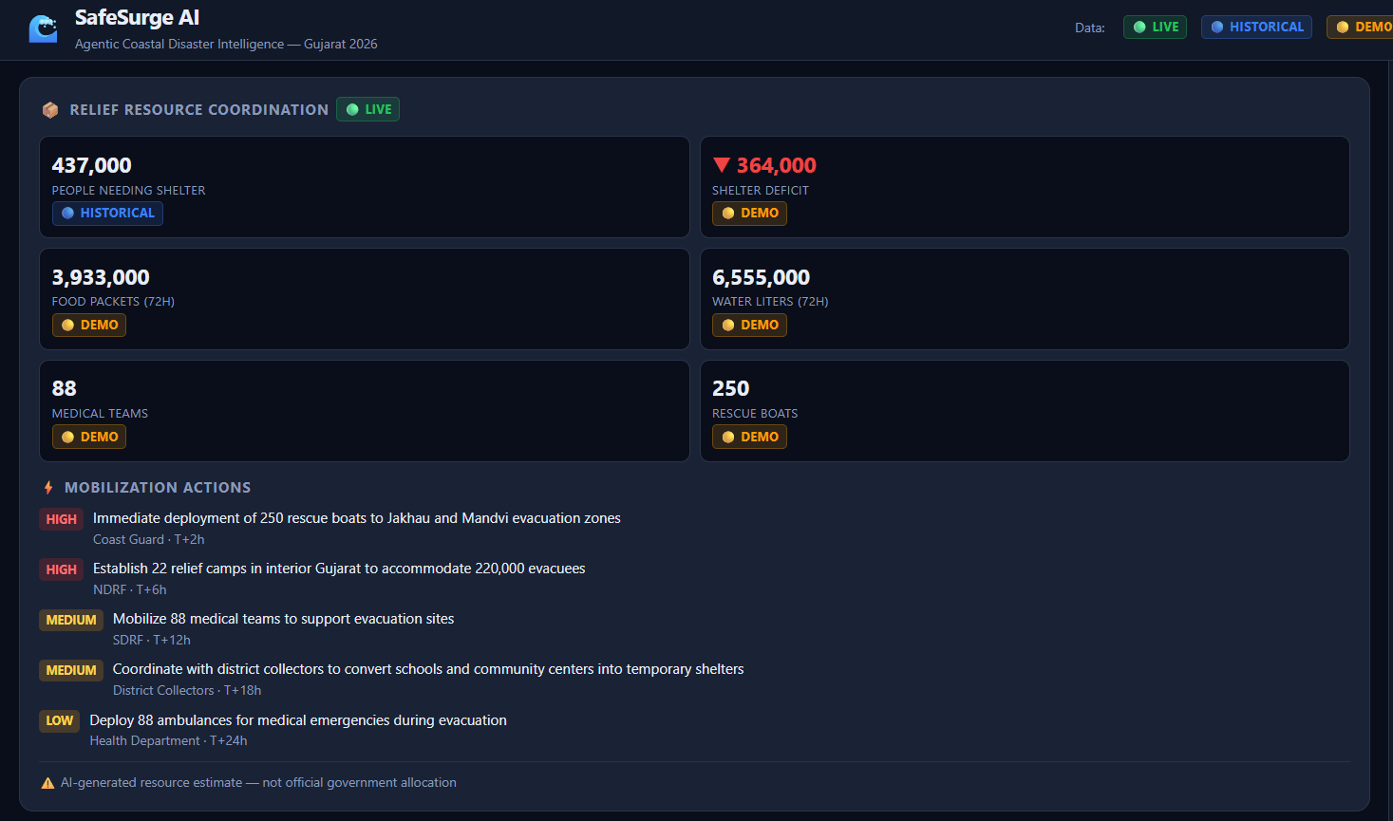
APPLICATION WALKTHROUGH
Evacuation Priority List & Relief Coordination
19

Slide 20
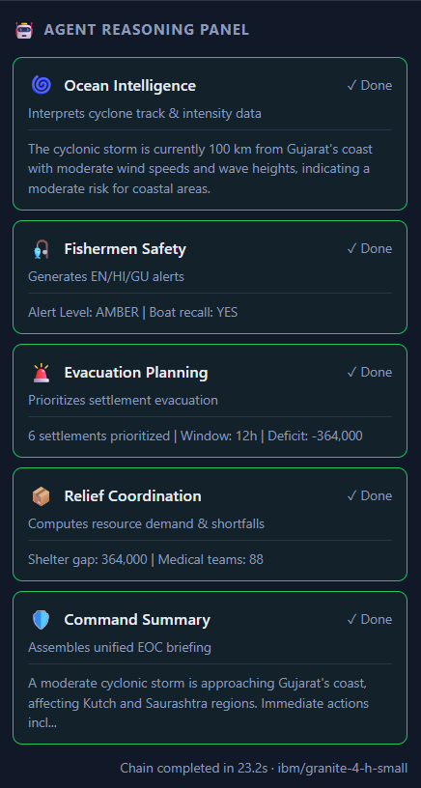
APPLICATION WALKTHROUGH
Agent Reasoning panel
18

Slide 21


