Slide 1
CO2 Emissions
Using Machine Learning

Slide 2
Group Members Names:
Miss Sindhu M J
Mr.Omkar Navnath Jagdale
Mr. Gopi Maran
Mr. Ashutosh Ramesh Gaikwad

Slide 3
Problem Statement:
Model CO2 emissions based on car engine features to optimize fuel efficiency, enhance environmental sustainability, and guide regulatory decisions for cleaner transportation systems.

Slide 4
Technical Parameter:
Data Preprocessing Parameter | Machine Learning Algorithms | Model Evaluation Metrics | Deployment
Data cleaning | Linear Regression | MAE | Pickled model
Handling missing values | Random Forest | MSE | Streamlit
Outlier detection and removal | Decision trees | RMSE
Data normalization |  | r2
Feature scaling

Slide 5
Dataset Details:
Co2 Emission Datasets:
Points | Values
Columns | 12
Rows | 7385
Data types | Object,int64, float64
Missing values | 0
Duplicates values | 1112
Co2 Emission Dataset

Slide 6
Exploratory Data Analysis(EDA)
Points
Dataset Overview: 7385entries, 12columns
No Missing Values: All columns have non-null values
Duplicated values : 1112 duplicates values present in dataset
Data Types: Mix of object, int64, and float64
Co2 Emission: the CO2 emissions as a function of several car engine features

Slide 7
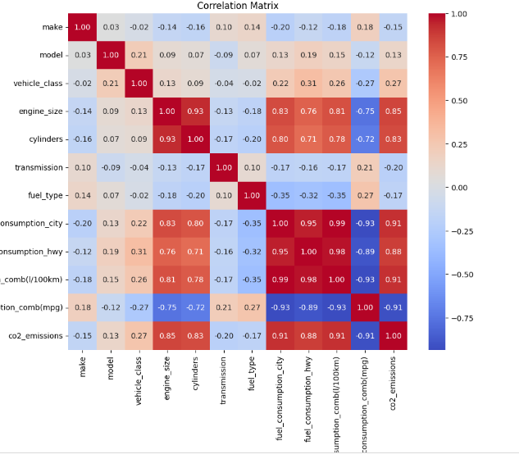
Data Visualization
HeatMap
A heat map of the correlation matrix is plotted using seaborn, displaying correlations between variables in a color-coded manner

Slide 8
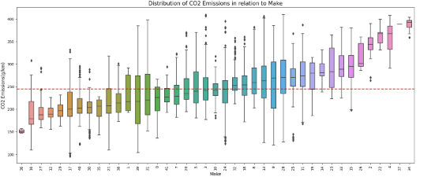
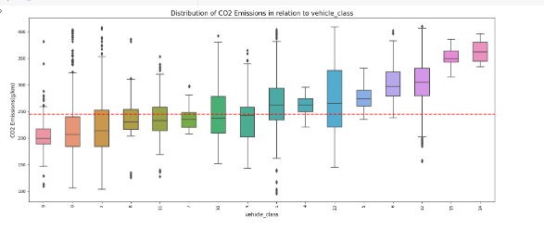
Box Plot:
Visualize CO2 emissions distribution across car makes, revealing emissions variations and guiding manufacturer-specific environmental efforts
Examine CO2 emissions distribution across vehicle classes, aiding understanding of emissions disparities and informing eco-friendly transportation strategies.

Slide 9
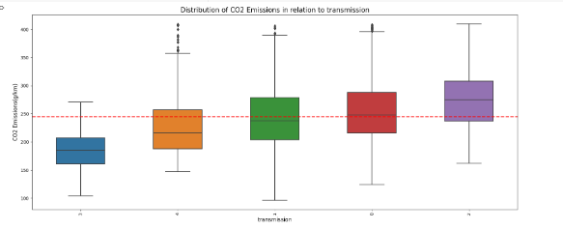
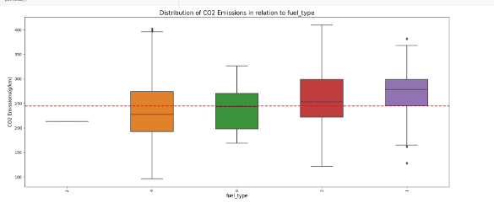
Explore CO2 emissions distribution by transmission types, discerning variations and implications for emissions reduction strategies.
Visualize CO2 emissions distribution across fuel types, highlighting medians, aiding insights into environmental impacts.

Slide 10
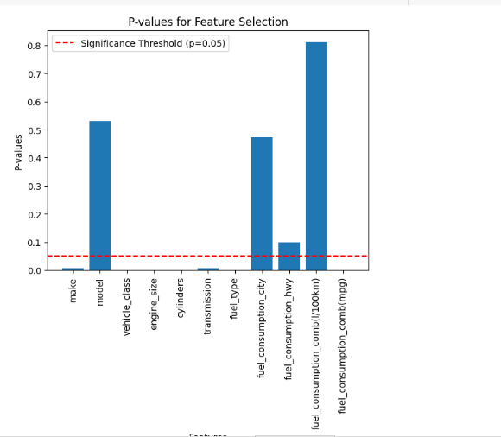
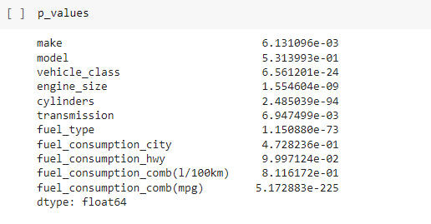
Feature Selection
Conducting feature selection guided by p-values to identify statistically significant variables and enhance model simplicity and predictive accuracy.

Slide 11
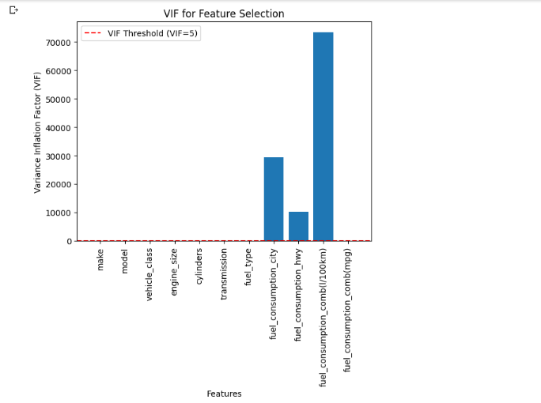
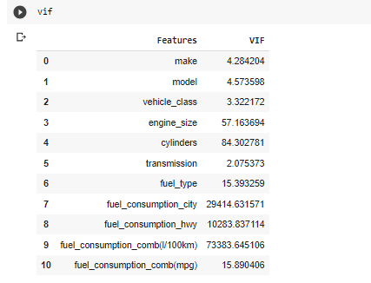
Multicollinearity
"Multicollinearity hampers regression with correlated predictors. In feature selection, combating it ensures robust, interpretable models."

Slide 12
Model Building
Model Performance Comparison:
Random Forest outperforms with the lowest MSE (3.51) and highest R-squared (0.988), showcasing superior predictive accuracy.
Decision Tree follows closely with MSE 3.66 and R-squared 0.987, indicating robust performance.
Linear Regression lags with higher MSE (8.19), implying lower accuracy compared to tree-based models.
Random Forest excels in predictive accuracy (MSE 3.51, R-squared 0.988), followed by competent Decision Tree (MSE 3.66, R-squared 0.987). Linear Regression lags (MSE 8.19)

Slide 13
Models | MAE | MSE | RMSE | R2
Linear Regression | 8.188448 | 129.434586 | 11.376932 | 0.948335
Decision Tree | 3.658399 | 33.727861 | 5.807569 | 0.986537
Random Forest | 3.512562 | 31.042888 | 5.571614 | 0.987609

Slide 14
Challenges
Challenge | Description
Data Collection | Gathering diverse emissions data sources.
Feature Selection | Choosing relevant influencing factors.
Data Preprocessing | Handling missing values, normalization.
Multicollinearity | Managing correlated predictor variables.
Model Complexity | Avoiding overfitting, controlling complexity.
Interpretability | Ensuring results are understandable.
Performance Evaluation | Assessing model effectiveness accurately.

Slide 15
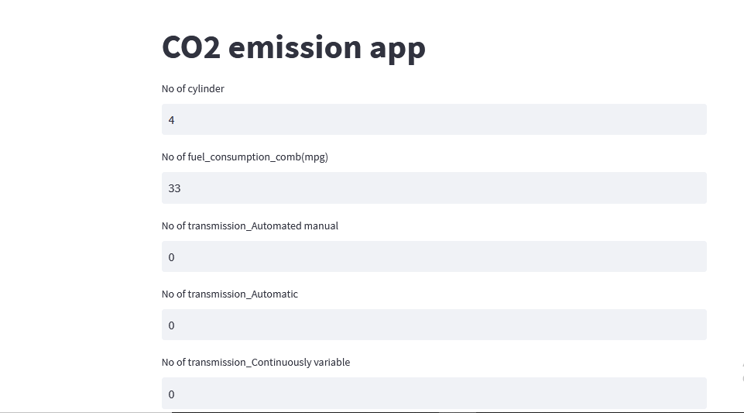
Model Deployment
Streamlit, Pickle, and Spyder integration allows user-friendly real-time predictions, enhancing accessibility, deployment, and monitoring.

Slide 16
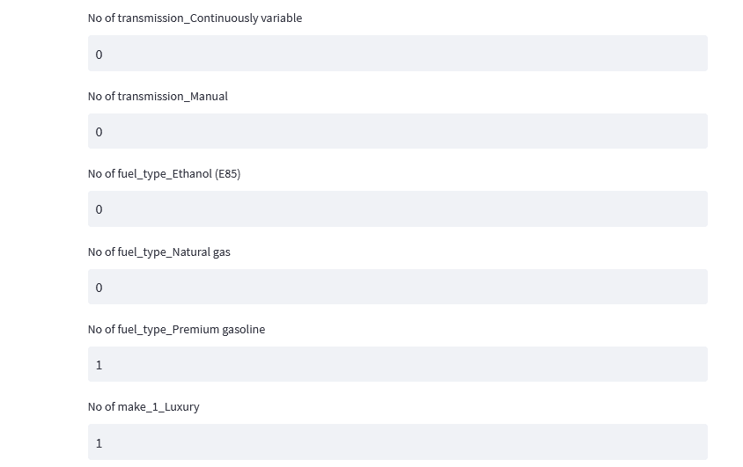
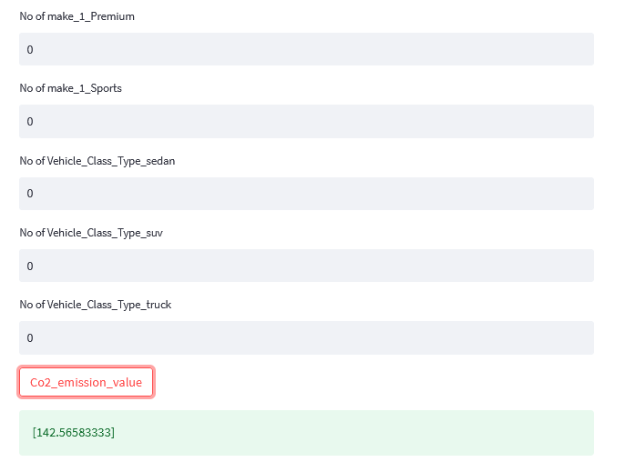

Slide 17
Conclusion
In the CO2 emission project, extensive data analysis, feature extraction, and model training were conducted using linear regression, random forest, and decision tree. Among these, the random forest excelled in training the dataset. The model is now deployed via Pickle, Streamlit, and the Spydle platform to serve automobile companies, offering a user-friendly application for automated insights

Slide 18
Thank You

