Slide 1


RAJIV GANDHI COLLEGE OF ENGINEERING & RESEARCH, NAGPUR Department of Computer Science & Engineering
Project Seminar On
“OBJECT DETECTION ON RASPBERRY PI ”
Presented by,
1. ONKAR KIRPAN
2. POOJA BAVISKAR
3. SHIVANI KHAWASE
4. ANJALI MANKAR
5. KARISHMA RAMTAKE
Under Guidance of
Prof. H.R. Turkar
Guide

Slide 2
Content
Introduction
Literature Survey
Problem Statement
Existing System
Aim & Objective
Proposed Work
System Flow
Methodology/Algorithm
Implementation Strategies
S/W & H/W Requirements
Cost Estimation
Conclusion
References/Bibliography

Slide 3
Introduction
The aim of this project is to present a method for object detection and tracking based on its color.
By using this method, one can easily detect and track any object which may be a ball or book or even an enemy aircraft’s missiles i.e., this method can be used even in many security applications.

Slide 4
Literature Survey
Sr.No. | Title of paper | Abstract | Proposed approach | Year | Focus/function /conclusion | Future work | Your opinion/comments/Suggestion
1 | OBJECT DETECTION AND TRACKING USING IMAGE PROCESSING | This paper mainly focuses on the basis to implement the object detection and tracking based on its color and shape. | This paper mainly focuses on the basis to implement the object detection and tracking based on its color. | 2014 | The objective is to build a model that can detect the object of specified color and that works on the basis of visual data captured from a typical webcam which has a fair clarity. | The future scope of this work is to develop a robotic arm which detects and tracks the object based on color and shape. | This paper gives the proper conception for implementing our project
2 | Real Time Object Detection & Tracking System (locally and remotely) with Rotating | This paper presents an implementation of real time detection and tracking of an unknown object | Detection of a moving object is necessary for any surveillance system. | 2013 | This paper describes object tracking application and its implementation using different designs with rotating camera. | This implementation can be expanded for multiple object tracking as well | Improve the knowledge about the camera.

Slide 5
Literature Survey
Sr.No. | Title of paper | Abstract | Proposed approach | Year | Focus/function /conclusion | Future work | Your opinion/comments/Suggestion
3 | Mobile Robot for Object Detection Using Image Processing | This paper describes a robotic application that tracks a moving object by utilizing a mobile robot with sensors and image processing. | In the majority of surveillance and video tracking systems, the sensors are stationary. | 2012 | This paper implemented Robotic Application which will detect the objects and avoid the obstacles. | In the future, we can extend the work to detect the moving object with multiple cameras | Use of mobile robot in object detection.
4 | Color Image Processing and Object Tracking System | This report describes a personal computer based system for automatic and semiautomatic tracking of objects on film or video tape. | The Tracking System achieves the automation by integrating the discrete components into a cohesive system . | 1996 | The automation of the system removes much of the tedium of tracking objects manually as was done in the past. | The Tracking System can also be used for analysis other than tracking object movements, such as color characterization | Described the application of object detection.

Slide 6
Literature Survey
Sr.No. | Title of paper | Abstract | Proposed approach | Year | Focus/function /conclusion | Future work | Your opinion/comments/Suggestion
5 | PRACTICAL APPLICATIONS OF ROBOTIC HAND USING IMAGE PROCESSING | Robotic hand is used in image processing our paper Presents various application for robotic hand. | The robot and robotic arm provide main function and useful for human worker in industry. | 2015 | In this paper we establish practical laboratory application. | This project can be extended for industrial automation. | Industrial use of robotic arm using object detection.
6 | Automated Driving Vehicle Using Image Processing. | This paper focuses on control and automation of intelligent road symbol detection system for vehicles in normal environment conditions. | Exploring the Signal Processing concepts such as Image Processing and Computer Vision along with algorithms of Data Structures we have developed a prototype of an autonomous vehicle with the a motivation to decrease the accidents. | 2014 | The image processing algorithms used here have found a lot of practical applications and it is still one of the most extensively researched areas | Technologies like corporative driving and inter-vehicle communication can be further included in order to enhance the efficiency. | This technique is used in safety purpose while driving.

Slide 7
Literature Survey
Sr.No. | Title of paper | Abstract | Proposed approach | Year | Focus/function /conclusion | Future work | Your opinion/comments/Suggestion
7 | Object Tracking Using Embedded Platform for Video Surveillance. | A real-time object tracking approach is important in video surveillance. | Object detection, object classification and object tracking are the basic steps for tracking an object | 2015 | In this paper, we proposed the color based algorithm to track the object | In future, the proposed algorithm will be used to remove the illumination, rotation and occlusions problems by adding color specification in proposed algorithm, which will be further research topic. | Describe the scope of object detection.

Slide 8
Literature Survey
Sr.No. | Book Name | Author’s Name
1 | Digital Image Processing: Part I | Huiyu Zhou, Jiahua Wu , Jianguo Zhang
2 | Image Processing: The Fundamental, 2nd Edition | Maria Petrou, Costas Petrou
3 | Image Processing and Acquisition using Python | Ravishankar Chityala, Sridevi Pudipeddi
4 | Image Processing: Principles and Applications | Tinku Acharya, Ajoy K. Ray
5 | The Essential Guide to Image Processing | Alan C. Bovik

Slide 9
Literature Survey
Sr.No. | Website Link:
1 | http://roboticssamy.blogspot.in/
2 | https://www.raspberrypi.org/blog/tag/opencv/
3 | https://www.cl.cam.ac.uk/projects/raspberrypi/tutorials/robot/image_processing/
4 | http://www.imageprocessingbasics.com/
5 | http://code.tutsplus.com/tutorials/image-processing-using-python--cms-25772

Slide 10
Problem Statement
Object detection in night vision.
The project mainly focuses on the basis to implement the object detection and tracking based on its color, which is a visual based project.
Reduce the complexity of system by using raspberry pi.
The input to the project will be the video/image data which is continuously captured with the help of a webcam which is interfaced to the Raspberry Pi.
It will detect the object and it tracks that object by moving the camera in the direction of the detected object.
For better image processing we are using graphics processing unit (GPU) which increases graphics-rendering performance on raspberry pi .

Slide 11
Existing System
Robotics: such as to avoid steering into an obstacle.
Machine vision: such as to automatically count items in factory conveyor belt.
Astronomy: such as calculating the size of planet.
Medicine: such as detecting cancer in a mammography scan.
Remote sensing: such as detecting intruders in a house, and producing land cover.
Security: such as detecting a persons eye color or hair color.

Slide 12
Aim & Objective
The objective is to build a model that can detect the object of specified color and that works on the basis of visual data captured from a typical webcam which has a fair clarity.

Slide 13
Propose Work
It may comprise of:-
1.Proposed Architecture/Model
2.Proposed Algorithm
3.Proposed Idea/Steps

Slide 14
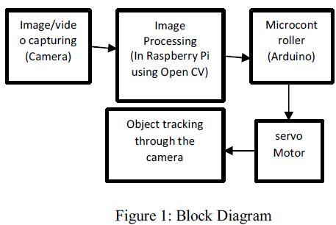
System Diagram/Architecture
The following figure shows the block diagram of this project. As shown in the figure, image will be captured through the camera which is then provided as an input to the Raspberry Pi
Fig: Block Diagram of Image Processing

Slide 15
Methodology/Algorithm
Building the robot platform
Image Input Phase
Object Tracking Phase
Robot Control Phase
Obstacle Detection Phase
Output Phase

Slide 16
Implementation Strategies
Creation of BOT
Implementation of Image Processing on BOT
Testing
Programming for Object Detection
Connection
Interfacing
Object Detection
Features Extraction
Output Generation

Slide 17
Pseudo code
START
INITIALIZE();
RUN THE CODE IN PYTHON
SAVE THE IMAGE IN SD CARD
EXTRACT THE DETAILS OF SAVE_IMG IN FSIMG
IF(FSIMG==NULL)
{
PRINTF ("IMAGE NOT SAVED")
}
DISPLAY THE IMAGE TO USER VIEWER
EXTRACT THE DETAILS OF CAP_IMG IN FCIMG
IF(FSIMG==FCIMG)
{
PRINTF("IMAGE FOUND")
}
ELSE
{
PRINTF("IMAGE NOT FOUND")
}
END

Slide 18
Pseudo code
function INITIALIZE()
{
INSTALL THE RASPBERRY PI OS TO THE SD CARD
CONNECT THE COMPONENTS TO THE HARDWARE AND SWITCH ON THE SUPPLY
LOGIN THE RASPBERRY PI BORD
CHECK THE NETWORK SETTINGS
ENABLE THE CAMERA AND CPTURE AN IMAGE
END function
}

Slide 19
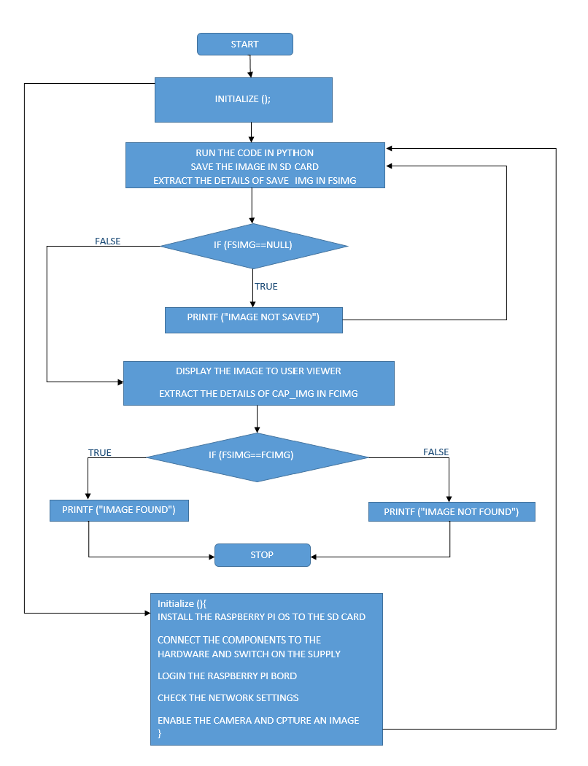
Flow Chart

Slide 20
S/W & H/W Requirements
Python- (open source)
Bash script- (open source)
Open CV- (open source)
Wheezy Raspbian- (open source)

Slide 21
Cost Estimation
Raspberry pi3 model B-(Rs.4398)
Camera with night vision-(Rs.3500)
Servo Motor-(Rs.3200)
Motor driver-(Rs.600)
Lipo battery-(Rs.2,930)
Chassis-(Rs.2000)
Ultra sonic sensor-(Rs.125)

Slide 22
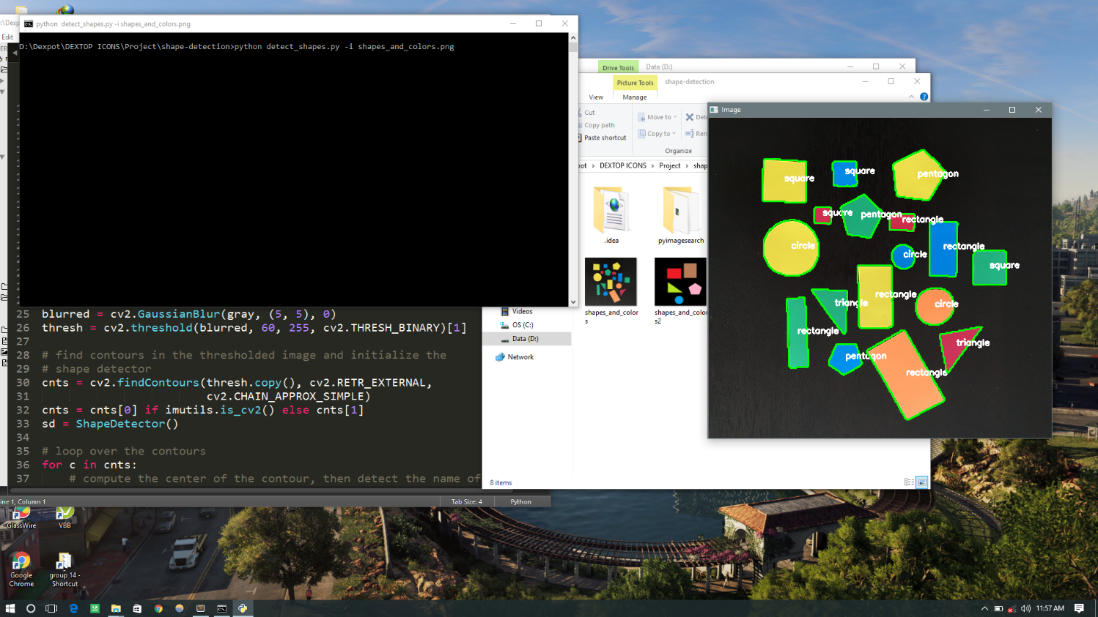
Result
The output of shape detection program shown in above figure. Shapes in the provided image are successfully detected and labelled on the image as shown in figure.

Slide 23
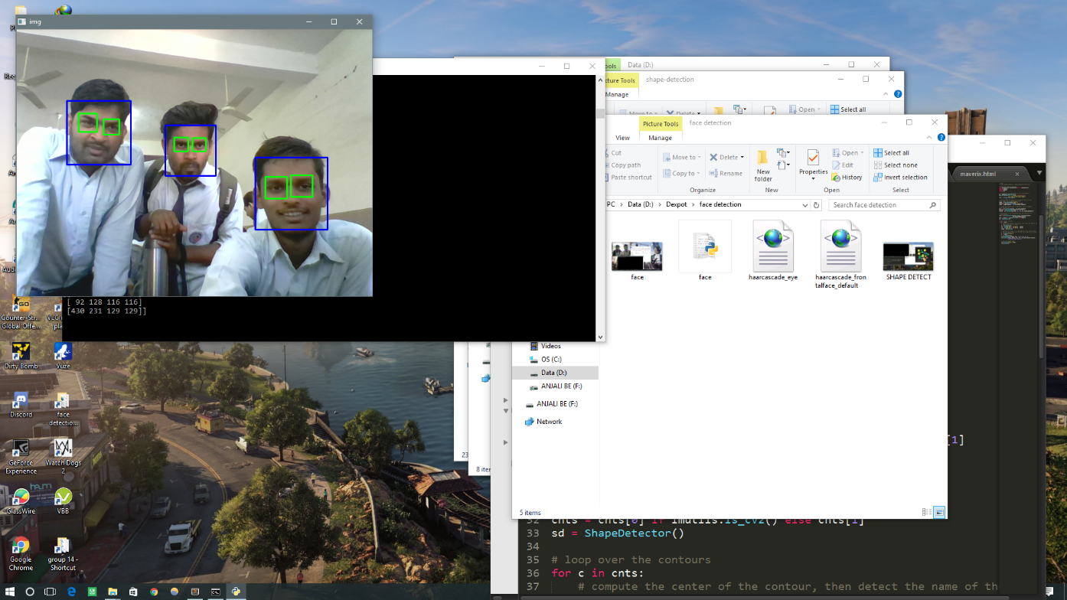
Result
The output of face detection program shown in above figure. Faces are successfully detected in real time as shown in figure.
All the image processing models were designed, implemented and finally verified and tested on the RPi3 platform successfully.

Slide 24
Conclusion
We have implemented Robotic Application which will detect the objects and
avoid the obstacles using image processing on Raspberry Pi.

Slide 25
References
Papers:
[1] LalehMakarem, Denis Gillet , “Information sharing among autonomous vehicles crossing an Intersection”,IEEE International Conference on Systems, Man, and Cybernetics, October 14-17, 2012.
[2] S. Yuan, H. Lau, D.K. Liu, S.D. Huang, G. Dissana yake, D. Pagac, T. Pratley, Simultaneous DynamicScheduling and Collision-Free Path Planning for Multiple Autonomous Vehicles, IEEEInternational Conference on Information and Automation June 22 -25, 2009
[3] Vijayalaxmi, K.Anjali, B.Srujana, P.Rohith Kumar "OBJECT DETECTION AND TRACKING USING IMAGE PROCESSING"Global Journal of Advanced Engineering Technologies,ISSN (Online): 2277-6370 & ISSN (Print): 2394-0921-2014.
[4] Prof. Saurabh Thakur1, Shekhar Dure2, Ajinkya Khutwad3'"ADVANCE VEHICLE CONTROL AND SAFETYSYSTEM USING FACE DETECTION"International Journal of Advance Research In Science And Engineering http://www.ijarse.comIJARSE, Vol. No.4, Issue 05, May 2015
[5] Swathi.V, Steven Fernandes"Raspberry Pi Based Human Face Detection"International Journal of Advanced Research in Computer and Communication Engineering Vol. 4, Issue 9, September 2015

Slide 26
[6] Samar D. Gajbhiye, Pooja P. Gundewar"Object Tracking Using Embedded Platform for Video Surveillance"International Journal of Innovative Research in Computer and Communication Engineering(An ISO 3297: 2007 Certified Organization)Vol. 3, Issue 7, July 2015.
[7] Ms. RenukaChuimurkar, Prof. Vijay Bagdi, Assistant Professor, A.G.P.C.E"Smart Surveillance Security &Monitoring System UsingRaspberry PI and PIR Sensor"International Journal of Scientific Engineering and Applied Science (IJSEAS) – Volume-2, Issue-1, January 2016
[8] Sneha Singh1, PradnyaAnap2, YogeshBhaigade3, Prof.J.P.Chavan4"IP Camera Video Surveillance using Raspberry Pi"International Journal of Advanced Research in Computer and Communication Engineering Vol. 4, Issue 2, February 2015.

Slide 27
Books:
[1] Digital Image Processing: Part I
Huiyu Zhou , Jiahua Wu , Jianguo Zhang
[2] Image Processing: The Fundamentals, 2nd Edition
Maria Petrou, Costas Petrou
[3] Image Processing and Acquisition using Python
RavishankarChityala SrideviPudipeddi 2015 CRC Press
[4] Image Processing: Principles and Applications
Tinku Acharya Ajoy K. Ray 2005
[5] The Essential Guide to Image Processing
Alan C. Bovik 2009

Slide 28
Websites:
[1] http://roboticssamy.blogspot.in/
[2] https://www.raspberrypi.org/blog/tag/opencv/
[3] https://www.cl.cam.ac.uk/projects/raspberrypi/tutorials/robot/image_processing/
[4] http://www.imageprocessingbasics.com/
[5] http://code.tutsplus.com/tutorials/image-processing-using-python--cms-25772

Slide 29
Questions & Answers

Slide 30
Thank You

