Slide 1
Session 1
Understand Ratios​

Slide 2
More or Less Than 500
27 × 18
39 × 14
31 × 16

Slide 3
Number String Matrix
9 + 7 = 16 | 1.9 + 0.7 | 1.9 + 1.7 | 1.9 + 2.7 | 1.9 + 3.7
0.9 + 0.7 | 1.9 + 0.7 | 1.9 + 2.7 | 2.9 + 2.7 | 2.9 + 3.7
0.9 + 0.8 | 1.9 + 0.8 | 1.9 + 2.8 | 2.9 + 2.8 | 2.9 + 3.8
0.9 + 0.9 | 1.9 + 0.9 | 1.9 + 2.9 | 2.9 + 2.9 | 2.9 + 3.9
0.9 + 1.9 | 1.9 + 1.9 | 1.9 + 2.9 | 2.9 + 2.9 | 2.9 + 3.9

Slide 4
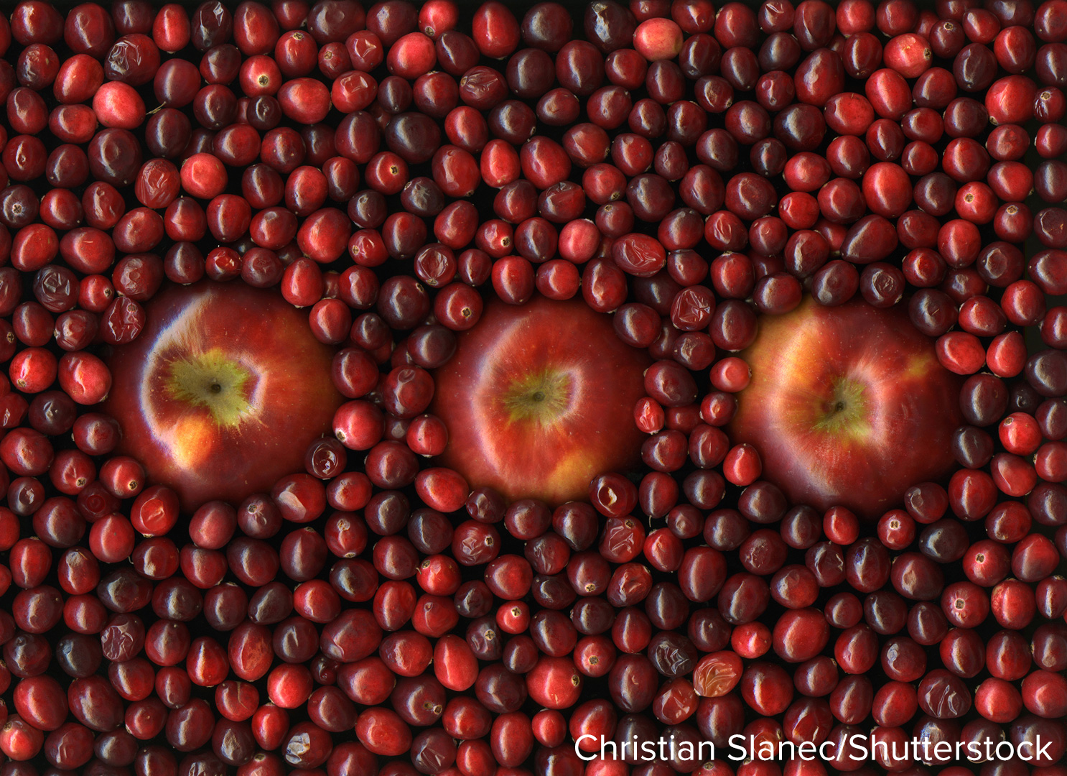

Be Curious
What do you notice? What do you wonder?
Mindset

Slide 5
Be Curious
What do you notice? What do you wonder?
Mindset
What helps you work productively with your classmates?

Slide 6
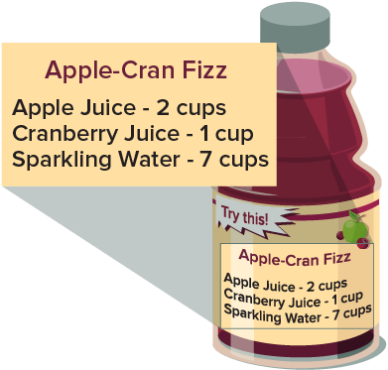
Making a Fruit Drink
The recipe shows the ingredients needed to make one batch of sparkling cranberry-apple fruit drink.
How can you describe the relationship between the apple juice and the fruit drink? between the apple juice and sparkling water?
Think About It:

Slide 7
Making a Fruit Drink
The recipe shows the ingredients needed to make one batch of sparkling cranberry-apple fruit drink.
How can you describe the relationship between the apple juice and the fruit drink? between the apple juice and sparkling water?
Think About It:
How many cups of fruit drink are in one batch?

Slide 8
What do you know about the cups of apple juice and total cups of fruit drink in one batch?
Reveal:

Slide 9
What do you know about the cups of apple juice and total cups of fruit drink in one batch?
Reveal:
Two cups of apple juice are needed to make 10 cups of fruit drink.

Slide 10
For 2 cups of apple juice used, 10 cups of fruit drink are made.
How might you represent this relationship?
Reveal:

Slide 11
For 2 cups of apple juice used, 10 cups of fruit drink are made.
How might you represent this relationship?
Reveal:
One way is to use a tape diagram.

Slide 12
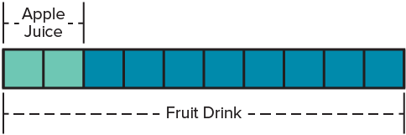
For 2 cups of apple juice used, 10 cups of fruit drink are made.
How are the two liquids related?
Reveal:

Slide 13
For 2 cups of apple juice used, 10 cups of fruit drink are made.
How are the two liquids related?
Reveal:
The apple juice is part of the fruit drink.

Slide 14
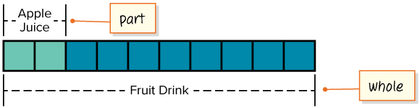
The apple juice is a part of the fruit drink.
The fruit drink is the whole.
Think About It:
Why is the fruit drink called “the whole”?

Slide 15
The relationship is a part-to-whole relationship.
It is a part-to-whole ratio.

Slide 16
A ratio is a relationship in which for every a units of one quantity, there are b units of another.
Two cups of apple juice are needed to make 10 cups of the fruit drink.

Slide 17
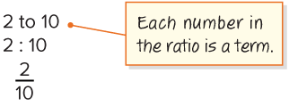
Two cups of apple juice are needed to make 10 cups of the fruit drink.
You can also use numbers to represent the relationship.
A part-to-whole relationship can be written in three ways.

Slide 18
Next, let’s look at the relationship between the apple juice and the sparkling water.
How can you describe the relationship?
Reveal:

Slide 19
Next, let’s look at the relationship between the apple juice and the sparkling water.
How can you describe the relationship?
Reveal:
Both are parts of the fruit drink.

Slide 20
Both the apple juice and the sparkling water are parts of the fruit drink.
The relationship is a part-to-part ratio.
For every 2 cups of apple juice, there are 7 cups of sparkling water.

Slide 21

Collaborate and Connect
For every 2 cups of apple juice, there are 7 cups of sparkling water.
How can you represent a part-to-part relationship?
Reveal:

Slide 22
Collaborate and Connect
For every 2 cups of apple juice, there are 7 cups of sparkling water.
How can you represent a part-to-part relationship?
Reveal:
One way is to use a tape diagram.

Slide 23
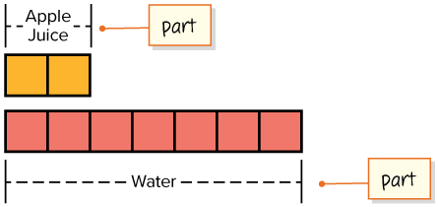

This tape diagram represents a part-to-part ratio. For every 2 cups of apple juice, there are 7 cups of sparkling water.
What is another way you can represent a part-to-part ratio?
Reveal:
Connecting Representations

Slide 24
This tape diagram represents a part-to-part ratio. For every 2 cups of apple juice, there are 7 cups of sparkling water.
What is another way you can represent a part-to-part ratio?
Reveal:
We can use numbers.
Connecting Representations
How can you connect mathematical ideas to representations?

Slide 25
For every two cups of apple juice in the fruit drink, there are seven cups of water.
You can represent a part-to-part ratio with numbers in two ways.
2 to 7
2 : 7

Slide 26
The recipe shows the ingredients needed to make one batch of sparkling cranberry-apple fruit drink.
How can you describe the relationship between the apple juice and the fruit drink? between the apple juice and the sparkling water?
The apple juice and fruit drink are a part-to-whole ratio. The apple juice and sparkling water are a part-to-part ratio.

Slide 27
Let’s Explore More
What kind of ratio is the cranberry juice to fruit drink relationship? Justify your thinking.
Workspace

Slide 28
Session 2
Understand Ratios

Slide 29
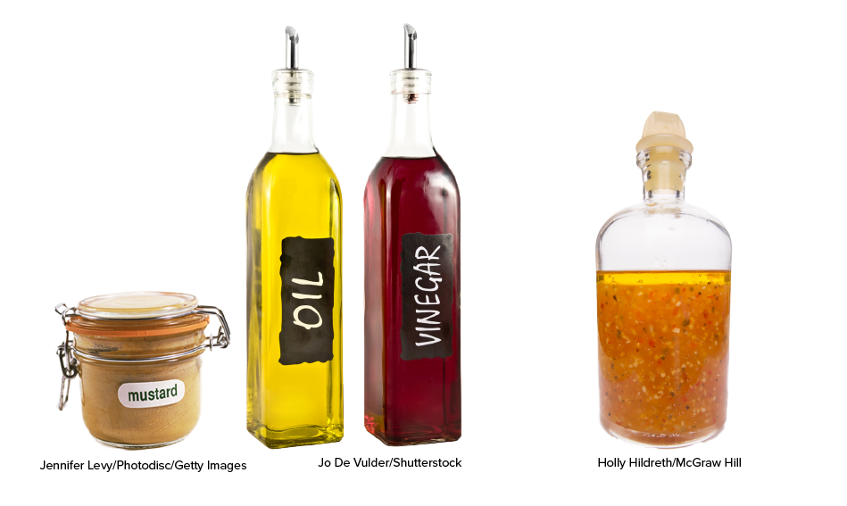
Be Curious
How are they the same? How are they different?
Mindset

Slide 30
Be Curious
How are they the same? How are they different?
Mindset
How are you building your confidence when engaging with math?

Slide 31
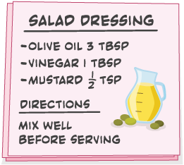
Making Salad Dressing
Tahira is making a salad dressing using the recipe shown. She plans to use 4 tablespoons of vinegar.
How can she determine the amount of olive oil she will need to keep the taste of the salad dressing the same?

Slide 32
Tahira is making a salad dressing using the recipe shown. She plans to use 4 tablespoons of vinegar.
How can she determine the amount of olive oil she will need to keep the taste of the salad dressing the same?
How do the vinegar and olive oil relate?
Reveal:

Slide 33
Tahira is making a salad dressing using the recipe shown. She plans to use 4 tablespoons of vinegar.
How can she determine the amount of olive oil she will need to keep the taste of the salad dressing the same?
How do the vinegar and olive oil relate?
Reveal:
Both are parts of the recipe for the salad dressing.

Slide 34
Both vinegar and olive oil are parts of the recipe. The relationship is a part-to-part ratio.
What is one way to represent the relationship?
Reveal:

Slide 35
Both vinegar and olive oil are parts of the recipe. The relationship is a part-to-part ratio.
What is one way to represent the relationship?
Reveal:
A tape diagram can represent the relationship.

Slide 36
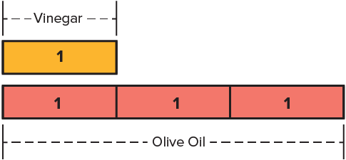
The tape diagram shows a part-to-part relationship.
How do the tablespoons of vinegar relate to the tablespoons of olive oil?
Reveal:

Slide 37
The tape diagram shows a part-to-part relationship.
How do the tablespoons of vinegar relate to the tablespoons of olive oil?
Reveal:
For every one tablespoon of vinegar, there are 3 tablespoons of olive oil.

Slide 38
Collaborate and Connect
For every one tablespoon of vinegar, there are three tablespoons of olive oil. The ratio of vinegar to olive oil is 1 to 3.
How can Tahira determine how much olive oil to use with 4 tablespoons of vinegar?

Slide 39
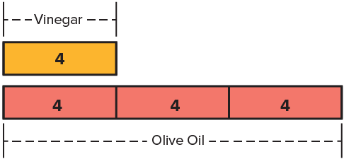
Collaborate and Connect (continued)
Tahira can change the value in each box of the tape diagram from 1 to 4.

Slide 40
How can Tahira determine how much olive oil to use with 4 tablespoons of vinegar?
Reveal:

Slide 41
How can Tahira determine how much olive oil to use with 4 tablespoons of vinegar?
Reveal:
She can add the values in the tape diagram, or she can multiply 4 by 3.

Slide 42
What could be another way to represent the part-to-part relationship?
Reveal:

Slide 43
What could be another way to represent the part-to-part relationship?
Reveal:
A double number line can represent the relationship.

Slide 44
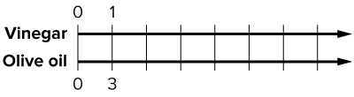
A double number line can be used to represent the relationship. A double number line consists of two number lines.
What patterns can you use to complete the number lines?
Reveal:

Slide 45
A double number line can be used to represent the relationship. A double number line consists of two number lines.
What patterns can you use to complete the number lines?
Reveal:
The numbers on the top number line increase by 1. The numbers on the bottom number line increase by 3.

Slide 46
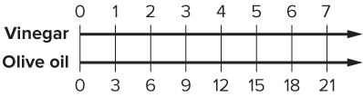
The numbers on the top number line increase by 1. The numbers on the bottom number line increase by 3.
Think About It:
Why do the numbers on the bottom number line increase by 3?

Slide 47
How can you use the double number line to determine how many tablespoons of olive oil are needed for 4 tablespoons of vinegar?
Reveal:

Slide 48
How can you use the double number line to determine how many tablespoons of olive oil are needed for 4 tablespoons of vinegar?
Reveal:
We can go to 4 on the top number line and look at the corresponding number on the bottom number line.

Slide 49
How can you use the double number line to determine how many tablespoons of olive oil are needed for 4 tablespoons of vinegar?
Looking for Structure

Slide 50
How can you use the double number line to determine how many tablespoons of olive oil are needed for 4 tablespoons of vinegar?
Looking for Structure
How can exploring patterns be helpful in solving this problem?

Slide 51
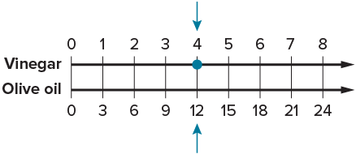
Twelve tablespoons of olive oil are needed when using 4 tablespoons of vinegar to make the salad dressing with the same taste.

Slide 52
Tahira is making a salad dressing using the recipe shown. She plans to use 4 tablespoons of vinegar.
How can she determine the amount of olive oil she will need to keep the taste of the salad dressing the same?
Tahira can use a tape diagram or a double number line to determine that 12 tablespoons of olive oil are needed when using 4 tablespoons of vinegar.

Slide 53
Let’s Explore More
How can Tahira determine the amount of salad dressing she will have if she uses 6 tablespoons of vinegar?
Workspace
Tahira added 4 teaspoons of mustard to the 4 tablespoons of vinegar. How will her salad dressing taste?
Workspace

Slide 54
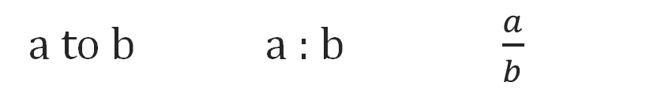
Summarize: Understand Ratios
A ratio is a relationship between two quantities. A ratio can represent a part-to-whole or a part-to-part relationship.
A ratio can be represented using tape diagrams and double number lines. A tape diagram is a rectangular visual representation used to represent relationships.
A ratio can be represented symbolically in three ways.
a to b a : b $\frac{a}{b}$

Slide 55
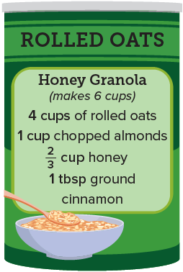
Apply: Middle School Fundraiser
Some sixth-grade students will make 50 bags of honey granola to sell at a fundraising event using the recipe shown. They will put 2 cups of granola in each bag and will sell each bag for $5.
Choose one question to answer.
Question 1: How many cups of rolled oats will the students need to buy?
Question 2: One pound of almonds costs $9.99 and has 3 cups of almonds. How much will the students need to budget for almonds?

Slide 56
Learning Targets
I can describe the relationship between quantities using ratios.
I can make sense of quantities to represent ratios using tape diagrams and double number lines.

