Slide 1
Handwritten Character Recognition using Bidirectional RNN
Date: 28-11-2019
Nikhil V Revankar - 01FB16ECS230
Omkar Metri - 01FB16ECS239

Slide 2
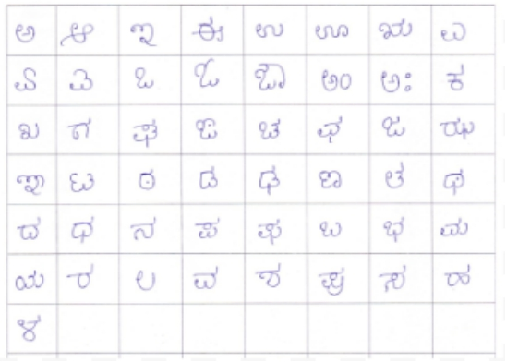
About the Dataset
Collected handwritten Kannada documents from different groups of people
Experiment was conducted on 500 such documents
Documents scanned from the scanner will have noise
Data preparation
The bounding box method is used on the images to extract the characters
Character images are extracted after drawing bounding box
Image resizing and binarization

Slide 3
Preprocessing
The images is resized to 28*28.
After this, the images is converted to black and white images using simple thresholding technique.
The pixel values are normalized for faster computation.
Labels are converted into one-hot encoding vector for the classification problem.

Slide 4
Environment
For training the model, Local Machine is sufficient with 4GB RAM and 1TB Hard disk space, since the dataset is not large enough to train the model.
The Bidirectional RNN model code was written in Tensorflow.

Slide 5
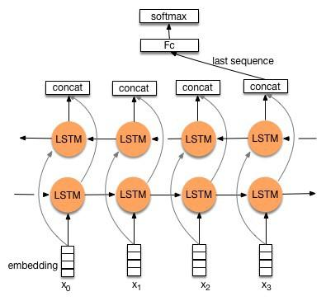
Bidirectional RNN Architecture

Slide 6
Model
The final layer of the architecture uses Softmax activation unit.
The error metric is softmax cross-entropy. The main reason for using softmax cross-entropy was because the gradient of the SCE error is directly proportional to the update made at that point.
For training the BiRNN model, Adam optimizer is used so that the effects of both momentum and RMSProp is considered.
The model is trained for 10 and 40 epochs. The model took 5 minutes to train. It is due to the presence of very small dataset.

Slide 7
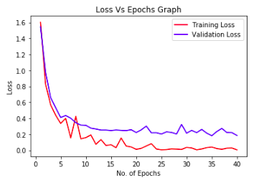
Evaluation Metrics and Results
Accuracy is used to measure the correctness of the model
Loss Measure vs Epochs graph
From the graph, the model seems to be overfitting from 15th epoch.
We concluded that the optimum number of epochs to train the model is 15
Achieved a Test accuracy of 90.9%

Slide 8
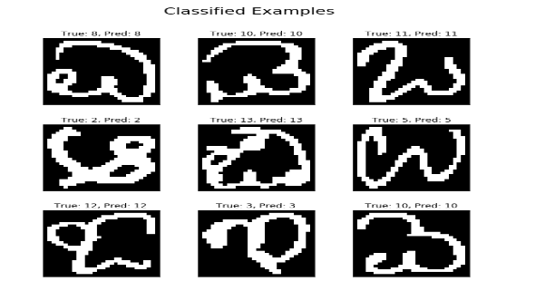
Correctly Classified Images

Slide 9
Thank You!!

