Slide 1

MeetYouDoctor
PRESENTATION ON
PROJECT REPORT

Slide 2
Guided By :- Mrs. Rupali Thorat
Presented By :-
Omkar Shivaji Mohite
Kunal Kisan Lokhande

Slide 3
INDEX : -
Introduction
Architecture
Technology platform used for project
User roles and responsibilities
Future extensions or scope
Conclusion

Slide 4
Introduction :-
Purpose :- The purpose of our Project “Meet Your Doctor” is to automate the process of getting medical treatment and health checkup in a way that saves both time and effort. It manages all the information of patient and doctors. The purpose of this project is to create a web application that reduces the manual efforts of looking for a doctor and booking appointments.

Slide 5
Architecture :-
Front End :- React JS, Bootstrap
Back End :- Java, Spring Boot REST API, JPA
DataBase :- MySQL

Slide 6
Reason for selecting the specific technology :-
React allows developers to create large web applications that can change data, without reloading the page. The main purpose of React is to be fast, scalable, and simple. It works only on user interfaces in the application.
Spring Boot provides a flexible way to configure Java Beans, XML configurations, and Database Transactions. It provides a powerful batch processing and manages REST endpoints. In Spring Boot, everything is auto configured; no manual configurations are needed.

Slide 7
User Roles And Responsibilities :-
MeetYourDoctor System consists of three roles described as below :-
Patient
Doctor
Admin

Slide 8
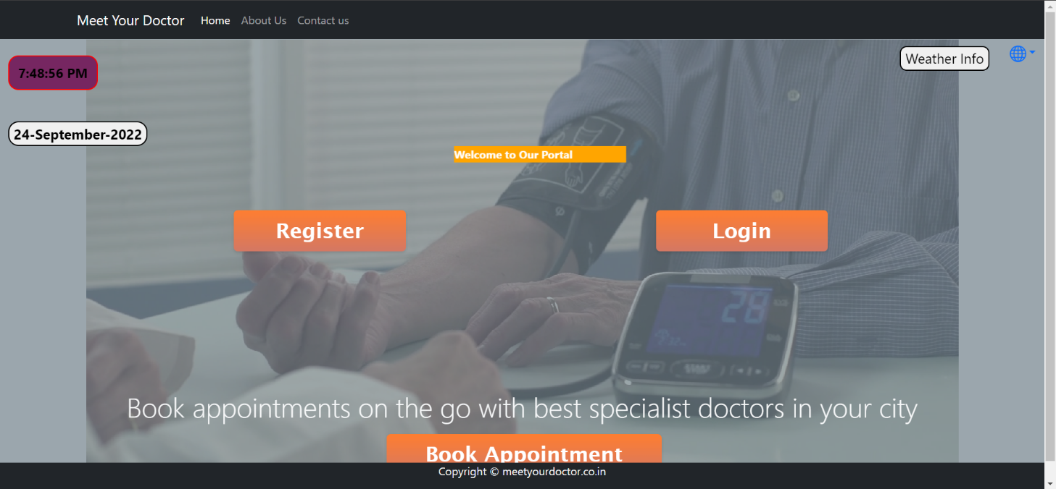
Home Page:

Slide 9
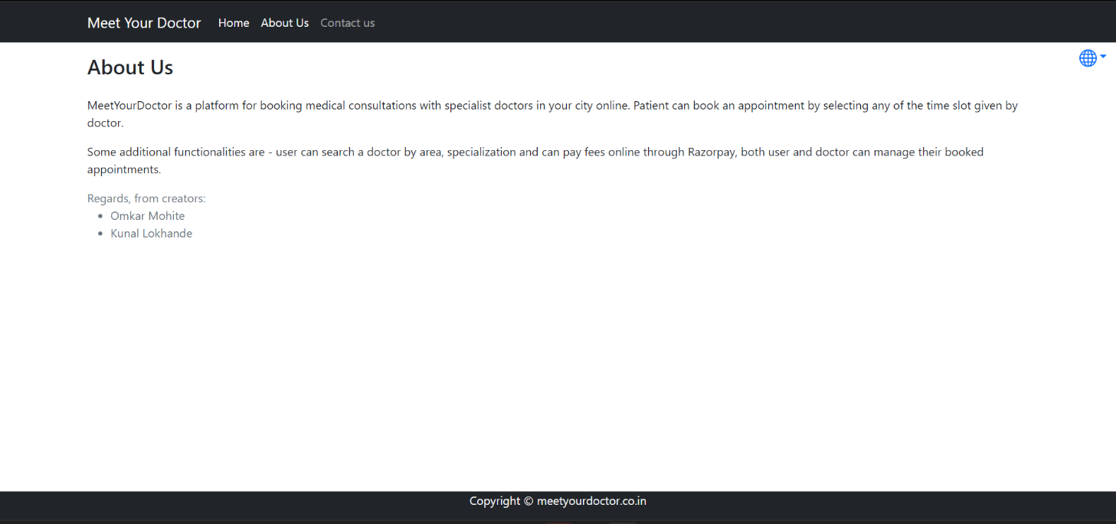
About and Contact Page

Slide 10
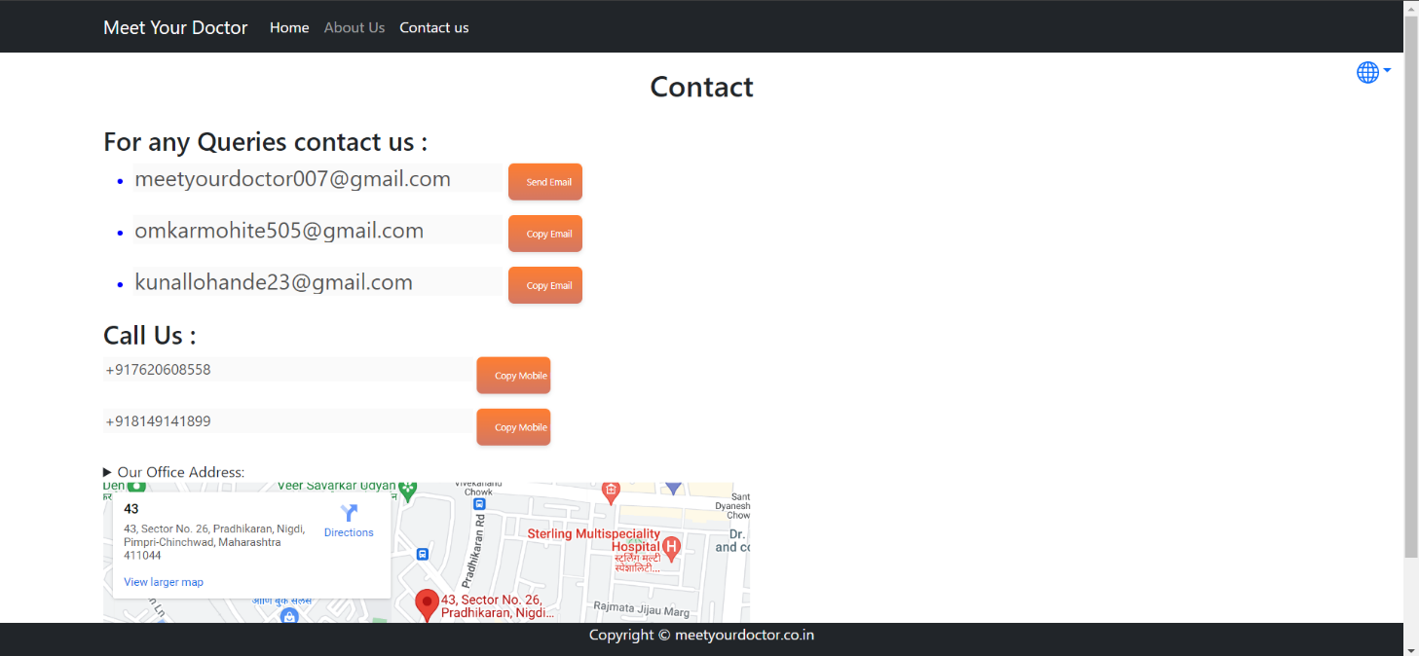

Slide 11
Patient :-
Registration Process
Login Process
Forgot Password
Change Password
Update Profile
Search Doctor
Book Appointment
Check Current Appointment
Cancel Appointment
View Appointment History

Slide 12
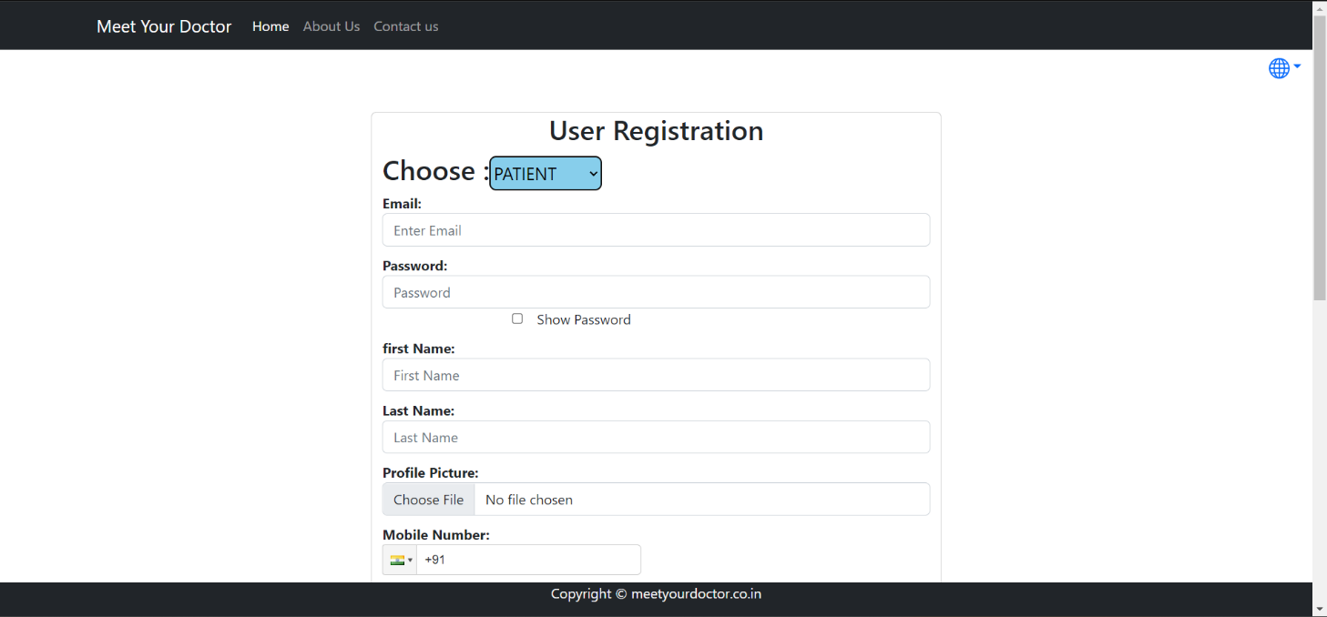
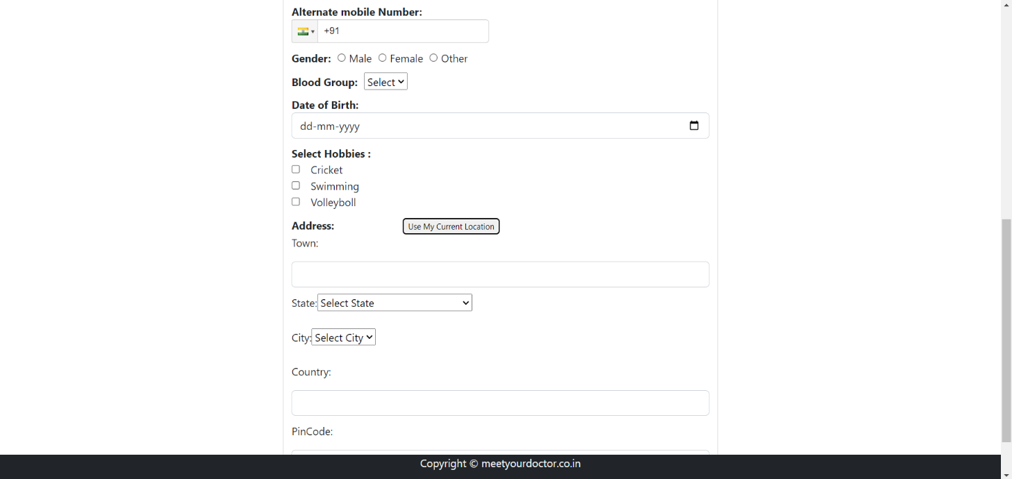
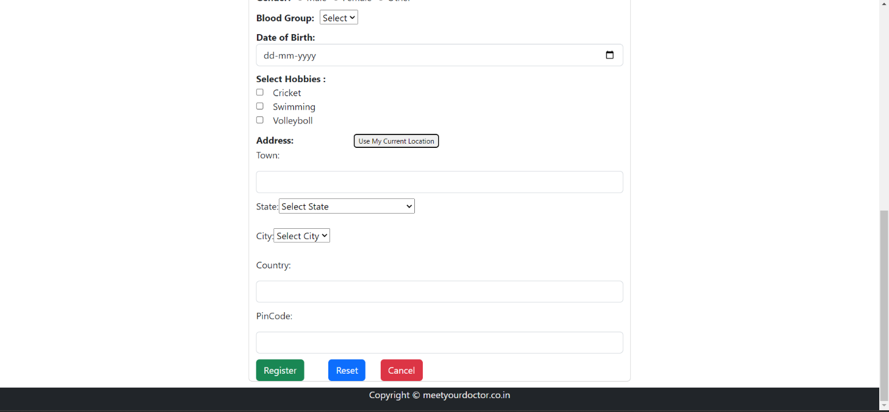
Patient Registration Page

Slide 13
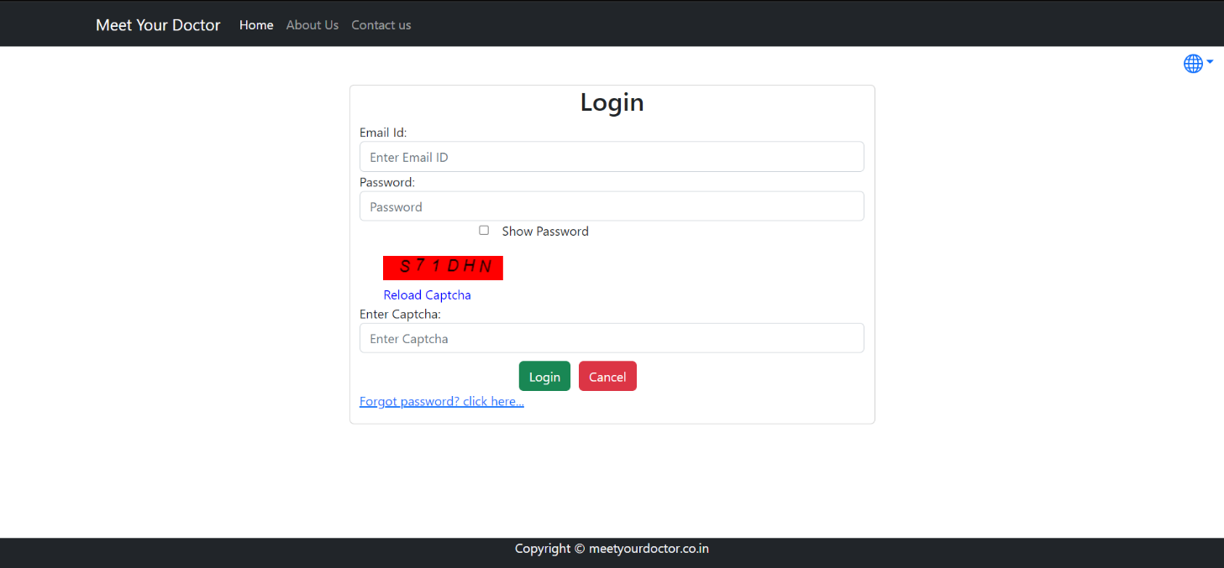
Login Page

Slide 14
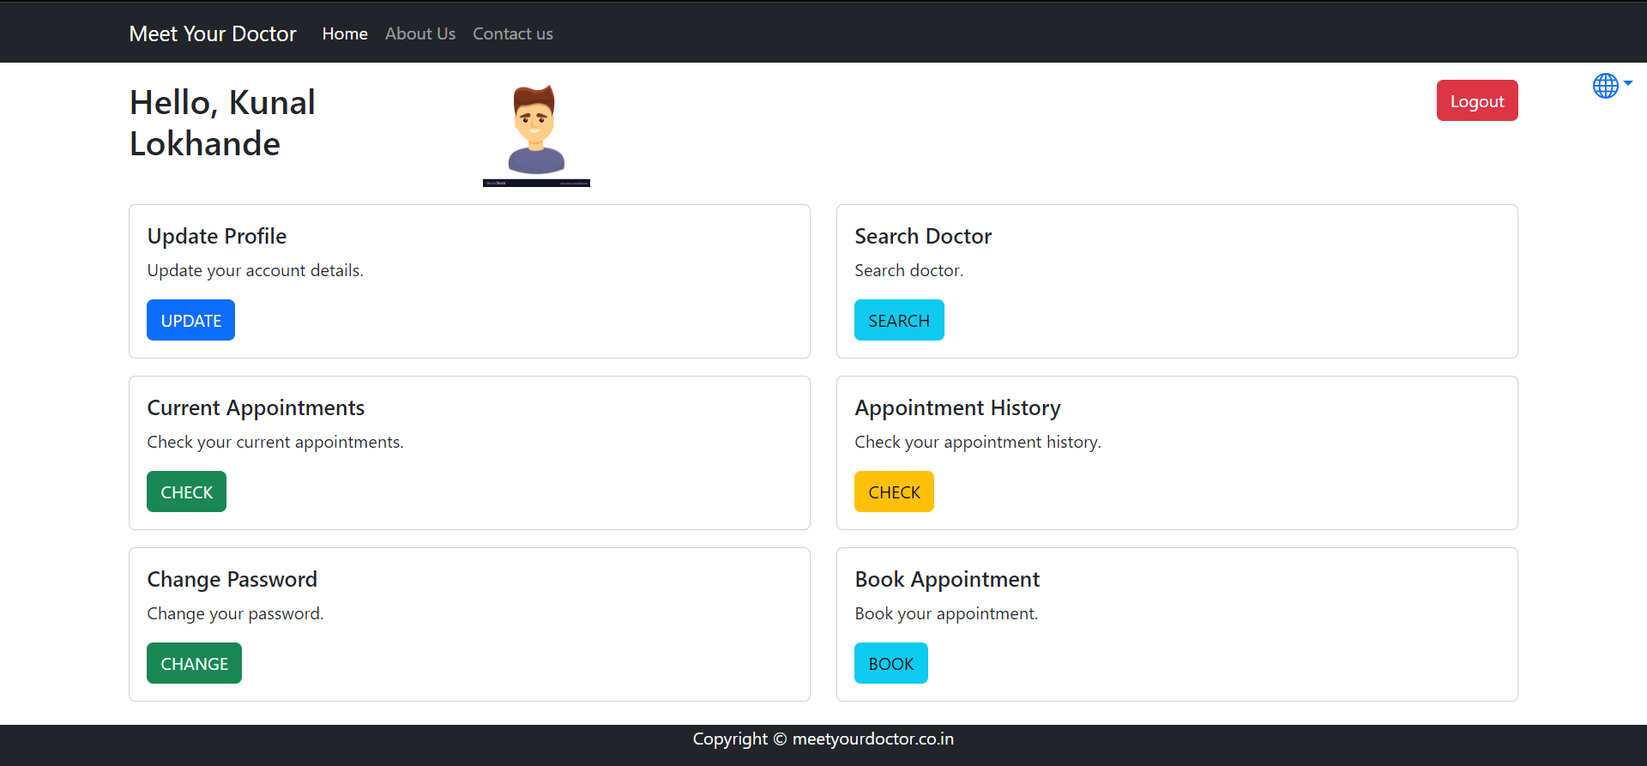
Patient Dashboard

Slide 15
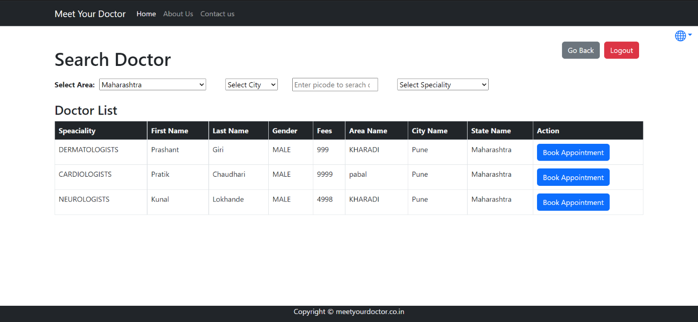
Patient Search Doctor

Slide 16
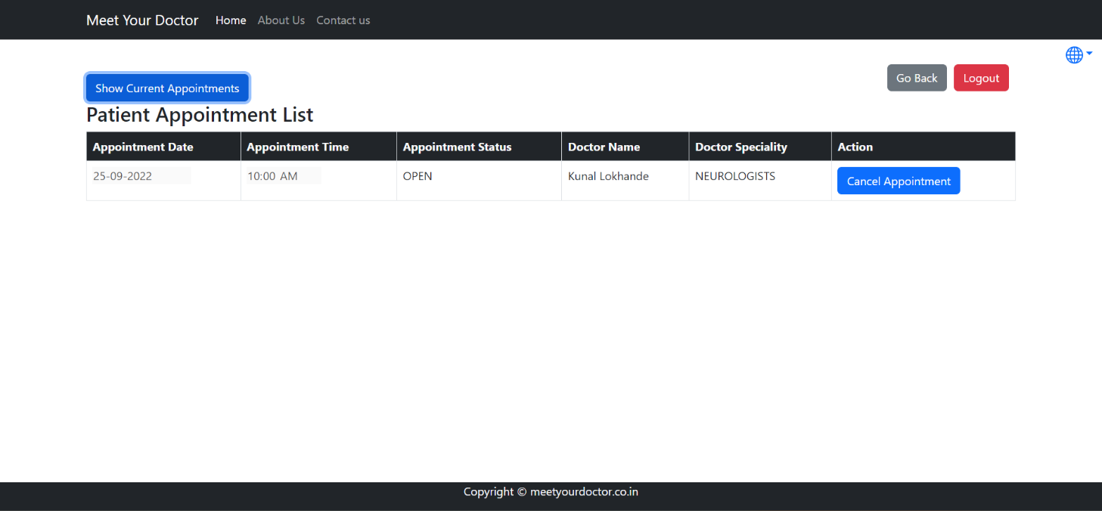
Patient Current Appointment

Slide 17
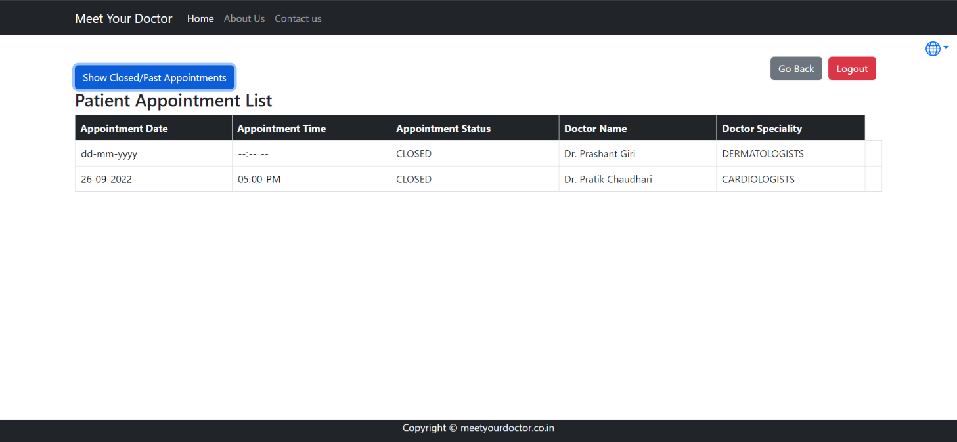
Patient Appointment History

Slide 18
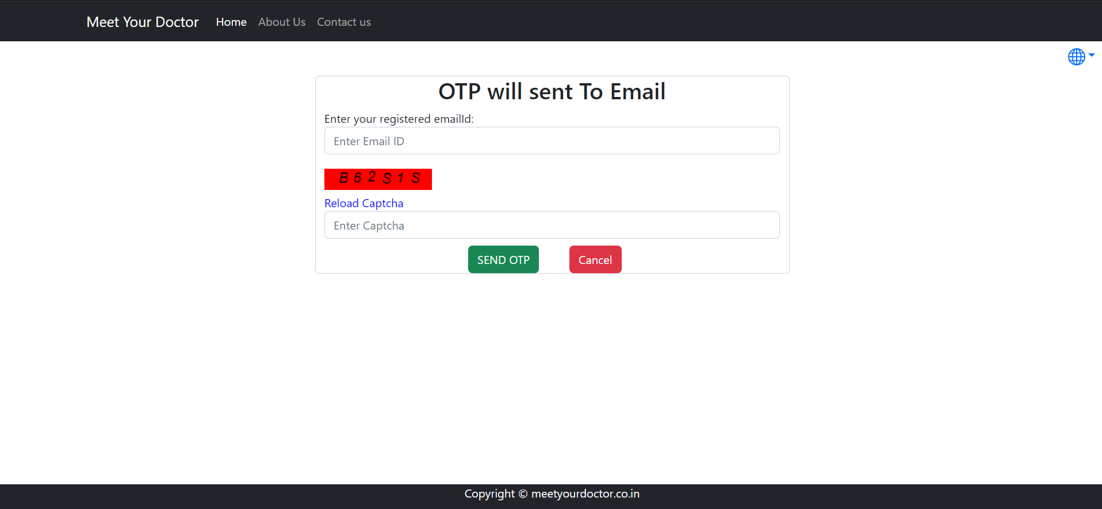
Patient Change Password

Slide 19

Patient Book Appointment

Slide 20
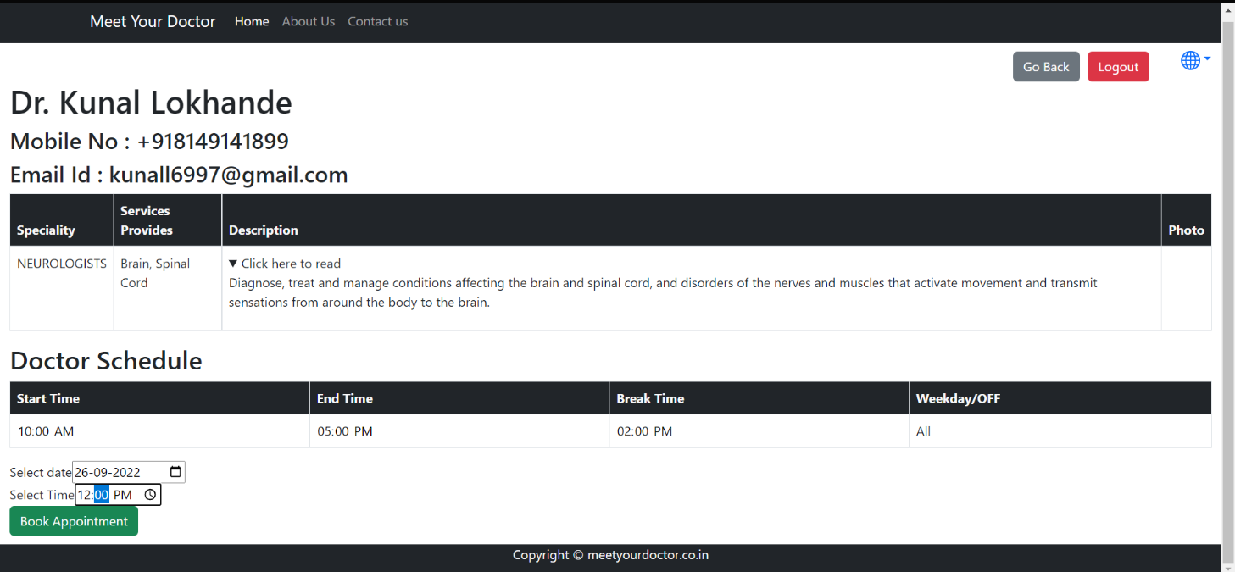

Slide 21
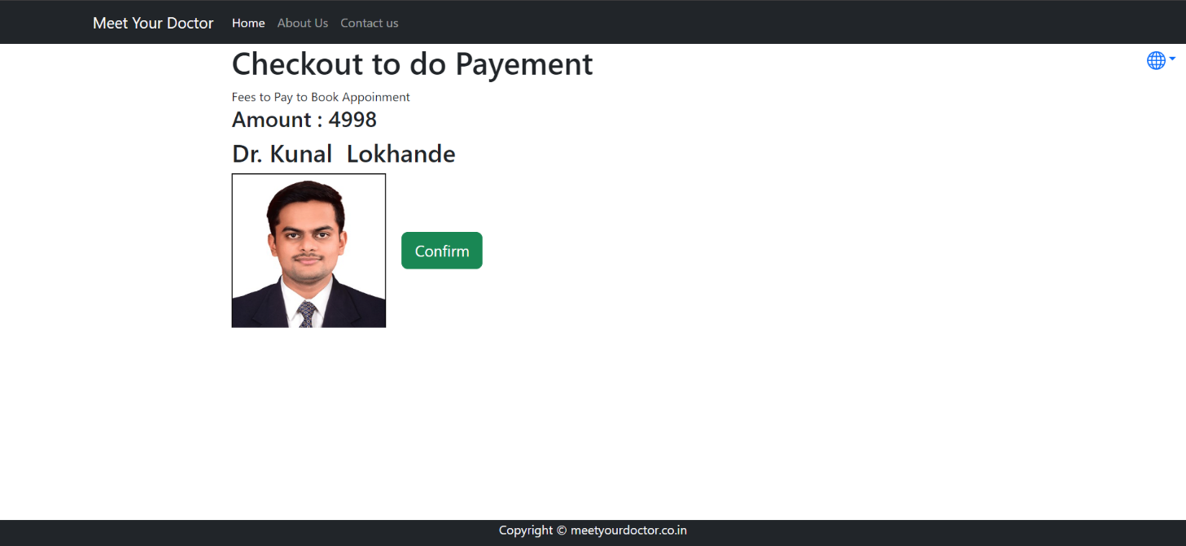
Payment Page

Slide 22
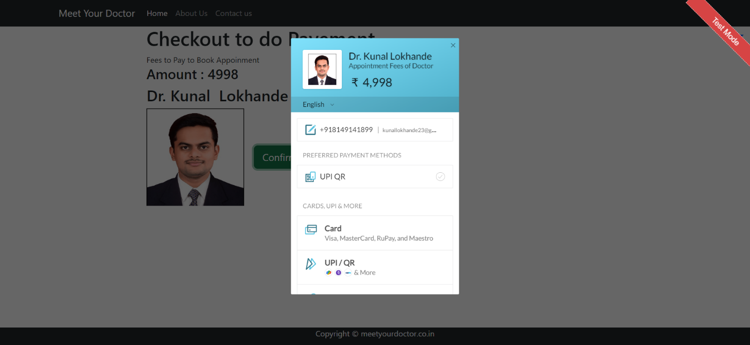
Payment Dashboard

Slide 23
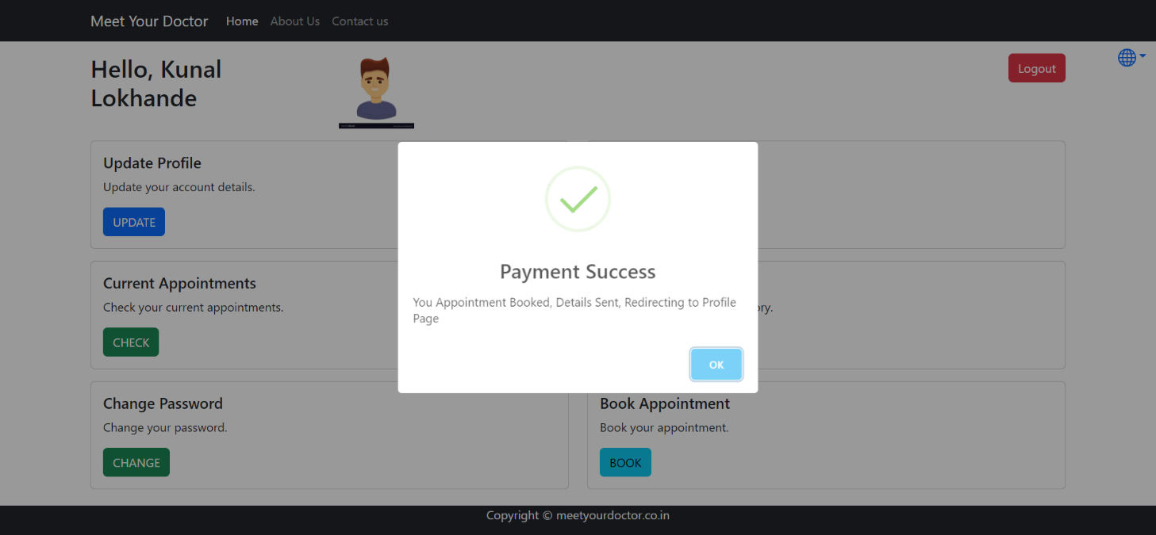
Payment Success

Slide 24
Doctor :-
Login Process
Forgot Password
Update Profile
Update Time Table
Change Password
Current Appointment
Set Time Table
Appointment History

Slide 25
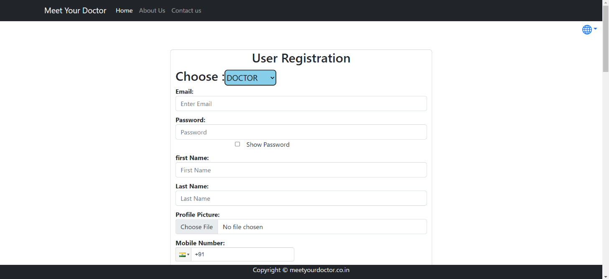
Doctor Registration Page

Slide 26
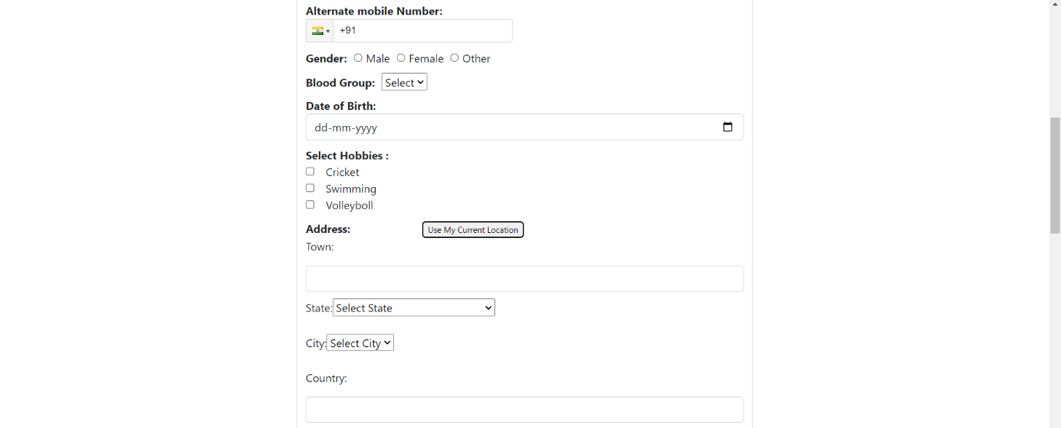

Slide 27
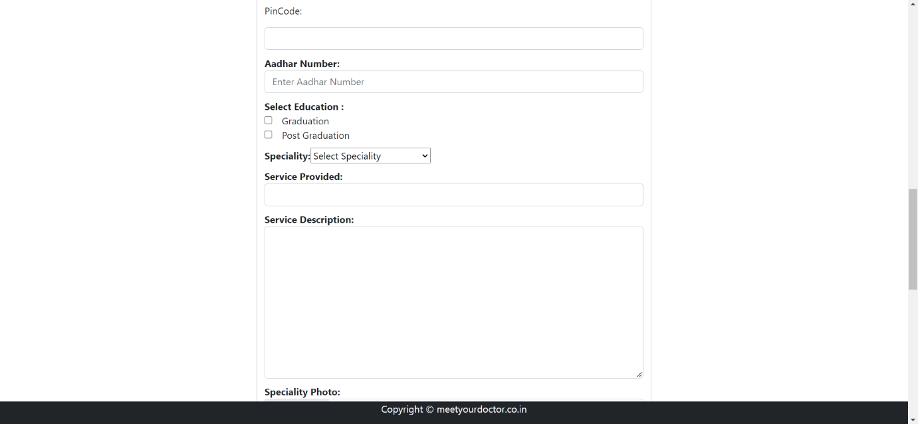

Slide 28
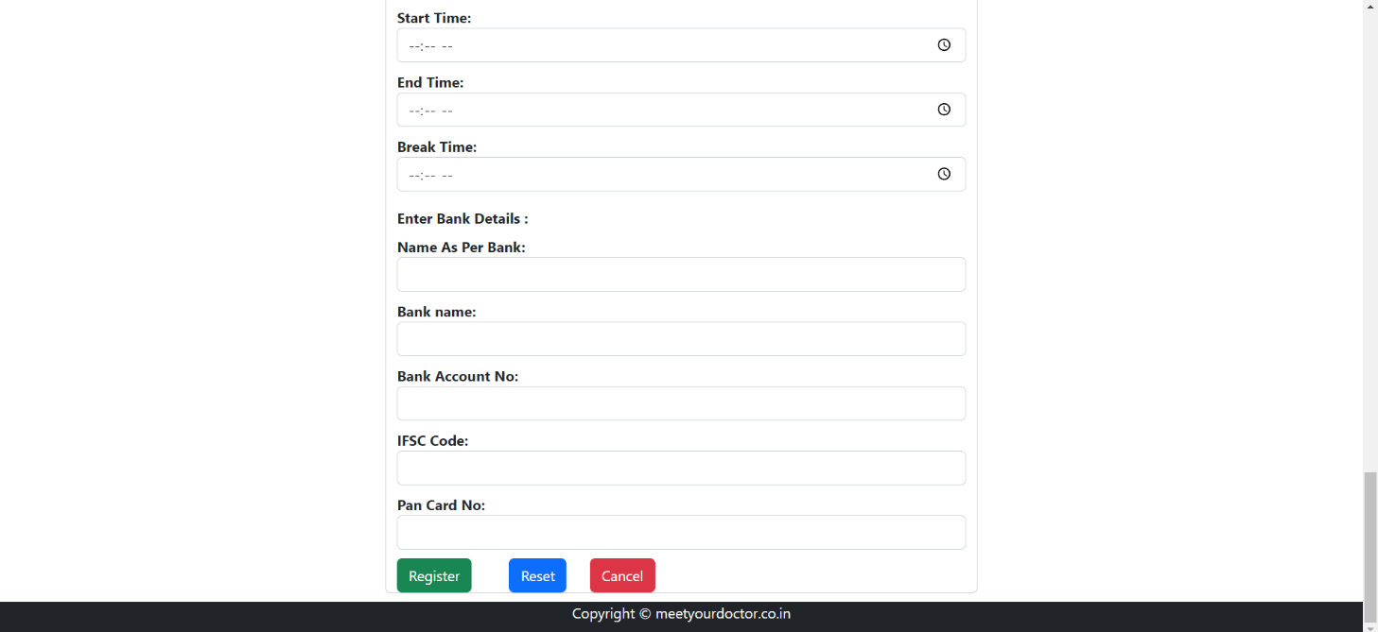

Slide 29
Doctor Login

Slide 30
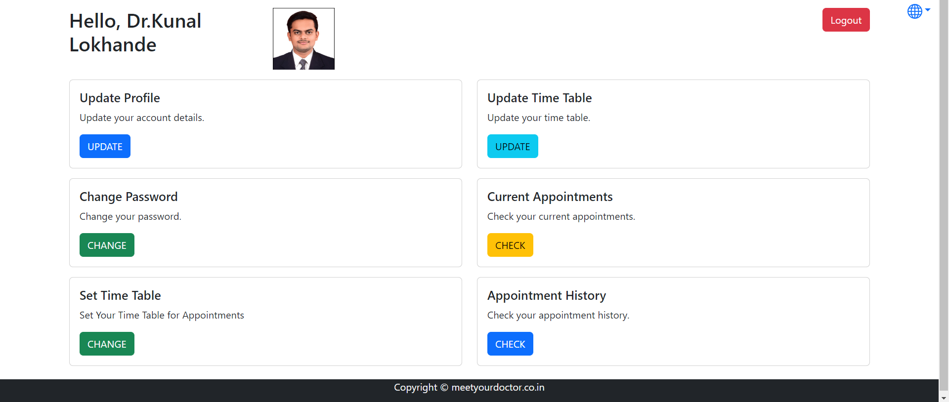
Doctor Dashboard

Slide 31
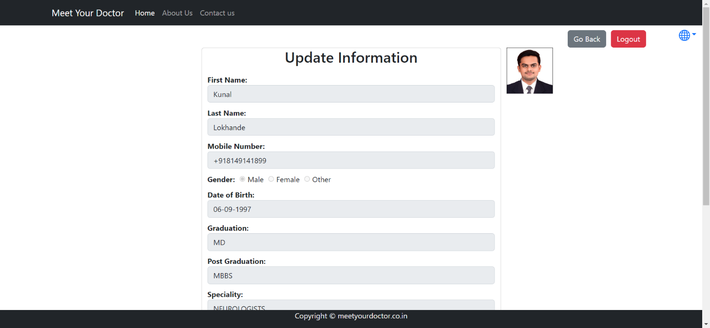
Doctor Update Information

Slide 32
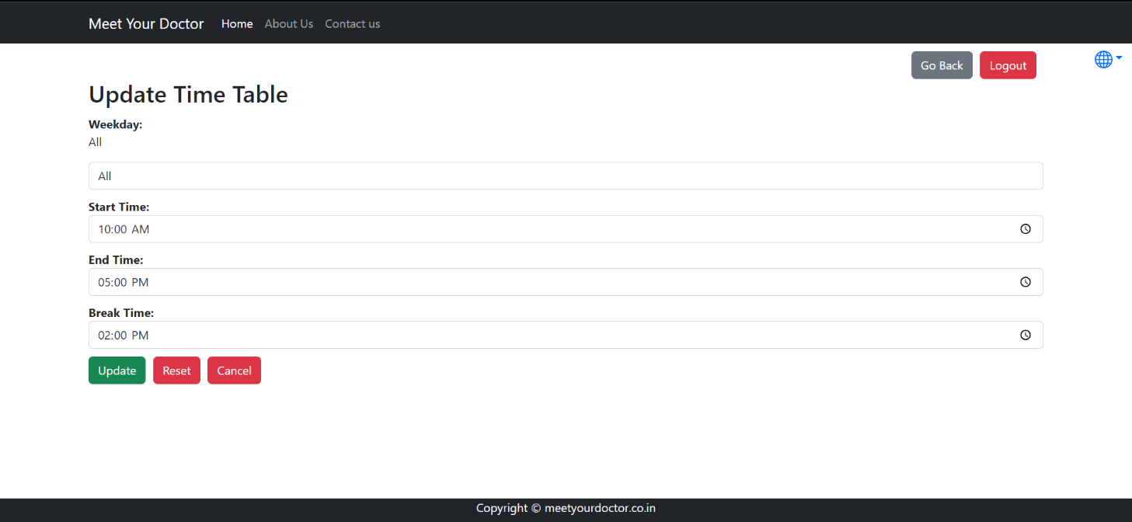
Doctor Update Timetable

Slide 33
Doctor Change Password

Slide 34
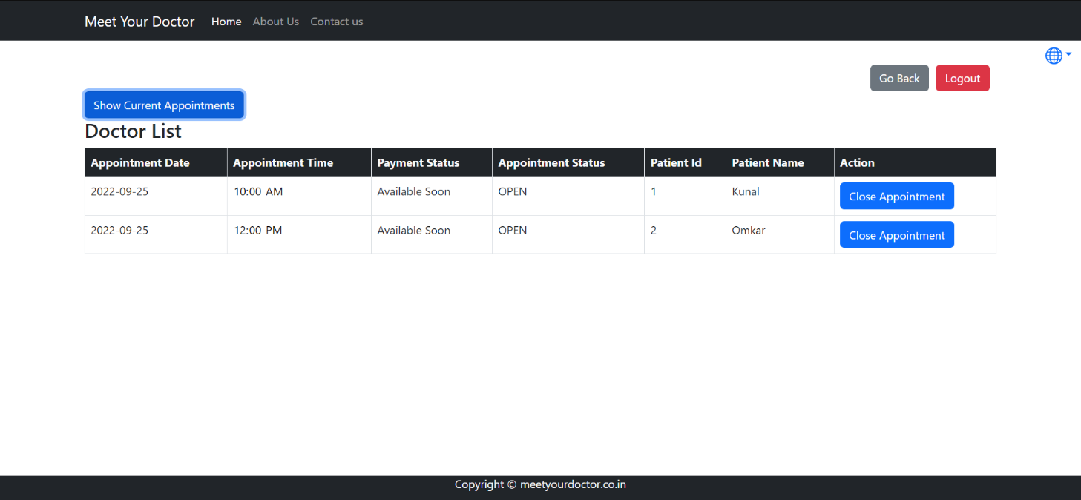
Doctor Current Appointment

Slide 35
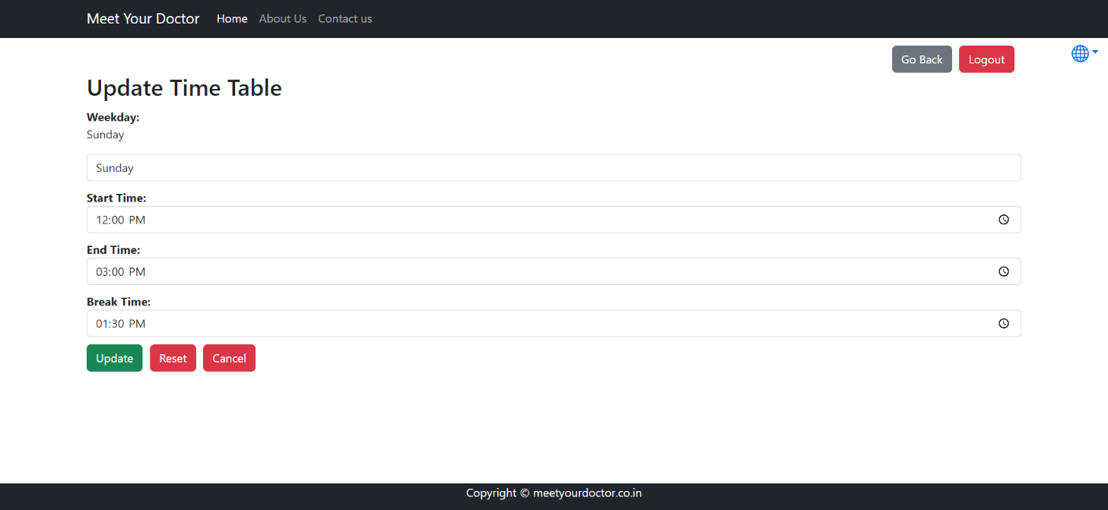
Doctor Add Timetable

Slide 36
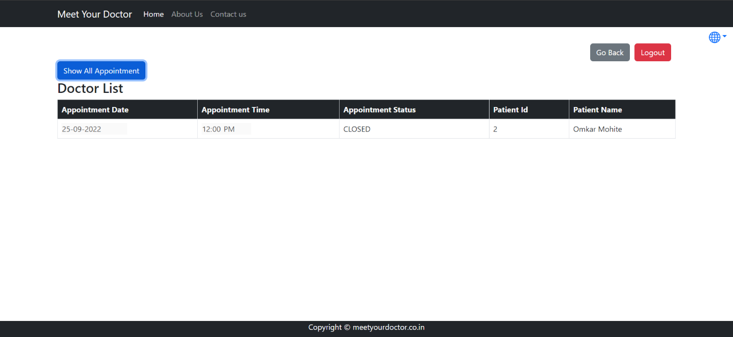
Doctor Appointment History

Slide 37
Admin :-
Login Process
Verify Doctor
Un-Verify Doctor
View Doctor List
View Patient List
Suspend Doctor
Remove Suspension
Upload Home Video

Slide 38
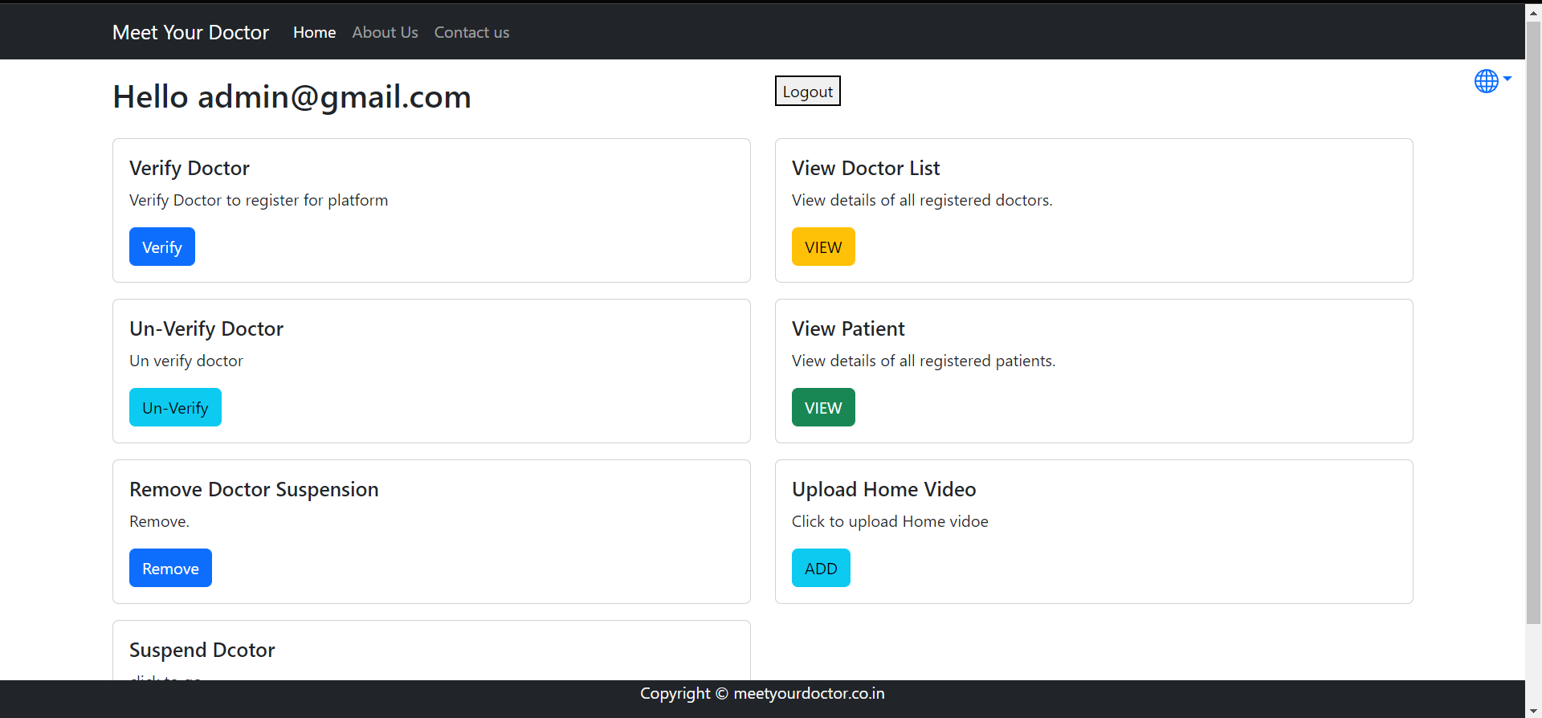
Admin Dashboard

Slide 39
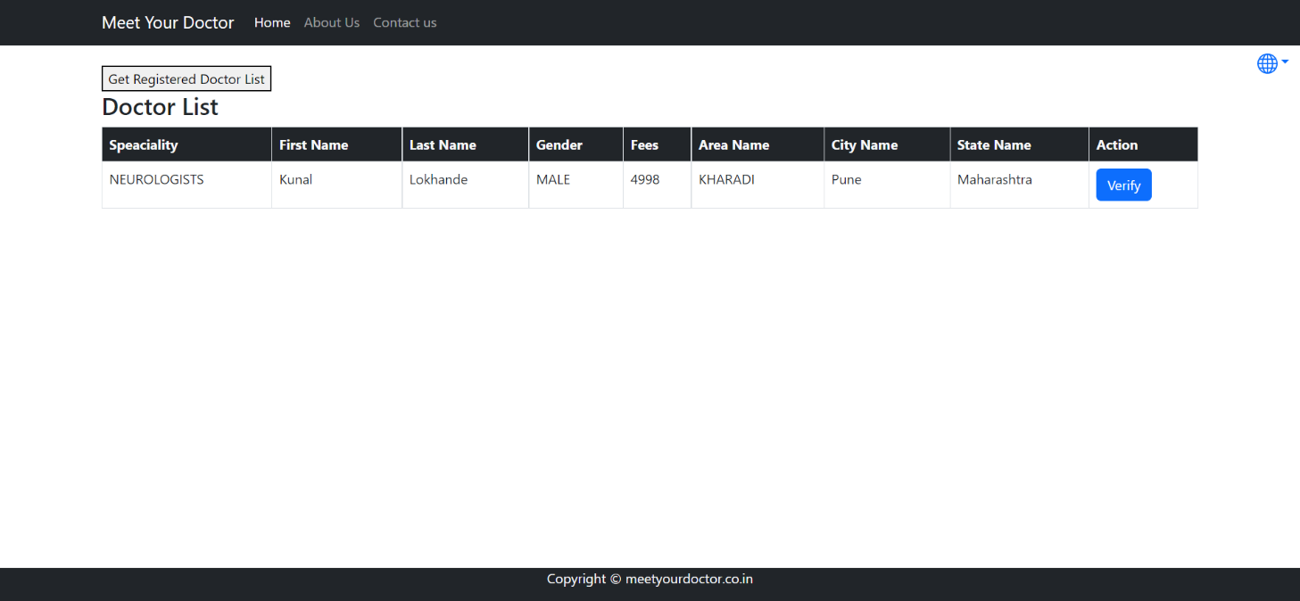
Admin Verify Doctor

Slide 40
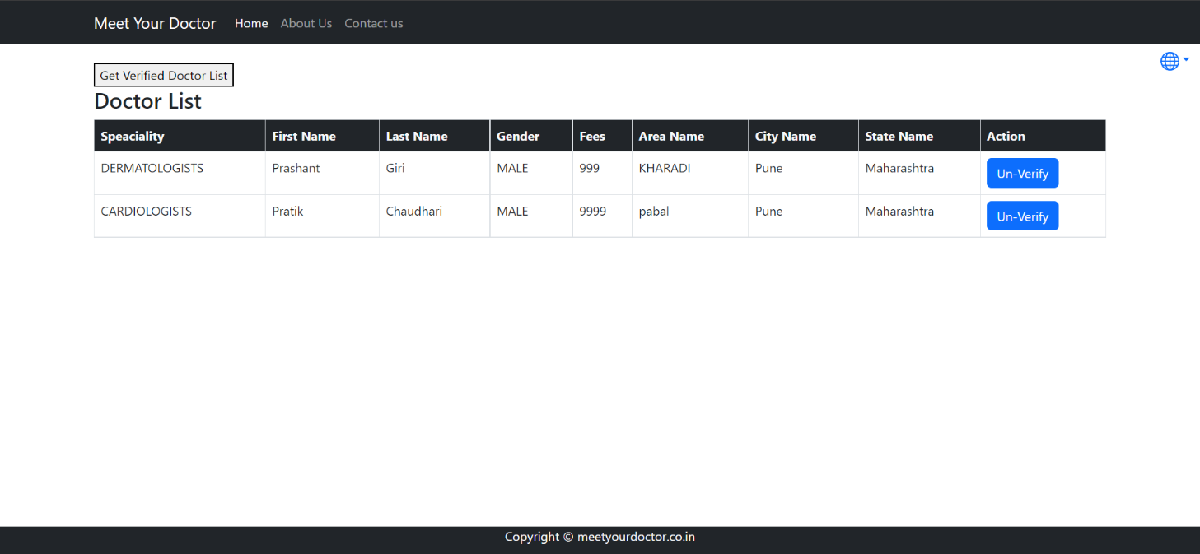
Admin Un-Verify Doctor

Slide 41
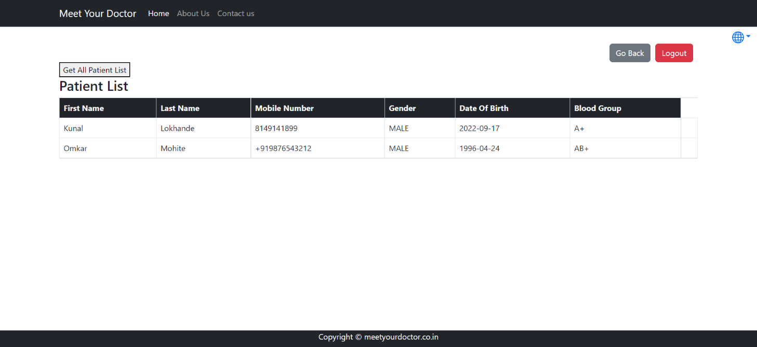
Admin View Patient List

Slide 42
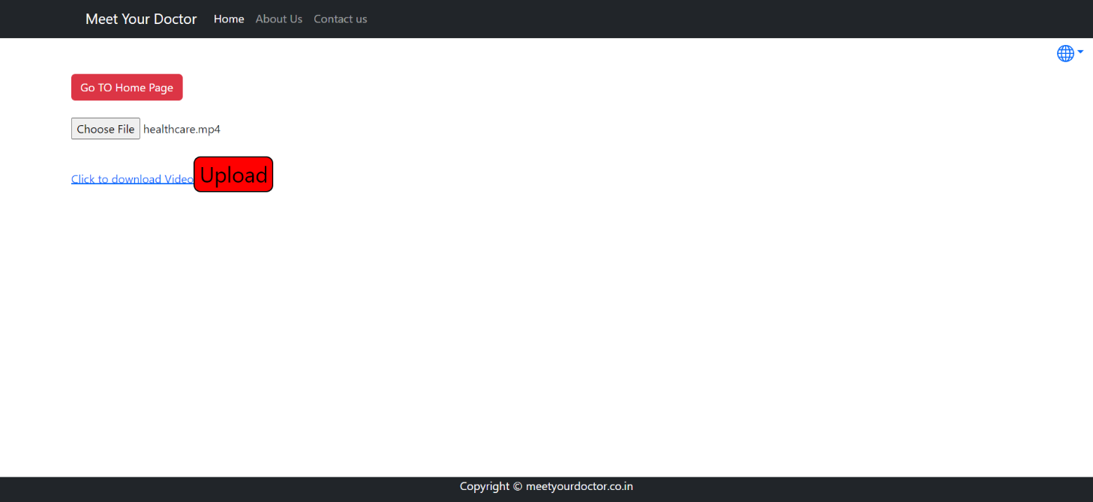
Admin Add Home Video

Slide 43
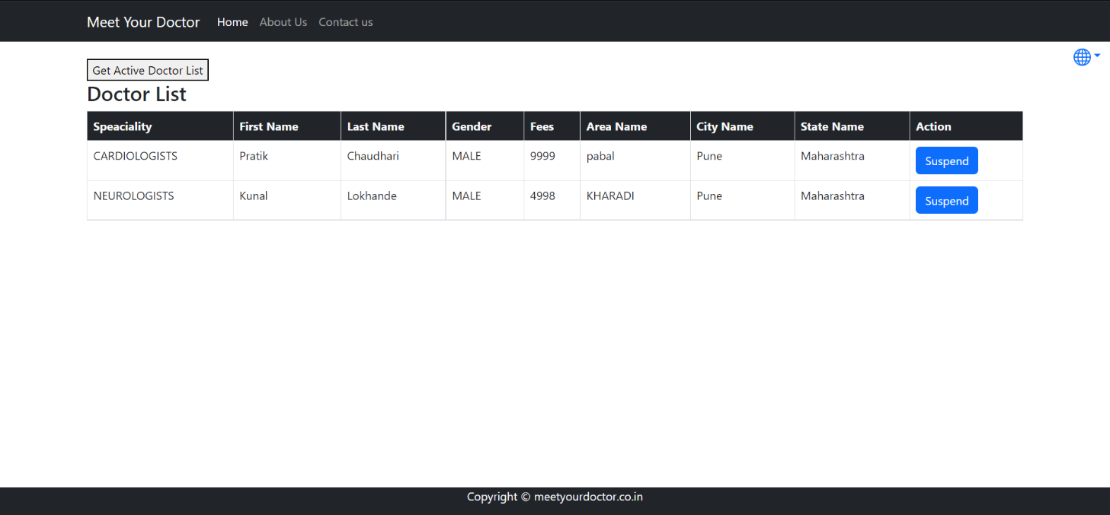
Admin Suspend Doctor

Slide 44
Future extensions or scope :-
We can add Online Consultation.
Home visit of doctor.
Blood Bank.
Pathology (Home Service).

Slide 45
Conclusion :-
Internet is changing the world. Though it is not possible to entirely switch the healthcare sector to online mode. But definitely it can help in bridging the gap between Patient and Doctor. Our project MeetYourDoctor serves the purpose of bridging the gap. It makes easy for the patient to search for the doctor in his/her locality or in any other locality. Addition to this patient can also search for the doctor based on the doctor’s specialty.

