Slide 1
Display

Slide 2
Agenda
Display
Sample output
Display implementation

Slide 3
Display
Display is a property in css used to display the blocks in a specific manner.
Let’s say we want to display two div blocks next to each other, or we want to display the blocks in between the text or we want to display as blocks which needs line break after every block. We can achieve all these with the help of display property.
Syntax:
display: inline;
display: block;
display: inline-block;

Slide 4
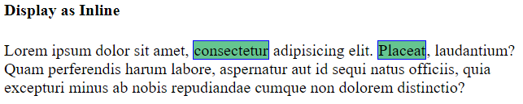
Display
Example:
Display using Inline.

Slide 5
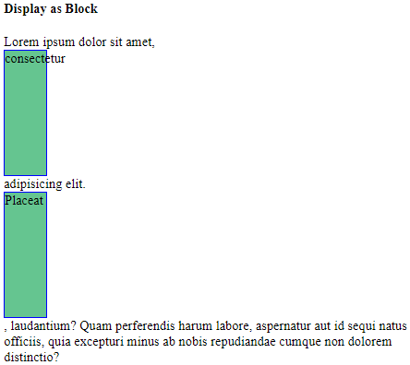
Display
Example:
2. Display using block.

Slide 6
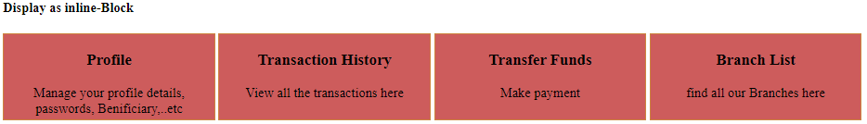
Display
Example:
3. Display using inline-block.

Slide 7
Display implementation
Let’s see implementation of display property.

Slide 8
Summary
Display property is used to display the tag in inline, block or inline-block manner.
DO NOT WRITE ANYTHING
HERE. LEAVE THIS SPACE FOR
WEBCAM

Slide 9
Thank You
Proprietary content. ©Great Learning. All Rights Reserved. Unauthorized use or distribution prohibited

