Slide 1
Cab Booking
Name - Rakshit Sharma (2010991063)
Email - rakshit1063@chitkara.edu.in
GitHub - https://github.com/rakshit-2/scaler_assignment
Website Link - http://43.205.95.49/ (Hosted using AWS EC2)

Slide 2
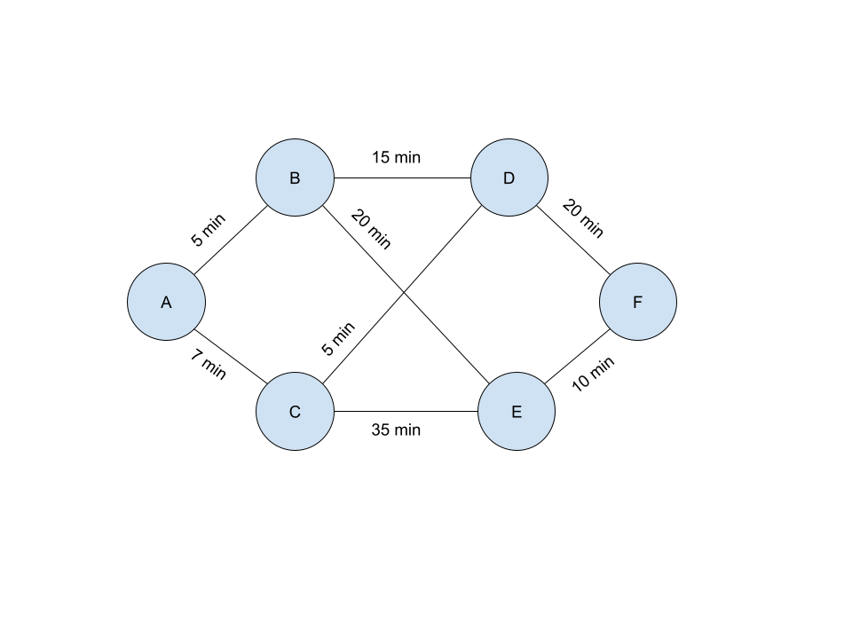
Naming of Variables:
According to the graph provided , provided the variable some good name such as:
A = Agra
B = Bangalore
C = Chennai
D = Delhi
E = East-Delhi
F = Faridabad

Slide 3
Finding The Shortest Timed Path:
Dijkstra algorithm (Python) calculates the shortest path using the source and destination fetched from the user. Once the shortest path has been calculated, the website will display the estimated time and distance of the trip to the user, as well as the price calculated according to the formula 10rs/min(cab GO).
Python file for the Shortest path is called using Child-process(NodeJS library). This creates a separate thread along with the main thread and calls the separate file while fetching the desired output

Slide 4
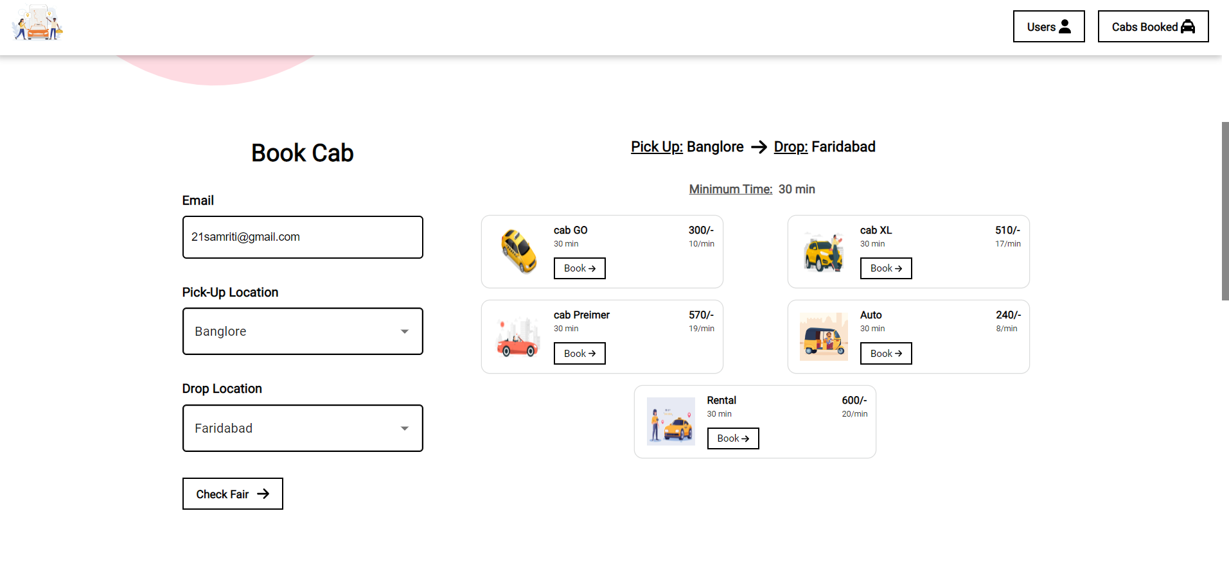
Type of Cabs:
5 different types of cabs available to the user to choose from.
Form Auto to Premier version with extra comfort, luxury space.
User just need to enter their email id, pick up location and dropdown location.
As soon as the user clicks the check fair button the algo runs and provides the desired price for each cab.

Slide 5
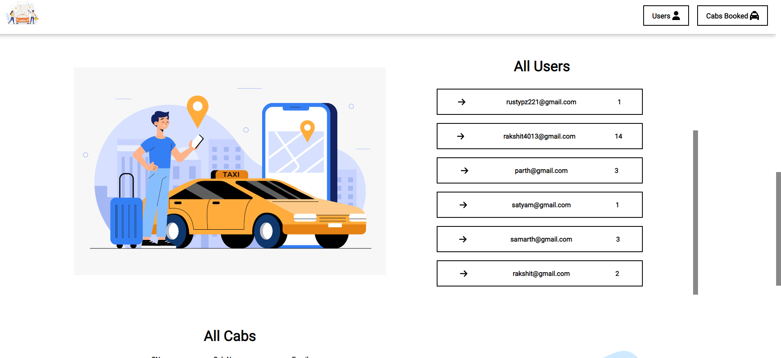
All Users Display(Admin)
All the users are visible to the admin view.
The admin can check how many cabs a user has booked, at what time, which type of cab.
The data loads on runtime on any change in the website booking process.
As soon as the booking is done the data is update automatically

Slide 6
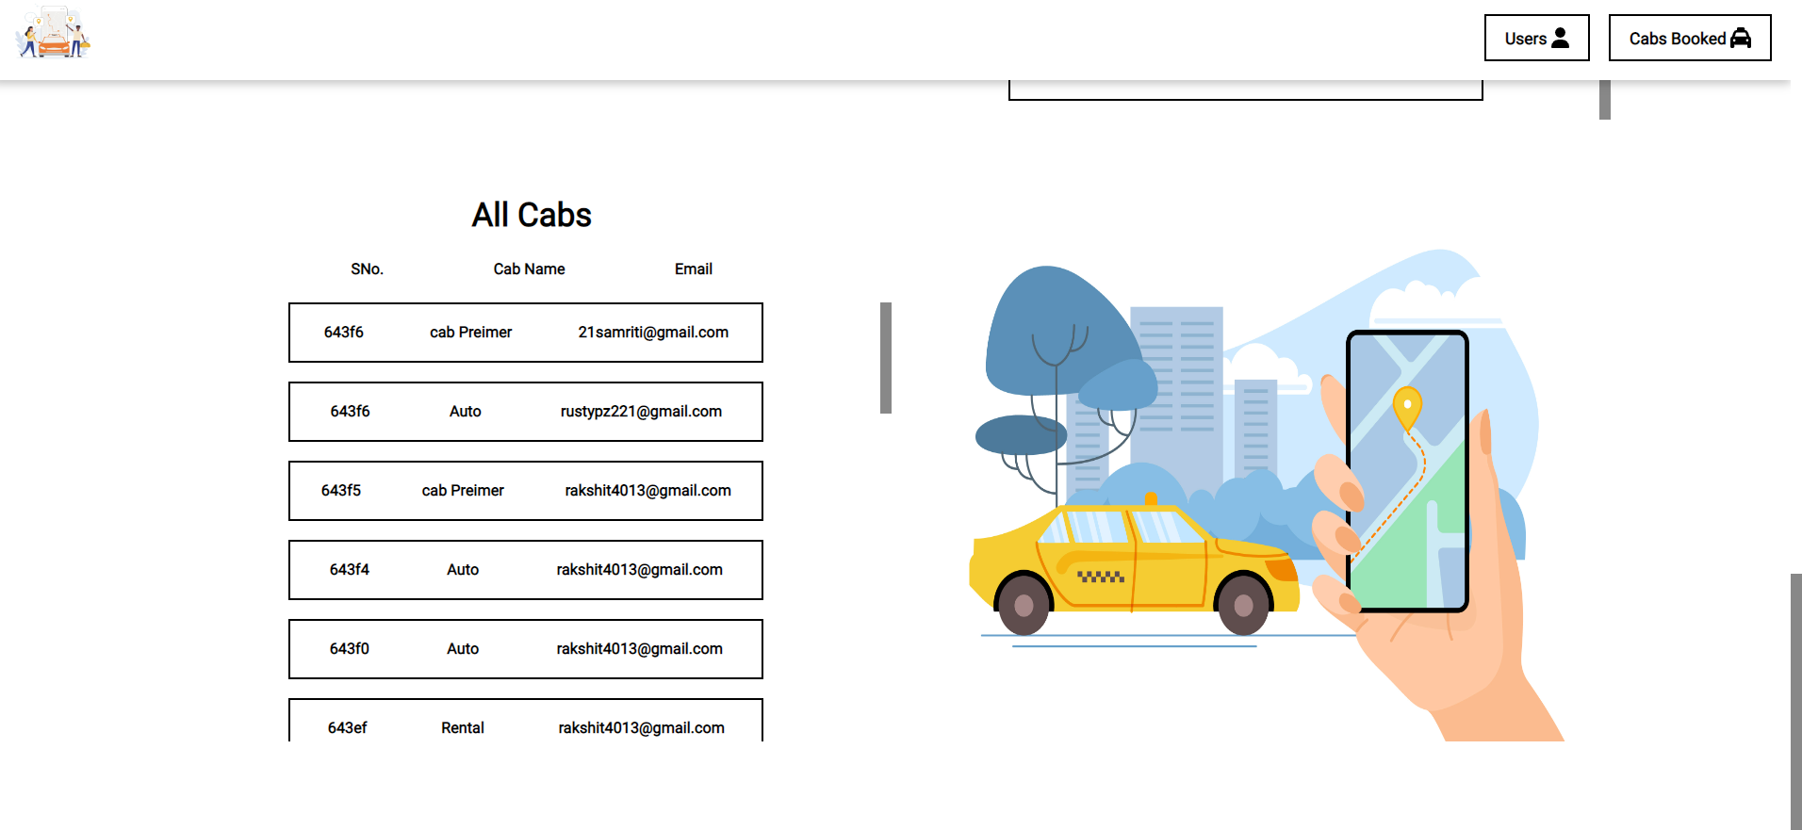
All Cabs Booked Display(Admin)
All the cabs are visible to the admin view.
The admin can check how many cabs a user has booked, at what time, which type of cab. Cab id is also visible.
The data loads on runtime on any change in the website booking process.
As soon as the booking is done the data is update automatically

Slide 7

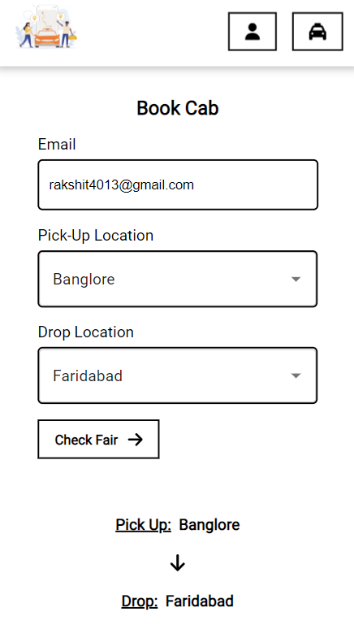
Responsive Design

