Slide 1
Introduction to Angular

Slide 2
What is Angular
Angular is one of the best frameworks for Web Development.
Angular is a Typescript-based open-source framework for building client-side web applications.
Angular is a client-side JavaScript framework that was specifically designed to help developers build SPAs (Single Page Applications) in accordance with best practices for web development.
Single-Page Applications (or SPA’s) are applications that are accessed via a web browser like other websites but offer more dynamic interactions resembling native mobile and desktop apps.
The most notable difference between a regular website and SPA is the reduced amount of page refreshes.

Slide 3
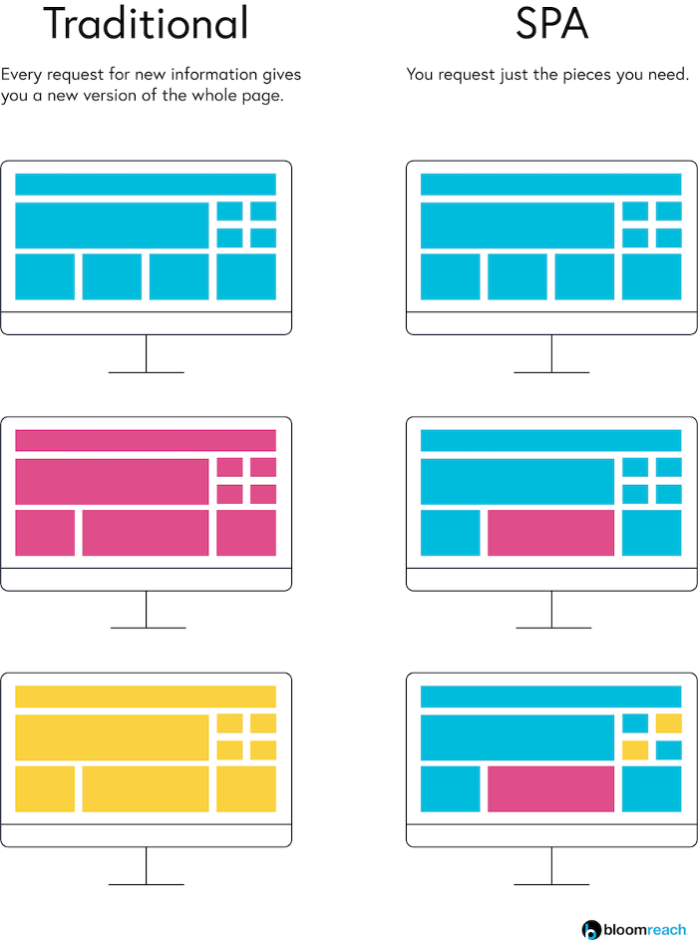
Difference between SPA and Traditional way

Slide 4
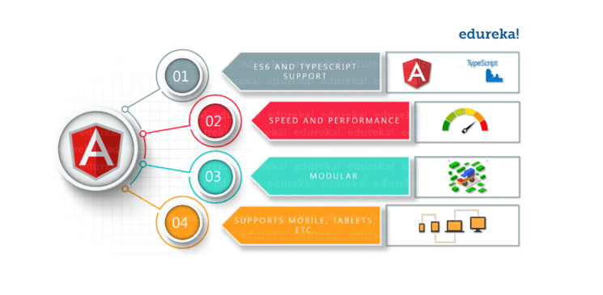
Angular Features

Slide 5
Cross-Platform
Progressive web apps: It uses modern web platform capabilities to deliver an app-like experience. It gives high performance, offline, and zero-step installation.
Native: You can build native mobile apps with strategies using Ionic Framework, NativeScript, and React Native.
Speed and Performance
Code generation: Angular turns your templates into code that’s highly optimized for JavaScript virtual machines, giving you all the benefits of hand-written code with the productivity of a framework.
Universal: You can use any technology with Angular for serving the application like node.js, .NET, PHP and other servers
Productivity

Slide 6
Templates: Quickly create UI views with simple and powerful template syntax.
Angular CLI: Command-line tools: You can easily and quickly start building components, adding components, testing them, and then, instantly deploy them using Angular CLI.
IDEs: Get intelligent code completion, instant errors, and other feedback in popular editors and IDEs like Microsoft’s VS Code.

Slide 7
Installation Setup
Install Visual Studio code
To install Angular and dependencies, we are going to Node Package Manager or NPM. For installing npm, install node js.
NPM is used to install libraries, Packages & applications from Public repositories.
We are going to use NPM to install Angular, Typescript, and any other packages/modules required by our application. NPM is can be used to upgrade these packages as and when necessary. Without NPM, we have to download and install all these packages manually.
Check npm –v

Slide 8
The NPM requires the Package.json file, which should contain the list of modules/packages used in your Application. We need to add all the list of dependencies required by our application the configuration file.
npm install.
Installing Angular
The Angular CLI helps us to quickly create an Angular application with all the configuration files and packages in one single command. It also helps us to add features (components, directives, services, etc) to existing Angular applications.
The Angular CLI creates the Angular application, and uses Typescript, Webpack(module bundling), karma(unit testing) and protractor(end to end testing).

Slide 9
npm i -g @angular/cli@latest (or)
npm i @angular/cli@6.1.1
To check the version, use the command
ng --version
Creating a new Angular Application
ng new FirstApp
Creates a new folder FirstApp
Sets up the folder structure for the application
Downloads and installs the angular libraries and dependencies
Installs and configures TypeScript
Installs and configures karma and protractor

Slide 10
To run,
ng serve or npm start
The above command compiles the Angular application and invokes the Webpack development server. The Webpack Development server listens on HTTP Port 4200. Hence open the browser and type http://localhost:4200/ and you will see FirstApp is displayed on the browser.
The root folder application contains subfolders e2e, node_modules and src. It also contains the few configuration files
.editorconfig: This is the configuration file for the Visual Studio code editor.
.gitignore: Git configuration to make sure autogenerated files are not committed to source control.

Slide 11
angular.json: This is the configuration file for Angular CLI. The older versions of the Angular used the file angular-cli.json
browserslist: Ensures the compatibility of the Angular app with different browsers.
karma.conf.js: The Configuration file for the karma test runner.
package.json: The package.json is an npm configuration file, that lists the third-party packages that your project depends on. We also have package-lock.json
README.md: The Read me file
tsconfig.json, tsconfig.app.json & tsconfig.spec.json are Typescript configuration files. The tsconfig.json is the Typescript compiler configuration file. This file specifies the compiler options required for the Typescript to compile (transpile) the project. The tsconfig.app.json is used for compiling the code, while tsconfig.spec.json for compiling the tests

Slide 12
tslint.json: tslint is a static code analysis tool. We use this to check Typescript code quality. To check if TypeScript source code complies with coding rules. TSLint checks your TypeScript code for readability, maintainability, and functionality errors.
e2e
This folder contains the files required for end to end tests by protractor. Protractor allows us to test our application against a real browser. You can learn more about protractor from this link.
node_modules
All our external dependencies are downloaded and copied here by NPM Package Manager.
src
This is where our application lives.

Slide 13
app folder
The Angular CLI has created a simple application, which works out of the box. It creates the root component, a root module, a unit test class to test the component.
The Component
The app.component.ts is the component that is added to the project by Angular CLI. You will find it under the folder app/src
import { Component } from '@angular/core';
@Component({
selector: 'app-root',
templateUrl: './app.component.html',
styleUrls: ['./app.component.css']
})

Slide 14
export class AppComponent {
title = ‘FirstApp';
}
The component class is the most important part of our application. It represents the view of the application. It consists of three main parts i.e. a class, a class decorator, and an import statement.
Component class
The component is a simple class. We define it using the export keyword. The other parts of the app can import it use it. The above component class has one property title. This title is displayed, when the application is run.
The component class can have many methods and properties. The main purpose of the component is to supply logic to our view.

Slide 15
@Component decorator
The AppComponent class is then, decorated with @Component decorator. The @Component (called class decorator) provides Metadata about our component. The Angular uses this Metadata to create the view. The @component Metadata above has three fields. The selector, templateURL & styleUrls
templateUrl
The templateUrl contains the path to the HTML template file. The Angular uses this HTML file to render the view. In the above example, it points to the app.component.html file.
styleUrls
The styleUrls is an array of Style Sheets that Angular uses to style our HTML file. In the above example, it points towards to app.component.css style sheet.
The app.component.css file is in the same folder as the AppComponent. The file is empty. You can create styles for the component and put it here.

Slide 16
selector
The selector tells angular, where to display the template. In the example above selector is app-root. The Angular whenever it encounters the above tag in the HTML file it replaces it with the template (app.component.html).
The app-root selector is used in index.html.
{{title}} is placed inside the h1 tags . We call this data binding (interpolation).
Root Module
Angular organizes the application code as Angular modules. The Modules are closely related blocks of code in functionality. Every application must have at least one module.

Slide 17
The Module, which loads first is the root Module. This Module is our root module.
The root module is called app.module.ts. (under src/app folder). It contains the following code.
import { AppRoutingModule } from './app-routing.module';
import { AppComponent } from './app.component';
@NgModule({
declarations: [
AppComponent
],
imports: [
BrowserModule,
AppRoutingModule
],

Slide 18
providers: [],
bootstrap: [AppComponent]
})
export class AppModule { }
Module class
The Module class is defined with the export keyword. Exporting the class ensures that you can use this module in other modules.
@NgModule class decorator
The Angular Modules require a @ngModule decorator. @ngModue decorator passes the metadata about the module.
The @ngModule Metadata above has four fields. The declarations, imports, providers, & bootstrap

Slide 19
Imports Metadata tells the angular list of other modules used by this module. We are importing BrowserModule and AppRoutingModule.
The BrowserModule is the core angular module, which contains critical services, directives, and pipes, etc.
The AppRoutingModule defines the application Routes.
Declaration Metadata lists the components, directives & pipes that are part of this module.
Providers are the services that are part of this module, which can be used by other modules.
Bootstrap Metadata identifies the root component of the module. When Angular loads the appModule it looks for bootstrap Metadata and loads all the components listed here. We want our module to load AppComponent , hence we have listed it here.

Slide 20
App Routing Module
The AppRoutingModule in the file app-routing.module.ts defines the Routes of the application. These Routes tells Angular how to move from one part of the application to another part or one View to another View.
The Routes defined in the constant const routes: Routes = [];, which is empty
This Module is defined as a separate Module and is imported in AppModule.
Bootstrapping our root module
The app.component.html is the file, which we need to show it to the user. It is bound to AppComponent component. We indicated that the AppComponent is to be bootstrapped when AppModule is loaded

Slide 21
Now we need to ask the Angular to load the AppModule when the application is loaded. This is done in main.ts file.
The main.ts file is found under the src folder.
import { enableProdMode } from '@angular/core';
import { platformBrowserDynamic } from '@angular/platform-browser-dynamic';
import { AppModule } from './app/app.module';
import { environment } from './environments/environment';
if (environment.production) {
enableProdMode();
}

Slide 22
platformBrowserDynamic().bootstrapModule(AppModule)
.catch(err => console.error(err));
The second line of the import is platformBrowserDynamic library. This library contains all the functions required to bootstrap the angular application.
We also import is enableProdMode from @angular/core library. The Angular’s code by default runs in development mode. The development mode runs few assertions and checks, which helps in debugging the application.
The last import is the environment, which is in the folder src/environments. The file environment.ts contains the contents for the current environment. The development environment uses the environment.ts file.

Slide 23
When you build the project for the production environment, then the environment.prod.ts will be used. The environment are configured in angular.json`
Finally, the bootstrapModule method of platformBrowserDynamic library to bootstrap our AppModule.
index.html
Index.html is the entry point of our application.
Assets
A folder where you can put images and anything else to be copied wholesale when you build your application.
Environments
The environment folder is where we define environment variables for various build setups. The build setups can be development, production, testing & staging.

Slide 24
polyfills.ts
Different browsers have different levels of support of the web standards. Polyfills help normalize those differences.
styles.css
Angular global styles go here. Most of the time you’ll want to have local styles in your components for easier maintenance, but styles that affect all of your apps need to be in a central place.
test.ts
This is the main entry point for your unit tests.

Slide 25
Bootstrapping in Angular
Bootstrapping is a technique of initializing or loading our Angular application.
The Angular takes the following steps to load our first view.
Index.html loads
Angular, Third-party libraries & Application loads
Main.ts the application entry point
Root Module
Root Component
Template

Slide 26
Application Loads
When index.html is loaded, the Angular core libraries, third-party libraries are loaded. Now the angular needs to locate the entry point.
Application Entry point
The entry point of our application is main.ts. You will find it under the src folder.
angular.json
The Angular finds out the entry point from the configuration file angular.json. This file is located in the root folder of the project.
main.ts Application entry point

Slide 27
Angular Components
The Component is the main building block of an Angular Application.
The Component contains the data & user interaction logic that defines how the View looks and behaves. A view in Angular refers to a template (HTML).
The Angular Components are plain JavaScript classes and defined using @Component Decorator. This Decorator provides the component with the View to display & Metadata about the Component.
The Component is responsible to provide the data to the view. The Angular does this by using data binding to get the data from the Component to the View.

Slide 28
This is done using the special HTML markup knows as the Angular Template Syntax. The Component can also get notified when the View Changes.
The Components consists of three main building blocks
Template
Class
MetaData

Slide 29
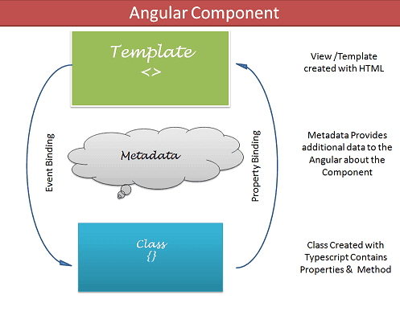

Slide 30
The template defines the layout and content of the View. Without the template, there is nothing for Angular to render to the DOM.
The Templates are nothing but HTML codes along with the Angular specific special HTML markups ( knows as the Angular Template Syntax).
You can add Angular directives , Angular Pipes & Other Angular Components on the template.
The data to Template comes from the Component, which in turn gets it from a Angular Service. Using the data binding techniques, we can keep the Template in sync with the Component. The templates can use the Event Binding or two way data binding to notify the component, when user changes something on the View.

Slide 31
There are two ways you can specify the Template in Angular.
Defining the Template Inline
Provide an external Template
Class
The Class provides the data & logic to the View. It contains the JavaScript code associated with Template (View). We use TypeScript to create the class, but you can also use JavaScript directly in the class.
Class Contains the Properties & Methods. The Properties of a class can be bind to the view using Data Binding.
export class AppComponent
{
title : string ="app"}

Slide 32
Data Binding
Angular components also need to respond to user interactions and react to events. The data binding keeps both component & view in sync with each other. We use techniques like Interpolation, Property Binding, Event Binding & Two Way Binding to bind data.
The data binding in Angular can be broadly classified into two groups. One way binding or two-way binding.
One way binding
In one way binding data flows from one direction. Either from view to component or from component to view.
From Component to View
To bind data from component to view, we make use of Interpolation & Property Binding.

Slide 33
Interpolation
The Angular uses the {{ }} (double curly braces) in the template to denote the interpolation. The syntax is as shown below
{{ templateExpression }}
//Template
{{getTitle()}}
//Component
title = 'Angular Interpolation Example';
getTitle(): string {
return this.title;
}

Slide 34
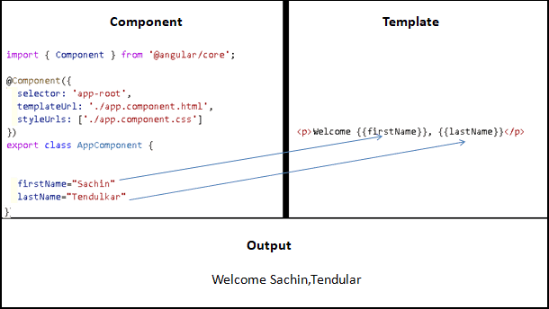

Slide 35
h2>Mathematical Operations</h2>
<p>100x80 = {{100*80}}</p>
<p>Largest: {{max(100, 200)}}</p>
//Component
max(first: number, second: number): number {
return Math.max(first, second);
}
Property binding
The Property binding allows us to bind HTML element property to a property in the component. Whenever the value of the component changes, the Angular updates the element property in the View. You can set the properties such as class, href, src, textContent, etc using property binding.

Slide 36
The Property Binding uses the following Syntax
[binding-target]=”binding-source”
The binding-target (or target property) is enclosed in a square bracket []. It should match the name of the property of the enclosing element. The Binding source must be a template expression.
Class binding with ClassName
The ClassName is the property name of HTML Element. Hence we can make use of Property binding to assign the class name to any HTML element.
The following example assigns CSS Class red to the div element.
<div [className]="'red'">Test</div>

Slide 37
HTML Class attribute
You can also add class using the normal HTML way.
<div class="red">red</div>
but, mixing both class and [className] results in removal of class attribute. You cannot use both.
<div class="red" [className]="'size20'">red</div>
Conditionally apply Classes
We can also bind the class name dynamically.
To do that first create a variable in your component class.
cssStringVar: string= 'red size20';
And then use it in the Template as shown below.
<div [className]="cssStringVar">Test</div>

Slide 38
Conditionally binding class
To dynamically or conditionally bind a class, First create a variable in the component class as shown below.
hasError:false;
<div [class.red]="hasError" [class.size20]="hasError">Test</div>
You can also create a function hasError(), which should return true or false as shown below.
hasError() {
return false
}
And use it in the template as shown below.

Slide 39
<div [class.red]="hasError()" [class.size20]="hasError()">Test</div>
Class binding with NgClass
NgClass
The ngClass directive adds and removes CSS classes on an HTML element. The syntax of the ngClass is as shown below.
<element [ngClass]="expression">...</element>
Where element is the DOM element to which class is being applied
expression is evaluated and the resulting classes are added/removed from the element. The expression can be in various formats like string, array or an object.

Slide 40
NgClass with a String
<element [ngClass]="'cssClass1 cssClass2'">...</element>
NgClass with Array
You can achieve the same result by using an array instead of a string as shown below. The syntax for ngClass array syntax is as shown below
<element [ngClass]="['cssClass1', 'cssClass2']">...</element>
NgClass with Object
You can also bind the ngClass to an object. Each property name of the object acts as a class name and is applied to the element if it is true.
<element [ngClass]="{'cssClass1': true, 'cssClass2': true}">...</element>

Slide 41
Style Binding
The syntax of the style binding is similar to the property binding.
[style.style-property] = "style-value"﻿
<p [style.color]="'red'">Give me red</p>
<p [style.background-color]="'grey'">some paragraph with grey background</p>
ngStyle Syntax
<element [ngStyle]="{'styleNames': styleExp}">...</element>

Slide 42
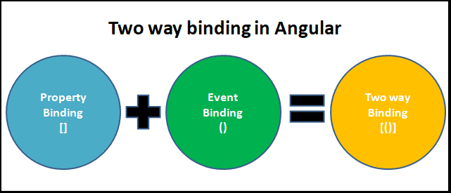
Two-way Data binding

Slide 43
ngModel Directive
The Angular uses the ngModel directive to achieve the two-way binding on HTML Form elements. It binds to a form element like input, select, selectarea. etc.
Internally It uses the ngModel in property, binding to bind to the value property and ngModelChange which binds to the input event.
<input type="text" name="value" [(ngModel)]="value">

