Slide 1

Makefits Demo using AT
Leah Wong
Sharma Chakravarthy
Weera Tanpisuth

Slide 2
Introduction
This demonstration illustrates the use of active capability (Java version) for alerting the operator for the OTH-Gold input data.
A number of events are monitored and corresponding rules are fired
Uses Not, aperiodic, periodic, and temporal events

Slide 3
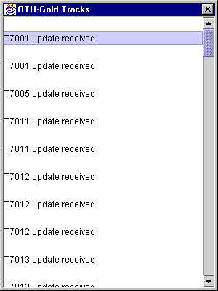
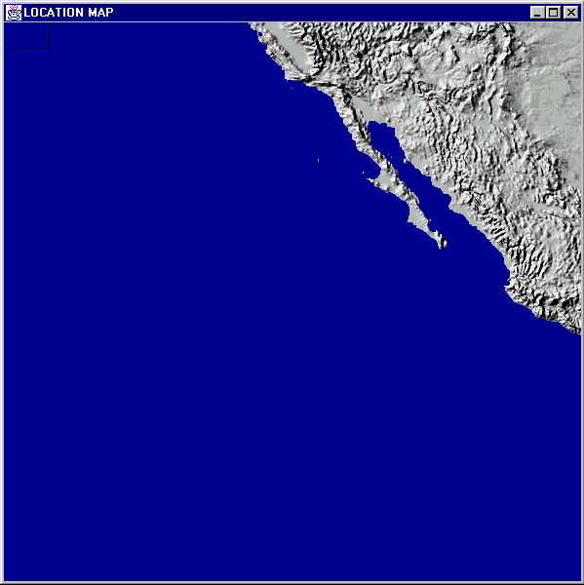
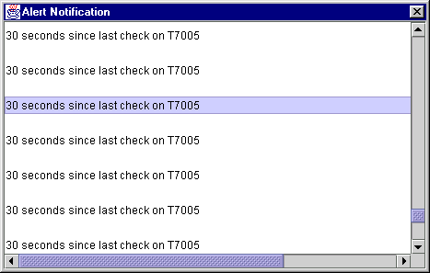
Monitoring Scenario

Slide 4
Introduction
A number of rules that monitor the tracks have been first specified at the user level and then translated to ECA rules using the powerful operators provided by Snoop and Sentinel
We will describe the rules and their implementation.

Slide 5
Rule 4
Show track-X status every Y minutes
This rule has modeled by creating a composite event using the PERIODIC operator.
A PERIODIC event is composed of three events (startDetectEvent , HOW_TRACK_EVERY_X_MINS , and endDetectEvent).

Slide 6
Rule 4 (Contd.)
After the new track is instantiated, it invokes startDetectEvent( ). The ‘startDetect’ event occurs, and the system starts detecting rule # 4. The system periodically shows the track X status every period of time (SHOW_TRACK_EVERY_X_MINS).

Slide 7
Rules 5 and 6
Rule 5: When there is no change of track-Z's location or altitude (or other track attributes) reported for X minute, notify the analyst (e.g. print a message "No change in location of track-Z for X minutes"
Rule 6:When there is no update on Track-X's location & altitude between T1 and T2, send message to request Track-X status.

Slide 8
Rules 5 and 6 (Contd.)
Rules 5 and 6 are modeled by creating a composite event using the NOT and PLUS operators
A NOT event consists of three events. The NOT event occurs when the middle event does not occur in the interval specified by the occurrences of left and right events.
The PLUS consists of two events. After the specified time interval beyond the occurrence of first event, the PLUS event will occur.

Slide 9
Rules 5 and 6 (Contd.)
E1 is defined as a primitive event.
E2 is defined as E1 PLUS time interval (NO_CHANGE_IN_LOCATION_FOR_X_MINS)
NOT( E1, reportLocation, E2)
When there is no report of location between the occurrences of E1 and E2, the detector alerts the analyst

Slide 10
Rule 7
When track(s) enters or leave the defined boundary, generate an alert
Boundaries: fixed areas with respect to a given latitude/longitude or a specific track

Slide 11
Rule 7 (Contd.)
The SEQUENCE operator is introduced here.
After there is an update location, we can check whether the track is in the ‘AOI’ zone or out of the “AOI” zone. We can use the results of this condition to detect entering or leaving of the zone.
For instance, at time t1, it is detected that track T7001 is in the ‘AOI’ zone. Then at time t2, we detect that track T7001 is out of the ‘AOI’ zone. In other words, this implies the T7001 has left the ‘AOI’ zone.

Slide 12
Rule 11
Notify analyst of Track Y 2 minutes after it enters the Area of Interest

Slide 13
Rule 11
The AND and PLUS operators are used in this rule. The AND consists of two events (inZoneEvent and (inZoneEvent + two minutes)).
When ‘track’ updates its location, the setLatitudeLongitude() is invoked. The detector then checks whether this track is in the zone or not. If the track is inside the zone, the ‘inZoneEvent’ will be raised.
After two minutes the ‘inZone’ event is detected, the detector will notify the analyst. The PLUS operator is used to represent the ‘after two minutes event’

