Slide 1
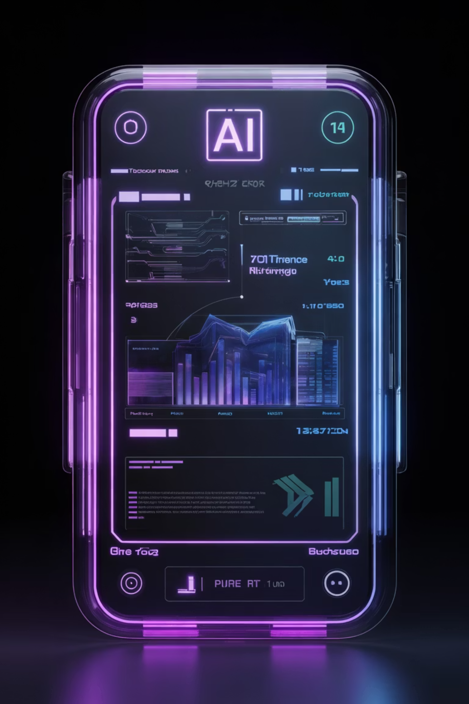
AI Complaint Analyzer System
Smart AI-Based Complaint Management & Analysis Platform
Presented By: Omkar Ittam
Sayali Yedur
Ayaan Mujawar

Slide 2
Problem Statement & Objectives
Current Challenges
Project Goals
Manual complaint handling creates delays
Difficult categorization without intelligent analysis
Language barriers prevent accessibility
No automated tracking system
Poor data management and reporting
Automate complaint management workflows
Implement AI-based analysis and categorization
Provide multi-language translation support
Enable faster complaint handling
Improve tracking and administration

Slide 3





System Overview & Technology Stack
The system enables users to submit complaints online. AI analyzes complaint text, translates content, categorizes complaints, and displays them on an intelligent admin dashboard.
User
Submit complaints
Complaint Form
Capture details
AI Analysis
Process & categorize
Translation
Multi-language
Dashboard
View analytics
Technologies Used
HTML5 & CSS3
JavaScript
AI APIs
Translation API
Database Storage

Slide 4
Core Features
AI Complaint Analysis
Smart Categorization
Intelligent text processing and analysis
Automatic complaint classification
Translation System
OTP Verification
Multi-language support
Secure authentication
User Dashboard
Admin Dashboard
Personalized interface
Complete control panel
Search & Filtering
Complaint Tracking
Responsive Design
Quick complaint retrieval
Real-time status updates
Cross-device compatibility

Slide 5
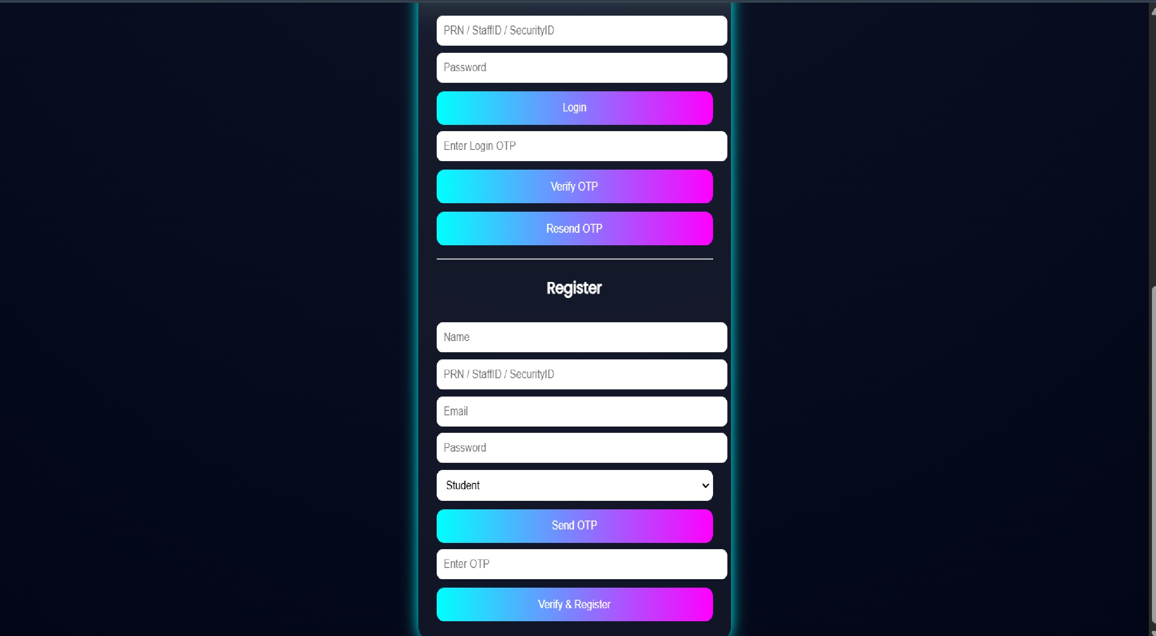
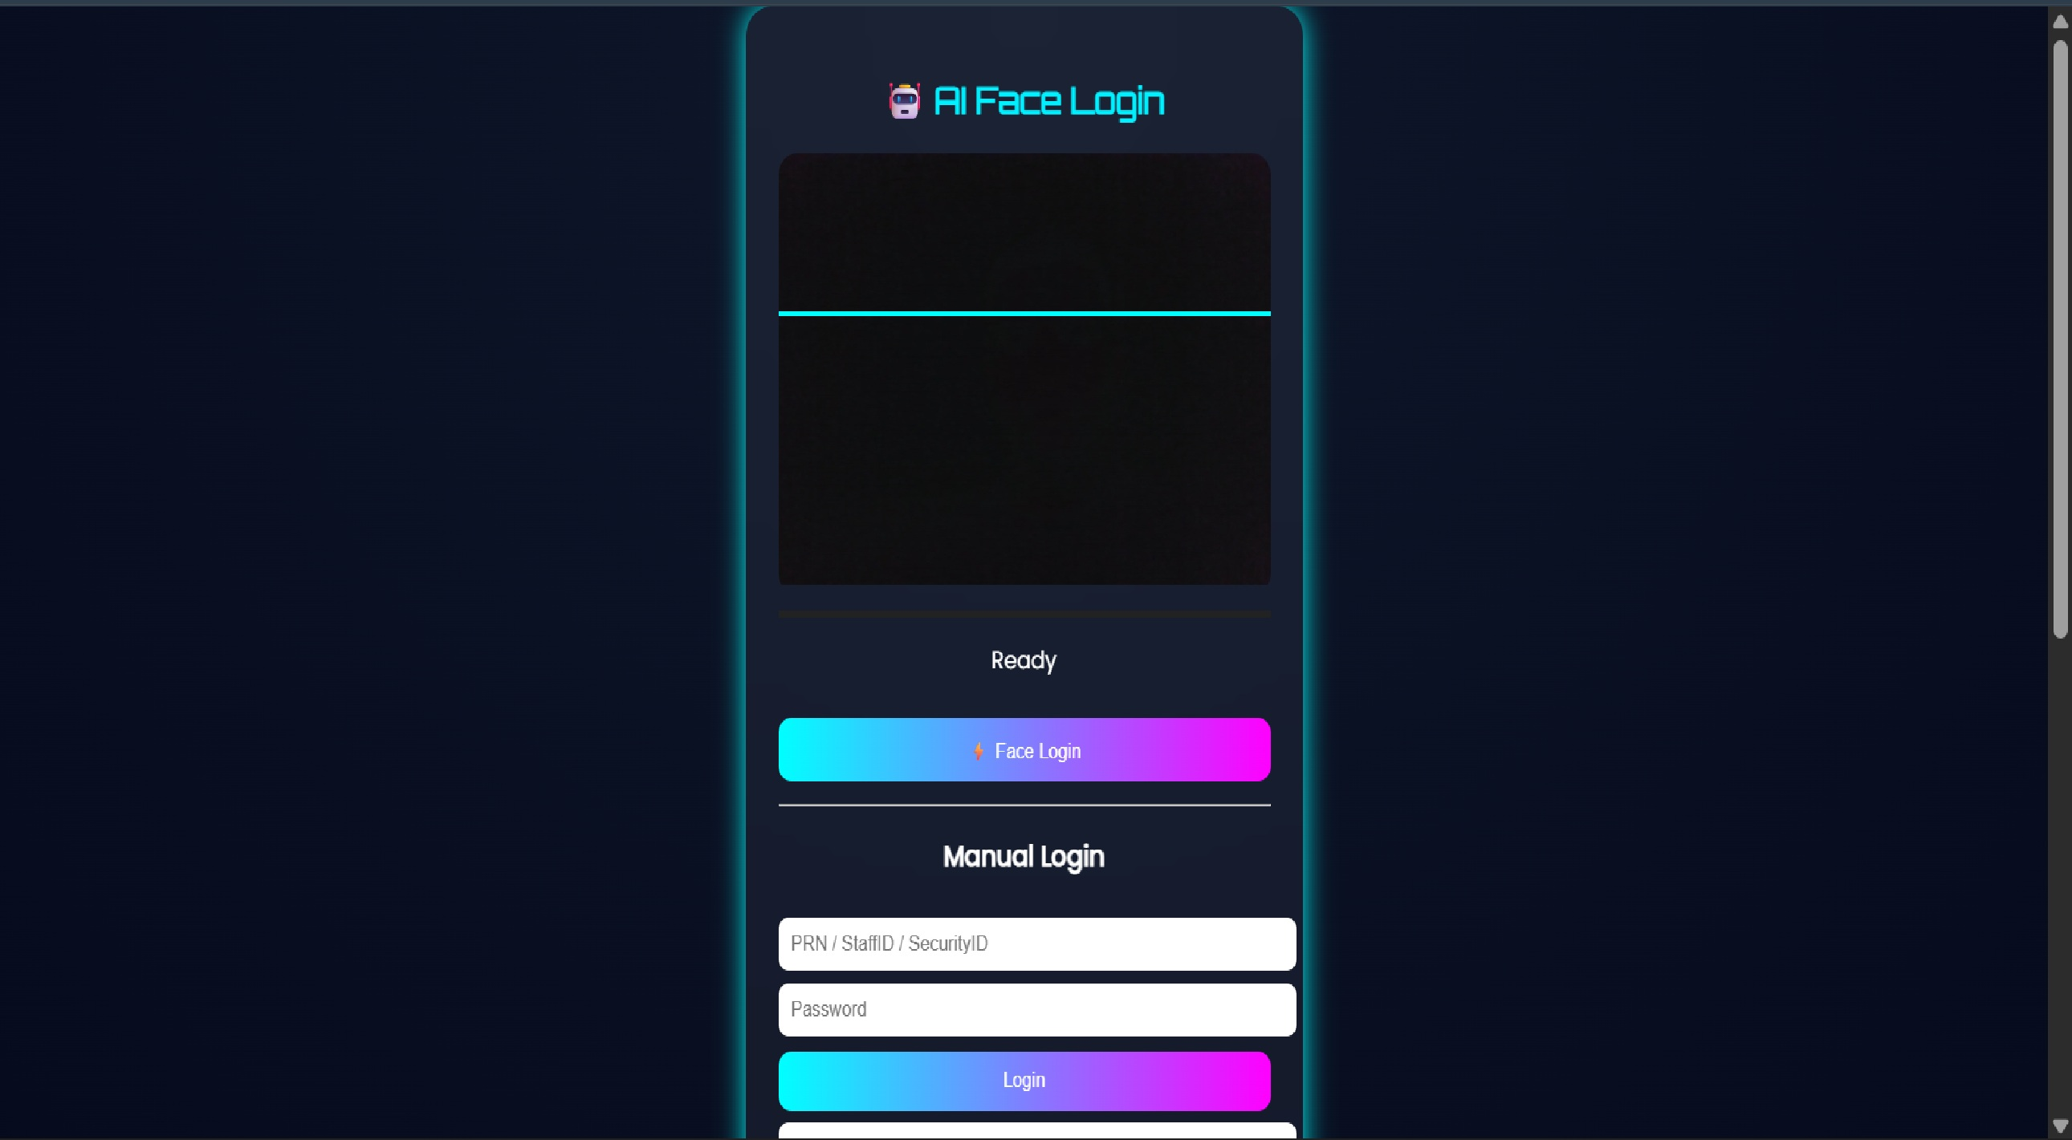
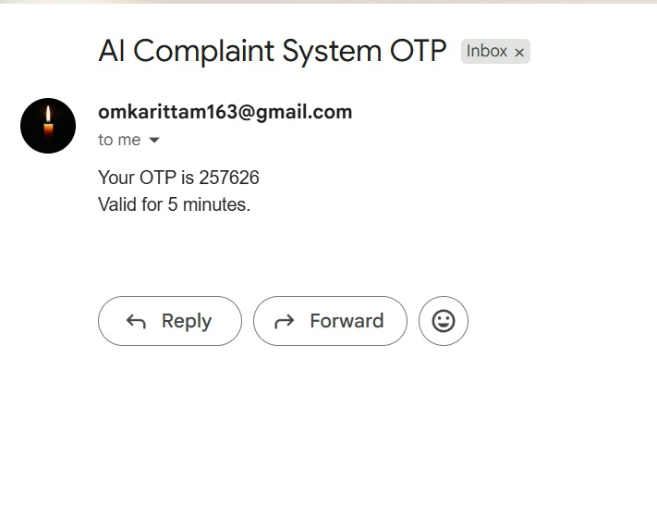
User Authentication System
Secure Registration, Login & OTP Verification
OTP Verification
Login Authentication
Email-based one-time password for enhanced security
User Registration
Protected access with session management
Secure account creation with encrypted data storage
User Registration
User Login
OTP Verification

Slide 6
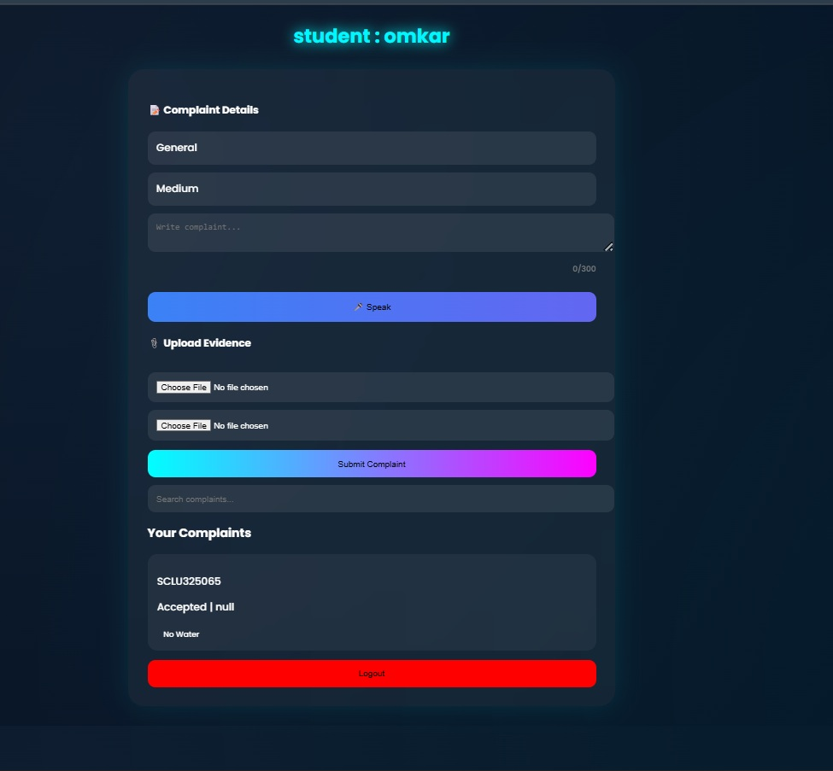
User Interface & Dashboard
User-friendly interface for complaint submission, tracking, and status updates with intuitive navigation.
User Interface

Slide 7
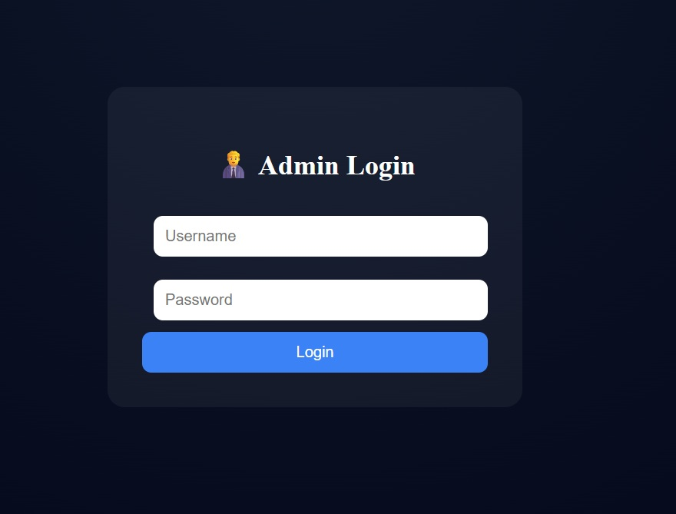
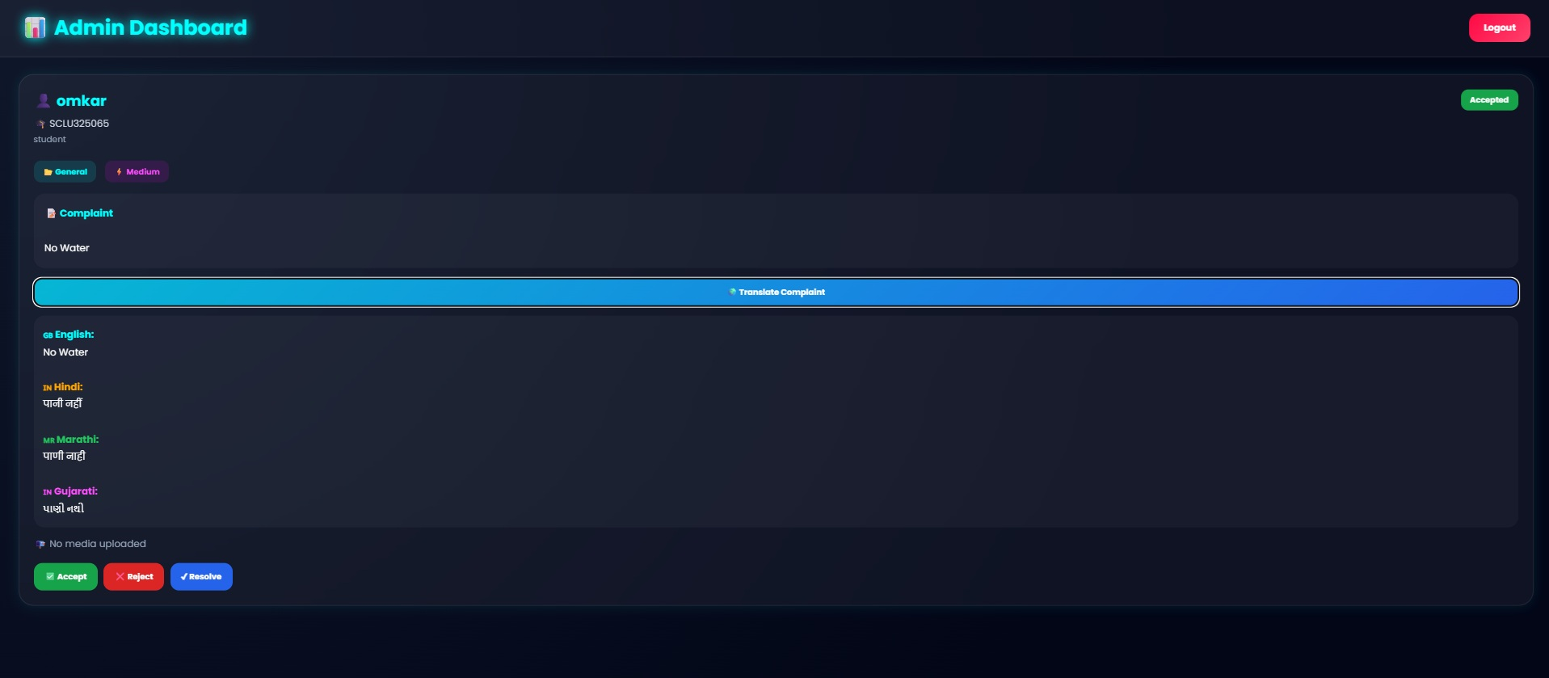
Admin Panel & Complaint Management
Secure Admin Login
View All Complaints
Protected access with enhanced security protocols
Complete overview of submitted complaints
Complaint Analysis
Translation Access
Detailed analytics and reporting
Multi-language complaint viewing
Status Management
Search & Filtering
Update complaint resolution status
Quick retrieval of specific complaints
Admin Login
Admin Dashboard

Slide 8

System Architecture & Advantages
Frontend Interface
User and admin interfaces
Authentication Layer
Secure user verification
Complaint Processing
Data validation and storage
AI Analysis Engine
Text processing and categorization
Translation Module
Multi-language conversion
Database Storage
Persistent data management
Admin Dashboard
Analytics and reporting
Key Advantages
Time Savings - Automated workflows reduce manual processing
Smart Automation - AI handles categorization and prioritization
Better Management - Centralized dashboard for oversight
Faster Resolution - Streamlined complaint handling
Multi-Language Support - Breaks language barriers
Reduced Manual Work - Eliminates repetitive tasks

Slide 9
Future Scope & Conclusion
Future Enhancements
Conclusion
Mobile application for iOS and Android
Voice-based complaint submission
Cloud infrastructure integration
AI sentiment analysis for emotion detection
Real-time notifications via email and push
The AI Complaint Analyzer System revolutionizes complaint management through AI automation, translation support, secure authentication, and intelligent administration. The system makes complaint processing faster, smarter, and more efficient.
Thank You

