Slide 1
Nutrition AI Agent
IBM HACKATHON PROJECT
Presented By: Omkar Pundlik Jagtap
Roll No : 2021ACAI1111046
College Name & Department : G H Raisoni College of Engineering and Management Pune , Computer Science & Engineering(Artificial Intelligence)

Slide 2
OUTLINE
Problem Statement
Technology used
IBM Cloud services used
Wow factor
End users
API Reference After Deployment
Deployment & Preview
Results
Conclusion
Git-hub Link
Future scope
IBM Certifications

Slide 3
Problem Statement
Today, many people want personalized nutrition advice. But most apps give same diet plans to everyone and don't consider lifestyle, culture, allergies, or health changes.
Dieticians and nutritionists can't help everyone personally because of limited time and resources.Generative AI can solve this by creating a smart and helpful virtual nutrition assistant.
It can understand input from text, voice, or images (like food photos or labels) and give custom meal plans and healthy food swaps.
The assistant can also explain why a food is good and change suggestions based on feedback.
This project uses IBM Cloud Lite and IBM Granite to build “The Smartest AI Nutrition Assistant”, making diet advice more personal and easy to access.

Slide 4
Technology used
IBM cloud lite services
Natural Language Processing (NLP)
IBM Granite model
IBM App Connect
Multimodal Input Analysis (Text, Voice, Image)
Large Language models (LLM)

Slide 5
IBM cloud services used
IBM Cloud Watsonx AI Studio
IBM Cloud Watsonx AI runtime
IBM Cloud Functions
IBM Cloud service
IBM Granite (via watsonx.ai studio)
IBM Cloud Object Storage
IBM AI Tools

Slide 6
Wow factors
Real-time dietary plan updates based on feedback
Smart food swaps and contextual nutritional explanations
Multimodal understanding (image, voice, text)
Hyper-personalized plans based on user lifestyle and culture
Continuous learning from user interactions

Slide 7
End users
Health-conscious individuals
Fitness enthusiasts
People with medical dietary needs
Dieticians & Nutritionists
Lifestyle coaches
Wellness app users

Slide 8
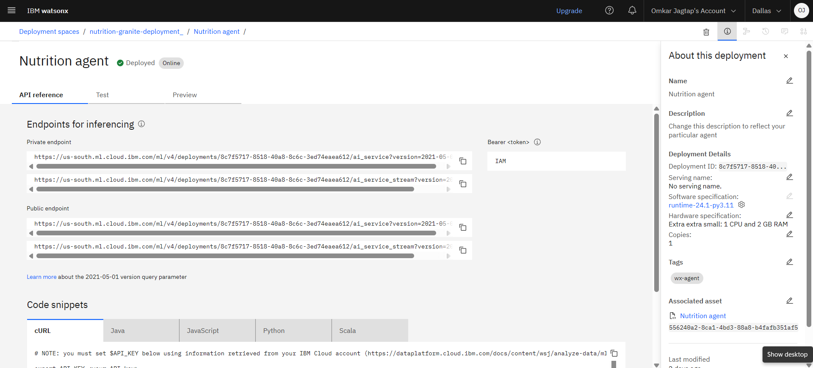
API REFERENCE AFTER DEPLOYMENT

Slide 9
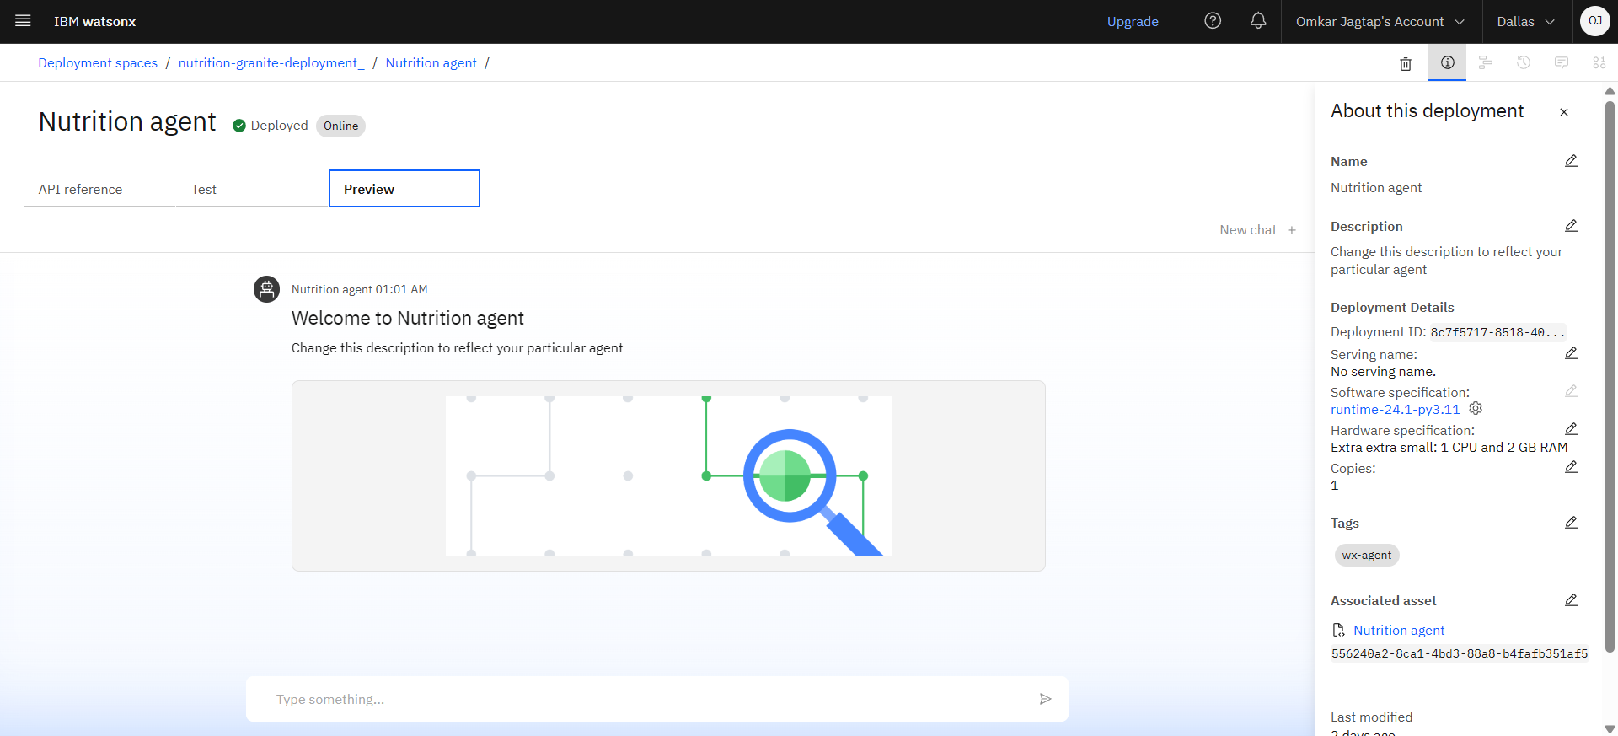
DEPLOYMENT & PREVIEW

Slide 10
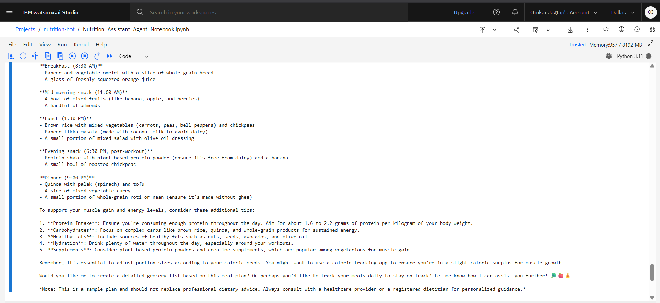
DEPLOYMENT & PREVIEW

Slide 11
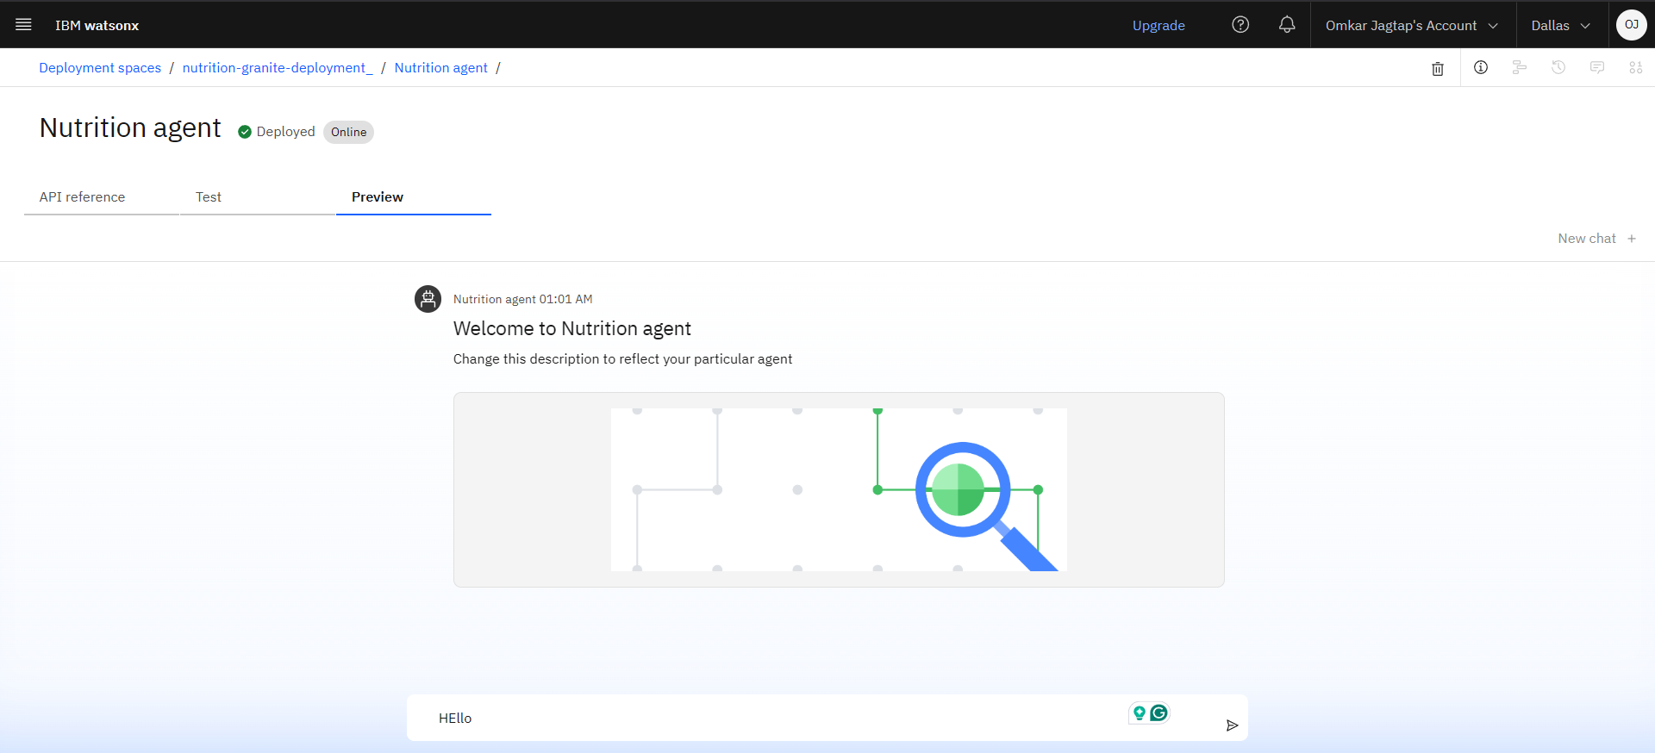
Results

Slide 12
Conclusion
The Nutrition AI Assistant makes healthy eating simple and personalized.By using IBM Cloud AI services, it delivers real-time, adaptive meal plans based on each person's unique needs and preferences.
The AI Nutrition Assistant transforms generic diet planning into an adaptive, interactive experience.
It brings scalable, personalized nutritional guidance through IBM's cutting-edge AI tools.
This project shows how AI can solve real-life health and lifestyle challenges in a smart, easy, and user-friendly way.

Slide 13
GitHub Link
https://github.com/Omkarj00/NUTRI-BOT_AI-Nutrition-Assistant-

Slide 14
Future scope
Integration with fitness wearables (e.g., Fitbit, Apple Watch) to track real-time activity and calories burned for more accurate meal planning.
AI-powered chatbot for 24/7 meal tracking, reminders, and personalized feedback based on user progress.
Multilingual support to help users around the world with nutrition guidance in their native languages.
Voice assistant integration (e.g., Alexa, Google Assistant) to allow hands-free access to meal suggestions and health tips.
Offline access mode for users in rural or low-connectivity areas, ensuring uninterrupted support and meal recommendations.

Slide 15
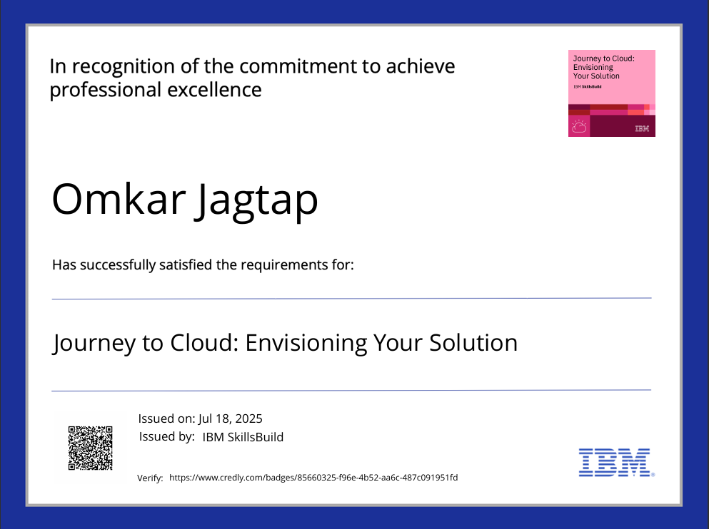
IBM Certifications

Slide 16
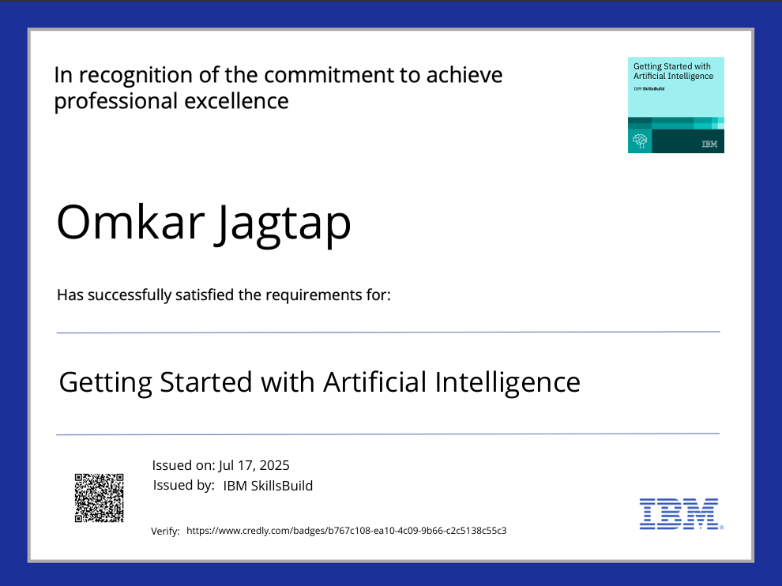
IBM Certifications

Slide 17
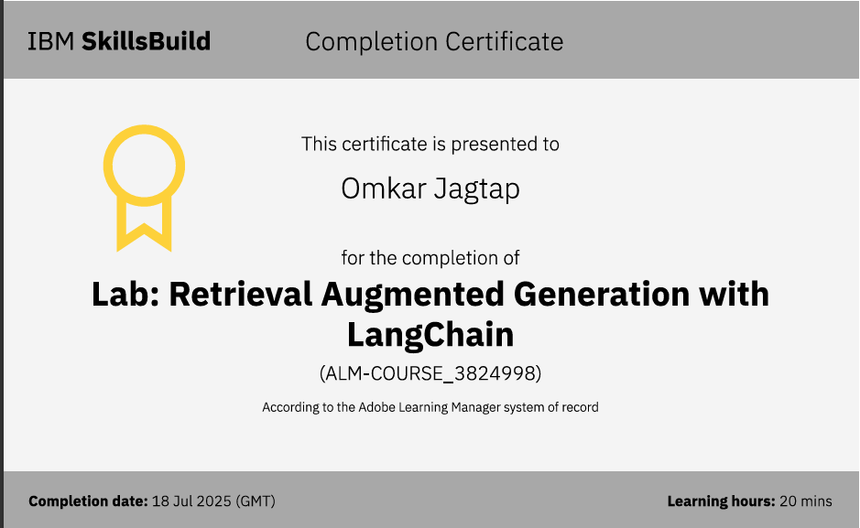
IBM LAB CERTIFICATE

Slide 18
THANK YOU

