Slide 1
PULSE OXIMETER AND HEART RATE MONITORING SYSTEM

Slide 2
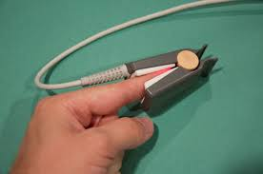
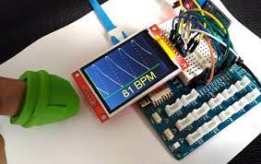
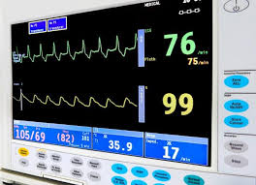
Introduction
Many further problems can be avoided if we could know heart rates and our oxygen level at right time.
In this project, we seek to monitor a patient's heart rate using pulse sensor and blood-oxygen level using a pulse
oximeter. The system used here is the heart rate monitoring model, this can be used in almost all the hospitals as
well as for general purposes like residential area. In this system, we have used pulse sensor to find the nearby or the actual value of heart beat rate of a normal person. Whenever problem arises in one’s heart functioning, in order to check the heart rate value this method is considered as the best method. When there is a low heart rate functioning happens, we call it as bradycardia. The lower of heart beat can be either a risky thing or sometimes it happens to normal person. Them main objective of our project is to provide a
Simple and easy heart rate monitoring system and pulse oximeter so that it could be useful to everyone.

Slide 3

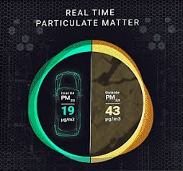
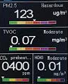
Objectives
IOT Based Air Pollution Monitoring System monitors the Air quality over a web server using Internet and will
trigger an alarm when the air quality goes down beyond a certain threshold level, means when there are
sufficient amount of harmful gases present in the air like CO2, smoke, alcohol, benzene, NH3, LPG and NOx . It
will show the air quality in PPM on the LCD and as well as on webpage so that it can be monitored very easily.
LPG sensor is added in this system which is used mostly in houses. The system can be installed anywhere but
mostly in industries and houses where gases are mostly to be found and gives an alert message when the
system crosses threshold limit.

Slide 4
Literature Review
This project is about Heart rate monitoring using pulse sensor in which the data is stored in the server for the later on use. Pulse Sensor is a simple sensor which is used in many places. The pin is constructed in such a way to indicate the heart rate. The basic sensor has three pins namely, ground and the input signal (which is also known as A0 signal). We have used pulse sensor to find the nearby or the actual value of heart beat rate of a normal person. The pulse sensor is connected to the server using Wi-Fi module (Node MCU) to track patients health. The data are sent to server using http protocol. It is like a small device which can be fixed to any atmosphere. It is a less bulky and a portable Wi-Fi module and the person can be connected to their android mobile using Wi-Fi hot spot settings.Esp8266 module can be interfaced with Arduino as well as in microcontrollers. ESP8266 Wi-Fi module plays a major role in the system. The Wi-Fi is connected to the external devices like phone, laptops etc. Once it is connected the IP address is noted in the code of Arduino software for the reference value of heart rate data. This is a compact device and can be taken anywhere easily. The heart rate device can be connected with other devices like microcontroller, MATLAB software and other suitable hardware and software can be used. It is easy to use and any people can handle it. By using the finger, we can able to find the heart rate easily. ARDUINO software for programming purpose and output will be shown in hardware part. This hardware is easy to handle and quite simple in its connections.in future this system can also be connected directly to hospital servers to manipulate patient’s data and would reduce the hectic work of monitoring various data.
This project is about Heart rate monitoring using pulse sensor in which the data is stored in the server for the later on use.
Pulse Sensor is a simple sensor which is used in many places. The pin is constructed in such a way to indicate the heart rate
. The basic sensor has three pins namely, ground and the input signal (which is also known as A0 signal).
We have used pulse sensor to find the nearby or the actual value of heart beat rate of a normal person.
The pulse sensor is connected to the server using Wi-Fi module (Node MCU) to track patients health.
The data are sent to server using http protocol. It is like a small device which can be fixed to any atmosphere.
It is a less bulky and a portable Wi-Fi module and the person can be connected to their android mobile using Wi-Fi hot spot settings.
Esp8266 module can be interfaced with Arduino as well as in microcontrollers. ESP8266 Wi-Fi module plays a major role in the system.
The Wi-Fi is connected to the external devices like phone, laptops etc. Once it is connected the IP address is noted in the code of
Arduino software for the reference value of heart rate data. This is a compact device and can be taken anywhere easily.
The heart rate device can be connected with other devices like microcontroller, MATLAB software and other suitable
hardware and software can be used. It is easy to use and any people can handle it. By using the finger, we can able to
find the heart rate easily. ARDUINO software for programming purpose and output will be shown in hardware part.
This hardware is easy to handle and quite simple in its connections.in future this system can also be connected directly to hospital servers
to manipulate patient’s data and would reduce the hectic work of monitoring various data.

Slide 5
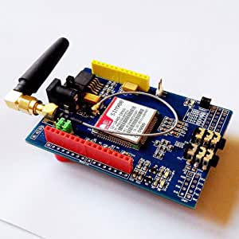
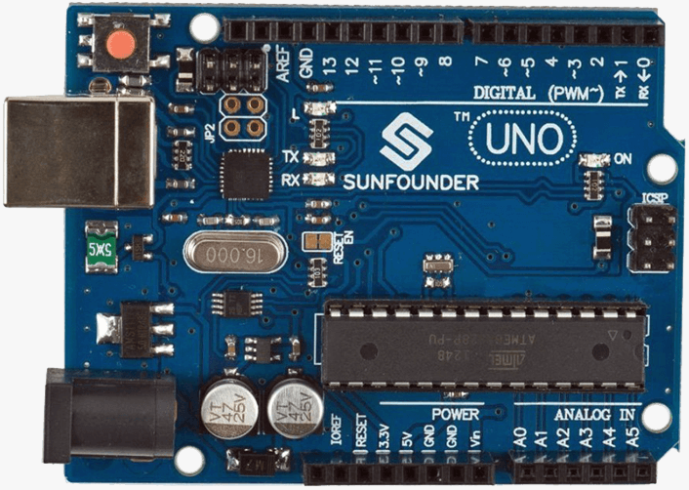
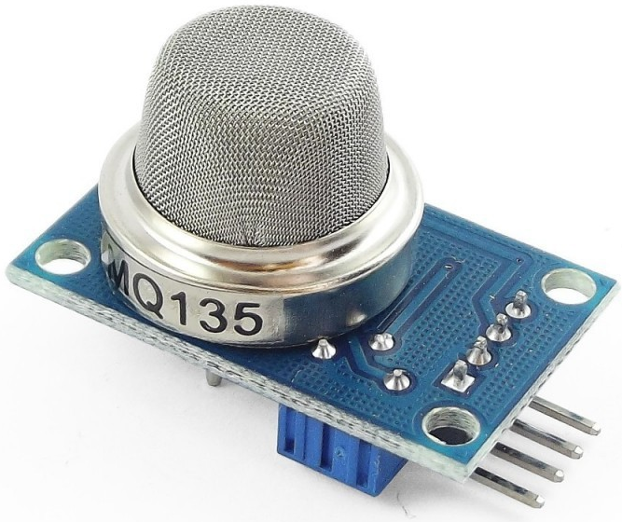
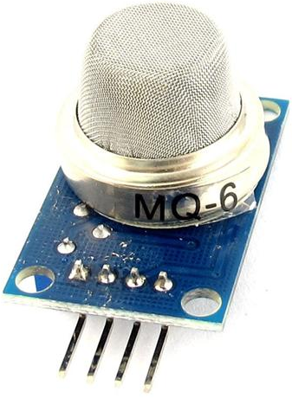
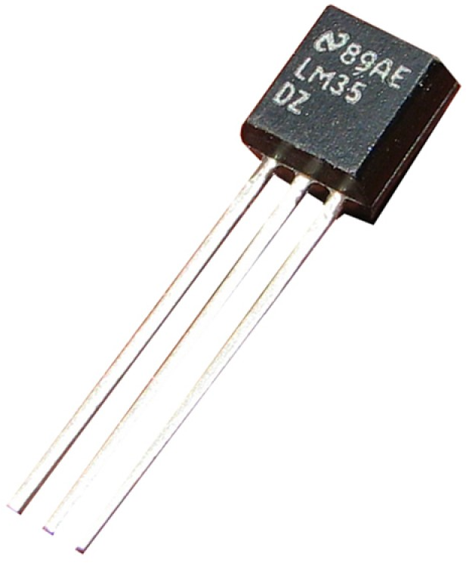
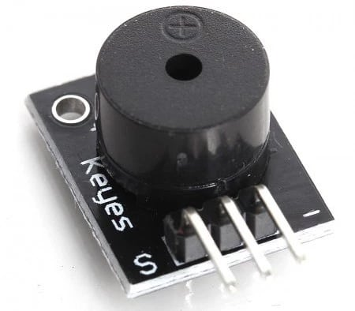
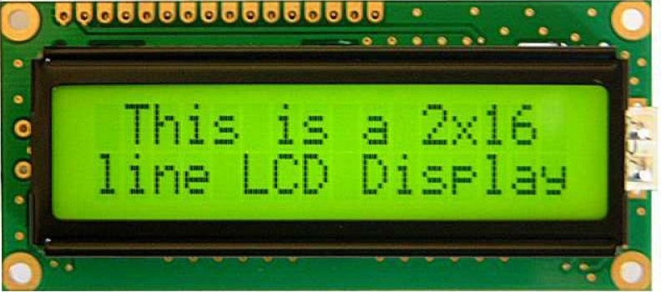


Tools and Components Used
MQ135
Sensor
LM35
Sensor
MQ6
Sensor
Arduino Uno R3
SIM TOOLKIT
WIX.COM
PIEZO BUZZER
TINKERCAD
.COM
LCD DISPLAY

Slide 6
Methodology Implemented
Proposed Air Pollution Monitoring System is based on the block
diagram as shown. The data of air is recognized by MQ135 gas
sensor, MQ6 LPG gas sensor and LM35 temperature sensor.
The MQ135 sensor can sense NH3, NOx, alcohol, Benzene, smoke,
CO2 When they will be connected to Arduino then it will sense all
gases, and it will give the pollution level in PPM. Gas sensors
will give the output in form of voltage levels and we have to
convert it into PPM. So for converting the output in PPM, we
have used a library for MQ135 gas sensor and MQ6 gas sensor.
According to the model the 3 sensors works as input data, they
transmit data for knowing which gas it is, what is the
temperature . LCD and Buzzer are the output devices. LCD
shows the data of the gases in ppm (parts per million) and Buzzer is used when ppm crosses above a threshold limit. Our system includes Arduino based temperature, transmitting monitored data to cloud based server.
POWER
SUPPLY
16 X 2
LCD DISPLAY
LM35
ARDUINO
UNO
R3
MQ6
BUZZER
MQ135
GSM SIM TOOLKIT

Slide 7
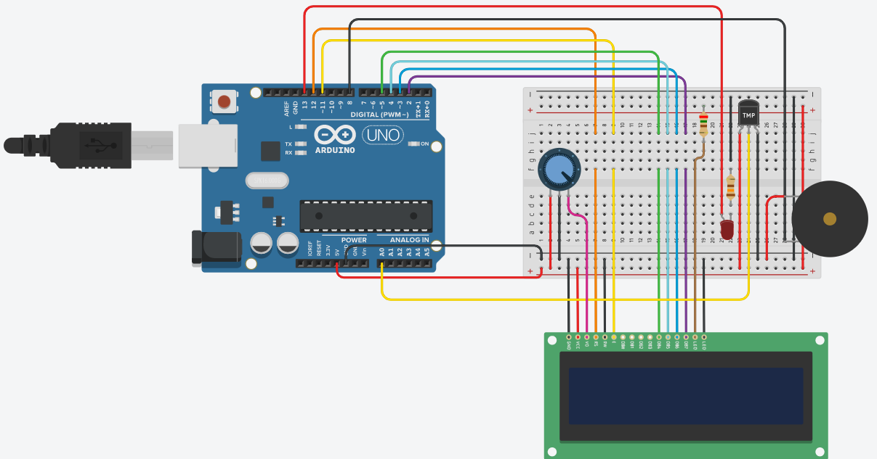
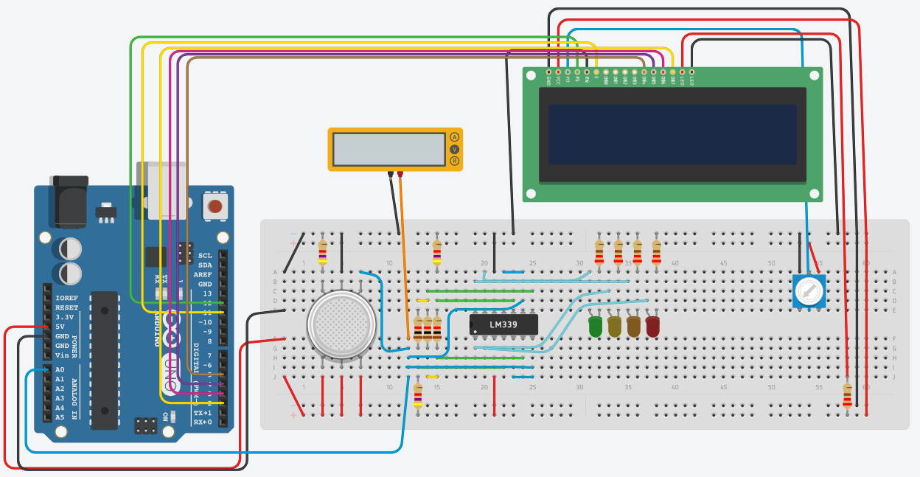
Progress Made So Far
Simulation of Temperature Sensor : https://www.tinkercad.com/things/3Pc6gK2alEtemperature-sensor-with-
display/editel
2. Simulation of Gas Sensor : https://www.tinkercad.com/things/4cjITFzqFXkgas-sensor/editel
3. Website : https://aiirqualitymonitor.wixsite.com/aiir

Slide 8



References
[1] https://www.arduino.cc/
[2] MQ-6.doc (sparkfun.com)
[3] Use introduction of HS-129 type gas sensitive components (olimex.com)
[4] LM35 Precision Centigrade Temperature Sensors datasheet (Rev. H)
[5]Wein wang, Suparna de, Xin Huang. “Distributed sensor data computing in smart city applications,” IEEE
International Symposium on a world of wireless, mobile and multimedia networks, 2017
[6]Philip Breitgger, Alexander Bergmann, “Air quality and health effects — how can wireless networks contribute?
A critical review,” International Conference on broadband communications for next generation networks and
multimedia applications pages 457-462, 2016
[7] Giovanni B. Fioccola, Raffaele Sommese “Polluino: An efficient cloud-based management of IoT devices for
air quality monitoring”IEEE 2nd International Forum on Research and Technologies for Society and Industry
Leveraging a better tomorrow (RTSI), 2016

Slide 9

Group Members
Roll No. 46 Ganesh Karode
Roll No. 47 Omkar Karpe
Roll No. 48 Kartik Rupauliha (Assistant GL)
Roll No. 49 Kartik Rajput (Group Leader)
Roll No. 50 Nakul Kasar
THANKYOU

