Slide 1
Disease prediction using Machine Learning Algorithm
B.Tech S.Y.
Division - B Batch - 2 Group – 5
Ganesh Karode
Omkar Karpe
Sushil Khandare
Rohit Jadhav
Mandar Kalse

Slide 2
Content:
Introduction
Problem Statement
Literature Survey
Methodology
Result And conclusion
References

Slide 3
Introduction
The rapid growth of internet technology and mobile devices has opened up new avenues for the online healthcare system. There are cases where online medical help or health advice is easier and faster to understand than real-world help.
People often feel reluctant to go to hospital or physician for minor symptoms. However, in many cases, these minor symptoms may trigger major health hazards.
As online health advice is easily reachable, it can be a great head start for users. Moreover, existing online health care systems suffer from a lack of reliability and accuracy.
Our system analyzes the symptoms provided by the user as input and gives the disease as an output. Prediction is done by implementing the RandomForest , KNeighbors and SVM Classifier.

Slide 4
problem statement
The wide adaptation of computer-based technology in the health care industry resulted in the accumulation of electronic data. Due to the substantial amounts of data, medical doctors are facing challenges to analyze symptoms accurately and identify diseases at an early stage. Certain Diseases and problems relating to health such as cholera, anaemia, brain tumor, cancer, kidney failure, dengue, diabetes, migraine, jaundice, hepatitis, aids etc., lead to serious health effects and can sometimes prove to be fatal. However, supervised machine learning (ML) algorithms have showcased significant potential in surpassing standard systems for disease diagnosis and aiding medical experts in the early detection of high-risk diseases. The aim of developing classifier system using machine learning algorithms is to immensely help to solve the health-related issues by assisting the physicians to predict and diagnose diseases at an early stage. This research work carried out demonstrates the disease prediction system developed using Machine learning algorithms such as Random forest classifier, SVM, and KNN.

Slide 5
SR. NO | PUBLICATION ON YEAR | NAME OF AUTHOR | TITLE OF PAPER | FEATURES PROVIDED
1 | 2016 | Divya Jain, Vijendra Singh | Utilization of Data Mining Classification Approach for Disease Prediction | Data Mining Technology The use of a Disease Predictability System is well known and emerges successfully in this area.
2 | 2020 | Sneha Grampurohit, Chetan Sagarnal | Disease Prediction using Machine Learning Algorithms | The disease prediction system developed using Machine learning algorithms namely, Decision Tree classifier, Random forest classifier, and Naïve Bayes classifier.
3 | 2019 | Maurya, A., Wable, R., Shinde, R., John, S., Jadhav, R., & Dakshayani | Chronic Kidney Disease Prediction and Recommendation of Suitable Diet Plan by using Machine Learning | The proposed system which includes the 4 main modules, namely pre-data processing, feature extraction, descriptive areas based on blood potassium levels, dietary module.

Slide 6
SR. NO | PUBLICATION ON YEAR | NAME OF AUTHOR | TITLE OF PAPER | FEATURES PROVIDED
4 | 2015 | R. Tamilarasi , Dr. R. Porkodi | A Study and Analysis of Disease Prediction Techniques in Data Mining for Healthcare | The effectiveness of different methods of classifying broad dataset. Similar algorithms include Naïve Bayes, K's closest neighbor, Artificial Neural Network, tree of decision.
5 | 2016 | Ritika Chadha, Shubhankar Mayank, Anurag Vardhan and Tribikram Pradhan. | Application of Data Mining Techniques on Heart Disease Prediction: A Survey | Analyze different mining techniques that have been implemented in the recent years for identification of heart Disease using Decision Trees, Genetic Algorithm ,Naïve Bayes and Neural Network .
6 | 2015 | S. Vijayarani, S. Dhayanand | Data Mining Classification Algorithms For Kidney Disease Prediction | To predict kidney disease using various classification approaches and finding the efficient classification algorithm Using Naïve Bayes and SVM Algorithm .

Slide 7
Methodology
The Dataset Is Downloaded from Kaggle in a csv (comma separated values) format.
The dataset is imported into the main file as panda Dataframe using pandas and other dependency such as:
Pandas: To format and structure data so it can be passed into the ML model for training.
Joblib: To save the trained model.
Sklearn: To import useful functions and ML models.
The data is separated into features and label and passed into the models imported from sklearn library.
The following classifiers are used to train:
KNN (K- nearest Neighbors) classifier
Random Forest classifier
SVM (Support vector machine) classifier

Slide 8


Methodology
4 . The Accuracies obtained using above classifiers:
Training Accuracies:
Testing Accuracies:
This trained models are saved using joblib library to be used later.

Slide 9
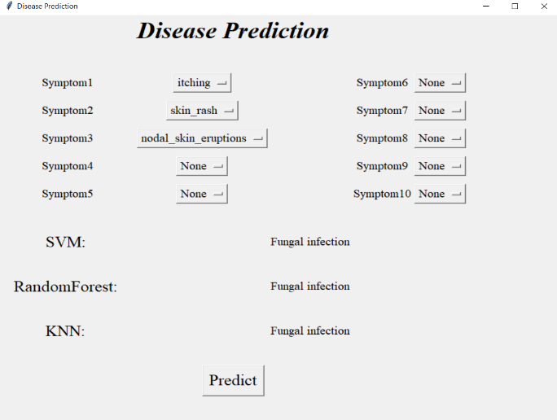
Methodology
Creating GUI in python using tkinter library.
Tkinter Interface:Python offers multiple options for developing GUI (Graphical User Interface). Out of all the GUI methods, tkinter is most commonly used method. It is a standard Python interface to the Tk GUI toolkit shipped with Python. Python with tkinter outputs the fastest and easiest way to create the GUI applications.
The GUI will have following features:
Allowing user to enter symptoms using drop down menu
A predict button which user can click to get prediction after entering the symptoms
A screen to display the predicted result.
Implementing the code to connect GUI to the models so that ,the symptoms selected can be passed into the models and the prediction from models can be displayed on the GUI.

Slide 10
Result and Conclusion
Actions that our system can perform:
Entering Symptoms
Disease Prediction
Entering Symptoms: Once user entered in to the system then he/she has to select the symptoms from the given drop-down menu.
Disease prediction: The predictive model predicts the disease of a person he might have, based on the user entered symptoms.

Slide 11
References
[1] Divya Jain, Vijendra Singh, "Use of Data Specification of Predictive Mining Data" 2016.
[2] Sneha Grampurohit, Chetan Sagarnal, "Disease Predicting Using Machine Learning Algorithms" 2020.
[3] Maurya, A., Wable, R., Shinde, R., John, S., Jadhav, R., & Dakshayani, “Chronic Kidney Disease Prediction and Commendation of Suitable Diet Plan through Machine Learning” 2019.
[4] R. Tamilarasi, Dr. R. Porkodi, "Research and Analysis of Disease Predictability Methods in Data Mining for Healthcare" 2015.
[5] Ritika Chadha, Shubhankar Mayank, Anurag Vardhan and Tribikram Pradhan, "Use of Data Mining Methods on Heart Disease Predictability: Examination" 2016.
[6] S. Vijayarani, S. Dhayanand, “Data Mining
Classification Algorithms for Kidney Disease Prediction ”2015.

Slide 12
THANK YOU

