Slide 1
WhatsApp Data Analytics
B.Tech F.Y.
Division - H Batch - 3 Group – H9
46-12010504-Ganesh Karode
47-12011084-Omkar Karpe
48-12010914-Kartik Rupauliha
49-12010397-Kartik Rajput
50-12011421-Nakul Kasar
Course Project
Computing with Python
Department of Engineering, Sciences and Humanities (DESH)
Vishwakarma Institute of Technology, Pune
A.Y.(2020-2021) Term II

Slide 2
OUTLINE
Introduction
problem statement
objectives and aim
background
Implementation
Results and discussion
Conclusion and Future Scope
References

Slide 3
Introduction
Today one of the most trendy social media platforms is WhatsApp. It is one of the favorite social media platforms among all of us because of its attractive features.
WhatsApp is an instant messaging application which enables users to send and receive messages in real time. It is a platform that has created an enabling environment for users to communicate with others at a cost of only a little internet access.
In the world of social media, the WhatsApp conversation groups are one of the most popular ways to stay in contact with family and friends.

Slide 4
problem statement
WhatsApp claims that nearly 55 billion messages are sent each day. The average user spends 195 minutes per week on WhatsApp, and is a member of plenty of groups. These groups contain a lot of information and data that can be analysed and visualized in forms of plots and graphs.

Slide 5
objectives and aim
Objectives
WhatsApp Data Analyzer means we are analyzing our WhatsApp group activities. It tracks our conversation and analyses how much time we are spending on WhatsApp.
We can also get the group activity tracked as we can know no. of messages sent, sleep cycle of group, most active person, hours or weekdays people are most active etc.
aim
Our aim is developing an GUI based WhatsApp data Analyzer which will have a simple interface and would be very helpful for people to analyse and visualize their WhatsApp activities.

Slide 6
background
AnalayzeTheChat [1] from towardsdatasience.com is an online platform for analyzing WhatsApp group chats where we need to drag and drop our extracted WhatsApp group chat txt file and we get statistics for our chats, limitation to this platform is that someone might not want to share their chats with website and also these chats can be used misused.
AnalyticsVidhya.com [2] also provides code in python for WhatsApp data analytics which we need to download and run on any python ide and we can see the visualizations in terminal and plots section, limitations to this code are that it is difficult for people without programming knowledge to run this and also code is too large.

Slide 7
Implementation
Category of the project
Data Analytics
GUI
Tools / Platform
Python 3.9
Front end-Backend Software Requirement
Spyder

Slide 8
Implementation (Cont.)
Modules / Features:-
Simple, easy to use GUI
Able to analyze / visualize :-
No. of messages sent by user
Letter count, word count, URL count
Average no. of messages per day
Sleep cycle of group
Media messages and emojis
No. of message sent on particular weekday or hour
Word cloud of most repeated words

Slide 9
Implementation (Cont.)
System Architecture (Block Diagram) :-
WhatsApp Data Analytics
Data Collection
Getting .txt file of chat
WhatsApp -> Chat -> 3 dots -> more -> export chat -> without media
Data Preparation
Text Pre-processing
Map reducing
Creating Data frame
Data Visualization
Using matplotlib for data visualizations
Fig.1 Block Diagram

Slide 10
Implementation (Cont.)
Overall Algorithm :-
We start by selecting the WhatsApp chat data text file(.txt)
Further the data from this file is processed and split into required format using regex library
Data-frame is created from this sorted output using pandas
Many columns such as message, user, weekday, hour, word count, media messages, group notification are created
Data is visualized from this data-frame using matplotlib, pyplot
We have used tkinter to make a user friendly GUI to use this code easily

Slide 11
Implementation (Cont.)
Overall Flowchart :-
START
Import WhatsApp chat text file
Select option to be visualized
According to your selection graphs would be displayed
EXIT
NO
YES
STOP
Fig.2 Flowchart

Slide 12
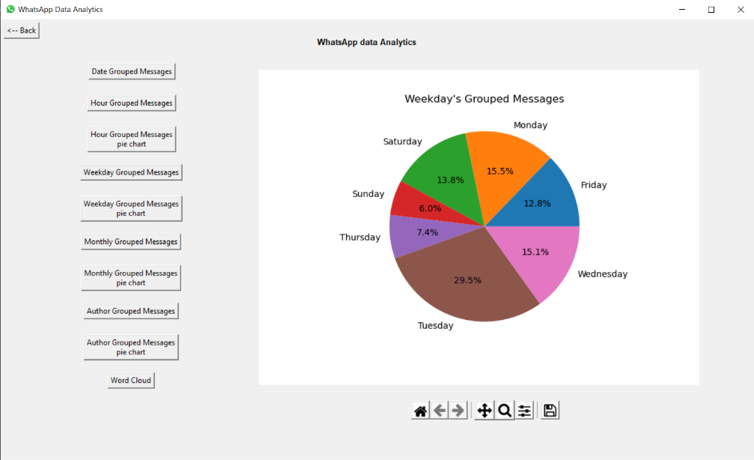
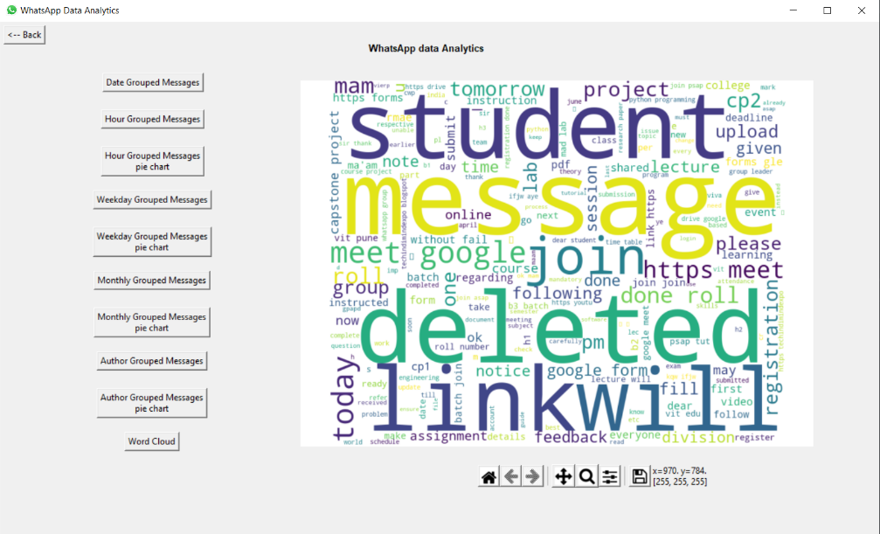
Results and discussion
The following represents the output of the result of the analysis done with Python on the given group chat :-
Fig.3 Output from our code which shows no. of messages on weekday’s
Fig.4 Output from our code which shows word cloud of most repeated words

Slide 13
Conclusion and Future Scope
Conclusion
This work was able to discuss the WhatsApp application and its libraries, to create an analysis of a WhatsApp group chat and visually represent the data.
The system was done with python, and the python libraries that were implemented includes, NumPy, Pandas, Matplotlib and Tkinter.
Future Scope
This system can further be upgraded to analyze data from different social media platforms such as twitter, Facebook etc.

Slide 14
Contribution
Div. H Batch 3 Group H9
Roll No 46-12010504-Ganesh Karode
IPL individual player data analytics for year 2015-2016
Roll No 47-12011084-Omkar Karpe
IPL team data analytics for year 2015-2019
Roll No 48-12010914-Kartik Rupauliha
IPL individual player data analytics for year 2019-2020
Roll No 49-12010397-Kartik Rajput
WhatsApp Data Analytics
GUI
Roll No 50-12011421-Nakul Kasar
IPL individual player data analytics for year 2017-2018

Slide 15
References
http://aqeelanwar.pythonanywhere.com/
https://www.analyticsvidhya.com/blog/2021/04/whatsapp-group-chat-analyzer-using-python/
https://medium.com/mcd-unison/whatsapp-group-chat-analysis-with-python-3f5196280ba
GeeksForGeeks.com
w3schools.com

Slide 16
Thank You

