Slide 1
Password Manager and Generator
B.Tech S.Y.
Division - B Batch - 2
Omkar Karpe
Roll No: 45

Slide 2
Content:
Introduction
Objective
Literature Survey
Methodology
Results and Discussions
References

Slide 3
Introduction
User authentication is a necessary security element in the open network environment, and the use of simple authentication information also has some severe problems.
One problem is that it is easy for the attackers to guess passwords whenever the users often choose personal information, such as their ID or telephone number as passwords.
In Today’s world a single person has many accounts such as Facebook, Instagram ,twitter, LinkedIn, YouTube, etc. So it becomes difficult to remember the usernames and passwords for each account we create.
So, to address this issue, in this paper, I have proposed an automated system to generate user-friendly and robust passwords by combining small letters, capital letters, special symbols and numbers. Later the user can copy the generated password for further usage.
Also, user can enter into the password manager by entering master password, in the password manager user can store passwords for various websites/platform with website name, username, and user can also paste his/her generated passwords generated from the password generator.

Slide 4
OBJECTIVE
The objective of this project is to give relief to the user from the burden of remembering the passwords and the username for various websites. If the user uses this system then he no longer needs to remember the password and user names for the various accounts he creates on the websites or platforms. Also, now user no longer needs to think about what should be the password for the accounts on various websites, because this system of password generator and manager will solve this issue of the user

Slide 5
SR. NO | PUBLICATION ON YEAR | NAME OF AUTHORS | TITLE OF PAPER | FEATURES PROVIDED
1 | 2019 | Farhana Zaman Glory , Atif Ul Aftab, Olivier Tremblay-Savard, Noman Mohammed. | Strong Password Generation Based On User Inputs | In this proposed system, they are generating passwords by prompting the users to provide them with some texts and numbers (which we can easily remember) as inputs. The generated passwords have ensured the minimum criteria of the password strength.
2 | 2010 | Ambarish Karole, Nicolas Christin. | A Comparative Usability Evaluation of Traditional Password Managers | In this proposed system, it compared the three password managers which were, online password manager, phone password manager and USB password manager.
3 | 2019 | Ridwan Olayinka Oladipupo, Ajayi Olusola Olajide | An enhanced web security for cloud-based password management. | This study in its own view, is set to design a highly secure cryptography for making the site /service more tightly secured. Consequently, this work presented an enhanced web security for cloud-based password management using SHA-256 and Diffie Hellman key exchange algorithm.

Slide 6
SR. NO | PUBLICATION ON YEAR | NAME OF AUTHORS | TITLE OF PAPER | FEATURES PROVIDED
4 | 2017 | Carlos Luevanos, John Elizarraras, Khai Hirschi, Jyh-haw Yeh | Analysis on the Security and Use of Password Managers. | In this paper there is discussion about three open-source password managers which are- passbolt, padlock and encryptr, there strengths and weakness have been discussed in this paper.
5 | 2014 | B. Yang, H. Chu, G. Li, S. Petrovic and C. Busch | Cloud Password Manager Using Privacy-Preserved Biometrics | The privacy-preserving biometrics (using rigidly-irreversible template protection method) based password manager scheme proposed in this paper enables people to use two factors (a master key and the biometrics) for password binding and releasing in a secure way
6 | 2017 | F. Al Maqbali and C. J. Mitchell | AutoPass: An automatic password generator | Use of the Pattern recognition and machine learning which is provided by server statements allows passwords to be automatically generated to satisfy some specific requirements. But still , while AutoPass only works in theory, it remains unverified that the system will actually work in practice.

Slide 7
Methodology
1. The project required following dependency :
i)Tkinter: For designing the required GUI for password generating
ii)PIL: Python Imaging Library (expansion of PIL) is the image processing package for Python language.
iii)Random: Python Random module is an in-built module of Python which is used to generate random numbers.
iv)Hashlib:The core purpose of this module is to use a hash function on a string, and encrypt it.
2.Using Tkinter, first I designed the required frame for the password generator and the password manager.
3.Password Generator GUI has following features:

Slide 8
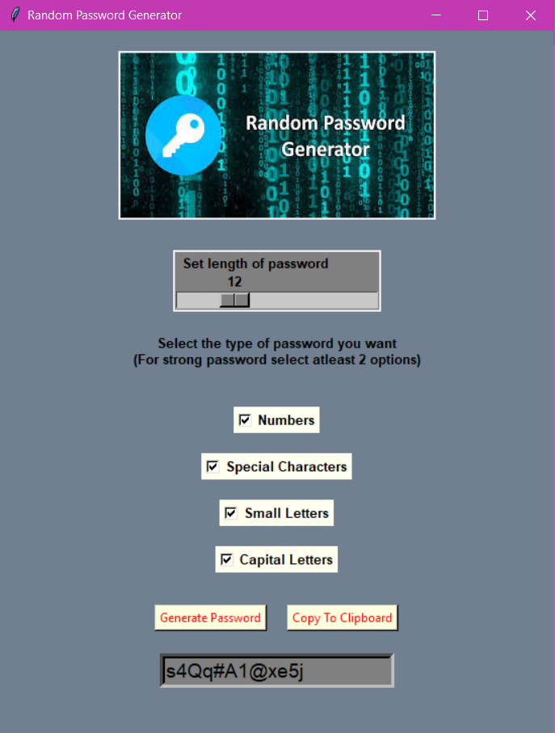
Methodology
3.Password Generator GUI has following features:
i) Asks the user about the length of the password he wishes for.
ii) Genearates the password on the basis of inputs given by the user
(capital letters, small letters etc.)
iii) Provides copy to clipboard button, so if user wishes to
copy the password, he can.

Slide 9
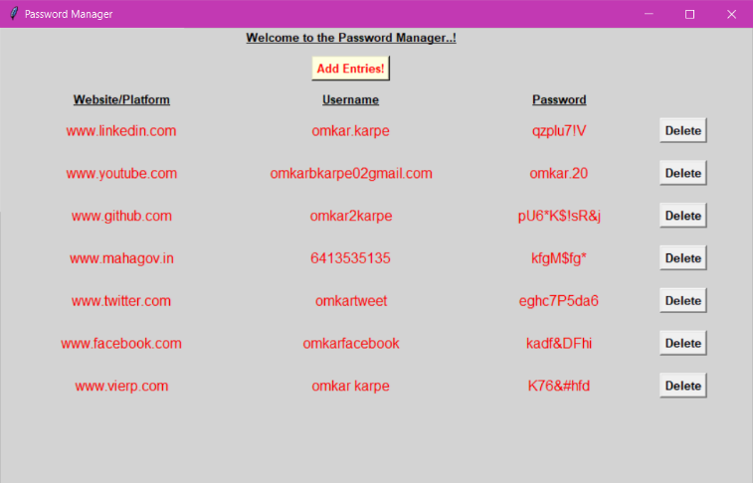
5. Password Manager GUI has following features:
i) When the user runs the programme for first time he
needs to create the master password for the vault.
ii) Later user has to enter the username, platform/website
and the password for the website by clicking “Add Entries”
iii) In GUI I have also provided the option for deleting
the entries from the password manager.

Slide 10
Results and discussions
Outcome of the project:
i) Can generate random passwords as per user inputs
ii) Manages all the passwords along with their usernames, so that user no longer needs to remember password and usernames.
iii) Also in case user wishes to delete the password, he can easily do it, as I have provided the delete button in the password manager.
iii) Provides security to the password manager, as only the user knows the masterpassword, which acts like the key to the password manager.

Slide 11
References
F. Z. Glory, A. Ul Aftab, O. Tremblay-Savard and N. Mohammed, "Strong Password Generation Based On User Inputs," 2019 IEEE 10th Annual Information Technology, Electronics and Mobile Communication Conference (IEMCON), 2019.
F. Al Maqbali and C. J. Mitchell, "AutoPass: An automatic password generator," 2017 International Carnahan Conference on Security Technology (ICCST), 2017.
P. Tsokkis and E. Stavrou, "A password generator tool to increase users' awareness on bad password construction strategies," 2018 International Symposium on Networks, Computers and Communications (ISNCC), 2018.
A. Ade-Ibijola and B. Ogbuokiri, "Syntactic Generation of Memorable Passwords," 2019 International Multidisciplinary Information Technology and Engineering Conference (IMITEC), 2019.
P. Lin, L. Weng and P. Huang, "Graphical Passwords Using Images with Random Tracks of Geometric Shapes," 2008 Congress on Image and Signal Processing, 2008.
C. Luevanos, J. Elizarraras, K. Hirschi and J. Yeh, "Analysis on the Security and Use of Password Managers," 2017 18th International Conference on Parallel and Distributed Computing, Applications and Technologies (PDCAT), 2017.
B. Yang, H. Chu, G. Li, S. Petrovic and C. Busch, "Cloud Password Manager Using Privacy-Preserved Biometrics," 2014 IEEE International Conference on Cloud Engineering, 2014.

Slide 12
Thank you..!

