Slide 1


E-Commerce Sales Analysis Dashboard
Analyzing Sales Performance and Customer Behavior
By Omkar Rahate

Slide 2
Problem Statement & Objective
Problem Statement -
Objective -
The rapid growth of e-commerce has led to vast amounts of data generated from online sales. Businesses need to understand their sales performance, customer demographics, and the impact of various factors such as platforms used and regions on sales to optimize strategies and enhance profitability
To analyse e-commerce sales data, identify key trends and patterns, and derive actionable insights to inform business decisions, improve customer targeting, and optimize product offerings.

Slide 3
Data Acquired
Source:
The dataset was acquired from Kaggle, an online community of data scientists and machine learning practitioners.
Description:
The dataset contains 31,047 entries and 19 columns, capturing various aspects of online orders including:
Order Details: Order ID, SKU, Quantity, Amount
Customer Demographics: Customer ID, Gender, Age, Age Group
Order Information: Order Date, Month, Status
Platform: E-commerce platforms (Myntra, Amazon, Ajio)
Shipping Information: ShipCity, ShipState, Region, Postal Code

Slide 4
Data Transformation
Cleaning Process:
The dataset was checked for missing values, and appropriate imputations were made where necessary.
Duplicate records were identified and removed to ensure data integrity.
Inconsistent entries, particularly in categorical columns (e.g., platforms, regions), were standardized.
Transformation:
Extracted the month from the order date to analyse monthly trends.
Grouped customer ages into categories (Teenager, Adult, Senior) for demographic analysis.
Mapped shipping locations to broader regions (North, South, East, West) to facilitate regional analysis.

Slide 5
Data Modeling
Structured Data:
The cleaned and transformed data was organized into a format suitable for analysis, enabling the creation of key
metrics such as Total Sales, Total Orders, and Total Quantity.
Key Tables:
Analysed sales distribution across different States and different months of the year 2022.
Examined Avg. sales by gender, age group, and region.
Explored the performance of Products Purchased in different product categories and Regions.

Slide 6


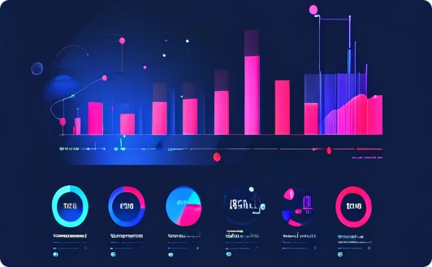
Data Visualization
Trend Lines
Visualizations Used:
Line Charts: Displayed sales distribution by platform, States, and age group.
Pie Charts: Illustrated the proportion of product purchased by different Regions.
Area Chart: Tracked monthly sales performance to identify seasonal trends.
Column Chart: Displayed the Product size in different categories of purchased products.
Interactive Elements:
The dashboard includes slicers & cards to filter data by gender, platform, age group, and region, making it dynamic and user-friendly.
Bar Charts
Pie Charts

Slide 7
Important Insights
Top Performing Regions:
South Region contributed the highest sales, indicating strong market presence and customer base.
North & West Region also showed significant sales, particularly for certain product categories.
Customer Demographics:
Teenager (18-30 years) were the most active buyers, followed by Seniors (51+ years).
Women accounted for the majority of purchases, suggesting targeted marketing opportunities.
Platform Performance:
Amazon dominated sales, especially in the clothing and apparel categories.
Myntra & Flipkart showed consistent performance across multiple categories, indicating its broad appeal.

Slide 8
Return Rate by Category:
Kurta & Set category exhibited a higher return rate, possibly due to unmet expectations.
Overall Lower return rates were observed in this category, indicating better customer satisfaction
or alignment with expectations.
Regional Price Sensitivity:
East Region customers showed higher price sensitivity, purchasing lower-priced items or smaller quantities.
North & South Regions were less price-sensitive, with higher average order values, suggesting these regions
could tolerate premium pricing or value-added services.
Impact of Discounts and Promotions:
Significant spike in sales volume was seen during promotional periods.
While promotions boost order numbers, they should be balanced with strategies that maintain or increase Avg.
order value to protect profit margins.

Slide 9
Recommendations
Targeted Marketing:
Focus marketing efforts on the East regions, particularly targeting adult women who are the primary buyers.
Platform Optimization:
Strengthen partnerships with Myntra and Amazon to capitalize on their strong performance. Consider exclusive deals
or targeted campaigns on these platforms.
Product Strategy:
Expand popular categories such as clothing and accessories. Introduce new products that cater the preferences
of the adult demographic.
Seasonal Promotions:
Launch promotions during peak months identified in the trend lines, maximizing sales opportunities.

Slide 10
Conclusion
The analysis of the e-commerce sales data has provided valuable insights into customer behaviour, regional
performance, and platform effectiveness. By implementing the recommendations, the business can
enhance its market positioning, improve customer engagement, and drive higher sales.

