Slide 1
Same score, different story
How resampling history shapes what spatial-frequency features
detect in AI-generated images
CSE 4883 Digital Image Processing · final presentation
Member 1 · Member 2 · Member 3
Introduction · Novelty · Methodology · Experiments · Results · Limitations · Future
Notes:
MEMBER 1 (10 s). We studied what simple spatial and frequency features measure when they separate real photographs from generated images. Our theme is: same score, different story.

Slide 2
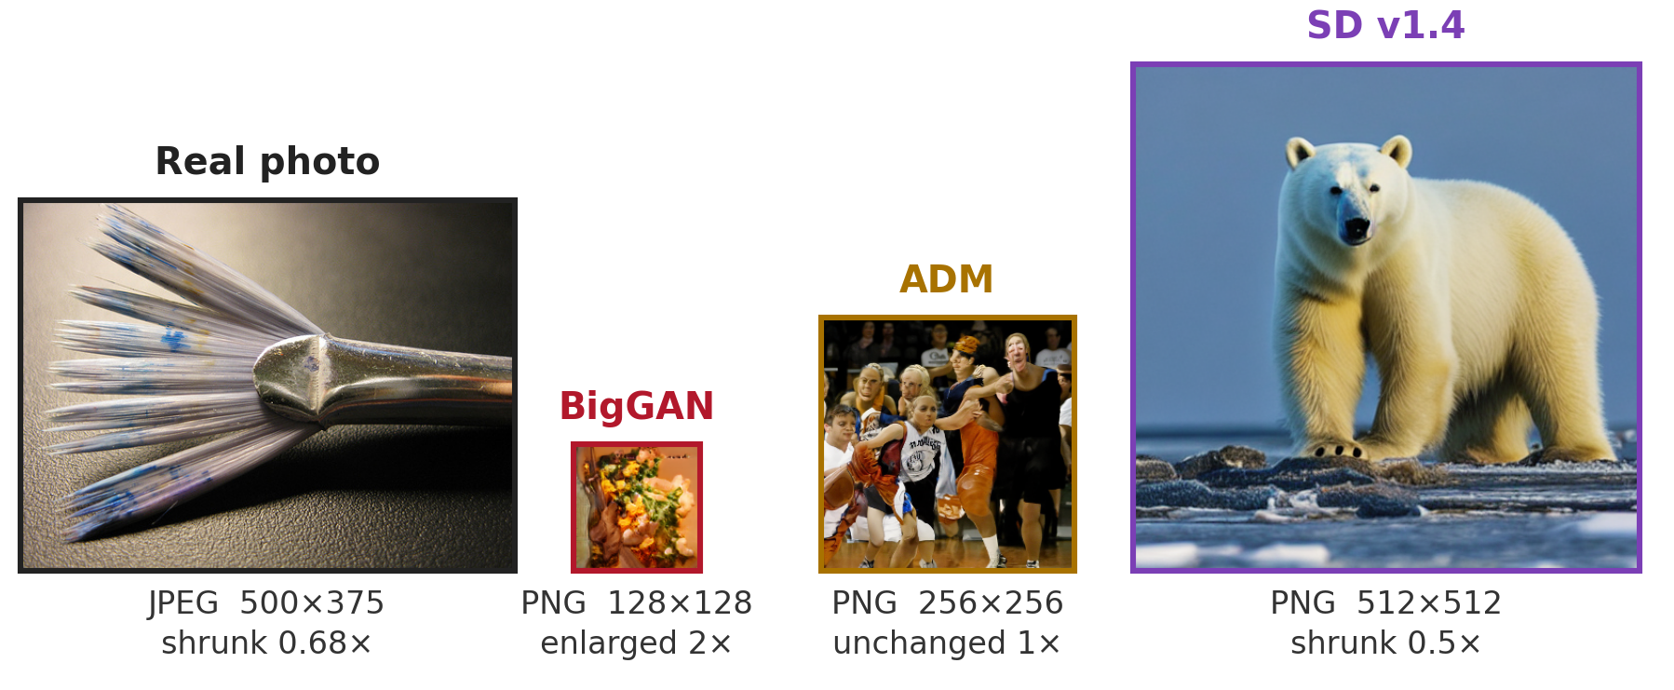
INTRODUCTION
NOVELTY
METHODOLOGY
EXPERIMENTS
RESULTS
LIMITATIONS
FUTURE
Real and fake images arrive differently
MEMBER 1
File format and size alone separate the classes (AUROC 1.000). A fair pipeline gives every image 256 × 256 px, but each class is resized by a different factor.
CSE 4883 Digital Image Processing · Same score, different story
2 / 11
Notes:
MEMBER 1 (45 s). Our sample contains three thousand GenImage images: half real, half generated by BigGAN, Stable Diffusion or ADM. Real images arrive as JPEGs of different sizes; generated images arrive as fixed-size PNGs. Original format and size alone separate the classes perfectly. We standardised both classes to 256 by 256 pixels, but that enlarges BigGAN twice and reduces other images. Equal output size does not erase processing history. We therefore compare seven spatial features, seven frequency features, and all fourteen together under JPEG compression and generator shift.

Slide 3
INTRODUCTION
NOVELTY
METHODOLOGY
EXPERIMENTS
RESULTS
LIMITATIONS
FUTURE
Contribution: a feature-level processing audit
MEMBER 1
Established questions
This project · 14 named features
Compression history
JPEG and size bias
Per feature, per generator
which statistic moves, and for which generator
one level
down
Benchmark comparability
content, format, size
Two stresses, one fixed protocol
matched JPEG + unseen generator
Resizing history
resize vs native, JPEG
Exploratory reference-data check
BigGAN pixels unchanged; crop and training data change
Contribution: trace processing effects through features, generator scores and decisions
CSE 4883 Digital Image Processing · Same score, different story
3 / 11
Notes:
MEMBER 1 (55 s). Our contribution is a feature-level audit. We connect image processing operations to individual statistics, generator-specific scores, and actual classification decisions. The planned study tests matched JPEG and an unseen generator. Later diagnostics examine a shared resampling operation and clean-model JPEG transfer. Those diagnostics are exploratory. BigGAN pixels are identical between the two resampling conditions, while the real-image comparison changes. However, crop and training data also change, so this is not a pure causal test of resizing. Member two will explain the pipeline and planned results.

Slide 4
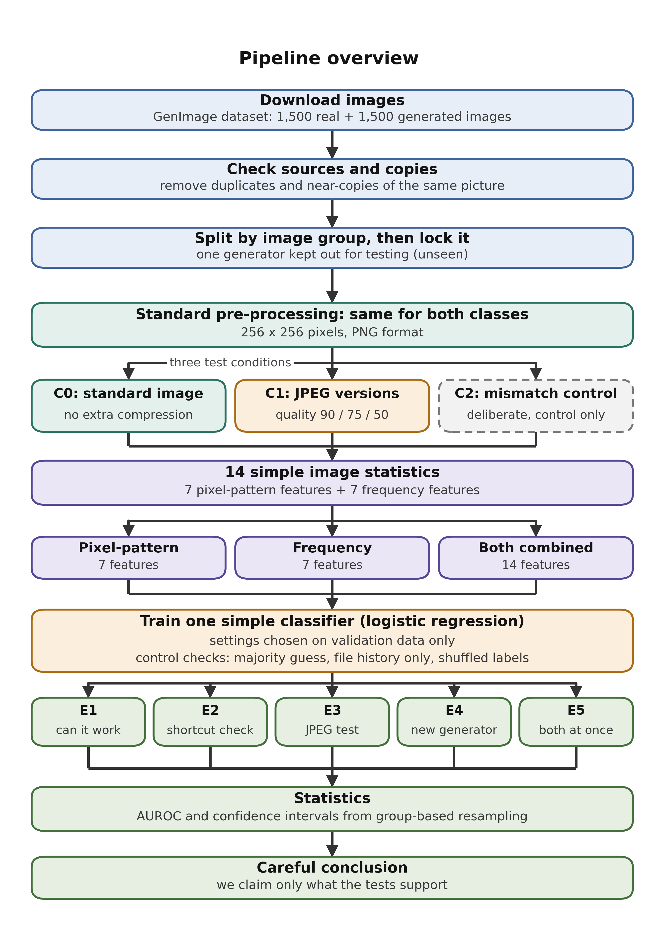
INTRODUCTION
NOVELTY
METHODOLOGY
EXPERIMENTS
RESULTS
LIMITATIONS
FUTURE
Pipeline, fixed before any image was processed
MEMBER 2
1
3,000 GenImage images
1,500 real · 500 each: BigGAN, SD v1.4, ADM
2
Clean before splitting
duplicates, near-copies, odd colour profiles removed
3
Same processing for both classes
resize to 256 × 256, lossless PNG
4
Three conditions
C0 clean · C1 JPEG 90 / 75 / 50 · C2 unfair control
5
Strict statistics
split by image group · one locked 600-image test set · 95% CIs
CSE 4883 Digital Image Processing · Same score, different story
4 / 11
Notes:
MEMBER 2 (25 s). The pipeline was fixed before processing. We check duplicates and image validity, then split by image group, so variants of an image cannot leak across train and test. All planned experiments share six hundred test images. Processing is applied equally to both classes, and confidence intervals use group bootstrap resampling.

Slide 5
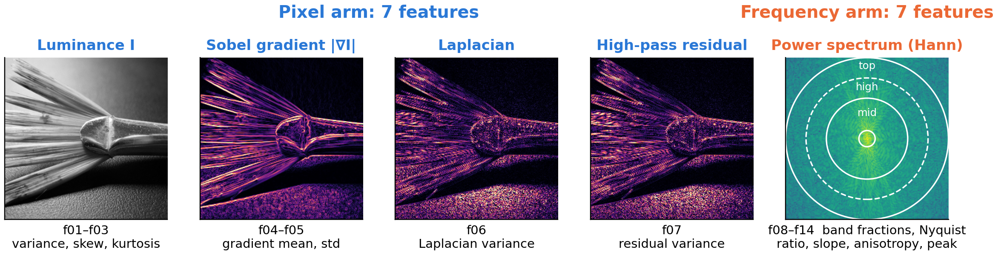
INTRODUCTION
NOVELTY
METHODOLOGY
EXPERIMENTS
RESULTS
LIMITATIONS
FUTURE
14 explainable features, one simple classifier
MEMBER 2
14 features
per image
Standardise
fit on train only
Logistic regression
L2, C chosen on val
Threshold
best val balanced acc.
Test AUROC
+ 95% bootstrap CI
CSE 4883 Digital Image Processing · Same score, different story
5 / 11
Notes:
MEMBER 2 (30 s). Spatial features measure brightness statistics, Sobel gradients, Laplacian variation and high-pass residuals. Frequency features measure power in different bands, spectral slope, directionality and peaks. Each feature set uses the same logistic-regression recipe. Standardisation is fitted on training data; model selection and the decision threshold use validation data only. AUROC measures ranking, with one half representing chance.

Slide 6
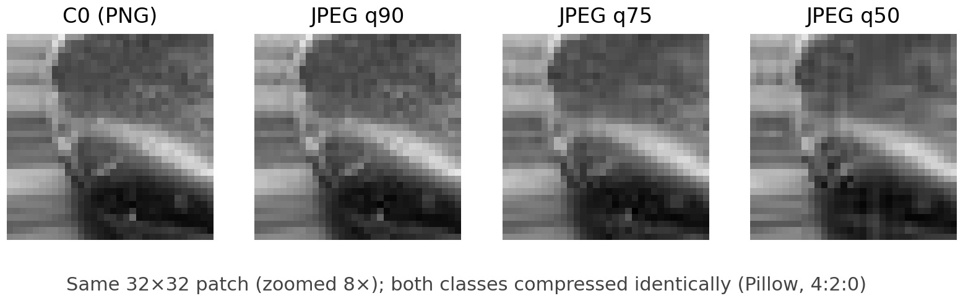
INTRODUCTION
NOVELTY
METHODOLOGY
EXPERIMENTS
RESULTS
LIMITATIONS
FUTURE
Experiments: what each one tests
MEMBER 2
 | Images | Trained on | Why it matters
E1 | clean (C0) | all 3 generators | is there any signal?
E2 | reals JPEG, fakes PNG | all 3 | how an unfair pipeline cheats
E3 | both JPEG 90 / 75 / 50 | all 3 | real images are compressed
E4 | clean (C0) | SD v1.4 held out | a generator never seen
E5 | JPEG 75 | SD v1.4 held out | both stresses (headline)
R | native crop + shared 2x resize | as E1 and E4 | is it resampling history?
R: exploratory crop + resampling
native image
no resize
crop 128 x 128
native pixels
enlarge 2x
bicubic, all classes
E1–E5 were fixed in advance.
R was added after the results: exploratory.
BigGAN (128 px) is pixel-identical in C0 and R.
CSE 4883 Digital Image Processing · Same score, different story
6 / 11
Notes:
MEMBER 2 (25 s). E1 checks the baseline. E2 deliberately mismatches compression as a shortcut control. E3 applies the same JPEG quality to both classes and refits the model at each quality. E4 holds Stable Diffusion out of training; E5 combines that holdout with JPEG quality 75. R is a later crop-and-resampling diagnostic, separate from those planned experiments.

Slide 7
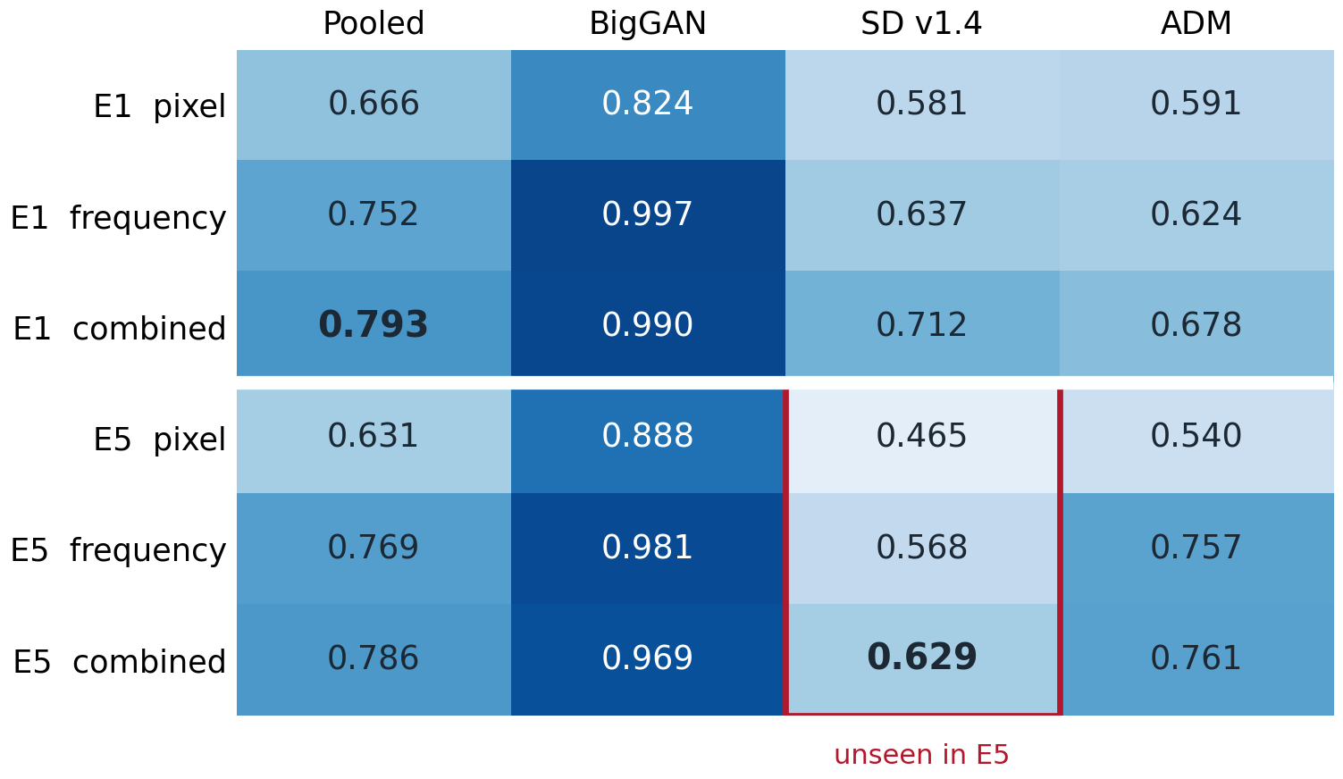
INTRODUCTION
NOVELTY
METHODOLOGY
EXPERIMENTS
RESULTS
LIMITATIONS
FUTURE
Results: combined wins pooled — not everywhere
MEMBER 2
Controls (matched conditions)
Always guess
0.500
File history (matched only)
0.500
Shuffled labels (×200)
0.50–0.52
Original file facts
1.000
Stress | AUROC change
Matched JPEG, any arm | at most 0.025
SD v1.4 unseen, combined | −0.078
Test AUROC (0.5 = chance). E5: SD v1.4 never seen in training, JPEG 75.
Source: results/*.csv, results/diagnostics/ (config 87f5489e9d59)
CSE 4883 Digital Image Processing · Same score, different story
7 / 11
Notes:
MEMBER 2 (30 s). Combined features have the best pooled scores. The baseline is 0.793, but on unseen Stable Diffusion under JPEG 75 it is only 0.629, with a confidence interval from 0.571 to 0.690. Frequency alone is 0.568 and spatial alone is 0.465. Combining them helps, yet the pooled score hides near-perfect BigGAN results and weaker diffusion results. Member three will explain why that distinction matters.

Slide 8
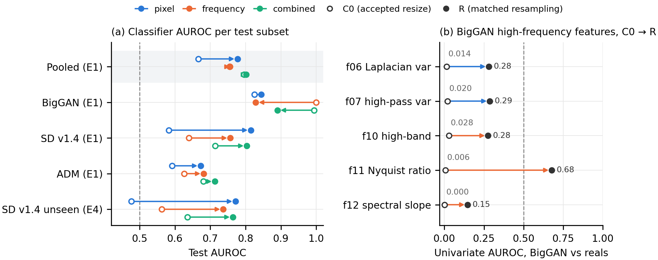
INTRODUCTION
NOVELTY
METHODOLOGY
EXPERIMENTS
RESULTS
LIMITATIONS
FUTURE
Similar pooled score, different generator results
MEMBER 3
Exploratory D1: 599 test images; crop, reference images and fitted models also change.
Pooled · combined arm
BigGAN · frequency arm
Unseen SD v1.4 · pixel arm
0.796 → 0.802
1.000 → 0.828
0.477 → 0.771
CSE 4883 Digital Image Processing · Same score, different story
8 / 11
Notes:
MEMBER 3 (40 s). The exploratory diagnostic compares the same 599 test images under the original processing and a native crop followed by shared enlargement. Pooled combined AUROC changes only from 0.796 to 0.802. But BigGAN frequency AUROC falls from nearly one to 0.828, and unseen Stable Diffusion spatial AUROC rises from 0.477 to 0.771. BigGAN images themselves are unchanged. These changes show sensitivity to the processing and reference data; crop and retraining prevent us from attributing everything to resampling alone.

Slide 9
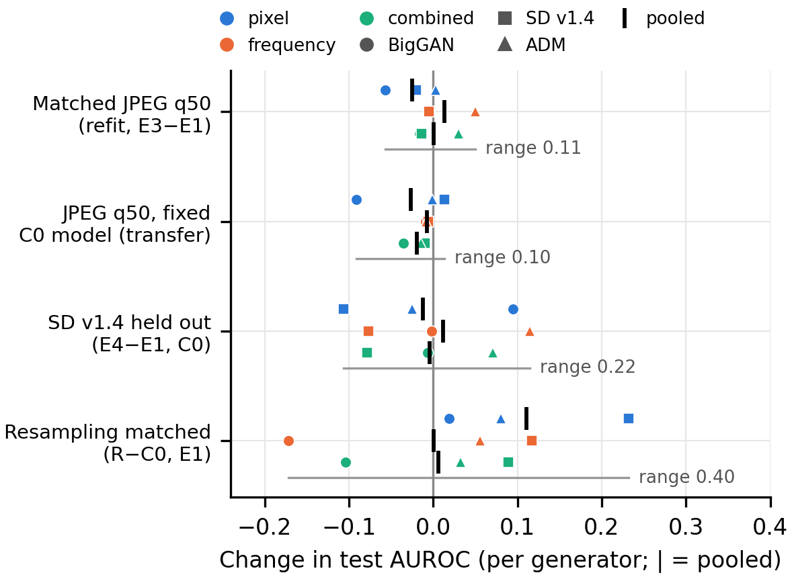
INTRODUCTION
NOVELTY
METHODOLOGY
EXPERIMENTS
RESULTS
LIMITATIONS
FUTURE
Processing changes scores and decisions
MEMBER 3
Which arm looks stronger? pixel − frequency
Pipeline | AUROC difference [95% CI]
Accepted resize | −0.088 [−0.130, −0.045]
Same resampling | +0.022 [−0.015, 0.056]
JPEG q50 on the clean model: reals flagged as fake
Arm | clean | JPEG q50
Pixel | 98 / 300 | 157 / 300
Frequency | 14 / 300 | 16 / 300
Combined | 37 / 300 | 42 / 300
Each dot: one feature set on one generator; tick = pooled.
CSE 4883 Digital Image Processing · Same score, different story
9 / 11
Notes:
MEMBER 3 (35 s). There is a second warning. In the original pipeline frequency beats spatial features; under the diagnostic that statistically supported advantage disappears. The interval does not establish spatial superiority. JPEG also affects decisions even when ranking changes little. With the clean model and threshold fixed, spatial false positives rise from 98 to 157 out of 300 real images at quality 50. Similar AUROC therefore does not guarantee similar decisions.

Slide 10
INTRODUCTION
NOVELTY
METHODOLOGY
EXPERIMENTS
RESULTS
LIMITATIONS
FUTURE
Limitations and planned extensions
MEMBER 3
Limitation
Planned extension
R is post-hoc; crop and models also change
pre-specify comparison with matched field of view
only SD v1.4 held out
hold out each generator in turn
real and fake content not matched
content-matched real / fake pairs
one JPEG encoder (Pillow 4:2:0)
a second encoder and subsampling
one dataset, one random split
repeated splits and a second dataset
CSE 4883 Digital Image Processing · Same score, different story
10 / 11
Notes:
MEMBER 3 (25 s). Our limits are one dataset and split, three generators, one held-out family and one JPEG encoder. Real and generated content is not matched. The resampling diagnostic is post-hoc and changes the crop. The next useful experiment would hold field of view fixed while comparing processing, followed by rotating the held-out generator. These are future tests, not completed results.

Slide 11
A pooled score cannot tell you what
simple features detect.
Report resampling history, and report per generator.
Combined features scored best pooled (0.793; 0.629 on an unseen generator under JPEG 75), yet the same pooled score hid per-generator changes of −0.17 to +0.30.
Thank you · questions?
CSE 4883 Digital Image Processing · Same score, different story
11 / 11
Notes:
MEMBER 3 (10 s). Our conclusion: simple features separate these samples, but their interpretation depends on processing history. Report results per generator and check decisions as well as pooled scores.

Slide 12
INTRODUCTION
NOVELTY
METHODOLOGY
EXPERIMENTS
RESULTS
LIMITATIONS
FUTURE
Our research question
MEMBER 1
Which simple feature set separates real from AI-generated images best?
same processing for both classes · strict split by image group
Pixel-pattern
7 features
Frequency
7 features
Combined
14 features
one simple classifier for all three
Stress 1: matched JPEG
both classes at quality 90 / 75 / 50
Stress 2: unseen generator
SD v1.4 never seen in training
CSE 4883 Digital Image Processing · Same score, different story
Backup
Notes:
BACKUP ONLY. Compare spatial, frequency and combined features under matched JPEG and generator holdout.

Slide 13
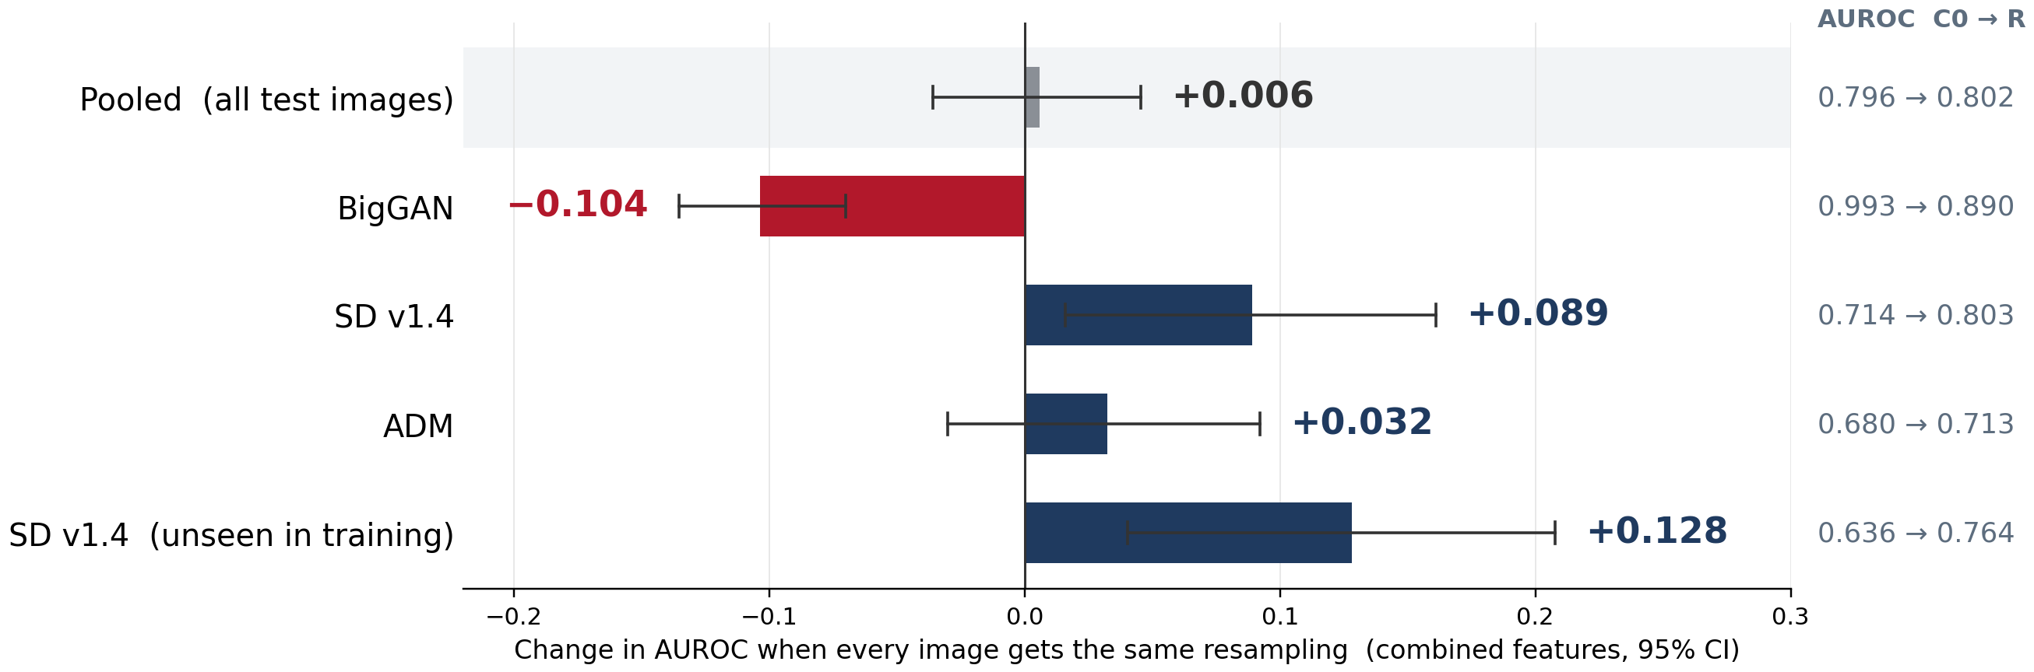
INTRODUCTION
NOVELTY
METHODOLOGY
EXPERIMENTS
RESULTS
LIMITATIONS
FUTURE
Novelty: same score, different story
MEMBER 1
Pooled score: similar. Per-generator scores: move both ways.
CSE 4883 Digital Image Processing · Same score, different story
Backup
Notes:
BACKUP ONLY. Exploratory D1: pooled combined change +0.006 has a confidence interval spanning zero. Generator-specific changes accompany crop, reference-data and fitted-model changes. These results do not isolate a pure resampling effect.

Slide 14
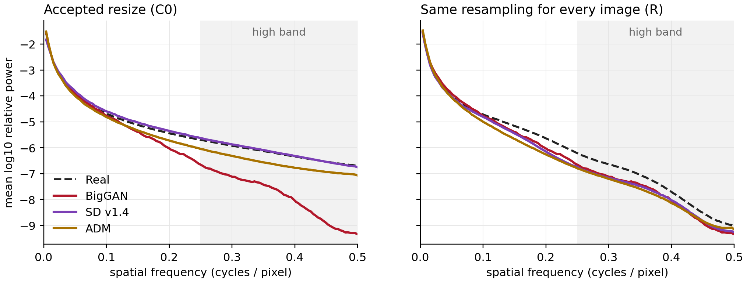
INTRODUCTION
NOVELTY
METHODOLOGY
EXPERIMENTS
RESULTS
LIMITATIONS
FUTURE
BigGAN's high-band deficit is consistent with enlargement
MEMBER 3
Mean power spectrum per class, all images. Left: BigGAN, the only class enlarged 2x, loses energy above 0.25 cycles/pixel. Right: with the native crop + shared 2x resize, the three fake curves coincide.
Source: results/diagnostics/radial_spectra.csv
CSE 4883 Digital Image Processing · Same score, different story
Backup
Notes:
BACKUP ONLY. Mean spectra show a BigGAN high-band deficit under the original pipeline and closer generator curves under R. R shares a final crop-and-enlargement operation, while prior history and content remain unmatched. Do not attribute all differences to resizing alone.

