Slide 1
Same score, different story
How resampling history shapes what spatial-frequency features
detect in AI-generated images
CSE 4883 Digital Image Processing · final presentation
Member 1 · Member 2 · Member 3
Introduction · Novelty · Methodology · Experiments · Results · Limitations · Future
Notes:
MEMBER 1 (10 s). Good morning. We studied what simple, explainable image statistics really measure when they separate real photographs from AI-generated images. Our title is our answer: the same score can tell very different stories.

Slide 2
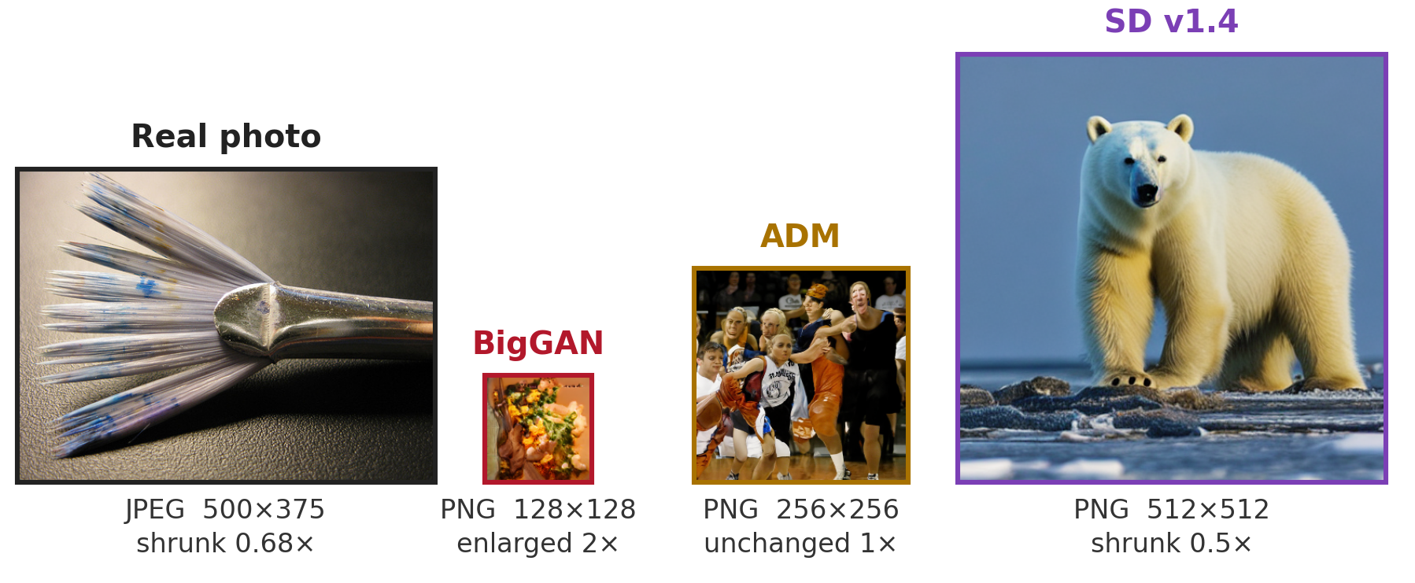
INTRODUCTION
NOVELTY
METHODOLOGY
EXPERIMENTS
RESULTS
LIMITATIONS
FUTURE
Real and fake images arrive differently
MEMBER 1
File format and size alone separate the classes (AUROC 1.000). A fair pipeline gives every image 256 × 256 px, but each class is resized by a different factor.
CSE 4883 Digital Image Processing · Same score, different story
2 / 13
Notes:
MEMBER 1 (35 s). Simple features such as edge strength or spectral band energy are popular for spotting AI images because they are cheap and explainable. We used GenImage, a standard benchmark. Look at how its images arrive: real photos are JPEGs of varying size, and each generator gives PNGs of one fixed size: 128 pixels for BigGAN, 256 for ADM, 512 for Stable Diffusion. A classifier that only reads format and size already separates the classes perfectly. So a fair study must give every image the same size and format. But that means BigGAN is enlarged two times, Stable Diffusion is halved, and real photos are shrunk to about two thirds.

Slide 3
INTRODUCTION
NOVELTY
METHODOLOGY
EXPERIMENTS
RESULTS
LIMITATIONS
FUTURE
Our research question
MEMBER 1
Which simple feature set separates real from AI-generated images best?
same processing for both classes · strict split by image group
Pixel-pattern
7 features
Frequency
7 features
Combined
14 features
one simple classifier for all three
Stress 1: matched JPEG
both classes at quality 90 / 75 / 50
Stress 2: unseen generator
SD v1.4 never seen in training
CSE 4883 Digital Image Processing · Same score, different story
3 / 13
Notes:
MEMBER 1 (30 s). Our question: with the same processing for both classes and a strict split, which simple feature set works best? We compare three sets: seven pixel-pattern features, seven frequency features, and all fourteen combined, each with the same simple classifier. Then we stress them in two realistic ways: JPEG compression applied equally to both classes, and a generator the classifier has never seen. Our goal is to measure what the features detect, not to build a new detector.

Slide 4
INTRODUCTION
NOVELTY
METHODOLOGY
EXPERIMENTS
RESULTS
LIMITATIONS
FUTURE
Novelty: same score, different story
MEMBER 1
Give every image the same resampling. The pooled AUROC barely moves (0.796 → 0.802), but per-generator AUROC shifts by −0.17 to +0.30.
Work | Level | What it varies
Grommelt et al. 2024 | whole detector | JPEG and size bias
B-Free 2025 | whole detector | content, format, size
Zhou & Wang 2026 | training-free detectors | resize vs native, JPEG
This work | 14 named features | resampling (isolated), matched JPEG, unseen generator
BigGAN images are pixel-identical in both versions, so any change in BigGAN comes from the real photos' processing alone.
We found no report of this feature-level protocol; we say “not found”, not “first”.
CSE 4883 Digital Image Processing · Same score, different story
4 / 13
Notes:
MEMBER 1 (45 s). This is our novelty. Earlier studies showed that whole detectors exploit format and size differences; one recent audit showed resizing changes the conclusions of training-free detectors. We go one level down, to fourteen named statistics, and we isolate the cause. When we give every image the same resampling history, the pooled score does not move, 0.796 before and 0.802 after. But per generator, results move by minus 0.17 to plus 0.30. Same score, different story. We can pin the cause down because the BigGAN images are pixel-identical in both versions; only the real photos changed. Member 2 will explain how we built the study.

Slide 5
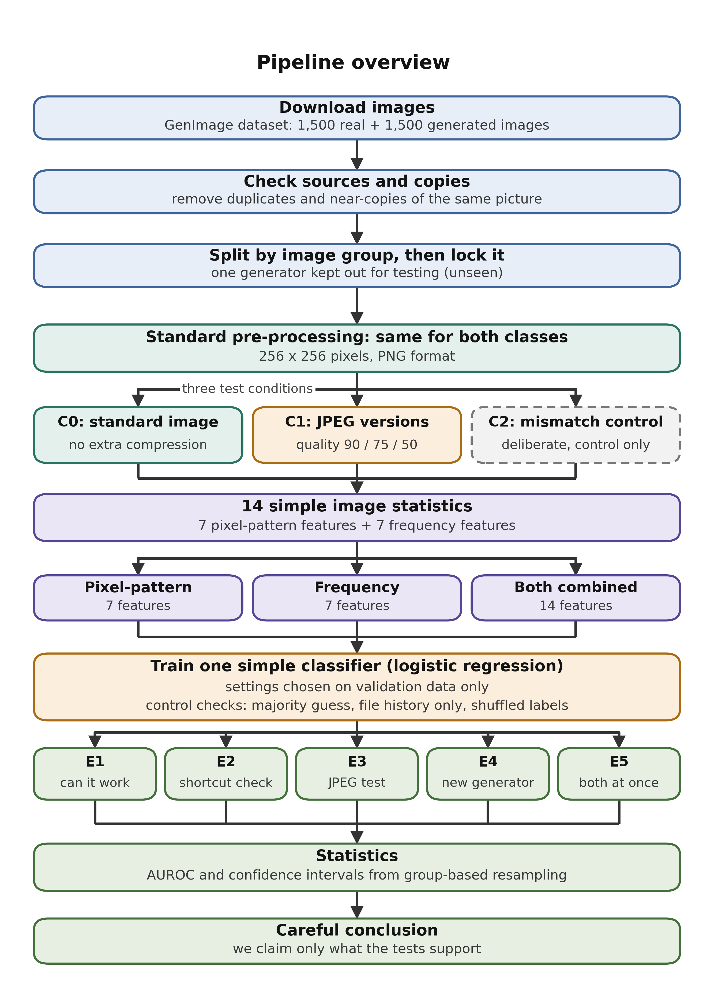
INTRODUCTION
NOVELTY
METHODOLOGY
EXPERIMENTS
RESULTS
LIMITATIONS
FUTURE
Pipeline, fixed before any image was processed
MEMBER 2
1
3,000 GenImage images
1,500 real · 500 each: BigGAN, SD v1.4, ADM
2
Clean before splitting
duplicates, near-copies, odd colour profiles removed
3
Same processing for both classes
resize to 256 × 256, lossless PNG
4
Three conditions
C0 clean · C1 JPEG 90 / 75 / 50 · C2 unfair control
5
Strict statistics
split by image group · one locked 600-image test set · 95% CIs
CSE 4883 Digital Image Processing · Same score, different story
5 / 13
Notes:
MEMBER 2 (30 s). This is the pipeline we presented and had accepted, fixed before we processed any image. We sample 3,000 GenImage images, half real and half generated. Before splitting, we remove duplicates, near-copies and images with unusual colour profiles. Both classes then get exactly the same processing: 256 by 256 pixels, lossless PNG. From that we make three conditions: clean, JPEG at three qualities, and one deliberately unfair control. Every image group stays on one side of the split, and all experiments share one locked test set of 600 images.

Slide 6
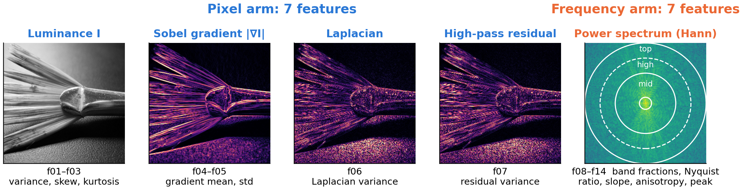
INTRODUCTION
NOVELTY
METHODOLOGY
EXPERIMENTS
RESULTS
LIMITATIONS
FUTURE
14 explainable features, one simple classifier
MEMBER 2
14 features
per image
Standardise
fit on train only
Logistic regression
L2, C chosen on val
Threshold
best val balanced acc.
Test AUROC
+ 95% bootstrap CI
CSE 4883 Digital Image Processing · Same score, different story
6 / 13
Notes:
MEMBER 2 (30 s). Each image becomes fourteen numbers. The pixel arm, in blue, looks at brightness statistics, edge strength from the Sobel gradient, fine detail from the Laplacian, and a high-pass residual. The frequency arm, in orange, looks at the power spectrum: how energy splits between low, mid and high bands, the top band near the Nyquist limit, the slope of the fall-off, directionality, and single peaks. The bottom row is the classifier: one L2 logistic regression for every arm, tuned on validation data only, and scored by AUROC with confidence intervals.

Slide 7
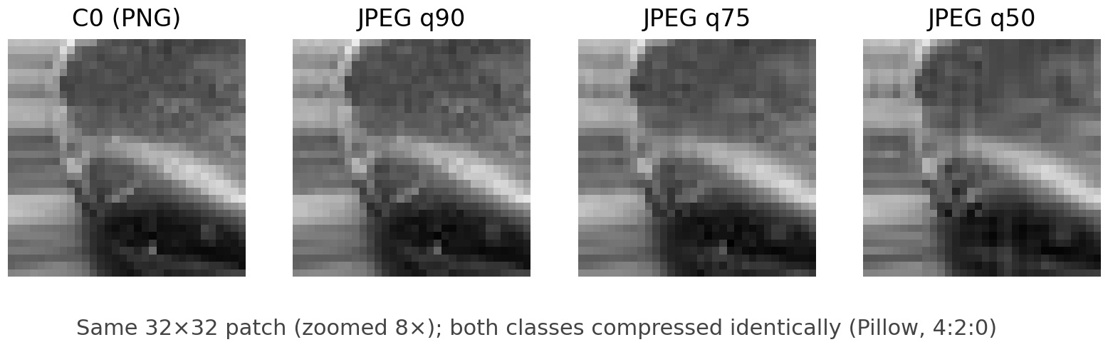
INTRODUCTION
NOVELTY
METHODOLOGY
EXPERIMENTS
RESULTS
LIMITATIONS
FUTURE
Experiments: what each one tests
MEMBER 2
 | Images | Trained on | Why it matters
E1 | clean (C0) | all 3 generators | is there any signal?
E2 | reals JPEG, fakes PNG | all 3 | how an unfair pipeline cheats
E3 | both JPEG 90 / 75 / 50 | all 3 | real images are compressed
E4 | clean (C0) | SD v1.4 held out | a generator never seen
E5 | JPEG 75 | SD v1.4 held out | both stresses (headline)
R | same resampling for all | as E1 and E4 | is it resampling history?
R: how every image is resampled
native image
no resize
crop 128 x 128
native pixels
enlarge 2x
bicubic, all classes
E1–E5 were fixed in advance.
R was added after the results: exploratory.
BigGAN (128 px) is pixel-identical in C0 and R.
CSE 4883 Digital Image Processing · Same score, different story
7 / 13
Notes:
MEMBER 2 (30 s). Each experiment answers one question. E1: is there any signal on clean images? E2 is the unfair control where only the reals are compressed. E3 compresses both classes equally; top right you see the same patch at each JPEG quality. E4 removes Stable Diffusion from training to test an unseen generator, and E5 adds JPEG on top; that was our planned headline. R, in red, is a diagnostic we added after the results: every image is cropped at native size and enlarged by the same factor, so all images share one resampling history.

Slide 8
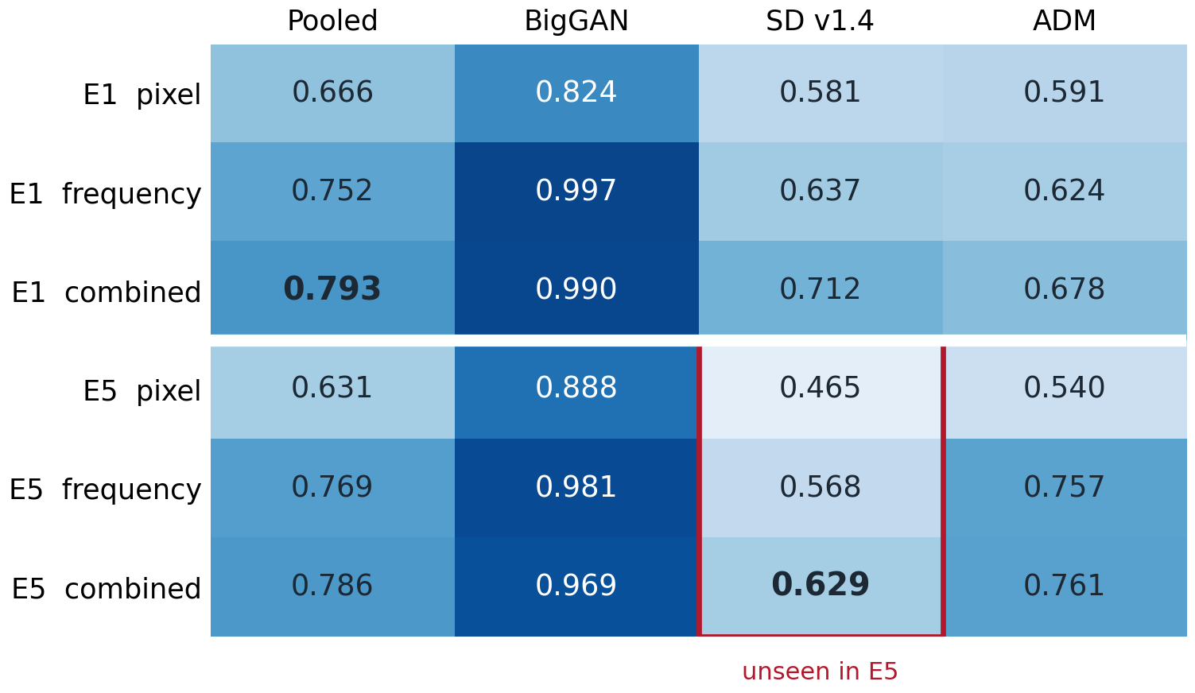
INTRODUCTION
NOVELTY
METHODOLOGY
EXPERIMENTS
RESULTS
LIMITATIONS
FUTURE
Results: combined wins pooled — not everywhere
MEMBER 2
Controls (every experiment)
Always guess
0.500
Processed-file history
0.500
Shuffled labels (×200)
0.50–0.52
Original file facts
1.000
Stress | AUROC change
Matched JPEG, any arm | at most 0.025
SD v1.4 unseen, combined | −0.078
Test AUROC (0.5 = chance). E5: SD v1.4 never seen in training, JPEG 75.
Source: results/*.csv, results/diagnostics/ (config 87f5489e9d59)
CSE 4883 Digital Image Processing · Same score, different story
8 / 13
Notes:
MEMBER 2 (45 s). Here are the results of the accepted pipeline. The combined set has the best pooled score, 0.793, and stays best in every experiment. On the unseen generator under JPEG it reaches 0.629. JPEG compression barely changes the scores, and the unseen generator costs about 0.08. The controls on the right pass: guessing, processed-file history and shuffled labels are at chance, while the original file facts separate perfectly, which is why identical processing matters. But look at the BigGAN column: almost perfect, 0.997 with frequency features, while the two diffusion generators stay between 0.58 and 0.71. Why is BigGAN so easy? Member 3 will show you.

Slide 9
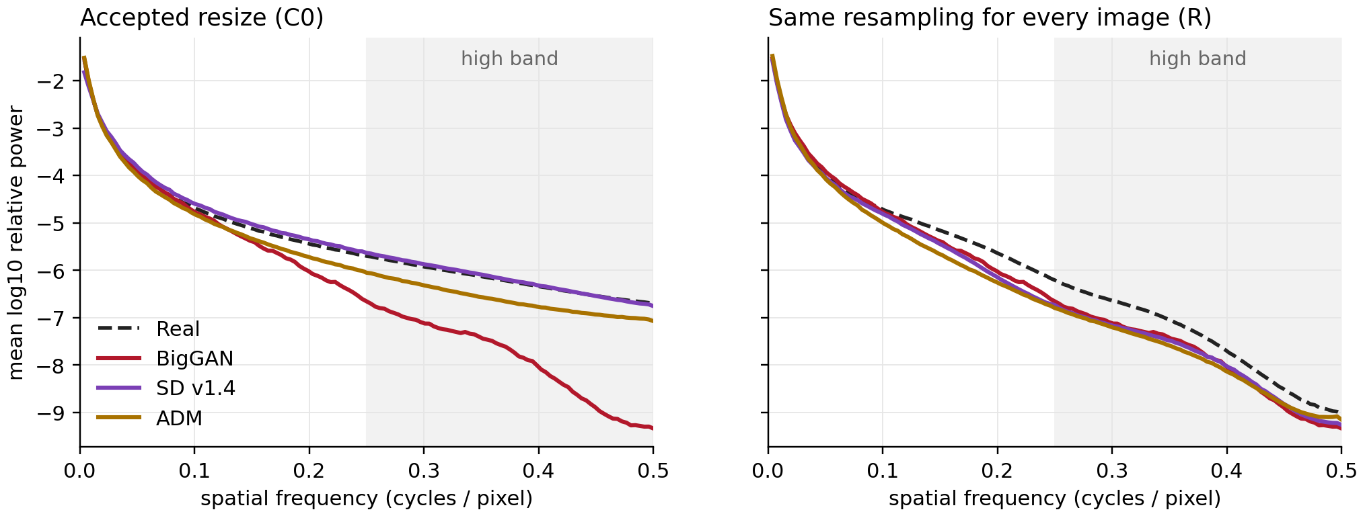
INTRODUCTION
NOVELTY
METHODOLOGY
EXPERIMENTS
RESULTS
LIMITATIONS
FUTURE
Why BigGAN is easy: our resize empties its high band
MEMBER 3
Mean power spectrum per class, all images. Left: BigGAN, the only class enlarged 2x, loses energy above 0.25 cycles/pixel. Right: with the same resampling for all, the three fake curves coincide.
Source: results/diagnostics/radial_spectra.csv
CSE 4883 Digital Image Processing · Same score, different story
9 / 13
Notes:
MEMBER 3 (30 s). This is the mechanism. The plot shows how much energy each class has at each spatial frequency. On the left, the accepted pipeline: BigGAN, in red, drops sharply in the high band, because it is the only class our resize enlarged, and bicubic enlargement cannot create fine detail. So high-frequency features find BigGAN almost perfectly, but they are detecting our resize, not the generator. On the right, every image gets the same resampling, and the three generators collapse onto one curve.

Slide 10
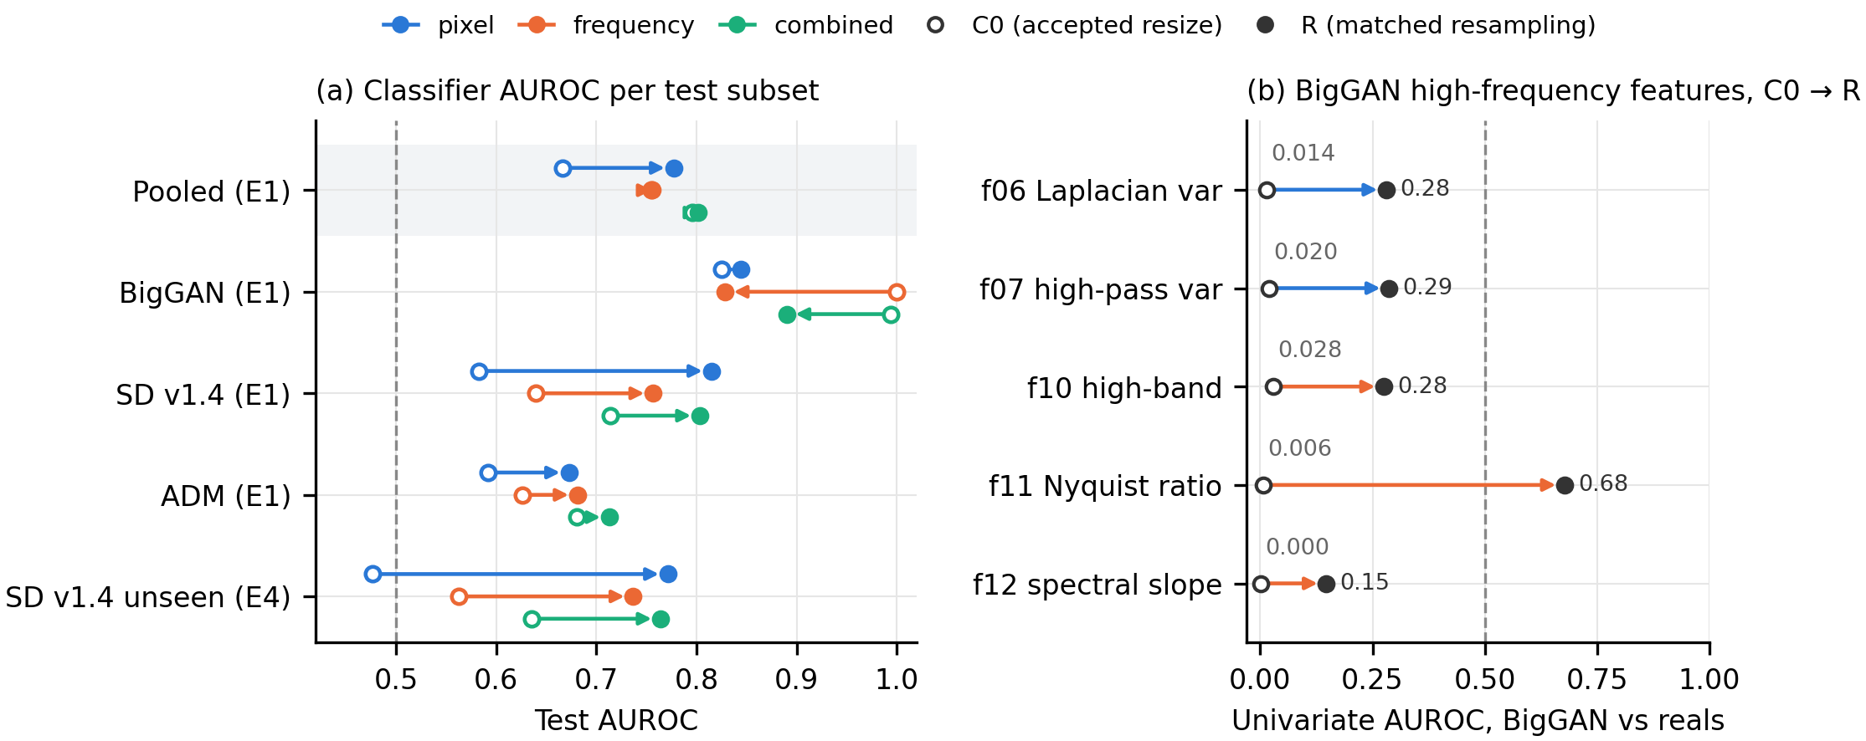
INTRODUCTION
NOVELTY
METHODOLOGY
EXPERIMENTS
RESULTS
LIMITATIONS
FUTURE
Same pooled score, different story
MEMBER 3
Pooled · combined arm
BigGAN · frequency arm
Unseen SD v1.4 · pixel arm
0.796 → 0.802
1.000 → 0.828
0.477 → 0.771
CSE 4883 Digital Image Processing · Same score, different story
10 / 13
Notes:
MEMBER 3 (35 s). Now the test. Open circles are the accepted pipeline, filled circles are the same-resampling version, on the same 599 test images. The pooled score does not move: 0.796 to 0.802. But BigGAN falls from 1.000 to 0.828 with frequency features, even though its images did not change at all. Stable Diffusion rises, and on the unseen generator the pixel arm goes from chance to 0.771. On the right, the features that found BigGAN almost perfectly lose most of that power. Resampling explains the near-perfect BigGAN result, though not all of it: the spectral slope still separates.

Slide 11
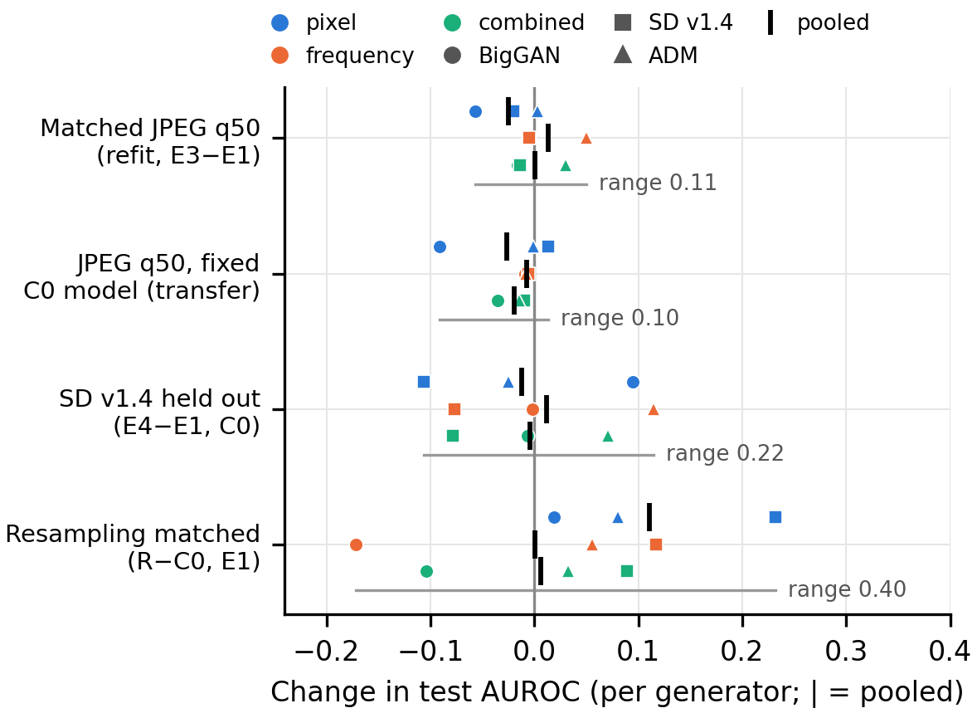
INTRODUCTION
NOVELTY
METHODOLOGY
EXPERIMENTS
RESULTS
LIMITATIONS
FUTURE
Resampling moves results more than JPEG or shift
MEMBER 3
Which arm looks stronger? pixel − frequency
Pipeline | AUROC difference [95% CI]
Accepted resize | −0.088 [−0.130, −0.045]
Same resampling | +0.022 [−0.015, 0.056]
JPEG q50 on the clean model: reals flagged as fake
Arm | clean | JPEG q50
Pixel | 98 / 300 | 157 / 300
Frequency | 14 / 300 | 16 / 300
Combined | 37 / 300 | 42 / 300
Each dot: one feature set on one generator; tick = pooled.
CSE 4883 Digital Image Processing · Same score, different story
11 / 13
Notes:
MEMBER 3 (30 s). This chart compares all changes side by side. JPEG moves scores within about 0.1, removing a generator spreads them over 0.22, and changing only the resampling spreads them over 0.40. It even changes which feature family looks stronger: frequency beats pixel under the accepted resize, but the difference disappears with matched resampling. One practical warning from JPEG: the ranking barely changes, but a clean pixel model flags more than half of the compressed real photos as fake.

Slide 12
INTRODUCTION
NOVELTY
METHODOLOGY
EXPERIMENTS
RESULTS
LIMITATIONS
FUTURE
Limitations and planned extensions
MEMBER 3
Limitation
Planned extension
R added after results; also narrows the field of view
pre-specified native-resolution protocol (matched view)
only SD v1.4 held out
hold out each generator in turn
real and fake content not matched
content-matched real / fake pairs
one JPEG encoder (Pillow 4:2:0)
a second encoder and subsampling
one dataset, one random split
repeated splits and a second dataset
CSE 4883 Digital Image Processing · Same score, different story
12 / 13
Notes:
MEMBER 3 (25 s). Our claims are bounded, and each limitation points to a planned extension. The resampling test was added after the results and also narrows the field of view, so next we would fix a native-resolution protocol in advance. We held out only one generator, the content of real and fake images is not matched, and we used one JPEG encoder, one dataset and one split. Each arrow is the step that removes that limitation.

Slide 13
A pooled score cannot tell you what
simple features detect.
Report resampling history, and report per generator.
Combined features scored best pooled (0.793; 0.629 on an unseen generator under JPEG 75), yet the same pooled score hid per-generator changes of −0.17 to +0.30.
Thank you · questions?
CSE 4883 Digital Image Processing · Same score, different story
13 / 13
Notes:
MEMBER 3 (10 s). To conclude: combined features scored best, but a pooled score cannot tell you what simple features detect. Report the resampling history and report per generator. Thank you; we are happy to take questions.

