Slide 1


Machine Learning Approach For Credit Card Fraud Detection

Slide 2

ABSTRACT
Credit Card Fraud Detection System includes:
Modelling past credit card transactions with the data of the ones that turned out to be a fraud.
Recognizing whether a new transaction is fraudulent or not.
Deploying the irregularity detection algorithm
Visualizing the dataset and interpreting the model

Slide 3
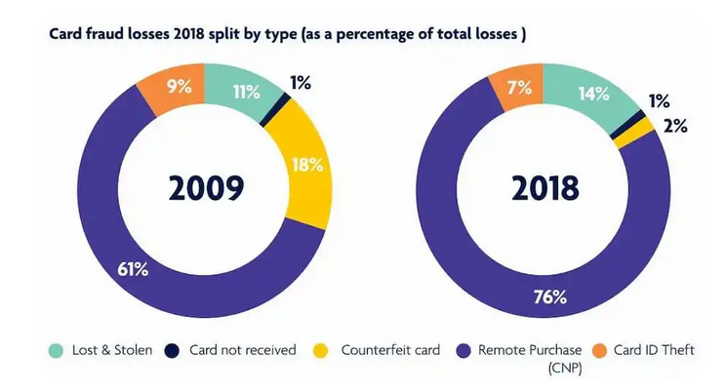
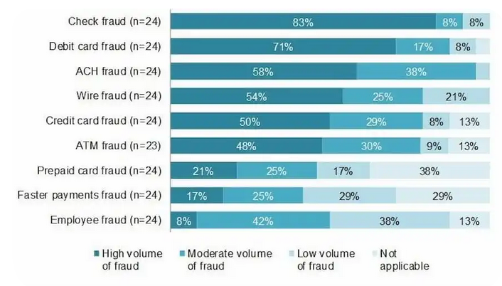
INTRODUCTION
When online transactions came into existence, credit cards and their increasing functionality have put a lot of people to ease.
But on the other hand, over the past few years, the rise of fraudulent activities was notable.
Organizations, consumers, banks, and merchants are put at risk and led to monetary theft.

Slide 4
PROBLEM DEFINITION
A predictive model is designed from the user-sensitive data transformed by PCA transformation.
Deals with credit card detection by processing genuine payments and rare fraudulent transactions.
The output is shown by observing the transaction pattern using neural network.
The true positive and true negative rates are maximized, while keeping the false positives and false negatives reduced.

Slide 5

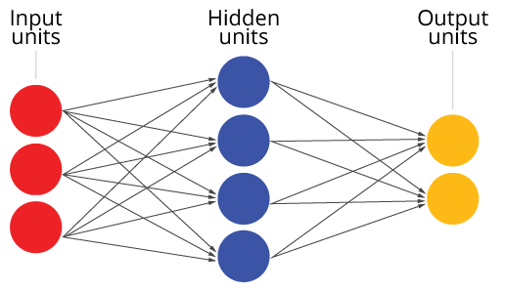
PROPOSED METHODOLOGY
The proposed detection system builds a binary classifier using Autoencoder approach.
Understands the relation between suspicious transactions and time.
The unsupervised learning algorithm is applied using keras framework.
The reconstruction error is reduced to optimize the autoencoder.

Slide 6
ARCHITECTURE DIAGRAM
Import libraries, packages
Class wise analysis
Data visualization
Autoencoder
Input Dataset
Data Analysis
Normalizing & Scaling
Model Training
Anomaly Detection
Fraudulent transaction
YES
Reconstruction error > threshold
Legitimate payment
Evaluation
NO

Slide 7


LIST OF MODULES
Data loading
Class wise analysis
Normalizing & scaling
Autoencoder algorithm
Reconstructi-on error

Slide 8
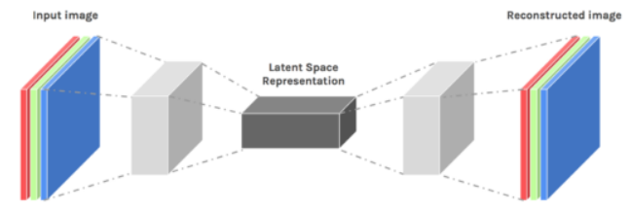
AUTOENCODERS
It is an unsupervised artificial neural network.
Which learns how to efficiently compress and encode data then learns how to reconstruct the data back to the original input as possible.
In an Autoencoder, the data which moves through, isn’t mapped in a straight manner.
Three components: an encoder, bottleneck, and a decoder portion.
It is similar to PCA.
Applications: Image Generation

Slide 9
MODULE IMPLEMENTATION
BUILDING AUTOENCODER:
Our Autoencoder uses 4 fully connected layers with 14,7,7 and 29 neurons respectively.
The first two layers are used for encoder and the last two go for the decoder.
Additionally, L1 regularization will be used during training.
The activation function used in our model
1) tanh
2) relu

Slide 10
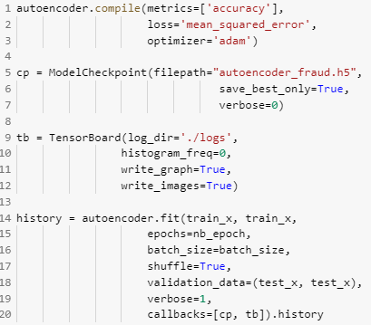
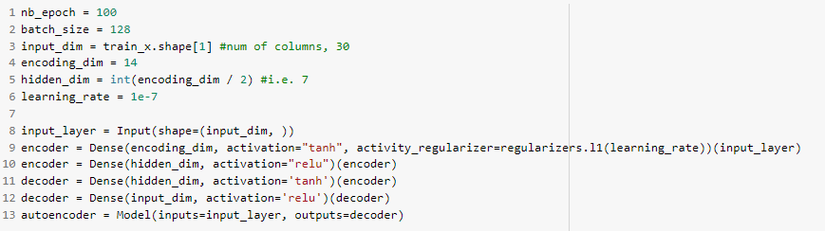
MODULE IMPLEMENTATION
CREATING THE MODEL:

Slide 11
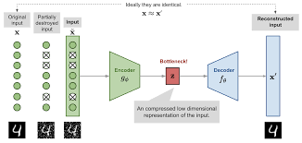
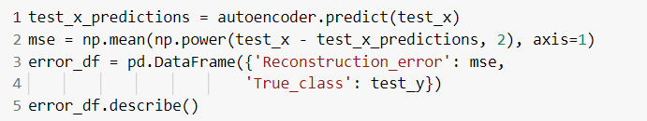
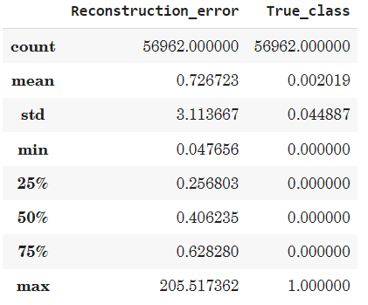
RECONSTRUCTION ERROR
Distance between the original input and its autoencoder reconstruction.
Minimized in order to optimize the parameters of the autoencoder.
The traditional squared error is often used.

Slide 12
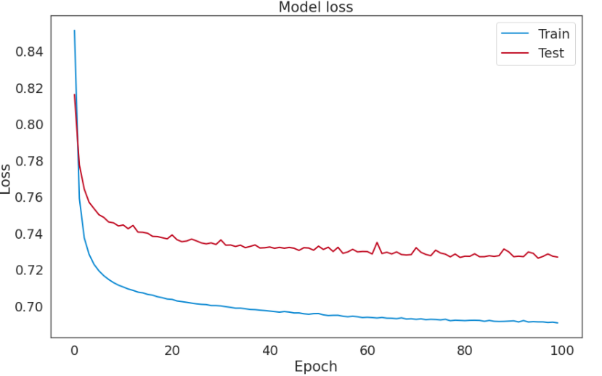
MODULE IMPLEMENTATION
MODEL LOSS:

Slide 13
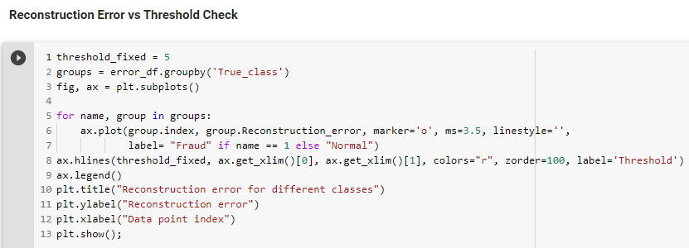
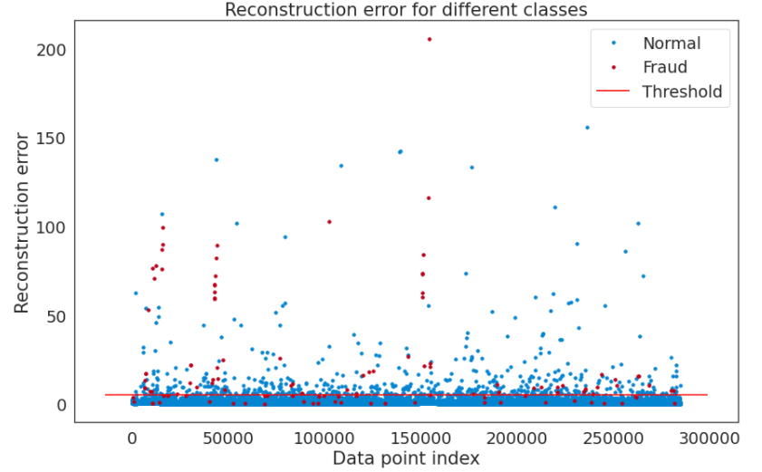
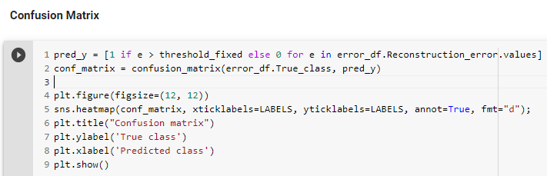
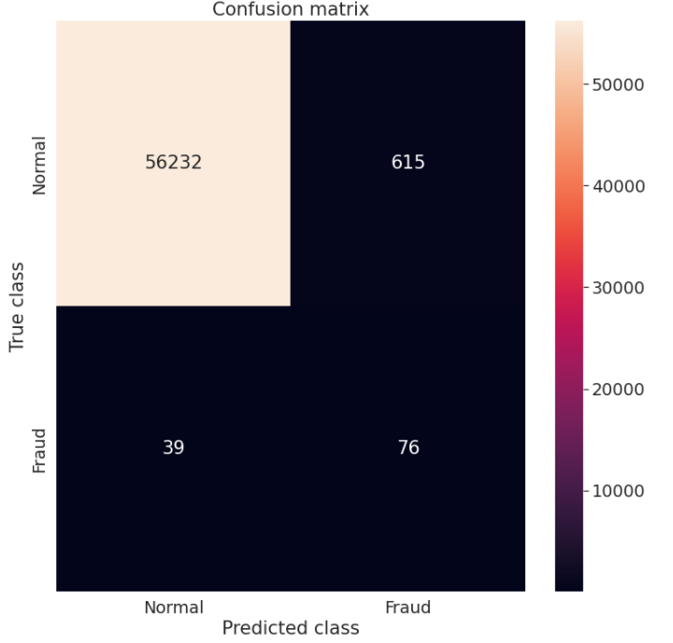
MODULE IMPLEMENTATION

Slide 14
CONCLUSION
The purpose of our work is to use multiple supervised methodologies and anomaly detection algorithms to separate scarce abnormal transactions from legitimate payment transactions.
The dataset is taken to build binary classification models and then notice fraudulent activities.
From the experiment results it can be concluded that the algorithm can detect fraudulent transaction at nearby accuracy.

Slide 15
REFERENCES
[1] “Credit Card Fraud Detection Based on Transaction Behavior -by John Richard D. Kho, Larry A. Via” published by Proc. of the 2017 IEEE Region 10 Conference (TENCON), Malaysia, November 5-8, 2017.
[2] CLIFTON PHUA1, VINCENT LEE1, KATE SMITH1 & ROSS GAYLER2 “ A Comprehensive Survey of Data Mining-based Fraud Detection Research” published by School of Business Systems, Faculty of Information Technology, Monash University, Wellington Road, Clayton, Victoria 3800, Australia

Slide 16
[3]“Survey Paper on Credit Card Fraud Detection by Suman” , Research Scholar, GJUS&T Hisar HCE, Sonepat published by International Journal of Advanced Research in Computer Engineering & Technology (IJARCET) Volume 3 Issue 3, March 2014 .
[4] “Research on Credit Card Fraud Detection Model Based on Distance Sum – by Wen-Fang YU and Na Wang” published by 2009 International Joint Conference on Artificial Intelligence.
[5] “Credit Card Fraud Detection: A Realistic Modeling and a Novel Learning Strategy” published by IEEE TRANSACTIONS ON NEURAL NETWORKS AND LEARNING SYSTEMS, VOL. 29, NO. 8, AUGUST 2018.

Slide 17
Thank you

