Slide 1
Network Virtualization

Slide 2
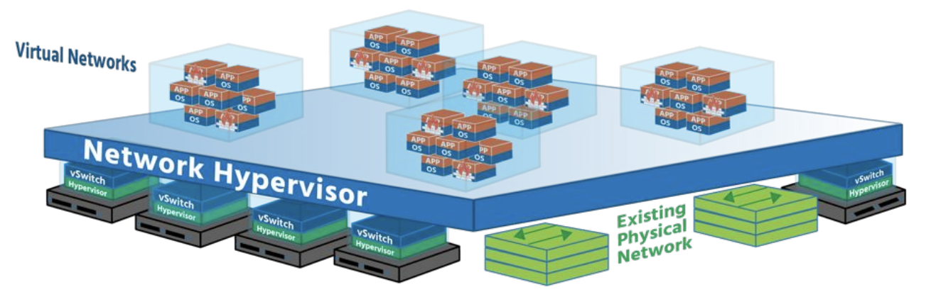
Network Hypervisor
• Physical network resources are recreated (virtualized) in software
• Routers, switches, and load balancers become virtual devices in the hypervisor layer
• The pool of devices can be used as needed, on demand
• The entire network can now be run on software

Slide 3
Virtual Networks vs VLANs
SAME????

Slide 4
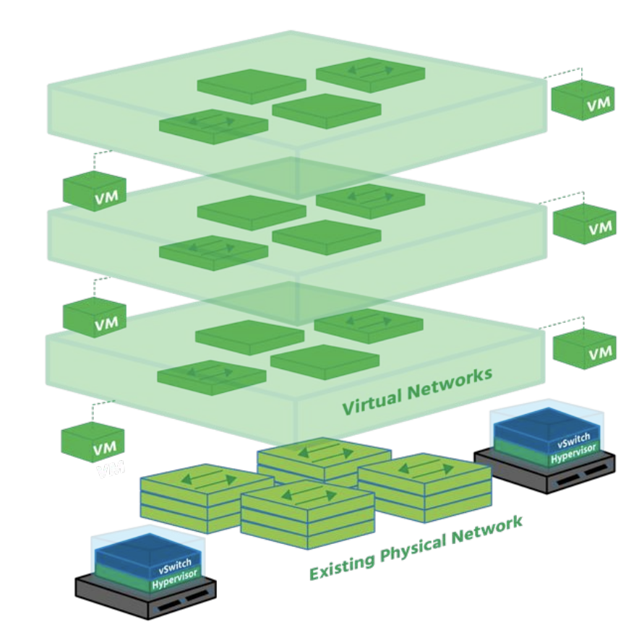
Virtual Networks in Physical Networks
Virtual networks dramatically increase the scope of physical networks
• Virtual networks can run in isolation along side or on top of identical physical networks
• Each network is unaffected by the events on another network

Slide 5
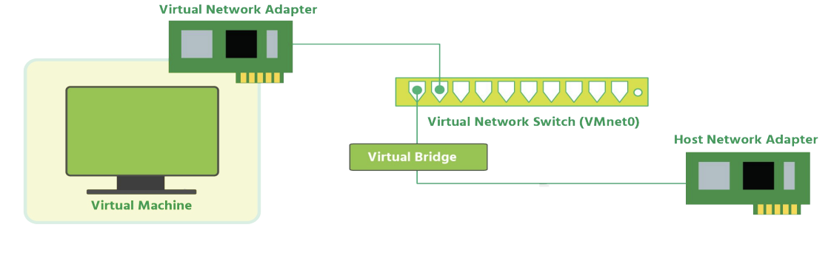
Bridged Networking
A network type where both a virtual machine and the host that it is running on are connected to the same network
• With bridged networking, the virtual network adapter (vNIC) for the virtual machine connects to a physical NIC on the physical host system
• The host network adapter enables the VM to connect to the Local Area Network (LAN) that the host system uses

Slide 6
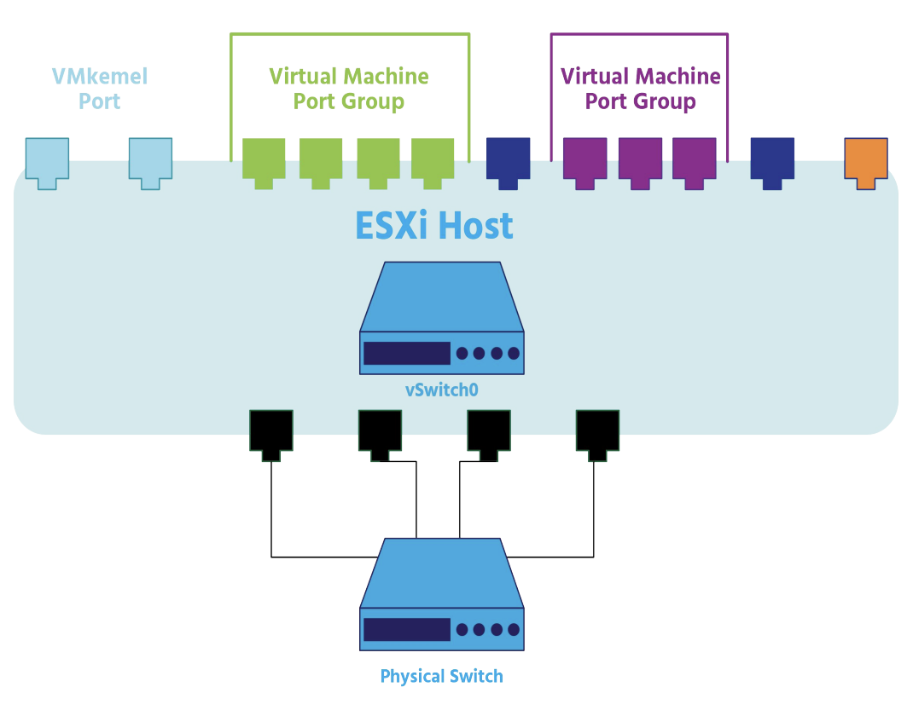
Virtual Switches
Allow virtual machines to connect to each other and to connect to the outside world
• By default, each ESXi host has a single virtual switch called vSwitch0
• Similar to the connection between a computer’s physical network adapter (NIC) and a physical switch

Slide 7
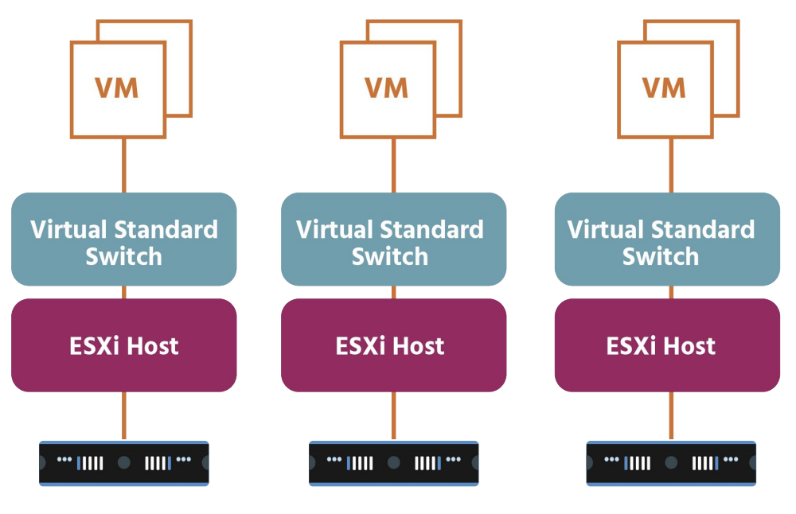
VMkernel Adapters
A VMkernel adapter is a port that is used by the hypervisor to attach a service to the network
• Every VMkernel adapter has an IP address by which this service is accessible
VMware vMotion (which enables you to move VMs from one host to another while they’re powered on with no downtime)
Management port (which is used for ESXi management traffic

Slide 8
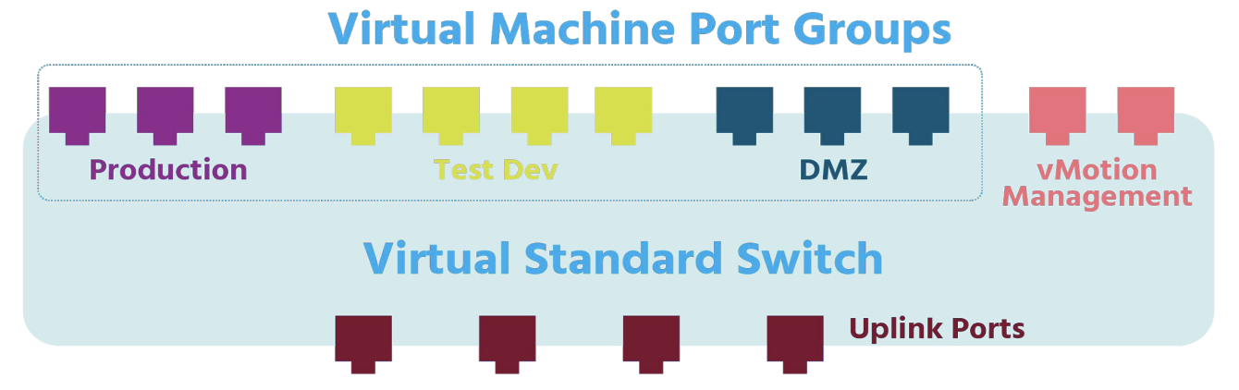
Virtual Machine Port Groups
• Each logical port on the standard switch is a member of a single port group
• Each port group on a standard switch is identified by a network label, which must be unique amongst other port groups on a host but consistent across hosts in order to ensure network connectivity

Slide 9
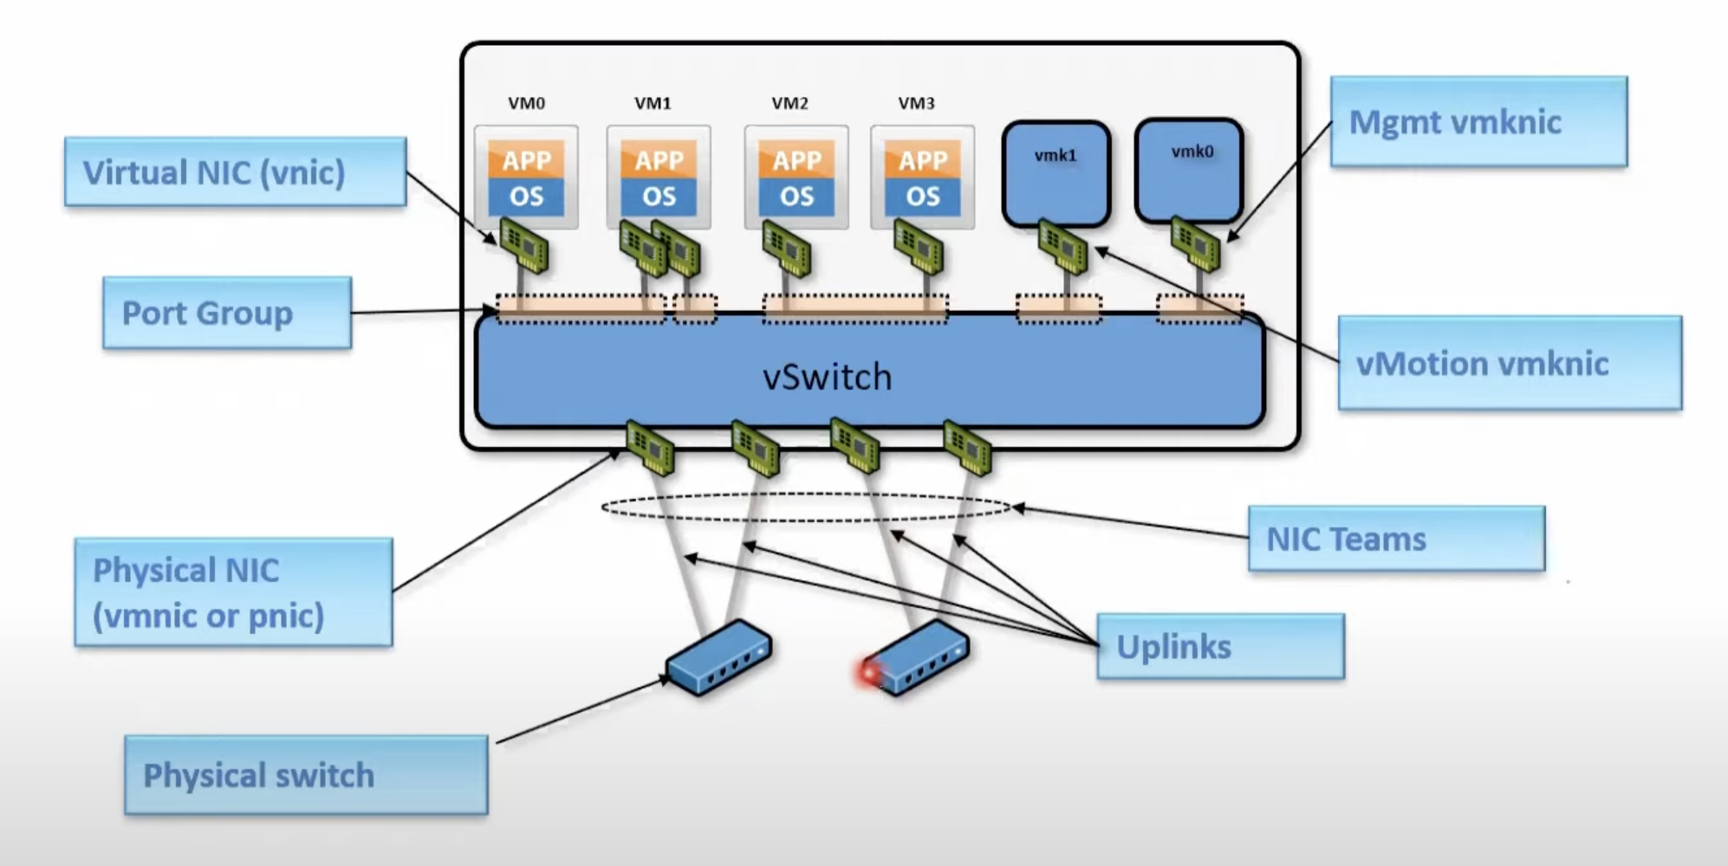
Virtual Network on VM

Slide 10
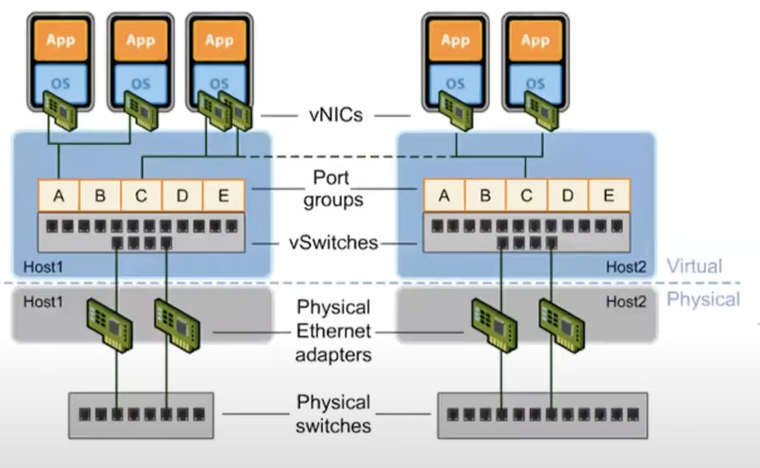
Virtual Network on VM

